Slide 1
Bryan B. Praditkul a portfolio pulse

Slide 2
Who is Bryan B. Praditkul?
…a DevOps leader who empathizes and thrives on building collaborative high functioning teams, forming cross functional partnerships, and growing professional careers, to achieve high value outcomes to the customer.

Slide 3








Career Pathing
4-9s/5-9s uptime for multiple web offerings
8yrs of Business & Finance
(PCI)
2yrs of Healthcare
startups
(HIPAA)
1yr of Insurance & Mobile
(PII)
5yrs of Ad and Travel startups
(IAB)
4000+ bare metal servers over 7DCs globally
Lead DevOps Eng.
First DevOps engineer to re-architect/reorganize all monitoring, CI/CD workflows, asset tracking, and runbooks across the marketing org.
Re-architected multi-region infrastructure for critical components. Platform uptime improved to 99.97%
Reduced overall cost for the 1000+ instance AWS platform by 52%
Developed an enterprise monitoring system decreasing customer detected outages by 57%.
Lead DevOps Eng.
Sr. DevOps Manager
2000+ AWS Instances & 4500+ bare metal Hybrid globally
Recipient of the “Hackathon – Coolest Innovation” award
Automated AWS security services across 7 core products
Lead DevOps Eng.
Brought a critical production 30k customer facing support implementation into HIPAA compliance
Rebuilt a disjointed DevOps organization through roundtables, knowledge-shares, and cross functional/product collaboration
Full CI/CD of Docker in AWS with Ansible, full monitoring suite, and test automation
Championed cost reduction measures in the AWS infrastructure, yielding 12-35% savings

Slide 4
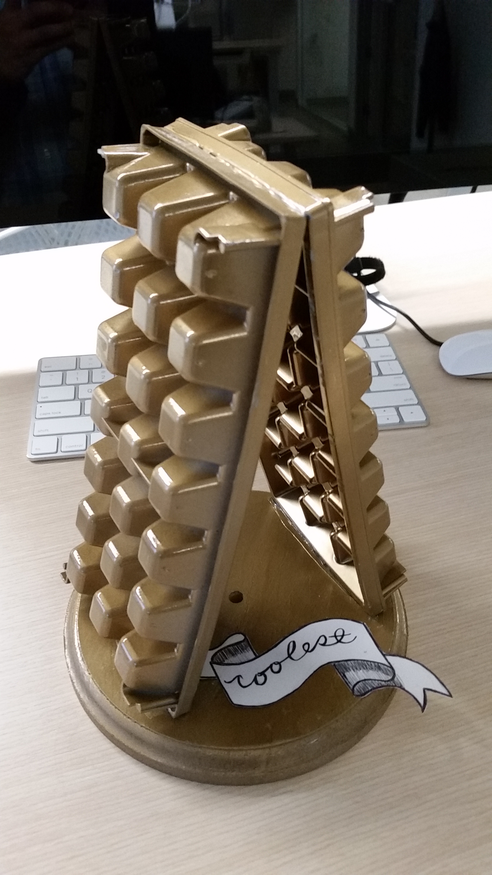
Random Awards
2016 “Hackathon – Coolest Innovation”
2016 Nominated a mentor for junior engineers
2013 Leadership “Living the Values” award
2012 Product Development Leadership “Inspire Through Action” award
2004 Single developer project nominated for the "Scott Cook Innovation Excellence" award

Slide 5
In Action: HIPAA into JIRA
Situation
Task
Upgrade Jira to the current rev.
Action
Automated bootstrapping and blue/green deployment w/Git, Jenkins, Ansible EC2 Module, and playbooks via Ansible Tower
Result
Partner with Dev/QA for Monitoring in Thousand Eyes, Cloudwatch, Pingdom, and Sumologic
Leveraged new runtime libs, latest packages, security measures, and OS patches
Partner with Dev for Full documentation (in git and confluence)
Uptime improved significantly.
The backend support and ticketing system (Jira integration with 40+plugins and customizations) was far out of compliance. Deployments were manual, monitoring was nonexistent incurring frequent outages, and releases couldn’t be done reliability. System was supportable by only one engineer.
Partner with Security to lock down access/controls w/Duo MFA through bastion
Institute standard best practices for provisioning, no-downtime deployment, and monitoring/alerting
Reduce Downtime MTTR and improve uptime.
Improve in-org supportability
Passed internal HIPAA compliance audit
Application now supported by entire DevOps organization
Stronger DevOps

Slide 6
In Action: Embracing a Culture of Change
Situation
Teams are disjointed. Little communication and next to no cross functional or cross product team collaboration. The DevOps team was seen as a burden/blocker
Task
Convince cross functional teams between San Mateo and Nashville (HQ) to work together
Build team relationships and a culture of learning
Action
Institute cross product team round table learning sessions
Build communication channels (chat, workspace, email distributions, knowledge-shares)
Result
DevOps, Cloud Governance, and Cloud Security teams have formed a healthy alliance.
Build trust and a sense of empowerment within the organization
Institute devops retrospectives sessions, office hours
Encourage teams to participate in backlog groomings sprint planning and standups
Recent informal organization survey results show a sizable improvement over previous year in collaboration, communication, motivation, and engineer operational efficiency
360 feedback was positive from ICs and upper leadership
Coordinate team building events.
Approached by engineers to join the team
Co-Authored Cloud Security Best practices
Notes:
Cloud best practices eg: Automated Cloud Vulnerability Management

Slide 7
In Action: Cost Control
Situation
As a startup with early exploratory initiatives (initiated prior to joining the company), cloud costs were out of control. For a single month, AWS costs topped $163K (company was not yet profitable).
Task
Reduce costs and improve operational efficiency without impacting overall performance and value to the customer.
Action
Implemented nightly shutdowns
Result
Reduced spend by 55%+ in the first month. By project end, costs were reduced to <24%
Reviewed all architecture and scaling thresholds. Identified core components and environments
Rightsized all applications
Reserved over On-Demand
Partnered with Dev to re-architect for efficiency.
Reduced environment complexity
Maximized operational support efficiency
Metrics showed little to no impact to end users
Improve monitoring and metrics dashboards

Slide 8

Sample Solution: Monolith to DevOps Cloud Microservices
Culture/People
Team Organization
DevOps Culture of Collaboration
Process
Feedback cycle & Continuous Improvement
Technology
Architecture
Data and Storage
Security and Privacy
API Management
Monitoring and Alerting
CI/CD/CD
DevOps
Cloud
Microservices
https://github.com/bbpraditkul/presentations/blob/master/DevOps_Monolith_Microservice_Cloud_Migration.pptx

Slide 9








Outside of the office…
Family
Smart Home
IOT
Camping & Grilling
Martial Arts
& Running
Auto repair
Reading

Slide 10




Contact Details
bbpraditkul@gmail.com
(650) 430-7958
https://www.linkedin.com/in/bryanpraditkul/
https://github.com/bbpraditkul

