Slide 2
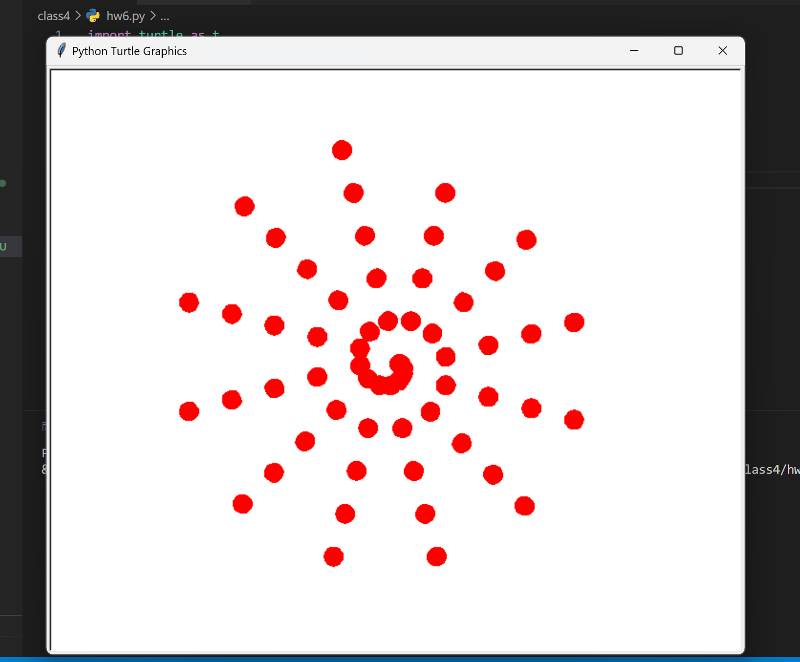
for i in range(60):
t.forward(i * 2)
t.stamp()
t.right(30)

