Slide 1
BEAN TESTING

Slide 2
because life is too short
for integration tests

Slide 3

Qaiser Abbasi
qaiser.abbasi@novatec-gmbh.de
Florian Fladung
florian.fladung@novatec-gmbh.de

Slide 4
Was
ist Bean-Testing?
Wie
funktioniert Bean-Testing?
Wofür
kann ich es verwenden?

Slide 5
Integration
Tests
Functional
Tests
Unit
Tests

Slide 6
Integration
Tests
Functional
Tests
Unit
Tests

Slide 7
Integration
Tests
Unit
Tests

Slide 8
CDT
Customer Driven Tests

Slide 9
Unit tests
Schnell
Code Einheiten
Mock

Slide 10

integration tests
Notes:
Server hochfahren
JRebel ist auch begrenzt bzgl. Bean Metadata

Slide 11
App Server
Int-Tests
Application

Slide 12

Arquillian
Deployment needed
Java EE embedded
Configuration hell

Slide 13
There are only 10 types of Testing:
Unit Tests
Integration Tests

Slide 14
JPA Queries
Persistence Services
CDI Components
Integration
Test ??
Bean Validation
Constraints
Distributed
Business Logic

Slide 15
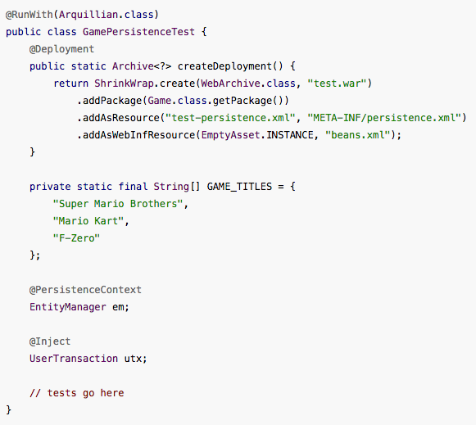

Unit Test
Integrationstest

Slide 16




Slide 17
Bean testing

Slide 18
Feedback
Unit Tests
BeanTests
Integration Tests
milliseconds
seconds
(several)
minutes

Slide 20

Since Java EE 6 (2009)
Origin JBoss Seam (Gavin King)
You can inject everything

Slide 21




Slide 22
Interceptors
Decorators
CDI Extensions
Dependency Injection
CDI Events
Producer Methods

Slide 23
EJB
Transactional
Interceptors
Security
Interceptors
Pooled
Scoped
Remote
?
Notes:
Mention Java EE 8
Proxies

Slide 24
CDI Extensions
@RequestScoped
@Transactional
public class MyService{}
@Stateless
public class MyService{}
@EJB
private MyService myService;
@Inject
private MyService myService;

Slide 25


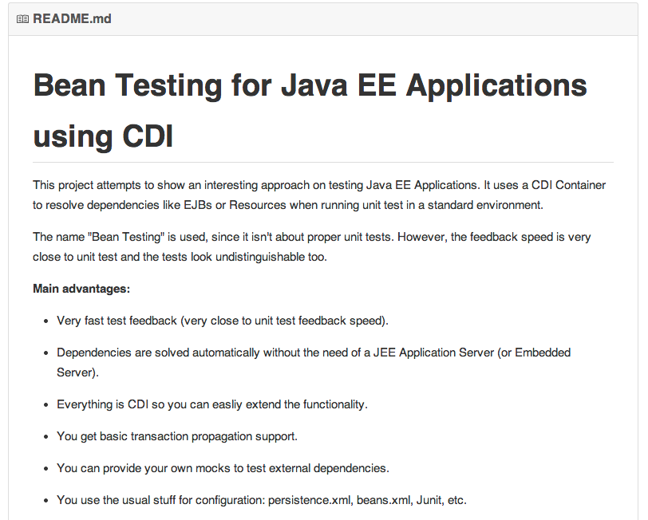
https://github.com/NovaTecConsulting/BeanTest

Slide 26
Wie kann ich Bean-Test in meinem Projekt einsetzen ?
1
<dependency>
<groupId>info.novatec</groupId>
<artifactId>bean-test</artifactId>
<version>0.1</version>
<scope>test</scope>
</dependency>
<repository>
<id>Novatec</id>
<name>Novatec Repository</name>
<url>http://repository.novatec-gmbh.de/content/repositories/novatec</url>
</repository>
2
Persistence-Unit “beanTestPU” in src/test/resources/META-INF
3
Empty beans.xml in src/test/resources/META-INF

Slide 27


Wo kann ich Bean-Test einsetzen?
7
6
5
Dependency
Injection

Slide 28
Was kann ich mit Bean-Test testen?
Was ist verfügbar? | Was kann man testen?
Dependency Injection | Dependencies (@EJB)
JPA Runtime | Queries, Beziehungen, Constraints
Interceptors & Decorators | Security
CDI Events, CDI Producers | CDI Events, CDI Producers (@Resource, @PersistenceContext)

Slide 29
Was kann ich mit Bean-Test testen?
BPM Engine
Integration
(Camunda, Activiti)
3rd Party Libraries
Integration
JSF Backing Beans

Slide 30
Services
(Façade)
Business
Functions
Persistence
Services

Slide 31
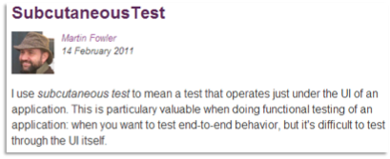
Backing Beans
(JSF)
Services
(Façade)
Business
Functions
Persistence
Services

Slide 32
Bean Testing
Hohe Geschwindigkeit (Feedback) mit großem Umfang
DRY – Alles ist schon da (JPA, EJB, CDI, Interceptors, TestNG)
nichtinvasive
TDD ist möglich
Unabhängig von Application Server
Verbesserte Qualität
Zeit und Geld (und Nerven) sparen.

Slide 33

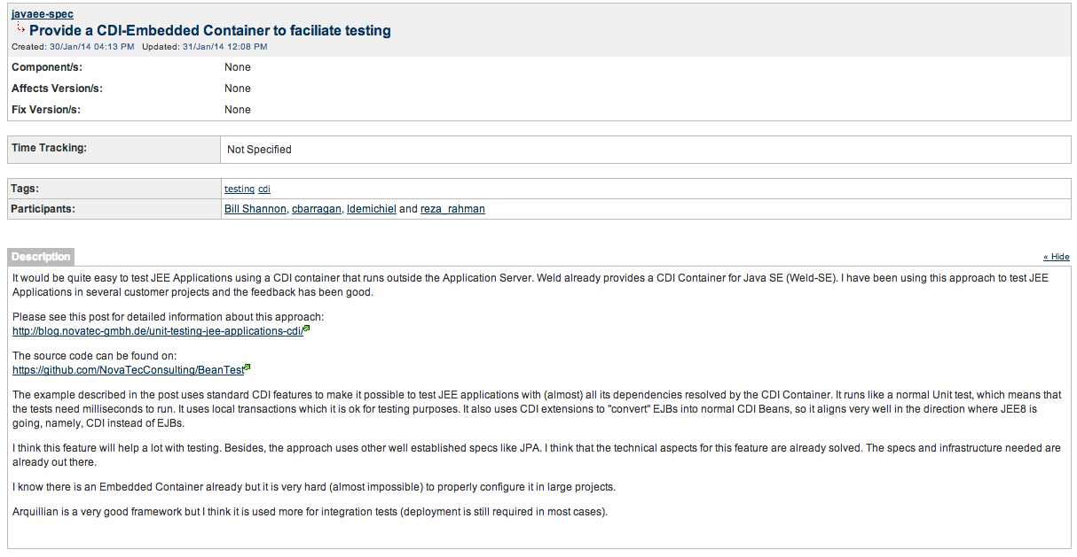
JavaEE 8 ?
https://java.net/jira/browse/JAVAEE_SPEC-35

Slide 34
Danke!

