Slide 1

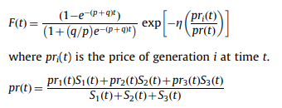
Fundamental
Multi-generation diffusion model
Norton
Speece and Maclachlan (1992) extended the multi-generation diffusion model by incorporating the pricing factor

Slide 2

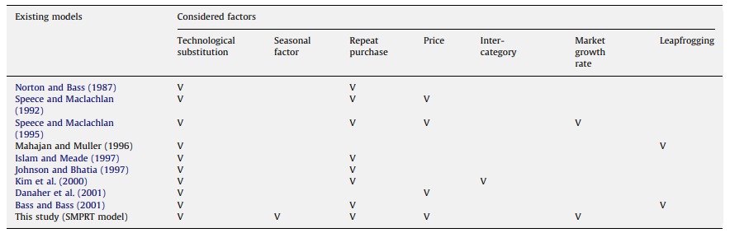
Fundamental
Multi-generation diffusion model
Speece and Maclachlan (1995) considered the factors of price and growth in a multi-generation diffusion model

Slide 3
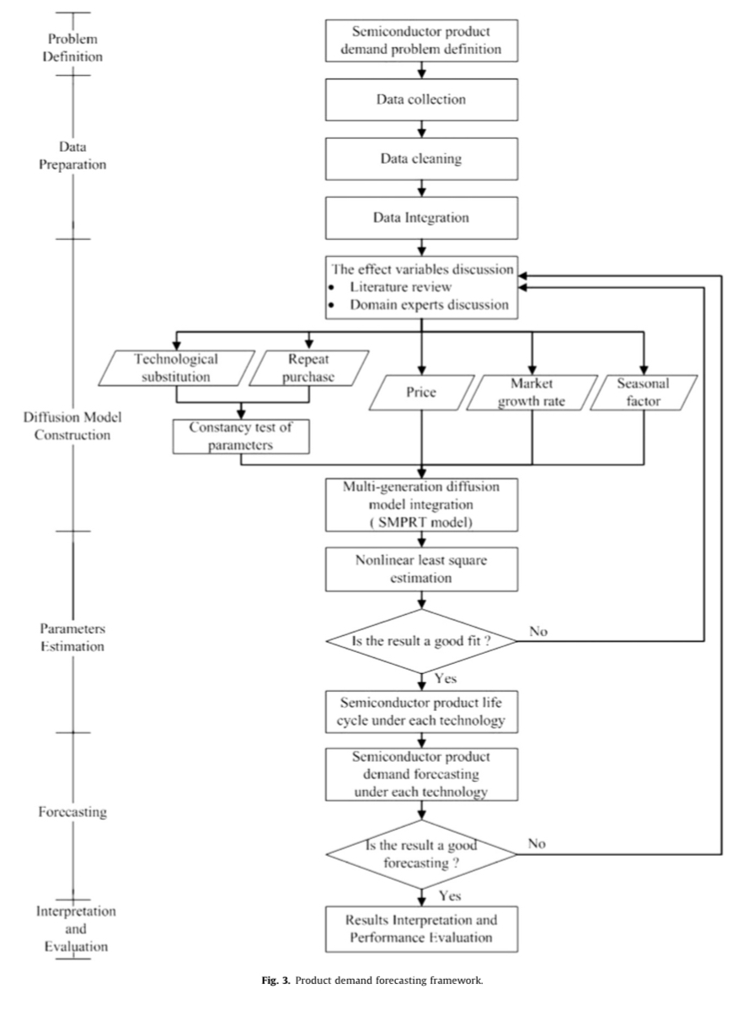
Approach

Slide 4
Approach
Problem definition
Semiconductor industry is growing rapidly, thus shortening the product life cycle (PLC) of semiconductor products.
In the semiconductor industry, R&D costs and capital investment requirements are enormous. To allocate the resource efficiently and thus to ensure efficient resource allocation firms require a method of accurately describing PLC and forecasting product demand.
This study designs a demand forecasting framework for accurately forecasting product demand, thus providing valuable information to assist managers in decision-making regarding capacity planning.

Slide 5
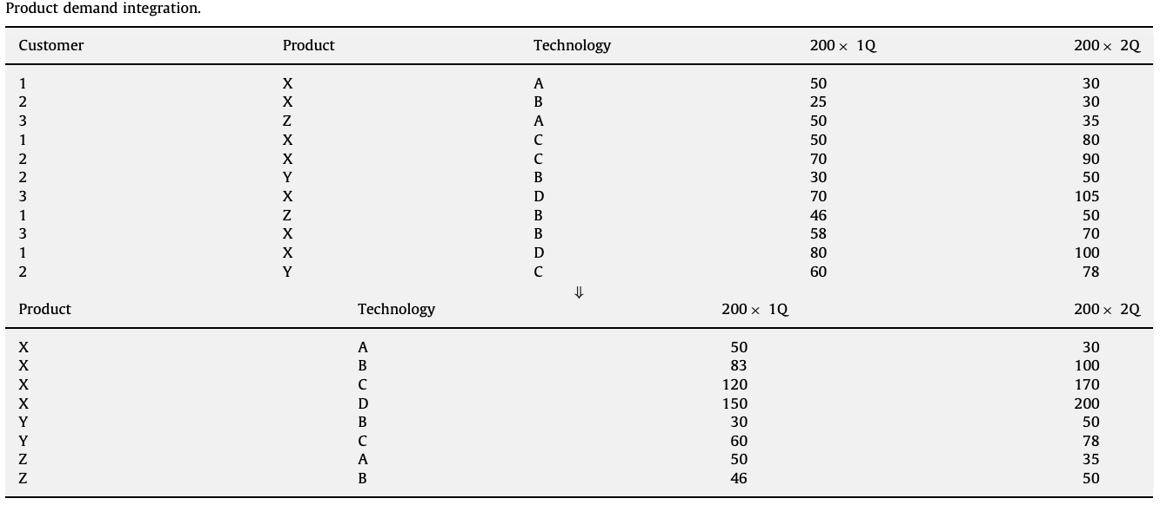
Approach
Data preparation
Process includes data collection, cleaning, and integration procedures.
Data integration merges data from different sources into a file. For example, product prices, semiconductor industry market growth rate, and semiconductor product demand
Summarize the same technology and the same product data

Slide 6
Approach
Diffusion model construction
This study constructs a multi-generation diffusion model based on the Norton and Bass model
Firstly, the model tests parameters to identify inter-generational changes
The proposed diffusion model matches up semiconductor product characteristics to obtain valuable information and thus incorporates technological substitution, price effect, market growth rate, and seasonal factor

Slide 7
Approach
Effect variables
Five factors, including seasonal factor, market growth rate, price, repeat purchases and technological substitution.
Seasonal factor
Seasonal factors affect numerous business activities
PC sales
Market growth rate
Describe the market structure and economic environment
Price
Key influence on customers purchase decisions
For semiconductor products, prices reduce rapidly during the initial stage and then stabilize

Slide 8
Approach
Repeat purchase
This study considers the effect of repeat purchases, because adopters do not purchase products in single unit quantities
Focused on forecasting the total sales of semiconductor products, in which separating the first and repeated adopters is not needed.
Technological substitution effect
As Moore’s Law continues to hold, newer technologies are continually being introduced to the market
Consider both diffusion and substitution for semiconductor products

Slide 9
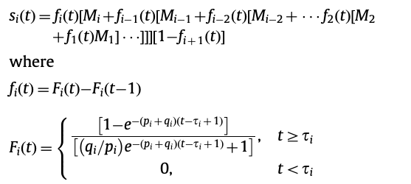
Approach
Multi-generation diffusion model (SMPRT model)
This study proposed a multi-generation diffusion model, namely the SMPRT model, incorporating seasonal factors (S), market growth rate (M), price (P), repeat purchases (R), and technological substitution (T)

Slide 10


Approach
Multi-generation diffusion model (SMPRT model)
The parameters in the proposed SMPRT model are tested for constancy across the generations
Establish the following hypothesis:
This hypothesis can be tested using a likelihood ratio test or full information maximum likelihood (FIML) estimation

Slide 11

Approach
Multi-generation diffusion model (SMPRT model)
The proposed SMPRT model also considers the price factor in which the expression of F(t) in the Norton and Bass model is substituted for the expression of F(t) proposed by Bass et al. (1994) as follows:

Slide 12
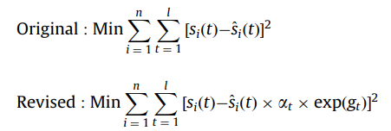
Approach
Multi-generation diffusion model (SMPRT model)
SMPRT model uses a multiplicative model to express seasonal variation and the market growth rate effect

Slide 13
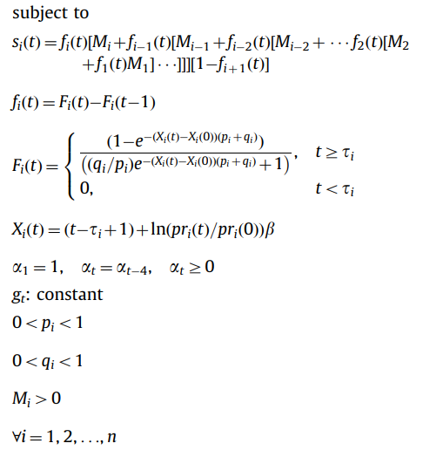

Approach
Multi-generation diffusion model (SMPRT model)
Finally, the SMPRT model is integrated as

Slide 14
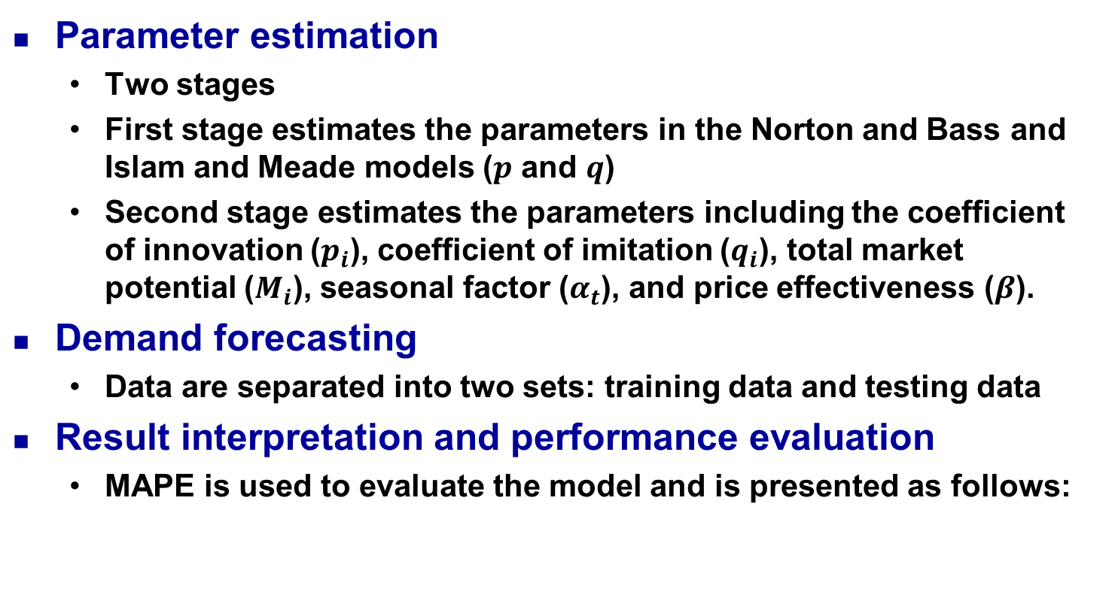

Approach

Slide 15
Empirical study
Problem definition
Semiconductor companies always adopt a make-to-order strategy
Quantity of semiconductor products affects capacity allocation and capacity level
This study constructs a systematic framework for solving problems involving product demand forecasting
Describes the PLC and accurately forecasts semiconductor product demand to assist in capacity allocation and expansion, thus maximizing capacity utilization and profit by using the product demand forecasting framework

Slide 16
Empirical study
Data preparation
Historical product demand transaction data collected on quarterly basis
A semiconductor product X for performing the validation
The analysis is performed using a quarterly time scale
The total time horizon is 36 quarters
Semiconductor product X is manufactured using different technologies
There are 36, 29, 17, and 9 quarters of data for generations 1–4, respectively

Slide 17
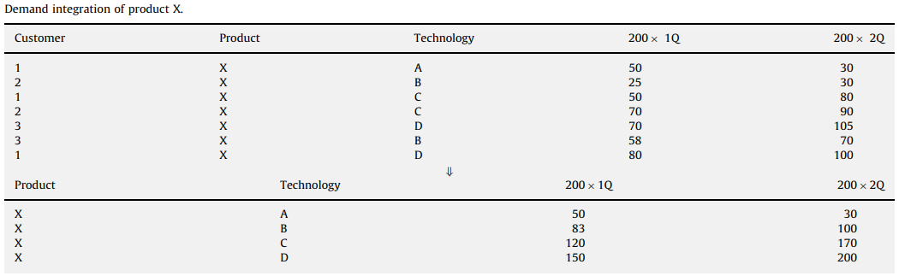
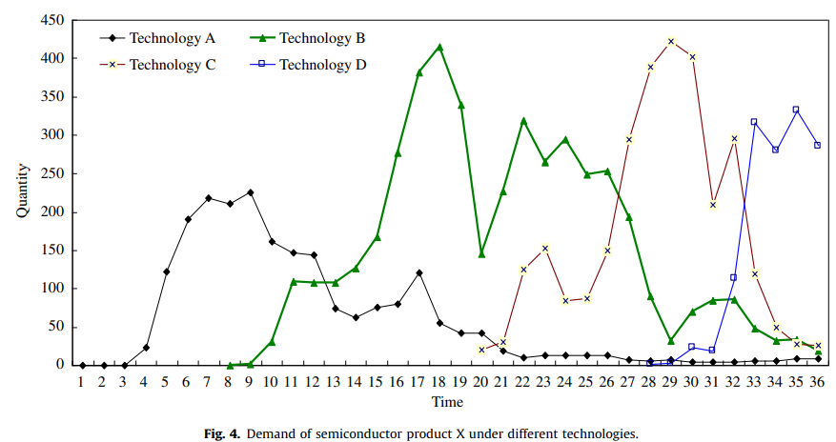
Empirical study

Slide 18
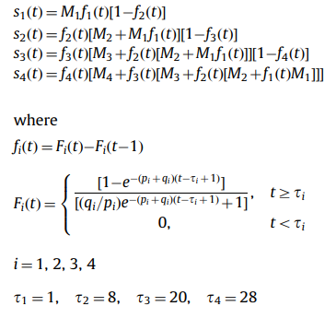
Empirical study
Diffusion model construction
Step 1: Compare the Norton and Bass and Islam and Meade models. Expand the model based on four generations

Slide 19

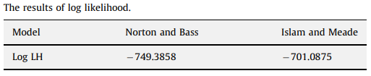
Empirical study
Diffusion model construction
Step 2: Test the parameter constancy (using FIML)
Define the Norton and Bass model as a restricted model.
Define the Islam and Meade model as an unrestricted model.
Test the statistics

Slide 20
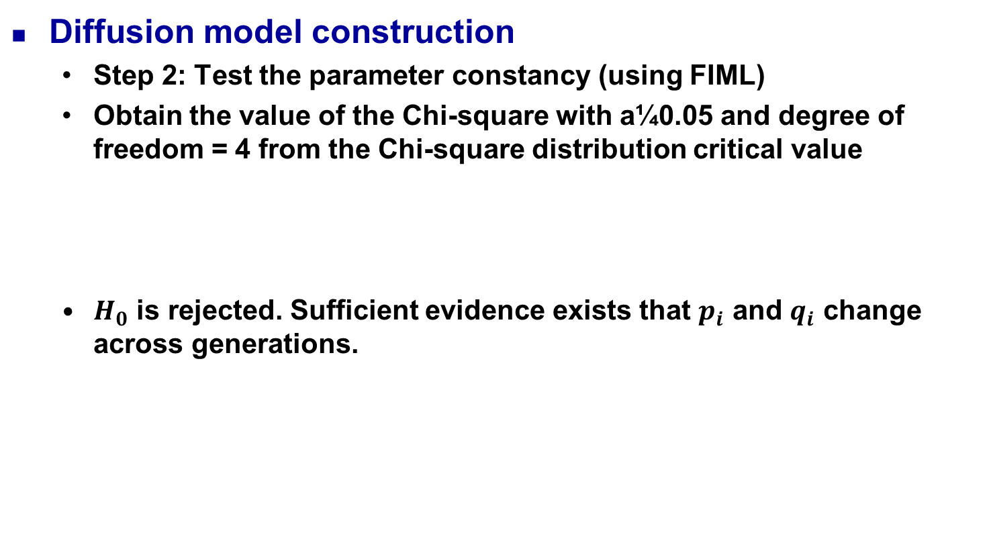


Empirical study

Slide 21
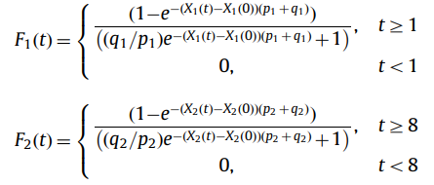
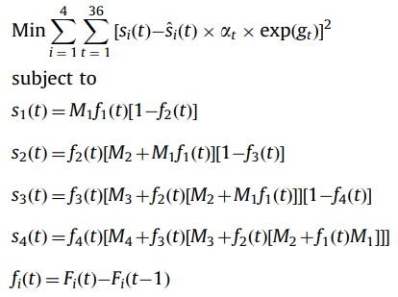
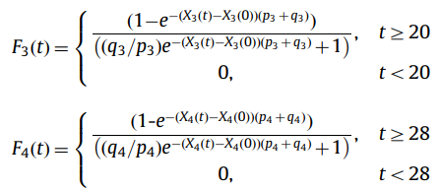
Empirical study
Diffusion model construction
Step 3: Incorporate the effects into the proposed SMPRT model
The introduction times of the four generations of semiconductor product X are in quarters 1, 8, 20, and 28, respectively

Slide 22
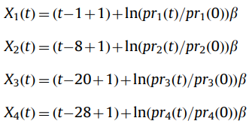

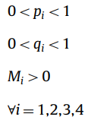

Slide 23
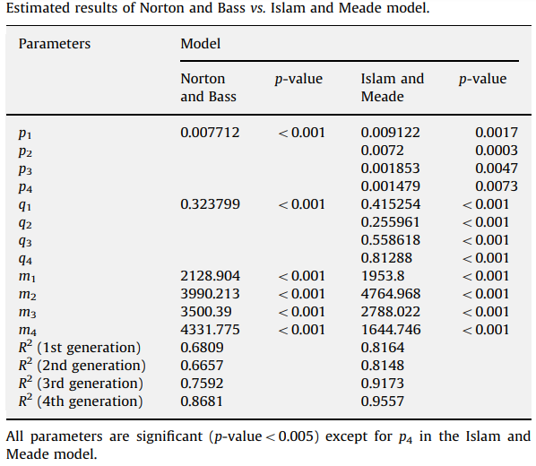
Empirical study
Parameter estimation
Use nonlinear least squares procedure to estimate the parameters.

Slide 24
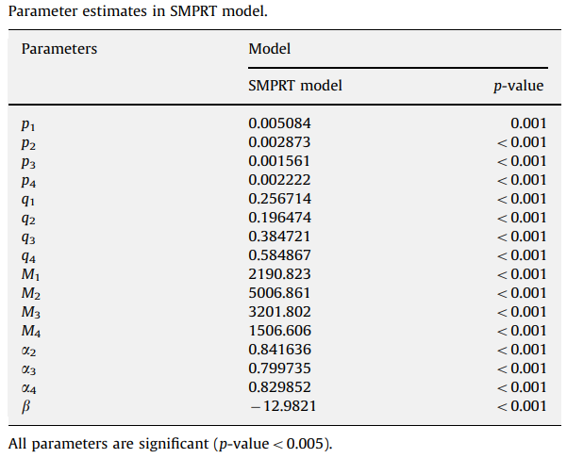
Empirical study
Parameter estimation
Use nonlinear least squares procedure to estimate the parameters.

Slide 25
Empirical study
Forecasting
Data are separated into two sets of training data and testing data
34 quarters as training data to estimate the parameters in SMPRT model
Forecast product demand for the remaining 2 quarters to estimate the validity of the proposed model

Slide 26
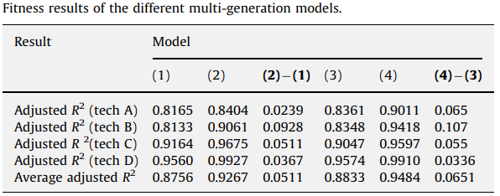
Empirical study
Results interpretation and performance evaluation
(1) Speece and MacLachlan model
(2) SMPRT model without market growth rate and seasonal factor
(3) Speece and MacLachlan model with market growth rate and seasonal factor
(4) SMPRT model with market growth rate and seasonal factors

Slide 27
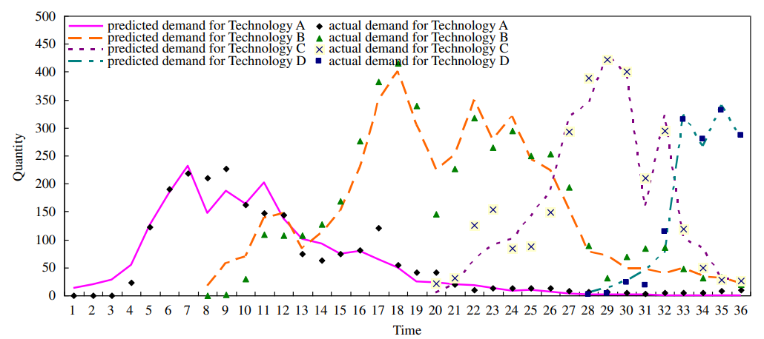
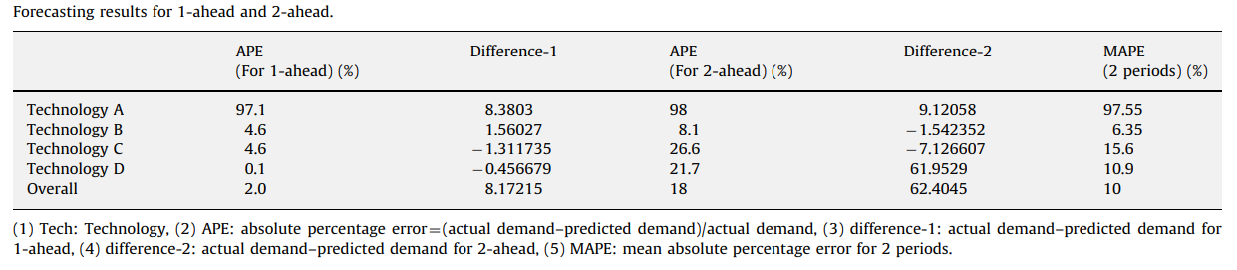
Empirical study
Results interpretation and performance evaluation

Slide 28
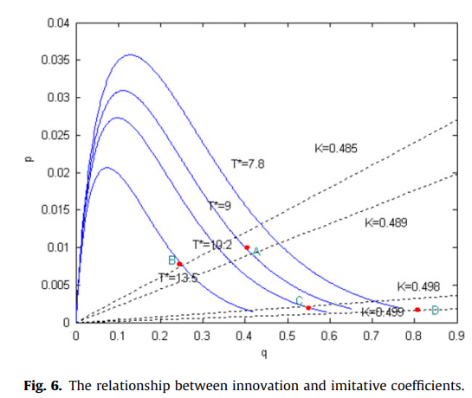
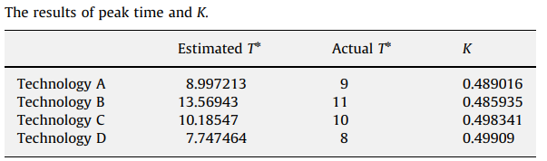
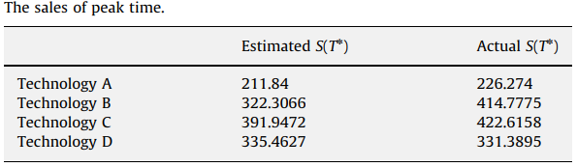
Empirical study
Discussion and application
No prior data are available for new products
The shape of product life cycle is influenced by the innovation coefficient (p) and imitation coefficient (q)
For simplicity, this study uses the estimated parameter values from the Islam and Meade model with different pi and qi across generations.

Slide 29
Conclusion
This study developed a framework for forecasting semiconductor product demand and proposed a multi-generation diffusion model (i.e., SMPRT model) that incorporated S, M, P, R, T to forecast the demand of semiconductor products
Future research can be done to examine the model assumptions in various settings and can be done to effectively expand the multi-generation diffusion model to forecast the sales of the matured technologies
Future studies can consider other factors such as market share, capacity restriction, and cycle effect in the diffusion model

Slide 30
Predictive Maintenance: Systems, Purposes and Approaches
2020.05.06
朱柏賢

Slide 31
Introduction
It is critical for companies to develop a well-implemented and efficient maintenance strategy to prevent unexpected outages, improve overall reliability and reduce operating costs.
The evolution of modern techniques (e.g., Internet of things, sensing technology, artificial intelligence, etc.) reflects a transition of maintenance strategies from Reactive Maintenance (RM) to Preventive Maintenance (PM) to Predictive Maintenance (PdM).

Slide 32
Introduction
The enabling technologies have the enhanced potential to detect, isolate, and identify the precursor and incipient faults of machinery equipment and components, monitor and predict the progression of faults, and provide decision-support or automation to develop maintenance schedules.
The emerging technologies enhance PdM in the following aspects:
IoT for data acquisition
Big data techniques for data (pre-)processing
Advanced Deep Learning (DL) methods for fault diagnosis and prognosis
Deep Reinforcement Learning (DRL) for decision making
Powerful hardwares for complex computing

Slide 33
Introduction
Although PdM becomes a promising approach to decrease the downtime of machines, improve overall reliability of systems, and reduce operating costs, the high complexity, automation and flexibility of modern industrial systems bring new challenges.
Three fundamental problems should be well considered in the context of PdM:
PdM system architectures
The purposes of PdM
The approaches for fault diagnosis and prognosis

Slide 34
Introduction A. Existing Surveys on Fault Diagnosis and Prognosis
The aforementioned survey papers have given interesting reviews related to the filed of fault diagnosis and prognosis, but they have the following limitations:
Most of the existing survey papers [10–18] only focus on reviewing the existing fault diagnosis and/or prognosis approaches, most of which are equipment specific.
Although PdM aims to prevent unexpected outages, improve overall reliability and reduce operating costs, there is no existing survey paper to summarize the mathematical models for the purposes of PdM.
Due to the rapid development of deep learning, many new DL based approaches (e.g., generative adversarial network, transfer learning, deep reinforcement learning, etc.) have been applied in the filed of PdM. Therefore, a new review is required to cover the advancements of this field in recent years

Slide 35
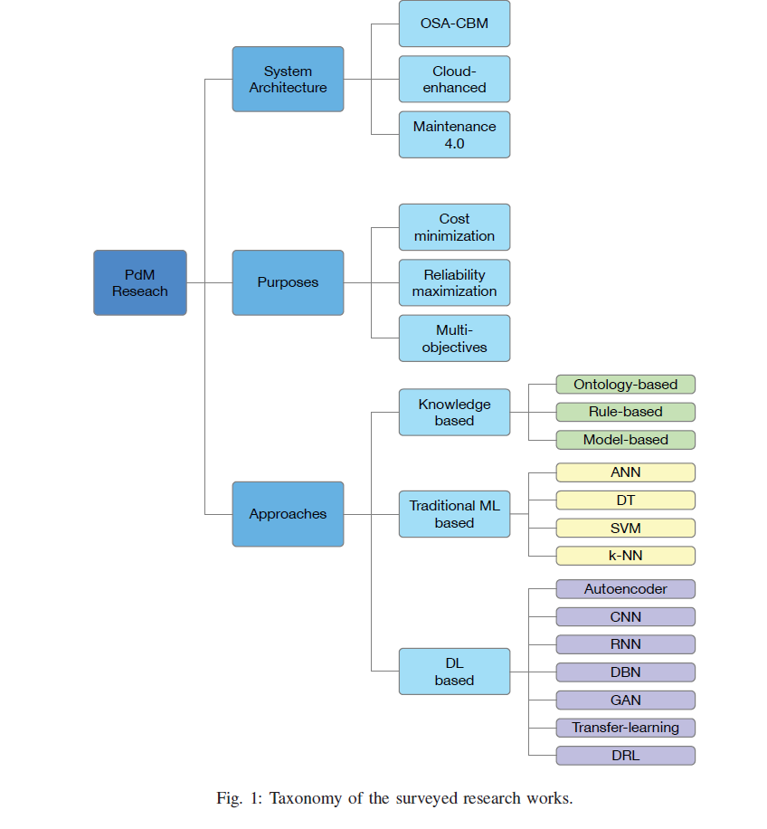
Introduction B. Literature Classification

Slide 36
Introduction B. Literature Classification
The surveyed PdM approaches mainly focus on the following aspects:
Classification models to identify (early) failure: This kind of approaches aims to know if the machine will fail “soon”, e.g., class = 0 indicating no failure in the next n days, class = 1 for failure type 1 in the next n days.
Anomalous behavior detection: This kind of approaches are able to flag anomalous behavior, in despite of not having any previous knowledge about the failures.
Regression models to predict RUL: This kind of approaches aims to predict RUL according to the degradation process that learns from the historical data.

Slide 37
Categories of Maintenance Techniques
Reactive Maintenance (RM)
A run-to-failure maintenance management method
RM offers the maximum utilization and in turn maximum production output of the equipment by using it to its limits
The cost of repairing or replacing a component would potentially be more than the production value received by running it to failure
Company should maintain extensive spare inventories for all critical equipment and components to react to all possible failures.

Slide 38
Categories of Maintenance Techniques
Preventive Maintenance (PM)
Also referred to as planned maintenance
Schedules regular maintenance activities on specific equipment to lessen the likelihood of failures
The maintenance is executed even when the machine is still working and under normal operation so that the unexpected breakdowns with the associated downtime and costs would be avoided.

Slide 39
Categories of Maintenance Techniques
Preventive Maintenance (PM)
The general process of PM can be presented in two steps:
1) statistically investigate the failure characteristics of the equipment based on the set of time series data collected
2) The second step is to decide the optimal maintenance policies that maximize the system reliability/availability and safety performance at the lowest maintenance costs.
PM could reduce the repair costs and unplanned downtime, but might result in unnecessary repairs or catastrophic failures
Existing analysis has shown that the maintenance cost of repairs made in a reactive mode (i.e., after failure) is normally three times greater than that made on a scheduled basis

Slide 40
Categories of Maintenance Techniques
Predictive Maintenance (PdM)
Also known as condition-based maintenance (CBM)
Aims to predict when the equipment is likely to fail and decide which maintenance activity should be performed such that a good trade-off between maintenance frequency and cost can be achieved
The principal of PdM is to use the actual operating condition of systems and components to optimize the O&M
The predictive analysis is based on data collected from meters/sensors connected to machines and tools, such as vibration data, thermal images, ultrasonic data, operation availability, etc.

Slide 41
Categories of Maintenance Techniques
Predictive Maintenance (PdM)

Slide 42
Categories of Maintenance Techniques
Predictive Maintenance (PdM)

Slide 43
System Architectures of PdM
OSA-CBM
Open System Architecture for Condition Based Monitoring
Provides a uniform and layered framework to guide the design and implementation of a PdM system.

Slide 44
System Architectures of PdM
Cloud-enhanced PdM System
Cloud-enhanced PdM is inspired by the potential of cloud computing and cloud manufacturing
Cloud computing enables that IT resources such as infrastructure, platform, and applications are delivered as services, while cloud manufacturing transforms manufacturing resources and capabilities into manufacturing services, and offers adaptive, secure, and on-demand manufacturing services over IoT.
As an important part of cloud manufacturing, PdM is enhanced by cloud concept to support companies or plants in deploying and managing PdM services over the Internet

Slide 45
System Architectures of PdM

Slide 46
System Architectures of PdM
Cloud-enhanced PdM System
Cloud-enhanced PdM paradigm possesses the following characteristics:
Service-oriented
Accessible and robust
Resource-aware
Collaborative and distributive
A variety of challenges are involved and remain to be investigated. For example, heterogeneous data storage and analysis, communication security and user privacy
PdM 4.0
PdM 4.0, aligned with Industry 4.0 principles, paints a blueprint for intelligent PdM systems.

