Slide 1
學術研究分享
2020.08.24
朱柏賢

Slide 2
異常程式分析架構 – 以半導體封裝廠為例
2018

Slide 3
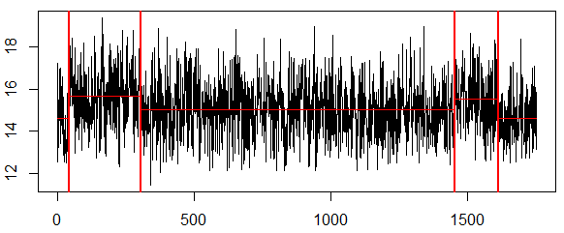
異常程式標訂
目的：由於實際生產資料未標記確切偏移點，故以人工標訂異常程式 ，以利 後續驗證。
方法：手動調整懲罰值，裁取資料區段，使一支程式只有一個明顯偏移點。
資料：20XX/XX/XX – 20XX/XX+6/XX
此處之正常與異常並不代表實際上程式之運作狀況，僅是依擷取區段判斷是否會影響後續EWMA之表現，作為參數設定的依據
原始資料
筆數> L
否
不採用
是
資料擷取區段範例
以CPA標定程式
偏移>S%
否
判為正常
模型不應偵測
是
判為異常
模型應偵測
最終測試資料

Slide 4
影響 Ball Shear 值之要素選擇
影響要素大致歸納如下：
影響BS值要素 | 原因
機型 | 機型新舊問題導致打線參數有些微不同
推球機 | 不同樓層使用之推球機不同
CID | 下列三者改變其一即更新：Sample Size改變、換廠區、 Spec 改變
管制界限 | 隨時間人為更新 (縮窄)
公司人員在後續EWMA監控機台時，僅有依照機型分類，並無將其他因素納入，故異常程式判定部分也僅納入機型。
Notes:
Spec 客戶別 線材 線徑

Slide 5


CUSUM構想
方法：利用CUSUM累加方法，驗證抓出之異常是否與先前CPA
訂定的偏移點互相印證。
Cusum 公式
參數設定
容差 k (allowance)：容許的誤差範圍，通常設定為目標值的一半。
管制界線CL (Control Limit)：超過則視為製程偏移。
容差與決定區間之設定，原皆為以資料標準差為單位進行設定，為配合以偏移百分比的計算標準，進行調整。
$$C_{i}^{+}=max⁡[0,x_{i}−\left(μ_{0}+K)+C_{i−ˊ1}^{+}\right]$$
$$C_{i}^{−}=max⁡[0, \left(μ_{0}+K)−x_{i}+C_{i−1}^{+}\right]$$
$C_{i}^{+}=C_{i}^{−}$=0 (初始值)

Slide 6
模型績效指標
以對應CPA之正確率為主、ARL為輔做排名順序
為避免 cpt 影響 ARL0 之大小，其排序以 ARL0 / cpt 作為衡量標準
平均連串長度，ARL (Average Run Length)示意圖
ARL0
cpt
資料起點
CUSUM超出管制線的1st 點
資料終點
cpt
ARL1
資料起點
CUSUM超出管制線的1st 點
資料終點
6

Slide 7
參數設定
以多種 Se.shift 及 Decision Interval 排列組合，再以K-fold交叉驗證，嘗試找出最佳參數設定
以標準差為參數
中心線(CL)：平均值
管制界限：平均值 ± k倍標準差
參數設定範圍：
Se.shift ：0.1 σ ~ 3 σ
Decision Interval ：1 σ ~ 30 σ
UCL
kσ
μ
CL
kσ
LCL
以標準差為參數之圖示

Slide 8
CUSUM參數設定
以多種 Se.shift 及 Decision Interval 排列組合，嘗試找出最佳參數設定
將各參數組合之 ARL0 及 ARL1 分別做排名，相加後為總排名之依據
為避免 cpt 影響 ARL0 之大小，其排序以 ARL0 / cpt 作為衡量標準
可依 ASE 意願決定 ARL0 及 ARL1 之權重 (此版為 1:1)
以正確率為主、ARL為輔做排名順序
以標準差為參數
中心線(CL)：平均值
管制界限：平均值 ± k倍標準差
參數設定範圍：
Se.shift ：0.1 σ ~ 2 σ
Decision Interval ：1 σ ~ 25 σ
UCL
kσ
μ
CL
kσ
LCL
以標準差為參數之圖示

Slide 9
總結
模型建立流程
建立異常程式分析架構 (上線流程)
原始資料
即時更新資料
筆數> L
否
不採用
將程式依機型分類
是
以CPA標定程式
放入CUSUM偵測
偏移>S%
否
判為正常
模型不應偵測
超出管制界限
否
是
納入EWMA機台控管
判為異常
模型應偵測
是
屏蔽超出
管制界限之後區段
屏蔽後之正常資料
最終測試資料
最佳參數測試
公司人員查明原因後修正
Notes:
正確率96%

Slide 10
UNISON data-driven intermittent demand forecast framework to empower supply chain resilience and an empirical study in electronics distribution
2019

Slide 11
Understand and define the problem
To fulfill the demands of downstream customers globally, semiconductor component distributors are supposed to maintain inventory management weekly based on future demand predictions for different product characteristics to maintain customer service levels and merge the separated forecasts into replenishment orders for upstream manufacturing factories.
Construct an appropriate automated forecast mechanism for semiconductor components with regard to the distinct dynamics of diversified demand features.

Slide 12
Structure influence relationship
To reduce the temporal effect on demand uncertainty, the proposed approach transforms the original demand into several time series with different aggregation levels.
At each sub-aggregated forecast stage, three demand forecast models with respective characteristics are occupied as decision strategies.
The weighted combination schema based on the decision regret is adopted for forecast combination at sub-aggregated levels.
Finally, the forecast results at different aggregation levels are integrated by the disaggregation procedure to generate a unique forecast result.

Slide 13
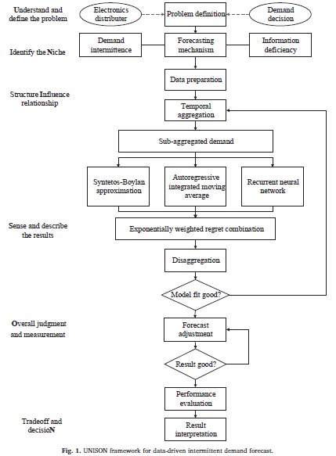

Slide 14
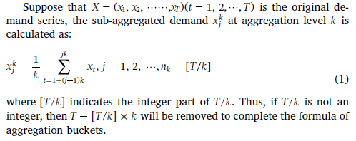
Temporal aggregation

Slide 15
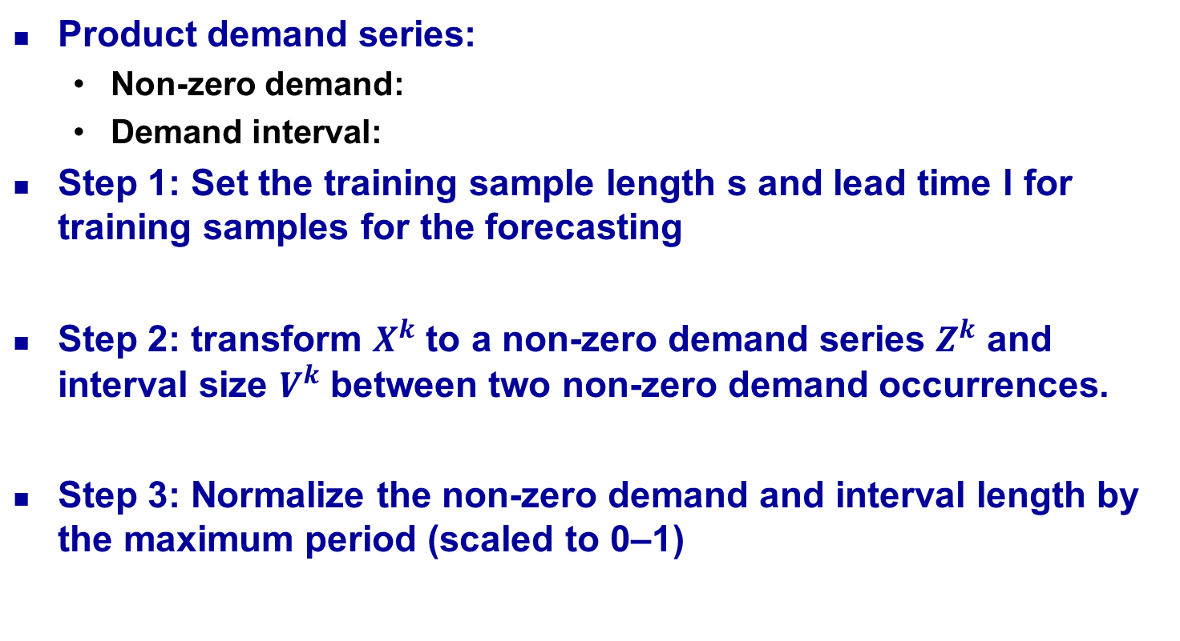
Sub-aggregated demand forecast

Slide 16
Sub-aggregated demand forecast
Step 4: Forecast the non-zero demand Z and interval V by three individual forecast models in representation of Croston variants, time series and machine learning forecast approaches with adaptive trained parameter settings constants.

Slide 17
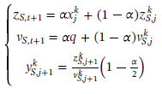

Sub-aggregated demand forecast
Syntetos-Boylan approximation (2005)

Slide 18


Sub-aggregated demand forecast
ARIMA (p, d, q)

Slide 19

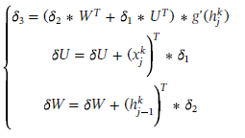
Sub-aggregated demand forecast
Recurrent neural network (RNN)
Input series:
Hidden layer vector:
Predicted result:
RNN unit is computed as:
Back-propagation

Slide 20
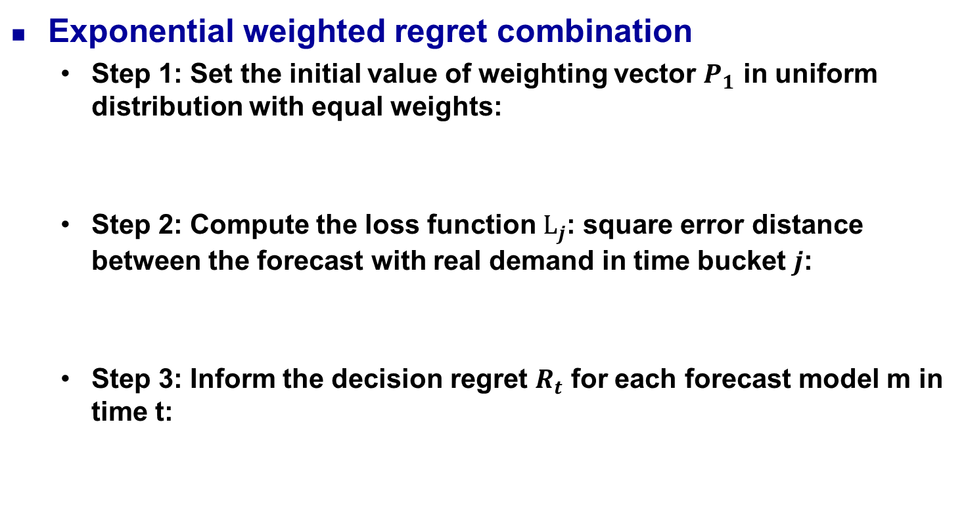



Sense and describe the results

Slide 21
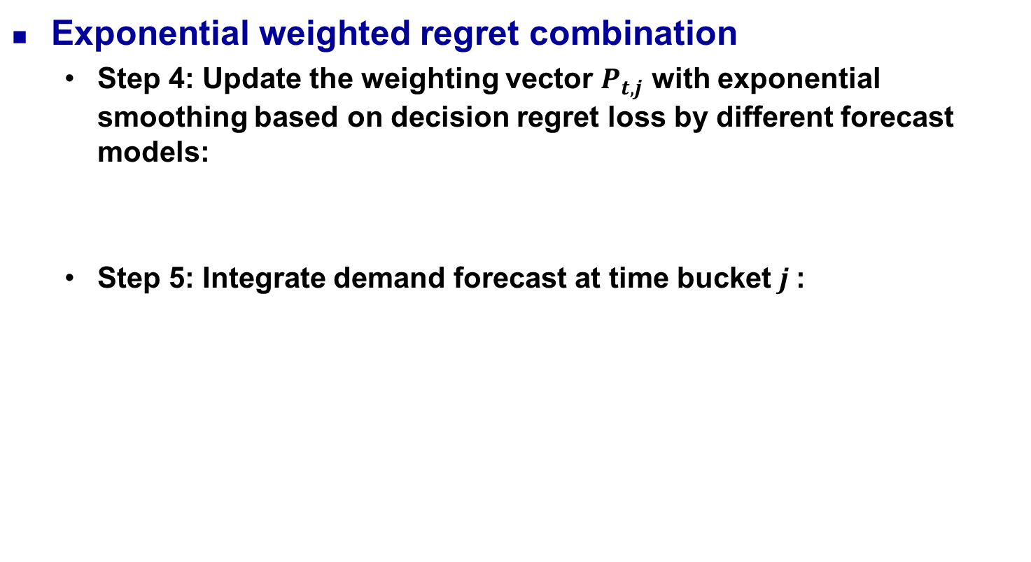


Sense and describe the results

Slide 22
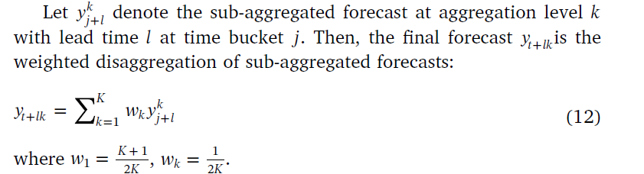
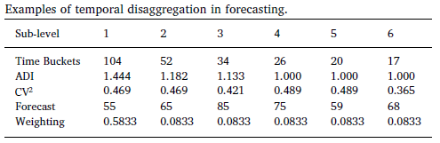
Sense and describe the results
Disaggregation

Slide 23



Overall judgement and measurement
RMSE:
MAE:
MASE

Slide 24
Empirical Study
Understand and define the problem
This study conducts an empirical study in a worldwide leading electronics distributor to validate the model effectiveness
Identify the niche
The empirical dataset includes a set of 265 products recorded for 104 weekly demand observations in three warehouses
23 component demand series with less than the in-sample baseline (5 pick-up points) for model fitting are removed from our experiment and the remaining 242 are separated into two parts: 78 observations for training and the remaining 26 for testing

Slide 25
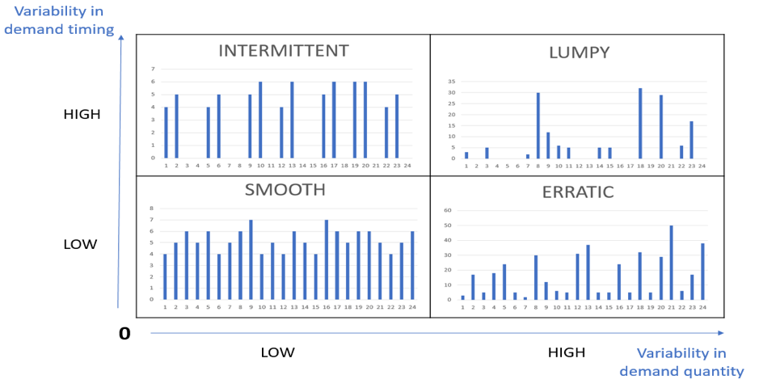

Empirical Study
Identify the niche
ADI
110
85
1.32
4
43
0.49

Slide 26
Empirical Study
Sense and describe the results
This study employs temporal aggregation and disaggregation to diminish the abnormally massive impact of unexpected event effects in different temporal segments
This study sets the aggregation level equal to the lead time in temporal aggregation stage
Three forecast horizons are considered in the experiment test: 4-periods for rush orders, 8-periods for regular orders, and 12-period lead time for customized orders

Slide 27
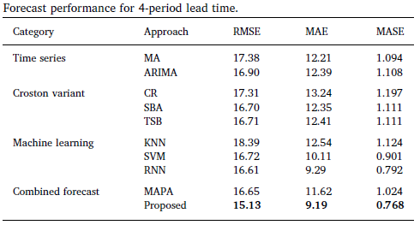
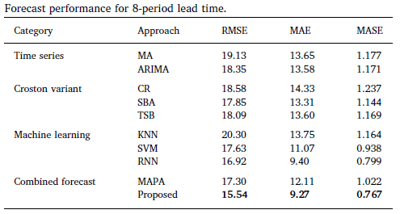
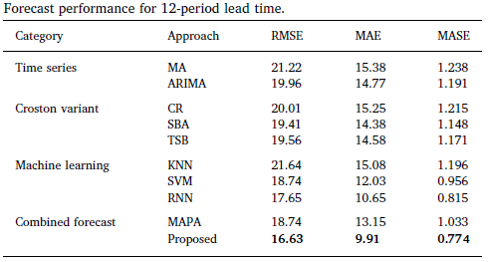
Empirical Study
Overall judgement and measurement

Slide 28
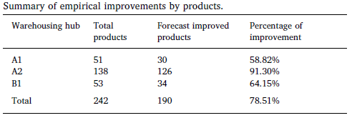
Empirical Study
Overall judgement and measurement

Slide 29
Empirical Study
Trade-off and implement the optimal decision
The results in empirical study have shown that the proposed approach can effectively handle general intermittent patterns such as product life cycles and periodic event effects of component transaction to support inventory decisions
Improve supply chain efficiency, reduce accumulated inventory, and finally reduce operating costs.

Slide 30
Conclusion
This study developed a novel data-driven demand forecast framework that can integrate temporal aggregation with time series and neural network for intermittent component demand forecast to support smart production for global manufacturing networks
More studies can also be conducted with further internal and external information to enhance the accuracy and generalizability of the forecast results

Slide 31
Manufacturing intelligence for semiconductor demand forecast based on technology diffusion and product life cycle
2019

Slide 32
Introduction
Semiconductor manufacturing companies have to forecast future demands to provide the basis for manufacturing strategic decisions including new fab construction, technology migration, capacity transformation and expansion, tool procurement, and outsourcing.
It is critical for high-tech industry to develop flexible forecasting systems that allow them to quickly respond to mitigate the negative impacts of the Bullwhip Effect.
Demand fluctuation due to shortening product life cycle and increasing product diversification in the consumer electronics era make the demand forecast problem increasingly difficult and complicated.

Slide 33
Introduction
These time series methods have difficulty for expressing the adoption process of new products. In addition, forecasting methods that are designed for a single generation cannot consider inter-generational substitution involved in semiconductor industry.
SMPRT model based on product life cycle and technology diffusion theories, for forecasting semiconductor product demand, in which the seasonal factor(S), market growth rate(M), price(P), repeat purchases(R), technology substitution(T) are considered.

Slide 34
Fundamental
Bass model
A basic diffusion model for new consumer durables to forecast the sales of the new product with the first purchase
Divided the adopters into two groups
First group : innovators who adopt the product via mass media communications
Second group : imitators who adopt the product via word of mouth communications.

Slide 35

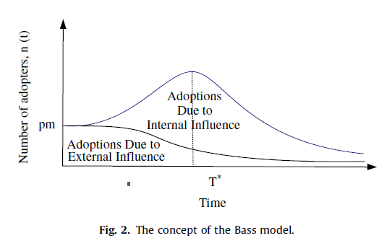
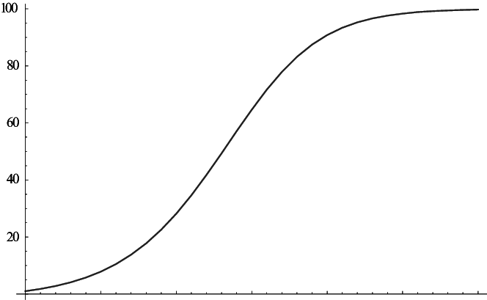
Fundamental
Bass model
f(t) : probability destiny function of adopters at time t
F(t) : cumulative destiny function of adopters at time t
p : coefficient of innovation (external coefficient)
q : coefficient of imitation (internal coefficient)

Slide 36
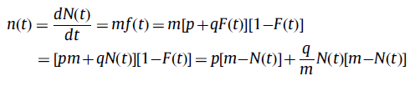


Fundamental
Bass model
m : market potential
n(t) : number of adopters at time t
N(t) : cumulative number of adopters at time t

Slide 37
Fundamental
Multi-generation diffusion model
Norton and Bass (1987) extended it into a multi-generation diffusion model for high-tech products.
Bass model assumes:
(1) the existence of a series of advancing generations, each of which with functions equaling or exceeding those of the previous generation
(2) a function of time to the adoption for each generation applied against a time-varying market potential
(3) the substitution of actual and potential sales from earlier to later generations

Slide 38
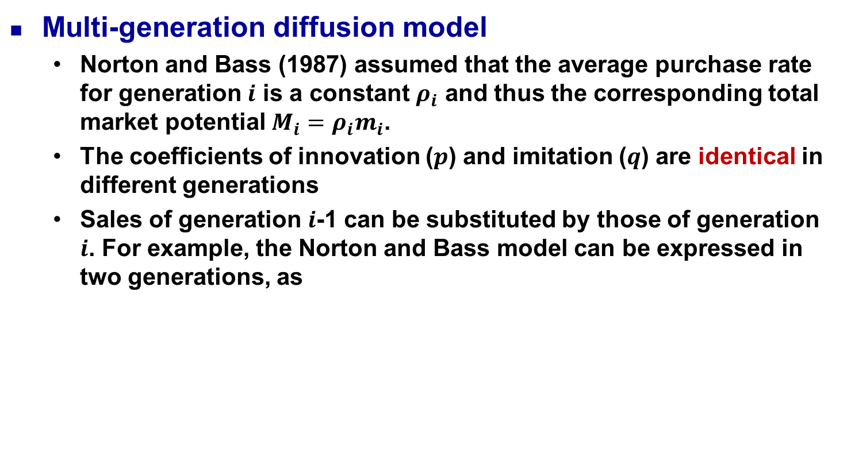

Fundamental

Slide 39

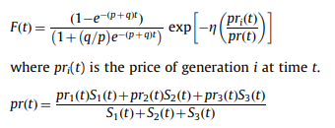
Fundamental
Multi-generation diffusion model
Norton
Speece and Maclachlan (1992) extended the multi-generation diffusion model by incorporating the pricing factor

Slide 40

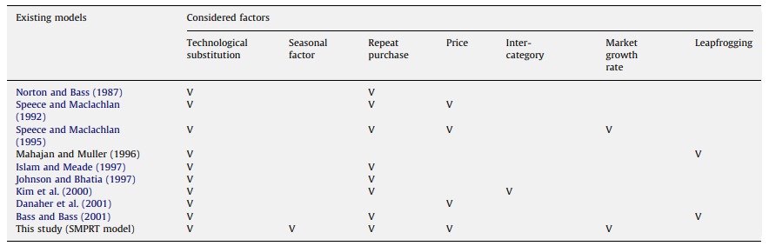
Fundamental
Multi-generation diffusion model
Speece and Maclachlan (1995) considered the factors of price and growth in a multi-generation diffusion model

Slide 41
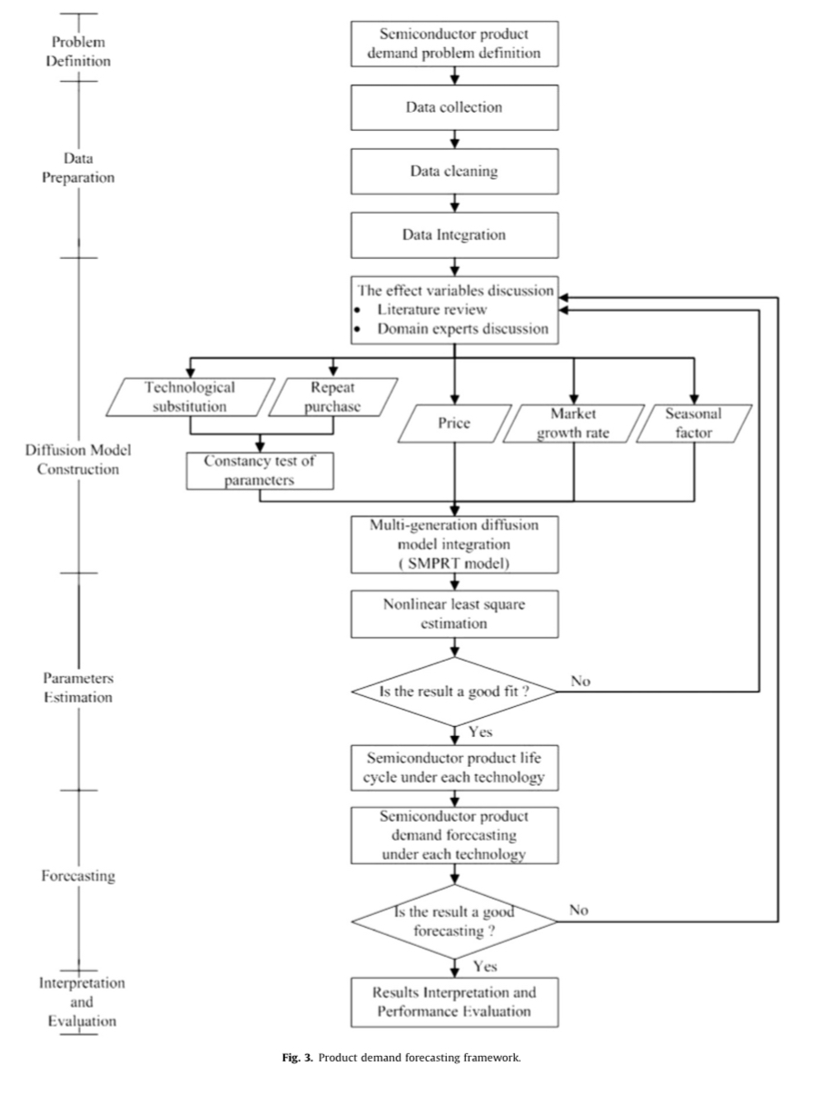
Approach

Slide 42
Approach
Problem definition
Semiconductor industry is growing rapidly, thus shortening the product life cycle (PLC) of semiconductor products.
In the semiconductor industry, R&D costs and capital investment requirements are enormous. To allocate the resource efficiently and thus to ensure efficient resource allocation firms require a method of accurately describing PLC and forecasting product demand.
This study designs a demand forecasting framework for accurately forecasting product demand, thus providing valuable information to assist managers in decision-making regarding capacity planning.

Slide 43
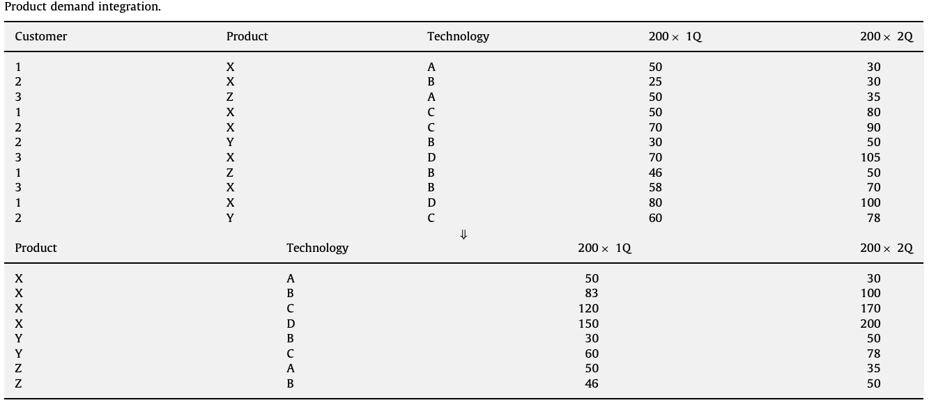
Approach
Data preparation
Process includes data collection, cleaning, and integration procedures.
Data integration merges data from different sources into a file. For example, product prices, semiconductor industry market growth rate, and semiconductor product demand
Summarize the same technology and the same product data

Slide 44
Approach
Diffusion model construction
This study constructs a multi-generation diffusion model based on the Norton and Bass model
Firstly, the model tests parameters to identify inter-generational changes
The proposed diffusion model matches up semiconductor product characteristics to obtain valuable information and thus incorporates technological substitution, price effect, market growth rate, and seasonal factor

Slide 45
Approach
Effect variables
Five factors, including seasonal factor, market growth rate, price, repeat purchases and technological substitution.
Seasonal factor
Seasonal factors affect numerous business activities
PC sales
Market growth rate
Describe the market structure and economic environment
Price
Key influence on customers purchase decisions
For semiconductor products, prices reduce rapidly during the initial stage and then stabilize

Slide 46
Approach
Repeat purchase
This study considers the effect of repeat purchases, because adopters do not purchase products in single unit quantities
Focused on forecasting the total sales of semiconductor products, in which separating the first and repeated adopters is not needed.
Technological substitution effect
As Moore’s Law continues to hold, newer technologies are continually being introduced to the market
Consider both diffusion and substitution for semiconductor products

Slide 47
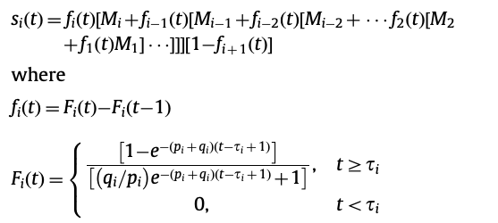
Approach
Multi-generation diffusion model (SMPRT model)
This study proposed a multi-generation diffusion model, namely the SMPRT model, incorporating seasonal factors (S), market growth rate (M), price (P), repeat purchases (R), and technological substitution (T)

Slide 48


Approach
Multi-generation diffusion model (SMPRT model)
The parameters in the proposed SMPRT model are tested for constancy across the generations
Establish the following hypothesis:
This hypothesis can be tested using a likelihood ratio test or full information maximum likelihood (FIML) estimation

Slide 49

Approach
Multi-generation diffusion model (SMPRT model)
The proposed SMPRT model also considers the price factor in which the expression of F(t) in the Norton and Bass model is substituted for the expression of F(t) proposed by Bass et al. (1994) as follows:

Slide 50
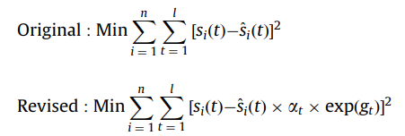
Approach
Multi-generation diffusion model (SMPRT model)
SMPRT model uses a multiplicative model to express seasonal variation and the market growth rate effect

Slide 51
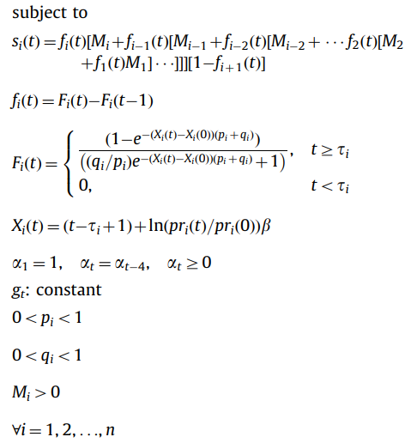

Approach
Multi-generation diffusion model (SMPRT model)
Finally, the SMPRT model is integrated as

Slide 52
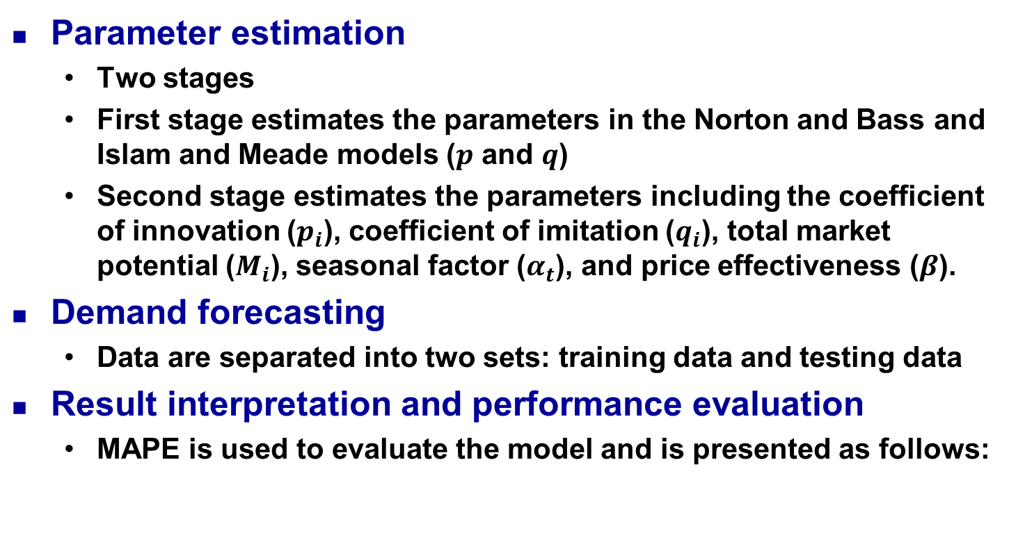

Approach

Slide 53
Empirical study
Problem definition
Semiconductor companies always adopt a make-to-order strategy
Quantity of semiconductor products affects capacity allocation and capacity level
This study constructs a systematic framework for solving problems involving product demand forecasting
Describes the PLC and accurately forecasts semiconductor product demand to assist in capacity allocation and expansion, thus maximizing capacity utilization and profit by using the product demand forecasting framework

Slide 54
Empirical study
Data preparation
Historical product demand transaction data collected on quarterly basis
A semiconductor product X for performing the validation
The analysis is performed using a quarterly time scale
The total time horizon is 36 quarters
Semiconductor product X is manufactured using different technologies
There are 36, 29, 17, and 9 quarters of data for generations 1–4, respectively

Slide 55
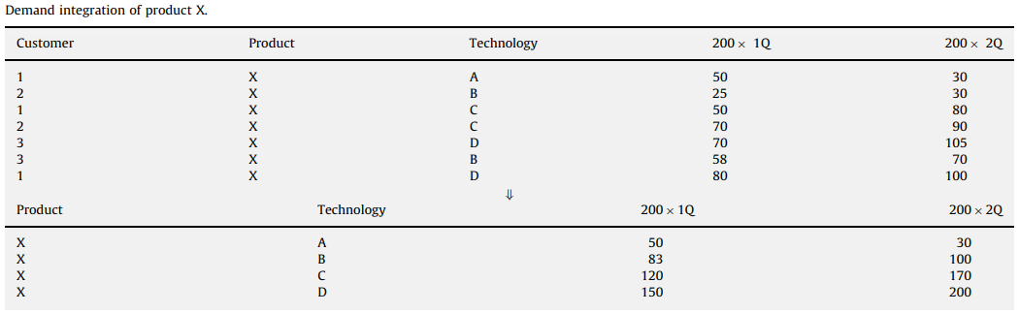
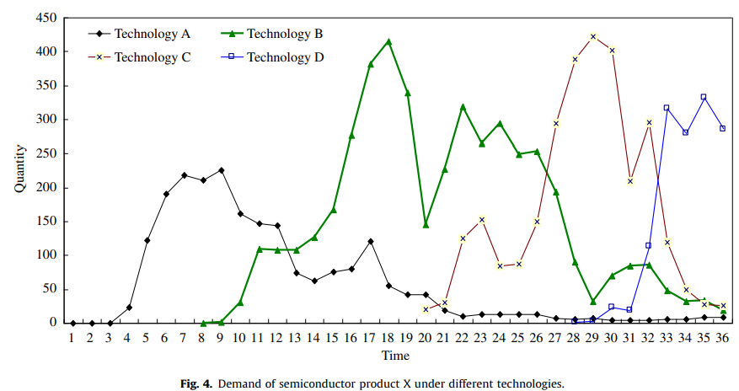
Empirical study

Slide 56
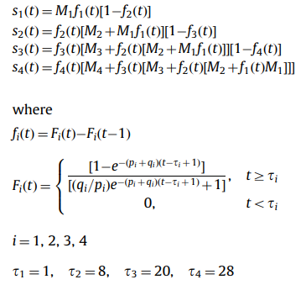
Empirical study
Diffusion model construction
Step 1: Compare the Norton and Bass and Islam and Meade models. Expand the model based on four generations

Slide 57

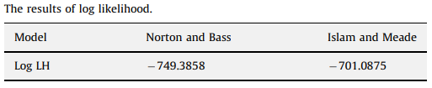
Empirical study
Diffusion model construction
Step 2: Test the parameter constancy (using FIML)
Define the Norton and Bass model as a restricted model.
Define the Islam and Meade model as an unrestricted model.
Test the statistics

Slide 58
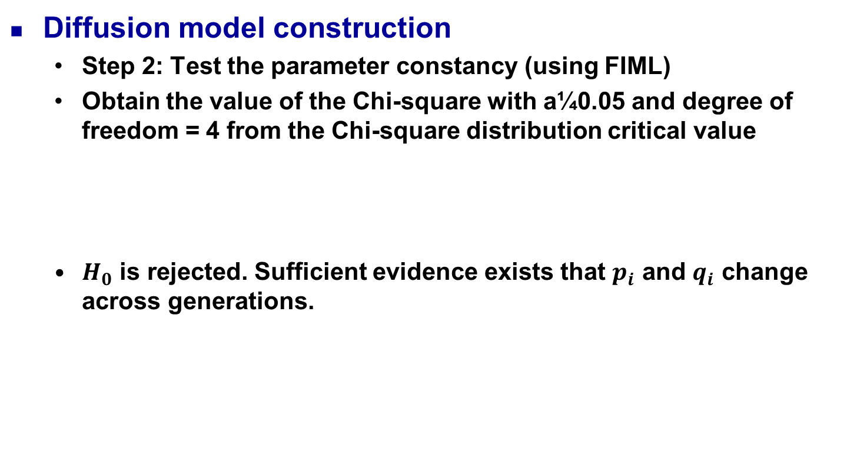


Empirical study

Slide 59
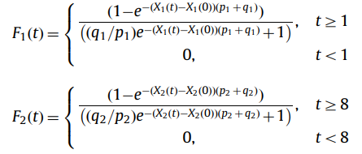
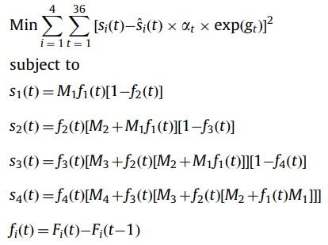
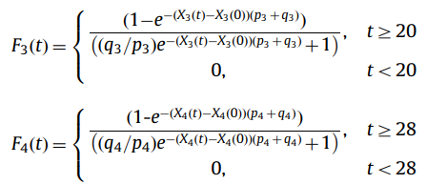
Empirical study
Diffusion model construction
Step 3: Incorporate the effects into the proposed SMPRT model
The introduction times of the four generations of semiconductor product X are in quarters 1, 8, 20, and 28, respectively

Slide 60
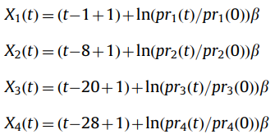

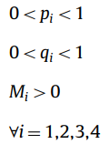

Slide 61
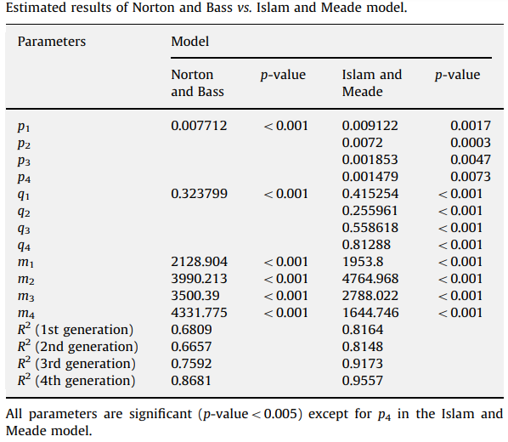
Empirical study
Parameter estimation
Use nonlinear least squares procedure to estimate the parameters.

Slide 62
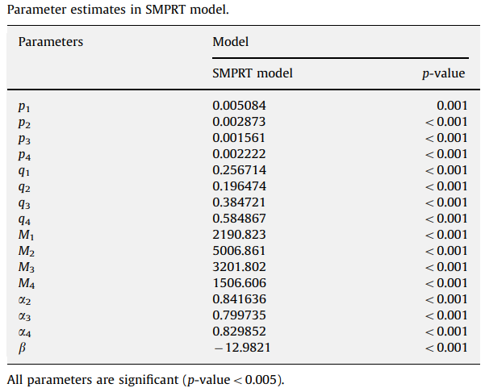
Empirical study
Parameter estimation
Use nonlinear least squares procedure to estimate the parameters.

Slide 63
Empirical study
Forecasting
Data are separated into two sets of training data and testing data
34 quarters as training data to estimate the parameters in SMPRT model
Forecast product demand for the remaining 2 quarters to estimate the validity of the proposed model

Slide 64
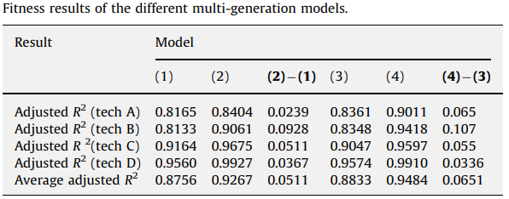
Empirical study
Results interpretation and performance evaluation
(1) Speece and MacLachlan model
(2) SMPRT model without market growth rate and seasonal factor
(3) Speece and MacLachlan model with market growth rate and seasonal factor
(4) SMPRT model with market growth rate and seasonal factors

Slide 65
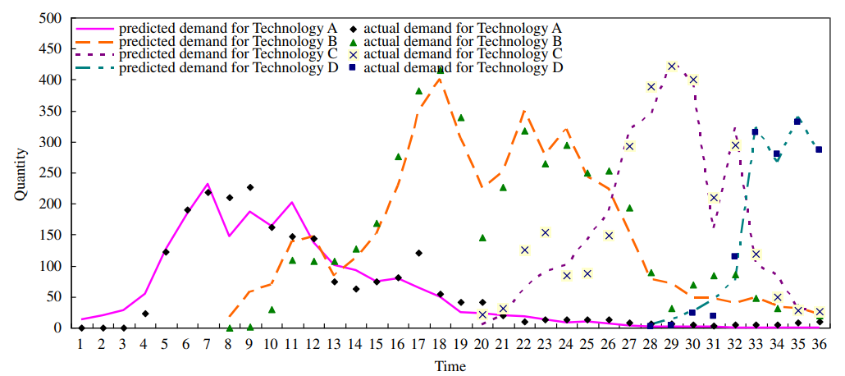
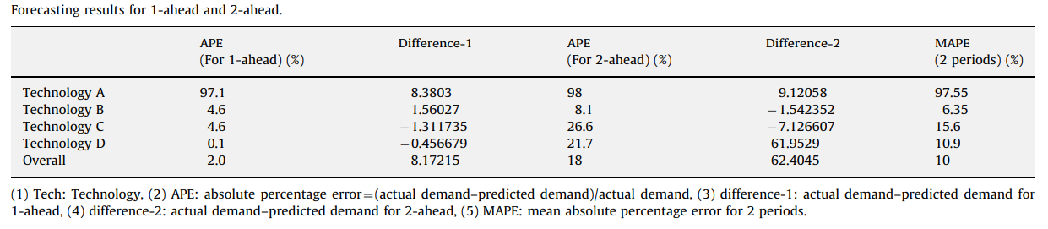
Empirical study
Results interpretation and performance evaluation

Slide 66
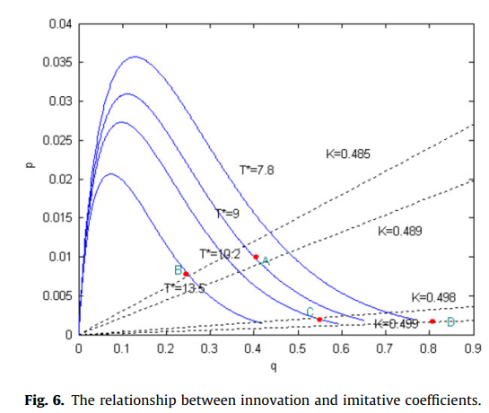
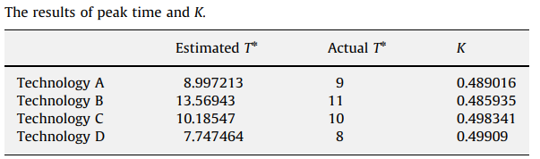
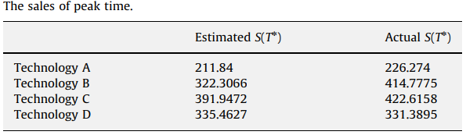
Empirical study
Discussion and application
No prior data are available for new products
The shape of product life cycle is influenced by the innovation coefficient (p) and imitation coefficient (q)
For simplicity, this study uses the estimated parameter values from the Islam and Meade model with different pi and qi across generations.

Slide 67
Conclusion
This study developed a framework for forecasting semiconductor product demand and proposed a multi-generation diffusion model (i.e., SMPRT model) that incorporated S, M, P, R, T to forecast the demand of semiconductor products
Future research can be done to examine the model assumptions in various settings and can be done to effectively expand the multi-generation diffusion model to forecast the sales of the matured technologies
Future studies can consider other factors such as market share, capacity restriction, and cycle effect in the diffusion model

