Slide 1
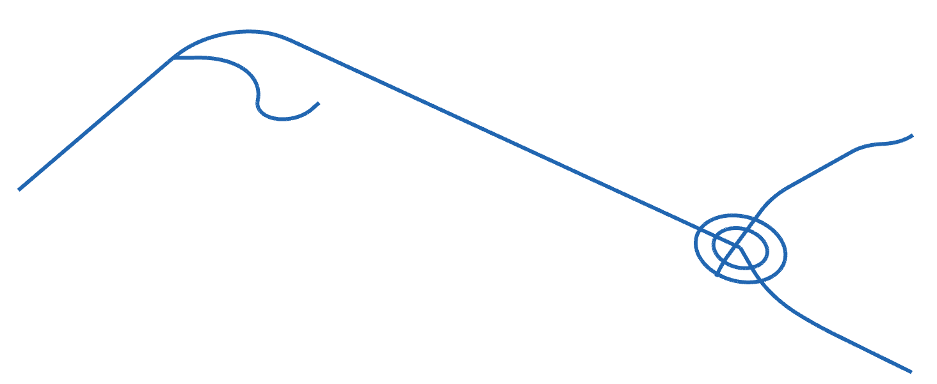
Open Infra Platform
Copyright © 2013-2016 Technische Universität München, Chair of Computational Modeling and Simulation
Arcisstraße 21, D-80333 Munich (Germany)

