Slide 1
Kotlin
Augusto A. B. Branquinho

Slide 2

Youtube
http://www.youtube.com/user/augustobranquinho
Github
https://github.com/bbranquinho

Slide 3
Sumário
1. Introdução
2. Kotlin
3. Avaliação
4. Conclusão

Slide 4

1. Introdução
Linguagem moderna
Reduzir códigos "desnecessários" do Java
Imutabilidade
Kotlin para Android
Kotlin JVM, Kotlin JS, Kotlin Native

Slide 5

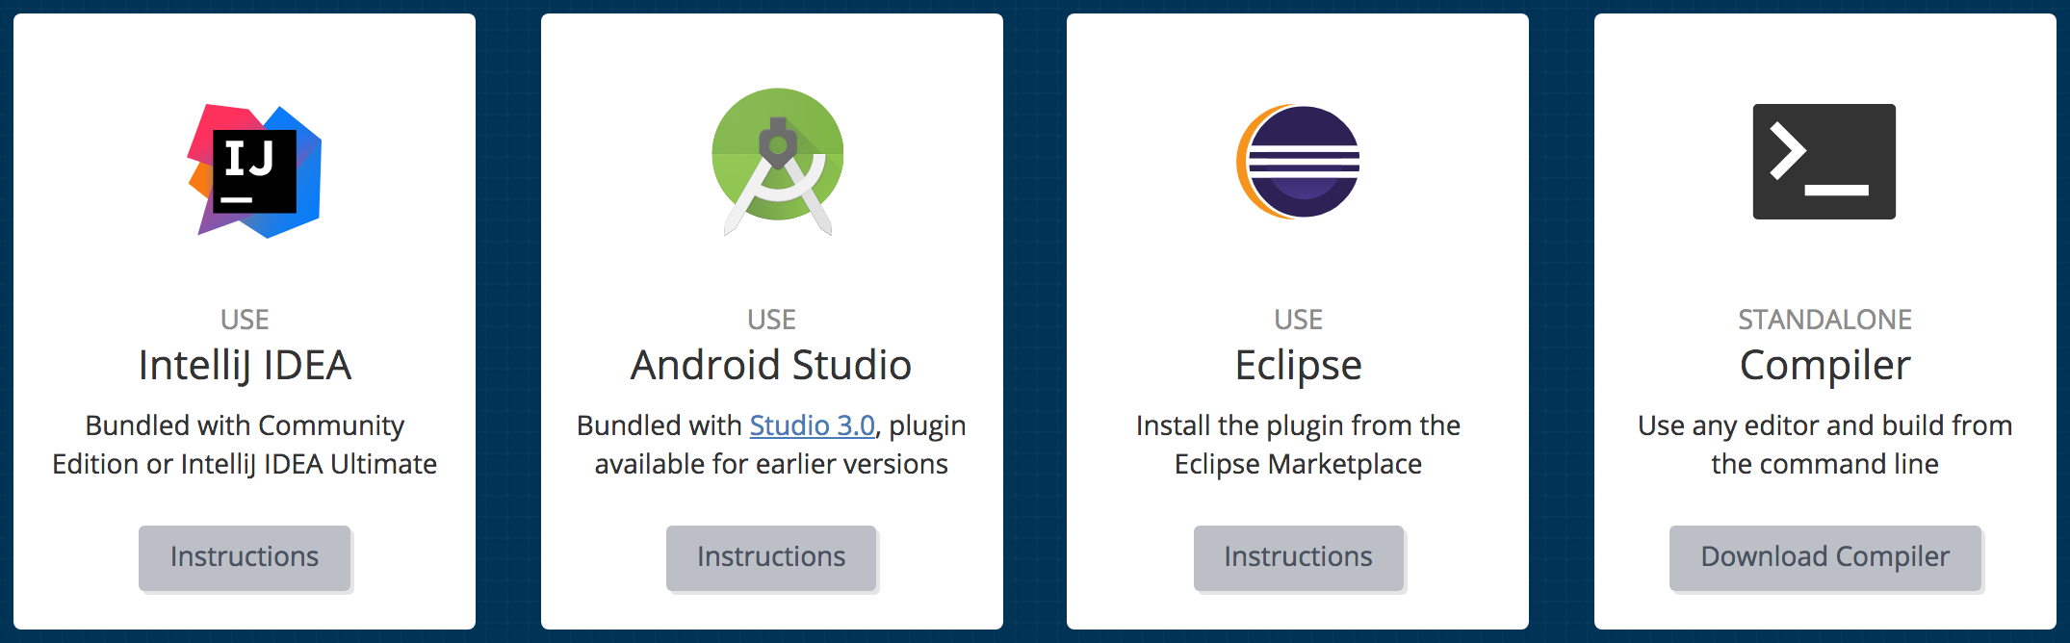
1. Introdução
https://try.kotlinlang.org/

Slide 6


1. Introdução
Convivência harmoniosa com Java
Como fica o meu Java???
Roda junto com o Java Padacoelho!!!

Slide 7
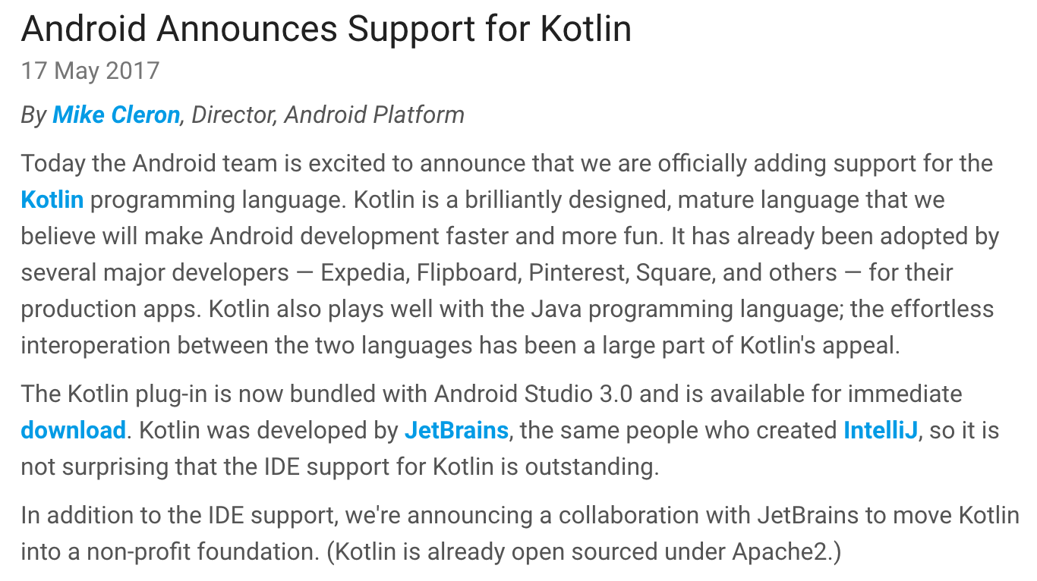
1. Introdução
Blog Android Developer:
https://android-developers.googleblog.com/2017/05/android-announces-support-for-kotlin.html

Slide 8
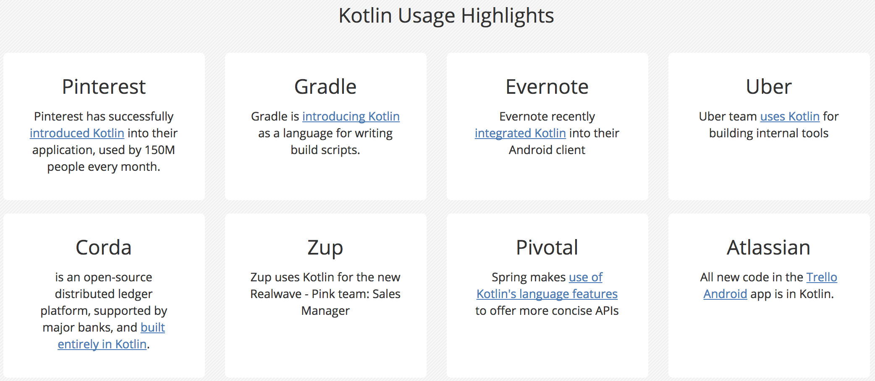
1. Introdução
Highlights - Site do Kotlin
Introducing Kotlin support in Spring Framework 5.0: https://spring.io/blog/2017/01/04/introducing-kotlin-support-in-spring-framework-5-0

Slide 9
2. Kotlin
IDE: Intellij
Hello world
package br.com.zup.hack4food fun main(args: Array<String>) { println("Hello, Hack4food!") }

Slide 10

2. Kotlin
Data Class
data class Person(val id: Int?, val name: String, val money: Money) data class Money(val amount: BigDecimal, val currency: String)
public class PersonJava {
private final Integer id; @NotNull private final String name; @NotNull private final Integer age; @NotNull private final Double salary; public PersonJava(Integer id, String name, Integer age, Double salary) { this.id = id; this.name = name; this.age = age; this.salary = salary; } public Integer getId() { return id; } public String getName() { return name; } public Integer getAge() { return age; } public Double getSalary() { return salary; }
public final PersonJava copy(Integer id, @NotNull String name, @NotNull Integer age, @NotNull Double salary) { return new PersonJava(id, name, age, salary); } @Override public String toString() { return "PersonJava{" + "id=" + id + ", name='" + name + '\'' + ", age=" + age + ", salary=" + salary + '}'; } @Override public boolean equals(Object o) { if (this == o) return true; if (o == null || getClass() != o.getClass()) return false; PersonJava that = (PersonJava) o; if (id != null ? !id.equals(that.id) : that.id != null) return false; if (name != null ? !name.equals(that.name) : that.name != null) return false; if (age != null ? !age.equals(that.age) : that.age != null) return false; return salary != null ? salary.equals(that.salary) : that.salary == null; } @Override public int hashCode() { int result = id != null ? id.hashCode() : 0; result = 31 * result + (name != null ? name.hashCode() : 0); result = 31 * result + (age != null ? age.hashCode() : 0); result = 31 * result + (salary != null ? salary.hashCode() : 0); return result; } }
NUUUHHHH, MUITOOO FÁCILLLL

Slide 11
2. Kotlin
Getter and Setter
class MoneyClass(amount: BigDecimal, currency: String) { var amount: BigDecimal = amount get() { return field } set(value) { field = value } val currency: String = currency }

Slide 12
2. Kotlin
Equality
val augusto = Person(id = 1, name = "Augusto", money = Money(amount = BigDecimal(1000), currency = "R$")) val branquinho = Person(id = 1, name = "Augusto", money = Money(amount = BigDecimal(1000), currency = "R$")) if (augusto == branquinho) { println("Same values") } else { println("Houston, we have a problem!") } if (augusto === branquinho) { println("Houston, we have a problem!") } else { println("Equals") } if ((augusto == augusto) && (augusto === augusto)) { println("Ok") } else { println("Houston, we have a problem!") }

Slide 13
2. Kotlin
Strings
val augusto = Person(id = 1, name = "Augusto", money = Money(amount = BigDecimal(1000), currency = "R$")) println("Person[id=" + augusto.id + ", name='" + augusto.name + "', money=" + augusto.money.currency + " " + augusto.money.amount + "]") println("Person[id=${augusto.id}, name='${augusto.name}', money=${augusto.money.currency} ${augusto.money.amount}]") println("PersonMutableJava[\n" + " id=" + augusto.id + ",\n" + " name=" + augusto.name + ",\n" + " money=" + augusto.money.currency + " " + augusto.money.amount + "\n" + "]") println( """PersonMutableJava[ id=${augusto.id}, name='${augusto.name}', money=${augusto.money.currency} ${augusto.money.amount} ]""")

Slide 14
2. Kotlin
When Expression
val x = readLine()!!.toInt() val validNumbers = arrayListOf(11, 15, 20) when (x) { in 1..10 -> print("x is in the range") in validNumbers -> print("x is valid") !in 10..20 -> print("x is outside the range") else -> print("none of the above") }

Slide 15

2. Kotlin
Que lindo!!!
Smart Cast
val people: IPerson = Augusto() if (people is Branquinho) { people.methodBranquinho() } when (people) { is Augusto -> people.methodAugusto() is Branquinho -> people.methodBranquinho() else -> throw IllegalArgumentException() }

Slide 16
2. Kotlin
Object (Singleton)
object DataSet { private val id = AtomicInteger(1) val data: MutableSet<Person> = mutableSetOf( Person(id = newId(), name = "Person 1", money = Money(amount = BigDecimal("1273.28"), currency = "R$")), Person(id = newId(), name = "Person 2", money = Money(amount = BigDecimal("2012.75"), currency = "$")) ) fun newId(): Int = id.getAndIncrement() }

Slide 17
2. Kotlin
Kotlin + Spring Boot
fun main(args: Array<String>) { println("Hello, Hack4Food!") SpringApplication.run(Hack4FoodConfig::class.java, *args) }
@SpringBootApplication @Configuration @ComponentScan(basePackages = arrayOf("br.com.zup.hack4food")) open class Hack4FoodConfig

Slide 18
2. Kotlin
interface Repository { fun findAll(): List<Person> fun add(person: Person): Person fun findOne(id: Int): Person? }
Repository
@Component class RepositoryImpl : Repository { override fun findAll() = DataSet.data.toList() override fun add(person: Person): Person { val newPerson = person.copy(id = DataSet.newId()) DataSet.data.add(newPerson) return newPerson } override fun findOne(id: Int) = DataSet.data.filter { it.id == id }.firstOrNull() }

Slide 19
2. Kotlin
REST
@RestController @RequestMapping("/person") class Controller @Autowired constructor(val repository: Repository) { @GetMapping fun findAll() = ResponseEntity(repository.findAll(), HttpStatus.OK)
@GetMapping("/{id}") fun findById(@PathVariable("id") id: Int) = Optional.ofNullable(repository.findOne(id)) .map { ResponseEntity (it, HttpStatus.OK) } .orElse(ResponseEntity (HttpStatus.NOT_FOUND))
}

Slide 20

2. Kotlin
LINDO!!!
De tão lindo chega a ser GOSTOSO!!!
Nullable checking
@GetMapping("/currency/{id}") fun currency(@PathVariable("id") id: Int): ResponseEntity<String> { when (repository.findOne(id)?.money?.currency) { "R$" -> return ResponseEntity("Real", HttpStatus.OK) "$" -> return ResponseEntity("Dolar", HttpStatus.OK) null -> return ResponseEntity(HttpStatus.NOT_FOUND) else -> return ResponseEntity(HttpStatus.NOT_FOUND) } }

Slide 21
2. Kotlin
Extension Method
data class PersonRepresentation(val id: Int?, val name: String, val money: String)
fun Person.toRepresentation() = PersonRepresentation( id = this.id, name = this.name, money = "${this.money.currency} ${this.money.amount}" ) fun List<Person>.toRepresentation() = this.map { it.toRepresentation() }

Slide 22
2. Kotlin
Infix
infix fun BigDecimal.percentage(percentage: Int) = this.multiply(BigDecimal(percentage)).divide(BigDecimal(100))
@GetMapping("/percentage/{id}") fun percentage(@PathVariable("id") id: Int) = Optional.ofNullable(repository.findOne(id)) .map { ResponseEntity(it.money.amount percentage 10, HttpStatus.OK) } .orElse(ResponseEntity(HttpStatus.NOT_FOUND))

Slide 23
2. Kotlin
Lazy
private object JacksonExtension { val jacksonObjectMapper: ObjectMapper by lazy { jacksonObjectMapper() } } fun <T> String.jsonToObject(t: Class<T>): T = JacksonExtension.jacksonObjectMapper.readValue(this, t) fun <T> T.objectToJson(): String = JacksonExtension.jacksonObjectMapper.writeValueAsString(this)

Slide 24
2. Kotlin
Operator Overloading
operator fun Money.plus(value: Money) = Money(this.amount + value.amount, this.currency)
@GetMapping("/sum/{firstId}/{secondId}") fun sum(@PathVariable("firstId") firstId: Int, @PathVariable("secondId") secondId: Int): ResponseEntity<String> { val first = repository.findOne(firstId) val second = repository.findOne(secondId) if ((first == null) || (second == null)) return ResponseEntity(HttpStatus.NOT_FOUND) val sum = first.money + second.money return ResponseEntity("${sum.currency} ${sum.amount}", HttpStatus.OK) }

Slide 25
2. Kotlin
Parameters and Modifiers
internal class ApiRunnable(val project: ProjectBean, val maxQueueSize: Int?, val onFinish: () -> Unit) : Runnable { override fun run() { …... onFinish() } }
private val apiCache = ConcurrentHashMap<String, ApiRunnable>() apiCache.computeIfAbsent(projectName, { ApiRunnable(project, applicationProperties.apiLogSize,
{ apiCache.remove(it) }).start() })

Slide 26

2. Kotlin
Kotlin é molezis!

Slide 27
3. Avaliação
Menos boilerplate code
Linguagem mais limpa e moderna
Evolução da linguagem
Validação de tipos e valores
Múltiplas plataformas
Mudança de mentalidade
Uso com o Spring
No início, JSON mais difícil de trabalhar
Existem muitas coisas novas que estão sendo desenvolvidas

Slide 28

4. Conclusão
Kotlin quer você!!!

Slide 29
Kotlin
Game Over!!! ☺
Augusto A. B. Branquinho
Email:
augusto.branquinho@zup.com.br
augustobranquinho@gmail.com

