Slide 1
For discussion
How to Apportion Blame for a Queue
with Arrivals in Bursts?
Bob Briscoe, Independent <research@bobbriscoe.net>
Feb 2023
Notes:
Cover Slide 1 of 3
Cable Labs

Slide 2
Roadmap
Question
Explanation of approach
Explain parameter space
Results
Evaluation
Interpretation
Implications & Next steps

Slide 3
Question
How to apportion blame for a queue
with arrivals in bursts?
Only marking packets, with no flow state
Arrivals in bursts can lead to a queue
    even if they can be served on average
Subsequent smoother arrivals sit behind the burst
    with knock-on impact on the next arrivals
    even after the initial burst has all departed
* may use flow state

Slide 4
Approach
Model? Simulate? Testbed?
    model first: initial goal is understanding
    noise of reality (packet sizing, timing dither, sync effects) could otherwise obstruct
Unresponsive? Responsive?
    unresponsive: cannot assume a response, so marking might solely drive policing*
Simplest sufficient scenario; 2 flows, a & b, with:
    constant but different burst sizes, β
    constant but different capacity shares, λ
    No need for either to vary (understand bursts first, not bursts of bursts)
Reduces to 2 (sawtooth) waves with different amplitude β & wavelength (interval t_{i})
    capacity share, λ = β / t_{i}
    any 1 of these 3 variables depends on the other 2
t_{ia}
q delay
* might use flow state
β_{a}
time

Slide 5
Approach
Normalized metrics
Goal: results applicable to any link rate and any step marking threshold delay
Burst size β is in units of time (queue delay)
    normalized to: marking threshold = 1 unit of time
On time series plots, time is also normalized
    queue delay at marking threshold = 1 unit of time
Marking rate, λp, is marked bits per unit time
    normalized as a dimensionless fraction of link bit rate = 1
Marking probability, p, and capacity share, λ
    both dimensionless and bounded within [0,1]
    so normalized marking rate, λp, also bounded within [0,1]
Comparison metrics use difference, p_{a} – p_{b} = Δp, not ratio p_{a}/p_{b}
    not inflated as p_{b} → 0
    for visualization, and irrespective of any congestion control assumptions

Slide 6
Approach
Parameter space
A full scan of all 4 dimensions:
    β_{a} , λ_{a} , β_{b} , λ_{b}
would generate more heat than light
To focus on apportioning blame, scan the parameter space of one flow (β_{a} , λ_{a} ),
while trying to keep the whole system constant, i.e.
    constrain Σλ (utilization) to a small selection of constants (assume Σλ ≤ 1)
    constrain Σβ (max total burst) to a small selection of constants
Compare two marking approaches, based on the q delay...
    ...a packet itself experiences (the queue ahead at enqueue)
    ...a packet causes to others (the queue behind at dequeue)

Slide 7
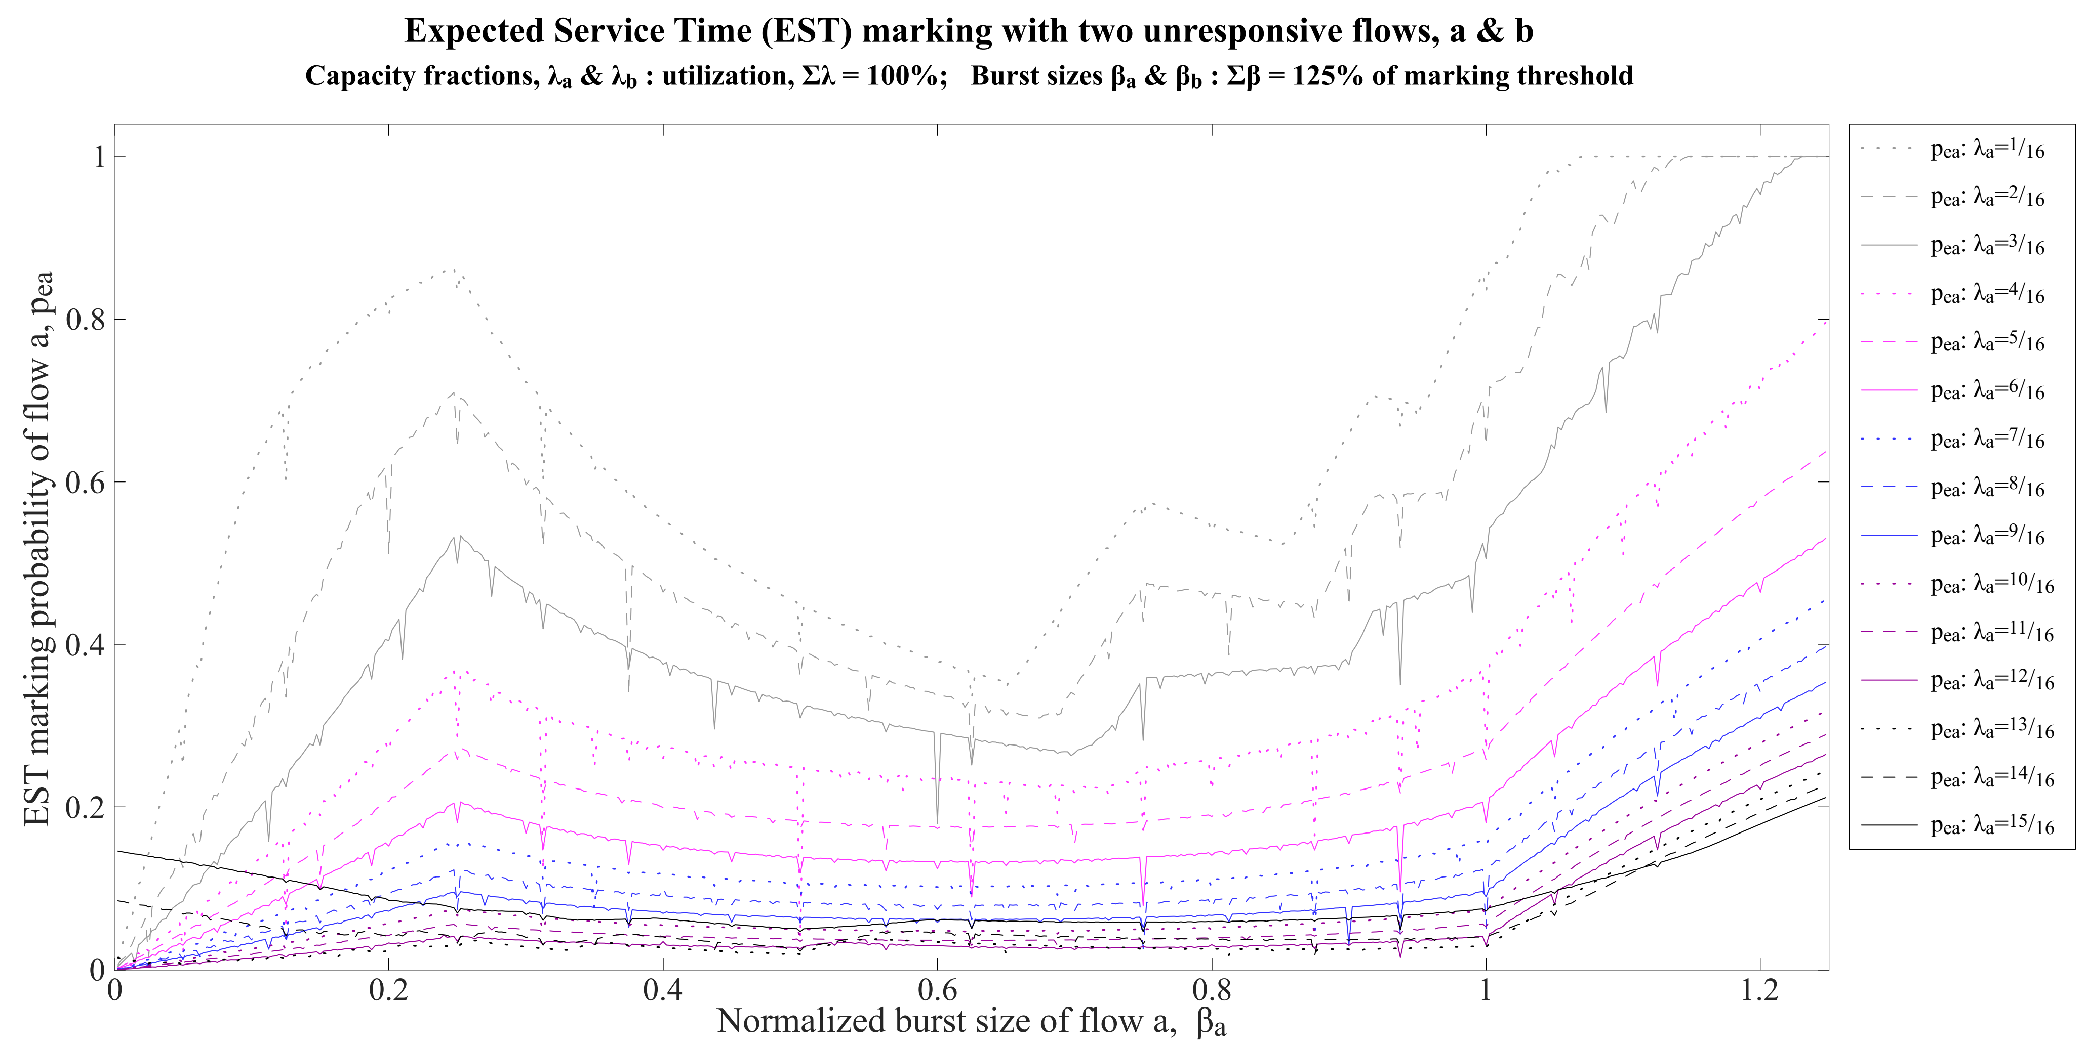
How to Interpret the Parameter Space
B´
C
A
C´
B

Slide 8
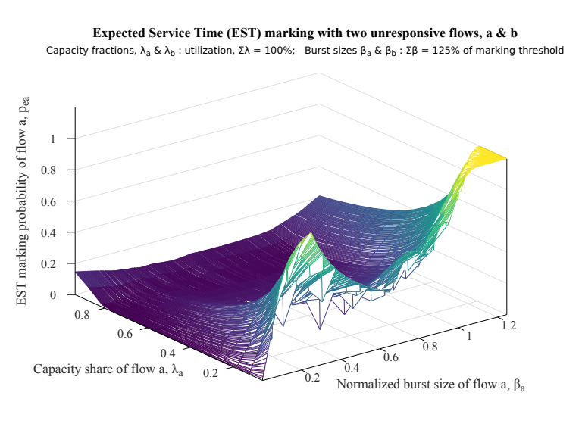
Same example parameter space in 3-D
A´
C´
B
A
C

Slide 9
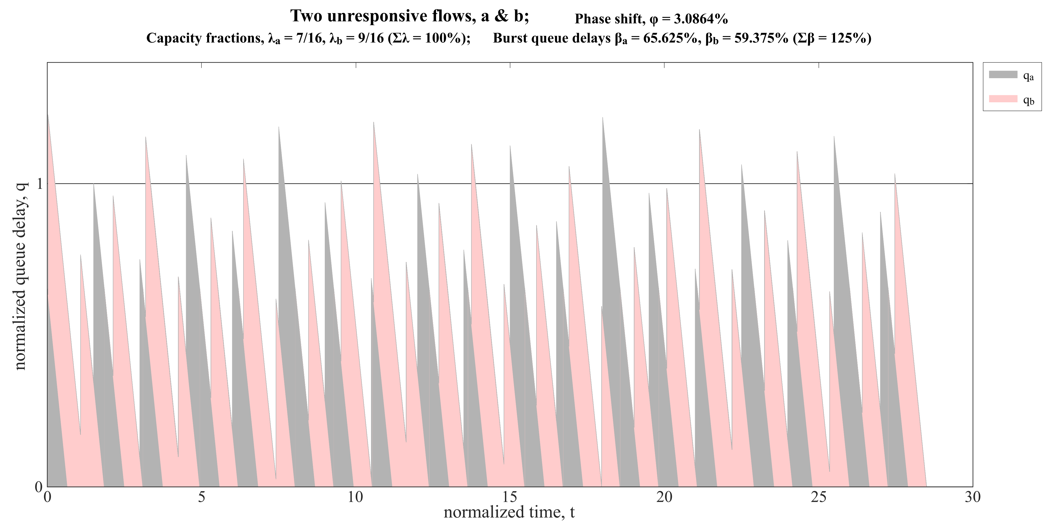
A

Slide 10
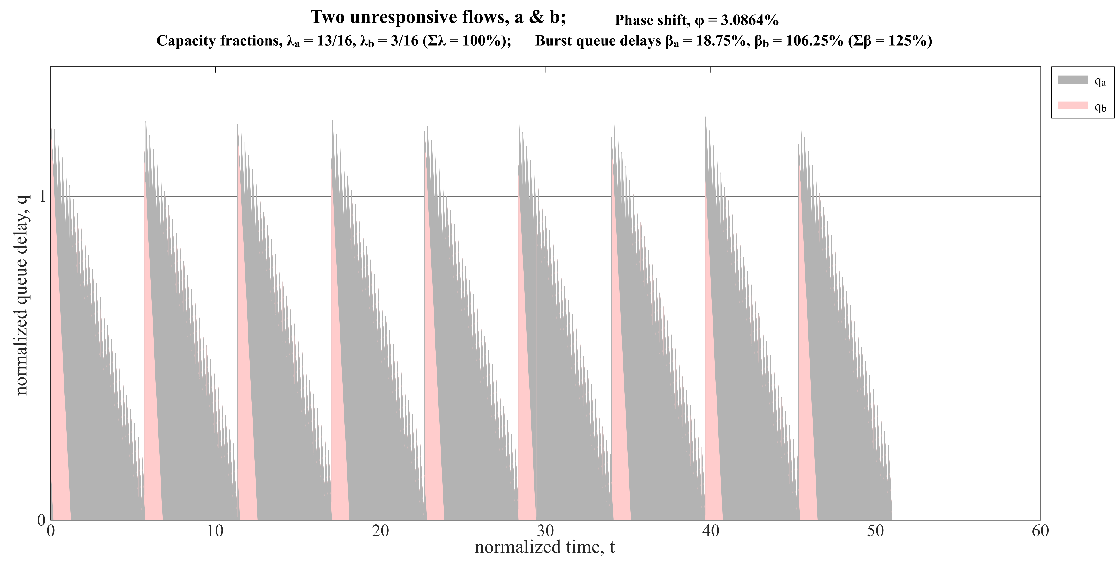
B

Slide 11
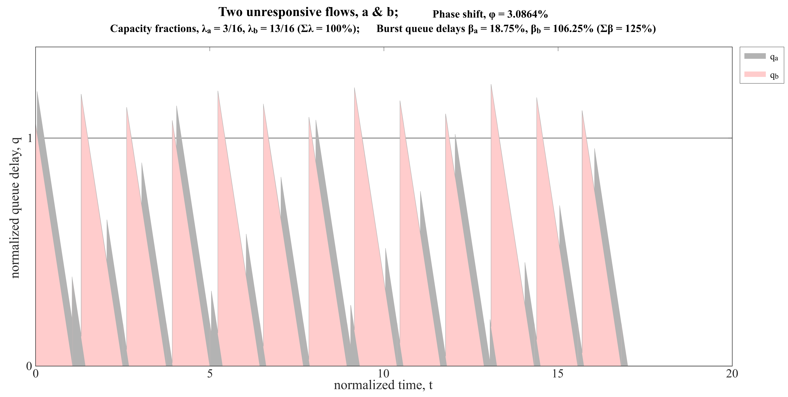
C

Slide 12
Ideals for apportioning blame
Marking probability of one flow, p_{a}
    should monotonically increase with its burst size, β_{a}
    should not decrease with its capacity share, λ_{a}
  assuming the whole system is otherwise constant
Satisfying both ideals would be robust but probably unattainable, e.g.
    would fail on #1 if marking saturates, e.g. v large bursts
    unsure if #2 is even satisfied with equal constant burstiness (see control expt later)
Some scope to relax either ideal,
    but unable to quantify precisely, so far

Slide 13
Compare 2 marking approaches
delay to self
    sojourn-based marking (s)
    queue delay ahead at enqueue
    visualization: colour of flow over threshold
delay to others
    expected service time (e)
    queue delay behind at dequeue
    visualization: colour of flow dequeued when q over threshold

Slide 14
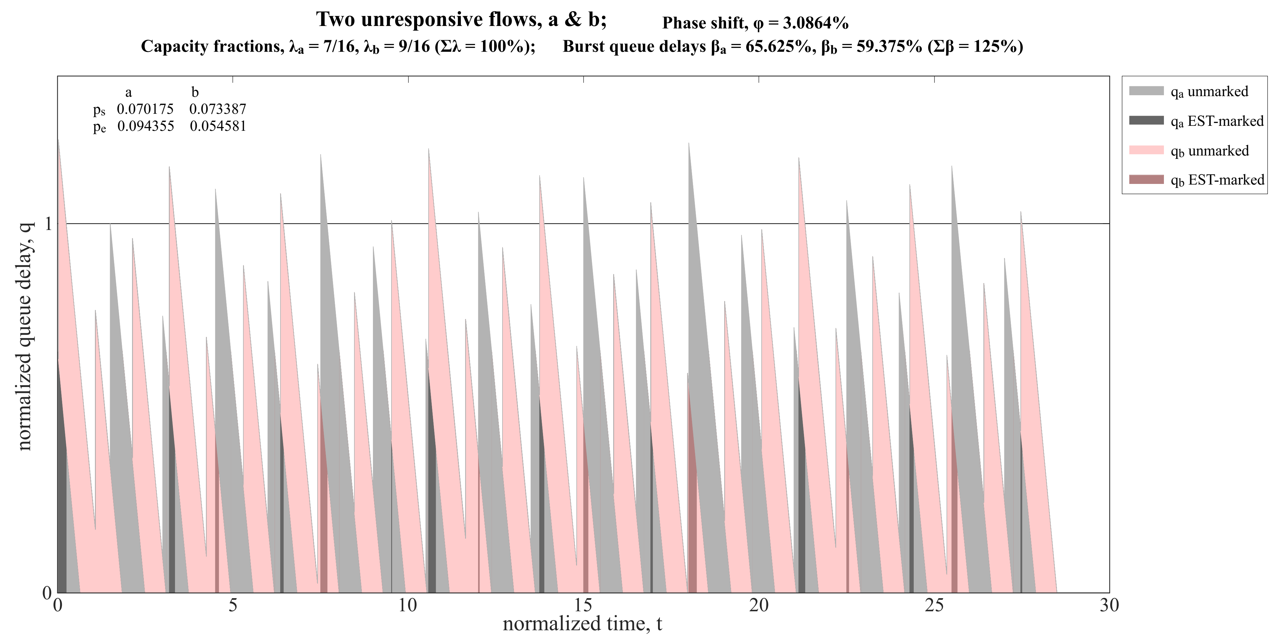
A

Slide 15
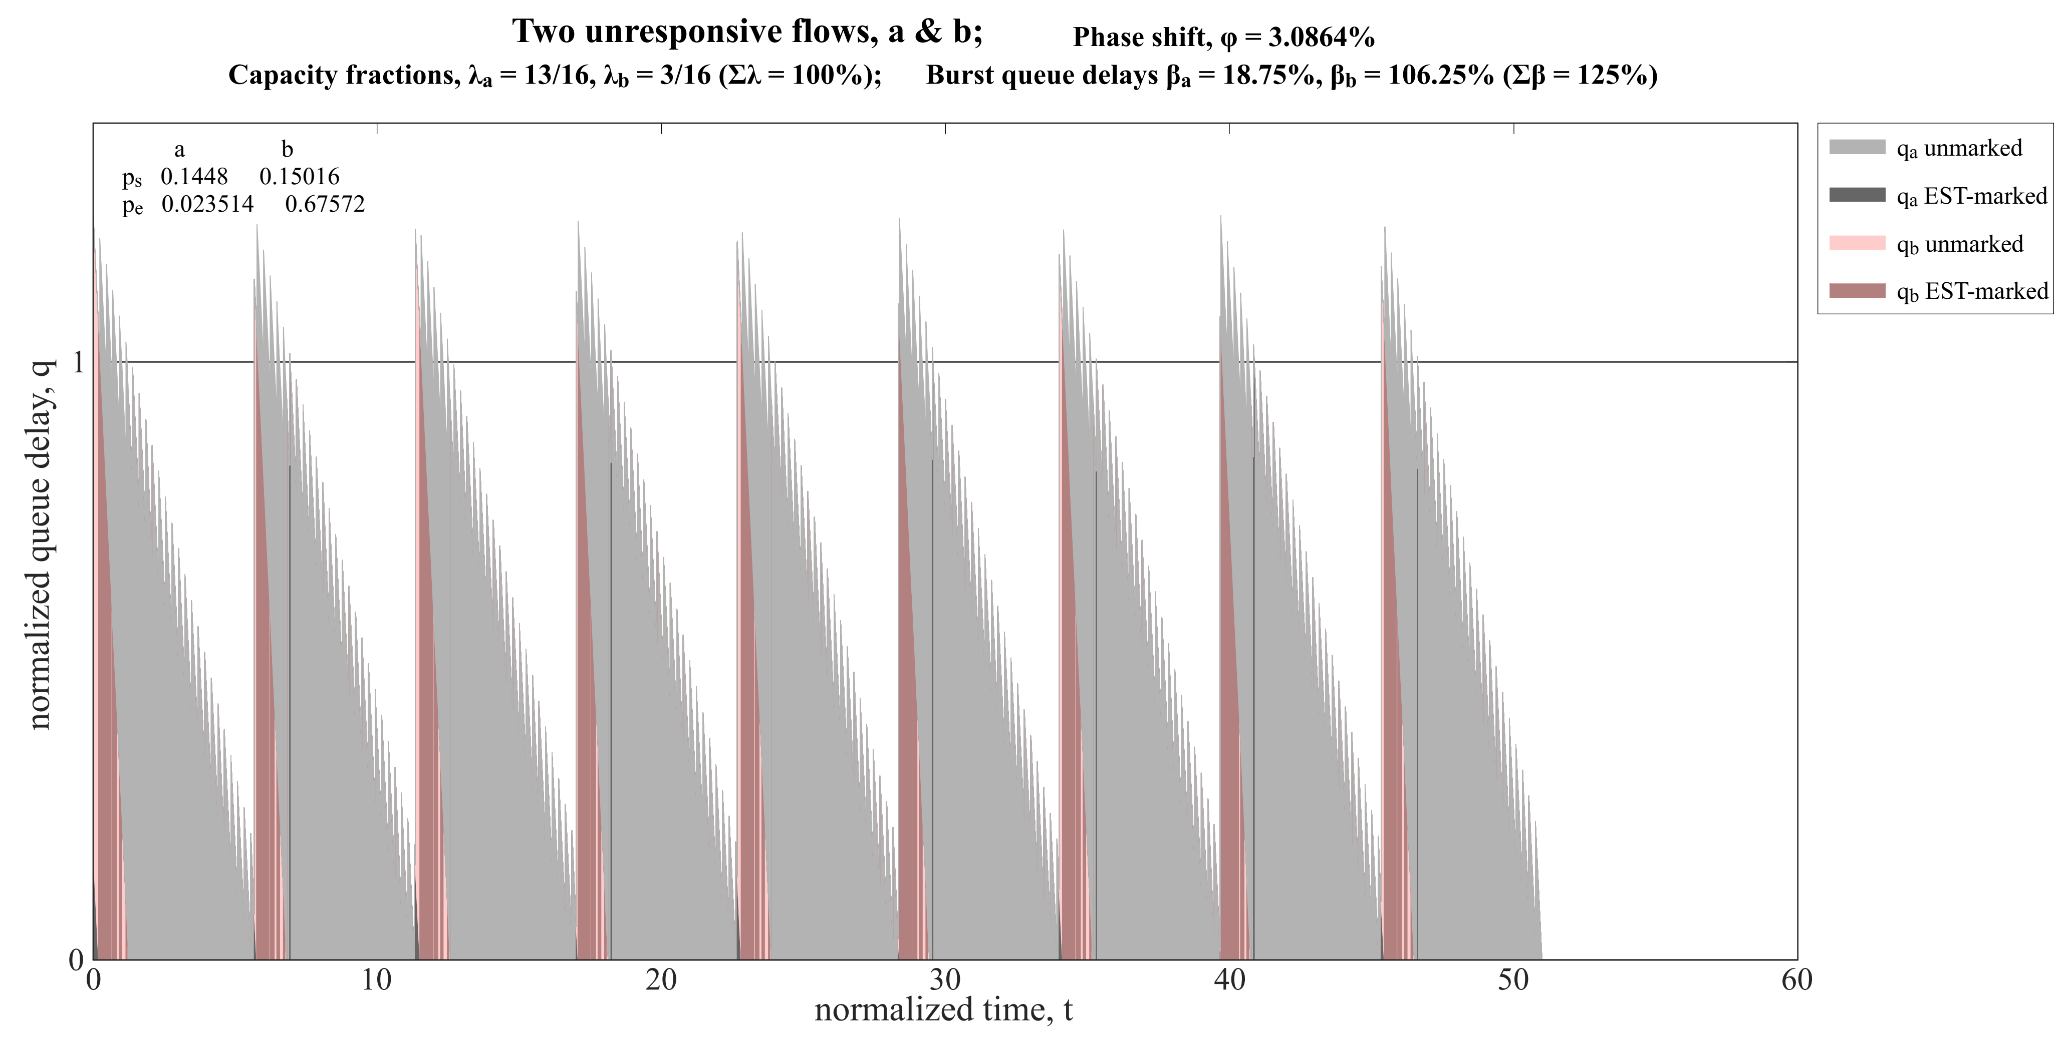
B

Slide 16
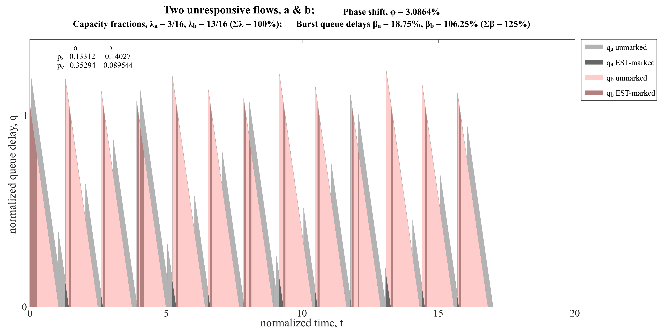
C

Slide 17
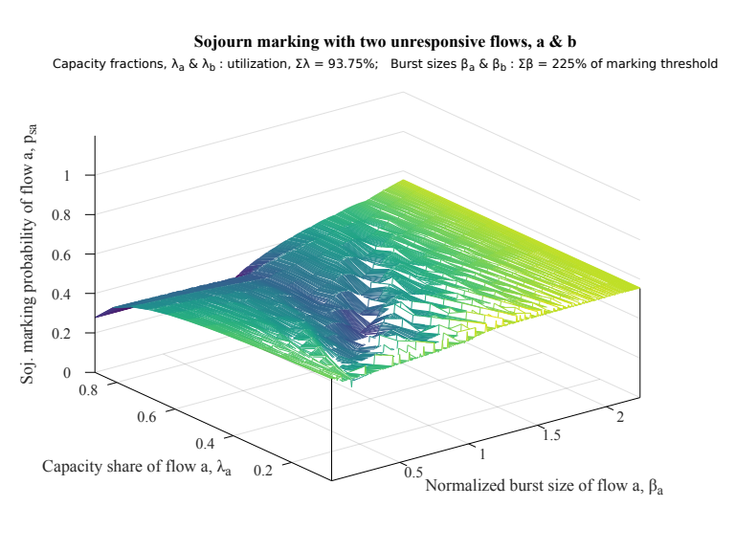
Results – Examples
Detailed 2-D plots (like above)
    in 4 complementary slide packs
    1 for each metric
choice of 4 metrics
    p_{a} : marking probability of flow a
    Δp = p_{a} – p_{b}
    λ_{a}p_{a} : marking rate of flow a
    Δ(λp) = λ_{a}p_{a} – λ_{b}p_{b}
Next 2 slides: 3-D plots
    using first metric only ( p_{a} )
    axes will be too small to read,
    but all like the example to the right

Slide 18
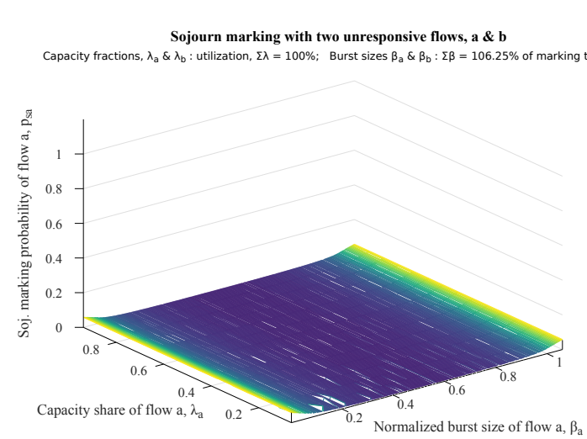
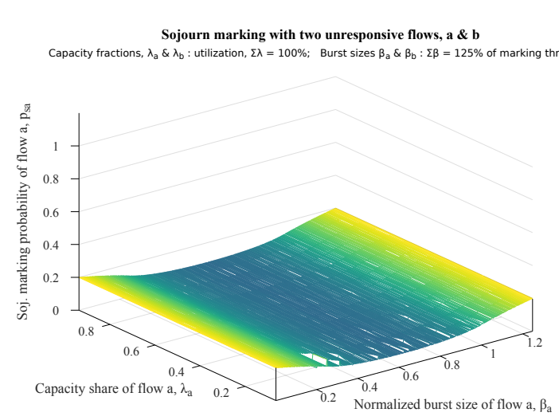
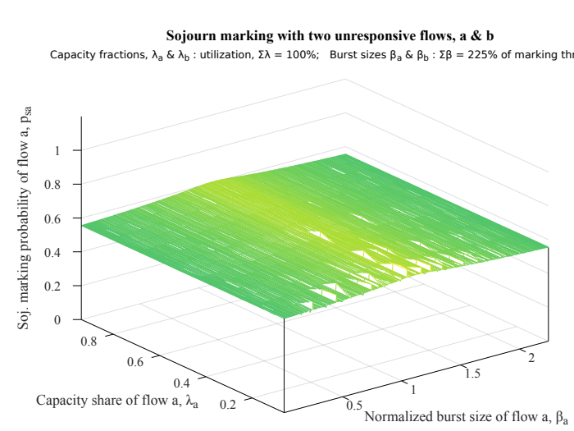
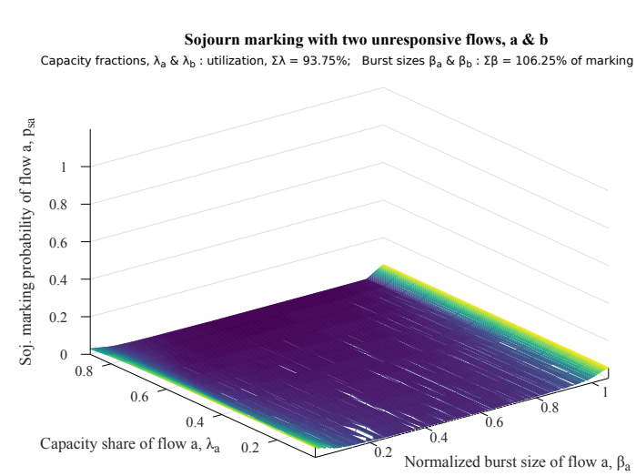
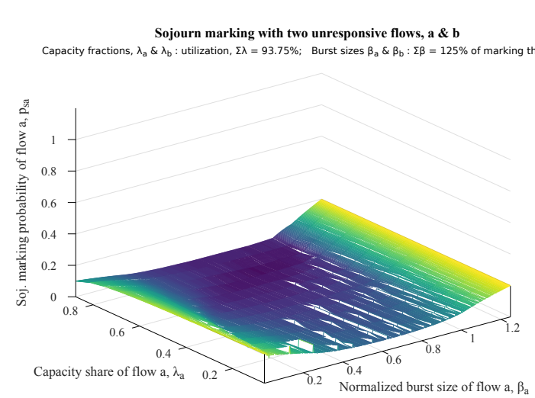
Sojourn marking
100%
utilization, Σλ
93.75%
max burst, Σβ
106.25%
125%
225%

Slide 19
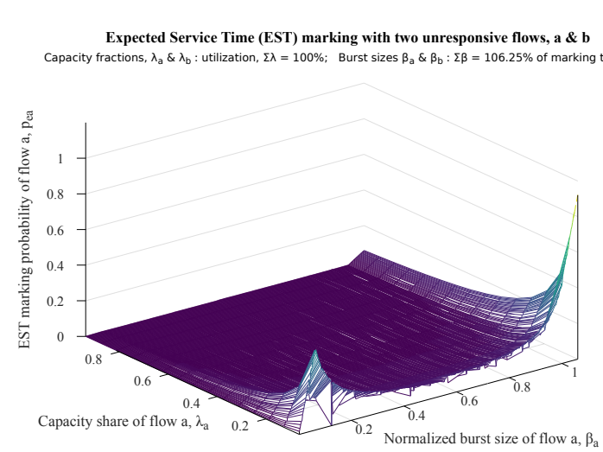
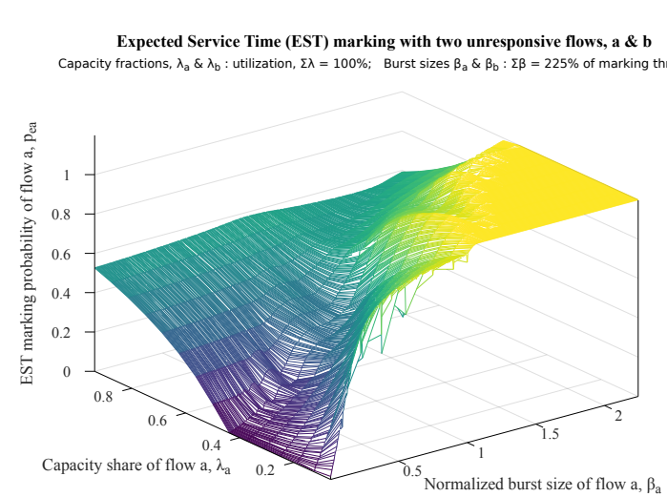
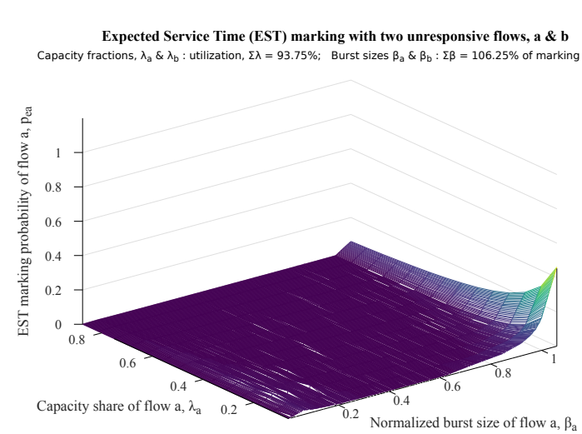
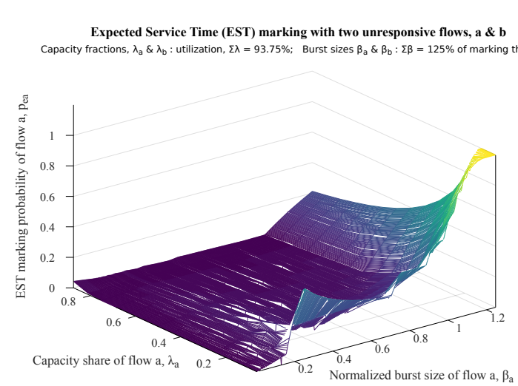
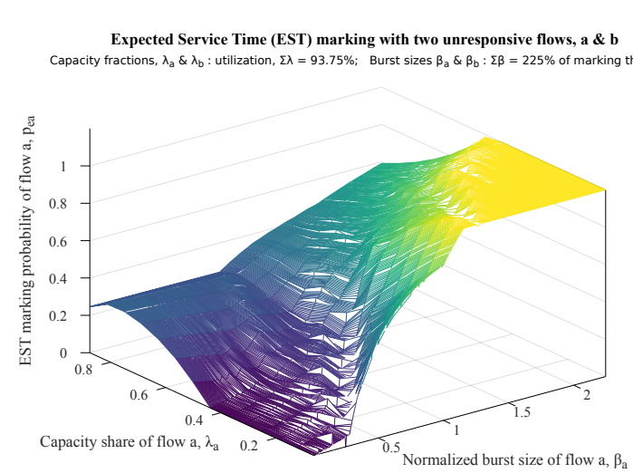
EST marking
100%
utilization, Σλ
93.75%
max burst, Σβ
106.25%
125%
225%

Slide 20
Evaluation
ideal: | increase with burst size β_{a}? | not decrease with capacity share λ_{a}?
sojourn¹ | N² | Y¹
EST | Y & N³ | N
¹ in general, other than high max burst and low utilization
² symmetric about the avg burst size
³ decreases from a peak at β_{a} = Σβ – 1 if low capacity share

Slide 21
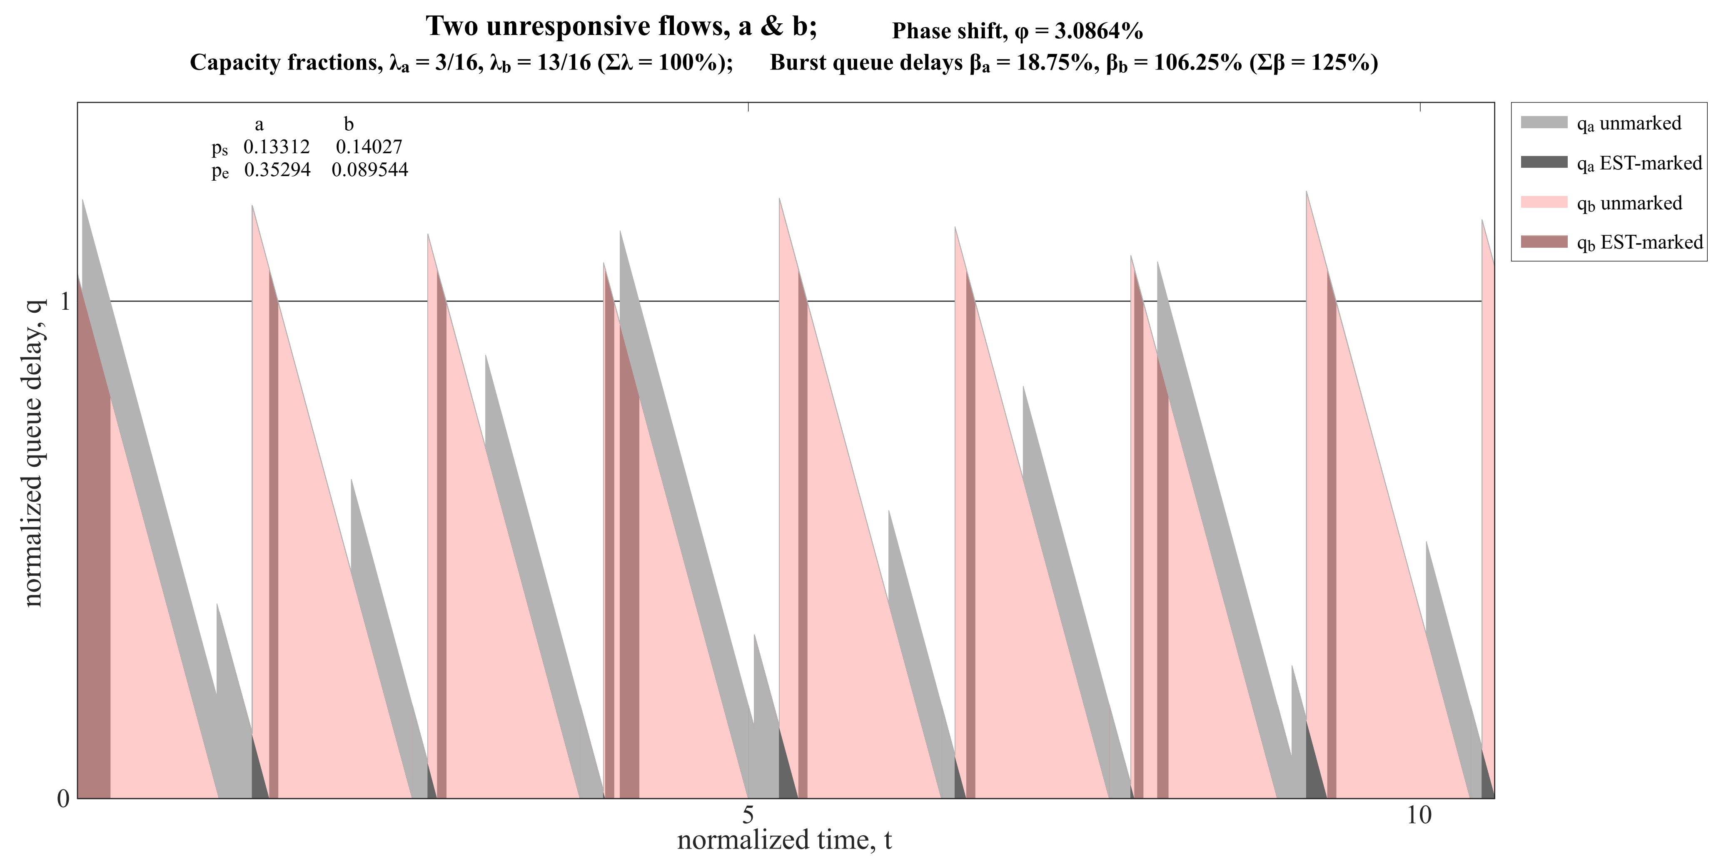
Interpretation
Example problematic case for EST marking
for a grey flow with low
capacity share and smaller
bursts than pink
even though grey arrives smoothly, it can only depart in the gaps betw. pink bursts
variation in these gaps and in how many grey bursts arrive between pink ones is high relative to average grey traffic
EST marks the residual grey in the q when the next pink burst arrives
and the pink burst gets pushed back, closing subsequent gaps
on average grey fits between pink bursts, but EST punishes grey for all variance

Slide 22
Next steps
Design a better marking approach?
    sthg like p_{e} – p_{s} ?
Validate model against:
    ns3 simulation
    testbed
Design and evaluate an aggregate policer?

Slide 23
How to Apportion Blame for a Queue with Arrivals in Bursts?
Discussion
and spare slides
Notes:
Cover Slide 1 of 3
Cable Labs

Slide 24
Compare 2 marking approaches: Sojourn (s) & EST (e)
Experiment plans
Revisit Original
Expt 1.1:
    For a set of fixed capacity shares λ_{a} + λ_{b} = Σλ (constant)
    burst size β: increase β_{a}, decrease β_{b}, with β_{a}+β_{b} = Σβ (constant)
    measure both marking probabilities, p_{s} & p_{e}
    for each approach, report mean, max & min of each marking metric over a range of phase shifts
Control expt 1.2:
    Same as #1.1, with Σλ and Σβ constant
    but with β_{a} = β_{b} increase λ_{a}
    marking should not depend on capacity share, λ
    (can visualize this on 3-D plots of expt 1.1)
Expt 2.1:
    Same as #1.1, except hold β_{b}, while increasing β_{a}
Expt 3.1:
    Same as #1.1 except increase β_{a} with λ_{a}
    (can visualize this on 3-D plots of expt 1.1)
Expt 4? Model packetization or use ns3
Redesign marking?
Design & Model aggregate policer

Slide 25
Approach – more detail
Phase Shift
At each point in the parameter space,
start from multiple different phase shifts
Avoid always including zero as one phase shift
Record mean, max & min* of marking metrics
* variation is not symmetric, so std. dev. not applicable

Slide 26
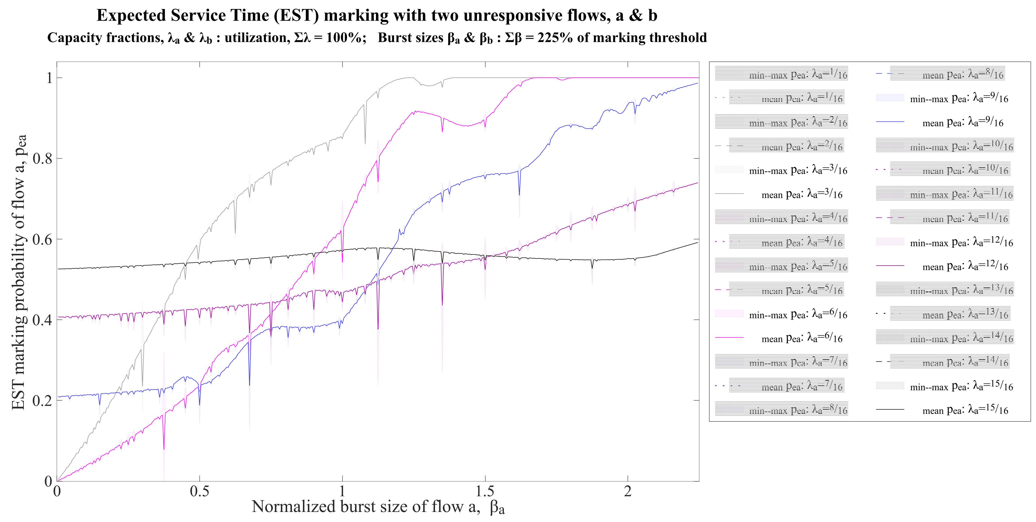
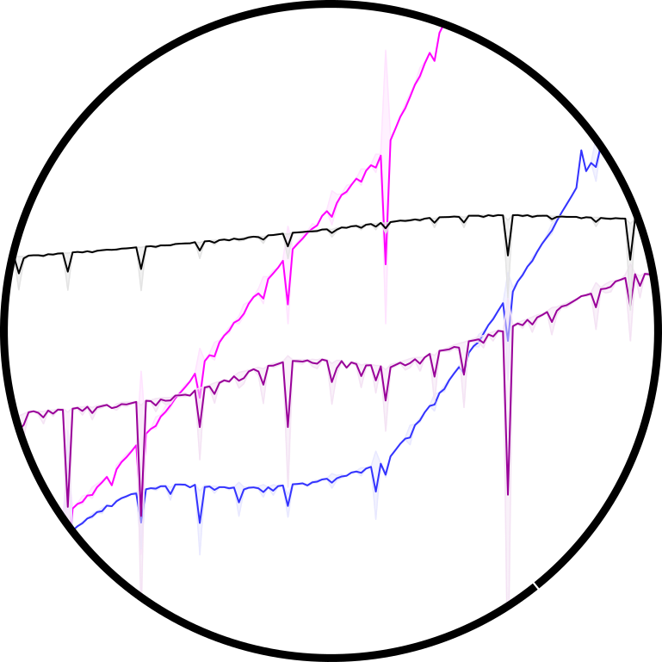
Typical Spread of Results over 8 phase samples

Slide 27
Interpretation: phase shift results
points where spread increases are where the pattern repeats after a few bursts
    i.e. lowest common integer multiple of the two burst intervals is low
    then "law of large numbers" doesn't apply
    unusual coincidences more likely,
    e.g. bursts never precisely coincide
flows are unlikely to get stuck at these points
    lower marking causes flow to increase window
recommend a little randomization of burst sizing – just in case

Slide 28
Approach – more detail
Minimal Repeating Pattern
Duration: lowest common integer multiple
    of the two burst intervals (not integers themselves)
Find where to start
    assume a sufficient standing queue to never go idle
    start 2nd pass where standing q is smallest
    challenge: 2 passes without doubling the run time
* variation is not symmetric, so std. dev. not applicable

Slide 29
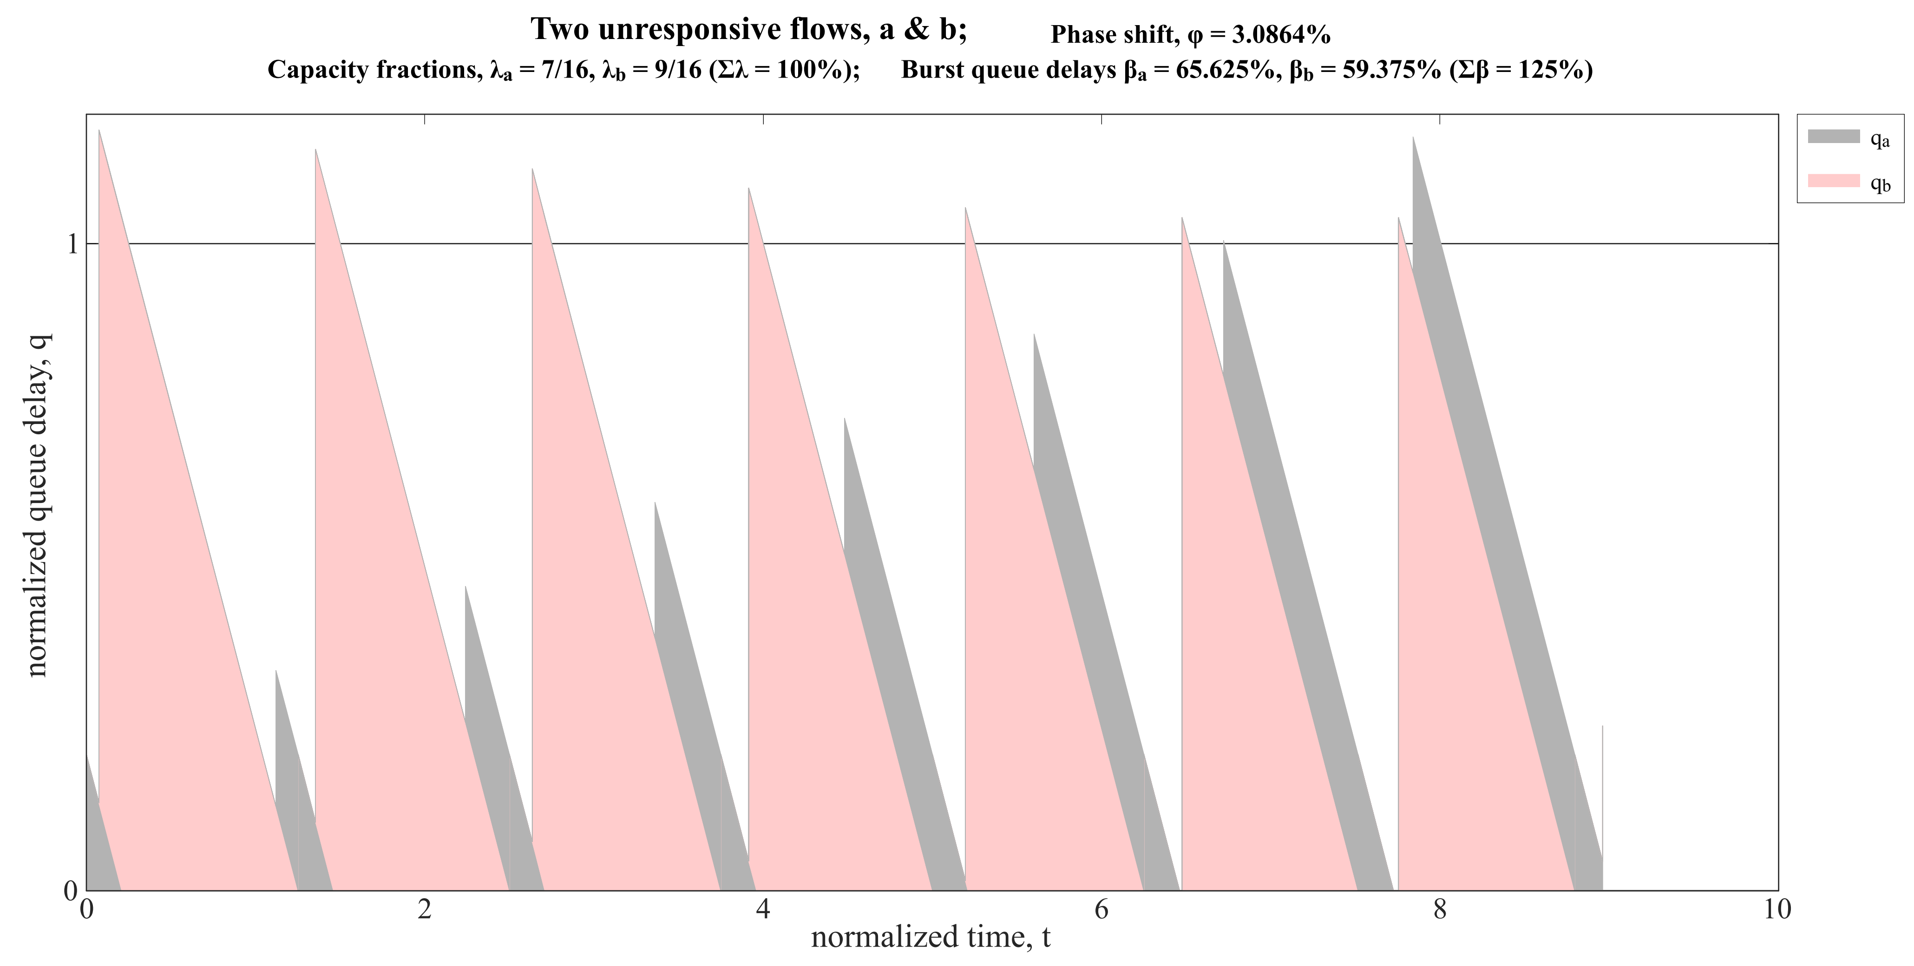
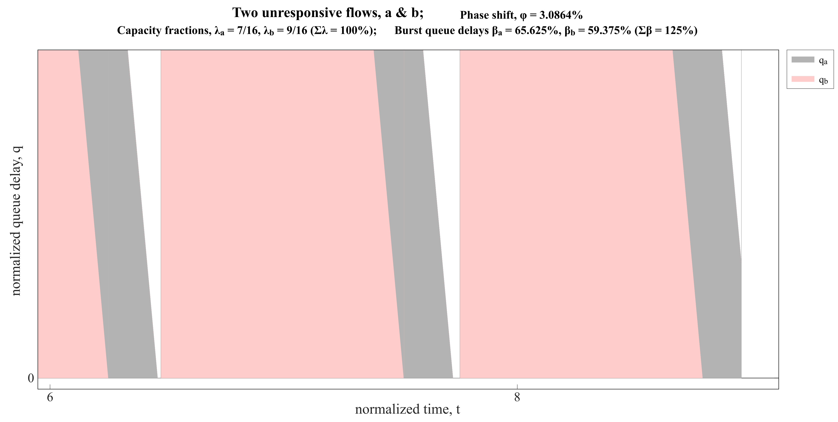
Example of q=0 at the wrong burst
duration, t_{max}
if set q = 0 at wrong burst,
q > 0 at end of duration
and starting with a slightly larger q has a knock-on effect next round
gaps show q did not
start deep enough
q

Slide 30
Approach
What if's
Check the validity of the approach,
by investigating alternative avenues
    increase burstiness of flow a, β_{a},
    while holding β_{b} at a small selection of const. values
    increase λ_{a} & β_{a} together,
    related by a selection of factors, e.g. Δλ = kΔβ
    investigate including zero in the range of phase shifts

