Slide 1
For discussion
Signalling Bursty Queue Delay
Expt 1.1 basic results
Bob Briscoe, Independent <research@bobbriscoe.net>
Feb 2023
metric used in this slide pack: marking probability of flow a, p_{a}
Notes:
Cover Slide 1 of 3
Cable Labs

Slide 2
Compare 2 marking approaches: Sojourn (s) & EST (e)
Experiment plans
2 unresponsive flows, a & b
Ideal: marking probability, p,
    monotonically increases with burst size, β
    does not decrease with capacity share, λ
Expt 1.1:
    For a set of fixed capacity shares λ_{a} + λ_{b} = Σλ (constant)
    burst size β: increase β_{a}, decrease β_{b}, with β_{a}+β_{b} = Σβ (constant)
    measure both marking probabilities, p_{s} & p_{e}
    for each approach, report mean, max & min of each marking metric over a range of phase shifts
Control expt 1.2:
    Same as #1.1, with Σλ and Σβ constant
    but with β_{a} = β_{b} increase λ_{a}
    marking should not depend on capacity share, λ
Expt 2.1:
    Same as #1.1, except hold β_{b}, while increasing β_{a}
Expt 3.1:
    Same as #1.1 except increase β_{a} with λ_{a}
Expt 4? Model packetization or use ns3
Redesign marking?
Design & Model aggregate policer

Slide 3
Normalized metrics
Goal: results applicable to any link rate and any step marking threshold delay
Burst size β is in units of time (queue delay)
    normalized to: marking threshold = 1 unit of time
On time series plots, time is also normalized
    queue delay at marking threshold = 1 unit of time
Marking rate, λp, is marked bits per unit time
    normalized as a dimensionless fraction of link bit rate = 1
Marking probability, p, and capacity share, λ
    both dimensionless and bounded within [0,1]
    so normalized marking rate, λp, also bounded within [0,1]
Comparison metrics use difference, p_{a} – p_{b} = Δp, not ratio p_{a}/p_{b}
    not distorted as p_{b} → 0
    visualization of unresponsive traffic marking, irrespective of any congestion control assumptions

Slide 4
Expt 1.1
Utilization λ_{a} + λ_{b} = Σλ | Max burst β_{a} + β_{b} = Σβ | sojourn vs. EST marking p_{a} Δp λ_{a}p_{a} Δ(λp)
100% | 106.25% | •• •• •• ••
 | 125% | •• •• •• ••
 | 225% | •• •• •• ••
93.75% | 106.25% | •• •• •• ••
 | 125% | •• •• •• ••
 | 225% | •• •• •• ••
This slide introduces the next 6 slides
    the rest are greyed out
4 marking metrics in 4 separate slide packs
    metrics in other slide packs are greyed out
p_{a} : marking probability of flow a
Δp = p_{a} – p_{b}
λ_{a}p_{a} : marking rate of flow a
Δ(λp) = λ_{a}p_{a} – λ_{b}p_{b}

Slide 5
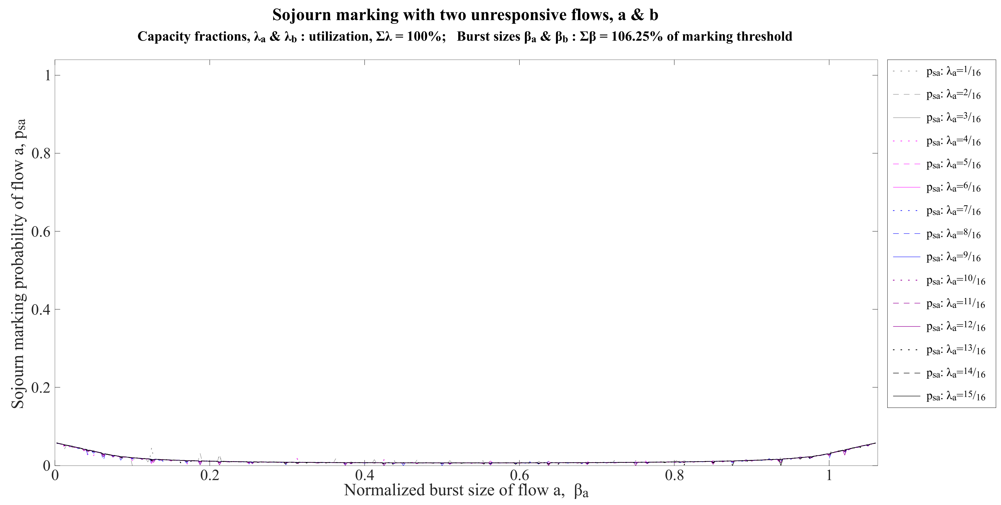

Slide 6
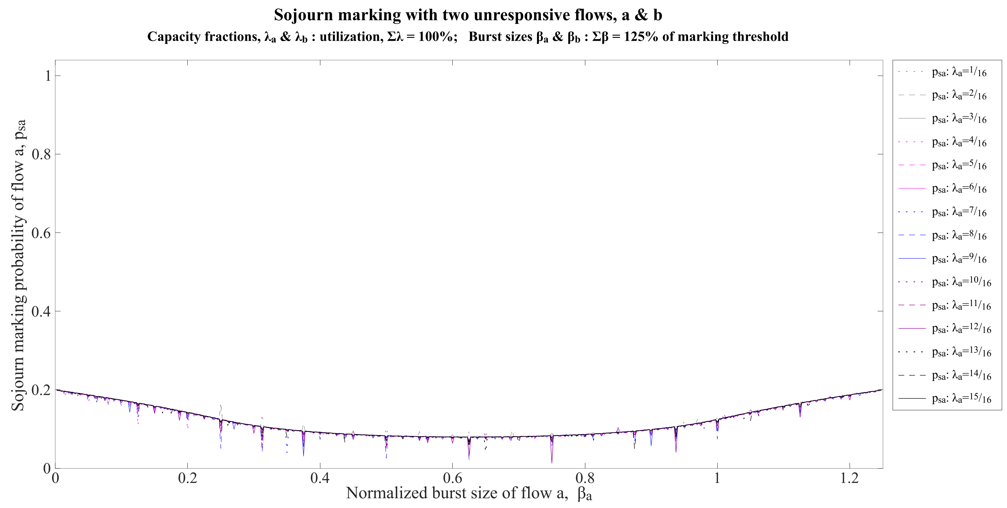

Slide 7
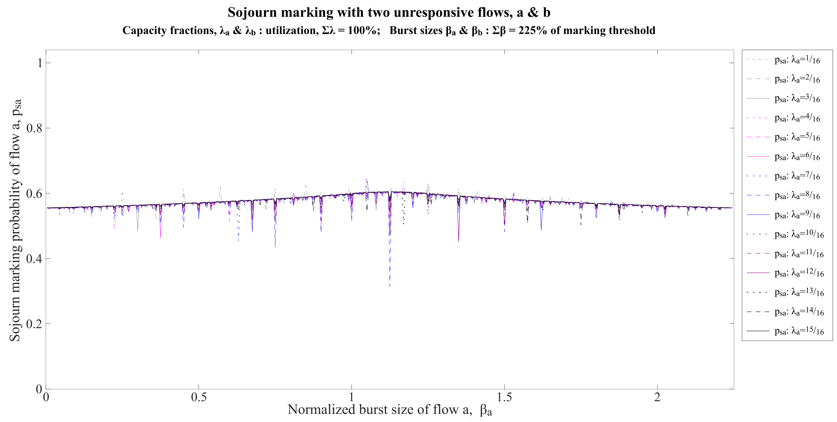

Slide 8
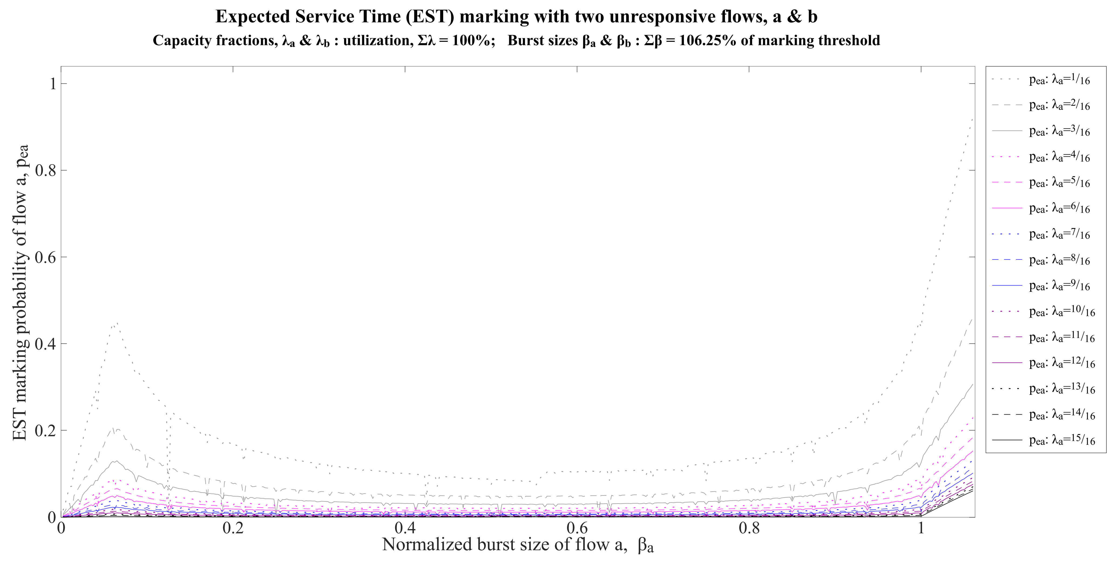

Slide 9
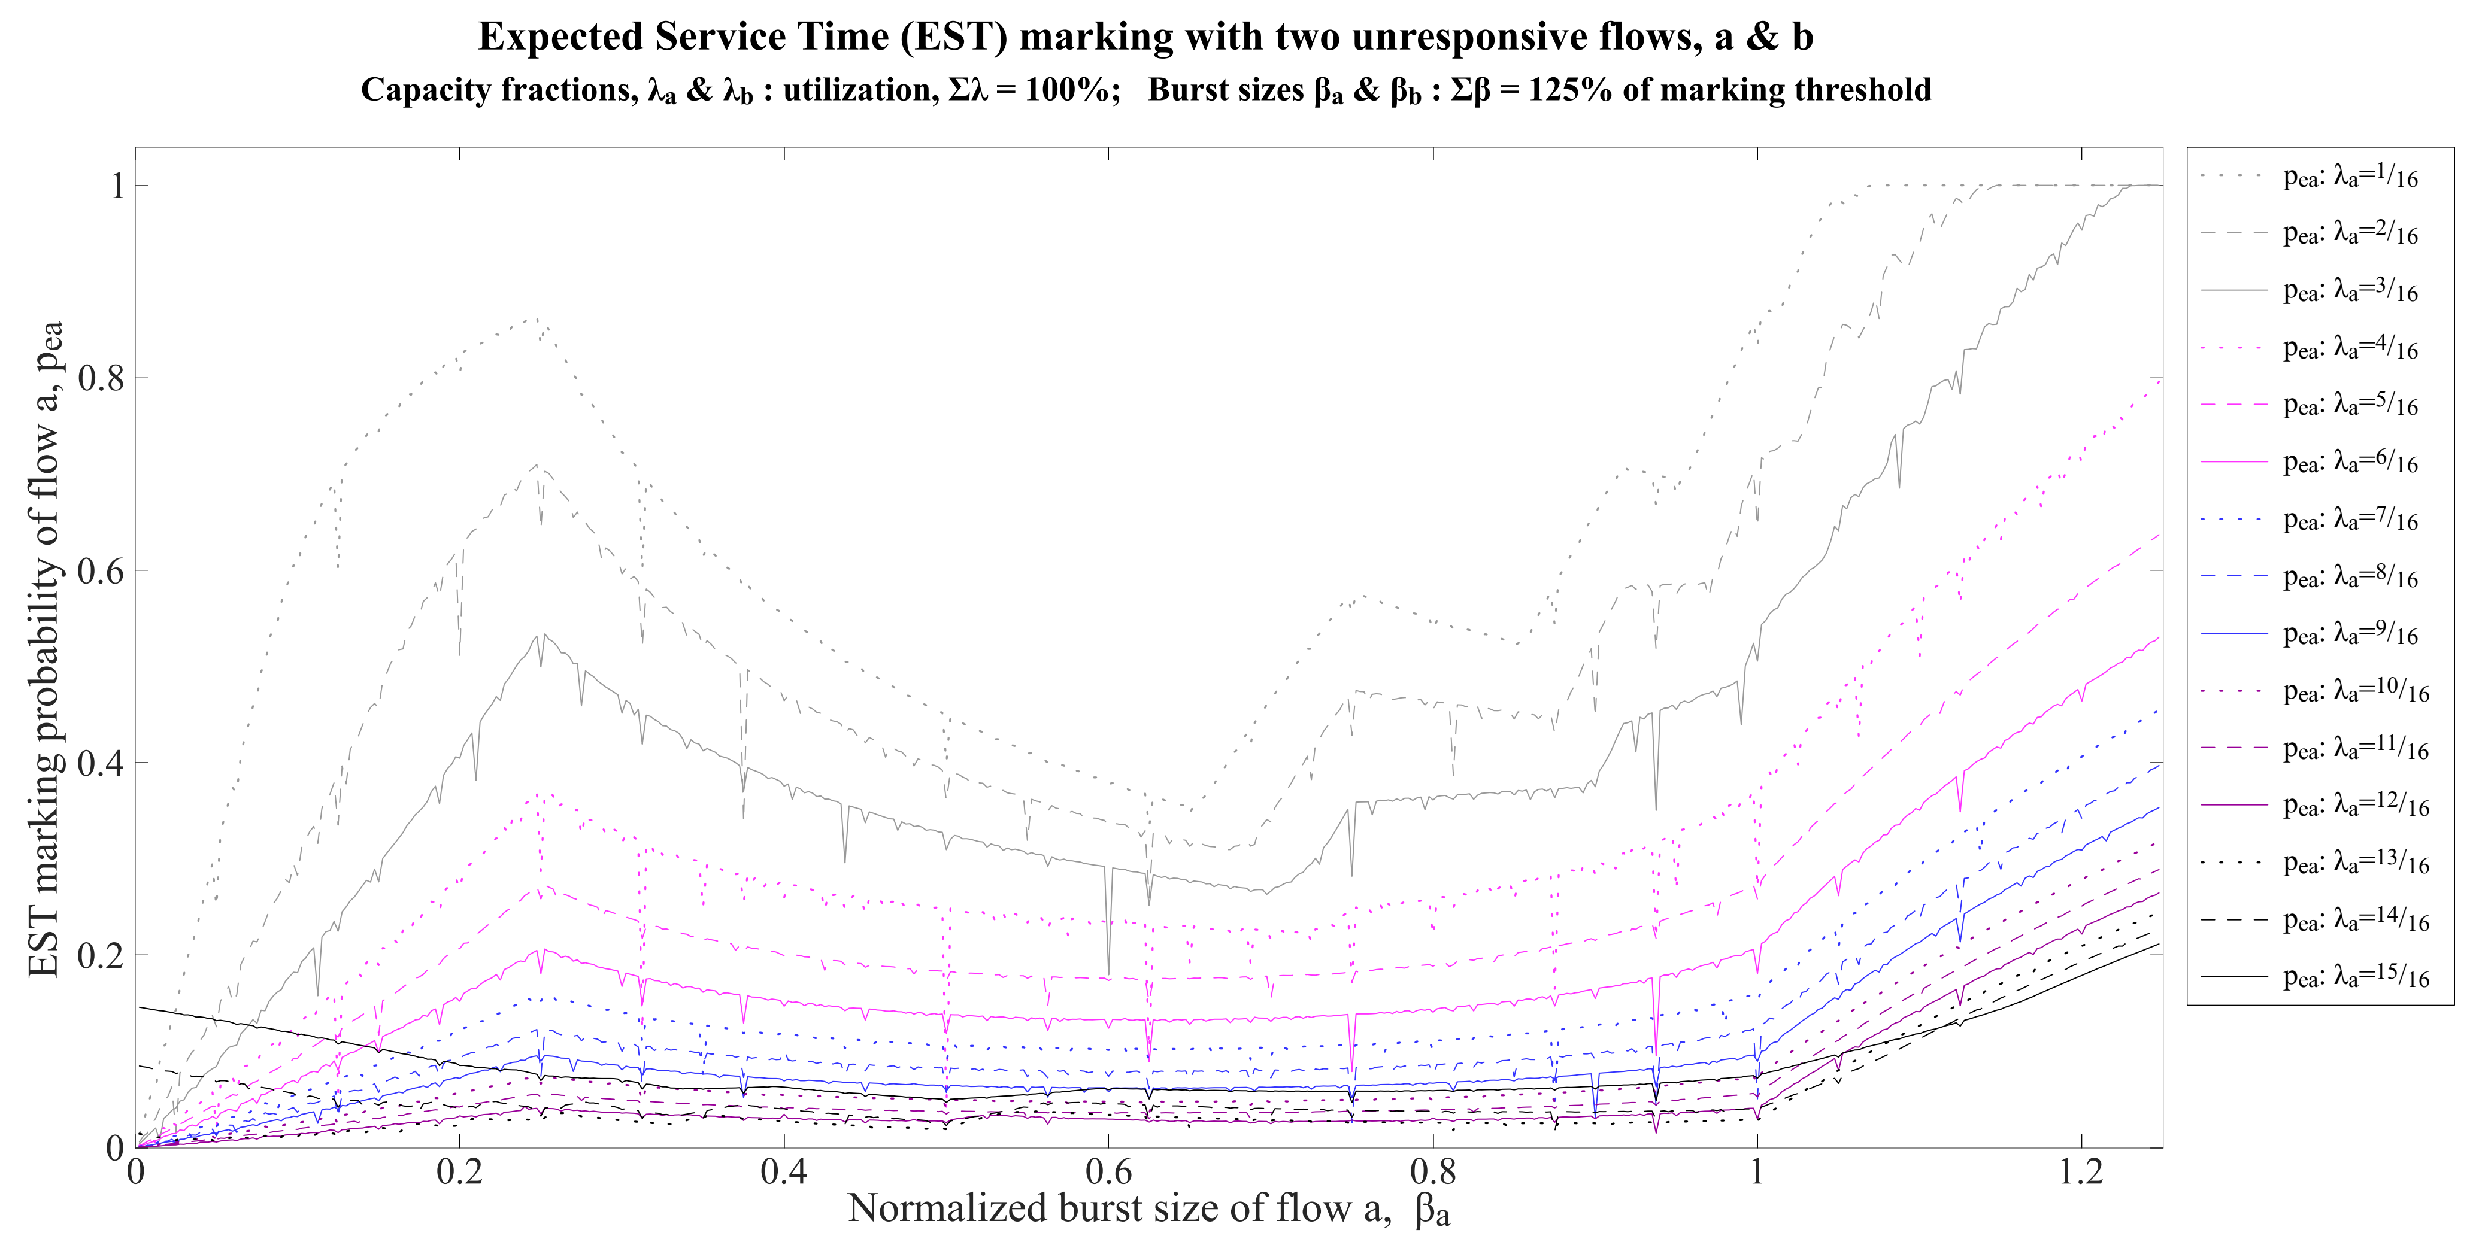

Slide 10
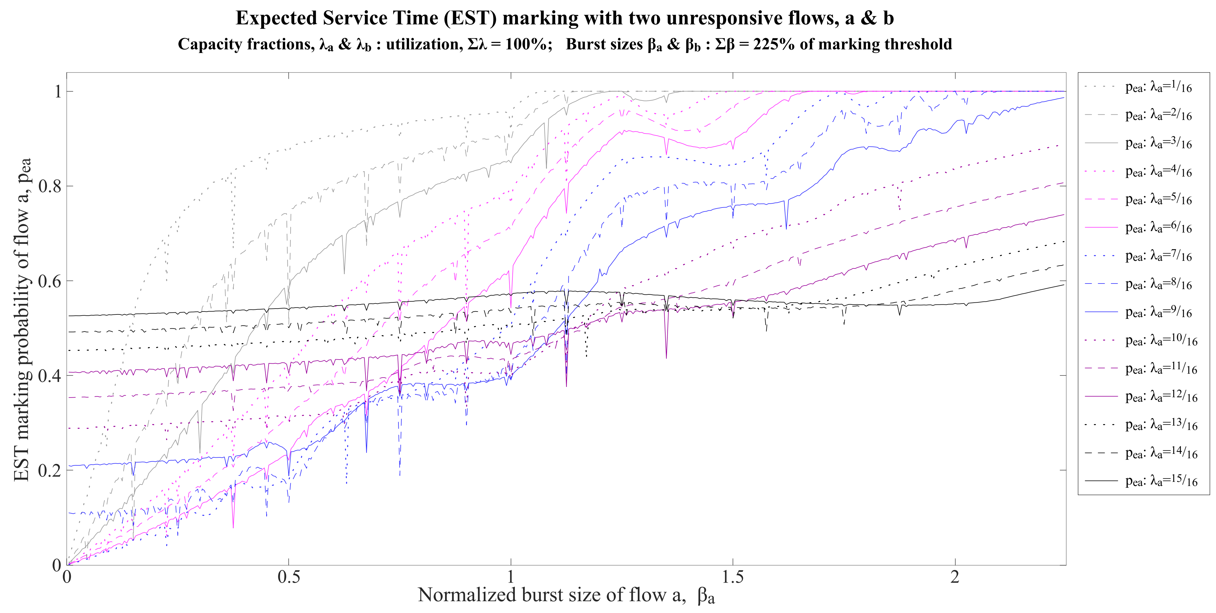

Slide 11
Expt 1.1
Utilization λ_{a} + λ_{b} = Σλ | Max burst β_{a} + β_{b} = Σβ | sojourn vs. EST marking p_{a} Δp λ_{a}p_{a} Δ(λp)
100% | 106.25% | •• •• •• ••
 | 125% | •• •• •• ••
 | 225% | •• •• •• ••
93.75% | 106.25% | •• •• •• ••
 | 125% | •• •• •• ••
 | 225% | •• •• •• ••
This slide introduces the next 6 slides
    the rest are greyed out
4 marking metrics in 4 separate slide packs
    metrics in other slide packs are greyed out
p_{a} : marking probability of flow a
Δp = p_{a} – p_{b}
λ_{a}p_{a} : marking rate of flow a
Δ(λp) = λ_{a}p_{a} – λ_{b}p_{b}

Slide 12
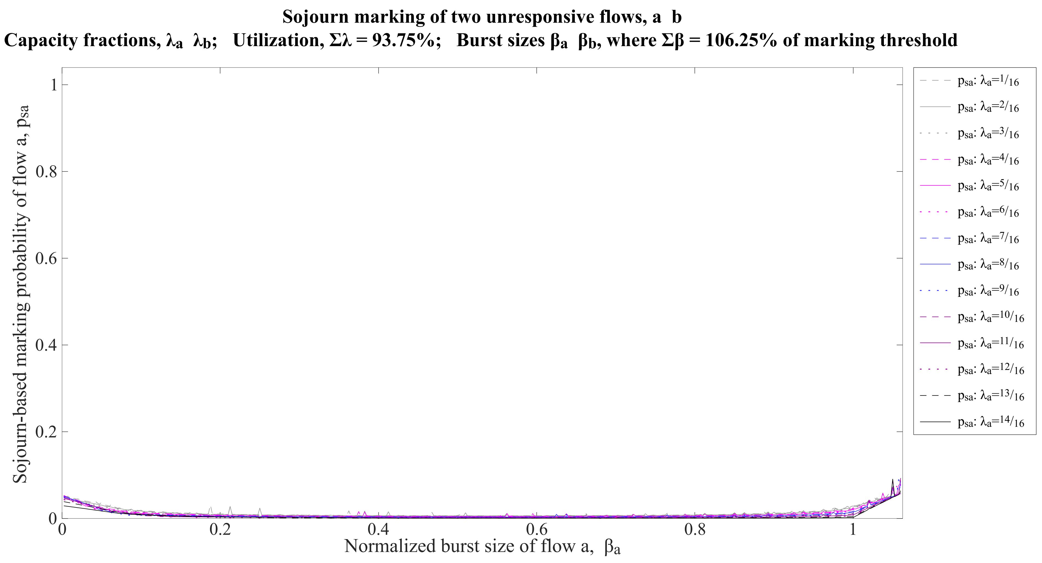

Slide 13
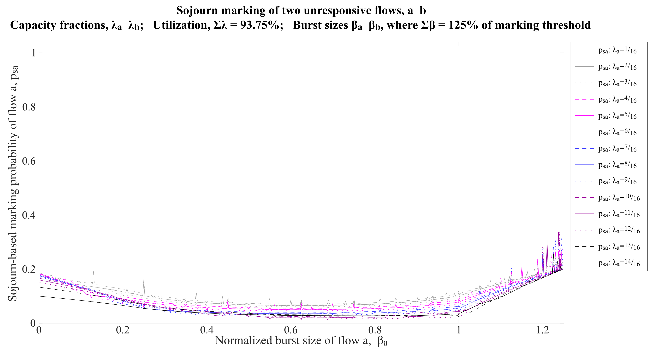

Slide 14
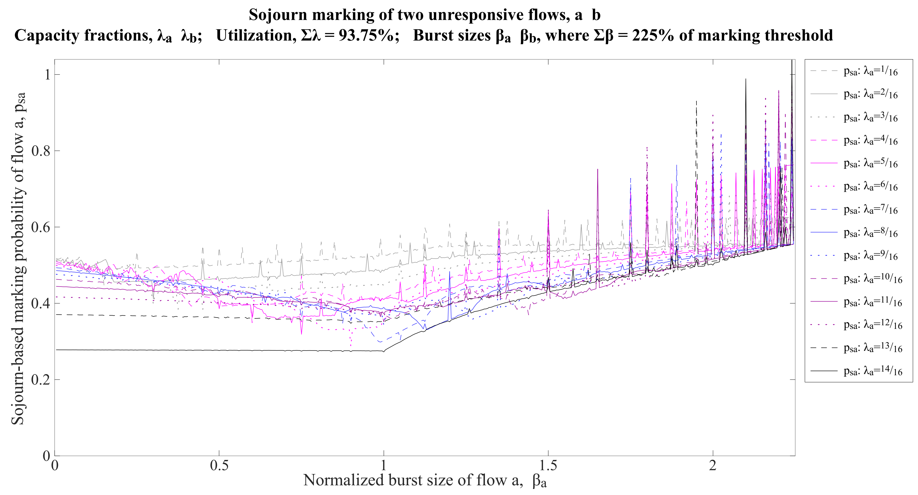

Slide 15
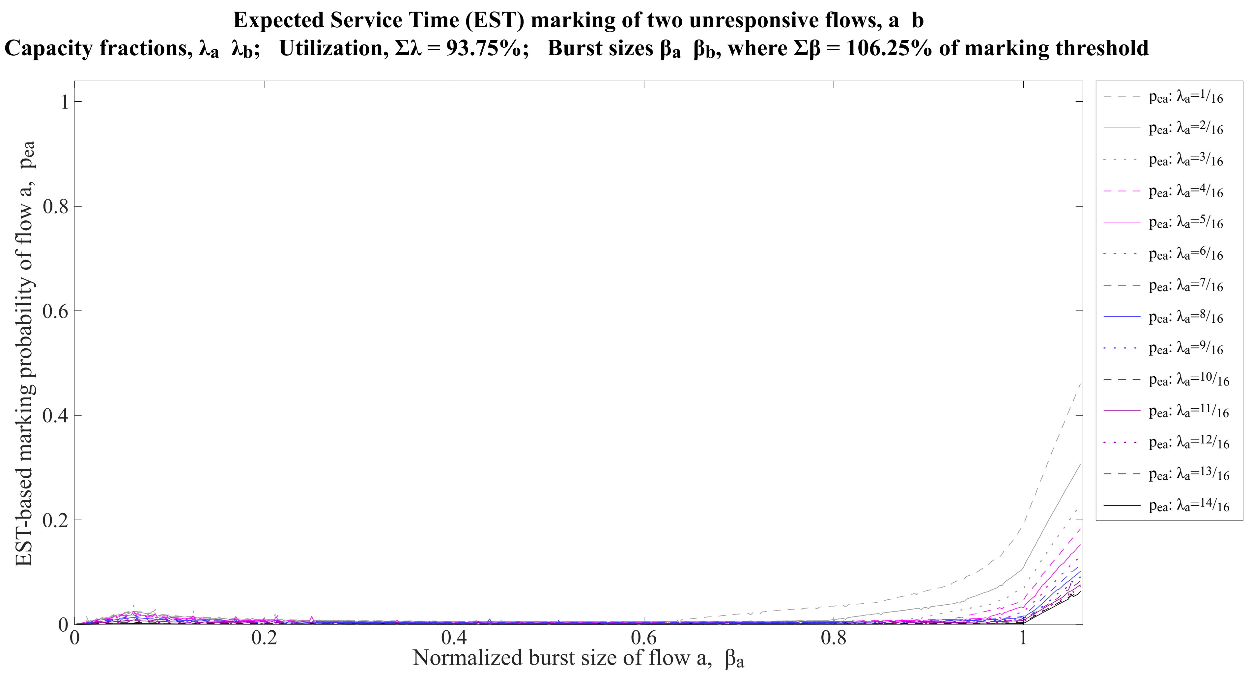

Slide 16
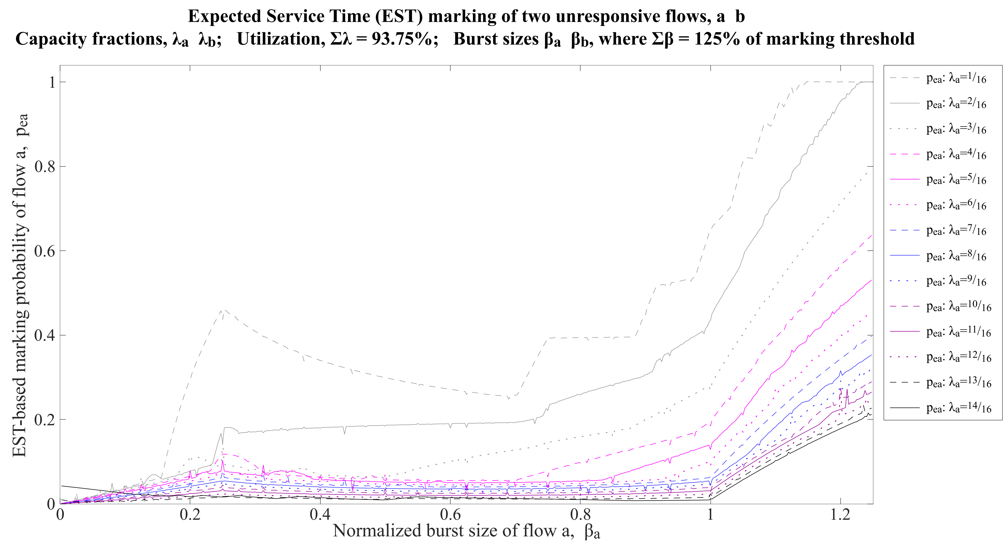

Slide 17


