Slide 1
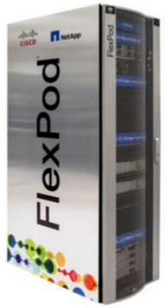
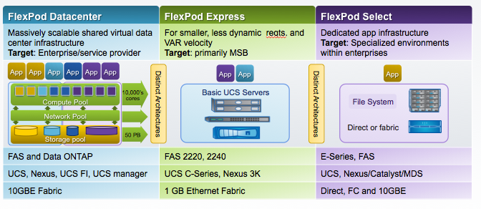
What is Flexpod? Flexpod is a reference architecture for server, storage and networking components that are pretested and validated to work together as an integrated infrastructure stack that is flexible and scalable What is it comprised of? Flexpod consist of Vmware (Hypervisor), Cisco (Networking & Compute) and NetApp (Storage). The infrastructure is then built based on Cisco Validated Design (CVD) - www.cisco.com/go/flexpod Types of Flexpod: Datacenter – Suited to enterprise Private Cloud as well as Software-Defined Data Center, secure multi-tenancy, databases, VDI and scale out storage Select – Suited to dedicated high-performance workloads such as Hadoop and Oracle RAC Express – Suited to small and medium-sized businesses to deliver a single, convenient, converged infrastructure platform.

Slide 2
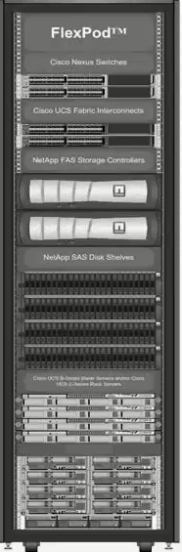
Benefits of Flexpod Infrastructure
Unified System
Simplified Setup
Increased Control
Support for multiple protocols (NFS/iSCSI/FC/FCoE) on converged fabric
Single point for Management
Higher Productivity
Abstraction of bare metal server elements
Policy-based automation & Service Profiles
Fewer errors (configuration drift)
Highly Efficient
Increased Workload agility
Self Integrating components
Higher reliability with no single point of failure
Simplified setup
Higher asset utilisation
Higher application performance
Scalable
More workloads with less gear
Scalability without complexity
Each individual component can be scaled in isolation
Multi-Tenant
Network segregation for multi-tenant hosting
Isolation of resources into virtual data centers

Slide 3
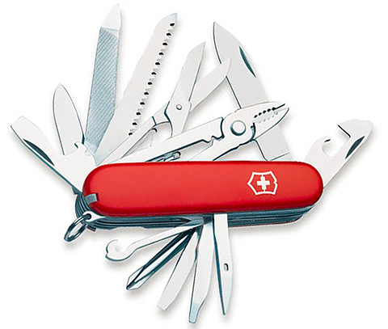
Converged Infrastructure
Converged infrastructure came about due to the complexities of multiple vendor products being put together which added IT complexity and administration headaches
Converged Infrastructure combines networking, compute and storage resources into one architectural package
CI increases manageability, decrease time
to deployment, cuts storage costs and
reduced power consumption.
Flexpod is just one flavour of converged
infrastructure. Others include VCE Vblock,
IBM VersaStack, Nimble SmartStack and
Hitachi UCP
The next generation of Converged
Infrastructure is Hyper-Converged
Infrastructure which brings the storage
closer to the compute layer for faster
performance from local storage

Slide 4
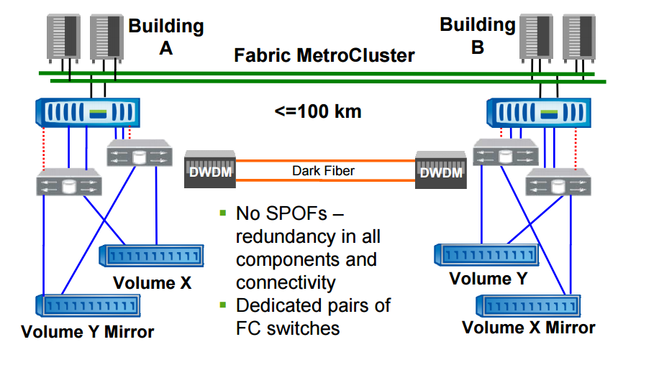
What is a Metrocluster?
A MetroCluster configuration consists of two NetApp FAS controllers, each residing in the same datacenter or two different physical locations, clustered together.
A Stretched MetroCluster has a range of 500m, a Fabric MetroCluster can stretch up to 100km. Both run on Fibre Channel only.
Instead of replicating writes from one site to another at the volume level MetroCluster replicates at the aggregrate level. SyncMirror is used to ensure mirroring using plexes to mirror the aggregrate
MetroCluster allows for synchronous writes on both sites and only once the write request is written on both side can it be committed

Slide 5
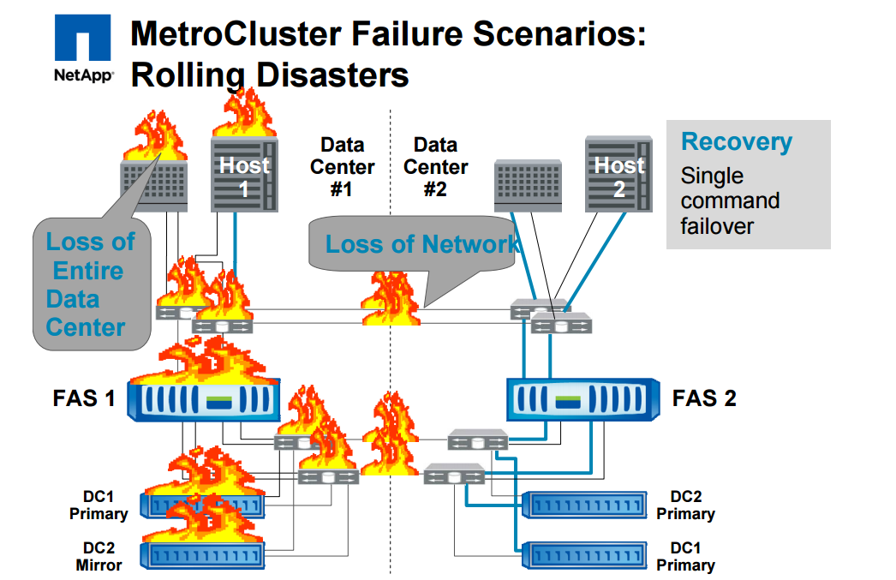
MetroCluster benefits:
Metrocluster can handle a number of failure scenarios as it has no single point of failure such as: Disk, disk shelves, disk loop, SAN Switches, ISLs, cables, interconnects or controller head
Zero unplanned downtime through transparent failover
Zero planned downtime through nondisruptive upgrades (we’ll see ;-))
Failover to DR site within minutes after site-wide failure

Slide 6
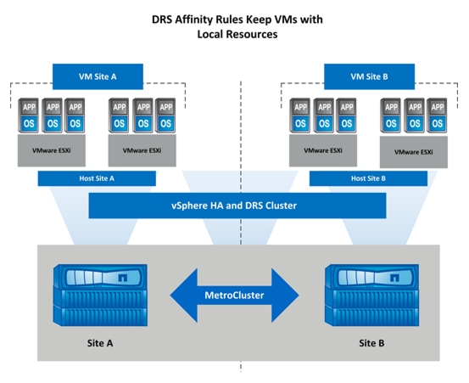
VMware vSphere Metro Storage cluster
VMware vSphere Metro Storage cluster is designed to leverage the benefits of highly available clusters across geographically dispersed locations
On vCenter HA cluster is used between two sites and allows the use of features such as vMotion and svMotion to migrate VMs between the sites
It provides the ability to load balance across both sites and provides enhanced downtime avoidance
DRS rules can be used to tie particular VMs to a site, if needed

Slide 7
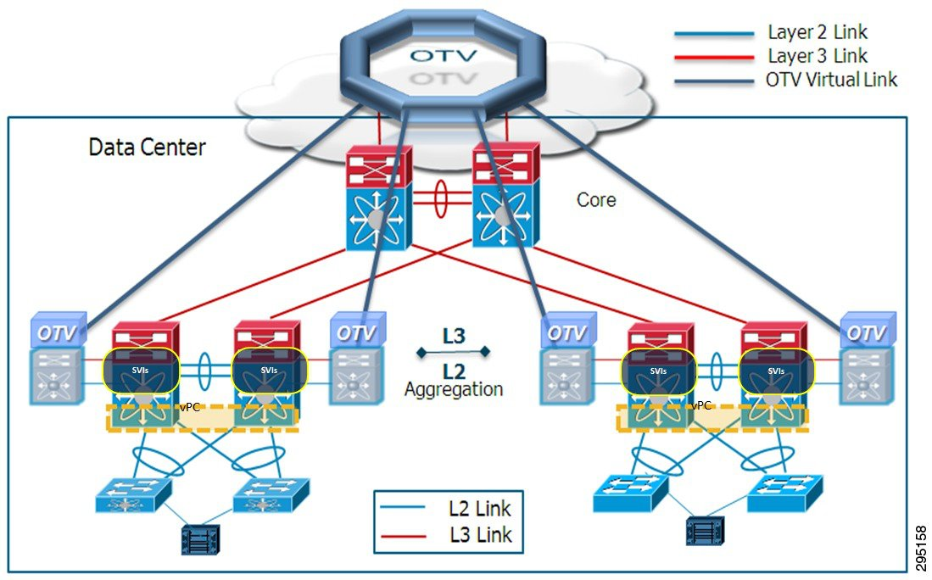
Fabric Metrocluster with OTV
OTV is required to allow the VMs to be able to vMotion between sites (only runs on Layer 2 communication)
Without OTV the sites could not communicate outside of their own boundary and HA would not be possible within vSphere
vSphere MSC utilises OTV to route L2 over L3 communication so both sites can communicate successfully
Each Nexus 7k has its own OTV VDC (Virtual Data Center) to make it routable and to handle the encapsulation of traffic across the link

Slide 8
UCS Director
Cisco UCS Director automates end-to-end IT processes and provides an end-to-end infrastructure management via a single pane of glass
Single management interface for Physical and Virtual infrastructure
Single click provisioning (with forethought into IP addressing etc)
Workflow based orchestration
Converged Infrastructure management
Self-service portal (including approval processes)
Multi-tenant / secure multi-tenant security
Cost modelling for chargeback
Reduces time to deployment by automating time-heavy tasks
UCS Director allows workflows to be packaged as catalogs and presented to the end user to allow self-service consumption of IT resources. It uses API calls to allow orchestration of the underlying managed infrastructure components, helping to standardize common tasks

