Slide 1
Converting a Signal to Digital
Radio waves are a set of wave bundles which are highly fluctuating electrical and magnetic fields superimposed on each other in space. They induce current in an antenna. There is always a band width of many frequencies.

Slide 2
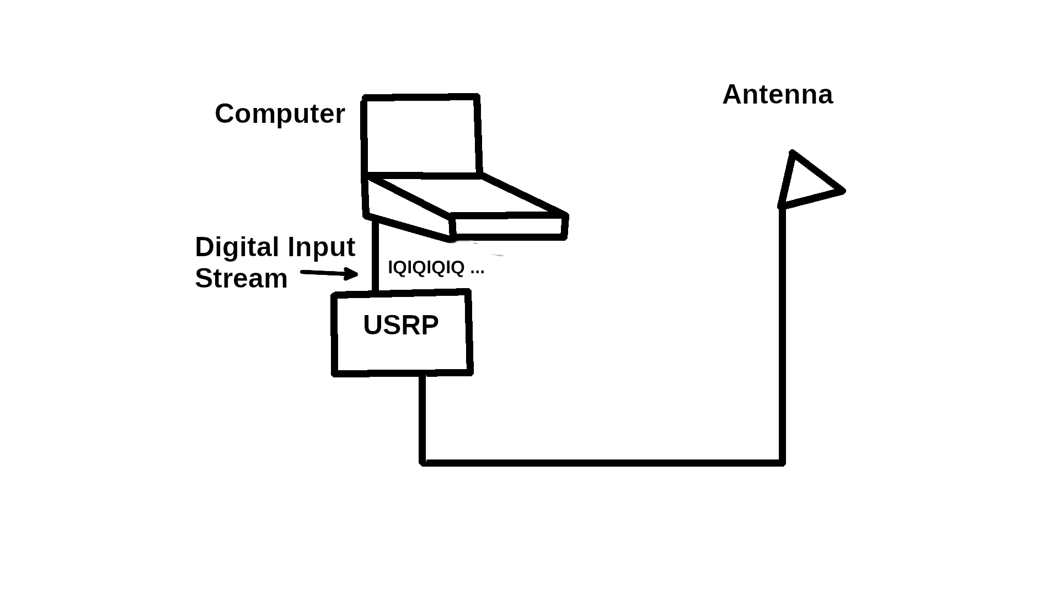

Slide 3
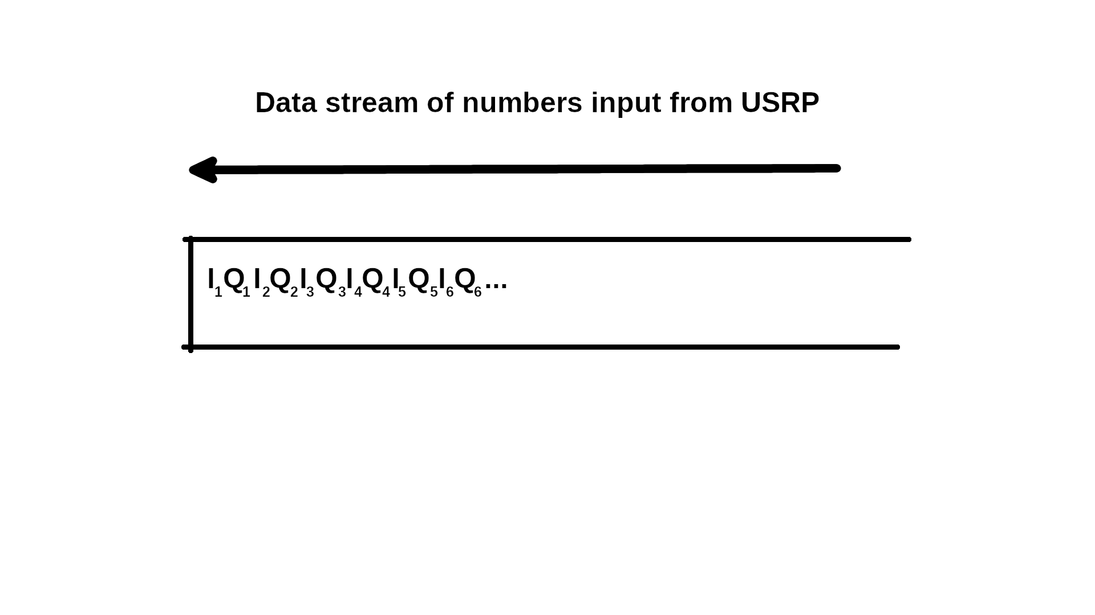

Slide 4
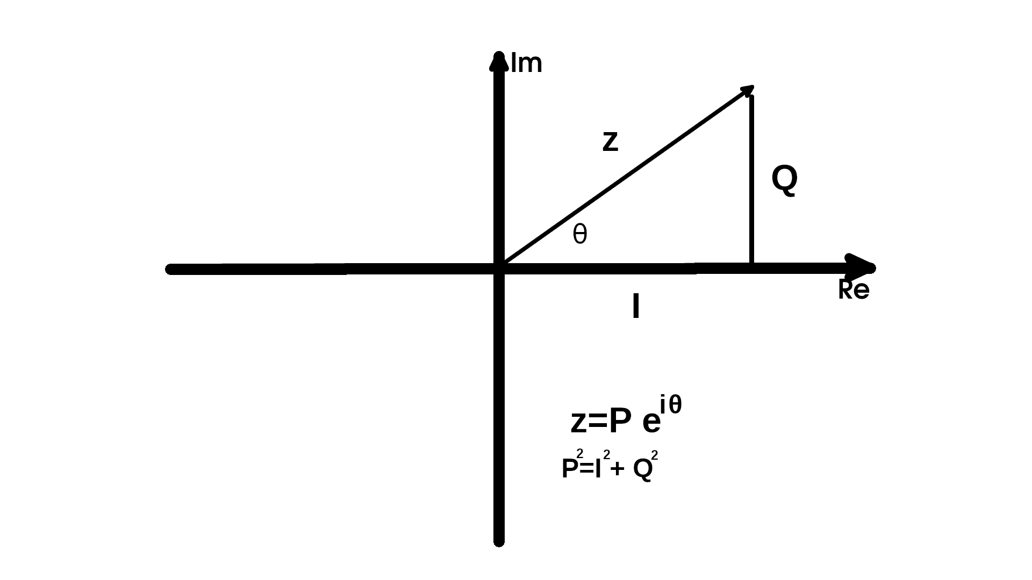

Slide 5
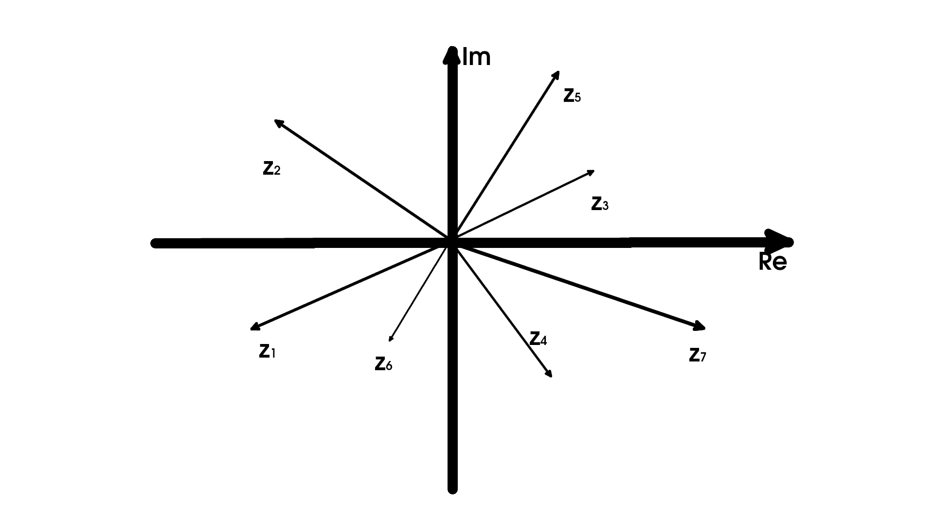

Slide 6
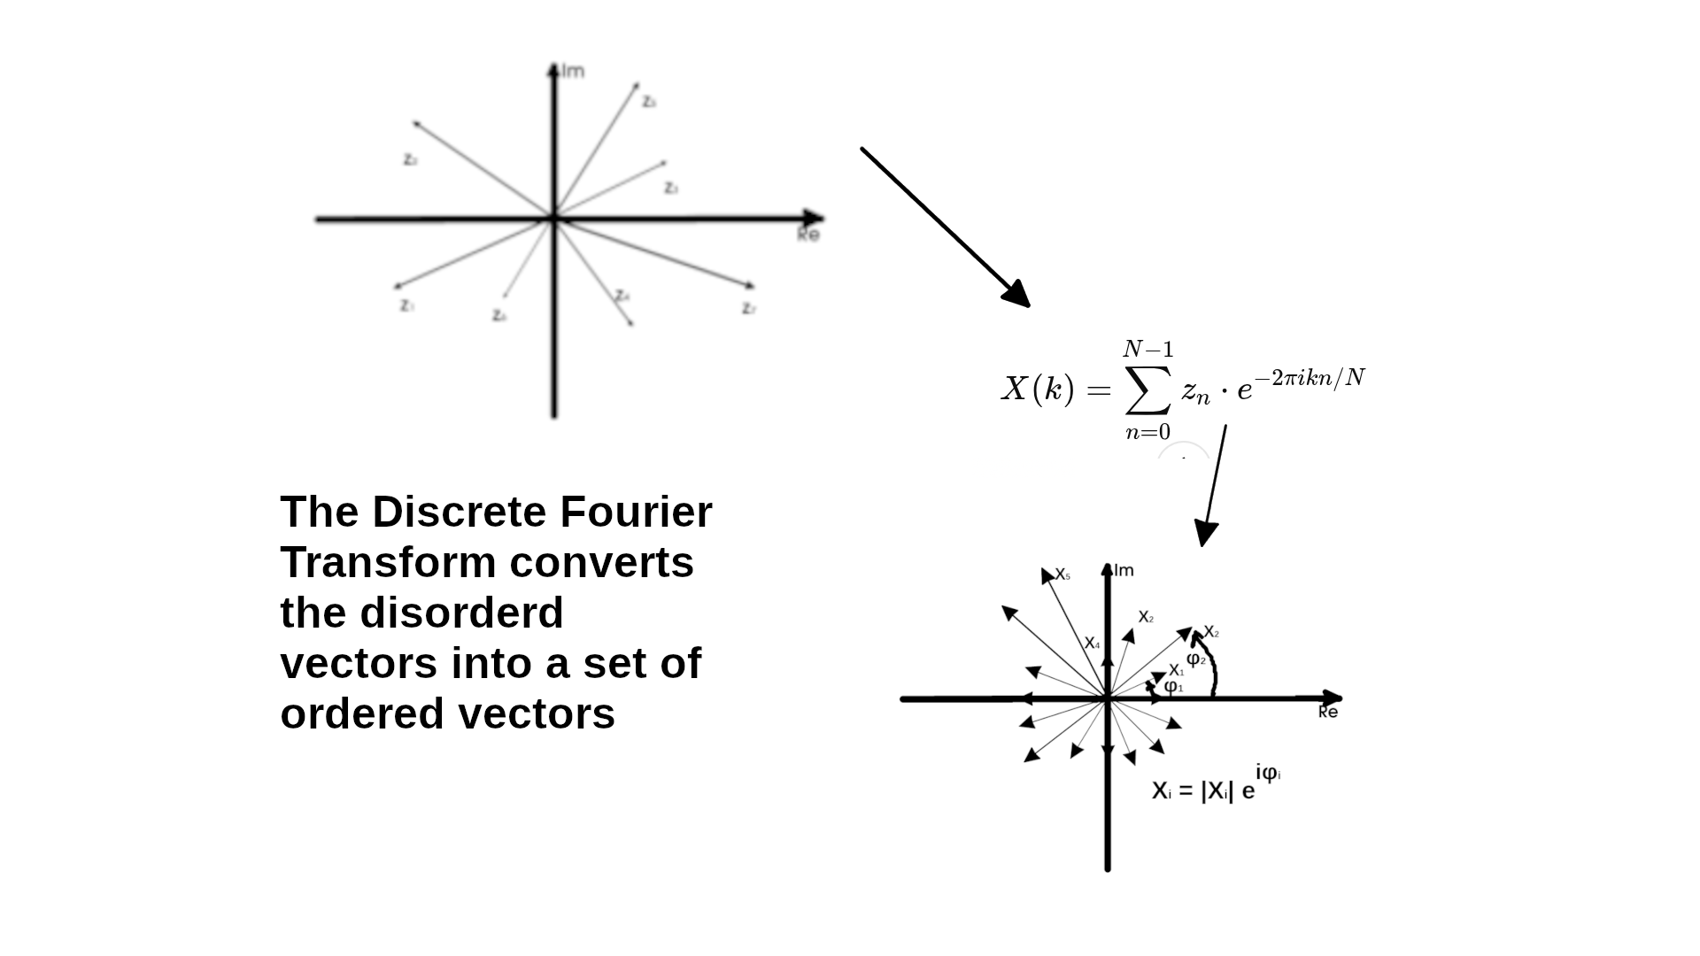

Slide 7
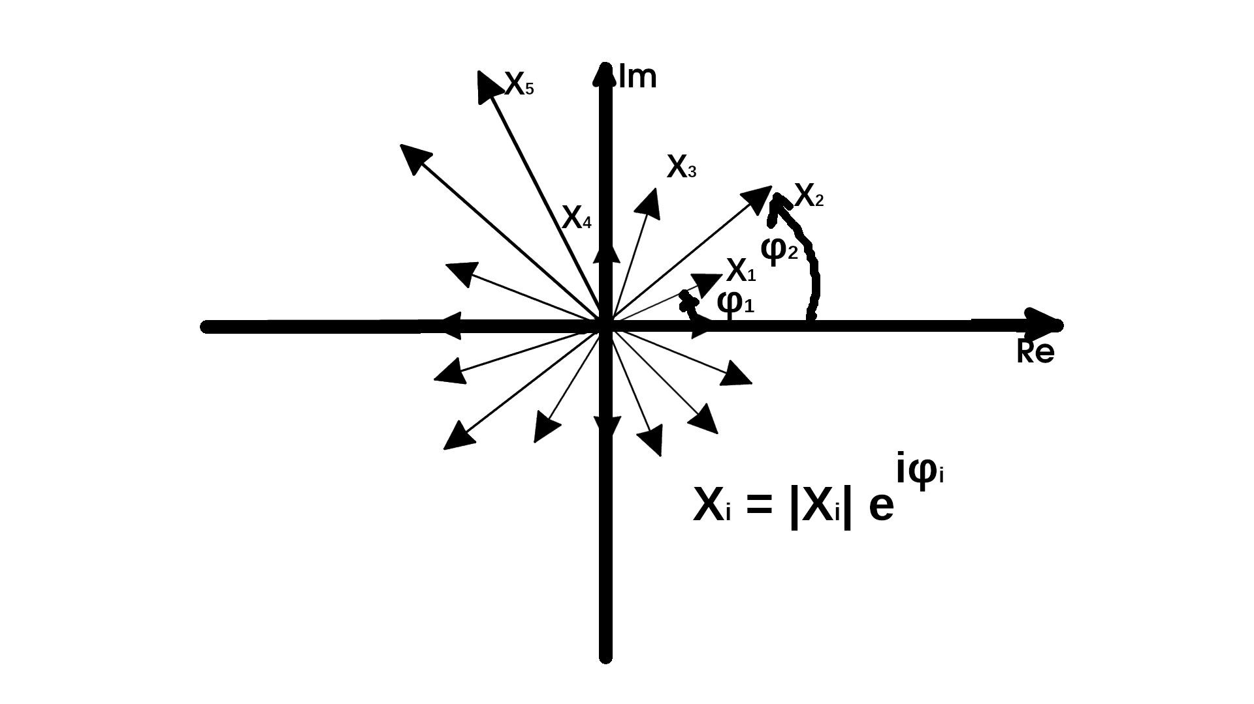

Slide 8
Finding Frequencies
N = number of samples
r = sampling rate (samples per second)
f_c = center frequency (e.g., 1420 MHz)
Δf = frequency resolution = r / N
f_k = f_c + (k - N/2) * (r / N) for k = 0 to N-1
This gives a frequency range from
f_min = f_c - r/2
f_max = f_c + r/2
(Amplitude)i = Sqrt(Re(Xi)² + Im(Xi)²)

Slide 9
Compare RTL-SDR to USRP1
Feature USRP1 RTL-SDR
Sample format fc32 (float32 complex) u8 + u8 (8-bit unsigned I/Q)
Bytes per sample 8 bytes 2 bytes
Block size 1024 samples 8192 samples
(8192 bytes) (8192 bytes)
Bandwidth Up to ~8 MHz Max ~2.4 MHz
Real-time reliability High (if FPGA is happy) Medium (USB bottlenecks)

