Slide 1
My Open Math
digital wRITING 350

Slide 2
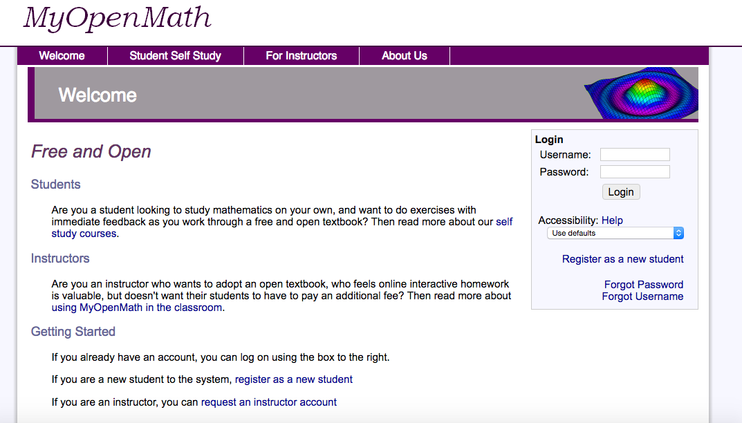
Getting started
MyOpenMath Lesson Plans
-Very straightforward and easy to use
-Almost all resources are on the site (book, video
lessons, homework, test reviews)
-Available classroom options including:
Web enhancement of an on-campus course
An added feature to a hybrid course
A fully online course
An individual self- study course
`

Slide 3
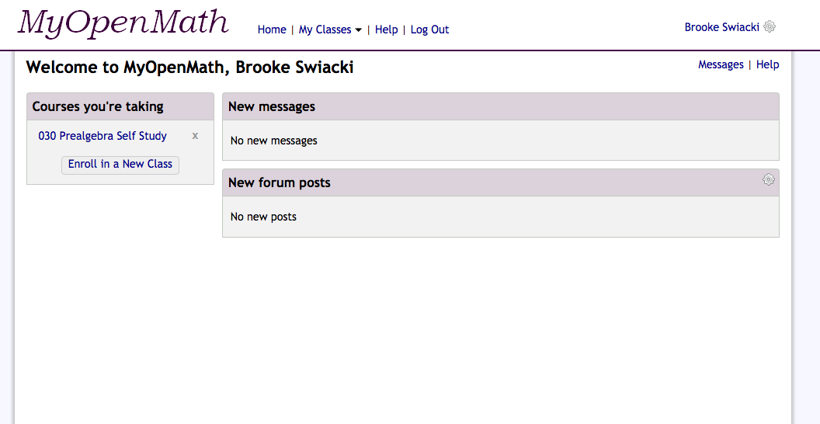
Why myopenmath?
Usability: My Open Math’s Web Site Ergonomics Delivers:
Website efficiency through effectively clear and organized content
Easy navigation and orientation use through distinct sections with bold titles
Easy methods of returning to the home page
Positive visual aspects and legibility through:
-Easy to read, visually identifying components
-Simply printed content
-Direct text lines
-Dramatic visual contrasts, such as bolding effects among each subject division

Slide 4
tEACHER AND STUDENT RESOURCES
My Open Math’s Website Criteria Delivers:
Availability to adopt a free online textbook
Free hosted use of the open-source platform
Use through free, open textbooks on OpenTextBookStore.com
Community-based support through support forums and training videos
Availability of comprehensive support through Lumen Learning
Homework with immediate feedback
Quizzes and tests
A full course management system including:
-File postings, discussion forums, videos & handouts, instructor resources
a full grade book

Slide 5
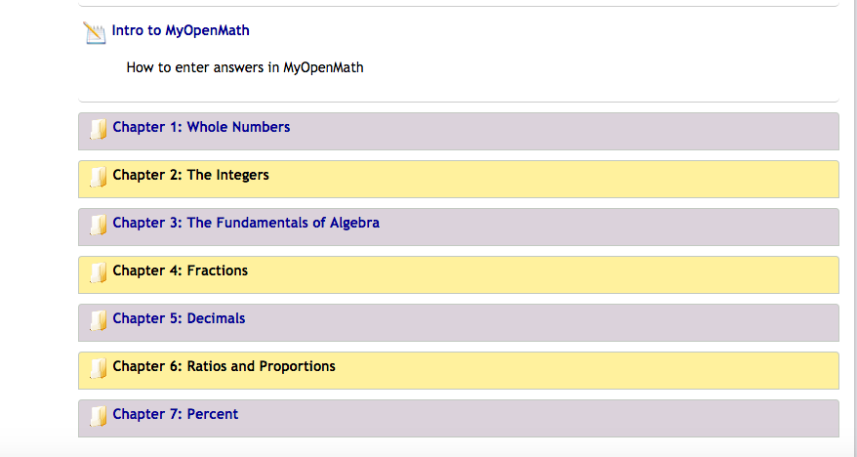
Who can use myopenmath?
Useful for a variety of education levels
Free classroom uses of the platform through the available course templates of:
Algebra
Pre-calculus
College algebra
Calculus
Math for liberal arts
Statistics

Slide 6
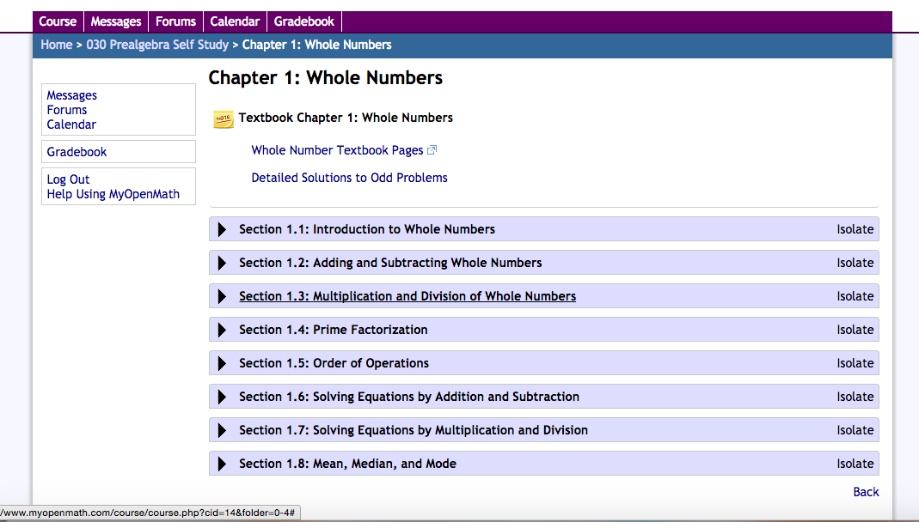
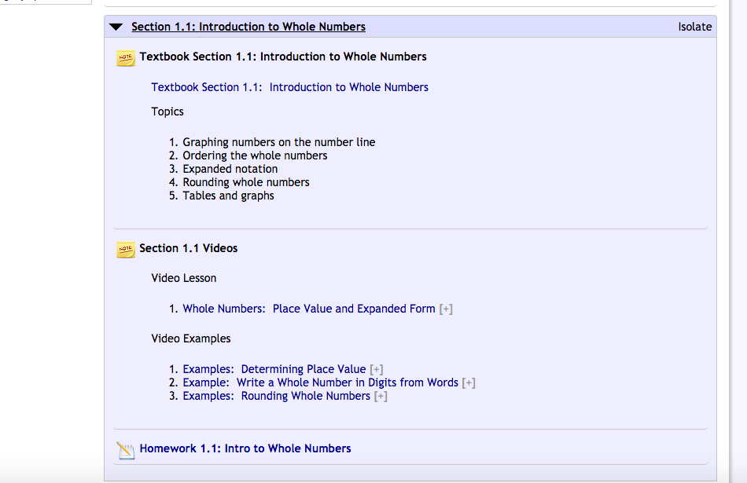
Sample course lesson
Each chapter has multiple sections with videos, practice problems, and a homework assignment.

Slide 7
Why Myopenmath?
Open Source Software (MyOpenMath)
Paid Software (i.e- MyMathLab)
MyOpenMath is a completely free and open source software and free textbooks
Curriculum for the paid and open software are nearly identical
MyOpenMath gives the instructor the option to edit lesson plans instead of all material being included
For profit math software costs on average $120 per student
For profit textbook costs approximately $150 each
Therefore:
Saves the student nearly $300 per semester = Saves schools approximately $5000 per class per semester

