Slide 1

自动化 Web Service
--介绍
SF系统管理部

Slide 2

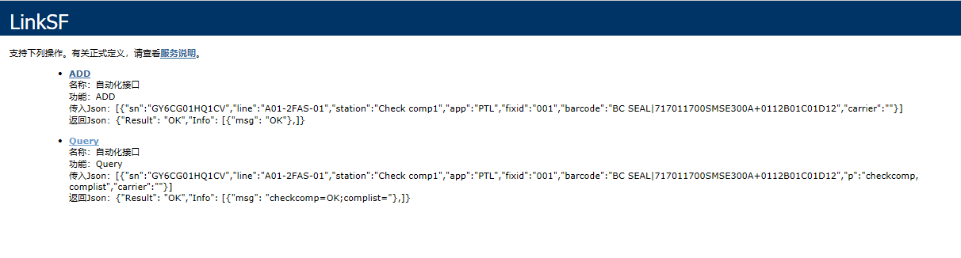
Webservice
SUB段: http://10.55.4.100/Automation_Sub/LinkSF.asmx
组装\镭射\包装段: http://10.55.4.100/Automation/LinkSF.asmx
Query: 用于自动化设备向MES获取数据(check逻辑)
ADD: 用于自动化设备向MES传送数据（过站）

Slide 3
Query传入与输出
传入：[{"sn":"GY6CG01HQ1CV","line":"A01-2FAS-01","station":"Check comp1","app":"PTL","fixid":"001","barcode":"BC SEAL|717011700SMSE300A+0112B01C01D12","p":"checkcomp, complist","carrier":""}]
输出：{"Result": "OK","Info": [{"msg": "checkcomp=OK;complist="},]}
备注：输出的msg里有多少信息取决于传入的P参数，传入有多少个P参数，输出的msg里就会有多少个值

Slide 4
ADD传入与输出
传入：[{"sn":"GY6CG01HQ1CV","line":"A01-2FAS-01","station":"Check comp1","app":"PTL","fixid":"001","barcode":"BC SEAL|717011700SMSE300A+0112B01C01D12","carrier":""}]
输出：{"Result": "OK","Info": [{"msg": "OK"},]}
备注：输出的Result会有OK/NG，Result就OK表示正常完成，Result是NG的表示异常，此时msg里会显示异常信息

Slide 5
Webservice
参数 | 重要 | 示例 | 说明
c | 必传 | c=QUERY | ADD或QUERY
sn | 必传 | sn=F9W2222J28MLKKH22 | ADD为主序号，Query可为主序号及材料序号
barcode | 必传 | barcode=H0001,btn11111 | 格式：材料序号1,材料序号2，如果不link材料只过站即传NA
line | 必传 | Line=A1_2F_HSG_01 | 按实际线传送
station | 必传 | station=Link BTN holder | 按实际站别
app | 必传 | app=PTL或者app=PQC | Link材料站传PTL，不link过站PQC，Laser镭雕
fixid | 必传 | fixid=ict_001 | 实际机台ID
errcode | 不良代码 | Errcode=PASS | PQC过站使用
carrier | Add时必传 | carrier=carrier001 | 有link carrier，传carrier序号，不link传空值，checkcarrier检查治具有无维护
p | Query时必传 | p=model,pn | 如下面P值列表（多个参数用，隔开）

Slide 6
Webservice
P值
sn
Model：机种
wo
PN；GB料号
stage
config
Checkrouting:检查流程
Labeltemplate：pack模版
bcm
hous
spacer
region
cust_pn
bezel_color：颜色
Country国别
BCM_Artwork
mod
moped
Usb_mac_address
Udid
Device_ID
BB_SNUM
IMEI
Ecid
Wifi_mac_address
bt_mac_address
BC_ANT
sensorflex
rxcoilsn
checkhold
checkComp：检查bom
Complist：返回材料特征码
LaserTemplate：镭雕模版
Checkcarrier：检查治具是否维护

Slide 7
P参数
P可带多个参数“,”隔开。
PC-SF:
[{“sn”:“FGR22222222N7GG222223”,“line”:“A01-2FT-02”,“station”:“Link NA flex”,“app”:“PTL”,“fixid”:“001”,“barcode”:“N FLEX|C4512312312PPKX12”,“p”:“checkcomp,checkrounting,complist,wo,pn","carrier":"LA1AC-AME-P2-2516&OL00013011"}]
SF-PC:
返回材料特征码，工单号，GB料号
{"Result": "OK","Info": [{"msg": "config=CS-R12b-f;wo=TESTBCM-A-002;complist=121-0000Z0-104H|N FLEX|0|C45********PPKX**,121-0000Z0-104H|N FLEX|0|C46********PKFG**;pn=L00WS207-CS-H-BCM"},]}

Slide 8
FCM可用SN:
MODEL | LINE | WO | SN | STATION
LA1D | BU18-NFA03 | FJ909-M200428-0131 | GQ101630026N8XGJE+E1A29VG64FBA031AFB2+GGH011101CLMQ404JQGB+0031314R9333312CT62000000000000000000+QGBFB2 | Shadowgraph-pre
LA1D | BU18-NFA03 | FJ909-M200428-0131 | GQ10163000MN8XGJ5+E1G49VG64FBA031AFB2+GGH0111001TMQ404BQGB+002435LW9333312CT62000000000000000000+QGBFB2 | Shadowgraph-pre

Slide 9
示例：checkrouting
Checkrouting检查流程是否正确，返回参数：checkrouting=ok，表示流程正确，否则流程错误。
PC-SF:
[{"sn":"GQ1015500DKN8XFJ4+E1J49VG64JAA031AFD1+GGH0096008TN1W244QXA+0015109M9341212OT22000000000000000000+QXAFD1","line":"BU18-NFA03","station":"Link Montblanc","app":"PTL","fixid":"atuomation","barcode":"MONTBLANC|GTT09876546NRD800","p":"checkrouting","carrier":"001"}]
SF-PC:
流程正确：
{"Result": "OK","Info": [{"msg": "checkrouting=OK"},]}

Slide 10
示例：checkcomp
checkcomp检查需要link材料的特征码是否正确，返回参数：checkcomp=ok，表示该材料特征码正确可link，否则不能link。
PC-SF:
[{"sn":"GQ1015500DKN8XFJ4+E1J49VG64JAA031AFD1+GGH0096008TN1W244QXA+0015109M9341212OT22000000000000000000+QXAFD1","line":"BU18-NFA03","station":"Link Montblanc","app":"PTL","fixid":"atuomation","barcode":"MONTBLANC|GTT09876546NRD800","p":"checkcomp","carrier":"001"}]
SF-PC:
该材料可用正常使用：
{"Result": "OK","Info": [{"msg": "checkcomp=OK"},]}

Slide 11
示例：checkcarrier
checkcarrier检查治具是否正确，系统是否维护，正确返回参数： checkcarrier=OK,不需要link治具:carrier=“”
PC-SF:
[{"sn":"","line":"","station":"","app":"PTL","fixid":"","barcode":"","p":"checkcarrier","carrier":"001"}]
SF-PC:
该治具可用正常使用：
{"Result": "OK","Info": [{"msg": "checkcarrier=OK"},]}

Slide 12
Webservice 报错信息List
1.line error(线体缺失,不正确)：
实例(线体缺失): Query
[{"sn":"GQ1015500DKN8XFJ4+E1J49VG64JAA031AFD1+GGH0096008TN1W244QXA+0015109M9341212OT22000000000000000000+QXAFD1","line":"BU18-NFA01","station":"Link Montblanc","app":"PTL","fixid":"atuomation","barcode":"MONTBLANC|GTT09876546NRD800","p":"checkrouting","carrier":"001"}]
结果:
{"Result": "OK","Info": [{"msg": "checkcarrier=OK;checkrouting=checkRouting NG:Routing Instance information not found"},]}
2.station error(制程名缺失,大小写,空格):
实例(制程大小写): Query
[{"sn":"GQ1015500DKN8XFJ4+E1J49VG64JAA031AFD1+GGH0096008TN1W244QXA+0015109M9341212OT22000000000000000000+QXAFD1","line":"BU18-NFA03","station":"Link montblanc","app":"PTL","fixid":"atuomation","barcode":"MONTBLANC|GTT09876546NRD800","p":"checkrouting","carrier":"001"}]
结果:
{"Result": "OK","Info": [{"msg": "checkcarrier=OK;checkrouting=checkRouting NG:Routing outstation information not found"},]}

Slide 13
Webservice 报错信息List
3.sn error（SN长度异常）：
实例(SN长度异常): Query [{"sn":"GQ1015500DKN8XFJ4+E1J49VG64JAA031AFD1+GGH0096008TN1W244QXA+0015109M9341212OT22000000000000000000+QXAFD","line":"BU18-NFA03","station":"Link Montblanc","app":"PTL","fixid":"atuomation","barcode":"MONTBLANC|GTT09876546NRD800","p":"checkrouting","carrier":"001"}]
结果:
{"Result": "OK","Info": [{"msg": "checkcarrier=OK; checkrouting=checkRouting NG:Routing Instance information not found"},]}
4.station 不在此站（SN流程异常）:
实例(SN流程异常): Query
[{"sn":"GQ1015500DKN8XFJ4+E1J49VG64JAA031AFD1+GGH0096008TN1W244QXA+0015109M9341212OT22000000000000000000+QXAFD1","line":"BU18-NFA03","station":"Shadowgraph-pre","app":"PTL","fixid":"atuomation","barcode":"MONTBLANC|GTT09876546NRD800","p":"checkrouting","carrier":"001"}]
结果:
{"Result": "OK","Info": [{"msg": "checkrouting=From:Link Montblanc---To:Assemble Montblanc to Display"},]}

Slide 14
Webservice 报错信息List
5.carrier error（治具未维护,刷错carrier sn）：
实例(治具未维护): Query
[{"sn":"GQ1015500DKN8XFJ4+E1J49VG64JAA031AFD1+GGH0096008TN1W244QXA+0015109M9341212OT22000000000000000000+QXAFD1","line":"BU18-NFA03","station":"Link Montblanc","app":"PTL","fixid":"atuomation","barcode":"MONTBLANC|GTT09876546NRD800","p":"checkrouting,checkcarrier","carrier":"00001"}]
结果:
{"Result": "OK","Info": [{"msg": "checkcarrier=NG;checkrouting=OK"},]}
6.kpsn error（link材料sn异常，检查kpsn与工单bom维护是否一致，可用complist to query）:
实例(link材料sn异常): Query
[{"sn":"GQ1015500DKN8XFJ4+E1J49VG64JAA031AFD1+GGH0096008TN1W244QXA+0015109M9341212OT22000000000000000000+QXAFD1","line":"BU18-NFA03","station":"Link Montblanc","app":"PTL","fixid":"atuomation","barcode":"MONTBLANC|GTT0987654","p":"checkrouting,checkcarrier,checkcomp","carrier":"001"}]
结果:
{"Result": "OK","Info": [{"msg": "checkcarrier=OK;checkrouting=OK;checkcomp=序号:GTT0987654,没有定义相应规则的特殊码"},]}

Slide 15
Webservice 报错信息List
7.kpsn 已被使用过（KPSN重复使用）:
实例(KPSN重复使用): Query
[{"sn":"GQ1015500DKN8XFJ4+E1J49VG64JAA031AFD1+GGH0096008TN1W244QXA+0015109M9341212OT22000000000000000000+QXAFD1
","line":"BU18-NFA03","station":"Link Montblanc","app":"PTL","fixid":"atuomation","barcode":"MONTBLANC|GTT0083Q31LNRD823","p":"checkrouting,checkcarrier,checkcomp","carrier":"001"}]
结果:
{"Result": "OK","Info": [{"msg": "checkcarrier=OK;checkcomp=序号:GTT0083Q31LNRD823,已经被使用过，不能重复使用!;checkrouting=OK"},]}
8. 在不需要Link材料的站位link材料
实例(站位不需要link材料): ADD
[{"sn":"GQ1015500GTN8XFJM+E1E69VG64AAA031AFD1+GGH009600HBN1W24TQXA+001413BD9341212OT22000000000000000000+QXAFD1","line":"BU18-NFA03","station":"Montblanc/Touch/ZIF MSMT","app":"PTL","fixid":"atuomation","barcode":"N FLEX|CR109878906PKFG01","p":"checkrouting,checkcomp","carrier":"001"}]
结果:
{"Result": "NG","Info": [{"msg": "没有维护SUB_PTL_Group,请联系运维"},]}

Slide 16
Webservice 报错信息List
9.SN 已link 过kpsn（此站主SN已经link过kpsn，不能在重复link）:
实例(主SN已经Link过材料): ADD
[{"sn":"BYD88888888PYR4666604","line":"BU18-NBA03","station":"Link NA flex","app":"PTL","fixid":"atuomation","barcode":"N FLEX|CR109878906PKFG01","p":"","carrier":"001"}]
结果:
{"Result“:"NG","Info“:[{"msg“:"ORA-00001违反唯一约束条件 (SHOPFLOOR.PK_PTL_AUTOLINKMATERIAL_COMP)"},]}
10.参数格式错误（Query时上传json格式不对）:
实例(此实例缺少中括号): Query
{"sn":"GQ1015500GTN8XFJM+E1E69VG64AAA031AFD1+GGH009600HBN1W24TQXA+001413BD9341212OT22000000000000000000+QXAFD1","line":"BU18-NFA03","station":"Assemble spring finger to FCM","app":"PQC","fixid":"atuomation","barcode":"N FLEX|CR109878906PKFG01","p":"checkrouting","carrier":"001"}
结果:
{"Result": "NG","Info": [{"msg": "在位置 0 处没有任何行。"},]}

Slide 17
Webservice 报错信息List
11.SN不存在(SN缺失,未投入工单)
实例(SN缺失): ADD
[{"sn":"GQ1015500GTN8XFJM+E1E69VG64AAA031AFD1+GGH009600HBN1W24TQXA+001413BD9341212OT22000000000000000000+QXAFD","line":"BU18-NFA03","station":"Assemble spring finger to FCM","app":"PQC","fixid":"atuomation","barcode":"N FLEX|CR109878906PKFG01","p":"checkrouting","carrier":"001"}]
结果:
{"Result": "NG","Info": [{"msg": "SN is not exist!"},]}
12. 缺少errorcode
实例(缺少errorcode): ADD
[{"sn":"GQ1015500GTN8XFJM+E1E69VG64AAA031AFD1+GGH009600HBN1W24TQXA+001413BD9341212OT22000000000000000000+QXAFD1","line":"BU18-NFA03","station":"Montblanc/Touch/ZIF MSMT","app":"PQC","fixid":"atuomation","barcode":"","p":"checkrouting","carrier":"001"}]
结果:
{"Result": "NG","Info": [{"msg": "不良代码不能为空"},]}

Slide 18

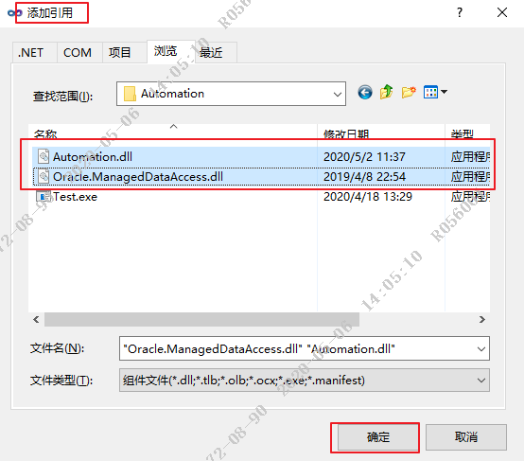
Dll和Webservice俩种（按引用方式区分）
添加引用（dll）

Slide 19
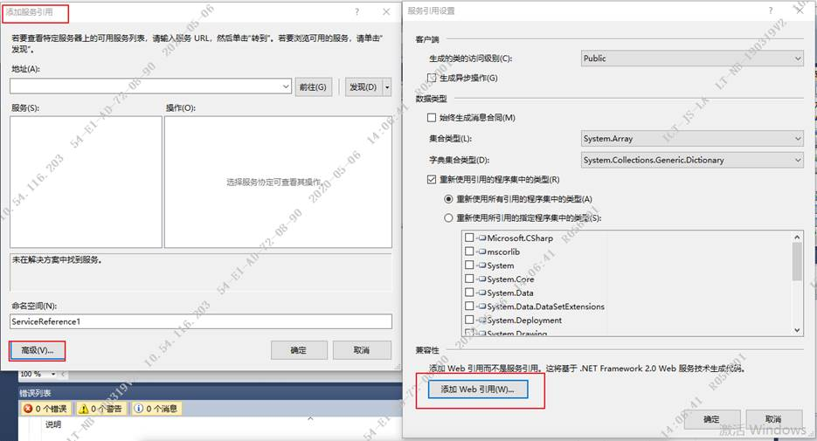
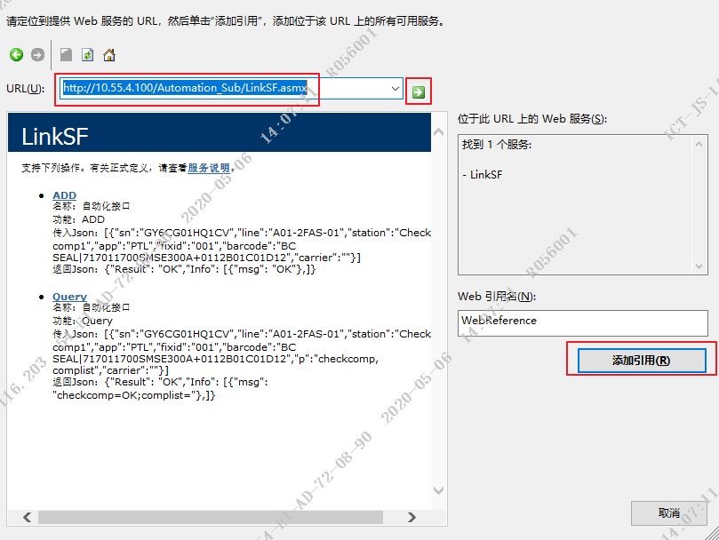
Dll和Webservice俩种（按引用方式区分）
服务引用（Webservice）
LinkSF sf = new LinkSF()
String result = sf.Query(json);
If(){
}
else{
}

Slide 20
谢谢

