Slide 1






Welcome back, user!
ANALYTICS
Tech Diversity: Race
Tech Diversity: Gender
Pay GAP By Job: 2017
Pay GAP By: 1997-2017
AI Influence in Students

Slide 2

Welcome back, user!
ANALYTICS
Tech Diversity: Race
Tech Diversity: Gender
CHARTS TO BE ADDED HERE!
Pay GAP By Job: 2017
Pay GAP By: 1997-2017
AI Influence in Students

Slide 3
Welcome back, user!
ANALYTICS
Tech Diversity: Race
Tech Diversity: Gender
Pay GAP By Job: 2017
Pay GAP By: 1997-2017
AI Influence in Students

Slide 4
Color Pallete
Regular
Color Name: Gainsbora
HEX: # DCDCDC
Color Name: Dark Cerulean
HEX: # 075293
Color Name: Alizarin
HEX: # DF1E37
Color Name: Black
HEX: # 000000
Color blind-friendly
Color Name: Loblolly
HEX: # B2BEB5
Color Name: Dark Cyan
HEX: # 007C91
Color Name: Permisimmon
HEX: # E66100
Color Name: Black
HEX: # 000000
Source: https://www.color-blindness.com/color-name-hue/

Slide 5
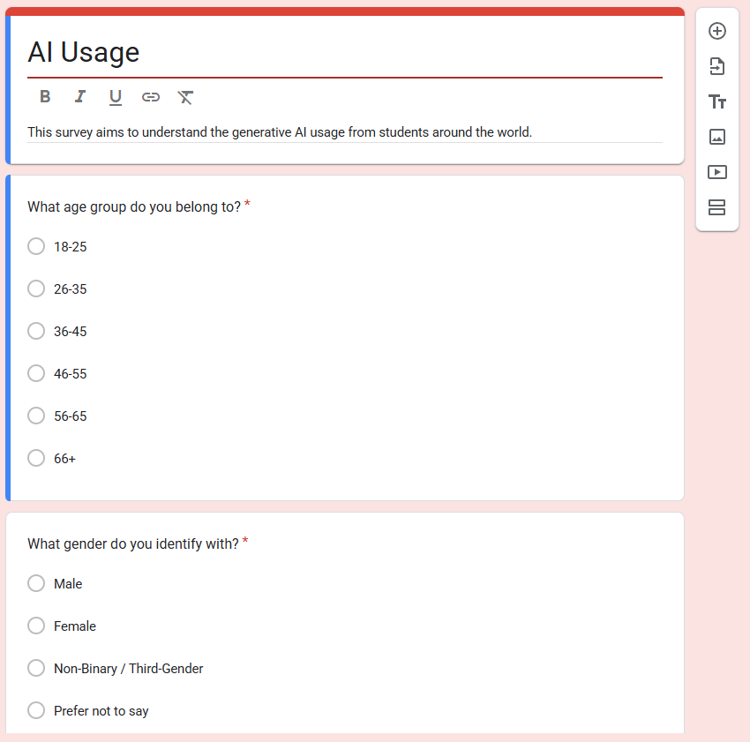
https://docs.google.com/forms/d/1mBRRFumyUNFU5tKt7iPgUIBBuC6FjxJDEgQB-A-M5sA/viewform?edit_requested=true

Slide 6
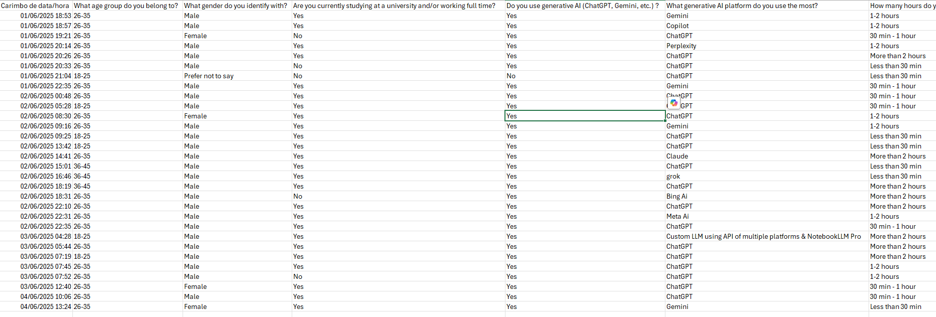

Slide 7




MOSCOW METHOD
TECH DIVERSITY RACE
Must
Should
Adequate charts into new canvas design (add off set variable)
Resize charts due to new canvas design
Duplicate pie charts and drop down menu (one for each)
Personalized colours to improve readability
Haven’t
Could
Add functionality to compare more than 2 companies
Smooth transition in the pie chart visual when changing companies

Slide 8




STRENGHTS
WEAKNESSES
Allows to compare side by side two companise at the same time
Better colors to visualization
Modularized code (create constructor in pay-gap-1997-2017.js and calls it in sketch)
Size of the pie chart could prejudice user readability
S
w
High complexity to zoom it, needs to check p5 documentation
Add zoom option (if left button clicked, zoom it)
T
O
THREATS
OPPORTUNITIES

Slide 9
MOSCOW METHOD
TECH DIVERSITY GENDER
Must
Should
Adequate charts into new canvas design (add off set variable)
Resize chart and allocate it into the left part of the canvas
Add legend while the user hover the mouse in each bar
Add mean values by gender into the right
Personalized colours to improve readability and to match with colour palette
Haven’t
Could
Support for more than 2 genders for inclusion
Change chart type to stacked columns to better fit in Canvas (better fit since the canvas will be splitted into two)

Slide 10
STRENGHTS
WEAKNESSES
Clear visual structure
Easy interaction infraestructure and good readability
Good styling
Static layout and limited responses (hard coded margins using x and y offset
Binary gender limitation
S
w
Limited scalability
Exclusion risks due gender
Framework limitation since using p5.js (face constraints in enterprise level web applications)
Implement hover based legends and tooltips
Personalize color palette
Customize stacked columns to improve visualization
T
O
THREATS
OPPORTUNITIES

Slide 11
MOSCOW METHOD
PAY GAP
Must
Should
Adequate charts into new canvas design (add off set variable)
Add stacked bars for each gender per year
Add extra y axis with percentage from 0% to 100% (for stacked bars)
Hover in each bar with legend and percentage represented by that bar
Haven’t
Could
Support for more than 2 genres for inclusion
Select start and end year plus start and end month for deeper analysis, but requires month granularity in dataset
The chart bars gradually rise year by year when the user enters the page
Add slider to choose date

Slide 12
STRENGHTS
WEAKNESSES
Combine time series analysis with stacked bars to improve analysis
Adaptable plot
Lack of tooltip and zoom
Some hardcoded values for x and y offset
No legend
S
w
Lack of check if data comes early (if automatically ingested)
Add interactive legend
Add hover with numeric details
Add a slider to select date
T
O
THREATS
OPPORTUNITIES

Slide 13
MOSCOW METHOD
AI USAGE
Must
Should
Collect data from survey
Create a pie chart with frequency of “How often do you double-check AI-generated information for accuracy?”
Add button to select gender (male or female)
Personalized colours to improve readability
Haven’t
Could
Add functionality to compare both genders at the same time
Smooth transition in the pie chart visual when changing gender

Slide 14
STRENGHTS
WEAKNESSES
Good and easy readability since the number of quantitative values is 4
Could have less than 30 observations, so, statistically speaking, can’t inference using the central limit theorem
Not much observations to deep analytics
S
w
Smooth transition in the pie chart visual when changing gender
Population couldn’t answer the survey
Population could provide fake information
T
O
THREATS
OPPORTUNITIES

Slide 15
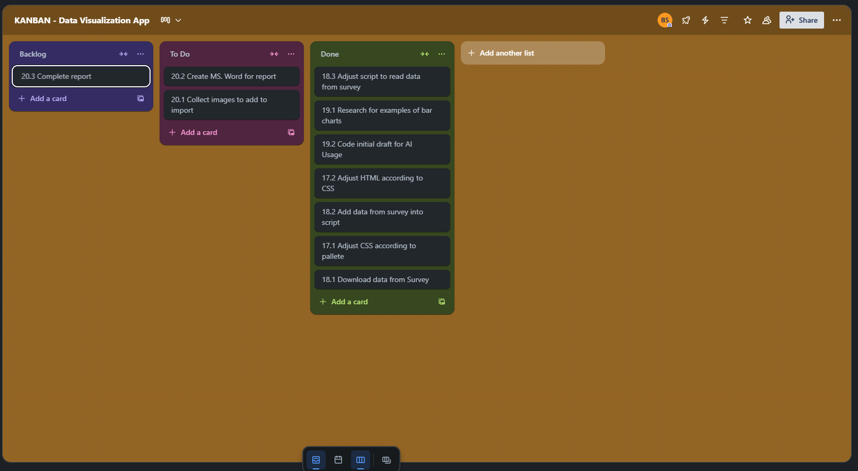

Slide 16
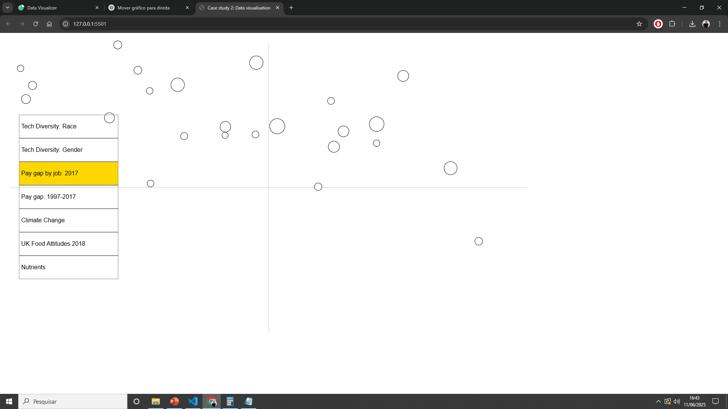

Slide 17
