Slide 1


Take Home Exercise
SR Data Analyst
Bruno Bucalon Serra

Slide 2

INDEX
Problem Definition
1.1 Dataset Attributes
1.2 Objective and Key Questions
1.3 Technologies and Programming Language
First Steps
Data GAP
3.1 Campaign ID
3.2 User ID
3.3 Nulls, NaNs and Missings
3.4 Wrong Campaign
3.5 Inconsistence in Window Number
3.6 Missing PK
3.7 N:N Relationship
3.8 Non Attributed Channel
4. Data Analysis
4.1 Valuable Users
4.2 Channels & Valuable Users
4.3 Convertion Rate
4.4 Recommendations
5. Recommendations

Slide 3
1. PROBLEM
DEFINITION

Slide 4
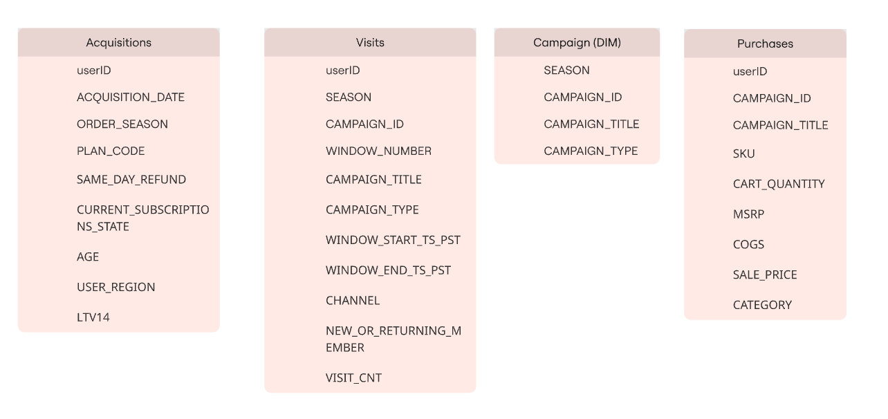
1. PROBLEM DEFINITION
1.1 DATASET ATTRIBUTES

Slide 5
1. PROBLEM DEFINITION
1.2 OBJECTIVES AND KEY QUESTIONS
Who are our most valuable members? How are they different from our less valuable members?
Which channels are best at driving these members to sales?
Where are purchase conversion rates strong?
Based on your analysis, provide actionable recommendations to improve the conversion rate from visits to purchases. Explain the rationale behind each recommendation.

Slide 6

1. PROBLEM DEFINITION
1.3 TECHNOLOGIES AND PROGRAMMING LANGUAGE
Environment using Anaconda
All analysis performed using Python
Used libraries: NumPy, Pandas, Matplotlib, Sklearn
Visual Studio Code used as IDE

Slide 7
2. FIRST STEPS

Slide 8
2. FIRST STEPS
DATA TYPES
Analyzed data types from all datasets and changed (if needed) their types
OUTLIERS
Used boxplots to understand the attributes with outliers and checked if they were real or system errors
COMPLETENESS AND UNIQUENESS
DATA TYPES
Checked the nulls, nans and missing values per attribute and the uniqueness for qualitative variables
DISTRIBUTIONS AND GENERAL STATISTICS
OUTLIERS
Checked the distributions, central tendency measures and other general statistics
COMPLETENESS AND UNIQUENESS
DISTRIBUTIONS AND GENERAL STATISTICS

Slide 9
3. DATA GAPS

Slide 10
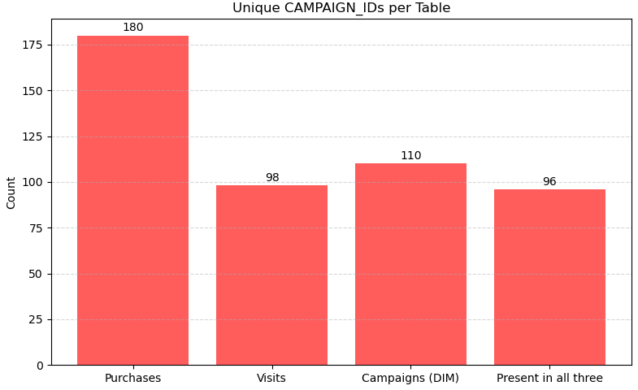
3. DATA GAP AND INCONSISTENCES
3.1 CAMPAIGN ID
INSIGHTS
Only 96 campaigns are available in the 3 datasets.

Slide 11
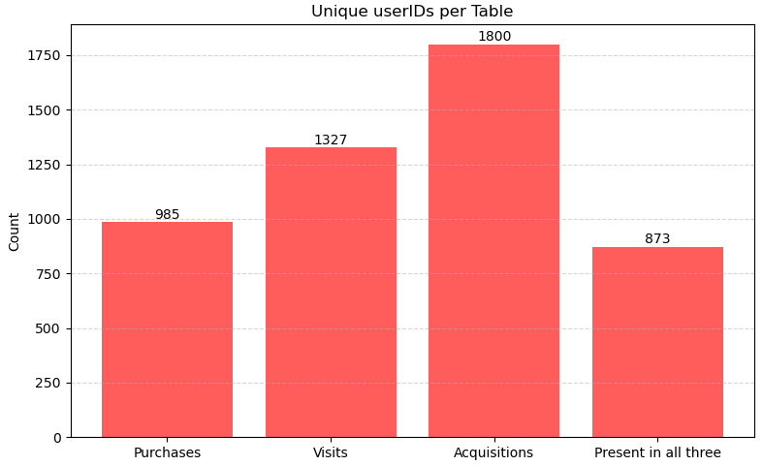
3. DATA GAP AND INCONSISTENCES
3.2 USER ID
INSIGHTS
Only 873 users are available in the 4 datasets.

Slide 12
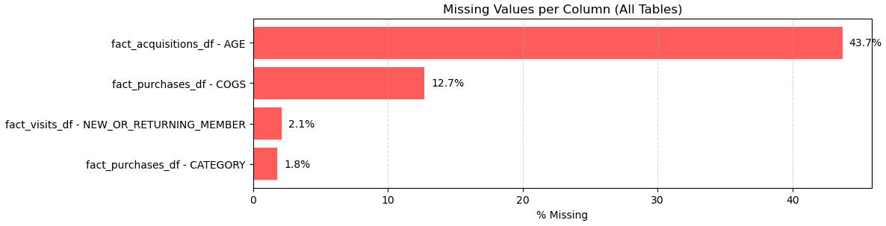
3. DATA GAP AND INCONSISTENCES
3.3 NULLS, NaNs and Missings
INSIGHTS
Ages has the higher quantity of Nulls, preventing its usage for deeper insights about users

Slide 13
3. DATA GAP AND INCONSISTENCES
3.4 MISSING PRIMARY KEY
Campaign 184 (12 Days of Deals 2022) has 12 different start and end dates.
Notes:
We can’t know which of the visit in fatct visits generated a convertion in the purshases, since there’re:
Different channels for the same user and campaign id
Different timestamps of campaign ids for each user
We can’t properly know from ‘where’ the user came that generated a convertion.
Composite Primary Key.

Slide 14
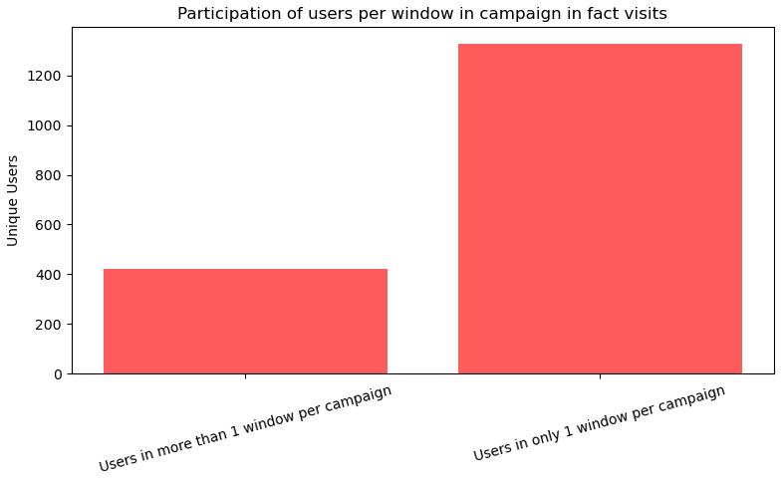
3. DATA GAP AND INCONSISTENCES
3.5 INCONSISTENCE WINDOW NUMBER
INSIGHTS
ASSUMPTION:
Subscription plan changed during campaign
Error in data ingestion
Notes:
We can’t know which of the visit in fatct visits generated a convertion in the purshases, since there’re:
Different channels for the same user and campaign id
Different timestamps of campaign ids for each user
We can’t properly know from ‘where’ the user came that generated a convertion.
Composite Primary Key.

Slide 15
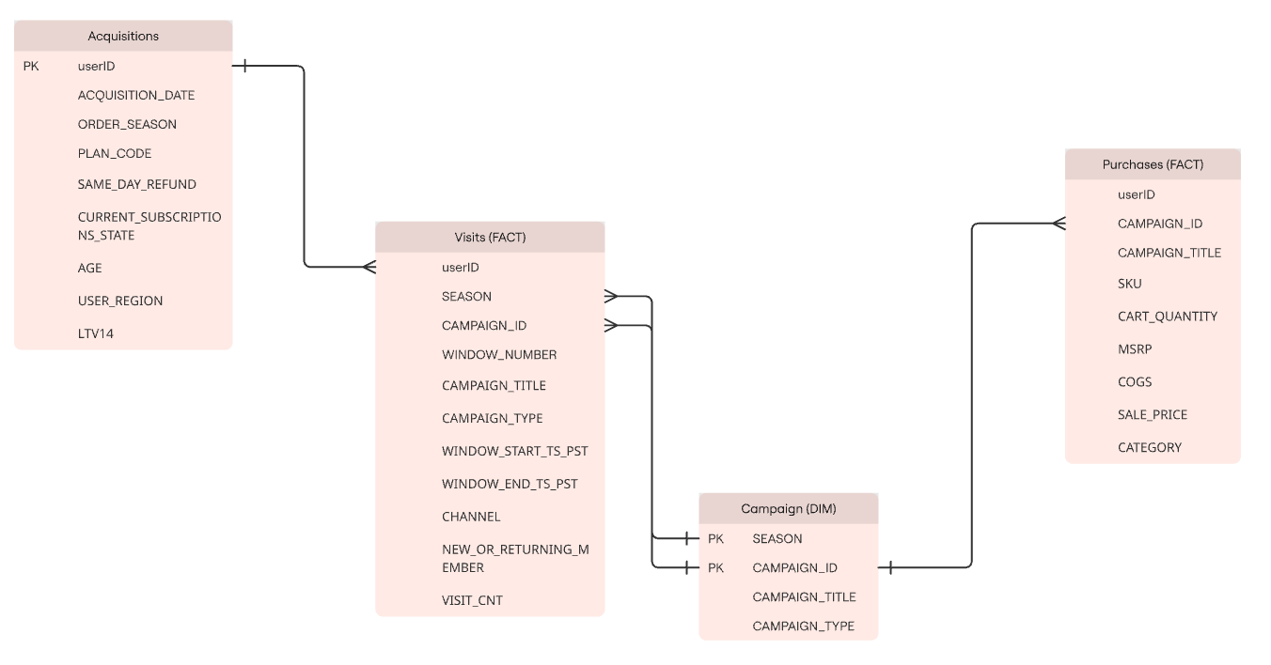
3. DATA GAP AND INCONSISTENCES
3.6 MISSING PRIMARY KEY
INSIGHTS
Relationship between Visits and Purchases table is N:N
No PK in Visits and Purchases
There’s no Window Number in Purchases, therefore there’s no way to identify which window it was converted
Notes:
We can’t know which of the visit in fatct visits generated a convertion in the purshases, since there’re:
Different channels for the same user and campaign id
Different timestamps of campaign ids for each user
We can’t properly know from ‘where’ the user came that generated a convertion.
Composite Primary Key.

Slide 16
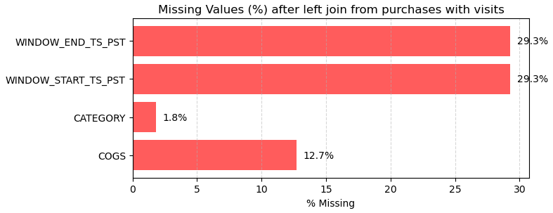
3. DATA GAP AND INCONSISTENCES
3.7 JOIN BETWEEN VISITS AND PURCHASES
INSIGHTS
By joining visits and purchases using User ID and Campaign ID, we’ll have a GAP of 29.3% of missing values for Window Start and Window End.
In addition, there’s no window number in purchases.

Slide 17
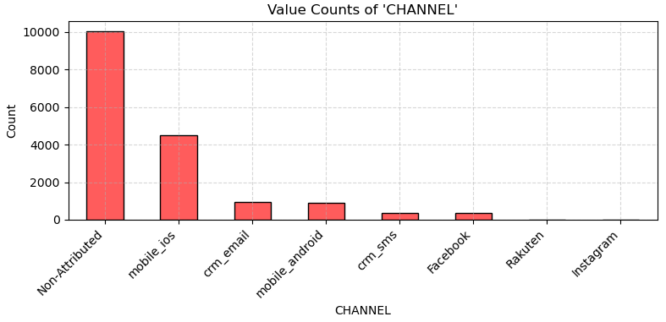
3. DATA GAP AND INCONSISTENCES
3.8 NON-ATTRIBUTED IN CHANNELS
INSIGHTS
Over 10000 rows with non attributed channel.

Slide 18
4. DATA ANALYSIS

Slide 19



4. DATA ANALYSIS
4.1 VALUEABLE USERS
A customer can only purchase an item if they have visit it
ANALYSIS ASSUMPTION
The date of the last visit of the customer for that specific campaign is the one they converted if available in purchases and visits
By performing this join, we kept 70.71% of the rows from Fact Purchases.
Notes:
WE WILL ASSUME THAT THE PURCHASE WERE DONE IN THE LAST VISIT FROM FACT VISITS.

Slide 20
4. DATA ANALYSIS
4.1 VALUEABLE USERS
Sort values by WINDOW_END_TS_PST and drop duplicates of userID and CAMPAIGN_ID
Inner join Fact Purchases with Fact Visits using of userID and CAMPAIGN_ID
Calculate TOTAL_REVENUE by performing CART_QUANTITY x SALE_PRICE
Final Table
Fact Purchases
Fact Visits
By performing this join:
Kept 70.71% of the rows from Fact Purchases
Kept 77.77% of the users from Fact Purchases
Kept 53.33% of the campaigns from Fact Purchases
Notes:
WE WILL ASSUME THAT THE PURCHASE WERE DONE IN THE LAST VISIT FROM FACT VISITS.

Slide 21




4. DATA ANALYSIS
4.1 VALUEABLE USERS
Frequency
Recency
How often or how many times the customer makes a purchase.
Used a time window¹ between:
2023-08-06 and 2024-08-06 per user.
How recently a customer made a purchase (in days).
Used a time window¹ between:
2023-08-06 and 2024-08-06 per user.
Monetary
How much money the customer has spent.
Used a time window¹ between:
2023-08-06 and 2024-08-06 per user.
Time window¹:
BETWEEN
MAX(WINDOW_END_TS_PST)
AND
MAX(WINDOW_END_TS_PST) - 1 YEAR

Slide 22




4. DATA ANALYSIS
4.1 VALUEABLE USERS
Weight
Assign each result a score from 1 to 4 based on quartile distribution: Recency -> lower, the better
Frequency & Monetary -> higher the better
Define Value
For score <5: Low Value
For score <9: Mid-Value
For Score >= 10: High-Value
Calculation
Calculate the general values for Recency, Frequency and Monetary per user
Score Result
Sum each result from Weight and find a final value of RFM per user

Slide 23
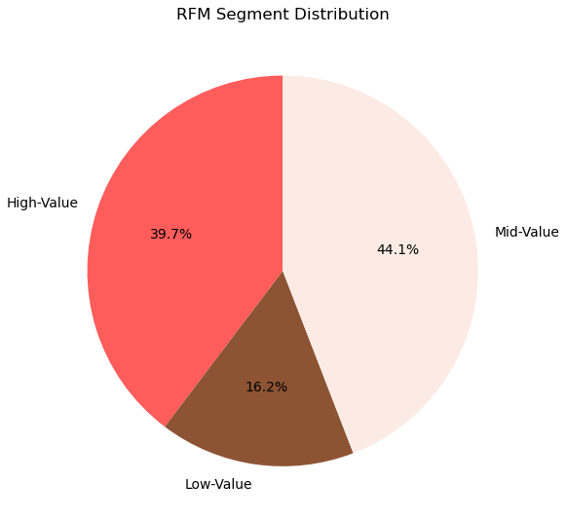

4. DATA ANALYSIS
4.1 VALUEABLE USERS
INSIGHTS
From 451 customers from 2023-08-06 to 2024-08-06:
39.7% have High Value
44.1% have Mid Value
16.2% have Low Value
Most valueble users represents 39.7%.
Notes:
They differ from each other:
* Higher value buyes frequently, high amount in a fewer period of time

Slide 24

4. DATA ANALYSIS
4.2 DIFFERENCE BETWEEN VALUEABLE USERS AND OTHER USERS
Create Features
Created features that could explain the difference between clusters, such as:
total cart quantity
total revenue
unique SKU count
Unique cat. Count
Total visits
Profit
average item price
total visits
Revenue per visit
Margin PCT
LTV14
Cluster
CORRELATION WITH RFM
Use unsupervised Machine Learning algorithm, K-Means, we need to find the value of K (clusters). Found k = 3 that better divided the clusters.
PRINCIPAL COMPONENT ANALYSIS
FEATURE IMPORTANCE
Correlation with RFM
FIND K
PCA
Perform the link between RFM classification with the clusters
Apply PCA to transform into 2D to visually understand the distribution
CREATE FEATURES
Feature Importance
Use supervised Machine Learning algorithm, Decision Tree, to understand the importance of each feature for the clusters

Slide 25
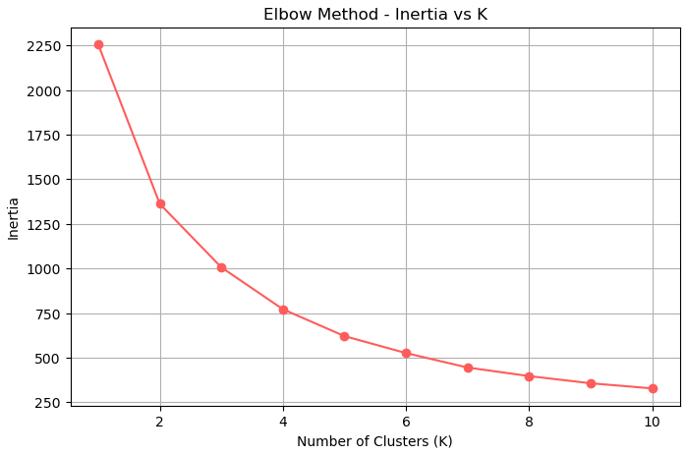
4. DATA ANALYSIS
4.2 DIFFERENCE BETWEEN VALUEABLE USERS AND OTHER USERS
Inertia stops to fall aggressively around k = 3~4.
We’ll choose 3.

Slide 26
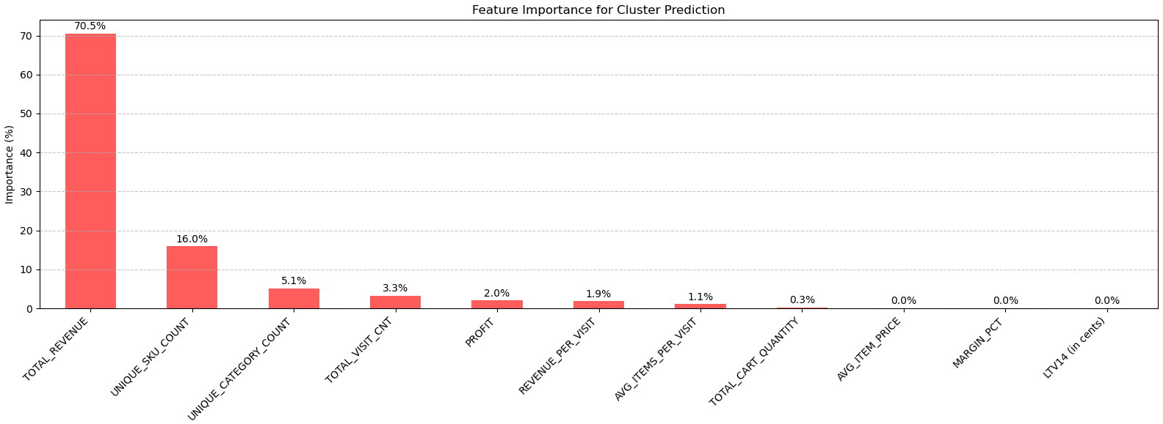
4. DATA ANALYSIS
4.2 DIFFERENCE BETWEEN VALUEABLE USERS AND OTHER USERS
Most of the features doesn’t represent much of the differences between clusters. Let’s create a threshold for over 3% to consider as an important feature
Notes:
CONSIDERING THE SUM OF ALL VISIT CNT BECAUSE IT’S PER YEAR!

Slide 27
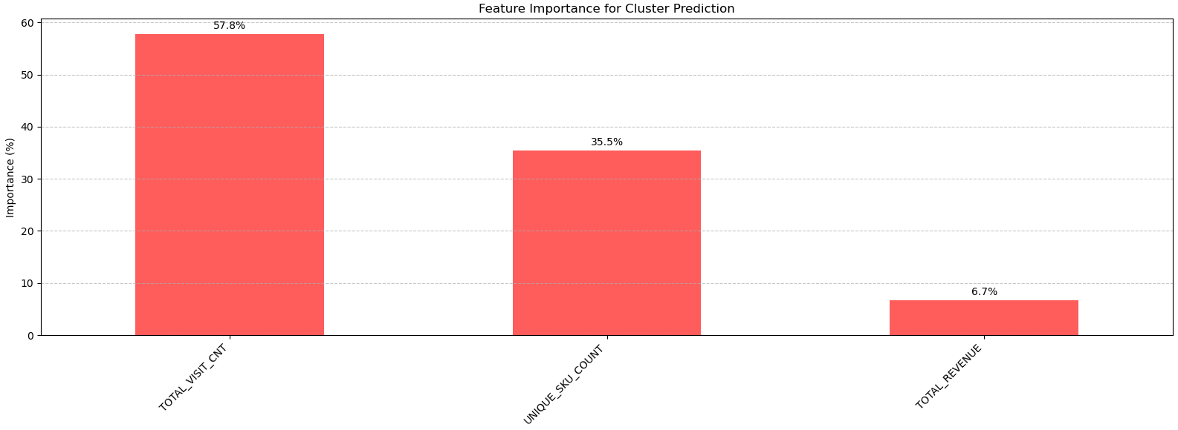
4. DATA ANALYSIS
4.2 DIFFERENCE BETWEEN VALUEABLE USERS AND OTHER USERS
Recalculated the new feature importances for the algorithm.
Total revenue is not the main attribute that best divides the cluster, it’s the visits and unique skus, meaning: DISCOVERABILITY (visits) and EXPLORABIILTY (unique skus)
Notes:
CONSIDERING THE SUM OF ALL VISIT CNT.

Slide 28
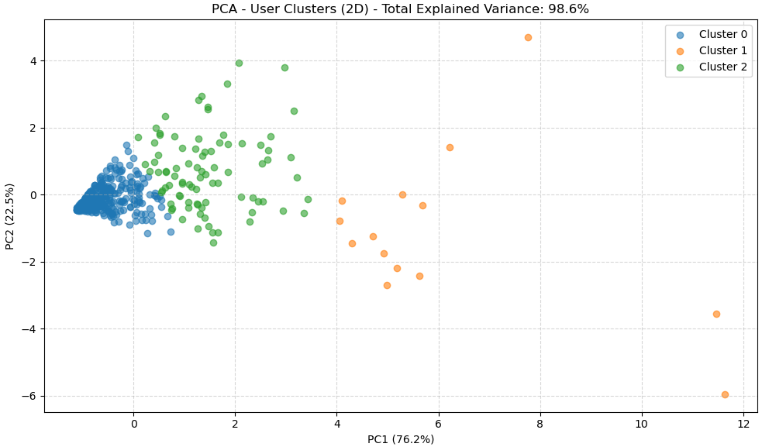
4. DATA ANALYSIS
4.2 DIFFERENCE BETWEEN VALUEABLE USERS AND OTHER USERS
INSIGHTS
Accumulated Variance: 98.6%

Slide 29
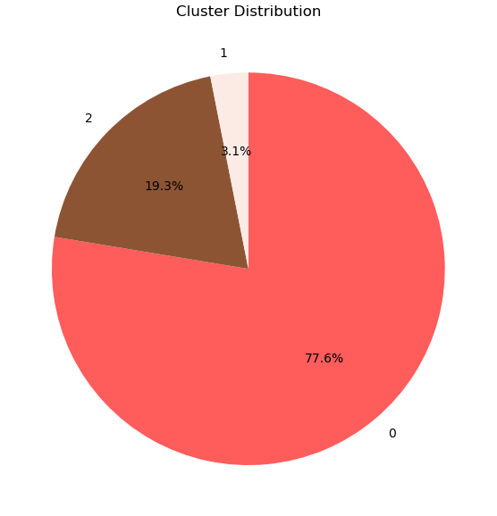
4. DATA ANALYSIS
4.2 DIFFERENCE BETWEEN VALUEABLE USERS AND OTHER USERS
From 451 customers from 2023-08-06 to 2024-08-06:
77.61% are in cluster 0
03.10% are in cluster 1
19.29% are in cluster 2
Notes:
Cluster 1 são os usuários de alto valor, Cluster 2 é o grupo intermediário, e Cluster 0 são os baixo valor.
Cluster 1 são os mais engajados recentemente, Cluster 0 estão inativos ou há muito tempo sem comprar.
Cluster 1 são clientes frequentes, Cluster 2 têm atividade moderada, Cluster 0 compraram poucas vezes.

Slide 30
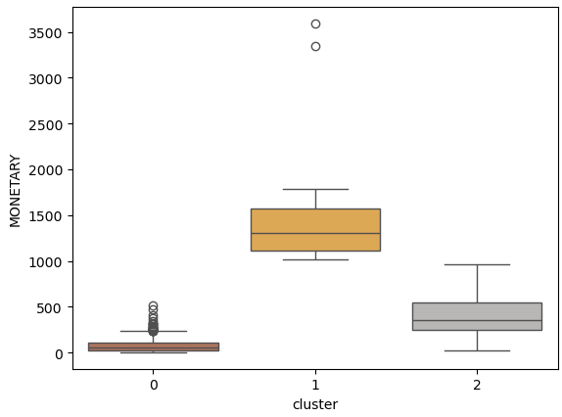
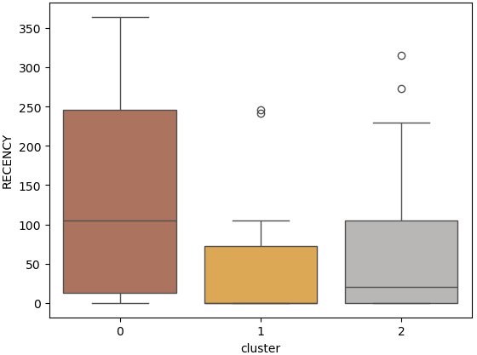
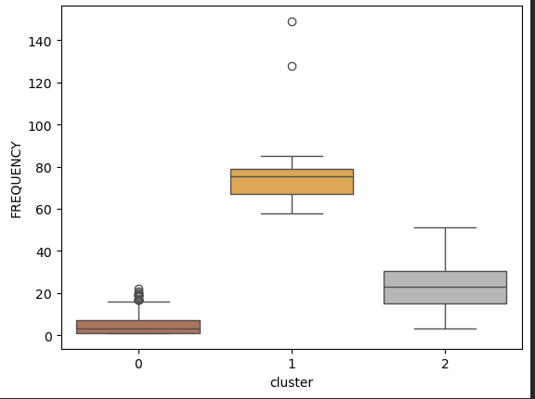
4. DATA ANALYSIS
4.2 DIFFERENCE BETWEEN VALUEABLE USERS AND OTHER USERS
Notes:
Cluster 1 são os usuários de alto valor, Cluster 2 é o grupo intermediário, e Cluster 0 são os baixo valor.
Cluster 1 são os mais engajados recentemente, Cluster 0 estão inativos ou há muito tempo sem comprar.
Cluster 1 são clientes frequentes, Cluster 2 têm atividade moderada, Cluster 0 compraram poucas vezes.

Slide 31
4. DATA ANALYSIS
4.2 DIFFERENCE BETWEEN VALUEABLE USERS AND OTHER USERS
CLUSTER | RFM SCORE | MEAN TOTAL REVENUE | MEAN UNIQUE SKU COUNT | MEAN VISIT CNT | % Of High Value Users | % Of Mid Value Users | % Of Low Value Users
0 | 6.65 | 81.10 | 4.92 | 11.24 | 25.71% | 20.86% | 53.43%
1 | 11.29 | 1599.75 | 79.07 | 52.93 | 100% | 0.00% | 0.00%
2 | 10.67 | 398.96 | 22.56 | 44.21 | 86.21% | 0.00% | 13.79%
Most valueble users are mainly in cluster 1. They differ from cart quantity, total revenue, unique skus and visits.

Slide 32
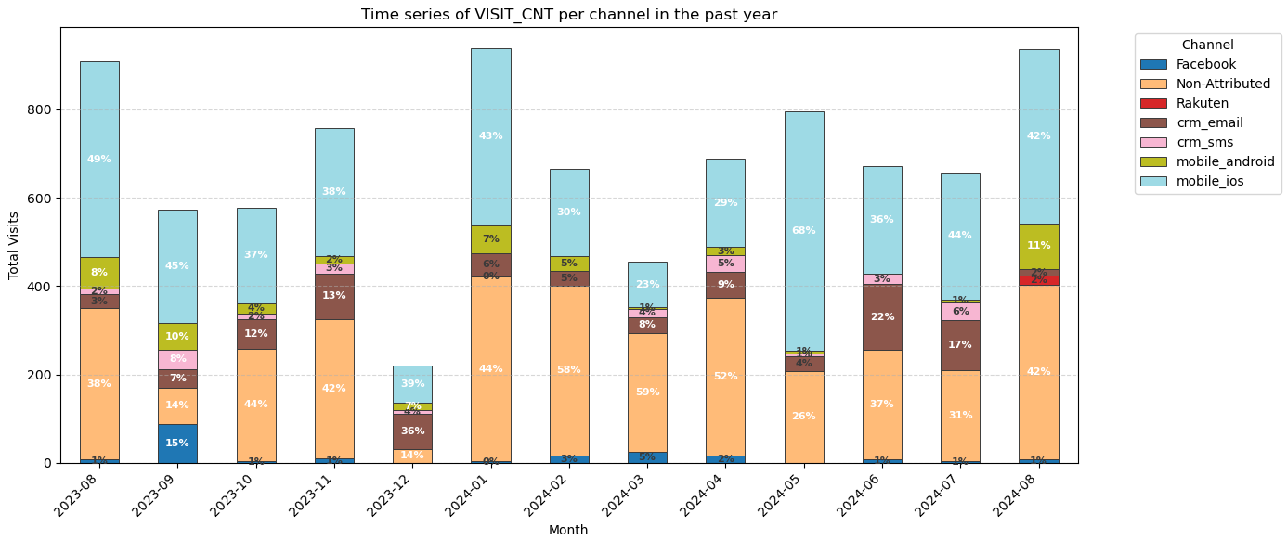
4. DATA ANALYSIS
4.2 CHANNELS – USING ONLY LAST VISIT
Notes:
Considering: - only the 451 users from before-
Only VISITS OF LAST CHANNEL (THE CONVERTED)

Slide 33
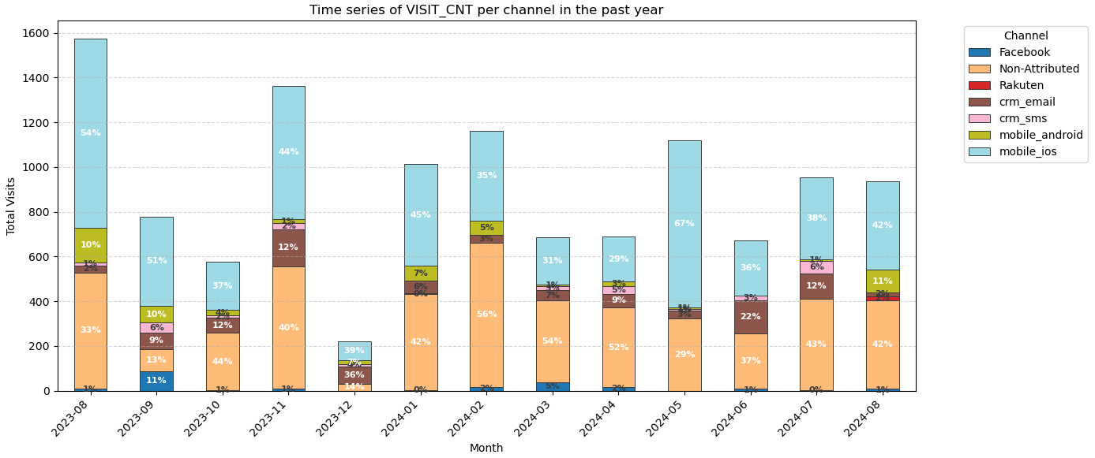
4. DATA ANALYSIS
4.2 CHANNELS – USING LAST VISIT + EQUAL CHANNELS PREVIOUSLY ACCESSED
Notes:
Considering: - only the 451 users from before-
COLLECTED THE CHANNEL OF THE LAST VISIT FOR EACH USER + CAMPAIGN ID, THAN IF THERE’S OTHER VISITS IN THE SAME CHANNEL, I SUMMED ALL THE VISIT CNT. EXAMPLE: facebook (visit cnt = 10), email (visit cnt = 5), facebook (visit cnt = 20), than, it will be 10 + 20 = 30 for this user / campaign id.

Slide 34
4. DATA ANALYSIS
4.2 CHANNELS
The channel that best drives these members to sales is Mobile IOS in all months.
* Considering time window of 1 year, same users and that the sum of visit cnt that has the same channel for each user + campaign.
Notes:
Considering: - only the 451 users from before-
COLLECTED THE CHANNEL OF THE LAST VISIT FOR EACH USER + CAMPAIGN ID, THAN IF THERE’S OTHER VISITS IN THE SAME CHANNEL, I SUMMED ALL THE VISIT CNT. EXAMPLE: facebook (visit cnt = 10), email (visit cnt = 5), facebook (visit cnt = 20), than, it will be 10 + 20 = 30 for this user / campaign id.

Slide 35
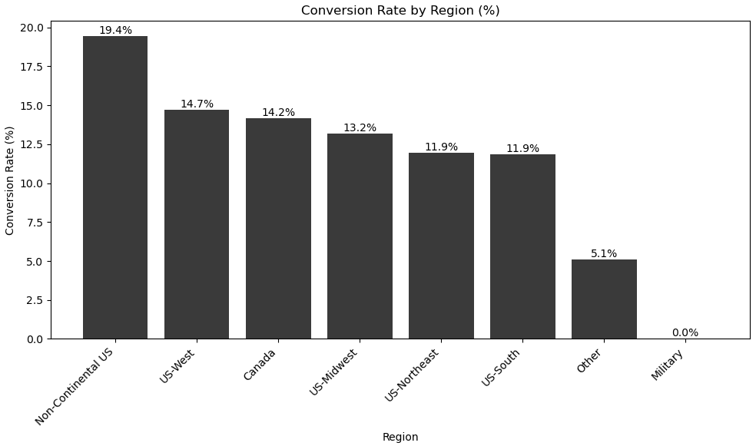
4. DATA ANALYSIS
4.3 STRONG CONVERTION RATE
The locations with a stronger convertion rates are, respectively: Non-continental us (19.4%), us-midwest (14.7%)
Notes:
Only visits that became a purchase (converted) -> CONSIDERING ONLY THE LAST VISIT CNT.

Slide 36
5. RECOMMENDATIONS

Slide 37


5. RECOMMENDATIONS
According to the RFM and K-Means, the focus should be on discoverability and explorability.
Personalized homepage* using machine learning models to reorder properly the SKUs according to users.
E.g. Algorithm: Matrix Factorization
* In e-commerce, homepage is mainly used to improve discoverability for users.

Slide 38
5. RECOMMENDATIONS
4.3 STRONG CONVERTION RATE
CLUSTER 0 (high volume, less convertion (REVENUE ÷ VISITS)):
Objective: focus on transform visits into purchases, than improve campaigns
Discounts in first purchases
Artificial urgency (“Promotion valid for an hour”, “Last unities on stock”)
CLUSTER 1 (small group, high convertion):
Objective: extract more value without pressure
Cross-sell in checkout (“Also take this item...”
Rewards for volumes (“Earn one extra product after buying 3”)
Faster checkout (reducing quantity of clicks, save preferences)
CLUSTER 2 (mid size group, mostly with high convertion):
Objective: convert more in the visits they already perform
Improve session (visit) performance (“Recently viewed” with easy click to buy button)
Reduce session (visit) pressure (highlight product rate, buy directly from home)

