Slide 1

WEB DEVELOPMENT
The presentation was developed using color-blind friendly palette.
Because everyone deserves to see all the details.

Slide 2
Index
1.

Slide 3
THE INTERNET

Slide 4

THE INTERNET
DEFINITION
What exactly is the internet?
The Internet is a global system of interconnected computer networks that communicate using the Transmission Control Protocol/Internet Protocol (TCP/IP) comprises the underlying physical infrastructure—such as fiber-optic cables, routers and switches.
(Comer, 2018; Kurose and Ross, 2021)
Notes:
IP (internet protocol) = is a protocol for addressing and routing data packets between devices accross the network, it acts like destination labels for data being sent. (Think of IP like a postal system—it sends envelopes to the correct address, but it doesn’t check if the recipient actually receives them.)
TCP (Transmission Control Protocol) = is on top of IP, it ensures the data to be properly delivered, in the proper order without loss. (If IP is the postal service, TCP is the person who checks whether each envelope was received, in the correct order, and asks for a resend if one is missing.
)

Slide 5
THE INTERNET
HISTORY
The entire story of the internet!
First public demonstration of ARPANET with 20 connected nodes. Still restricted to U.S. Military and approved academic institutions.
First protocol system came up: TCP (transmission control protocol) and IP (internet protocol). Standardizing communcation accross different networks
ARPA created a device that could manage the transmission and receipt of packets between machines.
Association of country domains, for example
“.uk”.
1968
1972
1974
1985
1957
1969
1973
1983
1989
In the Cold War, USA created ARPA (Advanced Resarch Projects Agency) to accelerate military technology. “Galactic Network” ideal came up
First computer-to-computer connection created (via wire). Packet switching came up. First between UCLA Stanford
UCL became the first non U.S. ARPANET node via link by Norway. First e-mail sent from UK.
ARPANET moved from TCP/IP, moreover splited into MILNET for military and ARPANET for research. ARPANET officialy adopted TCP/IP.
First commercial internet provider (ISP) launched in U.S.. World Wide Web (WWW) by Tim Berners-Lee, comming up with HTML, HTTP and URL’s.

Slide 6
THE WORLD WIDE WEB

Slide 7

THE WORLD WIDE WEB
What is World Wide Web?
The World Wide Web (WWW) is a system of interlinked hypertext documents and multimedia content that can be accessed via the Internet using a web browser.
(Berners-Lee et al., 1994; Kurose and Ross, 2021).
The term “web” comes from an idea of a network, a directed graph of documents connected by link, just like a spiderweb.
Notes:
Nowadays, most of the websites uses only HTTPS and search engines (such as Google) shows HTTPS websites in preference and warns the user if a website is using only HTTP.

Slide 8
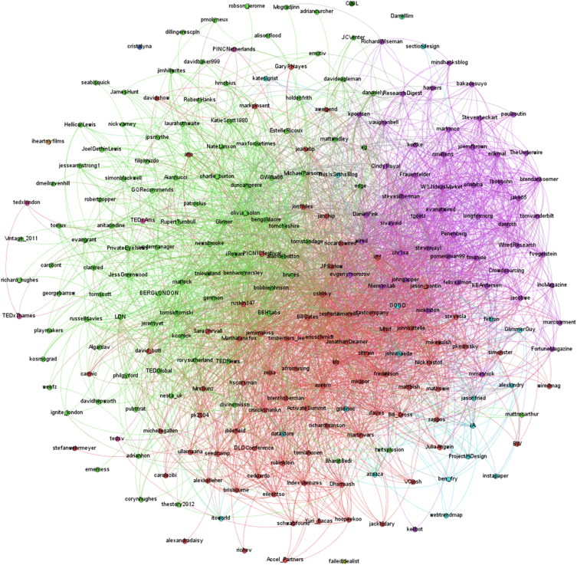
THE WORLD WIDE WEB
Each node represents a resource to access the URL.
While the directed edges represents the hyperlink that connect one or more resources to another.
Notes:
To access a URL, not necessarily you need a hiperlink, you can simply type the URL and you’ll reach the location. Therefore HTML is the base of the World Wide Web

Slide 9
THE WORLD WIDE WEB
Now, let’s dive into each of the technologies used in the World Wide Web.
Note... It’s not necessary to have all the three technologies for the World Wide Web, but it was created with those three.
Notes:
Nowadays, most of the websites uses only HTTPS and search engines (such as Google) shows HTTPS websites in preference and warns the user if a website is using only HTTP.

Slide 10
THE HTTP PROTOCOL

Slide 11
HYPER TEXT TRANSFER PROTOCOL (HTTP)
DEFINITION
What is HTTP?
It’s an application protocol created in 1989 by Tim Berners-Lee to enable communication between browser and servers. It follows a model of request-responde. It’s stateless, therefore it doesn’t keep information in each request. It uses 8080 port by default. It uses methods to read resources (GET), create resources (POST), etc. When typing the URLin a browser and enter in a site, a GET method is being done.
What about HTTPS?
The HTTPS (HyperText Transfer Protocol Secure) is a secure procotol of HTTP. The difference is that HTTPS adds encrypts via TLS (Transport Layer Security), ensuring:
Confidentiality.
Integrity.
Authenticity.
How the World Wide Web is connected to HTTP?
The World Wide Web uses the HTTP (currently, HTTPS) as the communication protocol. When you access a website, your browser sends an HTTP request to the server, and the server responds with the HTML document (e.g., JavaScript, CSS, HTML, image, etc.). It uses port 443 by default.

Slide 12
HYPER TEXT TRANSFER PROTOCOL (HTTP)
THE SECURITY PROBLEM
Why HTTP has security problems and HTTPS don’t?
The HTTPS uses the TCP (Transmission Control Protocol), ensuring data to arrive completed, ordered and not dupplicated. Then,
the TLS protocol (Transport Secure Layer) encrypts all data with a key to decript data, which only the server and client can calculate.
Notes:
HTTP uses the 8080 port (by default), and the requests from HTTP are always Plaintext (not encrypted) when sending data from your device usin
HTTP uses the 443. HTTPS IS ENCRYPTED BY TLS.
DNS = Domain Name System (DNS) is the Internet’s naming service that translates human-readable domain names into IP addresses used by computers to identify each other on the network (Mockapetris, 1987).
There’re two types of IP: IPv4 (32 bits, 4.3bi possible addresses (IPs)) and IPv6 (128 bits, 340 undecillion possible addresses (IPs)). The IPv6 was created because, if you think about it, every computer, TV, cellphone, etc., eventually 4.3bi wasn’t enough. For example, when connecting your cellphone to the internet, the modem provides a public or private IP, same goes for 3G/ 4G/5G. Public can be seen by anyone, private only you. The cellphone uses the public address from the modem to connect to the internet, therefore the ip from te cellphone is not shown.
You can discover an IP using ping -4 (or -6, depends if is IPv4 or IPv6) + website (without http or https)
WHEN ACCESSING FOR EXAMPLE GOOGLE.COM, the computer needs the IP from google and my IP.

Slide 13
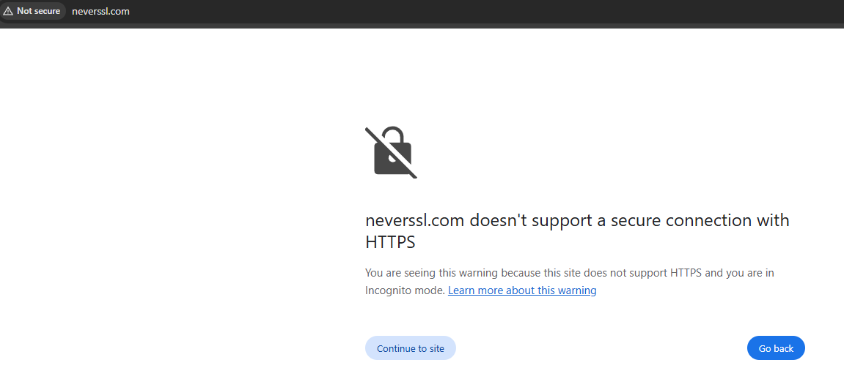
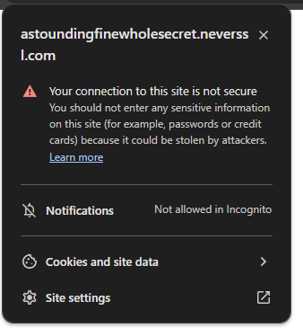
HYPER TEXT TRANSFER PROTOCOL (HTTP)
THE SECURITY PROBLEM
1
2
3
Check the website http://neverssl.com with HTTP protocol.
By accessing a not secure webpage, the browser:
Automatically warns the user about a not secure website
States the website doesn’t support HTTPS
Asks if the user wants to continue to the site

Slide 14
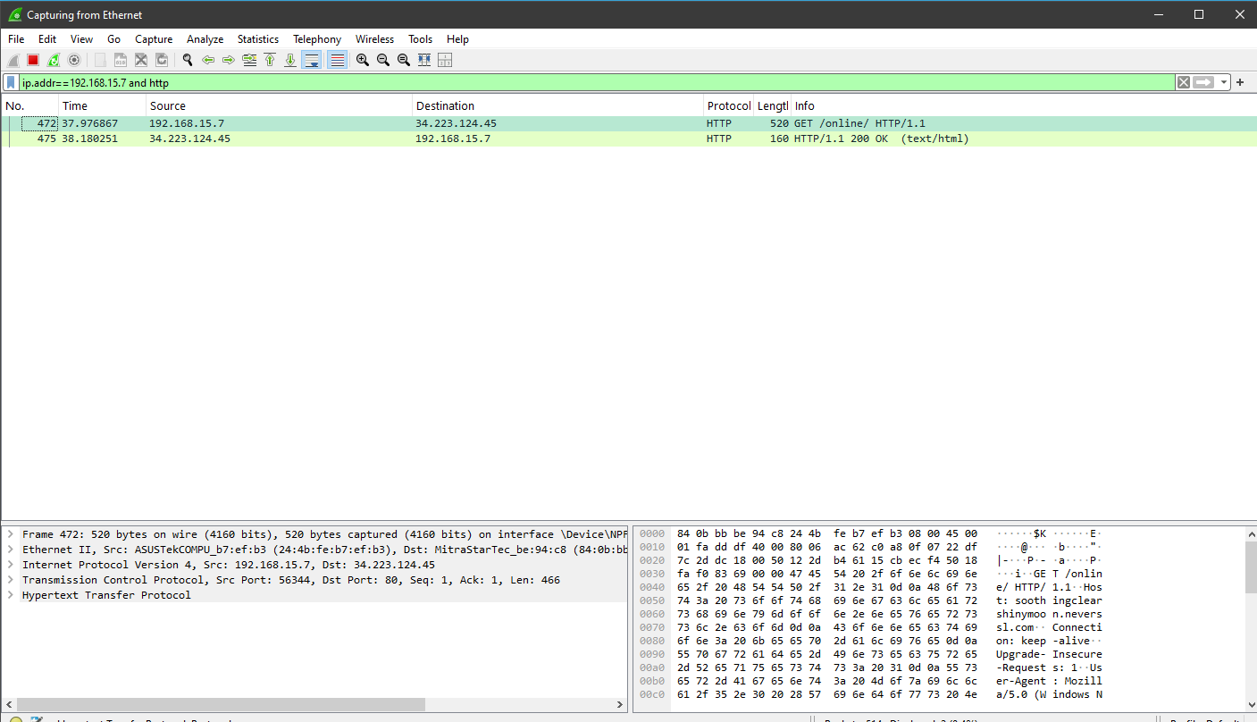
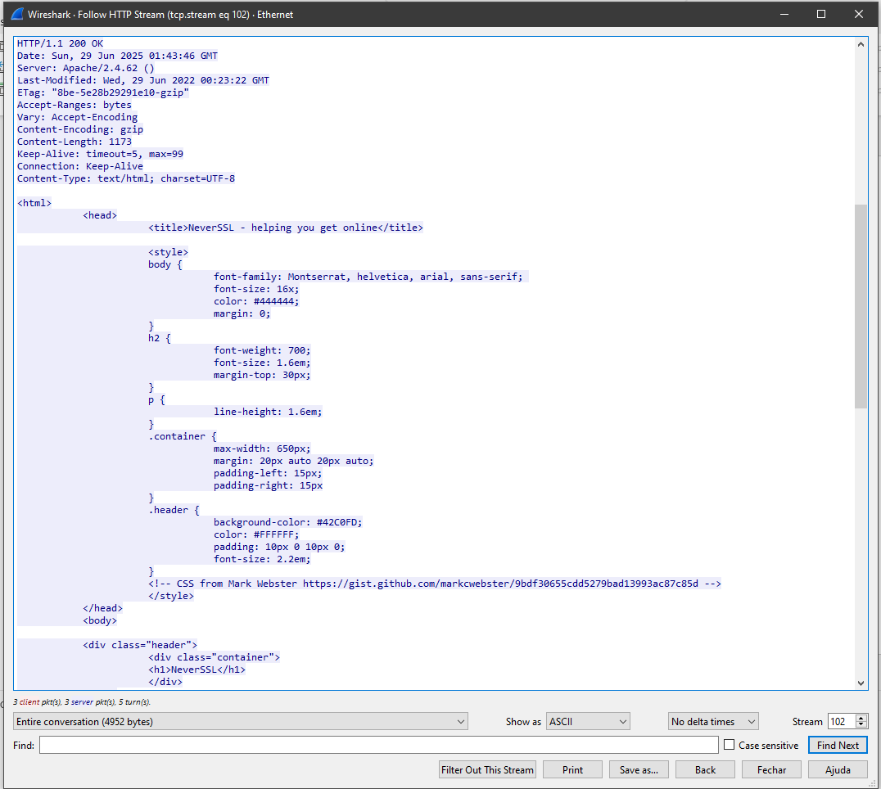
EXPERIMENTATION
THE SECURITY PROBLEM
Filtering the IP computer address and for HTTP.
All data from HTML can be seen here (even passwords!).

Slide 15
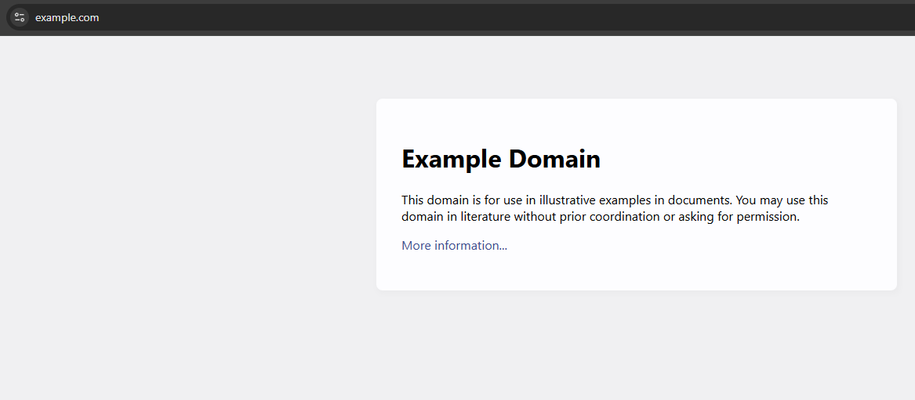
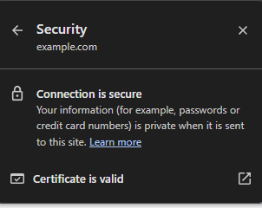
HYPER TEXT TRANSFER PROTOCOL (HTTP)
THE SECURITY PROBLEM
1
Check the website https://example.com/ with HTTPS protocol.
By accessing a secure webpage, the browser normally access the page.

Slide 16
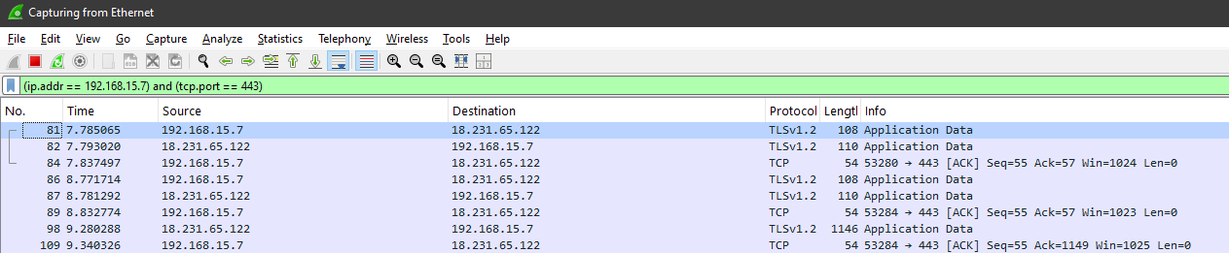
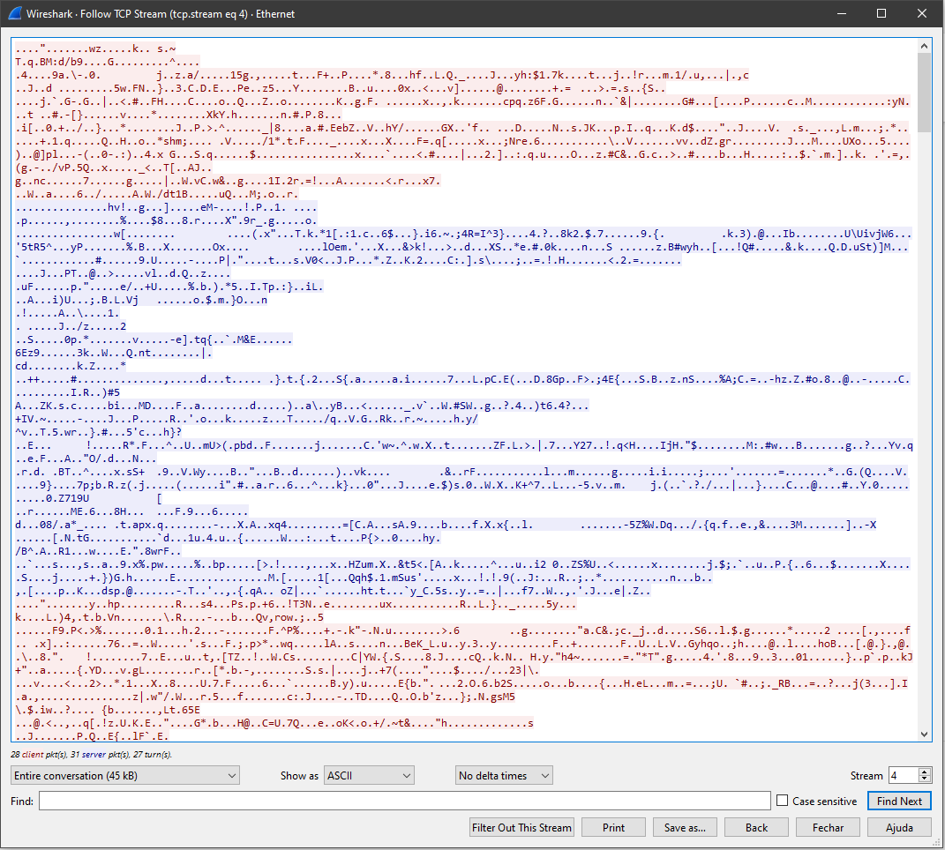
HYPER TEXT TRANSFER PROTOCOL (HTTP)
THE SECURITY PROBLEM
Filtering the IP address from the computer and for HTTPS (here, using its port 443)
Fully encrypted!

Slide 17
HYPER TEXT TRANSFER PROTOCOL (HTTP)
THE SECURITY PROBLEM
That is how phishing happens.
Phishing is a form of cyberattack that tricks users into revealing sensitive information by impersonating trusted entities.
Notes:
HTTP uses the 8080 port (by default), and the requests from HTTP are always Plaintext (not encrypted) when sending data from your device usin
HTTP uses the 443. HTTPS IS ENCRYPTED BY TLS.
DNS = Domain Name System (DNS) is the Internet’s naming service that translates human-readable domain names into IP addresses used by computers to identify each other on the network (Mockapetris, 1987).
There’re two types of IP: IPv4 (32 bits, 4.3bi possible addresses (IPs)) and IPv6 (128 bits, 340 undecillion possible addresses (IPs)). The IPv6 was created because, if you think about it, every computer, TV, cellphone, etc., eventually 4.3bi wasn’t enough. For example, when connecting your cellphone to the internet, the modem provides a public or private IP, same goes for 3G/ 4G/5G. Public can be seen by anyone, private only you. The cellphone uses the public address from the modem to connect to the internet, therefore the ip from te cellphone is not shown.
You can discover an IP using ping -4 (or -6, depends if is IPv4 or IPv6) + website (without http or https)
WHEN ACCESSING FOR EXAMPLE GOOGLE.COM, the computer needs the IP from google and my IP.

Slide 18
THE HTML

Slide 19
HTML
DEFINITION
What is HTML?
HTML stands for “HyperText Markup Language”, a markup language used do structure webpages. It allows represent images, videos in a semantic and hierarquick way. It incorporates native hyperlinks among documents using tags, such as “<a>” (anchog tag) and “href” (hypertext reference).
How the World Wide Web is connected to HTML?
The HTML is one of the main structures of the World Wide Web.

Slide 20
HTML
SEMANTIC HTML
According to Duckett (2011), a semantic HTML refeers to the proper usage of elements that represents the content of the page.

Slide 21
HTML
SEMANTIC HTML
<header>
<nav>
Checkout some semantic elements from HTML for structure.
<main>
<article>
<figure>
<aside>
<figure>
<section>
<footer>

Slide 22
HTML
SEMANTIC HTML
<h1>
Heading
<p>
Paragraph
<a>
Checkout some semantic elements from HTML for text.
Anchor
<ol>
Ordered List
<ul>
Unordered List
<q>
Blockquote
<em>
Emphasis
<code>
Block of computer code

Slide 23
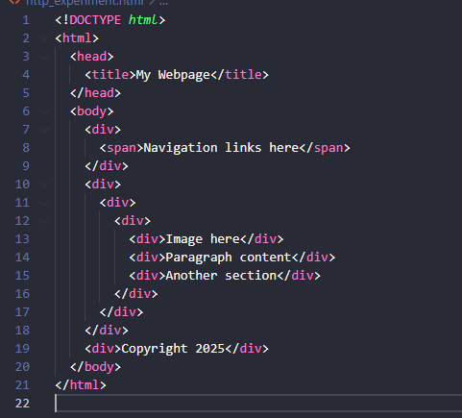
HTML
SEMANTIC HTML
1
Several divs where proper semantic should be added!

Slide 24
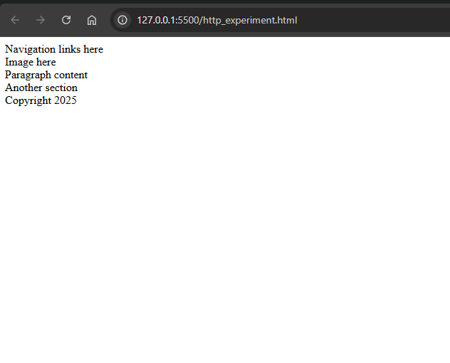
HTML
SEMANTIC HTML
That’s how the wrong semantic text and structure is.

Slide 25
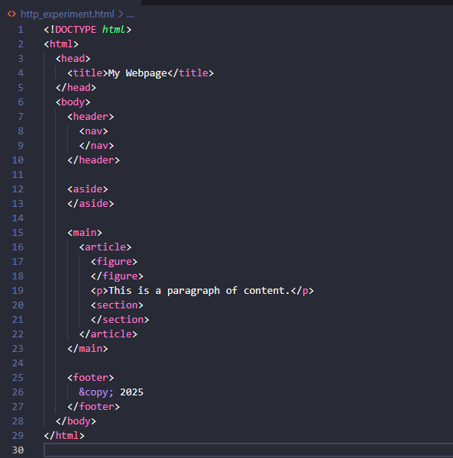
HTML
SEMANTIC HTML
Semantic properly stablished.

Slide 26
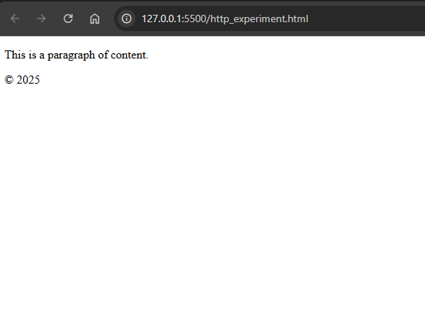
HTML
SEMANTIC HTML
That’s how the proper semantic text and structure is.

Slide 27
HTML
WELL-FORMED
According to Duffin (2011) well-formed HTML is basically a semantically correct HTML.
It has three main rules:
Closing tags
Proper nesting
Well written attributes

Slide 28
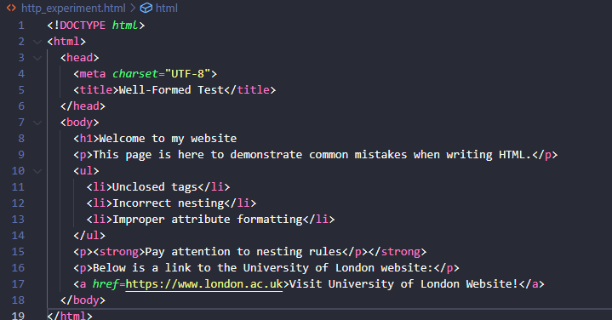
HTML
WELL-FORMED
1
2
3

Slide 29
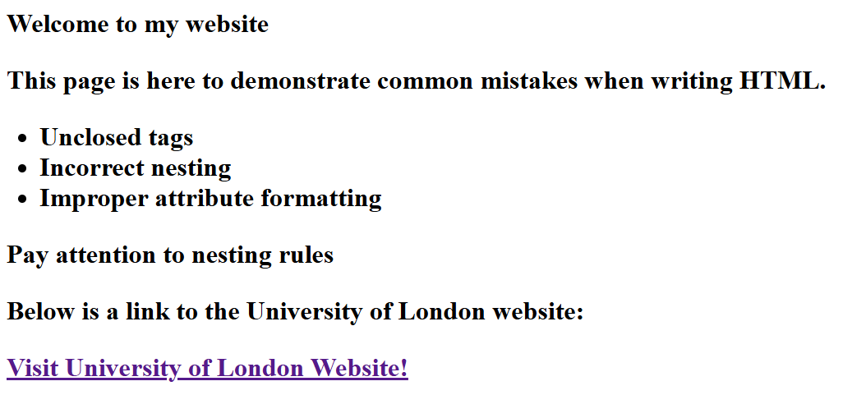
HTML
WELL-FORMED
1
All text is bold.
2
No visual changes, but it could cause problems with DOM and JavaScript interactions.
3
Violates W3C standard and the link could not work properly.

Slide 30
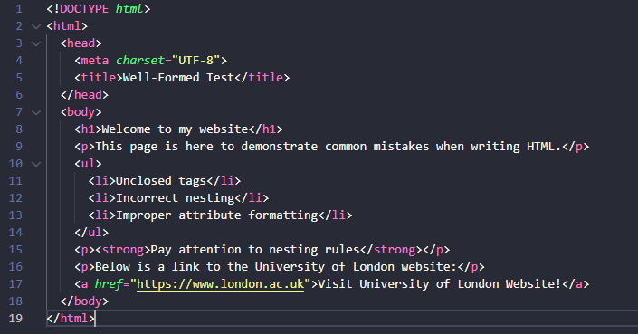
HTML
WELL-FORMED
1
2
3

Slide 31
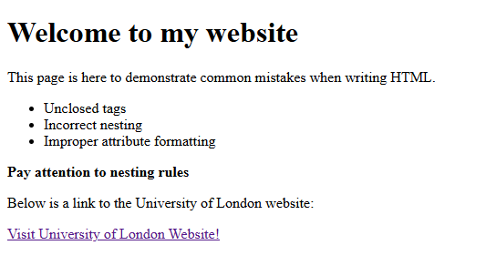
HTML
WELL-FORMED
You can use W3C to validate your HTML format!
1
Text font fixed.
2
No visual changes, but problems with DOM and JavaScript interactions was avoided.
3
Does not violates W3C standard and the link could not work properly.

Slide 32
HTML
VALID
According to Duckett (2011) a valid HTML follows all syntatic and structural rules in the official HTML specification (e.g. HTML5) according to W3C.

Slide 33
HTML
VALID
1
Use a tag where it’s not allowed by the description (e.g. <body> inside header).
2
Have more than one <body> or <header> in the same document.
3
On the left, check same examples of invalid HTML.
Missing fundamental elements, such as <title> and <head>.
4
Add not allowed children into a <tag>. (e.g. <div> inside a <p>).
5
Usage of obsolete elements (in HTML5, <font>, <center> and <big>.
6
Structure erros, such as </div> without <div>

Slide 34
THE URL

Slide 35
URL
DEFINITION
What is URL?
URL stands for Uniform Resource Locator, is the address used to locate a resource from the internet. For exemple: //https.www.london.ac.uk
What is DNS?
DNS stands for Domain Name System, it’s the internet naming service that translates human-readable domains into IP addresses to identify other on network (Mockapetris, 1987)
What is IP?
IP (Internet protocol) is a network protocol responsible to address and forward data packages (the IP doesn’t “understands” the packages, only deliveries). It can be IPv4 (32 bits, 4.3 BI possible addreses) or IPv6 (340 undecillion possible addresses)
Notes:
The IPv6 was created because, if you think about it, every computer, TV, cellphone, etc., eventually 4.3bi wasn’t enough. For example, when connecting your cellphone to the internet, the modem provides a public or private IP, same goes for 3G/ 4G/5G. Public can be seen by anyone, private only you. The cellphone uses the public address from the modem to connect to the internet, therefore the ip from te cellphone is not shown.
You can discover an IP using ping -4 (or -6, depends if is IPv4 or IPv6) + website (without http or https)
WHEN ACCESSING FOR EXAMPLE GOOGLE.COM, the computer needs the IP from google and my IP.

Slide 36
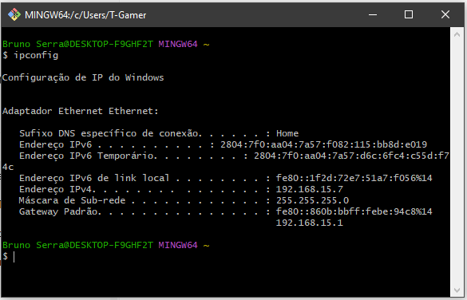
URL
HOW TO CHECK YOUR IP ADDRESS
Type ipconfig into your terminal and check your IPs (IPv6, IPv4)

Slide 37
REFERENCES
IETF (Internet Engineering Task Force) (2005) RFC 4084: Terminology for describing Internet connectivity. Available at: https://datatracker.ietf.org/doc/html/rfc4084 (Accessed: 28 June 2025).
Cambridge University Press (n.d.) HTTP. Cambridge Dictionary. Available at: https://dictionary.cambridge.org/dictionary/english (Accessed: 28 June 2025).
Rescorla, E. (2000) HTTP Over TLS, RFC 2818. Internet Engineering Task Force. Available at: https://datatracker.ietf.org/doc/html/rfc2818 (Accessed: 28 June 2025).
Kurose, J.F. and Ross, K.W., 2021. Computer Networking: A Top-Down Approach. 8th ed. Pearson.
Berners-Lee, T., Fischetti, M., and Dertouzos, M. L. (1994). Weaving the Web: The Original Design and Ultimate Destiny of the World Wide Web by Its Inventor. Harper San Francisco.
Duckett, J. (2011) HTML & CSS: Design and Build Websites. Indianapolis: John Wiley & Sons.
Mockapetris, P.V. (1987). Domain names - concepts and facilities. RFC 1034. Internet Engineering Task Force. Available at: https://www.rfc-editor.org/rfc/rfc1034.html (Accessed: 28 June 2025).

