Slide 1

WEB DEVELOPMENT
The presentation was developed using color-blind friendly palette.
Because everyone deserves to see all the details.

Slide 2
THE INTERNET
INDEX
Topic 1: HTTP and HTML
The Internet
The HTML
The URL
The HTTP
Topic 2: Working with Data Sources and Data Security
Structured Data Representation formats
Application Programming Interface (API & REST API)

Slide 3
THE INTERNET

Slide 4

THE INTERNET
DEFINITION
What exactly is the internet?
According to Kurose and Ross (2021), the Internet is the global infrastructure that enables digital communication and allows devices to exchange data using the TCP/IP protocols
Notes:
The Internet is the global infrastructure that enables digital communication and allows devices to exchange data using the TCP/IP protocols.
The TCP stands for Transmission Control Protocol, it ensures that data is delivered accurately and in the correct order.
The IP is Internet Protocol, esponsible for identifying and locating devices on the network. It assigns each device an IP address, allowing data to be routed to the correct destination.
STORY
1957: It started in 1957, when ARPA (Advanced Resarch Projects Agency) is founded in the U.S. to boost military innovation; early vision of a global network emerges
1969: then in 1969 First computer-to-computer connection using packet switching (UCLA ↔ Stanford).
1974 - TCP/IP protocols are introduced to standardize communication between different networks.
1983 - TCP/IP becomes the official protocol suite of the Internet.
1989 – AND THEN, WITH THE INTERNET, The World Wide Web is created by Tim Berners-Lee, using HTML, HTTP, and URLs. Therefore, we can state that the internet is the infrastructure of networks and protcols and the WWW is a service above this infrastructure.

Slide 5
THE INTERNET
HISTORY
The entire story of the internet!
First public demonstration of ARPANET with 20 connected nodes. Still restricted to U.S. Military and approved academic institutions.
First protocol system came up: TCP (transmission control protocol) and IP (internet protocol). Standardizing communcation accross different networks
ARPA created a device that could manage the transmission and receipt of packets between machines.
Association of country domains, for example
“.uk”.
1968
1972
1974
1985
1957
1969
1973
1983
1989
In the Cold War, USA created ARPA (Advanced Resarch Projects Agency) to accelerate military technology. “Galactic Network” ideal came up
First computer-to-computer connection created (via wire). Packet switching came up. First between UCLA Stanford
UCL became the first non U.S. ARPANET node via link by Norway. First e-mail sent from UK.
ARPANET moved from TCP/IP, moreover splited into MILNET for military and ARPANET for research. ARPANET officialy adopted TCP/IP.
First commercial internet provider (ISP) launched in U.S.. World Wide Web (WWW) by Tim Berners-Lee, comming up with HTML, HTTP and URL’s.
Notes:
STORY
1957: It started in 1957, when ARPA (Advanced Resarch Projects Agency) is founded in the U.S. to boost military innovation; early vision of a global network emerges
1969: then in 1969 First computer-to-computer connection using packet switching (UCLA ↔ Stanford).
1974 - TCP/IP protocols are introduced to standardize communication between different networks.
1983 - TCP/IP becomes the official protocol suite of the Internet.
1989 – AND THEN, WITH THE INTERNET, The World Wide Web is created by Tim Berners-Lee, using HTML, HTTP, and URLs. Therefore, we can state that the internet is the infrastructure of networks and protcols and the WWW is a service above this infrastructure.

Slide 6
THE HTML

Slide 7
HTML
DEFINITION
What is HTML?
HTML stands for “HyperText Markup Language”, a markup language used do structure webpages
Notes:
HTML stands for “HyperText Markup Language”, a markup language used do structure webpages. It allows us to represent images, videos in a semantic and hierarquick way.
It incorporates native hyperlinks among documents using tags, such as “<a>” (anchog tag) and “href” (hypertext reference).
HTML is a fundamental building block of the World Wide Web, as it provides the structural framework for creating and displaying content on web pages.
In web development, HTML works together with CSS (style) and JavaScript (interaction) — but HTML is the foundation.
To better understand how HTML fits into the Web, imagine a human body:
HTML is the skeleton – it gives structure to the webpage.
CSS is the skin and clothing – it controls appearance and layout.
JavaScript is the muscles and brain – it adds behavior and logic.

Slide 8

HTML
Semantic
Refers to the use of tags that convey meaning about the content they enclose
HTML documents should follow three essential principles for high-quality markup:
Well-Formed
Means that the syntax follows proper nesting, has closed tags, uses quoted attributes, and avoids structural ambiguity.
Valid
Means that the code follows the rules of the W3C HTML specification.
Notes:
This slide shows the three key principles for writing high-quality HTML: Semantic, Well-Formed, and Valid.
Semantic HTML means using tags that describe the meaning of content — like <nav> for navigation or <article> for a news post — which helps both browsers and users. Well-formed HTML follows proper syntax: correct nesting, closed tags, and quoted attributes. Valid HTML meets the W3C standards, ensuring that your code works consistently across browsers.
Together, these principles make HTML easier to maintain, more accessible, and more reliable.

Slide 9
THE URL

Slide 10
URL
DEFINITION
What is URL?
URL stands for Uniform Resource Locator, is the address used to locate a resource from the internet.
Notes:
URL stands for Uniform Resource Locator, is the address used to locate a resource from the internet. For exemple: //https.www.london.ac.uk.
DNS stands for Domain Name System, it’s the internet naming service that translates human-readable domains into IP addresses to identify other on network (Mockapetris, 1987).
IP (Internet protocol) is a network protocol responsible to address and forward data packages (the IP doesn’t “understands” the packages, only deliveries). It can be IPv4 (32 bits, 4.3 BI possible addreses) or IPv6 (340 undecillion possible addresses).
WHEN ACCESSING FOR EXAMPLE GOOGLE.COM, the computer needs the IP from google and my IP to a

Slide 11
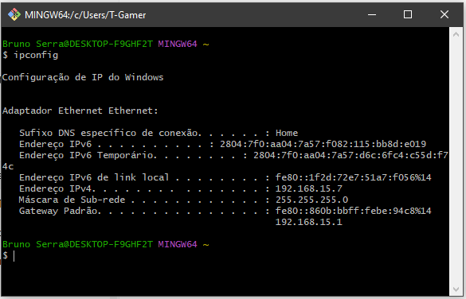
URL
HOW TO CHECK YOUR IP ADDRESS
Using ipconfig, you’re able to check your IPv6, IPv4, etc.

Slide 12
THE HTTP PROTOCOL

Slide 13
HYPER TEXT TRANSFER PROTOCOL (HTTP)
DEFINITION
What is HTTP?
It’s an application protocol created in 1989 by Tim Berners-Lee to enable communication between browser and servers
Notes:
It’s an application protocol created in 1989 by Tim Berners-Lee to enable communication between browser and servers. It follows a model of request-responde. It’s stateless, therefore it doesn’t keep information in each request. It uses 8080 port by default. It uses methods to read resources (GET), create resources (POST), etc. When typing the URL in a browser and enter in a wesite, a GET method is being done.

Slide 14
HYPER TEXT TRANSFER PROTOCOL (HTTP)
DEFINITION
What about the HTTPS?
Uses a different port (443 by default) and is encrypted via TLS (Transporter Layer Security). Ensuring:
Confidentiality
Integrity
Authenticity
Notes:
The HTTPS (HyperText Transfer Protocol Secure) is a secure procotol of HTTP. It uses port 443 by default. The difference is that HTTPS adds encrypts via TLS (Transport Layer Security), ensuring:
Confidentiality.
Integrity.
Authenticity.
The HTTPS, just as th HTTP, uses the TCP (Transmission Control Protocol), ensuring data to arrive completed, ordered and not dupplicated, howerever, it also uses the TLS protocol (Transport Secure Layer) encrypts all data.

Slide 15

HYPER TEXT TRANSFER PROTOCOL (HTTP)
LAB
It’s LAB time! In this section it’s going to be presented the differences from HTTP and HTTPS using browser and Wireshark.
Notes:
Abrir o Wireshark e mostrar.
No fim, falar:
“That is how phishing happens.
Phishing is a form of cyberattack that tricks users into revealing sensitive information by impersonating trusted entities.”

Slide 16
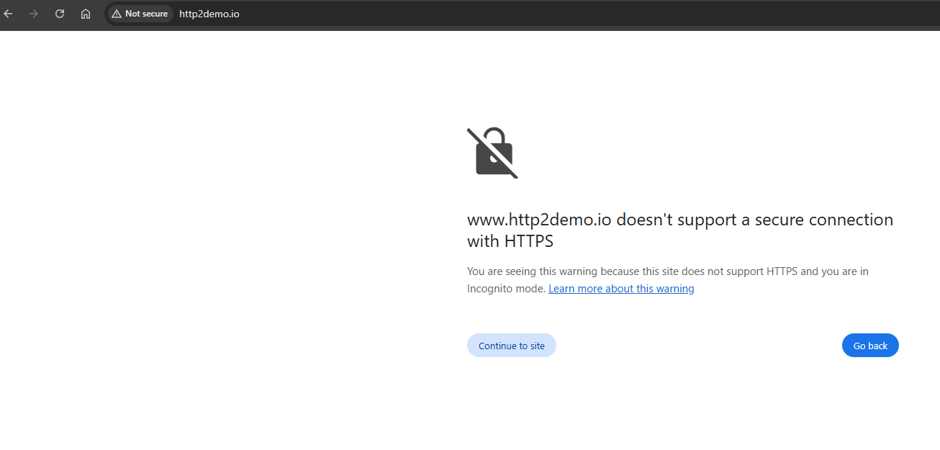
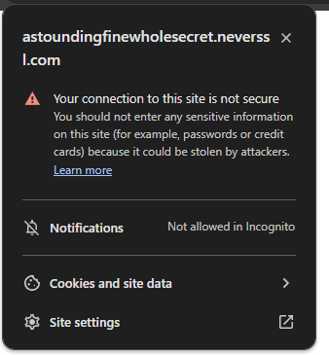
HYPER TEXT TRANSFER PROTOCOL (HTTP)
LAB
(Presented Live)
1
2
3
Check the website http://www.http2demo.io/ with HTTP protocol.
By accessing a non-secure webpage, the browser:
Automatically warns the user about a not secure website
States the website doesn’t support HTTPS
Asks if the user wants to continue to the site

Slide 17
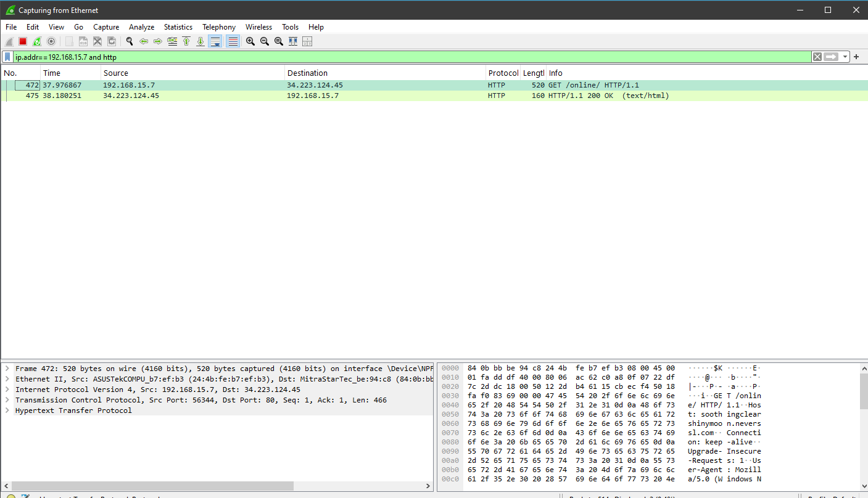
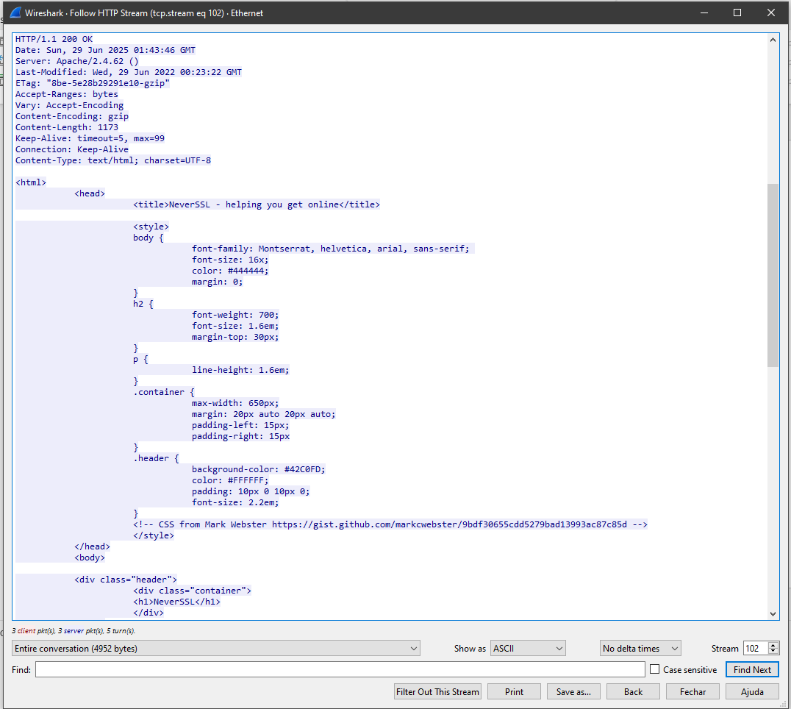
EXPERIMENTATION
LAB
(Presented Live)
Filtering the IP computer address and for HTTP.
All data from HTML can be seen here (even passwords!).
Notes:
Wireshark is a free, open-source program used to capture and analyze network traffic in real time. It allows users to inspect the details of data packets sent over a network, making it a key tool for network troubleshooting, performance analysis, and cybersecurity.

Slide 18
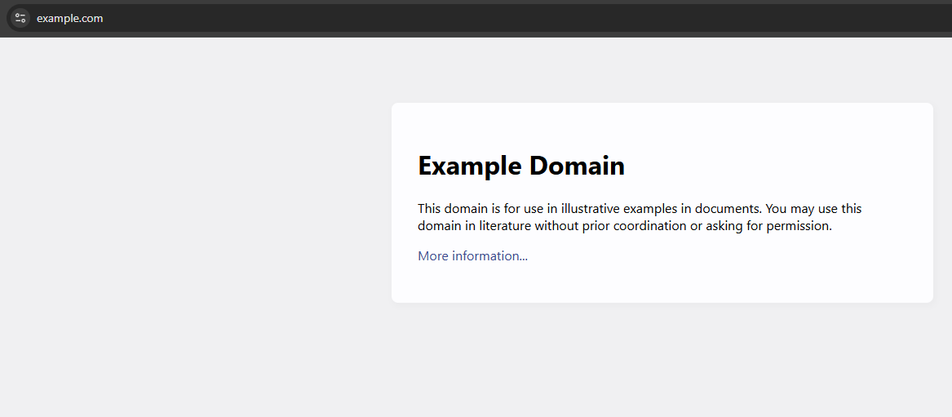
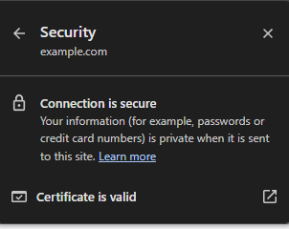
HYPER TEXT TRANSFER PROTOCOL (HTTP)
LAB
(Presented Live)
1
Check the website https://example.com/ with HTTPS protocol.
By accessing a secure webpage, the browser normally access the page.

Slide 19
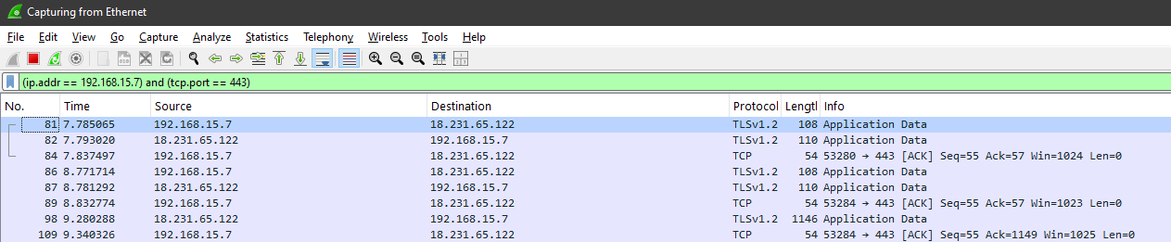
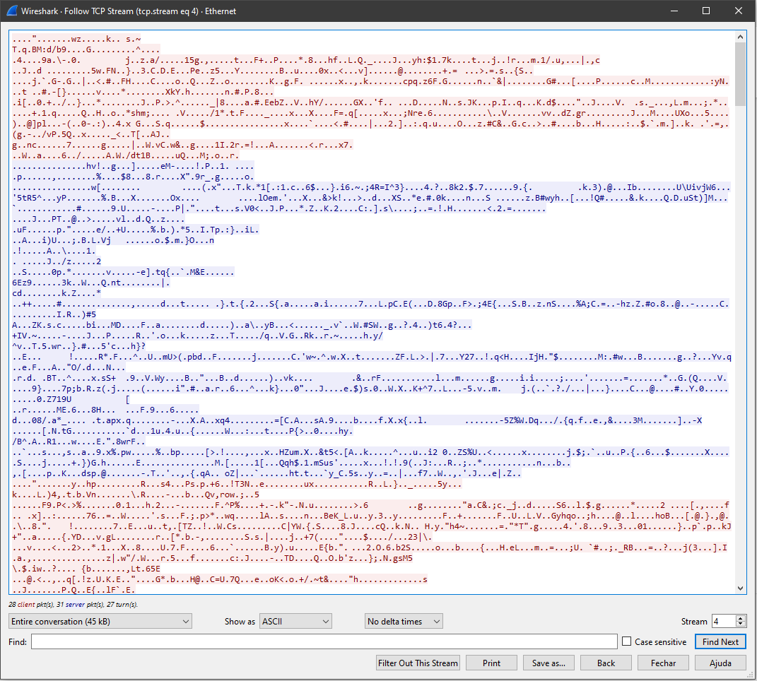
HYPER TEXT TRANSFER PROTOCOL (HTTP)
LAB
(Presented Live)
Filtering the IP address from the computer and for HTTPS (here, using its port 443)
Fully encrypted!

Slide 20
STRUCTURED DATA REPRESENTATION FORMATS
Notes:
In Topic 1, we explored how the HTTP protocol enables communication across the Web. Every time we visit a website or click a button, we’re making HTTP requests that trigger responses. But what do these responses actually contain? Quite often, instead of just HTML, we receive structured data — typically in JSON format — provided by REST APIs

Slide 21
STRUCTURED DATA REPRESENTATION FORMATS
DEFINITION
What are structured data representation formats?
Structured data representation formats are standardized ways to organize and encode data using predictable structures such as key-value pairs, tables, or hierarchies.
Notes:
Structured data representation formats are standardized ways to organize and encode data using predictable structures such as key-value pairs, tables, or hierarchies.

Slide 22


STRUCTURED DATA REPRESENTATION FORMATS
DEFINITION
Verbose
Used in older and enterprise systems
SOAP-based services
The two main types of archieves for data transfer, specially between APIs
Lightweight
Readable
Widely supported accross browsers and languages
Notes:
“The most common format is JSON — stands for JavaScript Object Notation. It’s lightweight, readable, and widely supported across browsers and languages
However, JSON is not the only format. Others include:
XML (eXtensible Markup Language) — more verbose and used in older or enterprise systems, especially for SOAP-based services.
Despite those alternatives, JSON remains the dominant format for web APIs due to its simplicity and native integration with JavaScript.

Slide 23
APPLICATION PROGRAMMING INTERFACE (API)
Notes:
In Topic 1, we explored how the HTTP protocol enables communication across the Web. Every time we visit a website or click a button, we’re making HTTP requests that trigger responses. But what do these responses actually contain? Quite often, instead of just HTML, we receive structured data — typically in JSON format — provided by REST APIs

Slide 24
APPLICATION PROGRAMMING INTERFACE (API)
What is an API? And a REST API?
An API (Application Programming Interface) is a set of rules that allows different software systems to communicate with each other. REST (Representational State Transfer) is an architecture style to built web APIs.
Roy Fielding (2000).
Notes:
Once we understand the data formats, the next step is to understand how we actually get this data — and that’s where API and REST API come in.
API stands for (Application Programming Interface), a set of rules that allows different software systems to communicate with each other. There are different ways to build APIs: REST, gRPC, SOAP... Today, we focus on REST, the most widely used on the Web.
REST stands for Representational State Transfer. It’s an architectural style for building web services that use standard HTTP methods are
GET, to read data
POST, to create a resource
PUT, update a resource
DELETE, remove a resource
For example, imagine we want to get a list of users from a server. We make a GET request to a specific URL — that’s the ‘endpoint’. If the API is well-designed and follows REST principles, it will return data in JSON format.

Slide 25


REST API
HTTP
URL
CLIENT
GET
POST
DELETE
PUT
SERVER
https://www.london.ac.uk/
https://www.london.ac.uk/study
https://www.london.ac.uk/study#undergraduate
JSON
{
"name": "Charlie",
"age": 30,
"country": "Unied Kingdom"
}
Notes:
This diagram illustrates the architecture of a REST which enables structured communication between a client and a server. The interaction occurs via the HTTP protocol, using standard methods such as GET, POST, PUT, and DELETE. Each request targets a specific resource identified by a URL. Once the server processes the request, it typically returns data formatted in JSON — JavaScript Object Notation — a widely adopted standard for data exchange due to its simplicity and readability. This response is then interpreted by the client, completing the request-response cycle.

Slide 26
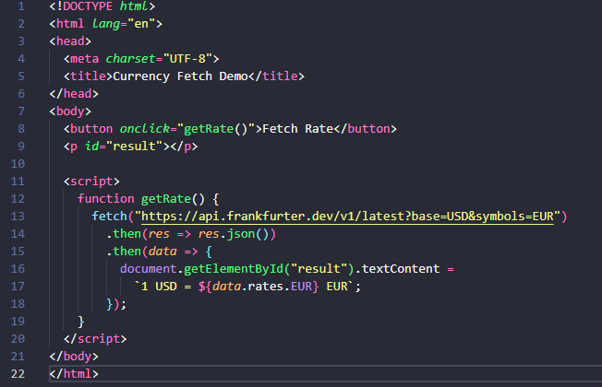
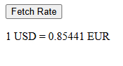
APPLICATION PROGRAMMING INTERFACE (API)
Notes:
This small demo shows a complete HTTP cycle: I make a GET request to a REST API using the fetch() method, I receive a JSON response, and then I update the DOM to display the users. This is exactly how many real-world web apps handle dynamic content.
https://frankfurter.dev/

Slide 27
REFERENCES
IETF (Internet Engineering Task Force) (2005) RFC 4084: Terminology for describing Internet connectivity. Available at: https://datatracker.ietf.org/doc/html/rfc4084 (Accessed: 28 June 2025).
Cambridge University Press (n.d.) HTTP. Cambridge Dictionary. Available at: https://dictionary.cambridge.org/dictionary/english (Accessed: 28 June 2025).
Rescorla, E. (2000) HTTP Over TLS, RFC 2818. Internet Engineering Task Force. Available at: https://datatracker.ietf.org/doc/html/rfc2818 (Accessed: 28 June 2025).
Kurose, J.F. and Ross, K.W., 2021. Computer Networking: A Top-Down Approach. 8th ed. Pearson.
Berners-Lee, T., Fischetti, M., and Dertouzos, M. L. (1994). Weaving the Web: The Original Design and Ultimate Destiny of the World Wide Web by Its Inventor. Harper San Francisco.
Duckett, J. (2011) HTML & CSS: Design and Build Websites. Indianapolis: John Wiley & Sons.
Mockapetris, P.V. (1987). Domain names - concepts and facilities. RFC 1034. Internet Engineering Task Force. Available at: https://www.rfc-editor.org/rfc/rfc1034.html (Accessed: 28 June 2025).

Slide 28
THANK YOU!
Notes:
In Topic 1, we explored how the HTTP protocol enables communication across the Web. Every time we visit a website or click a button, we’re making HTTP requests that trigger responses. But what do these responses actually contain? Quite often, instead of just HTML, we receive structured data — typically in JSON format — provided by REST APIs

