Slide 1
ServiceNow Analytics
Elham Saboori
Nodira Mamatova
Bilwa Buchake
Prabhakar Muriki
Jayachandran John

Slide 2
ServiceNow Data Requests Management App
Will serve as a web based portal for viewing, assigning priority and tracking all team data requests
Allow the users to perform CRUD operations against the ServiceNow Data Requests dataset
Provide users with ability to visualize status of Service Requests to help manage workload and priorities

Slide 3
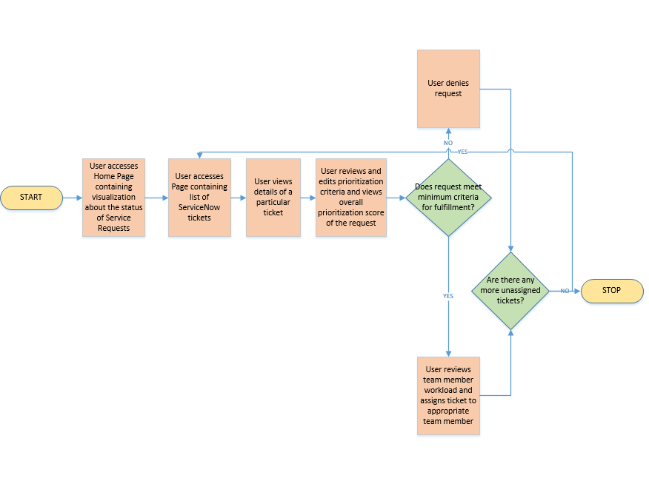
High Level Workflow

Slide 4
Application Components
Database
API Endpoints
User Interface
Visualizations

Slide 5
Lessons Learned
It is ALL ABOUT THE DATA
Requirements and Scope need to be clearly defined
Solid understanding of available technologies and team expertise is critical
There is always room for improvment

Slide 6
Next Steps
Expand Data Model
Expand User Interface to provide added functionality such as important dates in the life cycle of a request
Use a more robust framework such as Django for building the business logic
Expand visualizations and allow for real-time analytical capabilities

Slide 7
Questions?

