Slide 1
ZKEVM, SNARK tricks Folding
CSCI-GA 3033-107
https://brightspace.nyu.edu/d2l/home/353819
Hw3 out
Benedikt Bünz
New York University
https://coursefeedback.nyu.edu/nyu/
https://nycryptoday.wordpress.com/

Slide 2
ZK-EVM
Can we prove that all the Ethereum transactions are valid
In one block? (Gives you a rollup)
In all blocks? (Gives you a constant size blockchain)
We know how to do proofs for circuits. How do we prove that the entire Ethereum Virtual Machine is valid?

Slide 3
Ethereum compute layer: the EVM
World state: set of accounts identified by 32-byte address.
Two types of accounts:
externally owned accounts (EOA): controlled by ECDSA signing key pair (pk,sk).
sk: signing key known only to account owner
(2) contracts: controlled by code.
code set at account creation time, does not change

Slide 4
Data associated with an account
Account data Owned (EOA) Contracts
address (computed): H(pk) H(CreatorAddr, CreatorNonce)
code: ⊥ CodeHash
storage root (state): ⊥ StorageRoot
balance (in Wei): balance balance (1 Wei = 10⁻¹⁸ ETH)
nonce: nonce nonce
(#Tx sent) + (#accounts created): anti-replay mechanism
Notes:
The computed address for a contract created with CREATE is H(CreatorAddr, CreatorNonce) as shown in the table above. Same when contract is created by an owned account. However, the computed address for a contract created with CREATE2 is H(CreatorAddr, InitCodeOfNewContract, Salt). This means that CREATE2 can be used to overwrite the code of a previous contract that resided in that address. This is only possible if the earlier contract did a SELFDESTRUCT. Either way, the nonce of a newly created contract is initialized to zero.

Slide 5
Account state: persistent storage
Every contract has an associated storage array S[]:
S[0], S[1], … , S[2²⁵⁶-1]: each cell holds 32 bytes, init to 0.
Account storage root: Merkle Patricia Tree hash of S[]
Cannot compute full Merkle tree hash: 2²⁵⁶ leaves
0
0, a
S[000] = a
S[010] = b
S[011] = c
S[110] = d
time to compute root hash:
≤ 2×|S|
0
0
⊥, b
root
1
1
10, d
1
⊥, c
|S| = # non-zero cells
Notes:
Store suffix in nodes. Ethereum’s Merkle Patricia Tree has a branching factor of 16.

Slide 6
State transitions: Tx and messages
Transactions: signed data by initiator
To: 32-byte address of target (0 ⇾ create new account)
From, [Signature]: initiator address and signature on Tx (if owned)
Value: # Wei being sent with Tx (1 Wei = 10⁻¹⁸ ETH)
Tx fees (EIP 1559): gasLimit, maxFee, maxPriorityFee (later)
if To = 0: create new contract code = (init, body)
if To ≠ 0: data (what function to call & arguments)
nonce: must match current nonce of sender (prevents Tx replay)
chain_id: ensures Tx can only be submitted to the intended chain
Notes:
nonce must match current nonce of sender in sender’s account data. When Tx processed successfully, nonce in sender’s account data is incremented by 1.
chain_id: ensures that a Tx signed for the testnet cannot be submitting on the mainnet (same with L1/L2 confusion).

Slide 7
State transitions: Tx and messages
Transaction types:
owned ⇾ owned: transfer ETH between users
owned ⇾ contract: call contract with ETH & data

Slide 8
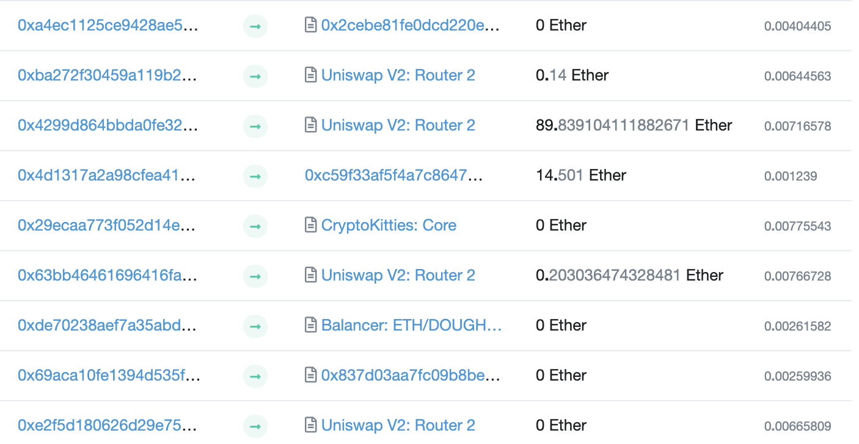
Example (block #10993504)
From
To
msg.value
Tx fee (ETH)
Notes:
Some Tx go to contracts, others go to owned addresses

Slide 9
Messages: virtual Tx initiated by a contract
Same as Tx, but no signature (contract has no signing key)
contract ⇾ owned: contract sends funds to user
contract ⇾ contract: one program calls another (and sends funds)
One Tx from user: can lead to many Tx processed. Composability!
Tx from owned addr ⇾ contract ⇾ another contract
another contract ⇾ different owned

Slide 10
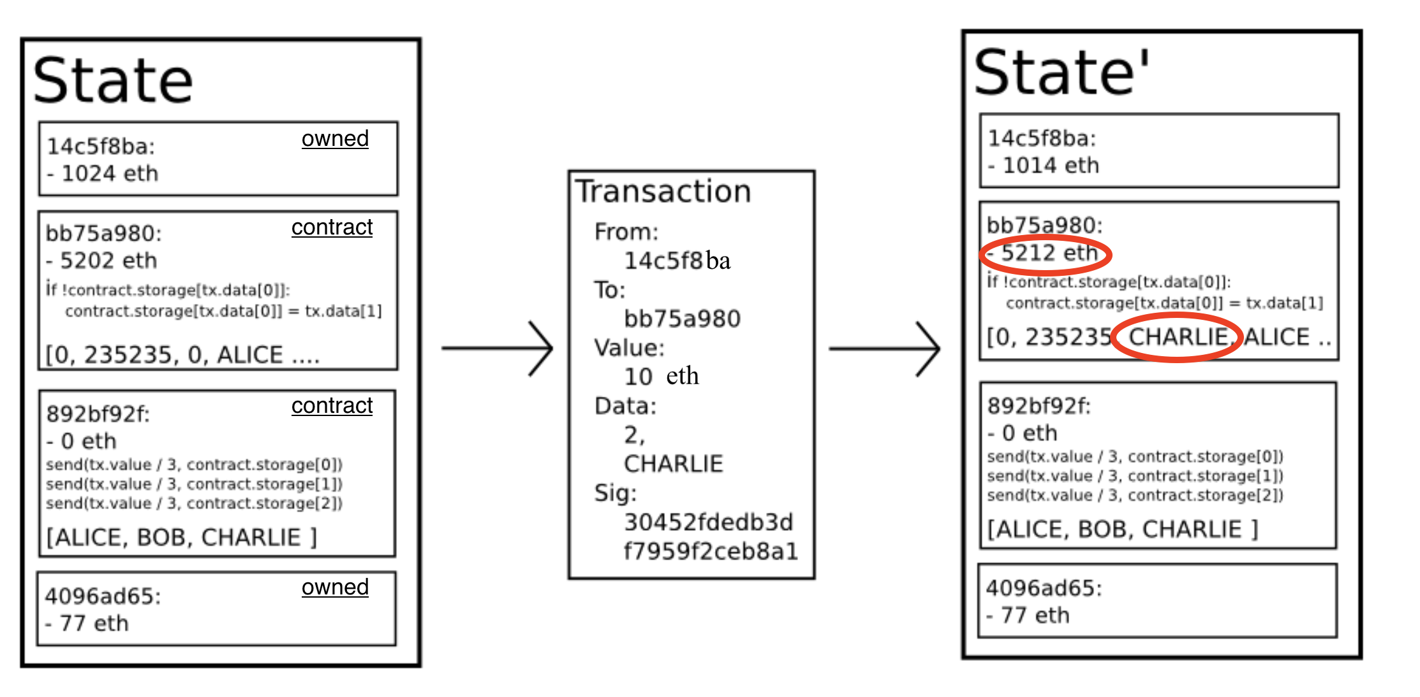
Example Tx
world state (four accounts)
updated world state

Slide 11
An Ethereum Block
Block proposer creates a block of n Tx: (from Txs submitted by users)
To produce a block do:
for i=1,…,n: execute state change of Tx_{i} sequentially
(can change state of >n accounts)
record updated world state in block
Other validators re-execute all Tx to verify block ⇒ sign block if valid ⇒ enough sigs, epoch is finalized.
Notes:
Other blockchains allow for non-interfering parallel execution: Flow, Avalanche.

Slide 12
Block header data (simplified)
consensus data: proposer ID, parent hash, votes, etc.
address of gas beneficiary: where Tx fees will go
world state root: updated world state
Merkle Patricia Tree hash of all accounts in the system
(4) Tx root: Merkle hash of all Tx processed in block
(5) Tx receipt root: Merkle hash of log messages generated in block
(5) Gas used: used to adjust gas price (target 15M gas per block)

Slide 13
The Ethereum blockchain: abstractly
prev hash
prev hash
…
…
accts.
accts.
updated world state
Tx
log messages
updated world state
Tx
log messages

Slide 14
EVM mechanics: execution environment
Write code in Solidity (or another front-end language)
⇒ compile to EVM bytecode
(some projects use WASM or BPF bytecode)
⇒ validators use the EVM to execute contract bytecode in response to a Tx

Slide 15
The EVM
Stack machine (like Bitcoin) but with JUMP
max stack depth = 1024
program aborts if stack size exceeded; block proposer keeps gas
contract can create or call another contract
In addition: two types of zero initialized memory
Persistent storage (on blockchain): SLOAD, SSTORE (expensive)
Volatile memory (for single Tx): MLOAD, MSTORE (cheap)
LOG0(data): write data to log
see https://www.evm.codes

Slide 16
Every instruction costs gas, examples:
SSTORE addr (32 bytes), value (32 bytes)
zero ⇾ non-zero: 20,000 gas
non-zero ⇾ non-zero: 5,000 gas (for a cold slot)
non-zero ⇾ zero: 15,000 gas refund (example)
Refund is given for reducing size of blockchain state
CREATE : 32,000 + 200×(code size) gas; CALL gas, addr, value, args
SELFDESTRUCT addr: kill current contract (5000 gas)
Notes:
Selfdestruct addr: sends all account funds to specified address. Refund removed to avoid gastokens.
CREATE: create a new contract
CALL: contract at address addr, with max gas, and value

Slide 17
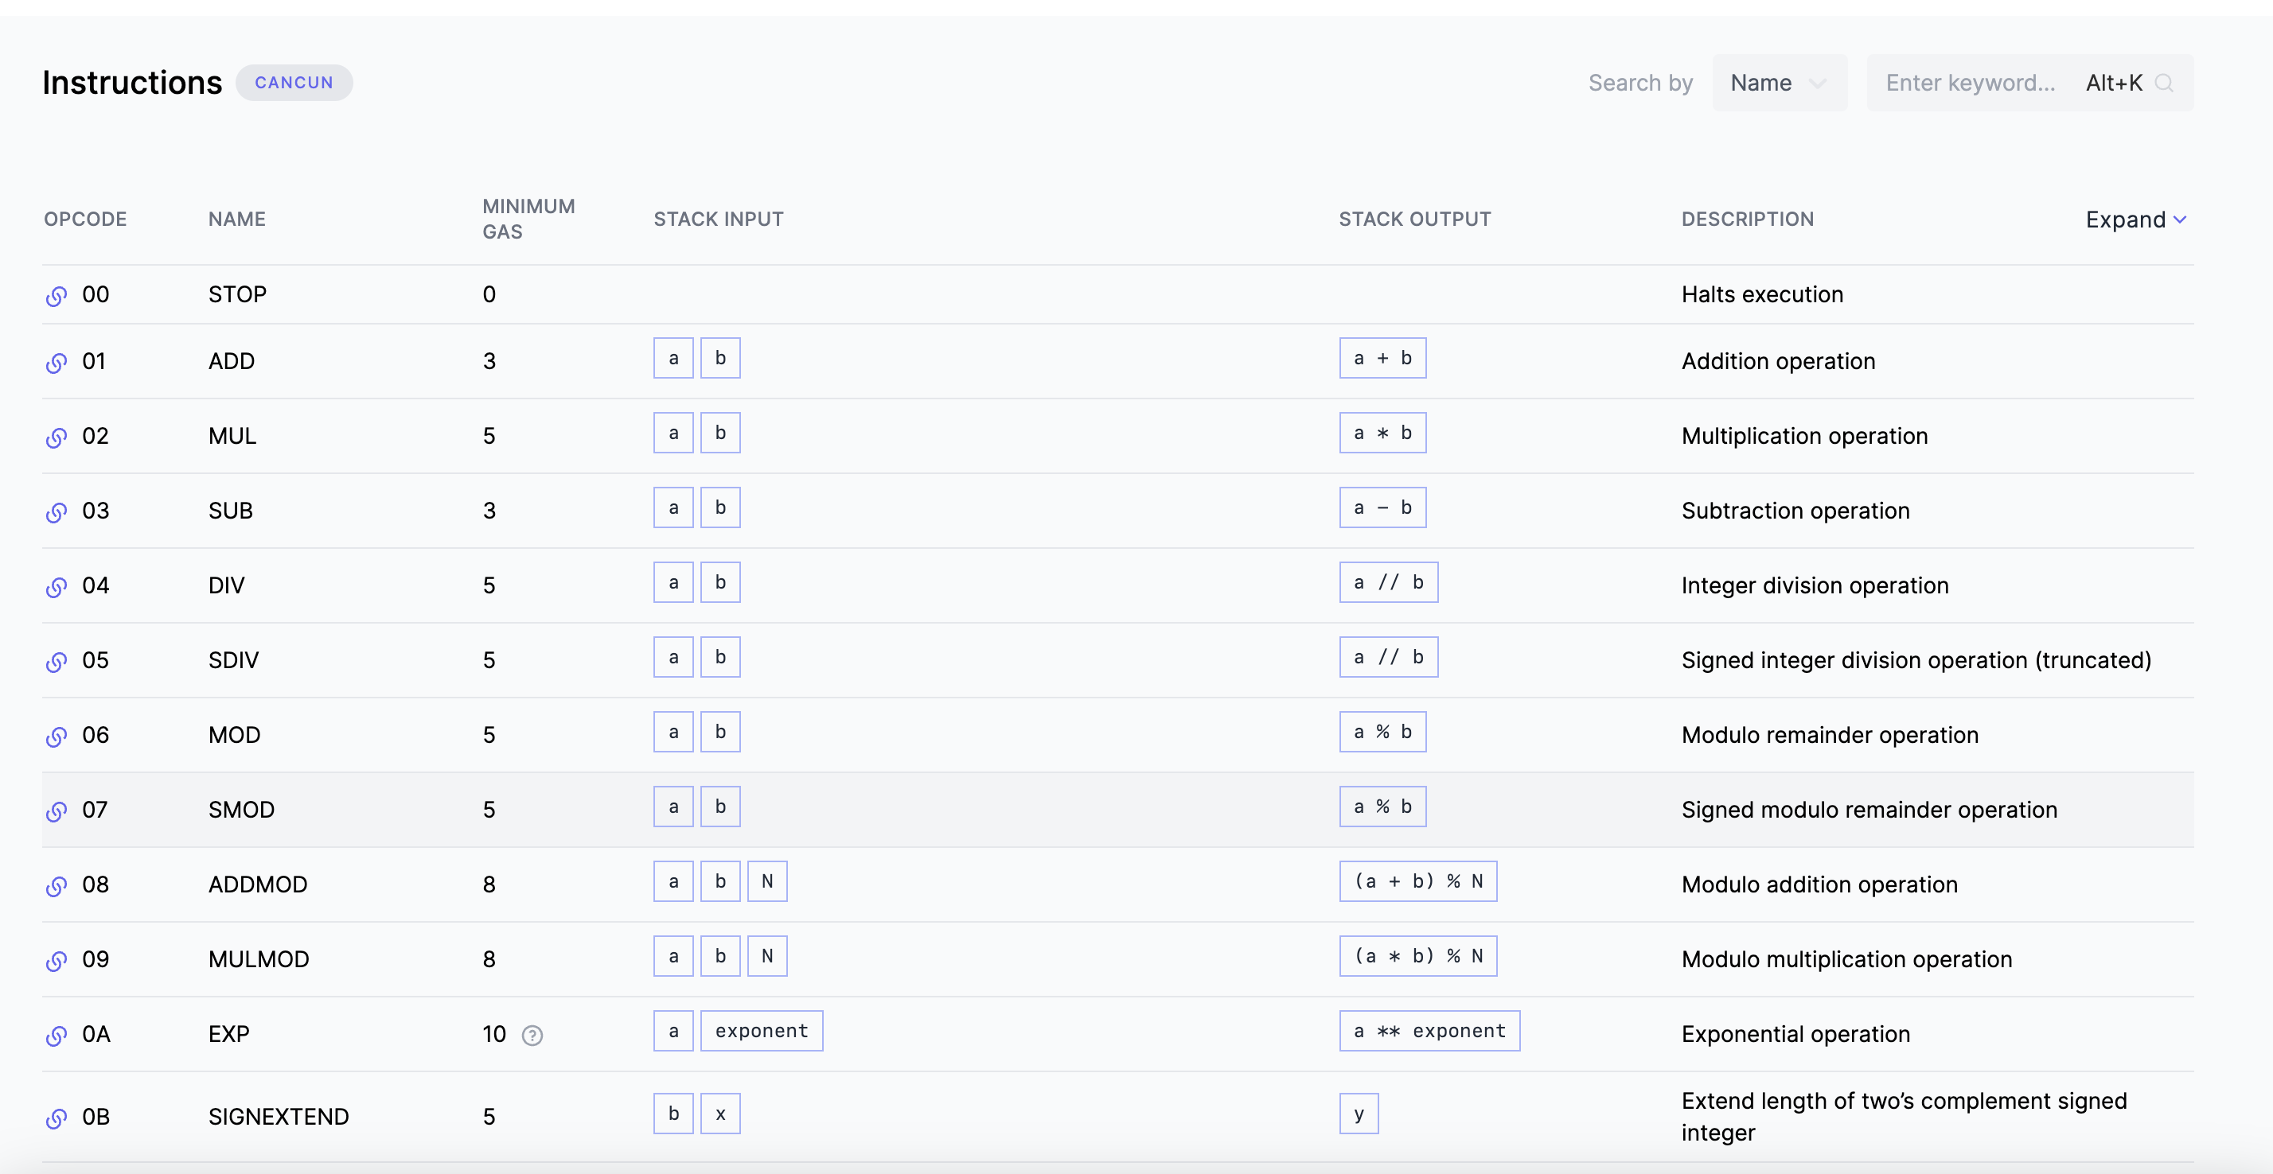
EVM OPCodes

Slide 18





MACHINE computation
circuit computation
Output 0/1
state_{i}
CPU
state_{i+1}
…
$$\text{×}$$
MEM
$$+$$
$$+$$
…
The reality in hardware
Most requires a memory
EVM is a machine
Public input $x$
Witness $w$

Slide 19
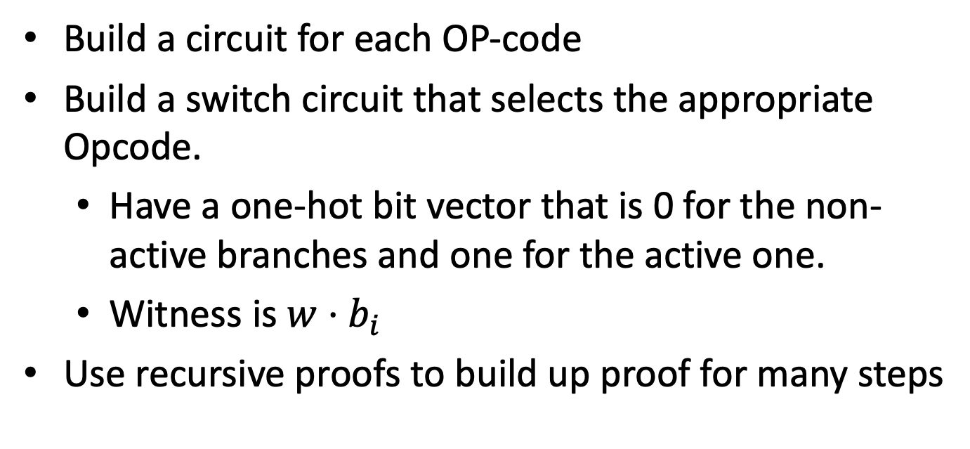
How to prove the EVM
Build a circuit for each OP-code
Build a switch circuit that selects the appropriate Opcode.
Have a one-hot bit vector that is 0 for the non-active branches and one for the active one.
Witness is $w⋅b_{i}$
Use recursive proofs to build up proof for many steps

Slide 20
How to prove reads/writes
Merkle Tree of state
zkEVM stores roots of trees
Prove that every read and write is consistent with MT
Merkle Trees use Keccack (variant of SHA3)
Most expensive part
prev hash
…
accts.
updated world state
Tx
log messages

Slide 21
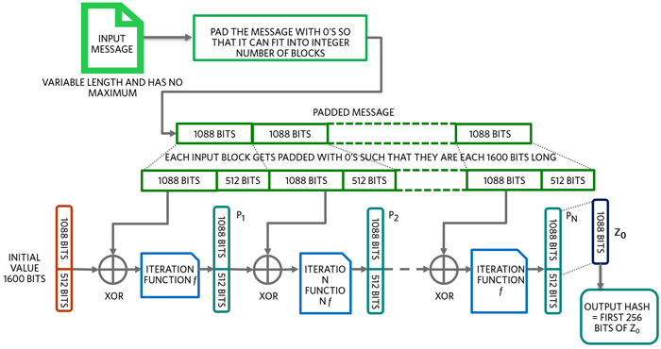
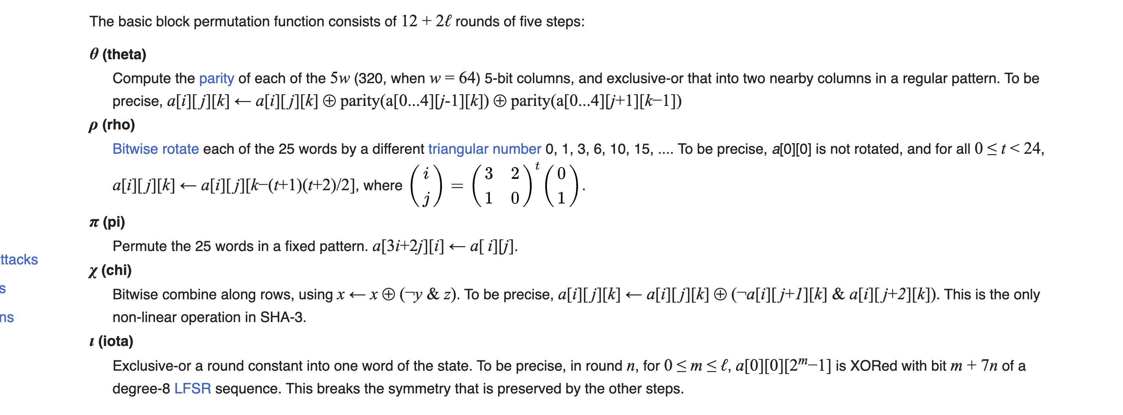
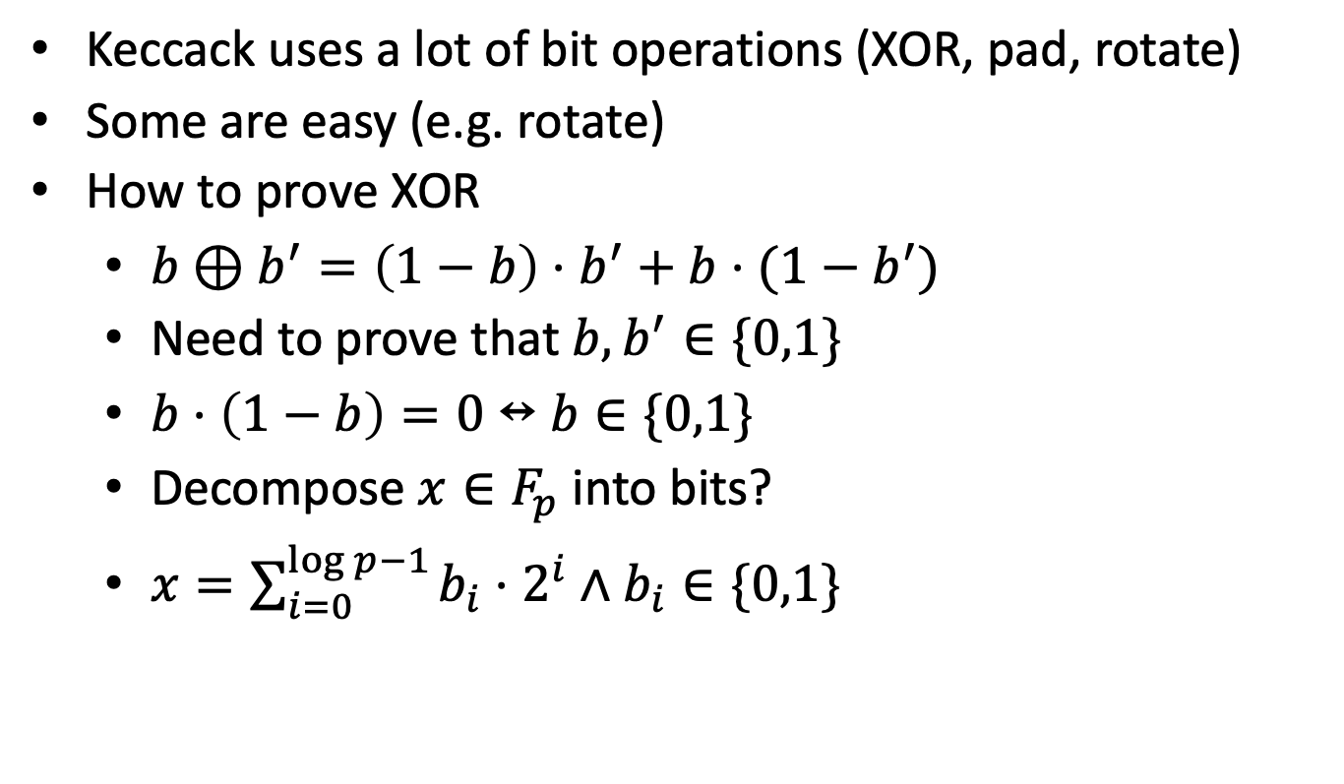
How to make proving zkEVM feasible
Keccack uses a lot of bit operations (XOR, pad, rotate)
Some are easy (e.g. rotate)
How to prove XOR
$b⊕b^{′}=\left(1−b\right)⋅b^{′}+b⋅(1−b^{′})$
Need to prove that $b,b^{′}∈\{0,1\}$
$b⋅\left(1−b\right)=0↔b∈\{0,1\}$
Decompose $x∈F_{p}$ into bits?
$x=\sum_{i=0}^{\log{p−1}}{b_{i}⋅2^{i}}∧b_{i}∈\{0,1\}$

Slide 22
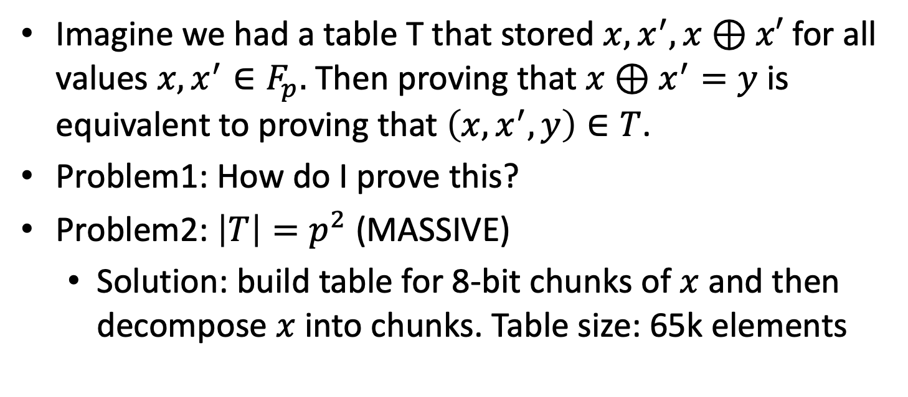
Can we do better
Imagine we had a table T that stored $x,x^{′},x⊕x′$ for all values $x,x^{′}∈F_{p}.$ Then proving that $x⊕x^{′}=y$ is equivalent to proving that $\left(x,x^{′},y\right)∈T$.
Problem1: How do I prove this?
Problem2: $\left|T\right|=p^{2}$ (MASSIVE)
Solution: build table for 8-bit chunks of $x$ and then decompose $x$ into chunks. Table size: 65k elements

Slide 23
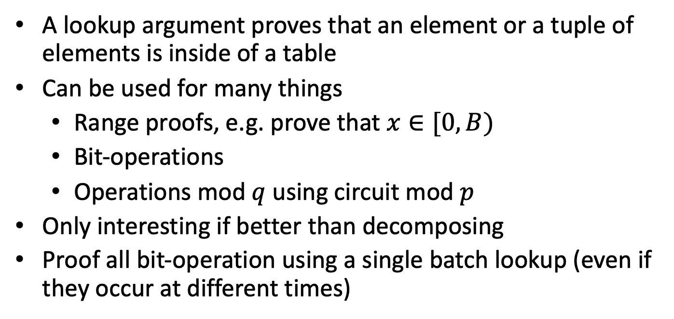
Lookup arguments
A lookup argument proves that an element or a tuple of elements is inside of a table
Can be used for many things
Range proofs, e.g. prove that $x∈[0,B)$
Bit-operations
Operations mod $q$ using circuit mod $p$
Only interesting if better than decomposing
Proof all bit-operation using a single batch lookup (even if they occur at different times)

Slide 24
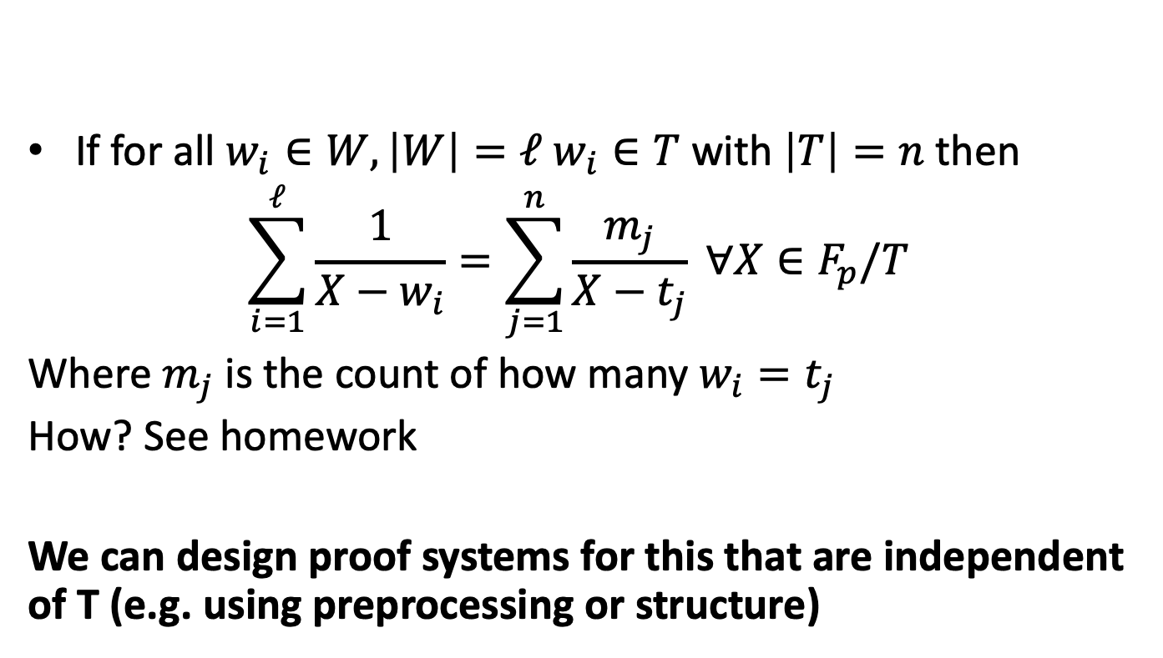
A lookup argument (Haböck 22)
If for all $w_{i}∈W, \left|W\right|=ℓ$ $w_{i}∈T$ with $\left|T\right|=n$ then
$$\sum_{i=1}^{ℓ}{\frac{1}{X−w_{i}}}=\sum_{j=1}^{n}{\frac{m_{j}}{X−t_{j}}} ∀X∈F_{p}/T$$
Where $m_{j}$ is the count of how many $w_{i}=t_{j}$
How? See homework
We can design proof systems for this that are independent of T (e.g. using preprocessing or structure)

Slide 25
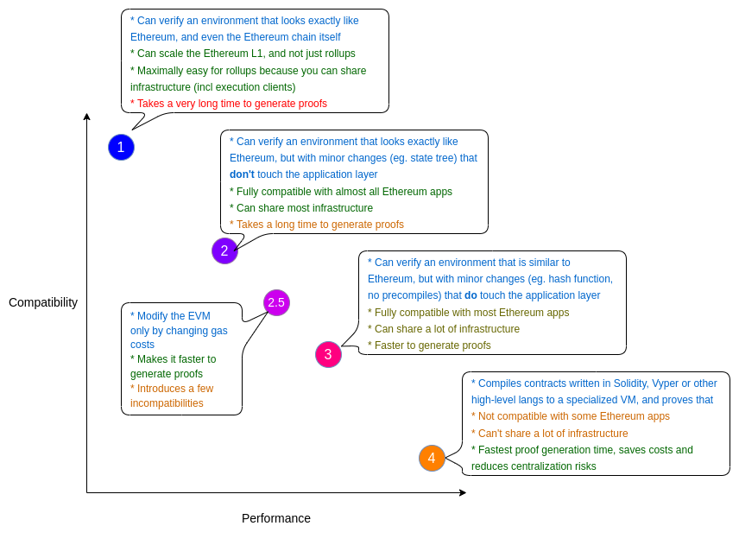
What if we can relax the requirement?
https://vitalik.eth.limo/general/2022/08/04/zkevm.html

Slide 26
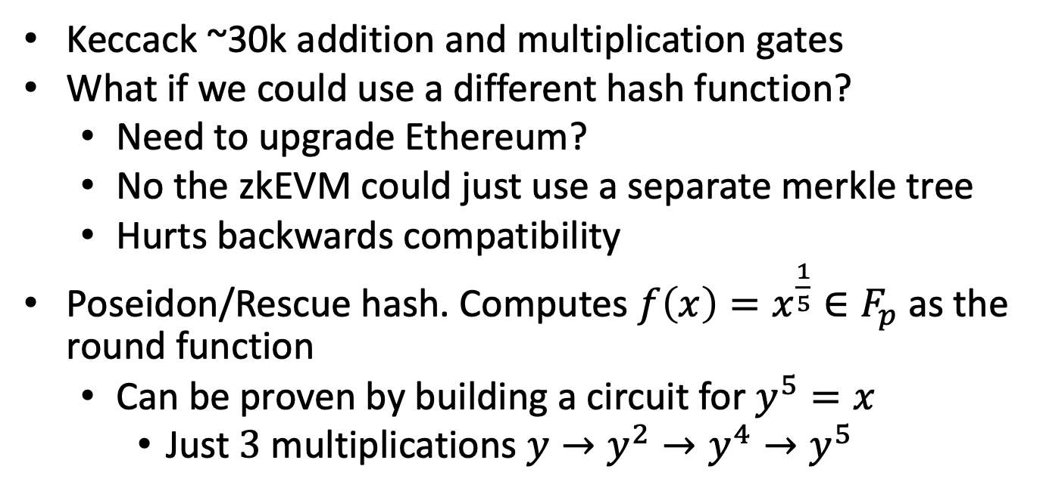
Replace Keccack?
Keccack ~30k addition and multiplication gates
What if we could use a different hash function?
Need to upgrade Ethereum?
No the zkEVM could just use a separate merkle tree
Hurts backwards compatibility
Poseidon/Rescue hash. Computes ${f\left(x\right)=x}^{\frac{1}{5}}∈F_{p}$ as the round function
Can be proven by building a circuit for $y^{5}=x$
Just $3$ multiplications $y→y^{2}→y^{4}→y^{5}$

Slide 27
Can we do even better?
What if we could read/write without Merkle Trees?
state_{i}
CPU
state_{i+1}
MEM
Notes:
Server stores db
Verifier/client stores some local state
Client does rw requests to the server, gets answer, checks answer against local state, updates local state

Slide 28
Tool: Memory Checking
SERVER
CLIENT
Database
Local state
Server stores database/memory.
Client/verifier stores some small local state.
Notes:
Server stores db
Verifier/client stores some local state
Client does rw requests to the server, gets answer, checks answer against local state, updates local state

Slide 29
Tool: Memory Checking
SERVER
r/w requests
CLIENT
Database
Local state
responses
Client issues read/write requests to server.
Server sends back responses.
Notes:
Server stores db
Verifier/client stores some local state
Client does rw requests to the server, gets answer, checks answer against local state, updates local state

Slide 30
Tool: Memory Checking
SERVER
r/w requests
CLIENT
checks responses
Database
Local state
responses
updates
Client verifies the responses against their local state,
updating local state as needed for future verification.
Notes:
Server stores db
Verifier/client stores some local state
Client does rw requests to the server, gets answer, checks answer against local state, updates local state

Slide 31
Verify Machine using Memory Checking
General paradigm: Verify computations assuming that reads and writes were done correctly
Read and write operations are recorded as part of the circuit
Prover simulates memory checking protocol and proves that the memory accesses would have been accepted by the memory-checking verifier.
This shows that all the read/writes were consistent with the memory.
Notes:
Not just in the input but every time the table changes

Slide 32
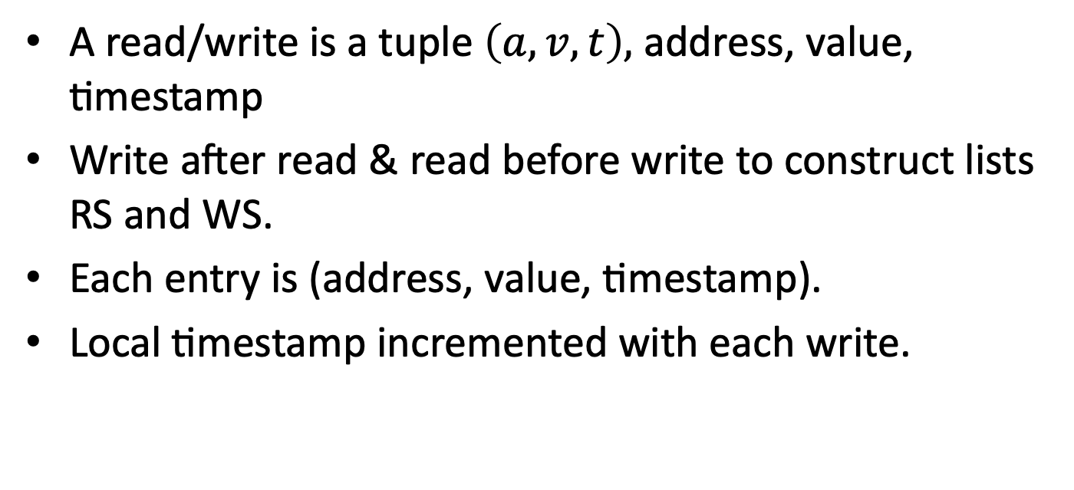
Record each read/write
A read/write is a tuple $\left(a,v,t\right),$ address, value, timestamp
Write after read & read before write to construct lists RS and WS.
Each entry is (address, value, timestamp).
Local timestamp incremented with each write.

Slide 33
Example
Cell | Memory | Last written
1 | 13 | 101
2 | 7 | 132
3 | 25 | 120
4 | 0 | 56
Original read/writes t=142
Read (1,13)
Write (2,8)
Write (4,2)
Cell | Memory | Last written
1 | 13 | 101
2 | 7 8 | 142
3 | 25 | 120
4 | 0 2 | 143

Slide 34
Example
Cell | Memory | Last written
1 | 13 | 101
2 | 7 | 132
3 | 25 | 120
4 | 0 | 56
Original read/writes
Read (1,13,101)
Write (1,13,142)
Read (2,7,132)
Write (2,8,143)
Read (4,0,56)
Write (4,2,144)
RS={(1,13,101); (2,7,132); (4,0,56)}
WS ={(1,13,142); (2,8,143); (4,2,144)}
Cell | Memory | Last written
1 | 13 | 142
2 | 7 8 | 143
3 | 25 | 120
4 | 0 2 | 144

Slide 35
Example
RS={(1,13,101); (2,7,132); (4,0,56)}
WS ={(1,13,142); (2,8,143); (4,2,144)}
Add new memory to RS, Add old memory to WS
W={(1,13,142); (2,8,143); (4,2,144);(1,13,101);(2,7,132);(3,25,120);(4,0,56)}
R= {(1,13,101); (2,7,132); (4,0,56);(1,13,142); (2,8,143); (3,25,120);(4,2,144)}
Cell | Memory | Last written
1 | 13 | 101
2 | 7 | 132
3 | 25 | 120
4 | 0 | 56
Cell | Memory | Last written
1 | 13 | 142
2 | 7 8 | 143
3 | 25 | 120
4 | 0 2 | 144

Slide 36
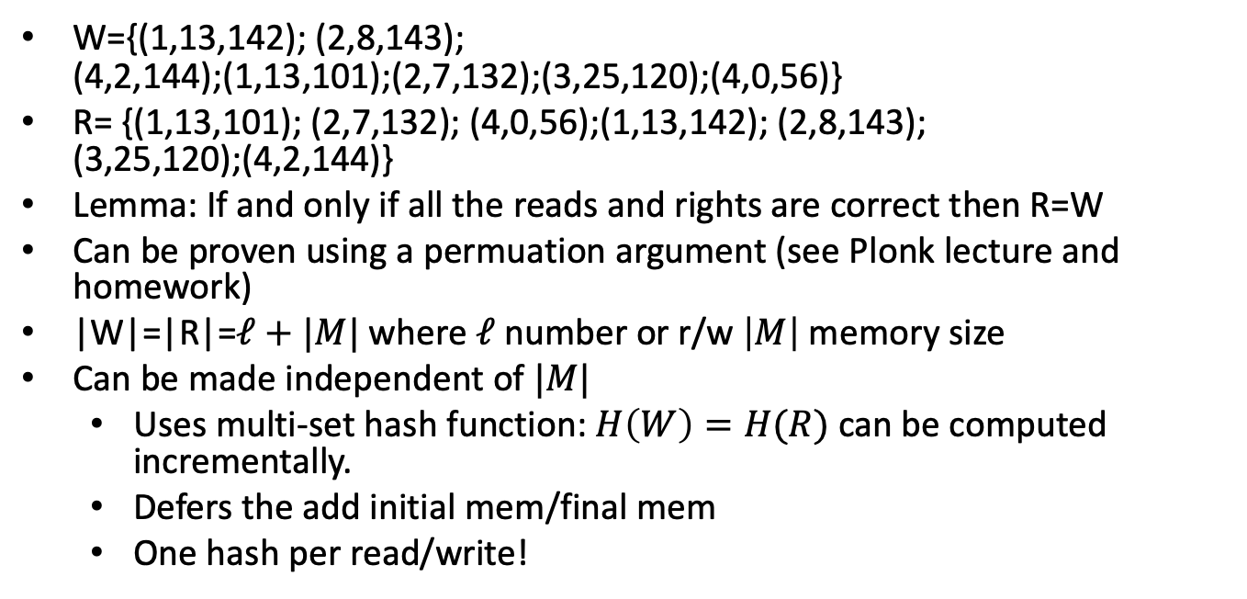
Memory Checking[BEG+91]
W={(1,13,142); (2,8,143); (4,2,144);(1,13,101);(2,7,132);(3,25,120);(4,0,56)}
R= {(1,13,101); (2,7,132); (4,0,56);(1,13,142); (2,8,143); (3,25,120);(4,2,144)}
Lemma: If and only if all the reads and rights are correct then R=W
Can be proven using a permuation argument (see Plonk lecture and homework)
|W|=|R|=$ℓ+|M|$ where $ℓ$ number or r/w $\left|M\right|$ memory size
Can be made independent of $|M|$
Uses multi-set hash function: $H\left(W\right)=H(R)$ can be computed incrementally.
Defers the add initial mem/final mem
One hash per read/write!

Slide 37
zkEVM for multiple Tx/Blocks
We design proof for one block/transaction/opcode
Use recursive proofs (IVC) to show that one EVM step is valid and that the previous computation step was valid

Slide 38
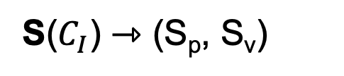
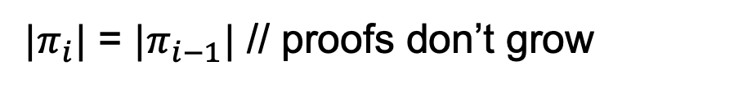
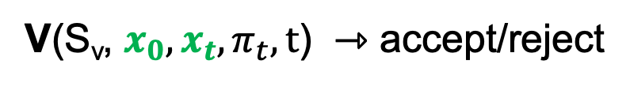
Incremental Proofs
We need updatable/incremental proofs
$C_{I}$– Circuit per computation step, $t$ number of steps/handoffs
S($C_{I}$) ⇾ (S_{p}, S_{v})
P(S_{p}, $x_{i}, w_{i},π_{i−1}$) ⇾ updated proof $π_{i}$ // $π_{0}=⊥$
V(S_{v}, $x_{0},x_{t},π_{t},t$) ⇾ accept/reject
$|π_{i}|$ = $|π_{i−1}|$ // proofs don’t grow

Slide 39
Constant size blockchains
Rollup reduces the verification cost
Still linear in the number of state updates
When a node joins the network they need to verify one rollup proof per block!
In general starting a full node requires verification of all blocks
Can take days!

Slide 40
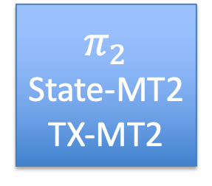
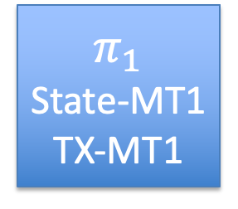
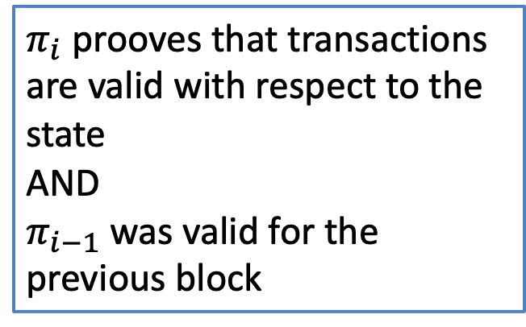
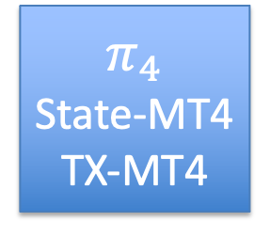
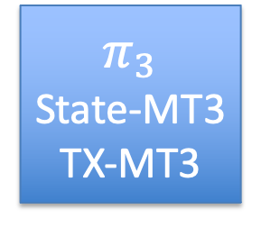
Constant size Blockchain
$$π_{1}$$
State-MT1
TX-MT1
$$π_{2}$$
State-MT2
TX-MT2
$$π_{3}$$
State-MT3
TX-MT3
$$π_{4}$$
State-MT4
TX-MT4
Merkle tree
$π_{i}$ prooves that transactions are valid with respect to the state
AND
$π_{i−1}$ was valid for the previous block
Transactions

Slide 41
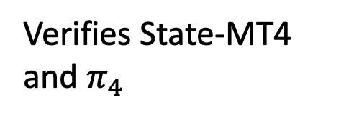
Constant size Blockchain
$$π_{1}$$
State-MT1
TX-MT1
$$π_{2}$$
State-MT2
TX-MT2
$$π_{3}$$
State-MT3
TX-MT3
$$π_{4}$$
State-MT4
TX-MT4
Merkle tree
Old miner
Head and State 4
Transactions
New miner
Verifies State-MT4 and $π_{4}$

Slide 42
Recursion without SNARKs (Folding)

Slide 43










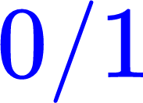





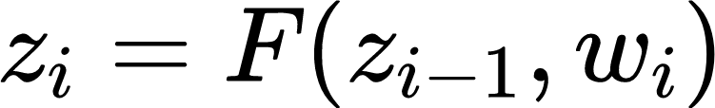
Incrementally Verifiable Computation (IVC)
IVC [Valiant08]: Prover P_{F} and Verifier V_{F} such that
P_{F}
P_{F}
…
…
P_{F}
V_{F}
Completeness:
Given accepted proof for input , can generate valid proof for
Knowledge soundness:
Can extract the witness (i.e. intermediate w and z) from the final output and the final IVC proof
Notes:
Surprisingly

Slide 44




IVC from SNARKs [Val08, BCCT13, BCTV14, COS20]
IVC.P_{F}
Can we construct IVCs w/o SNARKs?
SNARK.P
IVC.V_{F}
Circuit
F
SNARK.V
SNARK.V
Caveats:
expensive recursive verifier circuit (need to arithmetize)
expensive pairing-friendly cycles/trusted setup
Notes:
IVCs and SNARKs are different but highly related. Well known that IVC can be constructed from SNARKs
[Explain how it works]
Caveats, many followups are exploring approaches to construct IVCs w/o SNARKs

Slide 45
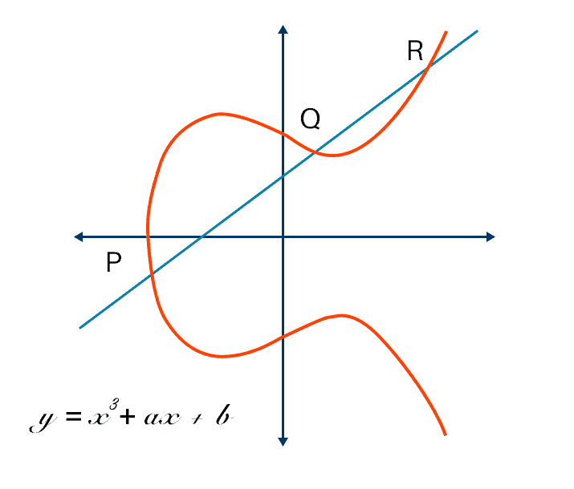
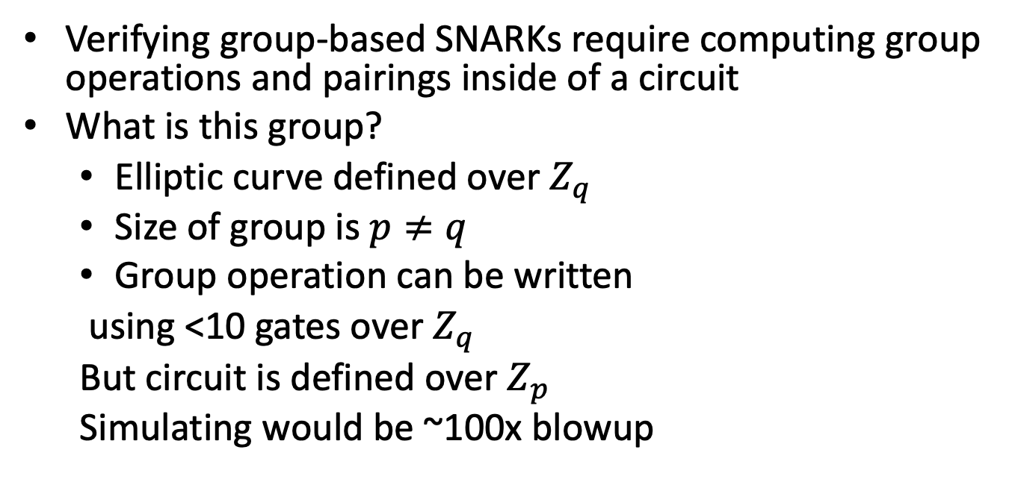
Detour: Cycles of curves
Verifying group-based SNARKs require computing group operations and pairings inside of a circuit
What is this group?
Elliptic curve defined over $Z_{q}$
Size of group is $p≠q$
Group operation can be written
using <10 gates over $Z_{q}$
But circuit is defined over $Z_{p}$
Simulating would be ~100x blowup

Slide 46
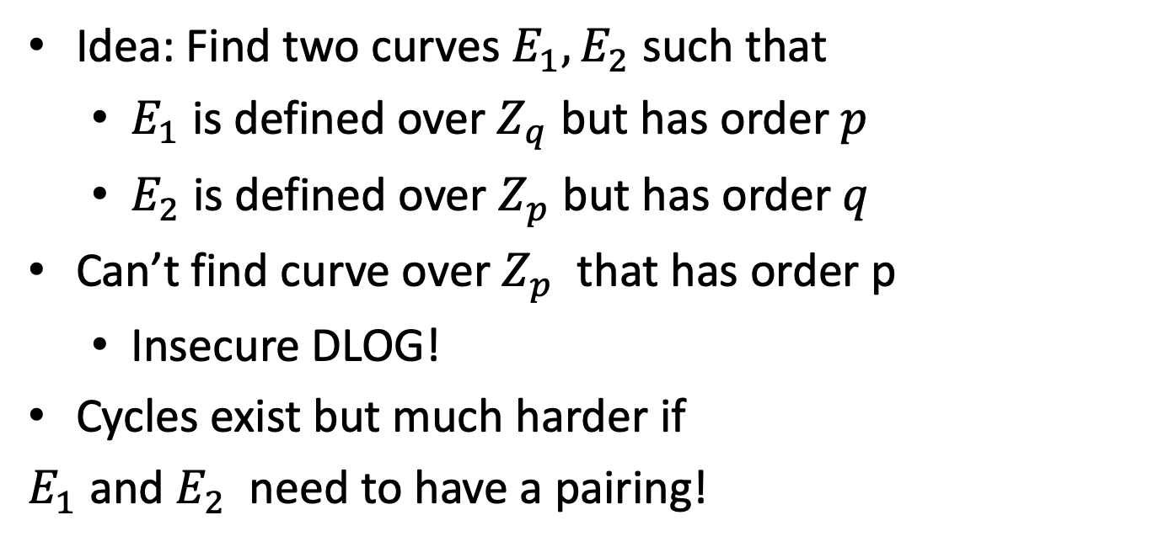
Detour: Cycles of curves
Idea: Find two curves $E_{1},E_{2}$ such that
$E_{1}$ is defined over $Z_{q}$ but has order $p$
$E_{2}$ is defined over $Z_{p}$ but has order $q$
Can’t find curve over $Z_{p}$ that has order p
Insecure DLOG!
Cycles exist but much harder if
$E_{1}$ and $E_{2}$ need to have a pairing!

Slide 47



Accumulating/Folding proofs [BGH19,BCLMS20, KST21]
Acc/Folding: reduce the task of proving two NP instances into proving a single instance
$$π_{1}$$
$$π_{2}$$
Acc.V
Checks procedure
$$π_{3}$$
Idea: Don’t check $π_{1},π_{2}$; reduce to checking $π_{3}$
Notes:
One popular direction is through the use of folding scheme
Problem statement
Syntax, completeness/soundness
Highlight difference from SNARKs

Slide 48
Split Accumulation/Folding [BCLMS20, KST21]
NP Relation R: (x , w) ∈ R
Acc/Folding: reduce the task of proving two NP instances into proving a single instance
Small
Claim
Large
Witness
Completeness:
If x₁,x₂ satisfiable, then x satisfiable
More efficient
than SNARK.V!
x₁
x₂
Acc.V
x
Acc.D
Knowledge Soundness:
If prover knows valid w, then it also knows valid w₁,w₂
Acc.P
w₁
w₂
w
Efficient IVC from Acc schemes
[BCLMS20, KST21, BNS23, KS23]
Acc.V becomes ”recursive circuit”
No trusted setup, just DLOG, no FFTs
Notes:
One popular direction is through the use of folding scheme
Problem statement
Syntax, completeness/soundness
Highlight difference from SNARKs

Slide 49
IVC from Split Accumulation/Folding [BCLMS20, KST21]
smaller circuit
than SNARK.V!
IVC.P_{F}
IVC.V_{F}
x_{i}: claim that C(z_{i-1})=z_{i}
ACC_{i}.x: claim that C^{i}(z₀)=z_{i}
Circuit
F
Acc.D
x_{i}
ACC_{i-1}.x
Acc.V
ACC_{i}.x
Acc.P
w_{i}
ACC_{i-1}.w
Acc.D may not be succinct:
Can use SNARK to delegate the computation of Acc.D
ACC_{i}.w
Notes:
Run Acc prover
Generate a NARK for the statement that the last step function execution is correct, and the last verifier’s folding step is correct
Acc.D check the last folded instance.
Explain how to make Acc.D succinct

Slide 50
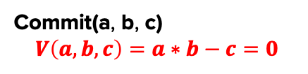
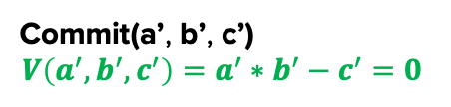
Accumulation is “easy” [BCLMS20, KST21]
Commit can be built from DLOG
Check: P knows a, b, c s.t. a_{i} * b_{i} = c_{i} for all i ∈ [n]
Commit(a, b, c)
$$V\left(a,b,c\right)=a∗b−c=0$$
Commit(a’, b’, c’)
$$V\left(a^{′},b^{′},c^{′}\right)=a^{′}∗b^{′}−c^{′}=0$$

Slide 51
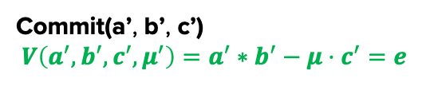
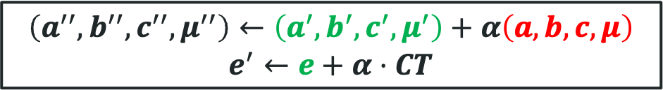

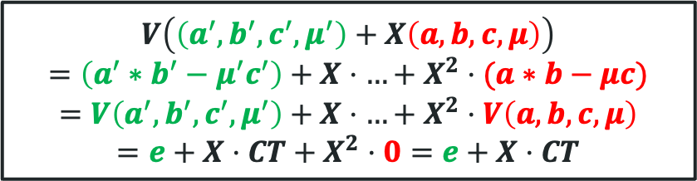
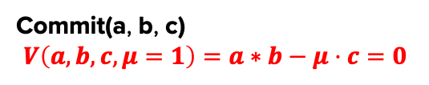
Accumulation is “easy” [BCLMS20, KST21]
Commit can be built from DLOG
Check: P knows a, b, c s.t. a_{i} * b_{i} = c_{i} for all i ∈ [n]
Commit(a, b, c)
$$V\left(a,b,c,μ=1\right)=a∗b−μ⋅c=0$$
Acc.P
Acc.V
Commit(a’, b’, c’)
$$V\left(a^{′},b^{′},c^{′},μ^{′}\right)=a^{′}∗b^{′}−μ⋅c^{′}=e$$
CT
$$α$$
$$\left(a^{′′},b^{′′},c^{′′},μ^{′′}\right)←\left(a^{′},b^{′},c^{′},μ^{′}\right)+α\left(a,b,c,μ\right)$$
$$e^{′}←e+α⋅CT$$
Can be done homomorphically
$$V\left(\left(a^{′},b^{′},c^{′},μ^{′}\right)+X\left(a,b,c,μ\right)\right)$$
$$=\left(a^{′}∗b^{′}−μ^{′}c^{′}\right)+X⋅…+X^{2}⋅(a∗b−μc)$$
$$=V\left(a^{′},b^{′},c^{′},μ^{′}\right)+X⋅…+X^{2}⋅V\left(a,b,c,μ\right)$$
$$=e+X⋅CT+X^{2}⋅0=e+X⋅CT$$

Slide 52
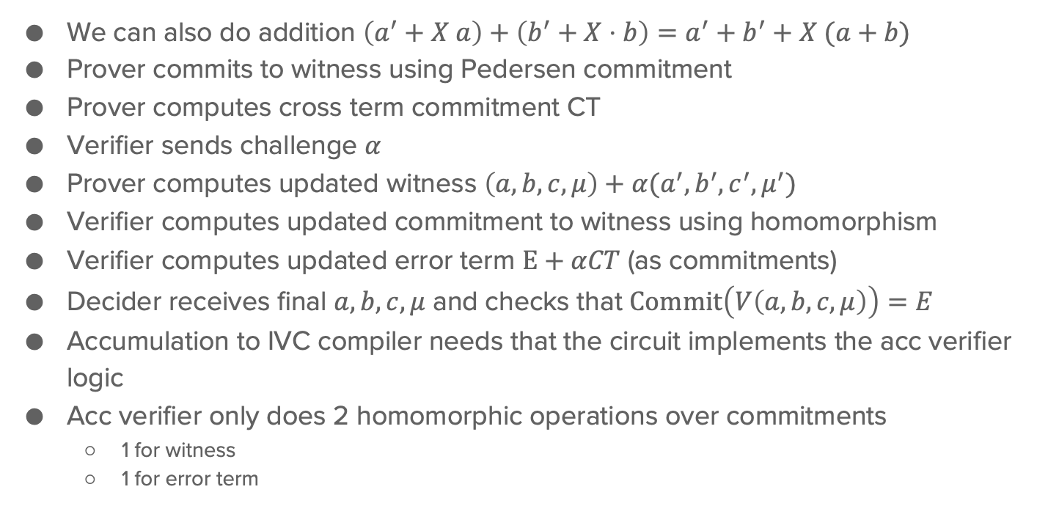
Accumulation
We can also do addition $\left(a^{′}+X a\right)+\left(b^{′}+X⋅b\right)=a^{′}+b^{′}+X (a+b)$
Prover commits to witness using Pedersen commitment
Prover computes cross term commitment CT
Verifier sends challenge $α$
Prover computes updated witness $\left(a,b,c,μ\right)+α(a^{′},b^{′},c^{′},μ^{′})$
Verifier computes updated commitment to witness using homomorphism
Verifier computes updated error term $E+αCT$ (as commitments)
Decider receives final $a,b,c,μ$ and checks that $Commit\left(V\left(a,b,c,μ\right)\right)=E$
Accumulation to IVC compiler needs that the circuit implements the acc verifier logic
Acc verifier only does 2 homomorphic operations over commitments
1 for witness
1 for error term

Slide 53
END OF LECTURE

