Slide 1
Optimistic Rollups, Data Availability and Verifiable Information Disperal
CSCI-GA 3033-107
https://brightspace.nyu.edu/d2l/home/353819
Benedikt Bünz
New York University
[second homework out (due 3/10)]

Slide 2
Scaling the blockchain: the problem
Transaction rates (Tx/sec):
Bitcoin: can process about 7 (Tx/sec)
Ethereum: can process about 15 (Tx/sec)
The visa network: can process up to 24,000 (Tx/sec)
Tx Fees fluctuate:
2$ to 60$ for simple Tx
Can we scale blockchains to visa speeds? … with low Tx fees

Slide 3
How to process more Tx per second
Many ideas:
Use a faster consensus protocol
Parallelize: split the chain into independent shards
Today: Rollups, move the work somewhere else
Payment channels: reduce the need to touch the chain
Requires locking up funds; mostly designed for payments.
reduces
composability

Slide 4
Recall: a basic layer-1 blockchain
A layer-1 blockchain
(e.g., Ethereum)
Can handle 15 Tx/sec …
current world state
Tx_{A}
updated world state
Tx_{B}
⋮
updated world state
World state: balances, storage, etc.

Slide 5
Rollup idea 1: batch many Tx into one
updated Rollup state root, and Tx list
A layer-1 blockchain
(e.g., Ethereum)
Rollup coordinator
Tx_{A}
current world state
(Rollup state Merkle root)
Tx_{B}
(Tx list)
Tx_{C}
updated world state
(updated Rollup state root)
Rollup state:
Alice’s balance
Bob’s balance
…

Slide 6
Rollup idea 1: batch many Tx into one
A layer-1 blockchain
(e.g., Ethereum)
Key point:
Hundreds of transactions on Rollup state are batched into a single transaction on layer-1
⇒ 100x speed up in Tx/sec
Let’s see how …
current world state
(Rollup state Merkle root)
(Tx list)
updated world state
(updated Rollup state root)
Rollup state:
Alice’s balance
Bob’s balance
…

Slide 7


Rollup operation (simplified)
Rollup coordinator
[A⇾B: 2 ETH], ${sig}_{A}$
Layer 1 blockchain
(e.g. Ethereum)
atomic swap:
[B⇾Z: 1 ETH]
[Z⇾B: 2 USDC]
Rollup state root
block 354
$${sig}_{B} {sig}_{Z}$$
Merkle Tree
Alice:
5 DAI
3 ETH
Bob:
2 ETH
Zoe:
1 ETH 3 USDC
Tx
…

Slide 8
Rollup operation (simplified)
Rollup coordinator
[A⇾B: 2 ETH], ${sig}_{A}$
Layer 1 blockchain
(e.g. Ethereum)
atomic swap:
[B⇾Z: 1 ETH]
[Z⇾B: 2 USDC]
new Rollup root
block 354
new root, Tx list
$${sig}_{B} {sig}_{Z}$$
Merkle Tree
block 361
Alice:
5 DAI
1 ETH
Bob:
3 ETH
2 USDC
Zoe:
2 ETH 1 USDC
Tx
…

Slide 9
In more detail
Rollup contract on layer-1 holds assets of all Rollup accounts
(and Merkle state root)
Rollup state (L2)
Alice:
4 ETH, 1 DAI
Bob:
3 ETH, 2 DAI
…
(coordinator stores state)
Alice:
state
Bob:
state
Uniswap: state
Rollup contract: root
…
7 ETH, 3 DAI,
Layer-1 blockchain (L1)

Slide 10

Transfers inside Rollup are easy (L2 ⇾ L2)
Rollup state (L2)
[A⇾B: 2 ETH], ${sig}_{A}$
Alice:
4 ETH, 1 DAI
Bob:
3 ETH, 2 DAI
…
(with hundreds of Tx)
Alice:
state
Bob:
state
Uniswap: state
Rollup contract:
…
7 ETH, 3 DAI,
root
Layer-1 blockchain (L1)
Notes:
Tx summary recorded on L1 chain as calldata into Rollup contract.

Slide 11
Transfers inside Rollup are easy (L2 ⇾ L2)
Coordinator updates root on Rollup contract
Rollup state (L2)
[A⇾B: 2 ETH], ${sig}_{A}$
Alice:
2 ETH, 1 DAI
Bob:
5 ETH, 2 DAI
…
(with hundreds of Tx)
new Merkle root,
Tx list
Alice:
state
Bob:
state
Uniswap: state
Rollup contract:
…
7 ETH, 3 DAI,
root
Layer-1 blockchain (L1)
Notes:
Tx summary recorded on L1 chain as calldata into Rollup contract.

Slide 12
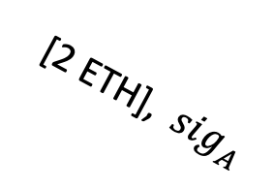
Transferring funds into Rollup (L1 ⇾ L2)
Alice issues an L1 Tx: slow and expensive
Rollup state (L2)
Alice:
2 ETH, 1 DAI
Bob:
5 ETH, 2 DAI
…
[2 ETH], ${sig}_{A}$
Alice:
state
Bob:
state
Uniswap: state
Rollup contract:
…
7 ETH, 3 DAI,
root
2 ETH
Layer-1 blockchain (L1)

Slide 13
Transferring funds into Rollup (L1 ⇾ L2)
Alice issues an L1 Tx: slow and expensive
Rollup state (L2)
Alice:
4 ETH, 1 DAI
Bob:
5 ETH, 2 DAI
…
[2 ETH], ${sig}_{A}$
new Merkle root,
Tx list
Alice:
state
Bob:
state
Uniswap: state
Rollup contract:
…
9 ETH, 3 DAI,
root
2 ETH
Layer-1 blockchain (L1)

Slide 14

Transferring funds out of Rollup (L2 ⇾ L1)
Requires extra gas on L1 to process transfer
Rollup state
[withdraw 4 ETH], ${sig}_{A}$
Alice:
4 ETH, 1 DAI
Bob:
5 ETH, 2 DAI
…
(plus hundreds of Tx)
Alice:
state
Bob:
state
Uniswap: state
Rollup contract:
…
9 ETH, 3 DAI,
root
Layer-1 blockchain (L1)

Slide 15
Transferring funds out of Rollup (L2 ⇾ L1)
Requires extra gas on L1 to process transfer
Rollup state
[withdraw 4 ETH], ${sig}_{A}$
Alice:
0 ETH, 1 DAI
Bob:
5 ETH, 2 DAI
…
(plus hundreds of Tx)
new Merkle root,
Tx list
Alice:
state
Bob:
state
Uniswap: state
Rollup contract:
…
5 ETH, 3 DAI,
root
4 ETH
Layer-1 blockchain (L1)

Slide 16
Summary: transferring Rollup assets
Transactions within a Rollup are easy:
Batch settlement on L1 network (e.g., Ethereum)
Moving funds into or out of Rollup system (L1 ⟺ L2) is expensive:
Requires posting more data on L1 network ⟹ higher Tx fees.
Moving funds from one Rollup system to another (L2 ⟺ L2)
Either via L1 network (expensive), or via a direct L2 ⟺ L2 bridge (cheap)

Slide 17
Running contracts on a Rollup?
Two copies of Uniswap
Rollup state (L2)
Alice:
4 ETH, 1 DAI
Bob:
3 ETH, 2 DAI
…
⇒ Rollup users can cheaply interact with Uniswap on Rollup
Bob:
state
Uniswap: state
Rollup contract: root
Alice:
state
Uniswap: state
…
7 ETH, 3 DAI,
Layer-1 blockchain (L1)

Slide 18
Running contracts on a Rollup?
Rollup state (L2)
Uniswap: state
Alice:
4 ETH, 1 DAI
Bob:
3 ETH, 2 DAI
…
Coordinator maintains state of all contracts on Rollup system:
It updates the Uniswap Merkle leaf after every Tx to Uniswap
Writes updated Rollup state Merkle root to L1 chain

Slide 19
Running contracts on a Rollup?
Rollup state (L2)
Uniswap: state
Alice:
4 ETH, 1 DAI
Bob:
3 ETH, 2 DAI
…
Rollup functions as Ethereum, but …
It relies on the L1 chain to attest to the current Rollup state

Slide 20
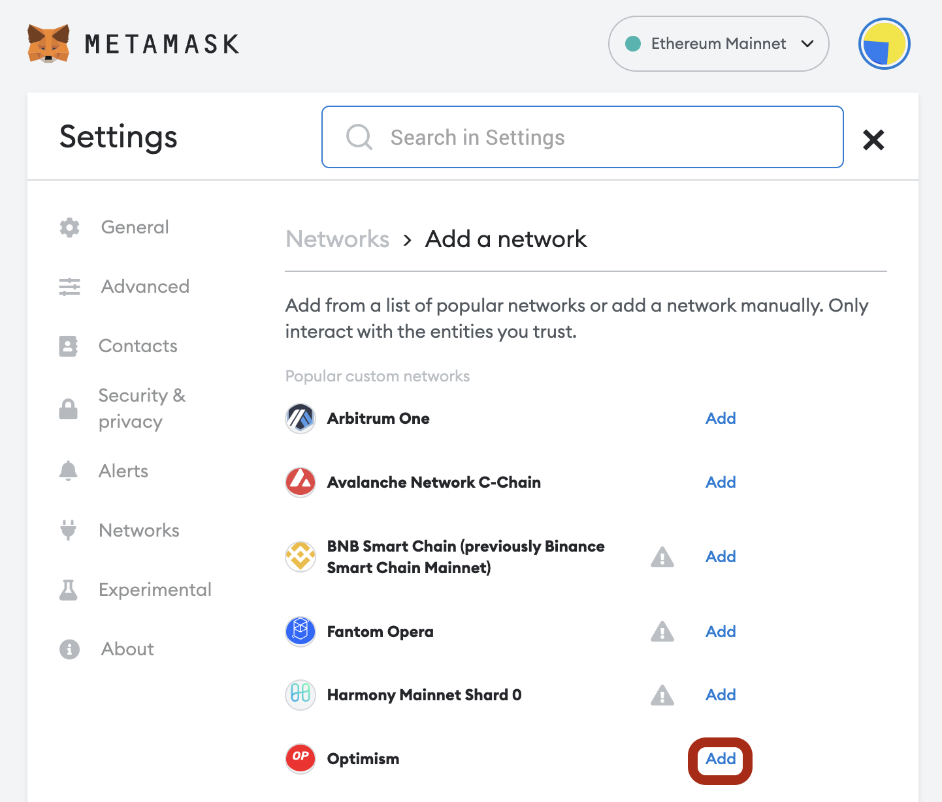
How to send Tx to the coordinator
Enduser configures its
wallet to send Tx to the RPC
points of the selected Rollup.
(by default Metamask sends Tx to the Ethereum Mainnet RPC points)

Slide 21
The role of the Coordinator
The Coordinator has multiple tasks:
Sequence incoming Tx from Rollup users into a stream of Tx ⇒ can extract MEV from searchers, in addition to Tx fees ⇒ very profitable to be a Rollup coordinator
Execute the stream of Tx on the latest Rollup state
Push updates to the L1 chain
Shared coordinator: one coordinator for multiple Rollups (not today)

Slide 22
Coordinator architectures
A centralized coordinator:
availability and censorship concerns,
… but cannot steal assets (as we will see)
A decentralized coordinator:
a set of parties that run a fast consensus protocol
At every epoch one party is chosen to sequence, execute, and push updates to the L1
Importantly: L1 provides ground truth of the Rollup state
Notes:
Why do we need an L1 if the L2 runs its own consensus? The L2 consensus can b tuned differently from L1 consensus and can be faster.

Slide 23
Tx rate on L2 is higher than on L1
L2 block
L2 chain
L1 chain
Finalize on L1
Finalize on L1

Slide 24
Not so simple …

Slide 25
Verifying Rollup state updates
Approach: fault proofs (called an optimistic Rollup)
Coordinator deposits stake in escrow on L1 Rollup contract
Operation: Coordinator submits state updates to L1 w/o a proof
If update is invalid: anyone has seven days to submit a fault proof
Successful fault proof means coordinator gets slashed on L1
Unsuccessful fault proof costs complainer a fee
Challenge: how to prove a fault to the Rollup contract on L1 ??
Naively: L1 can re-execute all Tx in batch ⇒ expensive and slow

Slide 26
Problems …
Problem 1: what if coordinator is dishonest?
It could steal funds from the Rollup contract
It could issue fake Tx on behalf of users
Problem 2: what if coordinator stops providing service?
If Rollup state is lost, how can users issue Tx?
… can’t compute updated Rollup Merkle root.

Slide 27
Problem 1: what if coordinator is dishonest?
Can coordinator steal funds from Rollup users?
No! L1 chain verifies that Rollup state updates are valid.
⇒ all Tx are valid and properly signed by the Rollup users
Challenge: how to do this cheaply ?? (with little gas on L1)
Alice:
state
Bob:
state
Rollup contract:
…
7 ETH, 3 DAI,
root
Layer-1 blockchain (L1)

Slide 28
Fault Proof game
pre-root
Tx list
fault claim
coordinator
Coordinator computes Merkle tree of all states. Sends Merkle root to L1
different post-root
claimed post-root
pre- state
post- state
break computation into small steps

Slide 29



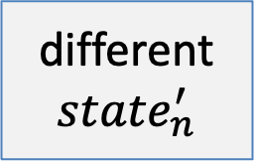
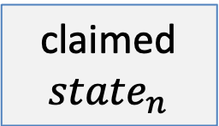
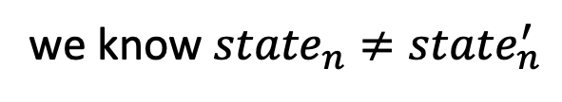
Fault Proof game
pre-root
Tx list
we know ${state}_{n}≠{state}_{n}^{′}$
fault claim
coordinator
Merkle root
different
$${state}_{n}^{′}$$
claimed $${state}_{n}$$
hash_{[0⇾n/2]}
hash_{[n/2⇾n]}
hash_{[0⇾n/4]}
hash_{[n/4⇾n/2]}
$${state}_{0}$$
$${state}_{n/2}$$
$${state}_{n}$$

Slide 30
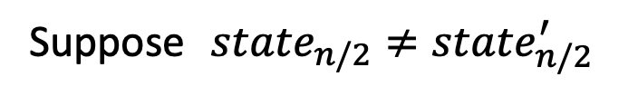
Fault Proof game: binary search
pre-root
Tx list
Suppose ${state}_{n/2}≠{state}_{n/2}^{′}$
fault claim
coordinator
Merkle root
different
$${state}_{n}^{′}$$
claimed $${state}_{n}$$
hash_{[0⇾n/2]}
hash_{[n/2⇾n]}
hash_{[0⇾n/4]}
hash_{[n/4⇾n/2]}
$${state}_{0}$$
$${state}_{n/2}$$
$${state}_{n}$$

Slide 31
Fault Proof game: binary search
pre-root
Tx list
Suppose ${state}_{n/2}≠{state}_{n/2}^{′}$
fault claim
coordinator
Merkle root
different
$${state}_{n}^{′}$$
claimed $${state}_{n}$$
hash_{[0⇾n/2]}
hash_{[n/2⇾n]}
hash_{[0⇾n/4]}
hash_{[n/4⇾n/2]}
Coordinator sends hash_{[0⇾n/2]} to L1
Alice sends “left” to L1
$${state}_{0}$$
$${state}_{n/2}$$

Slide 32

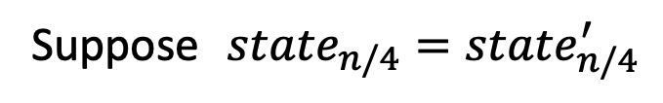
Fault Proof game: binary search
pre-root
Tx list
Suppose ${state}_{n/4}={state}_{n/4}^{′}$
fault claim
coordinator
Merkle root
different
$${state}_{n}^{′}$$
claimed $${state}_{n}$$
hash_{[0⇾n/2]}
hash_{[n/2⇾n]}
hash_{[0⇾n/4]}
hash_{[n/4⇾n/2]}
Coordinator sends hash_{[n/4⇾n/2]} to L1
Alice sends “right” to L1
$${state}_{0}$$
$${state}_{n/4}$$
$${state}_{n/2}$$

Slide 33
Fault Proof game: binary search
pre-root
Tx list
Suppose ${state}_{n/4}={state}_{n/4}^{′}$
fault claim
coordinator
Merkle root
different
$${state}_{n}^{′}$$
claimed $${state}_{n}$$
hash_{[0⇾n/2]}
hash_{[n/2⇾n]}
hash_{[0⇾n/4]}
hash_{[n/4⇾n/2]}
Coordinator sends hash_{[n/4⇾n/2]} to L1
Alice sends “right” to L1
$${state}_{n/4}$$
$${state}_{n/2}$$

Slide 34
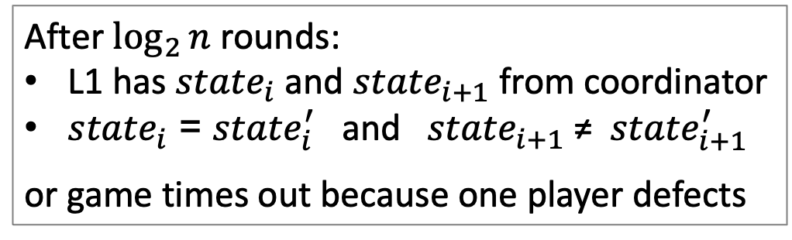
Fault Proof game: binary search
pre-root
Tx list
coordinator
After $\log_{2}{n}$ rounds:
L1 has ${state}_{i}$ and ${state}_{i+1}$ from coordinator
${state}_{i}$ = ${state}_{i}^{′}$ and ${state}_{i+1}$ ≠ ${state}_{i+1}^{′}$
or game times out because one player defects
⇒ Now L1 can verify fault proof by checking one computation step!

Slide 35
Some difficulties with optimistic approach
(1) Transactions only settle after 7 days (after fault window expires)
Alice needs to wait 7 days to withdraw funds from Rollup (Rollup contract will only send her the funds after 7 days)
For fungible tokens, a 3rd party can advance the funds to Alice after checking validity of Alice’s withdraw Tx. Does not apply to non-fungible tokens.
(2) Suppose a successful fault proof 4 days after batch is posted ⇒ all subsequent Tx need to be reprocessed

Slide 36
The end result
Can easily port any smart contract to an optimistic Rollup
The Rollup EVM can be enhanced with new features (opcodes)
High Tx throughput: in principle, up to 4000 tx/s
No need for special hardware at the coordinator
Anyone can act as a coordinator and a verifier
Downside: 7 day finality delay

Slide 37
Problem 2: centralized coordinator, what if it stops providing service?
… ok, so coordinator cannot submit invalid Tx.
Solution: setup a new coordinator
… but need the latest Rollup state
Where to get state?? The data availability problem

Slide 38
Ensuring Rollup state is always available
The definition of a Rollup:
Rollup state can always be reconstructed from data on the L1 chain
Layer 1 blockchain
(e.g. Ethereum)
updated
state
root
coordinator
Tx list
Rollup contract
state root
Sent to Rollup contract on L1 as part of state update message

Slide 39
Ensuring Rollup state is always available
To reconstruct current Rollup state:
Read all Rollup update messages and re-execute Tx.
⇒ anyone can become a coordinator
Rollups use L1 for data storage
What to store?
For zk-Rollup: send Tx summary to L1, without user signatures
(SNARK proof proves validity of signatures)
For optimistic: need to send Tx summary *and* signatures to L1
Notes:
EIP-4444: history expiry makes it possible to remove user signatures from chain after the dispute window elapses.

Slide 40
Ensuring Rollup state is always available
The downside: expensive
Tx list is sent as calldata: 16 gas per non-zero byte
(EIP-4844: store Tx list as a cheap blob)
Can we do better?
Notes:
Comparison to Eth is taken from EIP-4488.

Slide 41
Data Availability Committee (DAC)
To further reduce Tx fees:
Store L2 state root (small) on the L1 chain
Store Tx data (large) with a Data Availability Committee (DAC):
a set of nodes trusted to keep the data available
cheaper than storage on L1
L1 accepts an update only if all DAC members sign it
⇒ ensures that all DAC members accepted Tx data
Setting up a new coordinator depends on availability of the DAC

Slide 42
Validium/Plasma
Validium: an L2 using a DAC
Potential privacy benefits … only DAC members see Tx data
An example: StarkEx uses a five member DAC
Users can choose between Validium or Rollup modes
(Tx data off-L1-chain vs. Tx data on-L1-chain)
cheaper Tx fees,
but only secure as DAC
More expensive Tx, but same as L1 security

Slide 43
Scaling the DAC
Data Availability
Committee
Rollup coordinator
block
block
block
Problem 1: Scales as Size of Data * #Nodes in DAC
Problem 2: Any node in DAC can stop progress
Goal: Scale DAC to 1000s of nodes (e.g. all ETH stakers)

Slide 44
Idea: Split Data
Data Availability
Committee
Rollup coordinator
Block[0:1/3]
Block[1/3:2/3]
Block[2/3:1]
Problem: One Malicious can make block unrecoverable

Slide 45
Powerful Tool: Error Correcting Codes
With n parties and T data can each party receive a bit more than T/n data such that 2/3rd n can recover the data
Yes! This is solved by error correcting codes
An error correcting code enables reconstructing a message even if a limited positions have been corrupted
The Decoder doesn’t know which positions where corrupted or not

Slide 46
Idea: Split Data
Data Availability
Committee
Rollup coordinator
Code[0:1/3]
Code[1/3:2/3]
Code[2/3:1]
Code = ECC(Block)
If a small number of parties is corrupted/don’t respond, we can still decode.

Slide 47
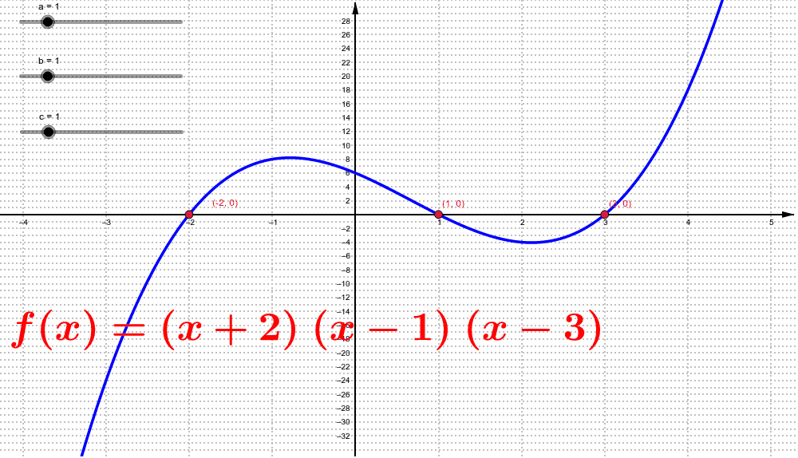
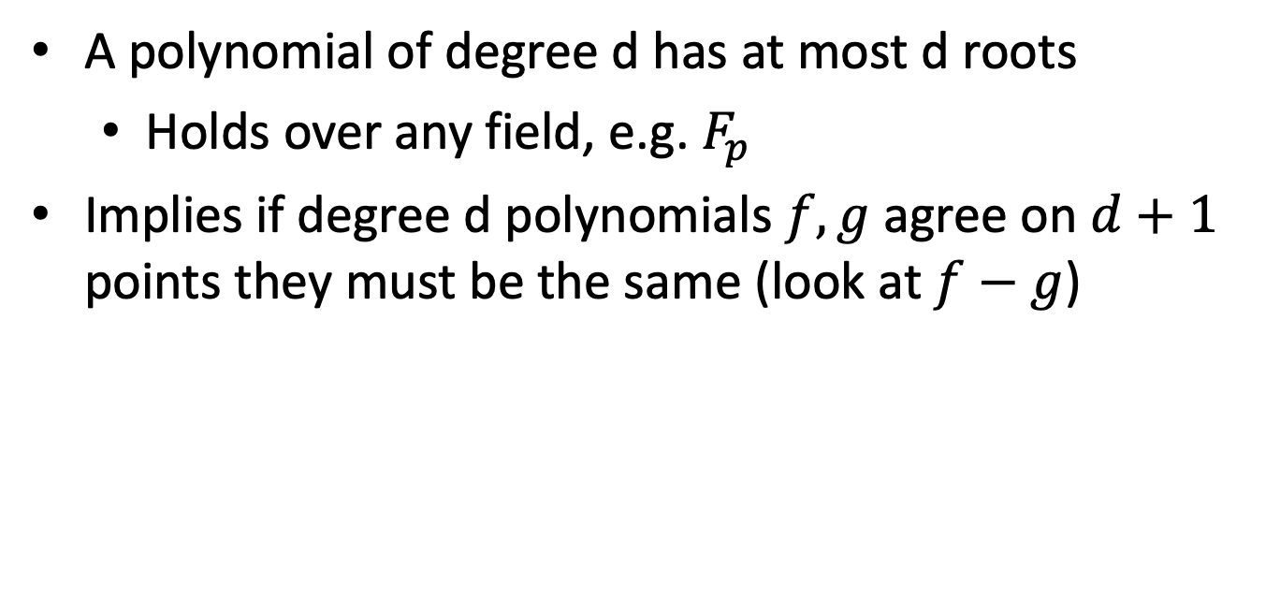
A very useful fact:
A polynomial of degree d has at most d roots
Holds over any field, e.g. $F_{p}$
Implies if degree d polynomials $f,g$ agree on $d+1$ points they must be the same (look at $f−g$)

Slide 48
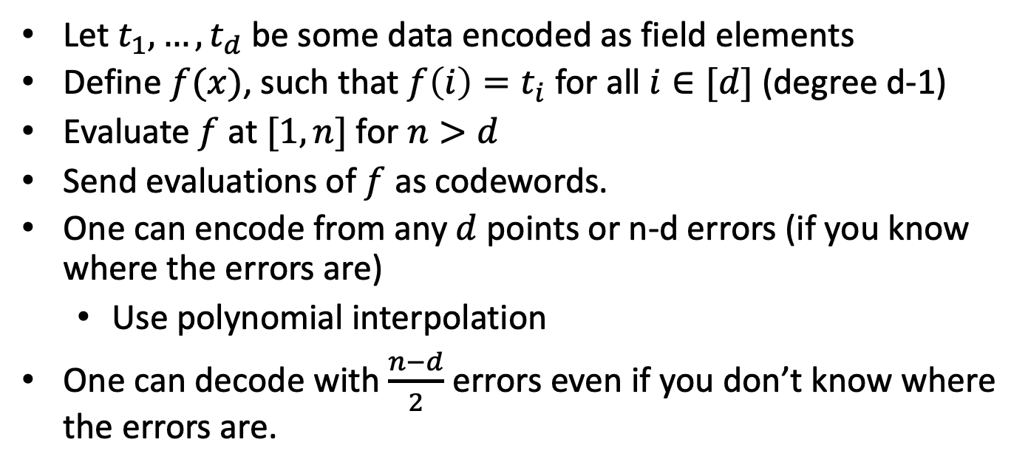
Reed Solomon code
Let $t_{1},…,t_{d}$ be some data encoded as field elements
Define $f(x)$, such that $f\left(i\right)=t_{i}$ for all $i∈[d]$ (degree d-1)
Evaluate $f$ at $[1,n]$ for $n>d$
Send evaluations of $f$ as codewords.
One can encode from any $d$ points or n-d errors (if you know where the errors are)
Use polynomial interpolation
One can decode with $\frac{n−d}{2}$ errors even if you don’t know where the errors are.

Slide 49
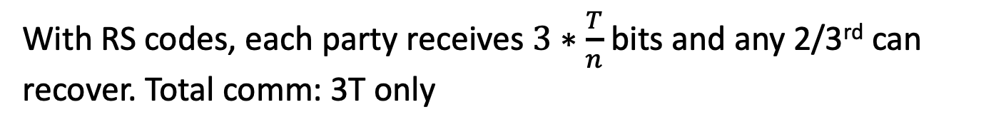
One more problem
Data Availability
Committee
Rollup coordinator
Code[0:1/3]
Code[1/3:2/3]
Code[2/3:1]
Code = RS-encode(Block)
With RS codes, each party receives $3∗\frac{T}{n}$ bits and any 2/3rd can recover. Total comm: 3T only
How does the DAC know that they received the correct data?

Slide 50
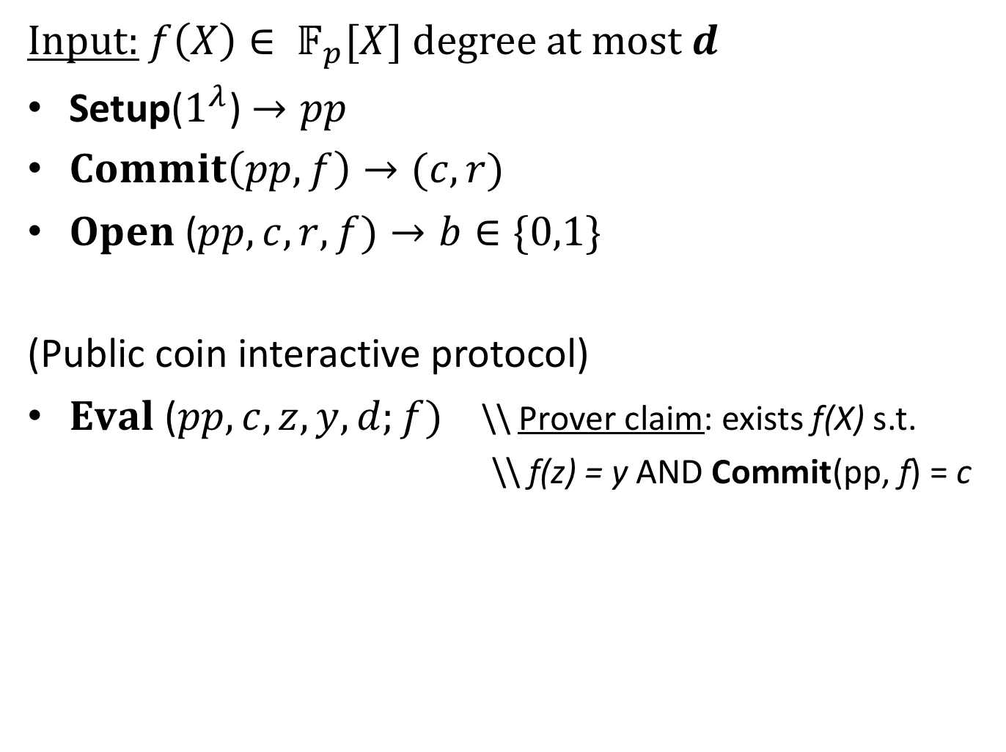

Polynomial Commitment [KZG’10]
Input: $f\left(X\right)∈ 𝔽_{p}[X]$ degree at most $d$
Setup($1^{λ}$) $→pp$
$Commit\left(pp,f\right)→(c,r)$
$Open$ ($pp, c, r,f)→b∈\{0,1\}$
(Public coin interactive protocol)
$Eval$ ($pp, c, z, y,d;f)$ \\ Prover claim: exists f(X) s.t.
\\ f(z) = y AND Commit(pp, f) = c
|c| << d
ideally O($λ$)
Communication sublinear in d

Slide 51
Security: Binding / Knowledge
Input: $f\left(X\right)∈ 𝔽_{p}[X]$ degree at most $d$
Setup($1^{λ}$) $→pp$
$Commit\left(pp,f\right)→(c,r)$
$Open$ ($pp, c, r,f)→b∈\{0,1\}$
(Public coin interactive protocol)
$Eval$ ($pp, c, z, y,d;f)$ \\ Prover claim: exists f(X) s.t.
\\ f(z) = y AND Commit(pp, f) = c
Commitment binding
Evaluation Binding / Argument of Knowledge

Slide 52
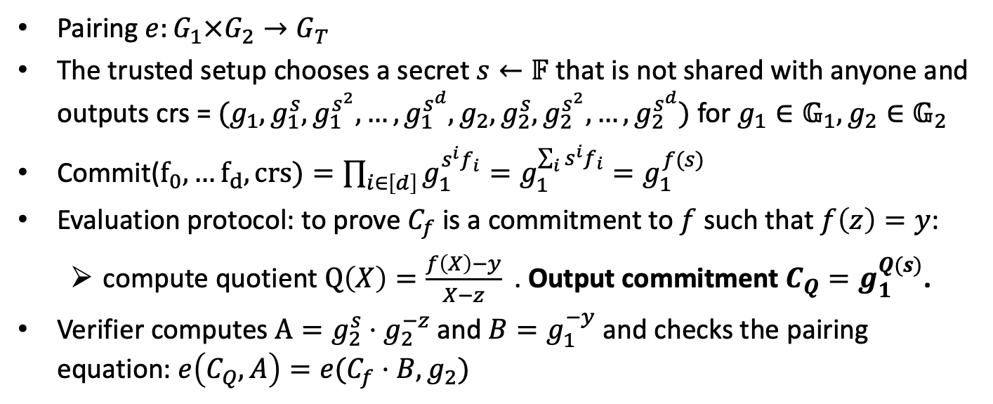
Kate PCS
Pairing $e:G_{1}×G_{2}→G_{T}$
The trusted setup chooses a secret $s←𝔽$ that is not shared with anyone and outputs crs = $(g_{1},g_{1}^{s}, g_{1}^{s^{2}},…,g_{1}^{s^{d}},g_{2},g_{2}^{s}, g_{2}^{s^{2}},…,g_{2}^{s^{d}})$ for $g_{1}∈𝔾_{1}, g_{2}∈𝔾_{2}$
Commit($f_{0},…f_{d}, crs)=\prod_{i∈\left[d\right]}{g_{1}^{s^{i}f_{i}}}=g_{1}^{\sum_{i}{{s^{i}f}_{i}}}=g_{1}^{f(s)}$
Evaluation protocol: to prove $C_{f}$ is a commitment to $f$ such that $f\left(z\right)=y$:
compute quotient $Q\left(X\right)=\frac{f\left(X\right)−y}{X−z}$. Output commitment $C_{Q}=g_{1}^{Q(s)}$.
Verifier computes $A=g_{2}^{s}⋅g_{2}^{−z}$and $B=g_{1}^{−y}$ and checks the pairing equation: $e\left(C_{Q}, A\right)=e(C_{f}⋅B,g_{2})$

Slide 53
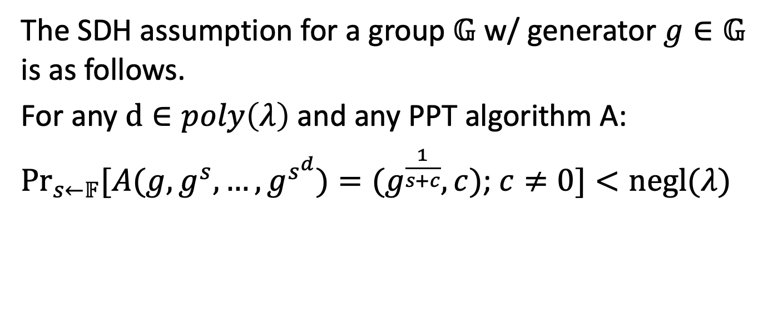
Strong Diffie-Hellman Assumption
The SDH assumption for a group $𝔾$ w/ generator $g∈𝔾$ is as follows.
For any $d∈poly\left(λ\right)$and any PPT algorithm A:
$\underset{s←𝔽}{Pr}{[A(g, g^{s},…,g^{s^{d}})}=(g^{\frac{1}{s+c}}, c)$; $c≠0]<negl(λ)$

Slide 54
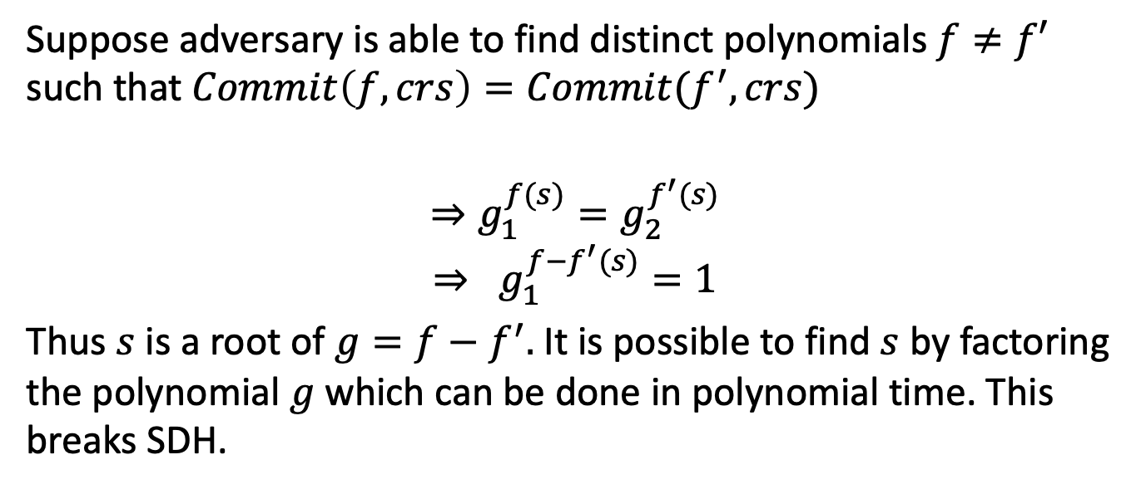
Binding of KZG
Suppose adversary is able to find distinct polynomials $f≠f′$ such that $Commit\left(f, crs\right)=Commit(f^{′}, crs)$
$$⇒g_{1}^{f(s)}=g_{2}^{f^{′}(s)}$$
$$⇒ g_{1}^{f−f^{′}(s)}=1$$
Thus $s$ is a root of $g=f−f^{′}.$It is possible to find $s$ by factoring the polynomial $g$which can be done in polynomial time. This breaks SDH.

Slide 55
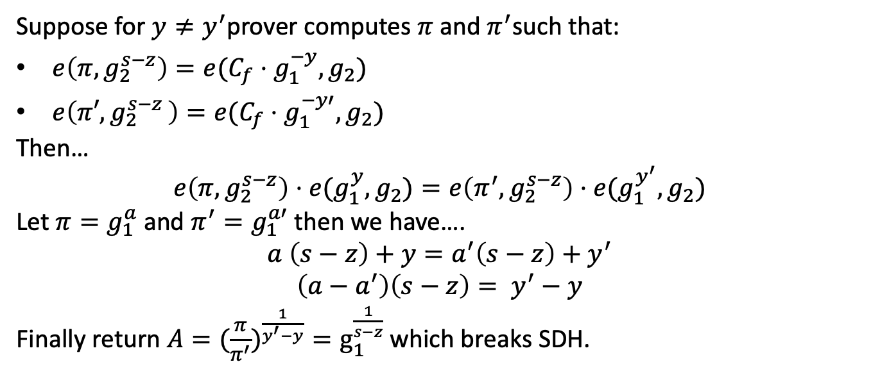
Evaluation binding of KZG
Suppose for $y≠y^{′}$prover computes $π$and $π^{′}$such that:
$e\left(π, g_{2}^{s−z}\right)=e(C_{f}⋅g_{1}^{−y},g_{2})$
$e\left(π′{,g}_{2}^{s−z}\right)=e(C_{f}⋅g_{1}^{−y′},g_{2})$
Then…
$$e\left(π,g_{2}^{s−z}\right)⋅e(g_{1}^{y},g_{2})=e\left(π^{′},g_{2}^{s−z}\right)⋅e(g_{1}^{y^{′}}, g_{2})$$
Let $π=g_{1}^{a}$ and $π^{′}=g_{1}^{a′}$ then we have….
$$a \left(s−z\right)+y=a^{′}\left(s−z\right)+y^{′}$$
$$\left(a−a^{′}\right)\left(s−z\right)= y^{′}−y$$
Finally return ${A=(\frac{π}{π^{′}})}^{\frac{1}{y^{′}−y}}=g_{1}^{\frac{1}{s−z}}$ which breaks SDH.

Slide 56
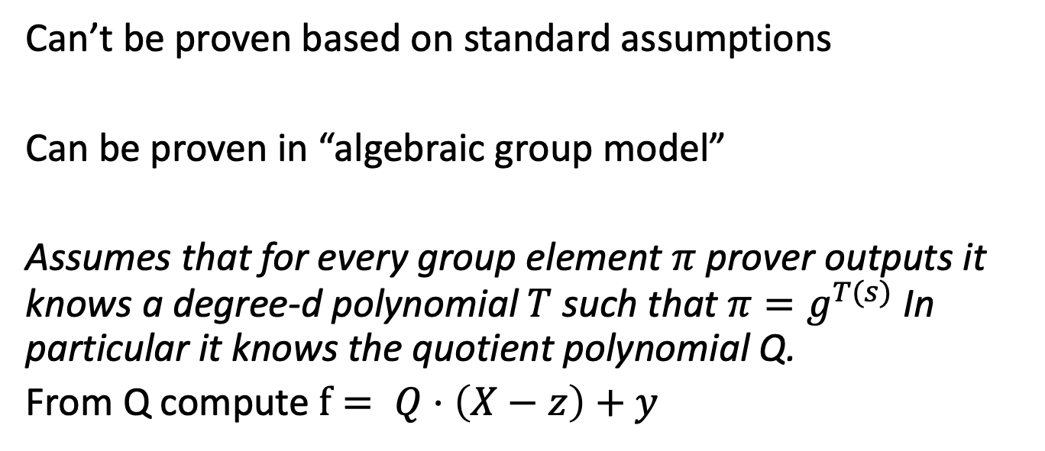
Knowledge Soundness of KZG?
Can’t be proven based on standard assumptions
Can be proven in “algebraic group model”
Assumes that for every group element $π$prover outputs it knows a degree-d polynomial $T$such that $π=g^{T(s)}$ In particular it knows the quotient polynomial Q.
From Q compute $f= Q⋅\left(X−z\right)+y$

Slide 57
Verifiable Information Disperal
Use KZG to prove that shares of ECC were correct
Prover encodes message using reed Solomon encoding and commits to it using KZG
Each party receives it’s share (n/T evaluations of the polynomial), the KZG commitment and a KZG proof that it’s shares were correct.
Can generate one KZG proof for many openings (Homework).
Can generate all KZG proofs at once.

Slide 58
END OF LECTURE
Next week: Finish VID, threshold crypto

