Slide 1
VID, Polynomial Commitments and Light Clients
CSCI-GA 3033-107
https://brightspace.nyu.edu/d2l/home/353819
Benedikt Bünz
New York University
[second homework out (due 3/10)]

Slide 2
Recap: Data Availability Committee (DAC)
To further reduce Tx fees:
Store L2 state root (small) on the L1 chain
Store Tx data (large) with a Data Availability Committee (DAC):
a set of nodes trusted to keep the data available
cheaper than storage on L1
L1 accepts an update only if all DAC members sign it
⇒ ensures that all DAC members accepted Tx data
Setting up a new coordinator depends on availability of the DAC

Slide 3
Scaling the DAC
Data Availability
Committee
Rollup coordinator
block
block
block
Problem 1: Scales as Size of Data * #Nodes in DAC
Problem 2: Any node in DAC can stop progress
Goal: Scale DAC to 1000s of nodes (e.g. all ETH stakers)

Slide 4
Idea: Split Data
Data Availability
Committee
Rollup coordinator
Block[0:1/3]
Block[1/3:2/3]
Block[2/3:1]
Problem: One Malicious can make block unrecoverable

Slide 5
Powerful Tool: Error Correcting Codes
With n parties and T data can each party receive a bit more than T/n data such that 2/3rd n can recover the data
Yes! This is solved by error correcting codes
An error correcting code enables reconstructing a message even if a limited positions have been corrupted
The Decoder doesn’t know which positions where corrupted or not

Slide 6
Idea: Split Data
Data Availability
Committee
Rollup coordinator
Code[0:1/3]
Code[1/3:2/3]
Code[2/3:1]
Code = ECC(Block)
If a small number of parties is corrupted/don’t respond, we can still decode.

Slide 7
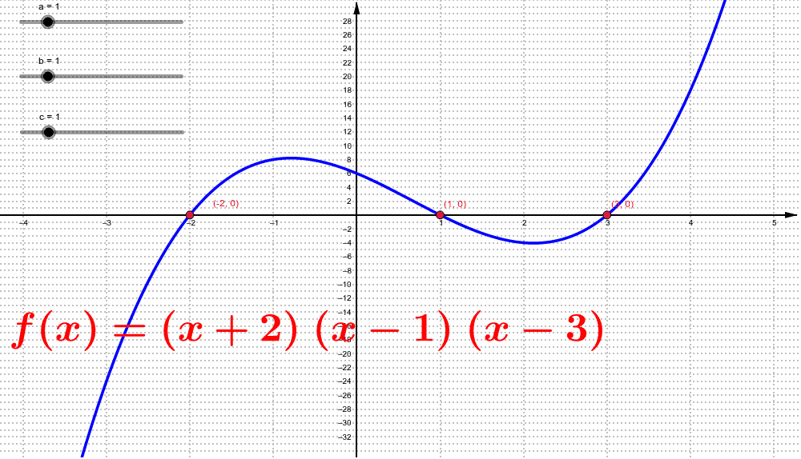
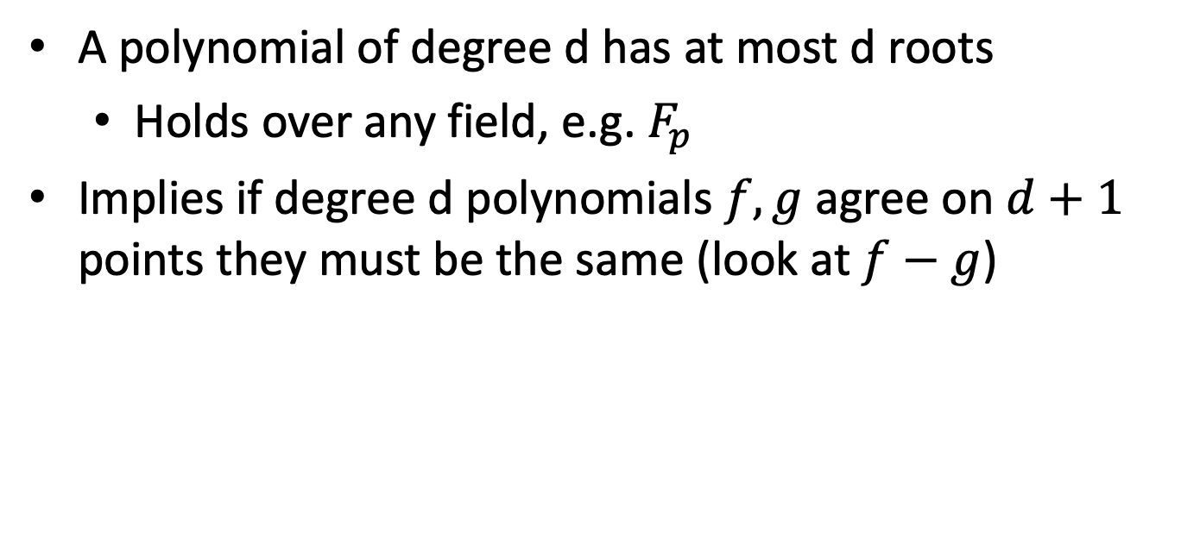
A very useful fact:
A polynomial of degree d has at most d roots
Holds over any field, e.g. $F_{p}$
Implies if degree d polynomials $f,g$ agree on $d+1$ points they must be the same (look at $f−g$)

Slide 8
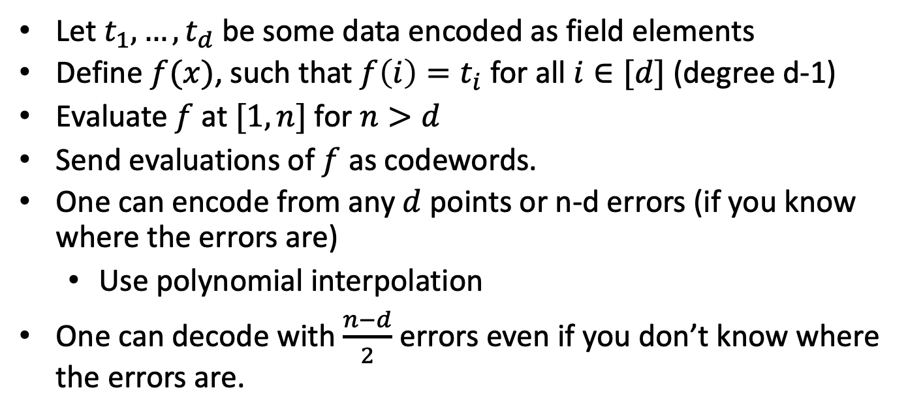
Reed Solomon code
Let $t_{1},…,t_{d}$ be some data encoded as field elements
Define $f(x)$, such that $f\left(i\right)=t_{i}$ for all $i∈[d]$ (degree d-1)
Evaluate $f$ at $[1,n]$ for $n>d$
Send evaluations of $f$ as codewords.
One can encode from any $d$ points or n-d errors (if you know where the errors are)
Use polynomial interpolation
One can decode with $\frac{n−d}{2}$ errors even if you don’t know where the errors are.

Slide 9
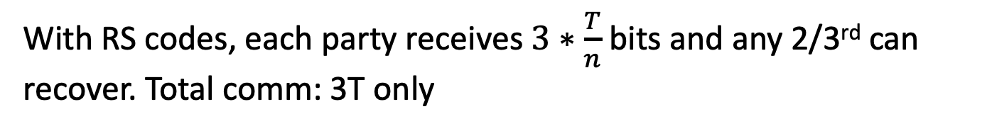
One more problem
Data Availability
Committee
Rollup coordinator
Code[0:1/3]
Code[1/3:2/3]
Code[2/3:1]
Code = RS-encode(Block)
With RS codes, each party receives $3∗\frac{T}{n}$ bits and any 2/3rd can recover. Total comm: 3T only
How does the DAC know that they received the correct data?

Slide 10
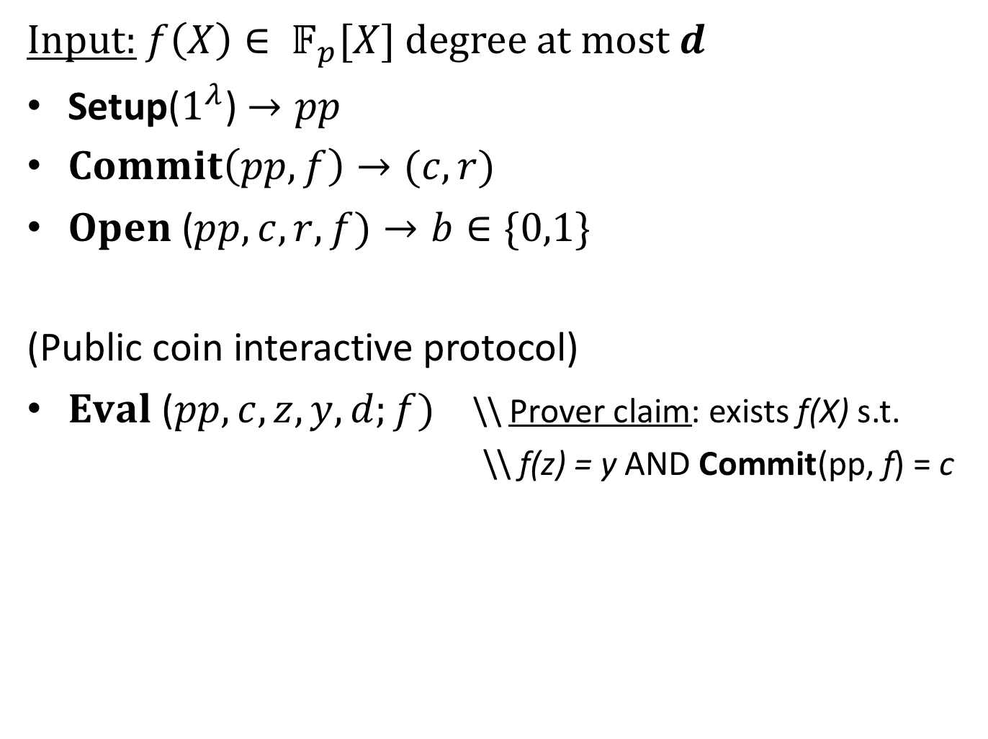

Polynomial Commitment [KZG’10]
Input: $f\left(X\right)∈ 𝔽_{p}[X]$ degree at most $d$
Setup($1^{λ}$) $→pp$
$Commit\left(pp,f\right)→(c,r)$
$Open$ ($pp, c, r,f)→b∈\{0,1\}$
(Public coin interactive protocol)
$Eval$ ($pp, c, z, y,d;f)$ \\ Prover claim: exists f(X) s.t.
\\ f(z) = y AND Commit(pp, f) = c
|c| << d
ideally O($λ$)
Communication sublinear in d

Slide 11
Security: Binding / Knowledge
Input: $f\left(X\right)∈ 𝔽_{p}[X]$ degree at most $d$
Setup($1^{λ}$) $→pp$
$Commit\left(pp,f\right)→(c,r)$
$Open$ ($pp, c, r,f)→b∈\{0,1\}$
(Public coin interactive protocol)
$Eval$ ($pp, c, z, y,d;f)$ \\ Prover claim: exists f(X) s.t.
\\ f(z) = y AND Commit(pp, f) = c
Commitment binding
Evaluation Binding / Argument of Knowledge

Slide 12
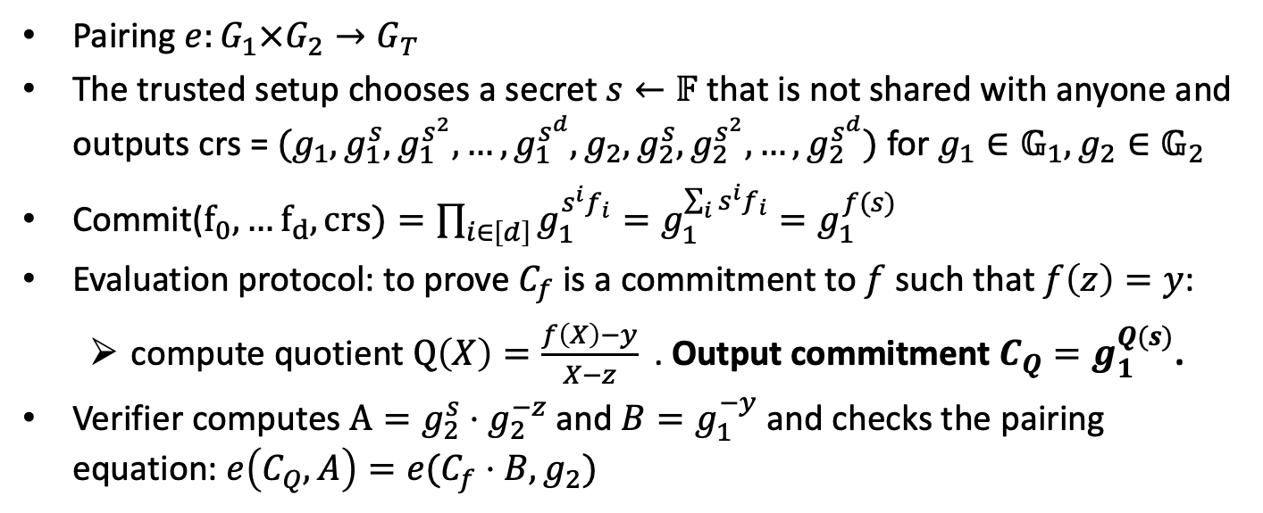
Kate PCS
Pairing $e:G_{1}×G_{2}→G_{T}$
The trusted setup chooses a secret $s←𝔽$ that is not shared with anyone and outputs crs = $(g_{1},g_{1}^{s}, g_{1}^{s^{2}},…,g_{1}^{s^{d}},g_{2},g_{2}^{s}, g_{2}^{s^{2}},…,g_{2}^{s^{d}})$ for $g_{1}∈𝔾_{1}, g_{2}∈𝔾_{2}$
Commit($f_{0},…f_{d}, crs)=\prod_{i∈\left[d\right]}{g_{1}^{s^{i}f_{i}}}=g_{1}^{\sum_{i}{{s^{i}f}_{i}}}=g_{1}^{f(s)}$
Evaluation protocol: to prove $C_{f}$ is a commitment to $f$ such that $f\left(z\right)=y$:
compute quotient $Q\left(X\right)=\frac{f\left(X\right)−y}{X−z}$. Output commitment $C_{Q}=g_{1}^{Q(s)}$.
Verifier computes $A=g_{2}^{s}⋅g_{2}^{−z}$and $B=g_{1}^{−y}$ and checks the pairing equation: $e\left(C_{Q}, A\right)=e(C_{f}⋅B,g_{2})$

Slide 13
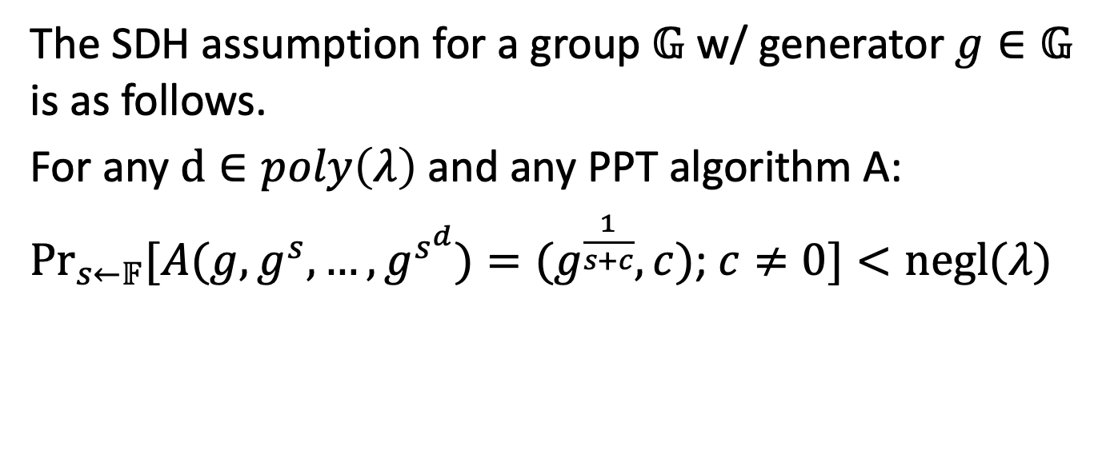
Strong Diffie-Hellman Assumption
The SDH assumption for a group $𝔾$ w/ generator $g∈𝔾$ is as follows.
For any $d∈poly\left(λ\right)$and any PPT algorithm A:
$\underset{s←𝔽}{Pr}{[A(g, g^{s},…,g^{s^{d}})}=(g^{\frac{1}{s+c}}, c)$; $c≠0]<negl(λ)$

Slide 14
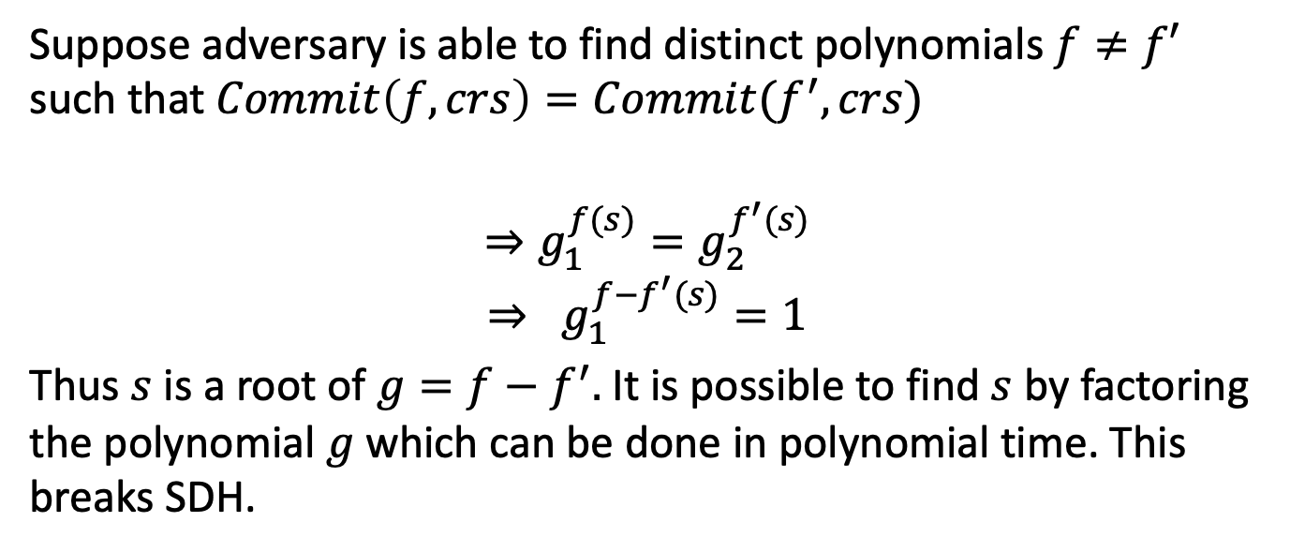
Binding of KZG
Suppose adversary is able to find distinct polynomials $f≠f′$ such that $Commit\left(f, crs\right)=Commit(f^{′}, crs)$
$$⇒g_{1}^{f(s)}=g_{2}^{f^{′}(s)}$$
$$⇒ g_{1}^{f−f^{′}(s)}=1$$
Thus $s$ is a root of $g=f−f^{′}.$It is possible to find $s$ by factoring the polynomial $g$which can be done in polynomial time. This breaks SDH.

Slide 15
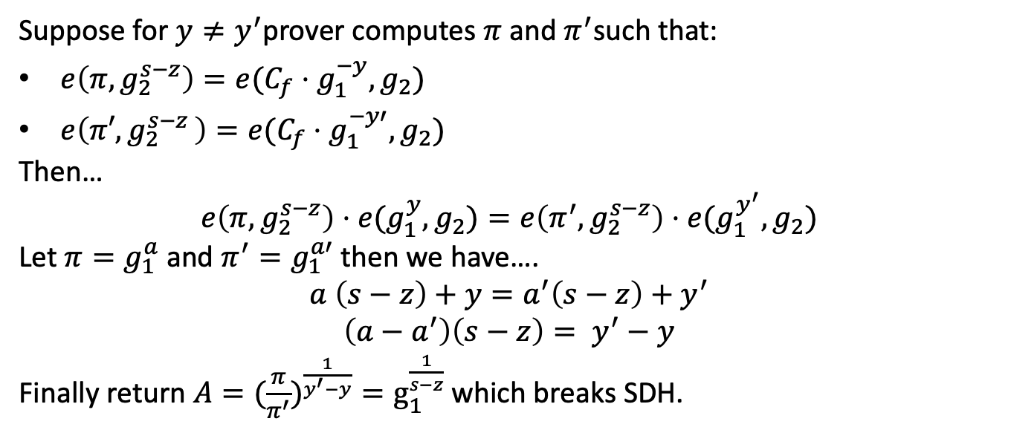
Evaluation binding of KZG
Suppose for $y≠y^{′}$prover computes $π$and $π^{′}$such that:
$e\left(π, g_{2}^{s−z}\right)=e(C_{f}⋅g_{1}^{−y},g_{2})$
$e\left(π′{,g}_{2}^{s−z}\right)=e(C_{f}⋅g_{1}^{−y′},g_{2})$
Then…
$$e\left(π,g_{2}^{s−z}\right)⋅e(g_{1}^{y},g_{2})=e\left(π^{′},g_{2}^{s−z}\right)⋅e(g_{1}^{y^{′}}, g_{2})$$
Let $π=g_{1}^{a}$ and $π^{′}=g_{1}^{a′}$ then we have….
$$a \left(s−z\right)+y=a^{′}\left(s−z\right)+y^{′}$$
$$\left(a−a^{′}\right)\left(s−z\right)= y^{′}−y$$
Finally return ${A=(\frac{π}{π^{′}})}^{\frac{1}{y^{′}−y}}=g_{1}^{\frac{1}{s−z}}$ which breaks SDH.

Slide 16
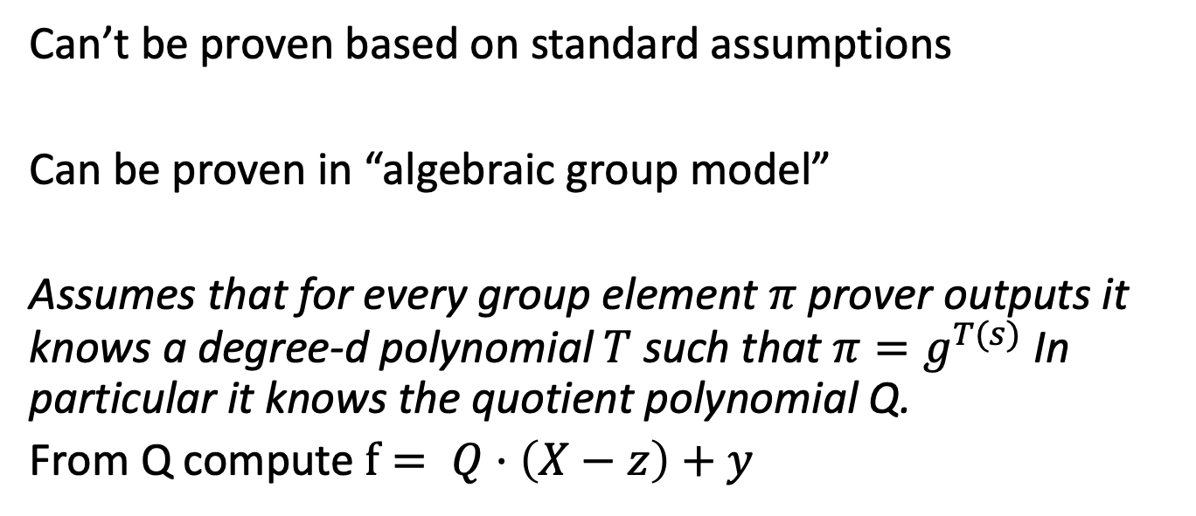
Knowledge Soundness of KZG?
Can’t be proven based on standard assumptions
Can be proven in “algebraic group model”
Assumes that for every group element $π$prover outputs it knows a degree-d polynomial $T$such that $π=g^{T(s)}$ In particular it knows the quotient polynomial Q.
From Q compute $f= Q⋅\left(X−z\right)+y$

Slide 17
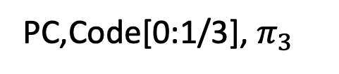
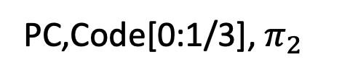
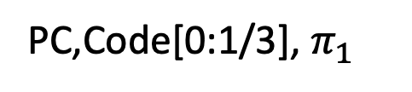
VID Broadcast
Data Availability
Committee
Rollup coordinator
PC,Code[0:1/3], $π_{1}$
PC,Code[0:1/3], $π_{2}$
PC,Code[0:1/3], $π_{3}$

Slide 18
Verifiable Information Disperal
Use KZG to prove that shares of ECC were correct
Prover encodes message using reed Solomon encoding and commits to it using KZG
Each party receives it’s share (n/T evaluations of the polynomial), the KZG commitment and a KZG proof that it’s shares were correct.
Can generate one KZG proof for many openings (Homework).
Can generate all KZG proofs at once.

Slide 19


The Diverse Blockchain Ecosystem
Data Availability Committee
Rollup coordinator
Even if DAC has data, how do we know everyone else can receive it?
Other clients:
Need Data to transact

Slide 20
Data Availability Sampling
Data Availability Committee
General nodes (not necessarially staked)
Sample random data values from DAC
Nodes respond with data and VID proof
Can be very lightweight
If DAC does not respond, go to Twitter
Query

Slide 21
Light Clients

Slide 22
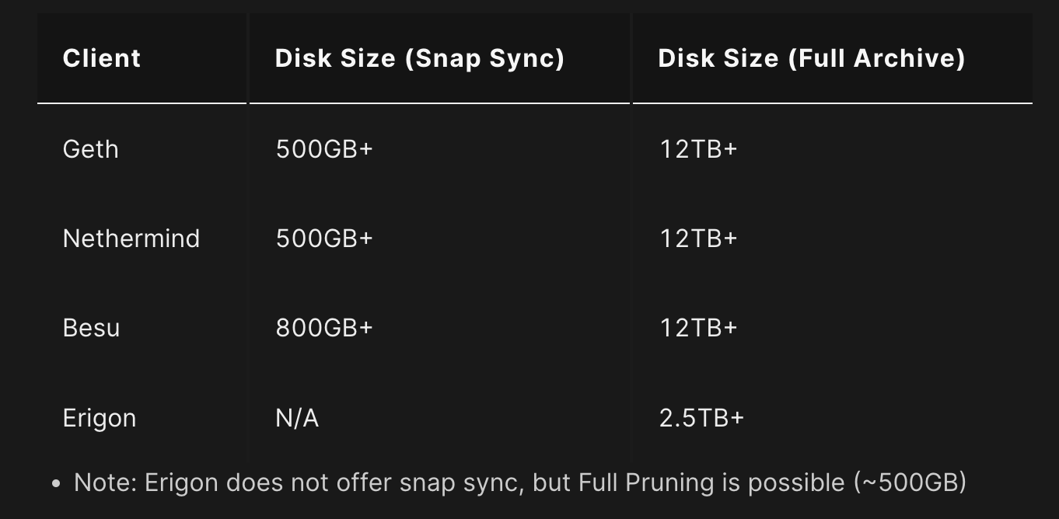
Full nodes, Archival Nodes, Light Clients
Archival node
Stores and Verifies the entire blockchain history

Slide 23
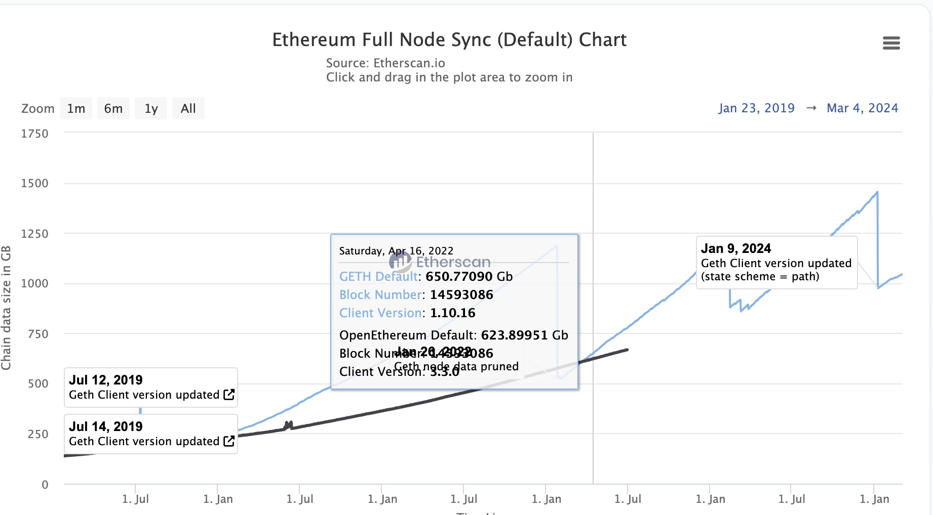
Full nodes, Archival Nodes, Light Clients
Full node
Executes transactions
Stores current state
Participates in consensus
About 1TB in size

Slide 24
Light Clients
Does not execute
Can check TX inclusion
Can get state proofs with state commitment
Minimal storage (runs as an app)
Goes online and offline

Slide 25
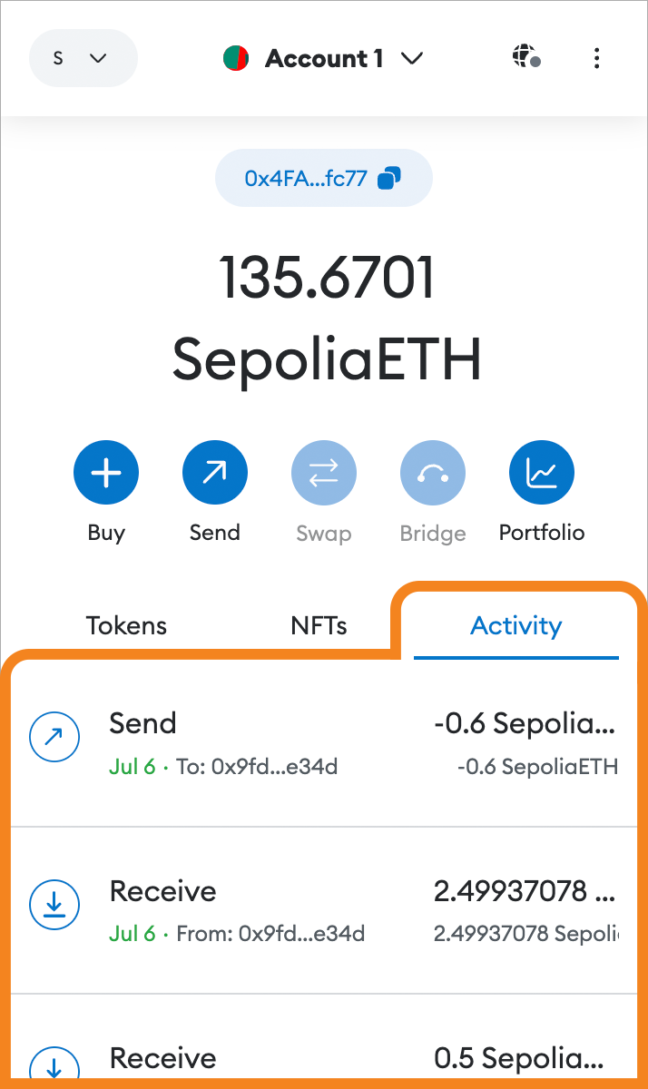
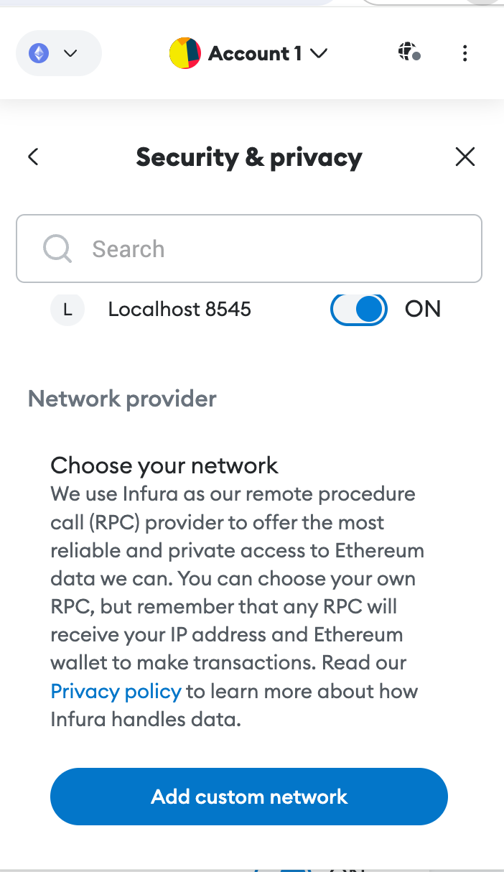
Trusted light clients
Most people access blockchains through a trusted wallet
Wallet connects with RPC endpoint
Endpoint can censor TX
Can give a false blockchain state
Cannot maliciously sign TX for user
Ok for most users?!

Slide 26
Tangent: Cross Chain message passing
Chain 1
Event happened on Chain 1
Cross chain message passing
Event received
Copy!
Chain 2

Slide 27
From message passing to bridging
Chain 1 locks some ETH in a smart contract (cannot be moved)
Chain 1 communicates this with chain 2
Chain 2 mints wrapped ETH that can be used on chain 2
User can burn the wrapped ETH, this gets communicated to chain 1
Chain 1 releases locked ETH
Value wrapped ETH=locked ETH

Slide 28

Light Clients for message passing
Chain 1
Smart contract that runs a Chain 1 light client
Chain 2

Slide 29
Light Clients for message passing
Each chain runs a smart contract
The smart contract encodes a light client for the other chain
It verifies the state of the other chain and can check transactions/messages
Push model: Someone has to forward the data (a relay)
Trusted light client model does not suffice (attack surface too big)

Slide 30

Ethereum light client
Block header
signed
Sample
Sync committee
All staking nodes

Slide 31
Ethereum sync committee
Samples 512 nodes using beacon
For 1.1 days
They sign block headers
If 2/3rd sign block is valid (This is too small)
Sign next sync committee
Light client only needs to verify sync committee and check one signature
What if the committee is corrupted?

Slide 32

Malicious Sync Committee
False Block header
Sync committee
Exclude transactions
Fake payments
…

Slide 33
Make Sync committee stake
💸
Slash
Real Block
Stake
Full node
False Block header
Sync committee
Light client

Slide 34
Slashable sync committee
Sync committee puts up stake
If full node realizes the sync committee signed a wrong block they submit the real block to the blockchain (e.g. to a smart contract)
Slash sync committee nodes (which loose fund)
After some time stake gets released
Not implemented in ETH

Slide 35
Long Range Attacks
💸
💸
💸
Stake
Stake
Stake
Hands off
Hands off
Committee 1
Committee 2
Committee 3
I’ll buy your keys
Problem: Nothing at stake anymore

Slide 36
Long Range Attack
Hands off
Hands off
Fake Committee 1
Fake Committee 2
Fake Committee 3
Corrupting one old committee enables generating an arbitrary long chain of fake committees.
No great solution (VDFs can help)

Slide 37
Bitcoin Light Client: Recap
Hash chain of blocks
prev: H( )
prev: H( )
prev: H( )
trans: H( )
trans: H( )
trans: H( )
H( ) H( )
Merkle Tree of transactions in each block
H( ) H( )
H( ) H( )
transaction
transaction
transaction
transaction

Slide 38
Validity of a blockchain
Hash chain of blocks
prev: H( )
prev: H( )
prev: H( )
trans: H( )
trans: H( )
trans: H( )
✅
H( ) H( )
Transactions are valid
Merkle tree correct
✅
H( ) H( )
H( ) H( )
✅
✅
✅
✅
transaction
transaction
transaction
transaction

Slide 39
Validity of a Block Header
prev: H( )
prev: H( )
prev: H( )
mrkl_root: H( )
mrkl_root: H( )
mrkl_root: H( )
✅
nonce: 0x0001...
nonce: 0xffff...
nonce: 0x0000...
nonce: 0x0001...
nonce: 0x0002...
nonce: 0xf77e...
nonce: 0x0001...
nonce: 0xffff...
nonce: 0x0000...
nonce: 0x0001...
nonce: 0x0002...
nonce: 0x7a83
nonce: 0x0000...
nonce: 0xf77e...
nonce: 0x0000...
hash: 0xd0c7...
hash: 0xd0c7...
hash: 0x6a1f...
hash: 0x300c...
hash:
hash: 0x0224...
hash: 0xc9c8...
hash: 0x0000...
hash: 0x6a1f...
hash: 0x300c...
hash:
hash: 0x0224...
hash: 0xc9c8...
hash: 0x3485...
hash: 0x0000...
hash: 0x0000
hash:
hash: 0x3485...
hash:
Hash
≤ 00000000000000001FB893000000000000000000000000000000000000000000
70+ leading zeroes required
✅

Slide 40



Two Valid Blockchains?
❓
This is the blockchain
No this is the blockchain

Slide 41
Longest Chain Rule
❗️
Take the longest chain!
Harder to produce.

Slide 42
Simple Payment Verifying Client [Satoshi’08]
prev: H( )
prev: H( )
prev: H( )
trans: H( )
trans: H( )
trans: H( )
H( ) H( )
Just store the block headers
H( ) H( )
H( ) H( )
transaction
transaction
transaction
transaction

Slide 43
Verify Block Headers
prev: H( )
prev: H( )
prev: H( )
mrkl_root: H( )
mrkl_root: H( )
mrkl_root: H( )
✅
nonce: 0x0001...
nonce: 0xffff...
nonce: 0x0000...
nonce: 0x0001...
nonce: 0x0002...
nonce: 0xf77e...
nonce: 0x0001...
nonce: 0xffff...
nonce: 0x0000...
nonce: 0x0001...
nonce: 0x0002...
nonce: 0x7a83
nonce: 0x0000...
nonce: 0xf77e...
nonce: 0x0000...
hash: 0xd0c7...
hash: 0xd0c7...
hash: 0x6a1f...
hash: 0x300c...
hash:
hash: 0x0224...
hash: 0xc9c8...
hash: 0x0000...
hash: 0x6a1f...
hash: 0x300c...
hash:
hash: 0x0224...
hash: 0xc9c8...
hash: 0x3485...
hash: 0x0000...
hash: 0x0000
hash:
hash: 0x3485...
hash:
Hash
≤ 00000000000000001FB893000000000000000000000000000000000000000000
70+ leading zeroes required...
✅

Slide 44
Use the Longest Chain Rule
❗️

Slide 45
Can’t verify all transactions (but that’s ok)
prev: H( )
prev: H( )
prev: H( )
trans: H( )
trans: H( )
trans: H( )
❓
Assumption:
Longest chain is produced honestly
H( ) H( )
❓
H( ) H( )
H( ) H( )
❓
❓
❓
❓
transaction
transaction
transaction
transaction

Slide 46
Can verify specific transactions (with help)
prev: H( )
prev: H( )
prev: H( )
trans: H( )
trans: H( )
trans: H( )
❓
transaction

Slide 47
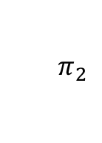
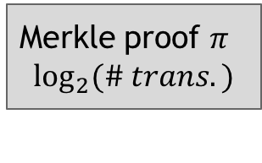
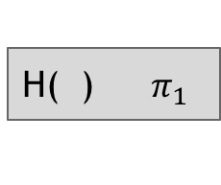
Can verify specific transactions (with help)
prev: H( )
prev: H( )
prev: H( )
trans: H( )
trans: H( )
trans: H( )
H( )
$${ π}_{2}$$
Merkle proof $π$
$$\log_{2}(\# trans.)$$
H( )${ π}_{1}$
✅
transaction

Slide 48
SPV Properties and Problems
Can determine the longest chain
Can verify transaction inclusion
Does not grow with #transactions
80 bytes * #blocks (Bitcoin)
508 bytes * #blocks (Ethereum)
Sufficient for sidechains and swaps
No long range attacks possible
Can’t verify all transactions
Grows with #blocks
Less block time-> larger SPV client
60 MB in Bitcoin
3.2 GB in Ethereum
Especially bad for multi-chain clients

Slide 49
Flyclient: A super-light clients
prev: H( )
prev: H( )
prev: H( )
trans: H( )
trans: H( )
trans: H( )

Slide 50
Flyclient: A super-light clients
Store just the head
root: H( )
root: H( )
root: H( )
trans: H( )
trans: H( )
trans: H( )

Slide 51
Flyclient: A super-light clients
Store just the head
Merkle Tree (MMR)
root: H( )
root: H( )
trans: H( )
trans: H( )

Slide 52

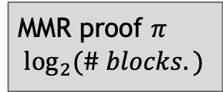

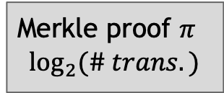
Verifying Transaction
MMR proof $π$
$$\log_{2}(\# blocks.)$$
root: H( )
root: H( )
trans: H( )
trans: H( )
Chain head
$${ π}_{2}$$
H( )
Merkle proof $π$
$$\log_{2}(\# trans.)$$
H( )${ π}_{1}$
✅
transaction

Slide 53
Flyclient: Two Heads?
❓
This is the head
Assumption:
At least one chain is honest
Other one has at most a c fraction of the mining power (c fraction blocks are valid)
Ex: c=1/3
No this is the head

Slide 54
Flyclient Strawman 1
Give me k blocks: 7,13,210…

Slide 55
Flyclient Strawman 1: sample constant # of blocks
Head 1
Honest chain
Sample k blocks + MMR inclusion proof for each
Malicious chain (only 1/3 of the blocks have a PoW)
Head 2

Slide 56
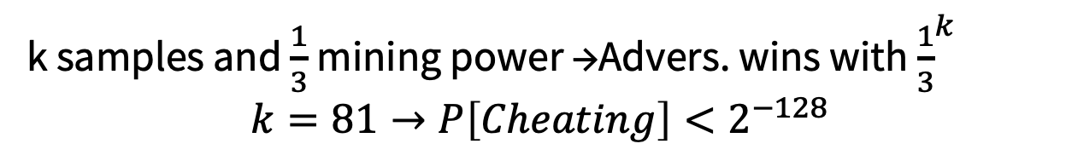
Flyclient Strawman 1: sample constant # of blocks
Head 1
Honest chain
k samples and $\frac{1}{3}$ mining power →Advers. wins with ${\frac{1}{3}}^{k}$
$$k=81→P\left[Cheating\right]<2^{−128}$$
Malicious chain (only 1/3 of the blocks have a PoW)
Head 2

Slide 57
Flyclient Strawman 1 problem: Forking
Head 1
Honest chain
Malicious Fork
Head 2

Slide 58
Flyclient idea: Find Fork Point
Head 1
Honest chain
Malicious Fork
Knowing this point suffices
Head 2
︸
Sample blocks after fork

Slide 59
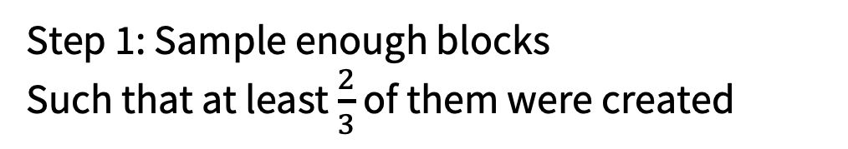
Flyclient: Idea bound forking point
Head 1
Honest chain
Head 2
Step 1: Sample enough blocks
Such that at least $\frac{2}{3}$ of them were created

Slide 60
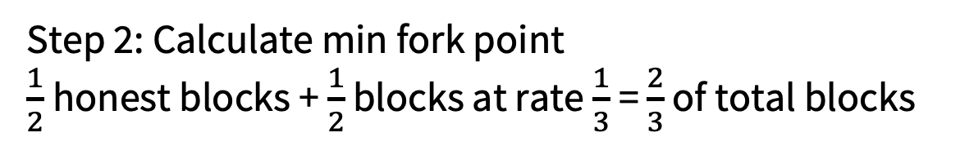
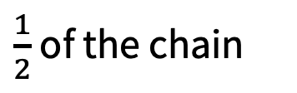
Flyclient: Idea bound forking point
Head 1
Honest chain
$\frac{1}{2}$ of the chain
Head 2
Step 2: Calculate min fork point
$\frac{1}{2}$honest blocks + $\frac{1}{2}$ blocks at rate $\frac{1}{3}$= $\frac{2}{3}$ of total blocks

Slide 61
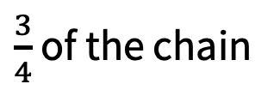
Flyclient: Idea bound forking point
Head 1
Honest chain
$\frac{3}{4}$ of the chain
Head 2
Step 3: Repeat

Slide 62
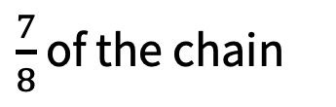
Flyclient: Idea bound forking point
Head 1
Honest chain
$\frac{7}{8}$ of the chain
Head 2
Step 3: Repeat

Slide 63
Flyclient: Idea bound forking point
Head 1
Honest chain
Head 2
Step 4: Check final L blocks (to prevent short forks)

Slide 64
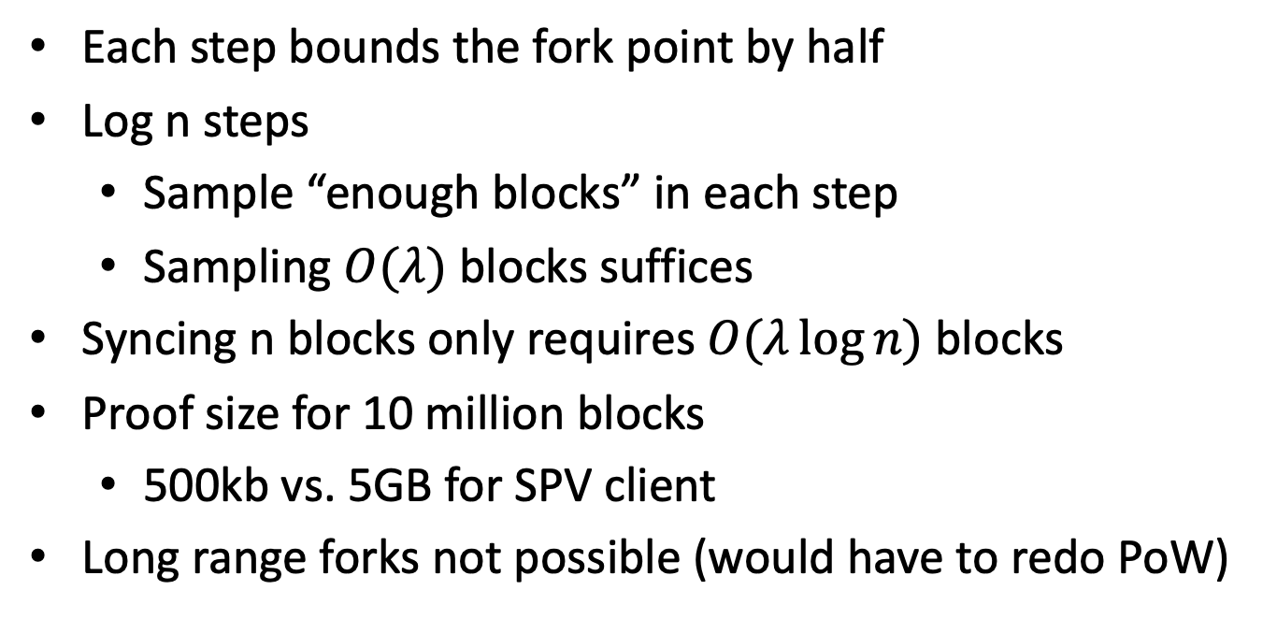
Flyclient
Each step bounds the fork point by half
Log n steps
Sample “enough blocks” in each step
Sampling $O(λ)$ blocks suffices
Syncing n blocks only requires $O(λ\log{n})$ blocks
Proof size for 10 million blocks
500kb vs. 5GB for SPV client
Long range forks not possible (would have to redo PoW)

Slide 65
The ultra light client
Ideally, we would have a light client protocol that enables verifying that all transactions are valid and that the entire consensus was correct while minimizing synchronization time and data storage
Possible: Using SNARKs! Lecture 8 onwards ☺

Slide 66
END OF LECTURE
Next week: Threshold crypto

