Slide 1
Proof-Carrying Data without Succinct Arguments
Alessandro Chiesa, Pratyush Mishra,
William Lin
Benedikt Bünz
Nick Spooner
Stanford
Boston University
UC Berkeley
Paper: ia.cr/2020/1618 Code: github.com/arkworks-rs/accumulation

Slide 2
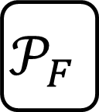


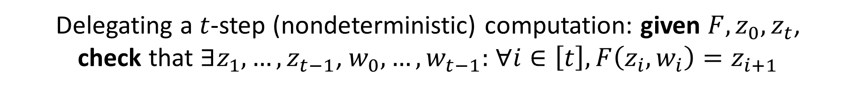










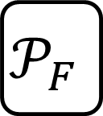

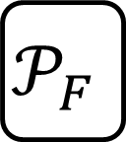
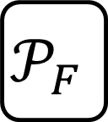
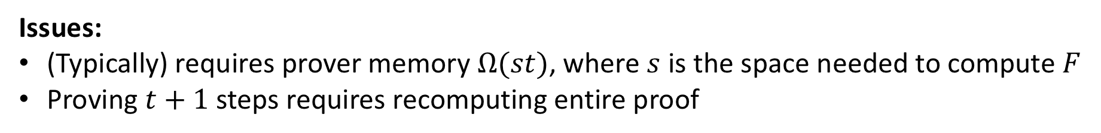



Motivation
Delegating a $t$-step (nondeterministic) computation: given $F,z_{0},z_{t}$,
check that $∃z_{1},…,z_{t−1}\text{,} w_{0},…,w_{t−1}:$ $∀i∈\left[t\right], F\left(z_{i},w_{i}\right)=z_{i+1}$
Applications include:
Succinct blockchains [BMRS20,KB20,CCDW20]
SNARKs with low space complexity [BCCT13]
Verifiable delay functions [BBBF18]
Byzantine agreement [BCG20]
ZK cluster computing [CTV15]
Verifiable image editing [NT16]
Enforcing language semantics across trust boundaries [CTV13]
Option 1: Monolithic proof
$$F^{t}\left(z_{0};w_{0},…,w_{t−1}\right)=z_{t}$$
$$P$$
$$π$$
Issues:
(Typically) requires prover memory $Ω(st)$, where $s$ is the space needed to compute $F$
Proving $t+1$ steps requires recomputing entire proof
Option 2: Incrementally-verifiable computation (IVC) [Val08]
$$w_{0}$$
$$w_{1}$$
$$w_{2}$$
$$w_{t−1}$$
$$z_{1}$$
$$z_{2}$$
$$z_{t−1}$$
$$z_{t}$$
$$z_{0}$$
$$𝒫_{F}$$
$$𝒫_{F}$$
$$𝒫_{F}$$
$$𝒫_{F}$$
$$π_{1}$$
$$π_{2}$$
$$⋯$$
$$π_{t−1}$$
$$π_{t}$$
Proof-carrying data (PCD) [CT10,BCCT13] generalizes this from path graph to any DAG
Notes:
application to byzantine agreement 2020/130

Slide 3
OK, but how do we construct IVC?
SNARK = Succinct
Non-interactive ARgument of Knowledge
So far, from a powerful primitive: SNARKs!
[BCCT13]: IVC from SNARKs with succinct (polylog) verification
[BCTV14]: Concretely efficient realization via preprocessing SNARKs
Since then, numerous efforts to relax this requirement:
[COS20]: IVC from SNARKs with sublinear verification
[BCMS20]: IVC from SNARKs with only sublinear accumulation
Built on ideas originally proposed in [BGH19]
But are SNARKs required for IVC?

Slide 4
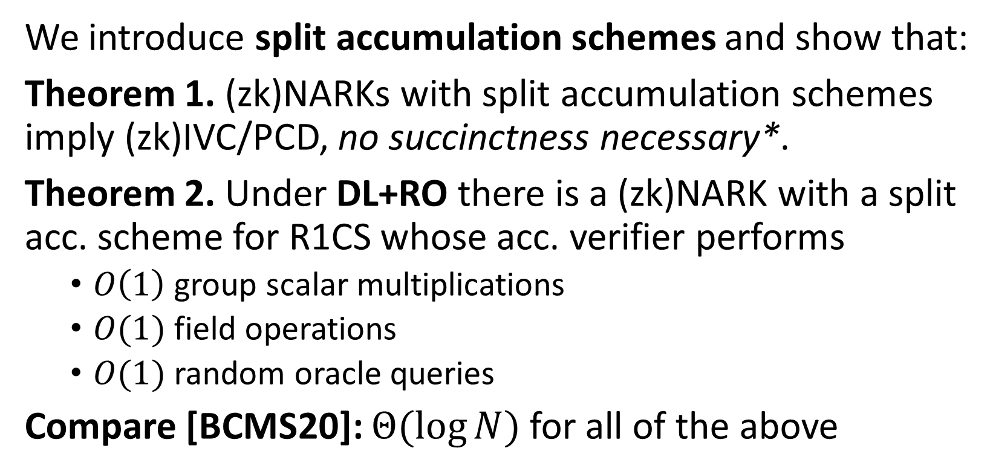
Theory contributions
NARK = Succinct
Non-interactive ARgument of Knowledge
Nothing to do with set accumulators!
We introduce split accumulation schemes and show that:
Theorem 1. (zk)NARKs with split accumulation schemes imply (zk)IVC/PCD, no succinctness necessary*.
Theorem 2. Under DL+RO there is a (zk)NARK with a split acc. scheme for R1CS whose acc. verifier performs
$O\left(1\right)$ group scalar multiplications
$O(1)$ field operations
$O(1)$ random oracle queries
Compare [BCMS20]: $Θ(\log{N})$ for all of the above
standard model
random oracle model
Notes:
acc. verifier is non black box part

Slide 5
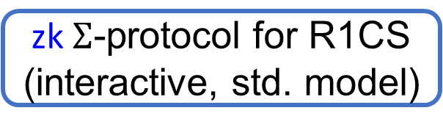
Construction from DL+RO
(with ZK)
Transparent setup (Common Random String)
New zkIVC/PCD constructions (heuristically)
Theorem 1
zkNARK for R1CS
(in standard model, heuristically)
zk Split Accumulation Scheme
for zkNARK
(in standard model, heuristically)
Standard
model
RO heuristic
RO heuristic
ROM
zkNARK for R1CS
(in ROM)
zk Split Accumulation Scheme for zkNARK
(in ROM)
Fiat-Shamir
zk $Σ$-protocol for R1CS
(interactive, std. model)
Notes:
Before I dive into the technical details, let me equickly summarize our contributions wrt implementation, and then we’ll return to the technical details.

Slide 6

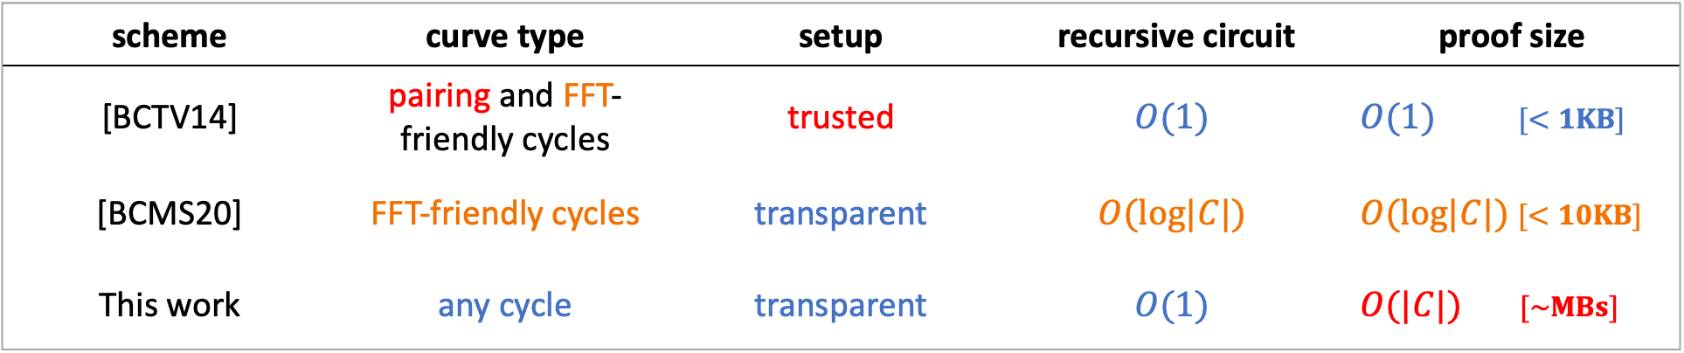
Implementation contributions
scheme | curve type | setup | recursive circuit | proof size
[BCTV14] | pairing and FFT-friendly cycles | trusted | $$O(1)$$ | $O(1)$ $[<1KB]$
[BCMS20] | FFT-friendly cycles | transparent | $$O(log|C|)$$ | $O(log|C|)$ $[<10KB]$
This work | any cycle | transparent | $$O(1)$$ | $O(|C|)$ $[\sim MBs]$
What about concrete efficiency?
To find out, we implemented our schemes in the Rust-based arkworks ecosystem of zkSNARK libraries
ark-accumulation: A generic framework for atomic and split accumulation.
ark-pcd: Existing PCD constructions + our accumulation-based PCD.
github.com/arkworks-rs/accumulation

Slide 7
Relative cost is unaffected by optimizations!
This is general-case; IVC-specific acc is even lower!
7

Slide 8
Background: Recent advances in IVC/PCD
Recursive composition and atomic accumulation schemes

Slide 9
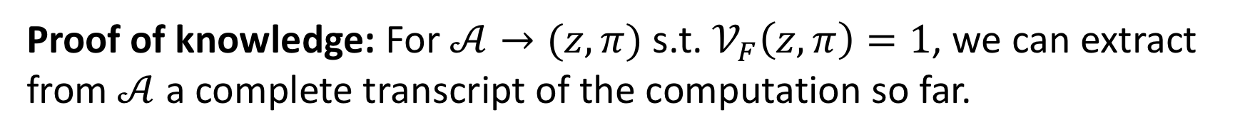

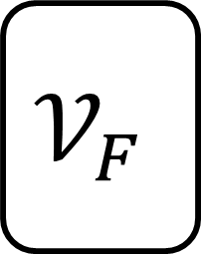
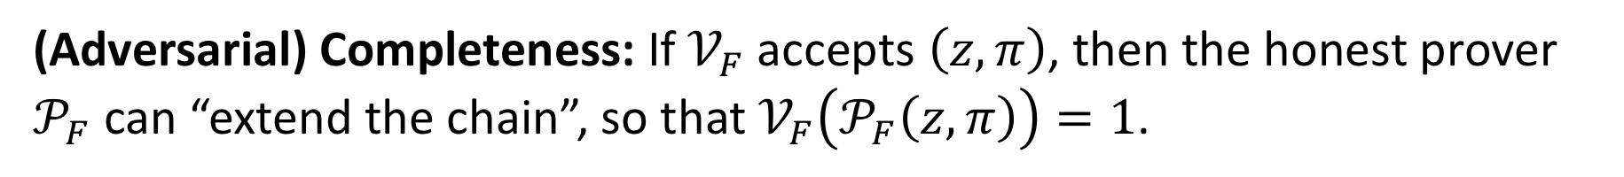

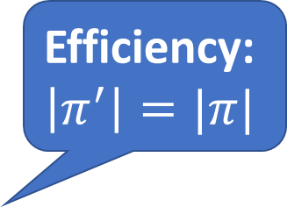







Definition of IVC
Efficiency:
$$\left|π^{′}\right|=|π|$$
$$z$$
$$𝒫_{F}$$
$$z′$$
$$z$$
$$𝒱_{F}$$
$$w$$
$$0/1$$
$$π$$
$$π′$$
$$π$$
(Adversarial) Completeness: If $𝒱_{F}$ accepts $\left(z,π\right)$, then the honest prover $𝒫_{F}$ can “extend the chain”, so that $𝒱_{F}\left(𝒫_{F}\left(z,π\right)\right)=1$.
Proof of knowledge: For $𝒜→(z,π)$ s.t. $𝒱_{F}\left(z,π\right)=1$, we can extract from $𝒜$ a complete transcript of the computation so far.

Slide 10



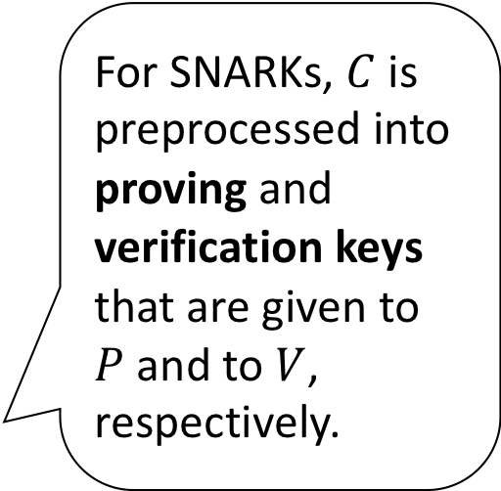
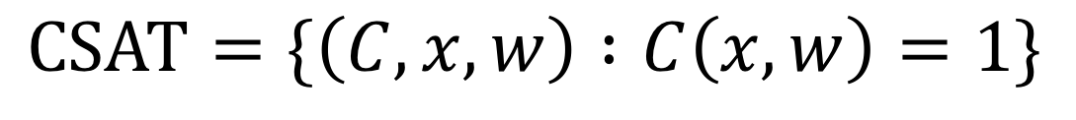


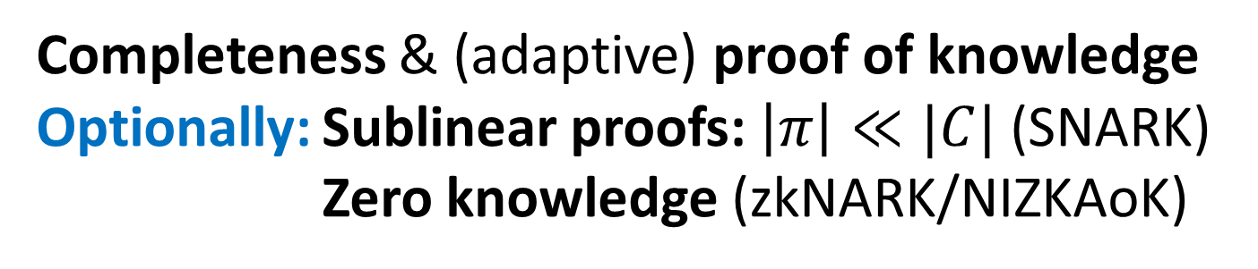
(zk)NARKs
For SNARKs, $C$ is preprocessed into proving and verification keys that are given to $P$ and to $V$, respectively.
$$CSAT=\{\left(C,x,w\right) :C\left(x,w\right)=1\}$$
$$C, x,w$$
$$C, x$$
$$P$$
$$π$$
$$V$$
Completeness & (adaptive) proof of knowledge
Optionally: Sublinear proofs: $\left|π\right|≪|C|$ (SNARK)
Zero knowledge (zkNARK/NIZKAoK)
Notes:
zk

Slide 11















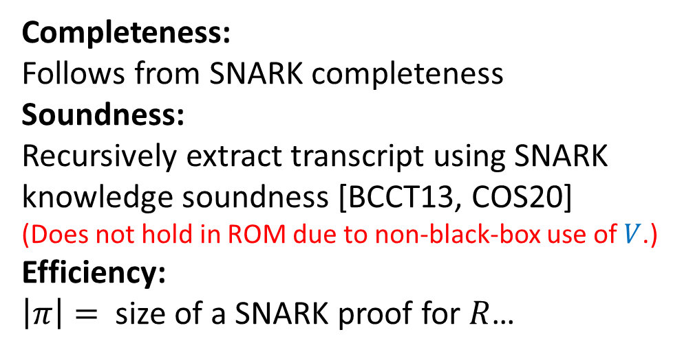
IVC from recursive composition of SNARKs [BCCT13, COS20]
$$IVC.𝒱_{F}$$
Recursive extraction requires strong “multi-instance witness-extended emulation”
knowledge property
Proving a statement about the SNARK verifier
$$⇓$$
Sublinear verification necessary to bound $|R|$
$$z_{1},z_{T}$$
$$IVC.𝒫_{F}$$
$$V$$
$$π_{T}$$
$$0/1$$
$$SNARK.P$$
Completeness:
Follows from SNARK completeness
Soundness:
Recursively extract transcript using SNARK knowledge soundness [BCCT13, COS20]
(Does not hold in ROM due to non-black-box use of $V$.)
Efficiency:
$\left|π\right|=$ size of a SNARK proof for $R$…
$$R$$
$$z_{t}$$
$$F$$
$$z_{t+1}$$
What about SNARKs without sublinear verification?
$$V$$
$$π_{t+1}$$
$$π_{t}$$
Notes:
change setup

Slide 12



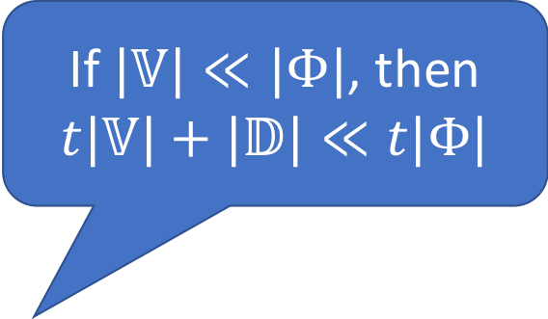


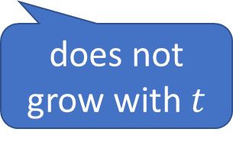











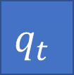






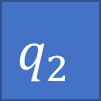






(Atomic) accumulation [BCMS20]
If $|𝕍|≪|Φ|$, then
$t|𝕍|+|𝔻|≪t|Φ|$
0/1
0/1
0/1
0/1
$$𝕍$$
$$∧$$
$$𝕍$$
$$∧$$
$$⋯$$
$$∧$$
$$𝕍$$
$$∧$$
$$𝔻$$
$$=1$$
decider
$$ℙ$$
$$ℙ$$
$$𝕒_{0}$$
$$𝕒_{1}$$
$$⋯$$
$$𝕒_{t}$$
$$⋯$$
accumulator
does not grow with $t$
$$q_{1}$$
$$q_{2}$$
$$⋯$$
$$q_{t}$$
$$⋯$$
$$=\bigwedge_{i=1}^{t}{Φ\left(q_{i}\right)\overset{?}{=}}1$$
$$Φ$$
$$Φ$$
$$Φ$$
$$∧$$
$$∧$$
$$⋯$$
$$∧$$
0/1
0/1
0/1

Slide 13







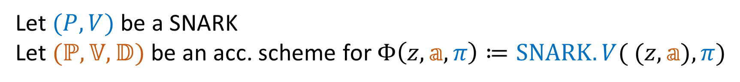
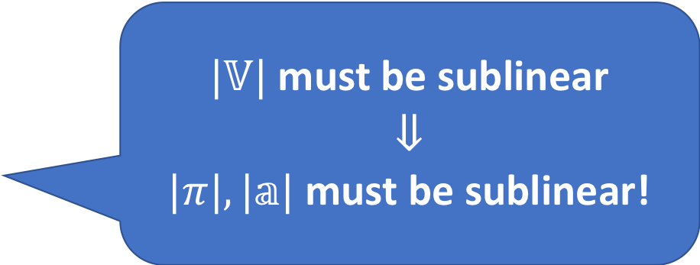



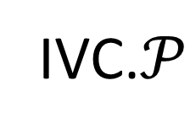





IVC from atomic accumulation
Let $(P,V)$ be a SNARK
Let $(ℙ,𝕍,𝔻)$ be an acc. scheme for $Φ\left(z,𝕒,π\right)≔SNARK.V( (z,𝕒),π)$
$$q$$
IVC.$𝒫$
recursive circuit does not contain SNARK verifier
IVC.$𝒱$
$$SNARK.P$$
Soundness:
Relies on same strong knowledge property of SNARK
but only soundness property of acc. scheme
$|𝕍|$ must be sublinear
$$⇓$$
$|π|, |𝕒|$ must be sublinear!
$$z_{i}$$
$$R$$
$$z_{i+1}$$
$$F$$
$$SNARK.V$$
$$[R]$$
$$π_{i}$$
$$𝕍$$
$$π_{i+1}$$
IVC proof
$$ℙ$$
$$𝔻$$
$$𝕒_{i}$$
$$𝕒_{i+1}$$

Slide 14
New tool: Split accumulation

Slide 15




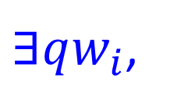






















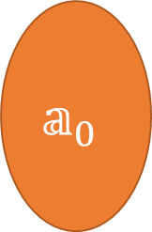

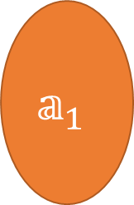




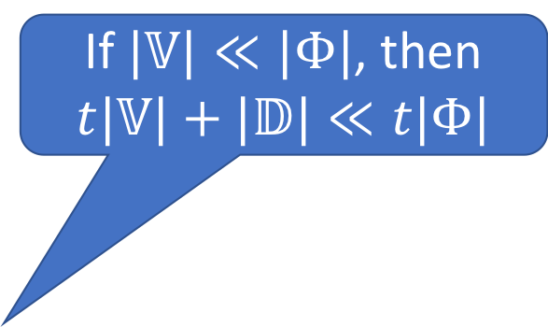
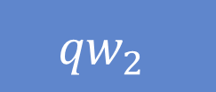
Split accumulation for relations
If $|𝕍|≪|Φ|$, then
$t|𝕍|+|𝔻|≪t|Φ|$
0/1
0/1
0/1
0/1
$$𝕍$$
$$∧$$
$$𝕍$$
$$∧$$
$$⋯$$
$$∧$$
$$𝕍$$
$$∧$$
$$𝔻$$
$$=1$$
$$𝕒_{0}$$
$$pf_{1}$$
$$𝕒_{1}$$
$$pf_{2}$$
$$pf_{t}$$
decider
$${𝕒x}_{0}$$
$${𝕒x}_{1}$$
$$𝕒_{t}$$
$$ℙ$$
$$ℙ$$
$${𝕒x}_{t}$$
$$⋯$$
$$⋯$$
does not grow with $t$
accumulator
$${qx}_{1}$$
$${qw}_{1}$$
$${qx}_{2}$$
$${qw}_{2}$$
$$⋯$$
$${qx}_{t}$$
$${qw}_{t}$$
$$⋯$$
$$=\bigwedge_{i=1}^{t}{Φ\left({qx}_{i},qw_{i}\right)}$$
$∃qw_{i}$,
$$Φ$$
$$Φ$$
$$Φ$$
$$∧$$
$$∧$$
$$⋯$$
$$∧$$
$$\overset{?}{=}1$$
0/1
0/1
0/1
Notes:
connection to/diff from batching: t|R| vs t|V|+|D|

Slide 16


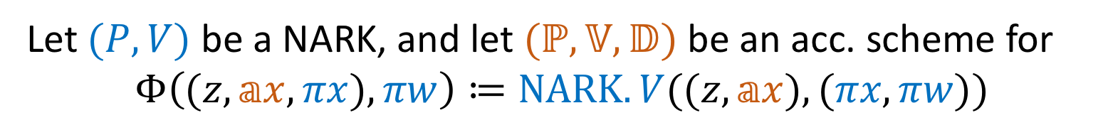






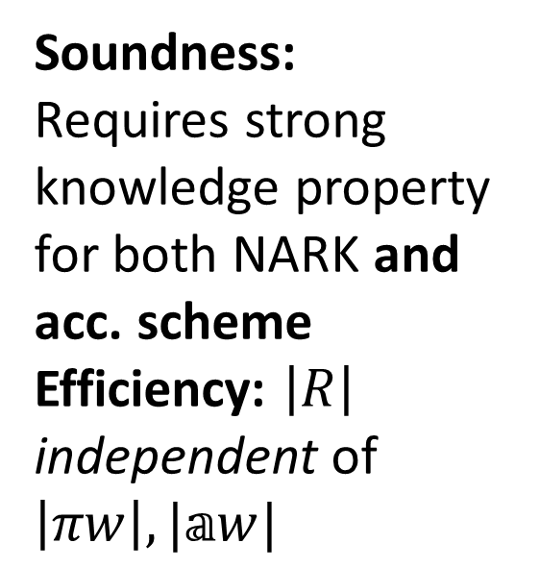




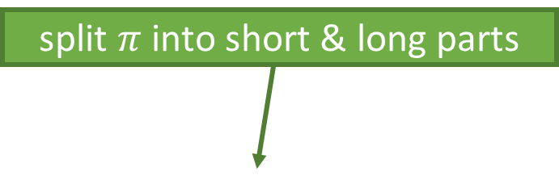







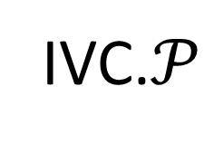


IVC from split accumulation
split $π$ into short & long parts
Let $(P,V)$ be a NARK, and let $(ℙ,𝕍,𝔻)$ be an acc. scheme for
$$Φ\left((z,𝕒x,πx),πw\right)≔NARK.V((z,𝕒x),(πx,πw))$$
$$qx$$
$$qw$$
IVC.$𝒫$
acc. verifier does not read all of $(π,𝕒)$
IVC.$𝒱$
Soundness:
Requires strong knowledge property for both NARK and acc. scheme
Efficiency: $\left|R\right|$ independent of $\left|πw\right|,|𝕒w|$
$$NARK.P$$
$$z_{i}$$
$$R$$
$$z_{i+1}$$
$$F$$
$$NARK.V$$
$$[R]$$
$$𝕍$$
$$π_{i+1}$$
$$πx_{i}$$
$$π_{i}$$
$$πw_{i}$$
IVC proof
$$ℙ$$
$$𝔻$$
$$𝕒x_{i}$$
$$𝕒_{i+1}$$
$$𝕒_{i}$$
$$𝕒w_{i}$$
Notes:
white on black for instances
strong knowledge property, mention for BCCT

Slide 17
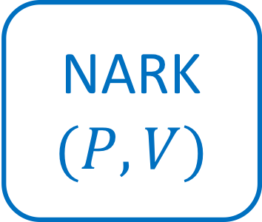
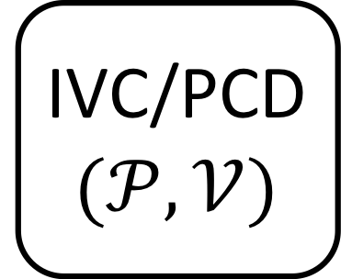
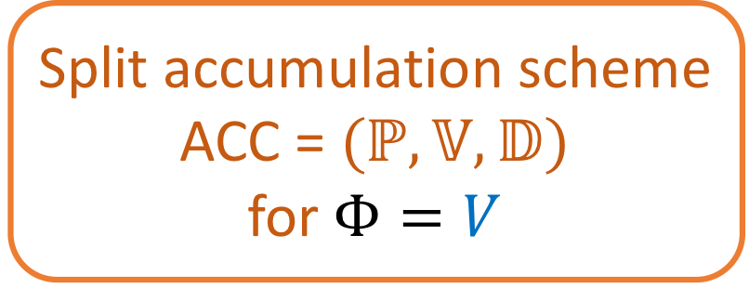
Theorem 1: IVC/PCD from split accumulation
NARK
$$(P,V)$$
Split accumulation scheme
ACC = $(ℙ,𝕍,𝔻)$
for $Φ=V$
IVC/PCD
$$(𝒫,𝒱)$$
First construction of IVC that relies on non-succinct NARKs!
Other nice properties:
if NARK, ACC are zero knowledge then so is PCD
if NARK, ACC are post-quantum secure then so is PCD
Notes:
colours for SNARK + Acc
note that Acc scheme has no knowledge assumption

Slide 18
A NARK for R1CS with split accumulation

Slide 19
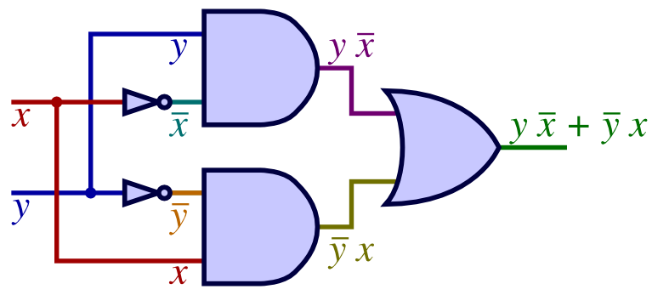
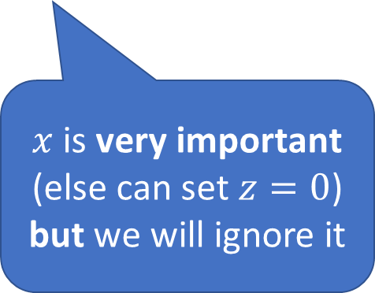

Rank-1 Constraint System (R1CS)
Given public input: matrices $A,B,C$ and vector $x$ (over $𝔽$)
Does there exist secret vector $w$ such that, for $z≔\left(x||w\right)$,
$Az∘Bz=Cz$ ?
$x$ is very important (else can set $z=0$)
but we will ignore it
element-wise product
Widely used in proof systems: balance between structure and expressivity
Notes:
NP-complete
Linear-size reduction from SAT_F to R1CS

Slide 20









A simple NARK for R1CS
$Az∘Bz=Cz$ ?
Check:
$$Az∘Bz=Cz$$
$$C_{A}=Comm\left(Az\right)$$
$$C_{B}=Comm(Bz)$$
$$C_{C}=Comm(Cz)$$
$$P$$
$$z$$
$$V$$
$$C_{A}=Comm\left(Az\right)$$
$$C_{B}=Comm(Bz)$$
$$C_{C}=Comm(Cz)$$
$$C_{A},C_{B},C_{C}$$
$Comm:𝔽^{n}→𝔾$ is a (det.) linearly-homomorphic vector commitment
(e.g. Pedersen, $Comm\left(\vec{a}\right)≔\prod_{i}{g_{i}^{a_{i}}}$)
Why? Commitments will allow us to accumulate proofs…

Slide 21











Split accumulation scheme
$$V$$
$$Az∘Bz\overset{?}{=}Cz$$
$$C_{M}\overset{?}{=}Comm\left(Mz\right)$$
$$z$$
$$C_{A},C_{B},C_{C}$$
$$𝔻(𝕒x,𝕒w)$$
Let $y=𝕒w$
Check $C_{∘}^{′′}=Comm(Ay∘By)$
Check $C_{M}^{′′}=Comm\left(My\right)$
$$𝕒x=\left(C_{A}^{′},C_{B}^{′},C_{C}^{′},C_{∘}\right)∈𝔾^{4},𝕒w=y∈𝔽^{n}$$
$$+$$
$$β\underset{←}{\$}𝔽$$
$$×$$
$$πx=\left(C_{A},C_{B},C_{C}\right)∈𝔾^{3}, πw=z∈𝔽^{n}$$
$$=$$
More details and general construction see paper.
$𝕍$ performs only 3 group scalar multiplications
No FFTs, no PCPs, just DLOG assumption
$$𝕒x′=\left(C_{A}^{′′},C_{B}^{′′},C_{C}^{′′},C_{∘}′\right)∈𝔾^{4},𝕒w′=y′∈𝔽^{n}$$
$$+$$
$$β⋅C_{π}$$
$$+$$
$$β^{2}⋅C_{C}$$
$$\}$$
Cross terms

Slide 22

Theorem 2: split accumulation for a simple NARK for R1CS
R1CS-NARK
is a single message protocol!
Split acc. scheme for R1CS-NARK is a sigma protocol!
non-black-box use of the random oracle
…but only one query
Thm 1 + Thm 2 (+ RO heuristic) means we get IVC from very simple ingredients. Furthermore,
Since IVC $⇒$ SNARKs, we also get a simple SNARK construction.
No PCPs, linear PCPs, IOPs, etc. in sight!
Notes:
colours for SNARK + Acc
note that Acc scheme has no knowledge assumption

Slide 23









Split accumulation scheme (attempt)
$$V$$
$$Az∘Bz\overset{?}{=}Cz$$
$$C_{M}\overset{?}{=}Comm\left(Mz\right)$$
$$z$$
$$C_{A},C_{B},C_{C}$$
$$πx=\left(C_{A},C_{B},C_{C}\right)∈𝔾^{3}, πw=z∈𝔽^{n}$$
$$𝕒x=\left(C_{A}^{′},C_{B}^{′},C_{C}^{′}\right)∈𝔾^{3},𝕒w=y∈𝔽^{n}$$
$$Comm\left(M\left(y+βz\right)\right)=Comm\left(M\left(𝕒w′\right)\right)$$
$$ℙ(π\text{,} 𝕒)$$
$𝕒w^{′}≔𝕒w+βπw$
$C_{M}^{′′}≔{C_{M}^{′}+βC}_{M}$
$𝕒x≔(C_{A}^{′′},C_{B}^{′′},C_{C}^{′′})$
$$𝕍(πx\text{,} 𝕒x)$$
Linear checks: $C_{M}^{′}+βC_{M}=C_{M}^{′′}$
$$β\underset{←}{\$}𝔽$$
$$𝕒x′$$
$$Ay^{′}∘By^{′}$$
$$=Ay∘By+β^{2}Az∘Bz$$
$$+β\left(Ay∘Bz+Az∘By\right)=Cy+β^{2}Cz+β⋅junk$$
$$≠Cy^{′}$$
$$=Cy+βCz$$
$$𝕒w′$$
$$𝔻(𝕒x′,𝕒w′)$$
Let $y^{′}=𝕒w′$
Check $C_{M}^{′′}=Comm\left(My^{′}\right)$
Check $Ay^{′}∘By^{′}=Cy^{′}$

Slide 24








Split accumulation scheme
$$V$$
$$Az∘Bz\overset{?}{=}Cz$$
$$C_{M}\overset{?}{=}Comm\left(Mz\right)$$
$$z$$
$$C_{A},C_{B},C_{C}$$
$$πx=\left(C_{A},C_{B},C_{C}\right) ∈𝔾^{3}, πw=z∈𝔽^{n}$$
$$𝕒x=\left(C_{A}^{′},C_{B}^{′},C_{C}^{′},C_{∘}\right)∈𝔾^{4},𝕒w=y∈𝔽^{n}$$
$$pf$$
$$Comm\left(M\left(y+βz\right)\right)=Comm\left(M\left(𝕒w′\right)\right)$$
$$ℙ(π\text{,} 𝕒)$$
$C_{π}≔Comm(Az∘By+Ay∘Bz)$
$𝕒w^{′}≔y^{′}=𝕒w+βπw$
$C_{M}^{′′}≔{C_{M}^{′}+βC}_{M}$
$C_{∘}^{′′}≔Comm\left(Ay′∘By′\right)$
$𝕒^{′}x≔(C_{A}^{′′},C_{B}^{′′},C_{C}^{′′},C_{∘}^{′′})$
$$C_{π}$$
$$𝕍(πx\text{,} 𝕒x)$$
Linear checks: $C_{M}^{′}+βC_{M}=C_{M}^{′′}$
Hadamard check:$C_{∘}^{′′}=C_{∘}+β^{2}C_{C}+βC_{π}$
$$β\underset{←}{\$}𝔽$$
$$𝕒x′$$
$$Ay^{′}∘By^{′}$$
$$=A(y+βz)∘B(y+βz)$$
$$=Ay∘By+β^{2}Az∘Bz$$
$$+β\left(Ay∘Bz+Az∘By\right)=Cy+β^{2}Cz+β⋅junk$$
$$𝔻(𝕒x′,𝕒w′)$$
Let $y^{′}=𝕒w′$
Check $C_{∘}^{′′}=Comm(Ay′∘By′)$
Check $C_{M}^{′′}=Comm\left(My^{′}\right)$
$$𝕒w′$$

Slide 25



Evaluation: Cost of IVC
$$R$$
What is the minimum constraint system size that suffices to verify one old proof?
$$F$$
$$𝕍$$
Let’s compare the 3 best methods:
¹ MNT-753 cycle
² Pasta cycle
What is the overhead of the recursive circuit for IVC?

Slide 26
Takeaways and Open Problems
1. IVC is a useful primitive, and we construct it from a simple ingredient: NARKs with accumulation.
2. We construct very efficient NARKs with accumulation.
3. Accumulation-based IVC is already being deployed by a number of projects, so now is a great time to work in the area!
A couple of interesting open problems:
Can we get rid of the RO via ideas from CI hashes, or other techniques?
Can we construct PQ accumulation schemes, maybe from lattices?
Thanks!
ia.cr/2020/1618

