Slide 1
Proofs for Inner Pairing Products and Applications
Benedikt Bünz
https://eprint.iacr.org/2019/1177.pdf
Joint work with:
Mary Maller, Pratyush Mishra, Nirvan Tirgay, Psi Vesely

Slide 2
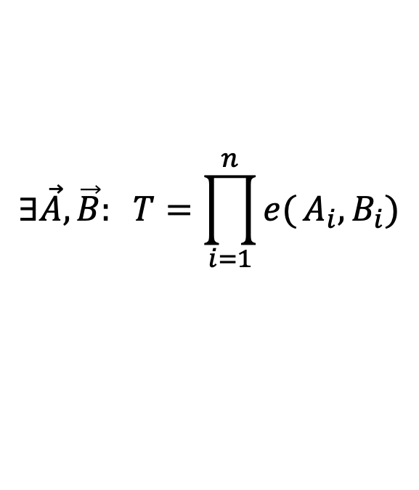
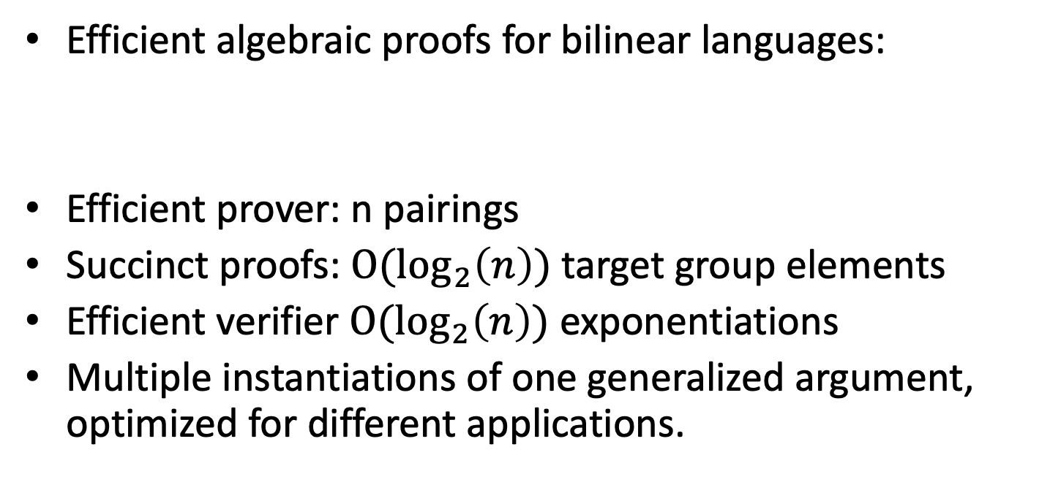
Inner Pairing Product
Efficient algebraic proofs for bilinear languages:
Efficient prover: n pairings
Succinct proofs: $O(\log_{2}\left(n\right))$ target group elements
Efficient verifier $O(\log_{2}\left(n\right))$ exponentiations
Multiple instantiations of one generalized argument, optimized for different applications.
$$∃\vec{A},\vec{B}: T=\prod_{i=1}^{n}{e(}A_{i},B_{i})$$

Slide 3



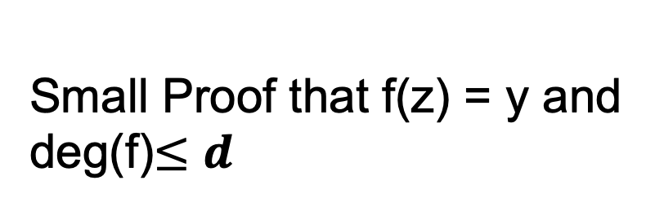
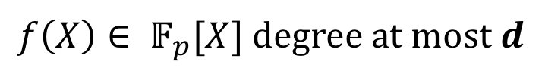
Polynomial Commitment
$f\left(X\right)∈ 𝔽_{p}[X]$ degree at most $d$
C
small value
Many applications:
SNARKs for NP
Accumulators
Vector Commitments
$$π$$
Small Proof that f(z) = y and deg(f)$≤$ $d$

Slide 4
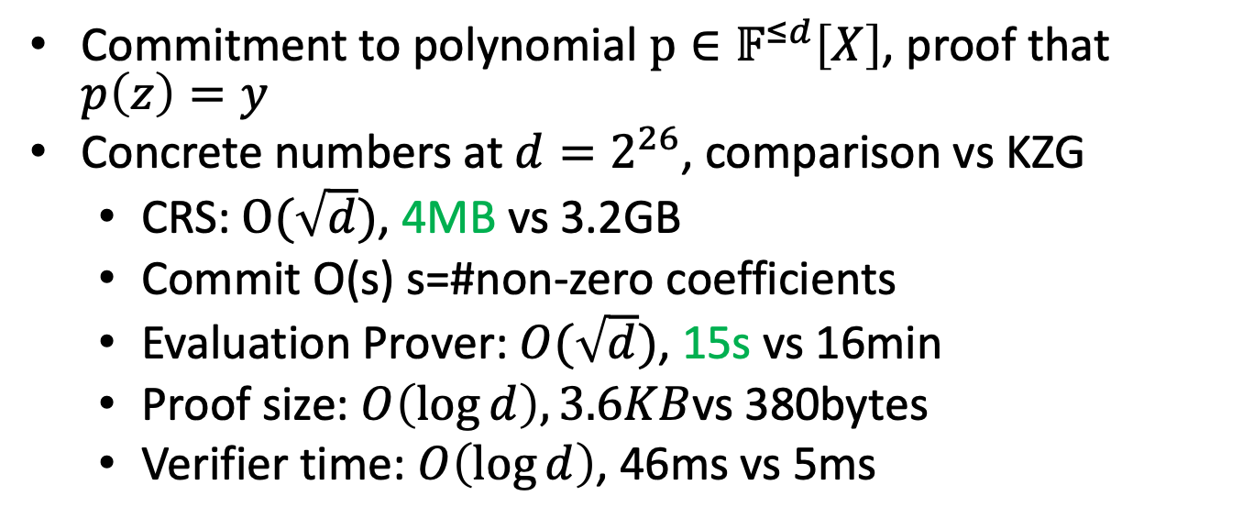
Application 1: PC
Commitment to polynomial $p∈𝔽^{≤d}\left[X\right]$, proof that $p\left(z\right)=y$
Concrete numbers at $d=2^{26}$, comparison vs KZG
CRS: $O(\sqrt{d})$, 4MB vs 3.2GB
Commit O(s) s=#non-zero coefficients
Evaluation Prover: $O(\sqrt{d})$, 15s vs 16min
Proof size: $O\left(\log{d}\right),3.6KB$vs 380bytes
Verifier time: $O\left(\log{d}\right)$, 46ms vs 5ms

Slide 5
Rollup
Today: every miner must verify every posted Tx
verify π
verify all Tx
verify all Tx ⇒ short proof π
verify all Tx
verify π
verify all Tx
summary, π
rollup server
verifying proof is much easier than verifying 10K Tx

Slide 6



Rollup with privacy
Add ZK-SNARKs to each TX
verify π
verify all Tx ⇒ short proof π
verify π
$$π_{tx}$$
summary, π
$$π_{tx}$$
rollup server
$$π_{tx}$$
Need to aggregate ZK-SNARKs

Slide 7
Application 2: Aggregating SNARKs
Aggregation of pairing based SNARKs (Groth16)
Many SNARKs-> 1 short proof, easy to verify
Previously only known from (one level) recursive SNARKs
For 64 proofs: 1.1s vs. 18min +256 GB of memory (900x)
In 12min our aggregation works for 65k proofs

Slide 8
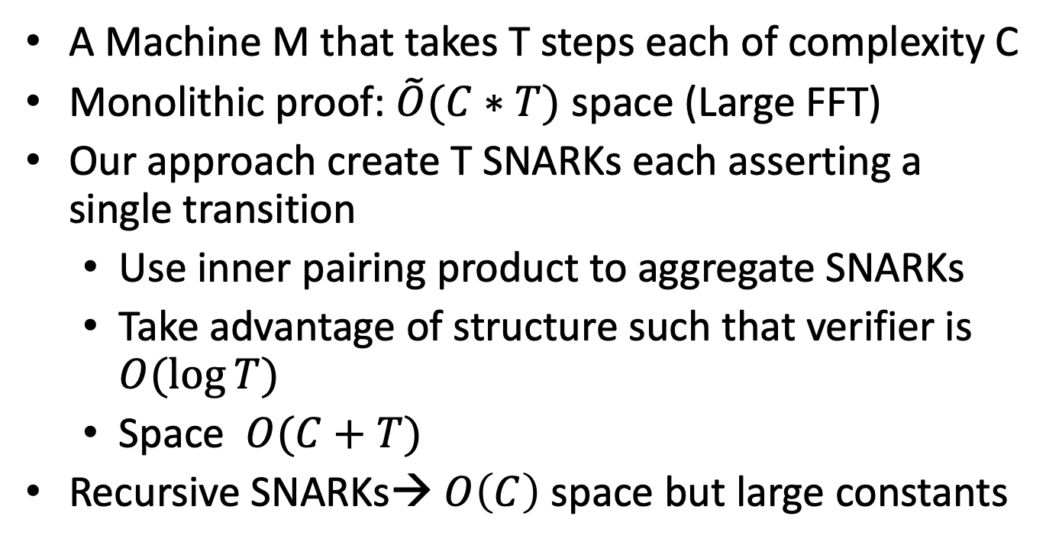
App 3: Low memory SNARKs for machines
A Machine M that takes T steps each of complexity C
Monolithic proof: $\tilde{O}(C∗T)$ space (Large FFT)
Our approach create T SNARKs each asserting a single transition
Use inner pairing product to aggregate SNARKs
Take advantage of structure such that verifier is $O(\log{T})$
Space $O(C+T)$
Recursive SNARKs→ $O\left(C\right)$ space but large constants

Slide 9
BLS Signature aggregation
Anyone can compress n signatures into one
Verify( pk , m , σ* ) = “accept”
convinces verifier that for i=1,…,n: user i signed msg m_{i}
pk₁ , m₁ ⟶ σ₁
⋮
aggregate
⟶ σ*
pk_{n} , m_{n} ⟶ σ_{n}
But verification still requires n expensive pairings!
single short signature

Slide 10
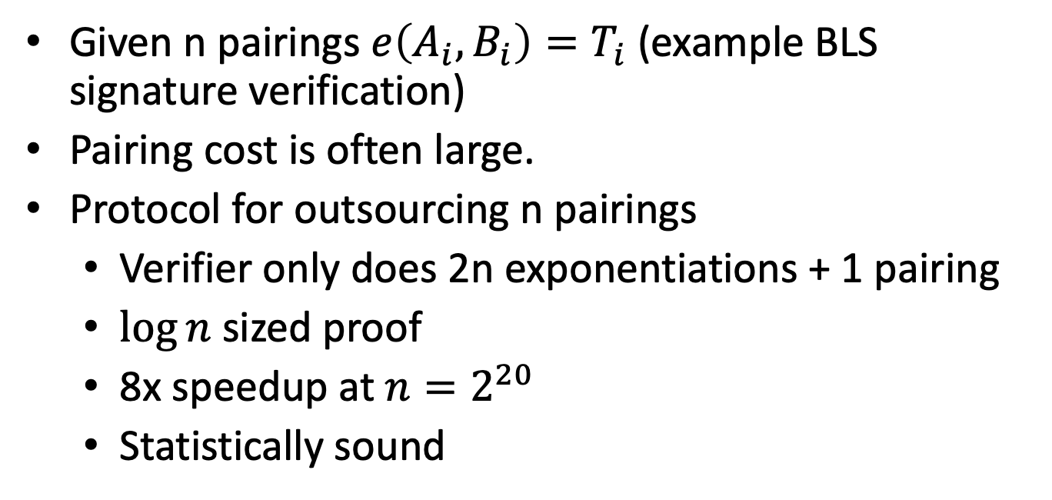
Application 4: Outsourcing of pairings
Given n pairings $e\left(A_{i},B_{i}\right)=T_{i}$ (example BLS signature verification)
Pairing cost is often large.
Protocol for outsourcing n pairings
Verifier only does 2n exponentiations + 1 pairing
$\log{n}$ sized proof
8x speedup at $n=2^{20}$
Statistically sound

Slide 11



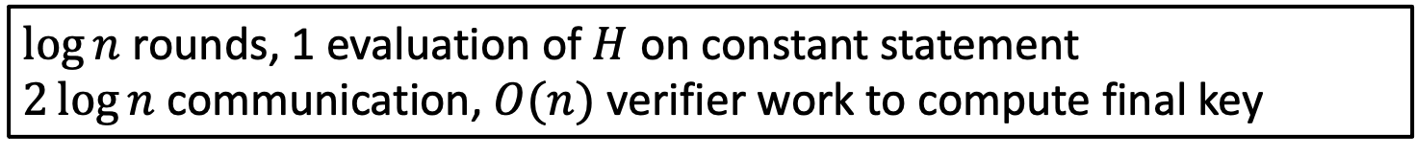

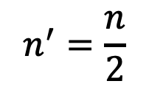




Inner product argument (BCCGP16,Bulletproofs)
$H(\vec{a},\vec{b},⟨\vec{a},\vec{b}⟩$): ${\vec{g}}^{\vec{a}}{\vec{h}}^{\vec{b}}u^{⟨\vec{a},\vec{b}⟩}$
Statement: For $P∈G ∃\vec{a},\vec{b} s.t. \left|\vec{a}\right|=\left|\vec{b}\right|=n∧P=H(\vec{a},\vec{b},⟨\vec{a},\vec{b}⟩$)
$P=H( , , )$
$$\vec{a}$$
$$\vec{b}$$
$$⟨\vec{a} ,\vec{b}⟩$$
One round interaction, 2 commitments sent,
Public coin
$$n^{′}=\frac{n}{2}$$
$P′=H( , , )$
$$\vec{a}′$$
$$\vec{b}′$$
$$⟨\vec{a}′ ,\vec{b}′⟩$$
$\log{n}$ rounds, 1 evaluation of $H$ on constant statement
$2\log{n}$ communication, $O(n)$ verifier work to compute final key

Slide 12
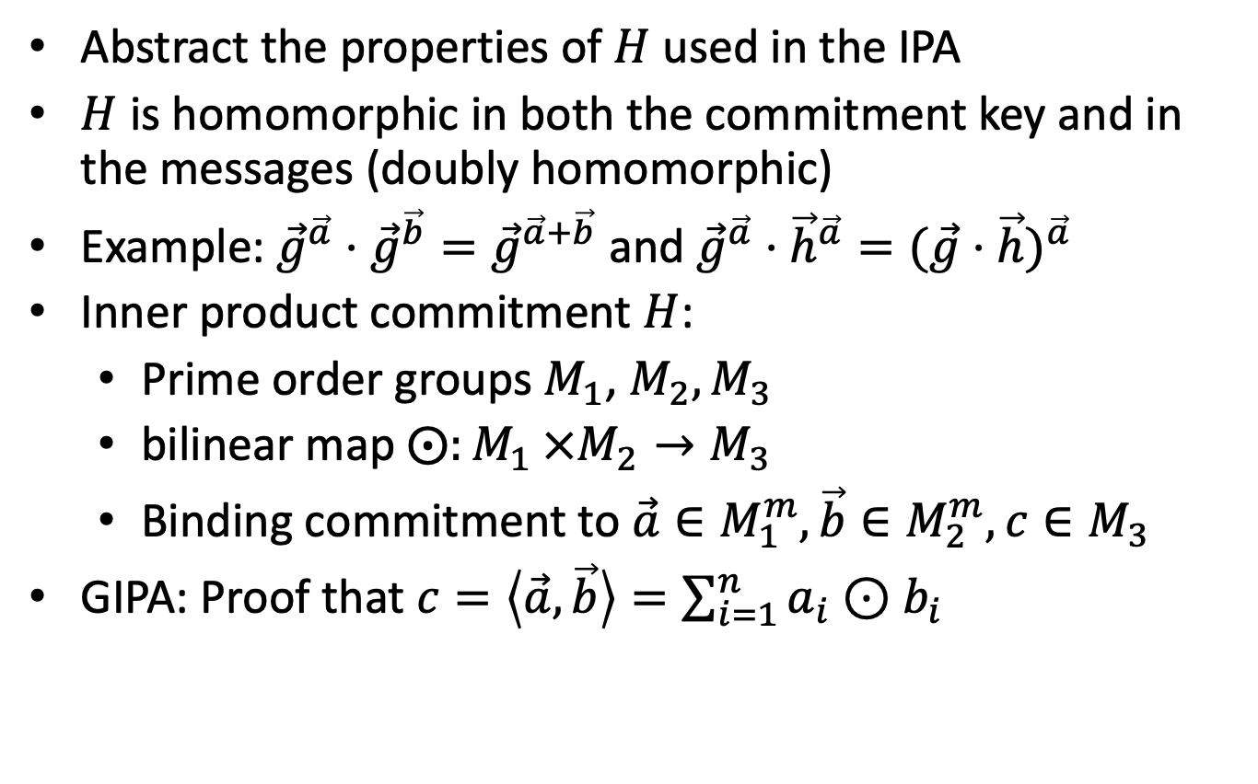
GIPA: Generalized inner product argument
Abstract the properties of $H$ used in the IPA
$H$ is homomorphic in both the commitment key and in the messages (doubly homomorphic)
Example: ${\vec{g}}^{\vec{a}}⋅{\vec{g}}^{\vec{b}}={\vec{g}}^{\vec{a}+\vec{b}}$ and ${\vec{g}}^{\vec{a}}⋅{\vec{h}}^{\vec{a}}={(\vec{g}⋅\vec{h})}^{\vec{a}}$
Inner product commitment $H$:
Prime order groups $M_{1}$, $M_{2},M_{3}$
bilinear map $⨀{:M_{1}}×M_{2}→M_{3}$
Binding commitment to $\vec{a}∈M_{1}^{m},\vec{b}∈M_{2}^{m},c∈M_{3}$
GIPA: Proof that $c=\left\langle \vec{a},\vec{b}\right\rangle =\sum_{i=1}^{n}{a_{i}⊙b_{i}}$

Slide 13
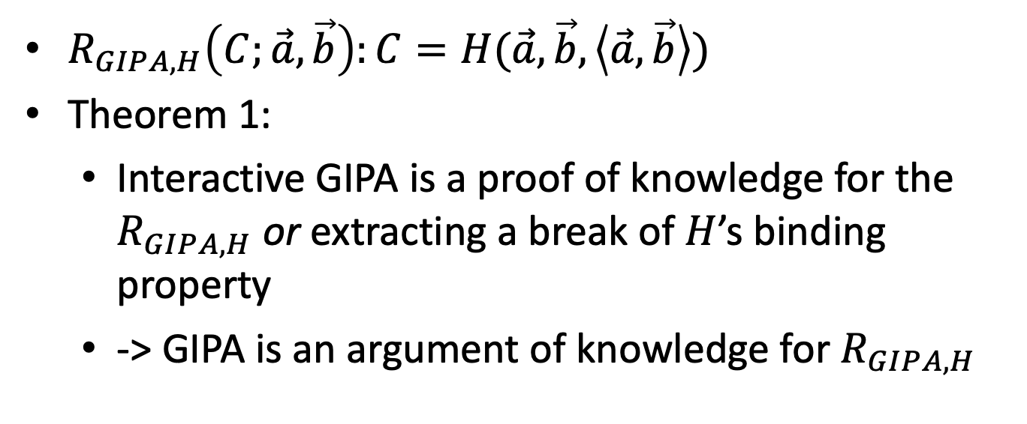
GIPA security
$R_{GIPA,H}\left(C;\vec{a},\vec{b}\right):C=H(\vec{a},\vec{b},\left\langle \vec{a},\vec{b}\right\rangle )$
Theorem 1:
Interactive GIPA is a proof of knowledge for the $R_{GIPA,H}$ or extracting a break of $H$’s binding property
-> GIPA is an argument of knowledge for $R_{GIPA,H}$

Slide 14
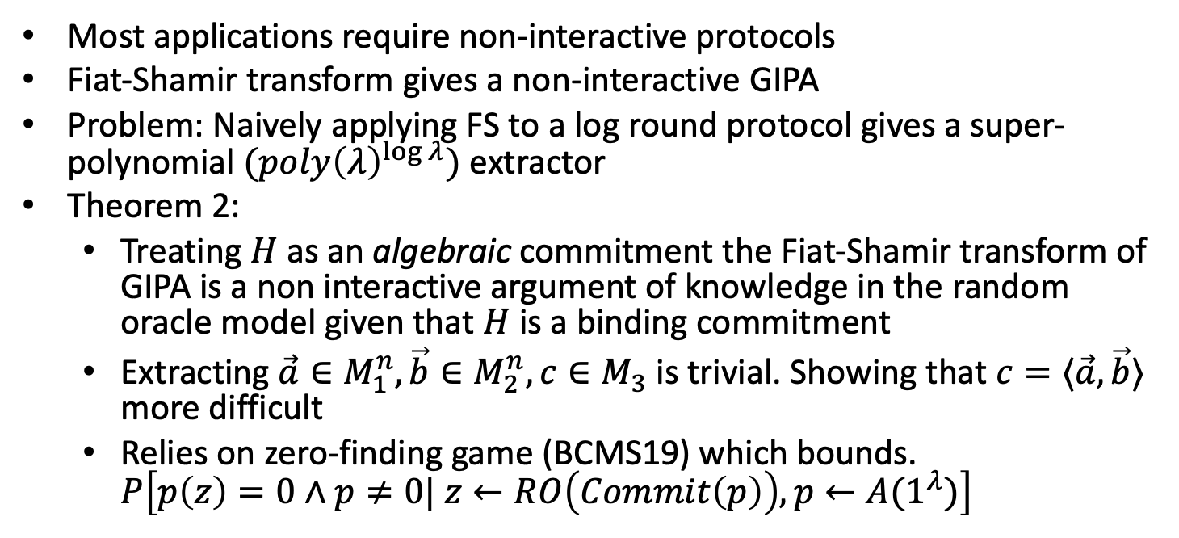
GIPA security
Most applications require non-interactive protocols
Fiat-Shamir transform gives a non-interactive GIPA
Problem: Naively applying FS to a log round protocol gives a super-polynomial $(poly{\left(λ\right)}^{log λ})$ extractor
Theorem 2:
Treating $H$ as an algebraic commitment the Fiat-Shamir transform of GIPA is a non interactive argument of knowledge in the random oracle model given that $H$ is a binding commitment
Extracting $\vec{a}∈M_{1}^{n},\vec{b}∈M_{2}^{n},c∈M_{3}$ is trivial. Showing that $c=⟨\vec{a},\vec{b}⟩$ more difficult
Relies on zero-finding game (BCMS19) which bounds. $P\left[p\left(z\right)=0∧p≠0| z←RO\left(Commit\left(p\right)\right),p←A(1^{λ})\right]$

Slide 15
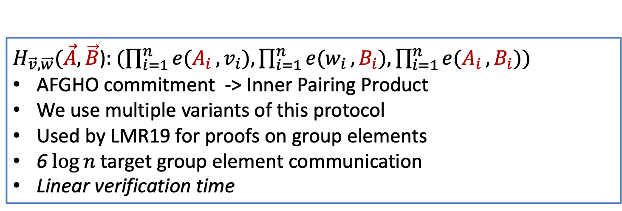
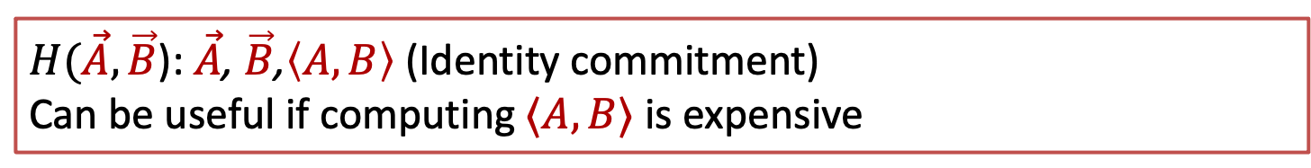
GIPA Instantiations
$H_{\vec{g},\vec{h},u}(\vec{a},\vec{b}$): ${\vec{g}}^{\vec{a}}{\vec{h}}^{\vec{b}}u^{⟨\vec{a},\vec{b}⟩}$ (Peddersen commitment -> Bulletproofs)
$H_{\vec{v},\vec{w}}(\vec{A},\vec{B}$): $(\prod_{i=1}^{n}{e(A_{i}},v_{i}), \prod_{i=1}^{n}{e(w_{i}},B_{i}),\prod_{i=1}^{n}{e(A_{i}},B_{i}))$
AFGHO commitment -> Inner Pairing Product
We use multiple variants of this protocol
Used by LMR19 for proofs on group elements
6 $\log{n}$ target group element communication
Linear verification time
$H(\vec{A},\vec{B}$): $\vec{A}$, $\vec{B}$,$\left\langle A,B\right\rangle$ (Identity commitment)
Can be useful if computing $⟨A,B⟩$ is expensive

Slide 16
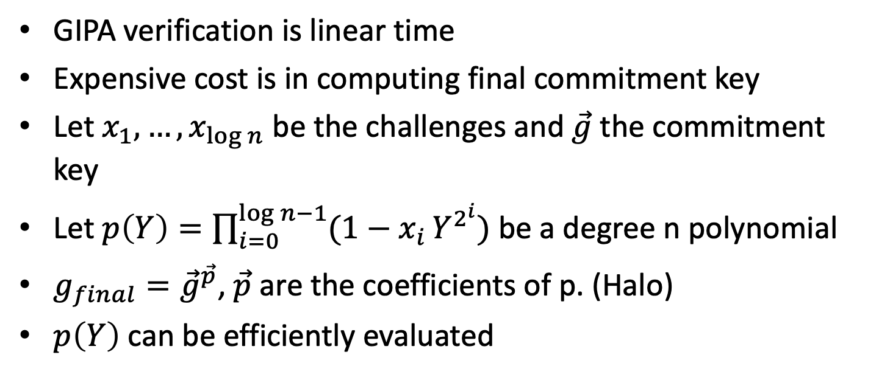
TIPP: Trusted setup inner pairing product
GIPA verification is linear time
Expensive cost is in computing final commitment key
Let $x_{1},…,x_{\log{n}}$ be the challenges and $\vec{g}$ the commitment key
Let $p\left(Y\right)=\prod_{i=0}^{\log{n−1}}{(1−x_{i}}Y^{2^{i}})$ be a degree n polynomial
$g_{final}={\vec{g}}^{\vec{p}}$, $\vec{p}$ are the coefficients of p. (Halo)
$p\left(Y\right)$ can be efficiently evaluated

Slide 17
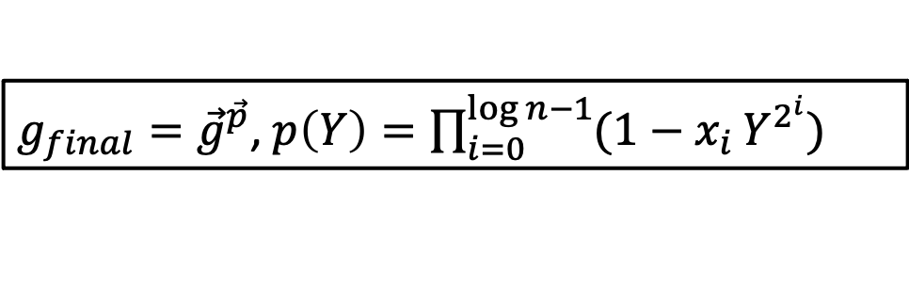
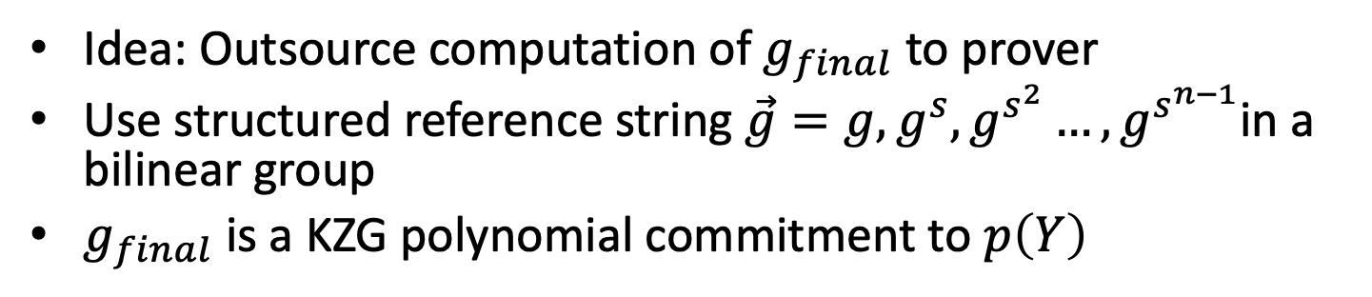
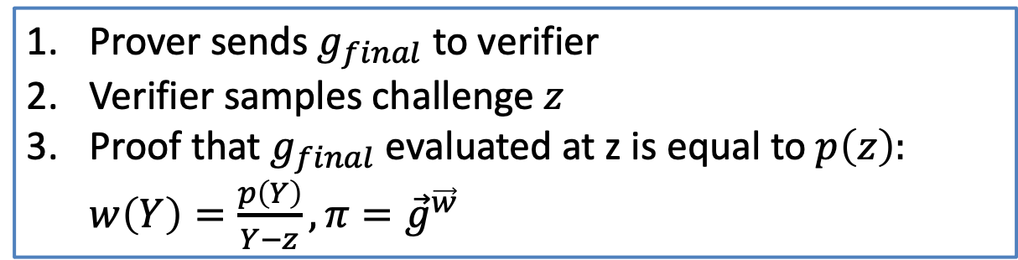
TIPP
$g_{final}={\vec{g}}^{\vec{p}}$, $p\left(Y\right)=\prod_{i=0}^{\log{n−1}}{(1−x_{i}}Y^{2^{i}})$
Idea: Outsource computation of $g_{final}$ to prover
Use structured reference string $\vec{g}=g,g^{s},g^{s^{2}}…,g^{s^{n−1}}$in a bilinear group
$g_{final}$ is a KZG polynomial commitment to $p\left(Y\right)$
Prover sends $g_{final}$ to verifier
Verifier samples challenge $z$
Proof that $g_{final}$ evaluated at z is equal to $p\left(z\right):$
$w\left(Y\right)=\frac{p\left(Y\right)}{Y−z},π={\vec{g}}^{\vec{w}}$
Important details missing, see paper

Slide 18
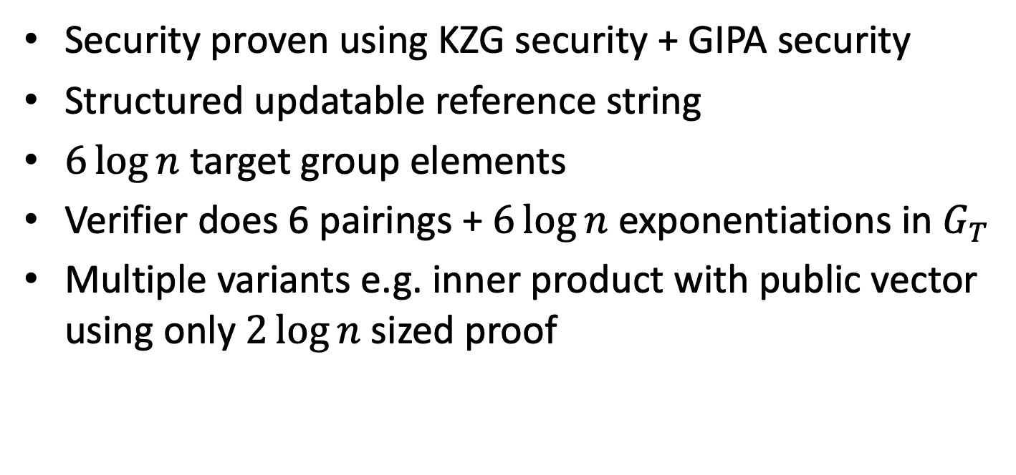
TIPP summary
Security proven using KZG security + GIPA security
Structured updatable reference string
$6\log{n}$ target group elements
Verifier does 6 pairings + $6\log{n}$ exponentiations in $G_{T}$
Multiple variants e.g. inner product with public vector using only $2\log{n}$ sized proof

Slide 19
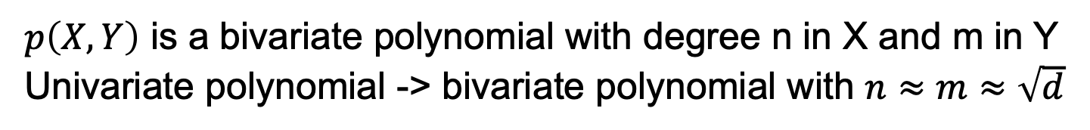
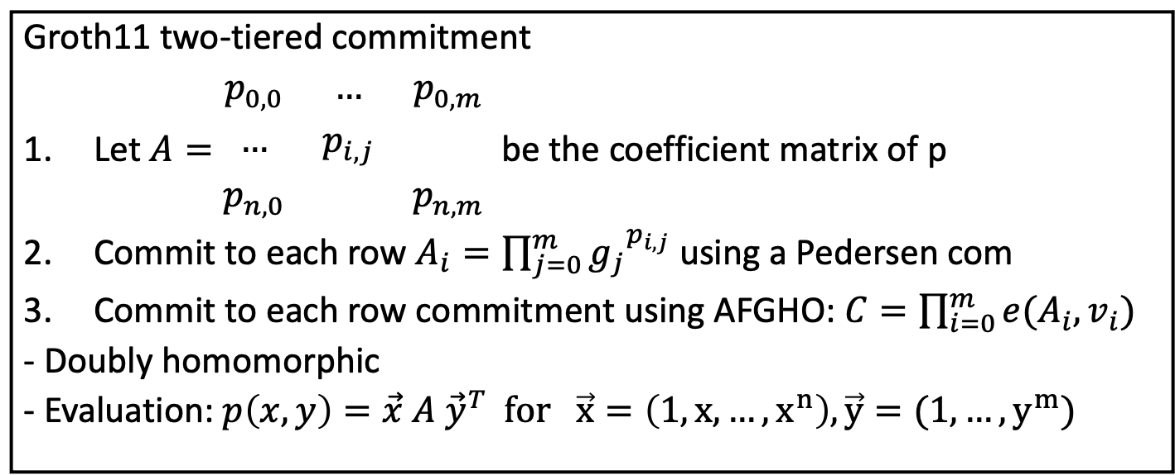
Polynomial Commitment from TIPP
$p\left(X,Y\right)$ is a bivariate polynomial with degree n in X and m in Y
Univariate polynomial -> bivariate polynomial with $n≈m≈\sqrt{d}$
Groth11 two-tiered commitment
Let $A=\begin{matrix}p_{0,0} & … & p_{0,m} \\ … & p_{i,j} & \\ p_{n,0} & & p_{n,m}\end{matrix}$ be the coefficient matrix of p
Commit to each row $A_{i}={\prod_{j=0}^{m}{g_{j}}}_{}^{p_{i,j}}$ using a Pedersen com
Commit to each row commitment using AFGHO: $C=\prod_{i=0}^{m}{e(A_{i},v_{i})}$
- Doubly homomorphic
- Evaluation: $p\left(x,y\right)=\vec{x} A {\vec{y}}^{T} for \vec{x}=\left(1,x,…,x^{n}\right),\vec{y}=(1,…,y^{m})$

Slide 20
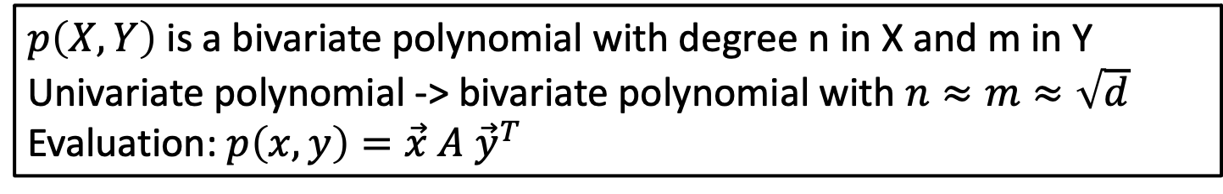
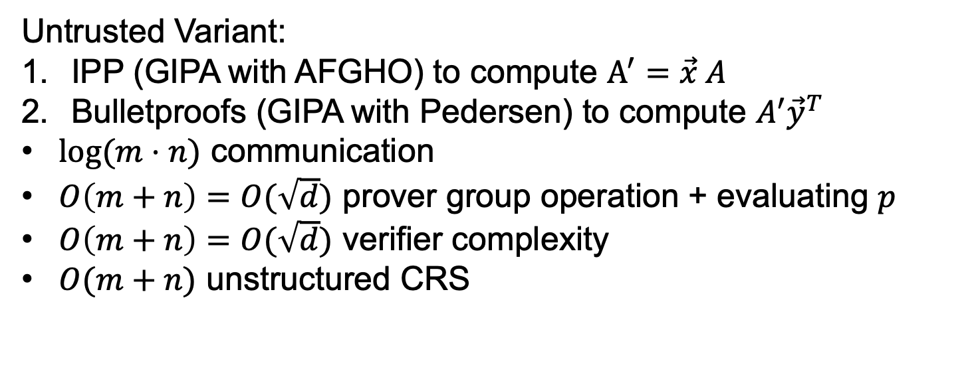
Polynomial Commitment from TIPP
$p\left(X,Y\right)$ is a bivariate polynomial with degree n in X and m in Y
Univariate polynomial -> bivariate polynomial with $n≈m≈\sqrt{d}$ Evaluation: $p\left(x,y\right)=\vec{x} A {\vec{y}}^{T}$
Untrusted Variant:
IPP (GIPA with AFGHO) to compute $A^{′}=\vec{x} A$
Bulletproofs (GIPA with Pedersen) to compute $A^{′}{\vec{y}}^{T}$
$\log{(m⋅n)}$ communication
$O\left(m+n\right)=O(\sqrt{d})$ prover group operation + evaluating $p$
$O\left(m+n\right)=O(\sqrt{d})$ verifier complexity
$O(m+n)$ unstructured CRS

Slide 21
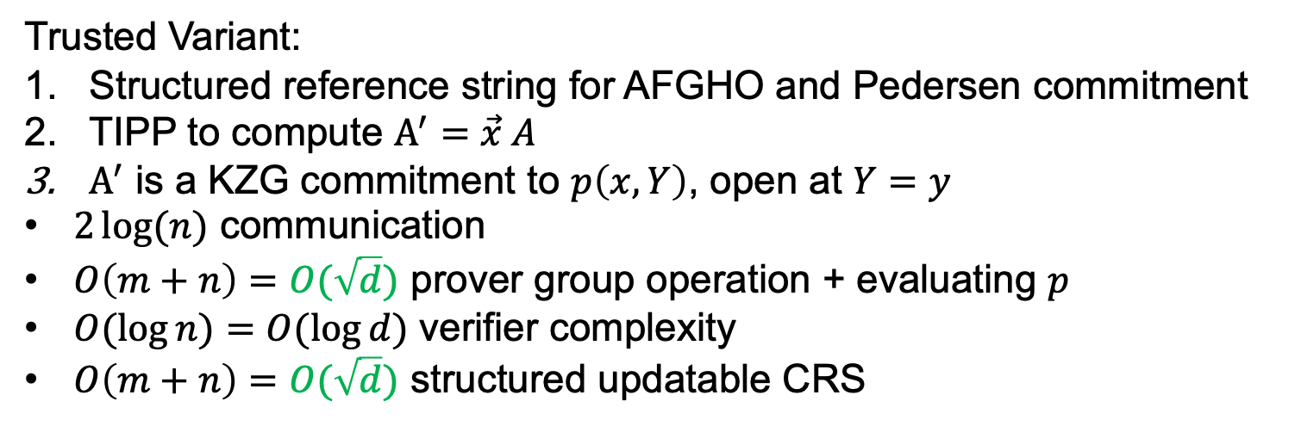
Polynomial Commitment from TIPP
$p\left(X,Y\right)$ is a bivariate polynomial with degree n in X and m in Y
Univariate polynomial -> bivariate polynomial with $n≈m≈\sqrt{d}$ Evaluation: $p\left(x,y\right)=\vec{x} A {\vec{y}}^{T}$
Trusted Variant:
Structured reference string for AFGHO and Pedersen commitment
TIPP to compute $A^{′}=\vec{x} A$
$A^{′}$ is a KZG commitment to $p\left(x,Y\right)$, open at $Y=y$
$2\log{(n)}$ communication
$O\left(m+n\right)=O(\sqrt{d})$ prover group operation + evaluating $p$
$O(\log{n})=O(\log{d})$ verifier complexity
$O\left(m+n\right)=O(\sqrt{d})$ structured updatable CRS
Recent work: Dory (Lee20)
Similar asymptotics
Worse constants
No trusted setup!

Slide 22
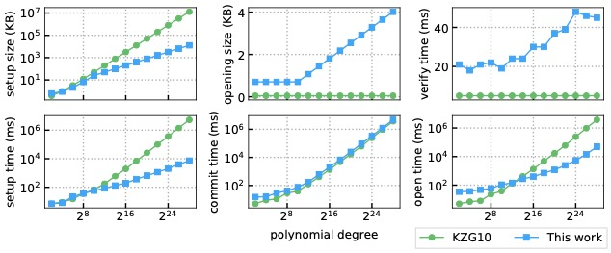
TIPP evaluation
Rust implementation in open source library: https://github.com/arkworks-rs/ripp
Notes:
15s vs 16min
4MB vs 3.2GB
Protocol labs circuits of size 2^30

Slide 23
Rollup with privacy
Add ZK-SNARKs to each TX
verify π
verify all Tx ⇒ short proof π
verify π
$$π_{tx}$$
summary, π
$$π_{tx}$$
rollup server
$$π_{tx}$$
Prior solution: Recursive SNARKs

Slide 24
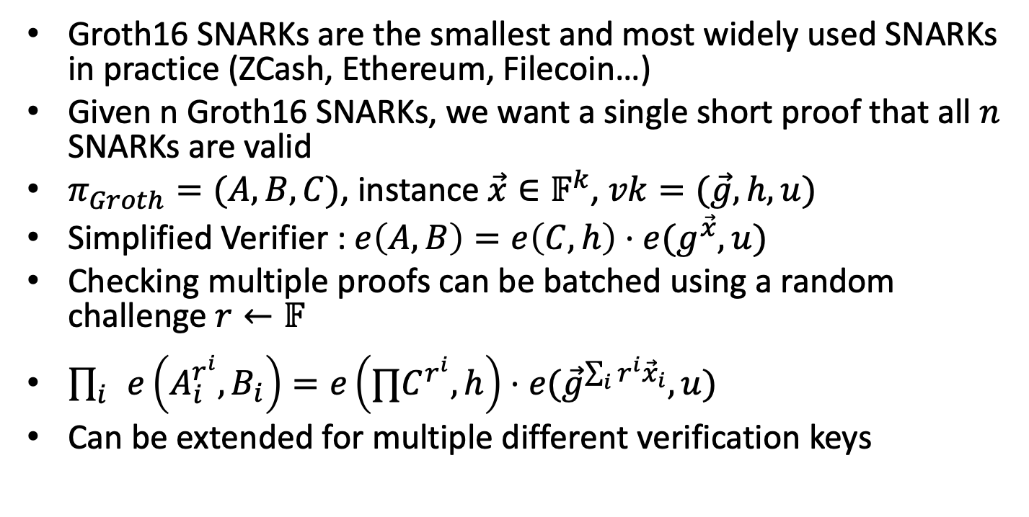
SNARK aggregation
Groth16 SNARKs are the smallest and most widely used SNARKs in practice (ZCash, Ethereum, Filecoin…)
Given n Groth16 SNARKs, we want a single short proof that all $n$ SNARKs are valid
$π_{Groth}=(A,B,C)$, instance $\vec{x}∈𝔽^{k}$, $vk=(\vec{g},h, u)$
Simplified Verifier : $e\left(A,B\right)=e\left(C,h\right)⋅e(g^{\vec{x}},u)$
Checking multiple proofs can be batched using a random challenge $r←𝔽$
$\prod_{i}{e\left(A_{i}^{r^{i}},B_{i}\right)=e\left(∏C^{r^{i}},h\right)⋅e({\vec{g}}^{\sum_{i}{r^{i}}{\vec{x}}_{i}},u) }$
Can be extended for multiple different verification keys

Slide 25
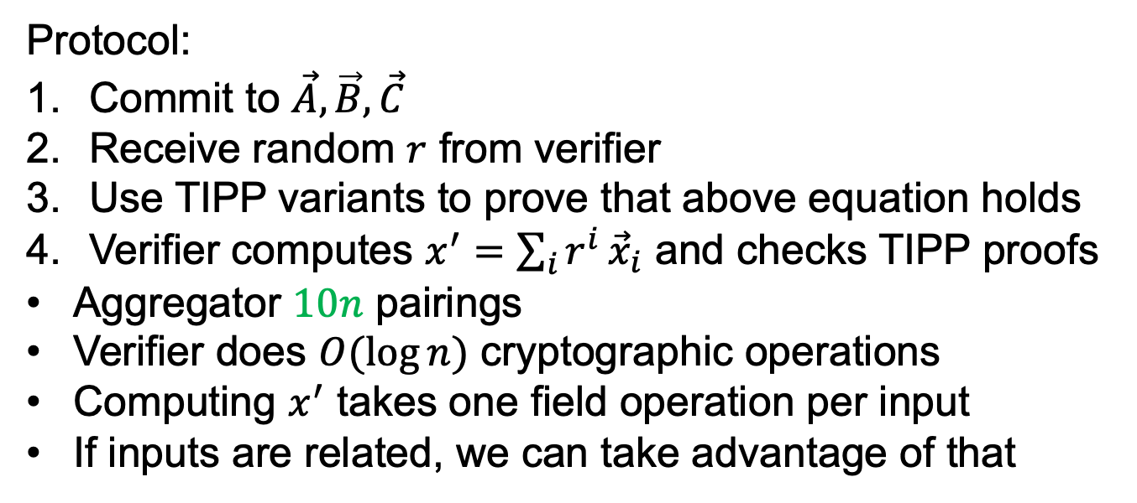
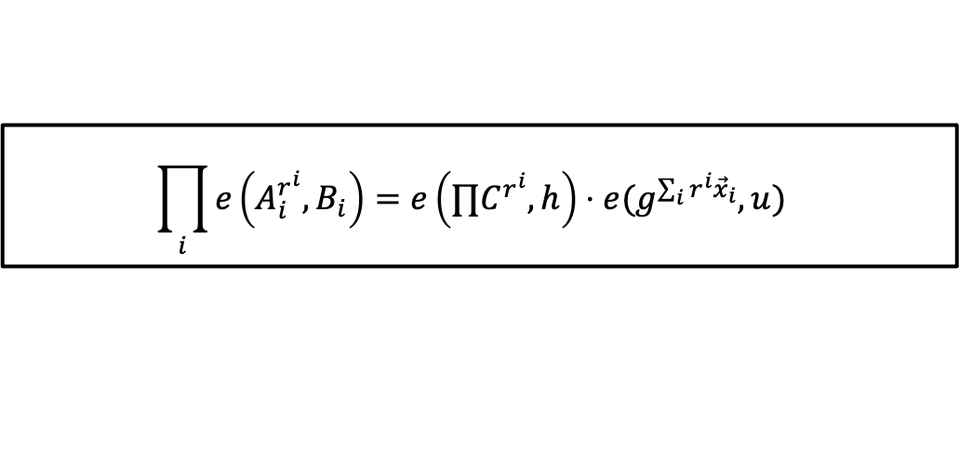
SNARK aggregation
$$\prod_{i}{e\left(A_{i}^{r^{i}},B_{i}\right)=e\left(∏C^{r^{i}},h\right)⋅e(g^{\sum_{i}{r^{i}}{\vec{x}}_{i}},u) }$$
Protocol:
Commit to $\vec{A},\vec{B},\vec{C}$
Receive random $r$ from verifier
Use TIPP variants to prove that above equation holds
Verifier computes $x^{′}=\sum_{i}{r^{i}}{\vec{x}}_{i}$ and checks TIPP proofs
Aggregator $10n$ pairings
Verifier does $O(\log{n})$ cryptographic operations
Computing $x^{′}$ takes one field operation per input
If inputs are related, we can take advantage of that

Slide 26
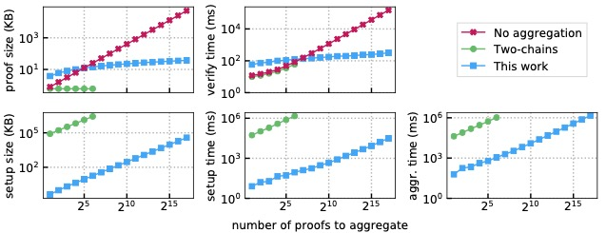
SNARK aggregation evaluation
Comparison with one level recursion ZEXE
After 64 proofs ZEXE runs out of memory,
We can easily handle >65k proofs

Slide 27
Thanks
https://eprint.iacr.org/2019/1177.pdf

