Slide 1
Accumulators and
Proofs in Groups of Unknown Order
Dan Boneh, Benedikt Bünz, Ben Fisch
https://eprint.iacr.org/2018/1188
To appear at Crypto 2019

Slide 2
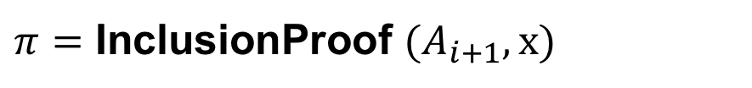
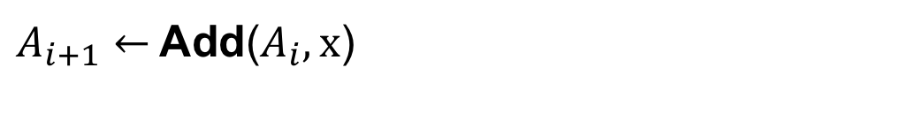

Accumulators [Bd94, CL02]
Short
Membership Witness
$A_{i+1}←$Add($A_{i},x$)
$π=$ InclusionProof ${(A}_{i+1}, x)$
Verify($π,A_{i+1},x)=\{0,1\}$
Constant size
Examples:
Merkle trees
RSA Accumulators [CL02]
Pairing-based accumulators [NG05]

Slide 3
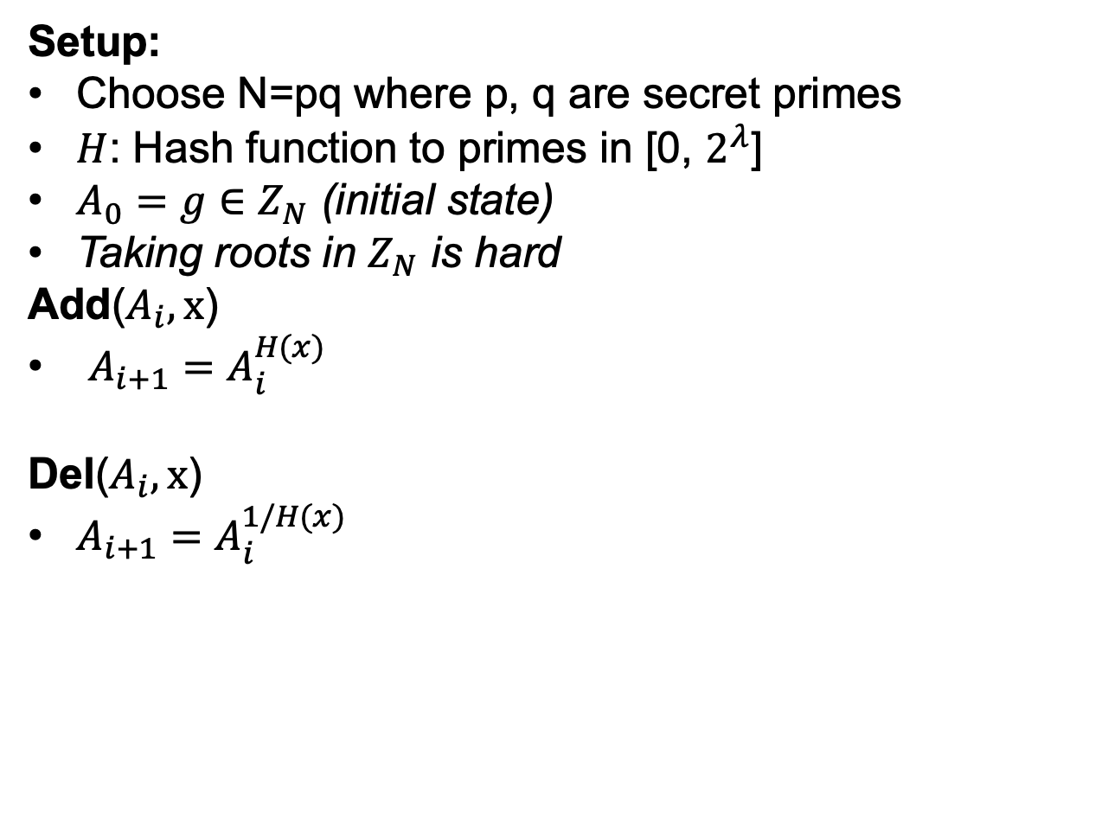
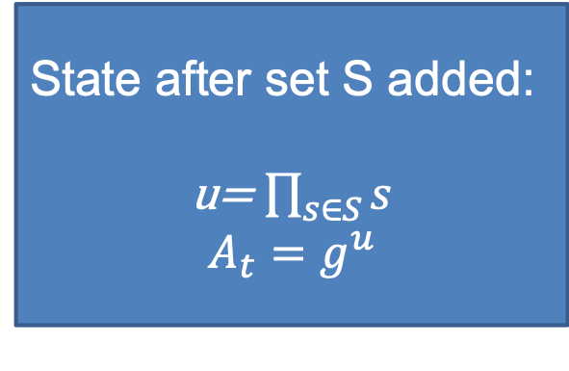
RSA Accumulators [CL02, LiLiXue07]
Setup:
Choose N=pq where p, q are secret primes
$H$: Hash function to primes in [0, $2^{λ}$]
$A_{0}=g∈Z_{N}$ (initial state)
Taking roots in $Z_{N}$ is hard
Add($A_{i},x$)
$A_{i+1}=A_{i}^{H(x)}$
Del($A_{i},x$)
$A_{i+1}=A_{i}^{1/H(x)}$
State after set S added:
u= $\prod_{s∈S}{s}$
$$A_{t}=g^{u}$$
Notes:
We’ll omit H

Slide 4
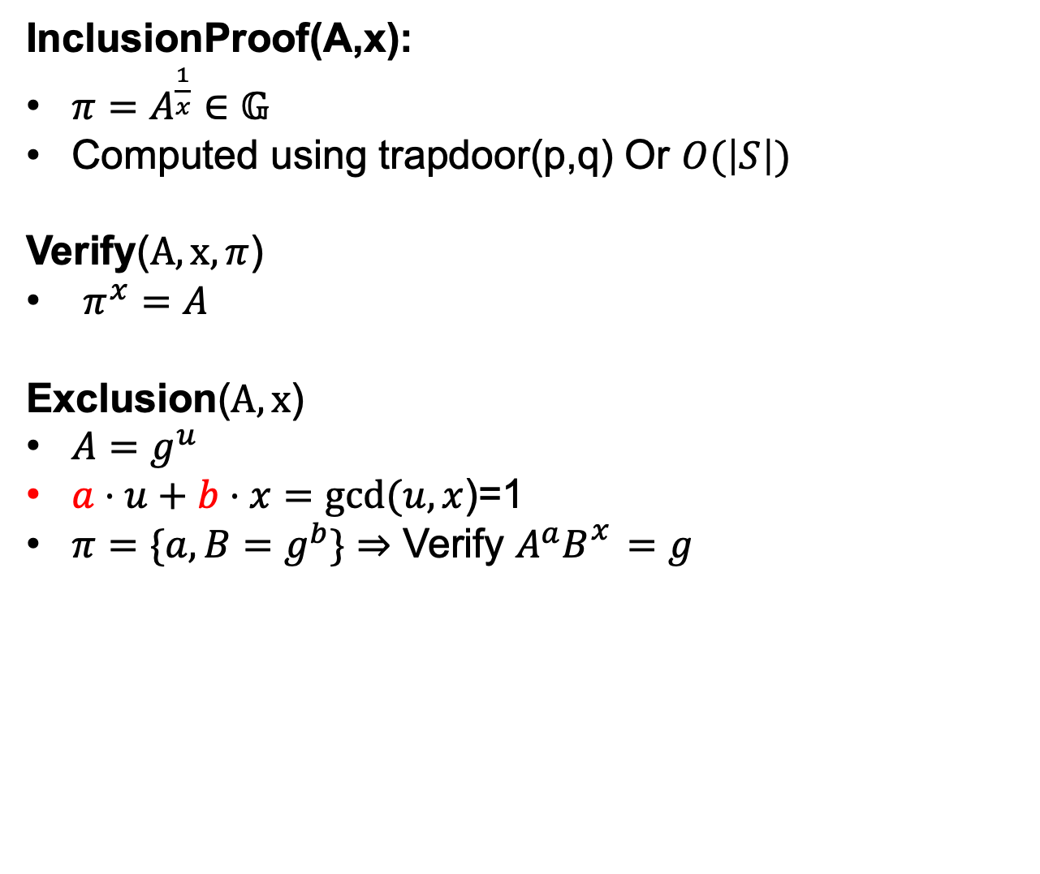
Accumulator Proofs
InclusionProof(A,x):
$π=A^{\frac{1}{x}}∈𝔾$
Computed using trapdoor(p,q) Or $O(\left|S\right|)$
Verify($A,x,π$)
$π^{x}=A$
Exclusion($A,x$)
$A=g^{u}$
$a⋅u+b⋅x=gcd⁡(u,x$)=1
$π=\{a, B=g^{b}\}⇒$ Verify $A^{a}B_{}^{x}=g$
Efficient stateless updates to (non)-membership witnesses:
[LiLiXue07]

Slide 5
An application: low-memory blockchains
☓
Simplified Bitcoin State model (UTXOs)
State:
Coin₁ : {PK: y₁, Value: 13}
Coin₂ : {y₂, 7}
Coin_{i}
Coin_{j}
Coin_{j+1}
Added
Tx:
Coin₂
sig
Coin_{new,j} :{y_{j},3}
Coin_{new,j+1}:{y_{j+1},4}
Spent
Created
Created

Slide 6
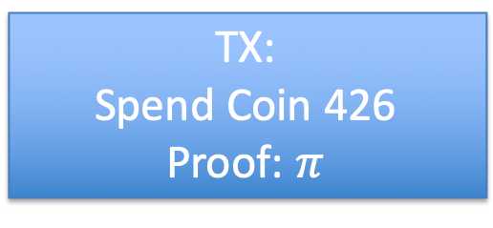
“Stateless” mining
prev: H( )
prev: H( )
prev: H( )
trans: H( )
trans: H( )
trans: H( )
Coins Accum
Coins Accum
Coins Accum
Looks good
TX:
Spend Coin 426
Proof: $π$

Slide 7
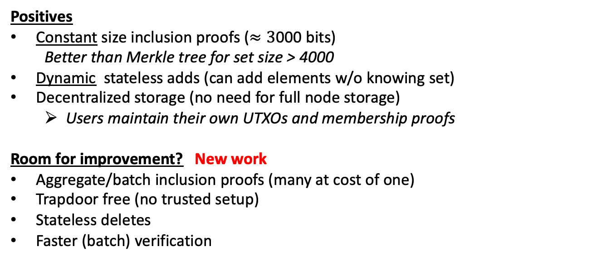
RSA Accumulator State of Art
Positives
Constant size inclusion proofs ($≈3$000 bits)
  Better than Merkle tree for set size > 4000
Dynamic stateless adds (can add elements w/o knowing set)
Decentralized storage (no need for full node storage)
  Users maintain their own UTXOs and membership proofs
Room for improvement? New work
Aggregate/batch inclusion proofs (many at cost of one)
Trapdoor free (no trusted setup)
Stateless deletes
Faster (batch) verification

Slide 8
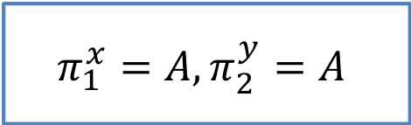
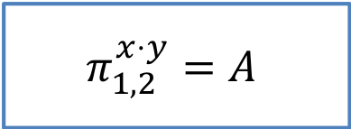
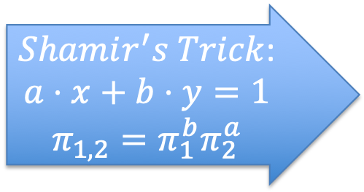
Aggregate Membership Witnesses
$Shamir^{′}s Trick$:
$$a⋅x+b⋅y=1$$
$$π_{1,2}=π_{1}^{b}π_{2}^{a}$$
$$π_{1}^{x}=A,π_{2}^{y}=A$$
$$π_{1,2}^{x⋅y}=A$$
All membership witnesses per transaction block: ~3000 bits
Notes:
Remember if merkle trees than 160gb

Slide 9
RSA = Trusted Setup?
N=p*q, p,q unknown
Efficient delete needs trapdoor
MPC to generate N with unknown trapdoor

Slide 10
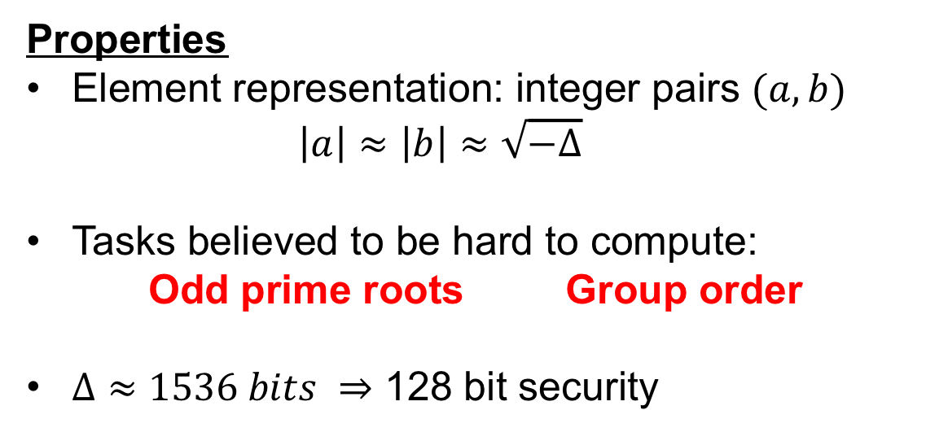
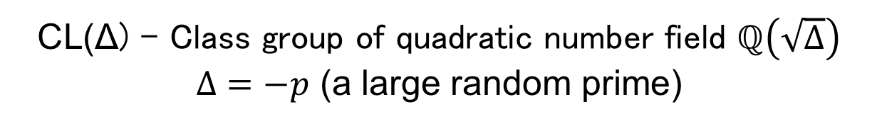
Class Groups [BW88,L12]
CL(Δ) - Class group of quadratic number field $ℚ\left(\sqrt{Δ}\right)$
$Δ=−p$ (a large random prime)
Properties
Element representation: integer pairs $(a, b)$
  $$\left|a\right|≈\left|b\right|≈\sqrt{−Δ}$$
Tasks believed to be hard to compute:
    Odd prime roots Group order
$Δ≈1536 bits ⇒$ 128 bit security
No trusted setup

Slide 11
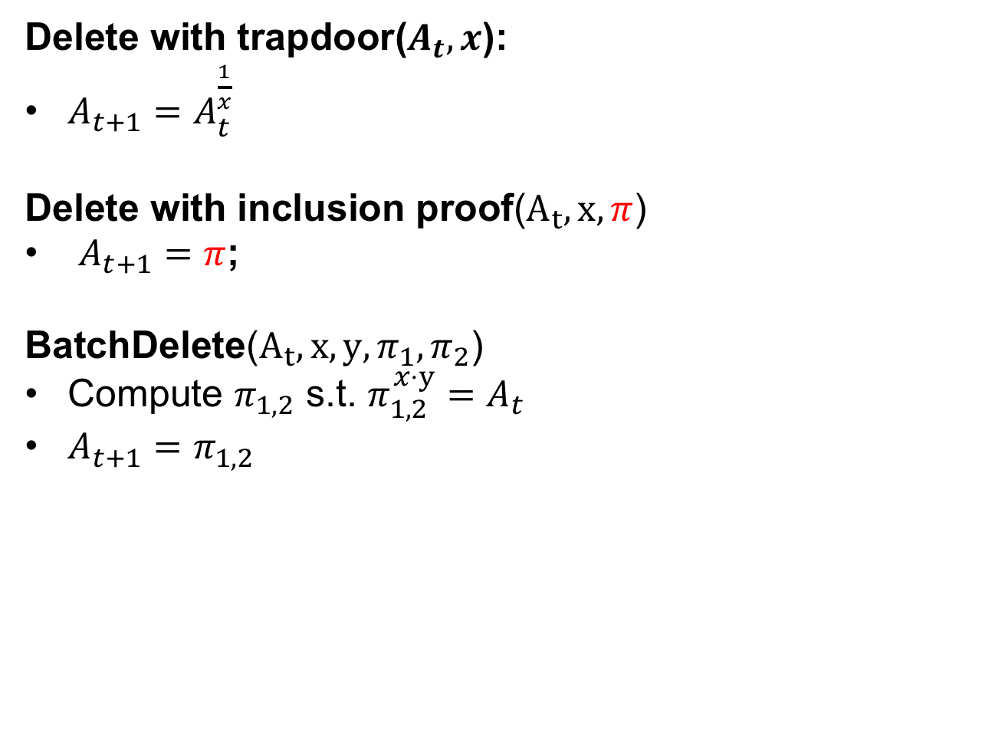

Stateless Deletion
Delete with trapdoor($A_{t},x$):
$A_{t+1}=A_{t}^{\frac{1}{x}}$
Delete with inclusion proof($A_{t},x,π$)
$A_{t+1}=π$;
BatchDelete($A_{t},x,y,π_{1},π_{2}$)
Compute $π_{1,2}$ s.t. $π_{1,2}^{x⋅y}=A_{t}$
$A_{t+1}=π_{1,2}$
Using knowledge of p, q
$$π=g^{\frac{u}{x}}$$
No State,
no Trapdoor,
asynchronous
Notes:
Unclear

Slide 12
Verification of Witnesses Too slow?
Java Big Integer Microbenchmark:
  600 exponentiations per second (256 bit exponents)
  Verification/Full sync would be problematic
  (On my laptop)

Slide 13



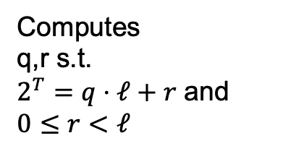


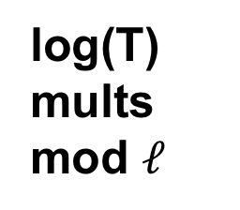
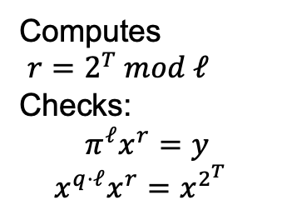
Wesolowski Proof [Wesolowski’18]
$$\left(x,y,T\right):x^{2^{T}}=y$$
y
Peggy
Random $λ$ bit prime $ℓ$
Victor
Computes
q,r s.t.
$2^{T}=q⋅ℓ+r$ and $0≤r<ℓ$
$$π=x^{q}$$
Computes
$r=2^{T} mod ℓ$
Checks:
$$π^{ℓ}x^{r}=y$$
$$x^{q⋅ℓ}x^{r}=x^{2^{T}}$$
log(T)
mults mod $ℓ$
Notes:
Verification in log(T) steps to reduce 2^T mod l

Slide 14
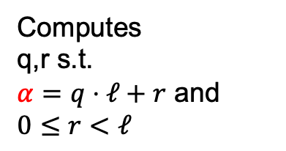

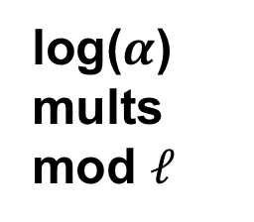
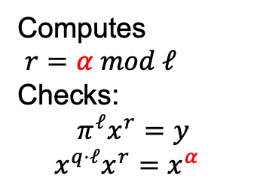
Proof of Exponentiation (PoE)
$$\left(x,y,α\right):x^{α}=y$$
y
Peggy
Random $λ$ bit prime $ℓ$
Victor
Computes
q,r s.t.
$α=q⋅ℓ+r$ and $0≤r<ℓ$
$$π=x^{q}$$
Computes
$r=α mod ℓ$
Checks:
$$π^{ℓ}x^{r}=y$$
$$x^{q⋅ℓ}x^{r}=x^{α}$$
log($α$)
mults mod $ℓ$

Slide 15
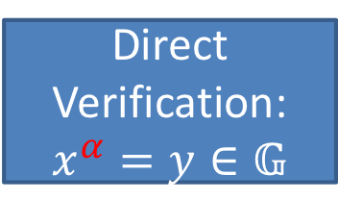
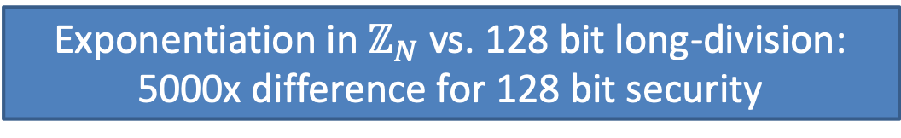
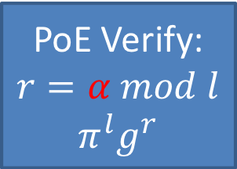
PoE Efficiency
Both linear in bitlength
$$\left(x,y,α\right):x^{α}=y$$
Direct Verification:
$$x^{α}=y∈𝔾$$
PoE Verify:
$$r=α mod l$$
$$π^{l}g^{r}$$
Much faster
Exponentiation in $ℤ_{N}$ vs. 128 bit long-division:
5000x difference for 128 bit security
Notes:
G is Z_N where N has 2000 bit or class group

Slide 16
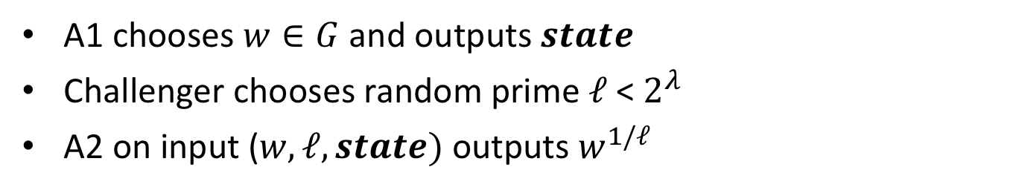
Security: Adaptive Root Assumption
Assumption: No adversary succeeds in following game with non. negl. probability:
A1 chooses $w∈G$ and outputs $state$
Challenger chooses random prime $ℓ$ < $2^{λ}$
A2 on input ($w, ℓ, state)$ outputs $w^{1/ℓ}$
Adaptive root implies it’s hard to find the order of any element!
Theorem[BBF’19]: Holds in generic group model

Slide 17

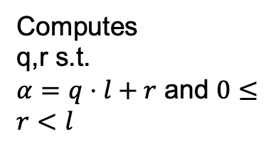



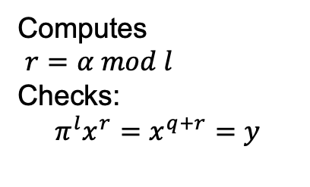
Breaking Adaptive Root/PoE
$$\left(x,y,T\right):x^{α}=y$$
$$w,s.t. w^{2}=1$$
y
Peggy
Random $λ$ bit prime l
Victor
Computes
q,r s.t.
$α=q⋅l+r$ and $0≤r<l$
$$π=x^{q}$$
Computes
$r=α mod l$
Checks:
$$π^{l}x^{r}=x^{q+r}=y$$

Slide 18

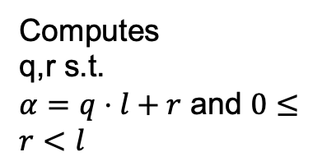
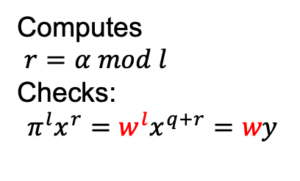
Breaking Adaptive Root/PoE
$$\left(x,y,T\right):x^{α}=y$$
$$w,s.t. w^{2}=1$$
w*y
Peggy
Random $λ$ bit prime l
Victor
Computes
q,r s.t.
$α=q⋅l+r$ and $0≤r<l$
$$π={w∗x}^{q}$$
Computes
$r=α mod l$
Checks:
$$π^{l}x^{r}=w^{l}x^{q+r}=wy$$
w=-1 in Z_{N} -> We work in Z_{N} /{1,-1}

Slide 19

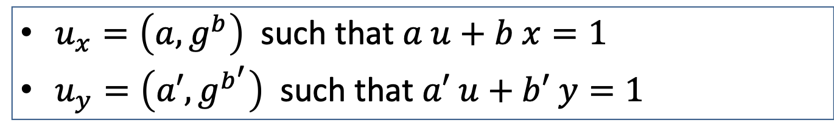
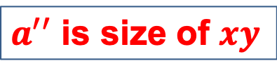
Aggregating Non Mem Witnesses
$$A=g^{u}$$
$u_{x}=\left(a, g^{b}\right)$ such that $a u+b x=1$
$u_{y}=\left(a′, g^{b^{′}}\right)$ such that $a′ u+b′ y=1$
Not smaller!
$u_{xy}=\left(a^{′′}, g^{b^{′′}}\right)$ such that $a′′ u+b′′xy=1$
$a^{′′}$ is size of $xy$

Slide 20
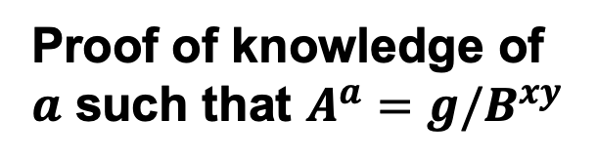
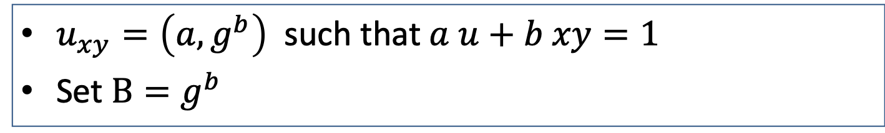
Aggregating Non Mem Witnesses
$$A=g^{u}$$
$u_{xy}=\left(a, g^{b}\right)$ such that $a u+b xy=1$
Set $B=g^{b}$
Proof of knowledge of $a$ such that $A^{a}={g/B}^{xy}$

Slide 21
Proof of Knowledge of Dlog? (non-ZK)
G group of unknown order
Goal 1: P wants to convince V it knows a ∈ ℤ s.t. V = U^{α}
no zero-Knowledge ⇒ P can just sends α to V
Goal 2: V’s work should be poly(λ), independent of α
Prover
α ∈ [B] ⊆ ℤ
Verifier
(U, V = U^{α}) ∈ G²
c ∈ 𝓒
c ⟵ 𝓒 ⊆ ℤ
fast decision test

Slide 22
Proof of Exponentiation (PoE)
$$\left(x,y,α\right):x^{α}=y$$
y
Peggy
Random $λ$ bit prime $ℓ$
Victor
Computes
q,r s.t.
$α=q⋅ℓ+r$ and $0≤r<ℓ$
V knows x
$$π=x^{q}$$
Computes
$r=α mod ℓ$
Checks:
$$π^{ℓ}x^{r}=y$$
$$x^{q⋅ℓ}x^{r}=x^{α}$$

Slide 23

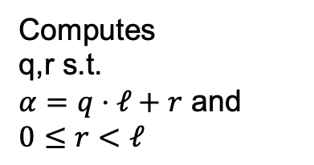

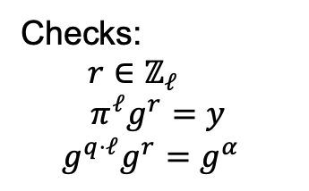
Knowledge of Exponent (PoKE*)
g is encoded in CRS
$$\left(y;α\right):g^{α}=y$$
y
Peggy
Random $λ$ bit prime $ℓ$
Victor
Computes
q,r s.t.
$α=q⋅ℓ+r$ and $0≤r<ℓ$
$$π=x^{q},r$$
Checks:
$r∈ℤ_{ℓ}$
$$π^{ℓ}g^{r}=y$$
$$g^{q⋅ℓ}g^{r}=g^{α}$$
Notes:
Needed for batch exclusion

Slide 24
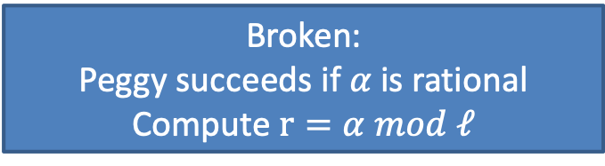

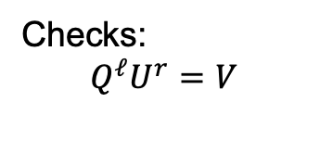

Knowledge of Exponent (PoKE)
$$\left(U,V;α\right):U^{α}=V$$
Peggy
Random $λ$ bit prime $ℓ$
Victor
Computes
q,r s.t.
$α=q⋅ℓ+r$ and $0≤r<ℓ$
$$Q=U^{q},r$$
Checks:
$$Q^{ℓ}U^{r}=V$$
Broken:
Peggy succeeds if $α$ is rational
Compute $r=α mod ℓ$
Notes:
Alpha is invertible mod ell

Slide 25
Impossibility result [Bangerter, Camenisch, Krenn, 2010]
BCK’10: No ”Schnorr-like” protocol can
achieve soundness error less than ½.
... assuming no common reference string (CRS)
This work: a very simple CRS suffices to get exponential soundness!

Slide 26


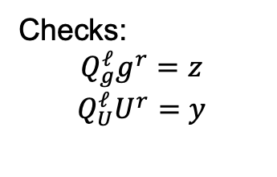

Knowledge of Exponent (PoKE)
$$\left(U,V;α\right):U^{α}=V$$
g is generic generator in CRS
$$y,z=g^{α}$$
Peggy
Random $λ$ bit prime $ℓ$
Victor
Computes
q,r s.t.
$α=q⋅ℓ+r$ and $0≤r<ℓ$
$$Q_{U}=U^{q},Q_{g}=g^{q},r$$
Checks:
$$Q_{g}^{ℓ}g^{r}=z$$
$$Q_{U}^{ℓ}U^{r}=y$$
Notes:
We can combine Qx and Qg

Slide 27
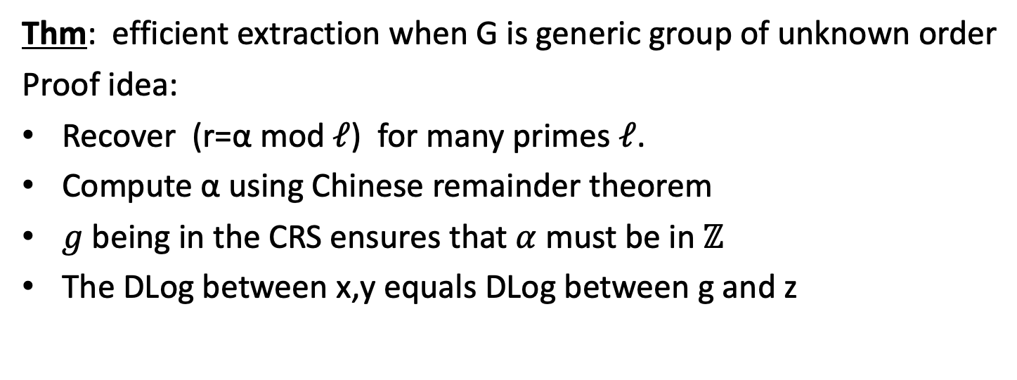
Extracting the witness α
Thm: efficient extraction when G is generic group of unknown order
Proof idea:
Recover (r=α mod 𝓁) for many primes 𝓁.
Compute α using Chinese remainder theorem
$g$ being in the CRS ensures that $α$ must be in ℤ
The DLog between x,y equals DLog between g and z
Can be made non-interactive using Fiat-Shamir
  𝓁 ⟵ HashToPrime(Trans) ∈ Primes(λ)
Protocol generalizes to PoK of preimage of 𝛷: ℤ^{n} ⟶ G

Slide 28
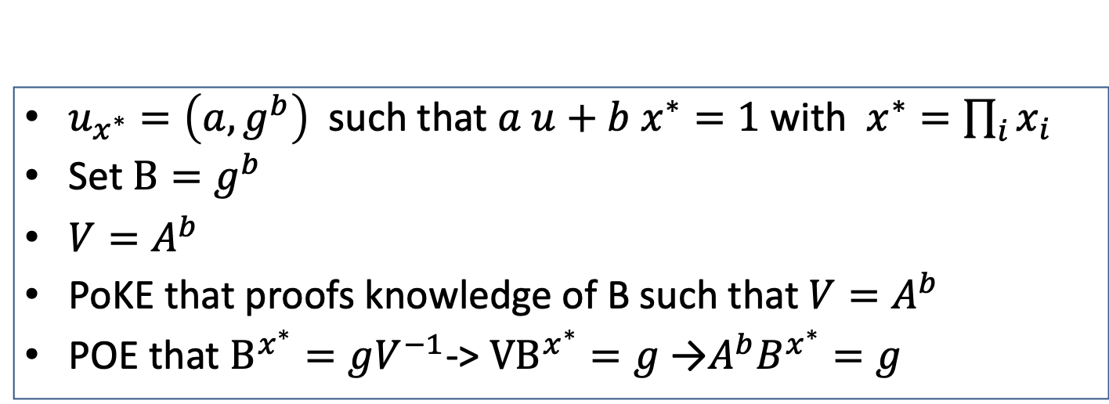
Batch Non Mem Witnesses
$$A=g^{u}$$
$u_{x^{∗}}=\left(a, g^{b}\right)$ such that $a u+b{ x}^{∗}=1$ with $x^{∗}=\prod_{i}{x_{i}}$
Set $B=g^{b}$
${V=A}^{b}$
PoKE that proofs knowledge of B such that ${V=A}^{b}$
POE that $B^{x^{∗}}=gV^{−1}$-> ${VB}^{x^{∗}}=g$ →$A^{b}B^{x^{∗}}=g$

Slide 29
Accounting Systems
Key/value store
Accounts[id] = balance
h = Commit(Accounts)
Vector commitment
Transaction
Proof
Accounts: id₁, id₂
h = Commit(Accounts)
Accounts[id₁] = b₁
Accounts[id₂] = b₂
Balances: b₁, b₂
Update
Proof
Notes:
The stateless member can verify that each update was accepted and agreed upon by the other consensus nodes
And all agree on history of updates

Slide 30


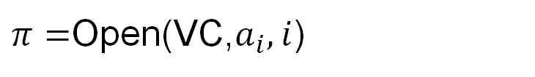
Vector Commitments [Catalano,Fiore 13]
VC=Commit( )
$$a_{1},a_{2},a_{3},…,a_{n}$$
Classical VCs: Linear CRS
Limits #accounts
New VCs: Constant CRS, batch openings,
Built from PoKE and batch proofs
$π=$Open(VC,$a_{i},i$)
Verify($VC,π,a_{i},i)=\{0,1\}$
Notes:
Accumulator inserting (a, i) element a along with index i is not enough
(because can insert polynomially many elements paired with same index, not a commitment)

Slide 31
Vector Commitments
V – a bit vector of length N
For each i ---> HashPrime(i) is a unique prime
Init accumulator A
For all i where V[i] = 1
add HashPrime(i) to A
Open(i):
if i = 1
Give MemWit
if i = 0
Give NonMemWit
Batch MemWit and NonMemWit
Notes:
Accumulator inserting (a, i) element a along with index i is not enough
(because can insert polynomially many elements paired with same index, not a commitment)

Slide 32
New Vector Commitments
Dimension | Merkle Trees | Catalano Fiore VC | This Work
Opening Proof size | log(N) | O(1) | O(1)
Batch Inclusion Proofs | No | Yes | Yes
Fast Proof Check | Yes | No | Yes
Parameters | O(1) | O(n) | O(1)
Sparse Vectors | Yes | No | Yes
Prover work | Small | Large | Larger
Notes:
Accumulator inserting (a, i) element a along with index i is not enough
(because can insert polynomially many elements paired with same index, not a commitment)

Slide 33
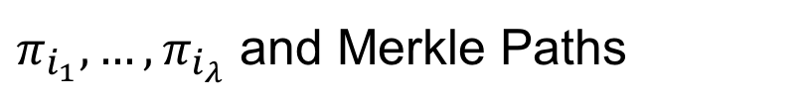

Application: Shorter IOPs [BCS16,LM18]
MT=Commit( )
Long Proof
$$i_{1},…,i_{λ}$$
$π_{i_{1}},…,π_{i_{λ}}$ and Merkle Paths

Slide 34
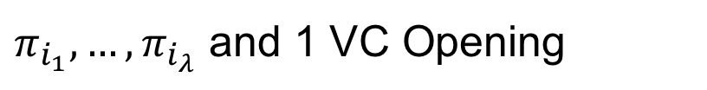
Application: Shorter IOPs [BCS16,LM18]
VC=Commit( )
Long Proof
$$i_{1},…,i_{λ}$$
200kb
vs.
600kb
$π_{i_{1}},…,π_{i_{λ}}$ and 1 VC Opening

Slide 35
THE END
Paper:
https://eprint.iacr.org/2018/1188.pdf
Implementation by Cambrian Tech:
https://cambrian.dev/accumulator/docs/

