Slide 1
Transparent SNARKs from DARK Compilers
Benedikt Bünz
Stanford University
Joint with Alan Szepieniec and Ben Fisch

Slide 2
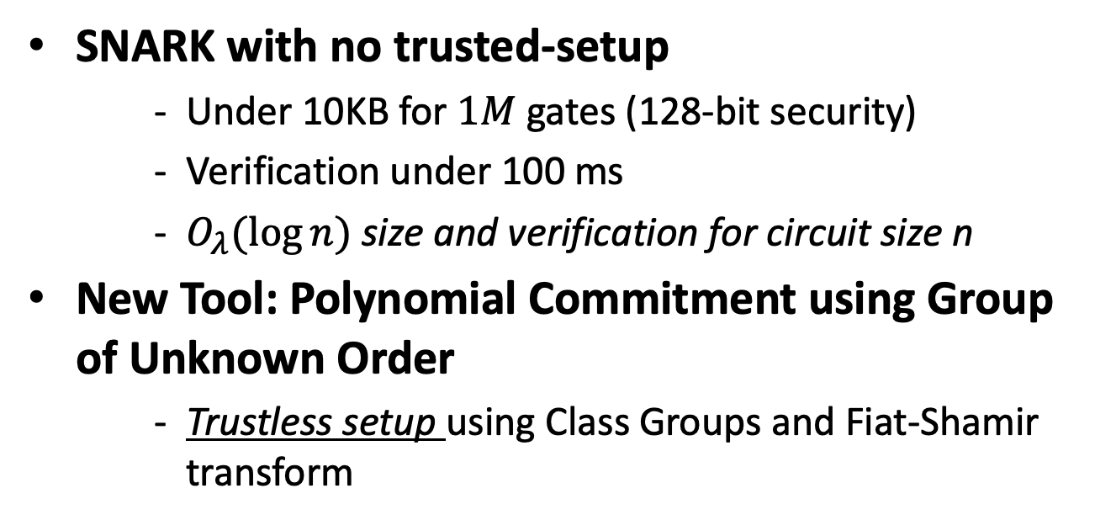

Concrete Results
Previously 200-600 KB
SNARK with no trusted-setup
Under 10KB for $1M$ gates (128-bit security)
Verification under 100 ms
$O_{λ}(\log{n)}$size and verification for circuit size n
New Tool: Polynomial Commitment using Group of Unknown Order
Trustless setup using Class Groups and Fiat-Shamir transform
Previously $O_{λ}(\log^{2}{n)}$

Slide 3



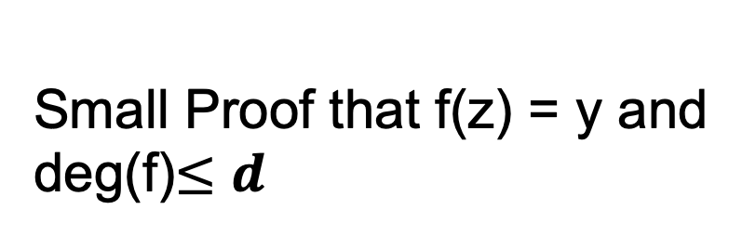
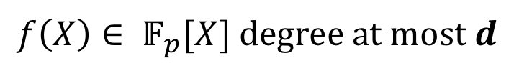
Polynomial Commitment
$f\left(X\right)∈ 𝔽_{p}[X]$ degree at most $d$
C
small value
$$π$$
Small Proof that f(z) = y and deg(f)$≤$ $d$

Slide 4


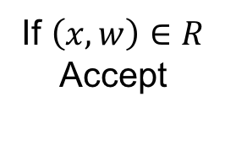
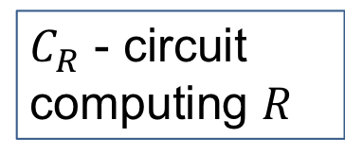



Succinct Non-interactive Argument of Knowledge
Setup$\left(C_{R},1^{λ}\right)→pp$
$C_{R}$ - circuit computing $R$
Inputs:
$$\left(x, w\right)∈R$$
$$x$$
If $\left(x, w\right)∈R$
Accept
$$π$$
Prover
Verifier
Succinctness:
$$\left|π\right|<polylog \left(\left|C_{R}\right|\right)$$

Slide 5
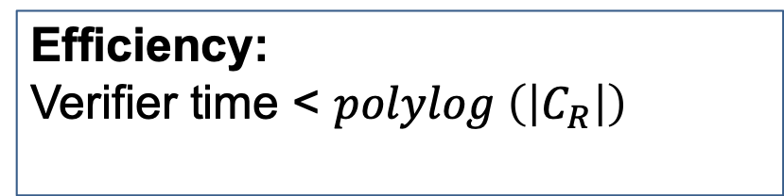
SNARK: Efficiency
Setup$\left(C_{R},1^{λ}\right)→pp$
$C_{R}$ - circuit computing $R$
Inputs:
$$\left(x, w\right)∈R$$
$$x$$
If $\left(x, w\right)∈R$
Accept
$$π$$
Prover
Verifier
Efficiency:
Verifier time < $polylog \left(\left|C_{R}\right|\right)$

Slide 6
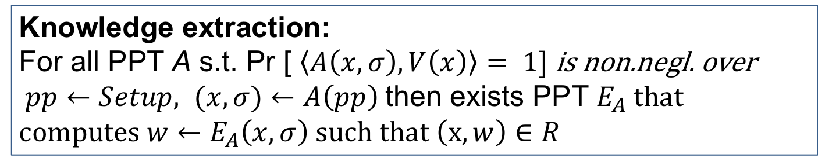
SNARK: Knowledge
Setup$\left(C_{R},1^{λ}\right)→pp$
$C_{R}$ - circuit computing $R$
Inputs:
$$\left(x, w\right)∈R$$
$$x$$
If $\left(x, w\right)∈R$
Accept
$$π$$
Prover
Verifier
Knowledge extraction:
For all PPT A s.t. Pr [ $\left\langle A\left(x, σ\right), V\left(x\right)\right\rangle = 1]$ is non.negl. over
$pp←Setup, (x,σ)←A\left(pp\right)$ then exists PPT $E_{A}$ that c$omputes {w←E}_{A}\left(x, σ\right) such that \left(x,w\right)∈R$

Slide 7

Transparent Setup
Setup$\left({C_{R},1}^{λ}\right)→pp$
$C_{R}$ - circuit computing $R$
Inputs:
$$\left(x, w\right)∈R$$
$$x$$
If $\left(x, w\right)∈R$
Accept
$$π$$
Prover
Verifier
Publicly verifiable setup

Slide 8
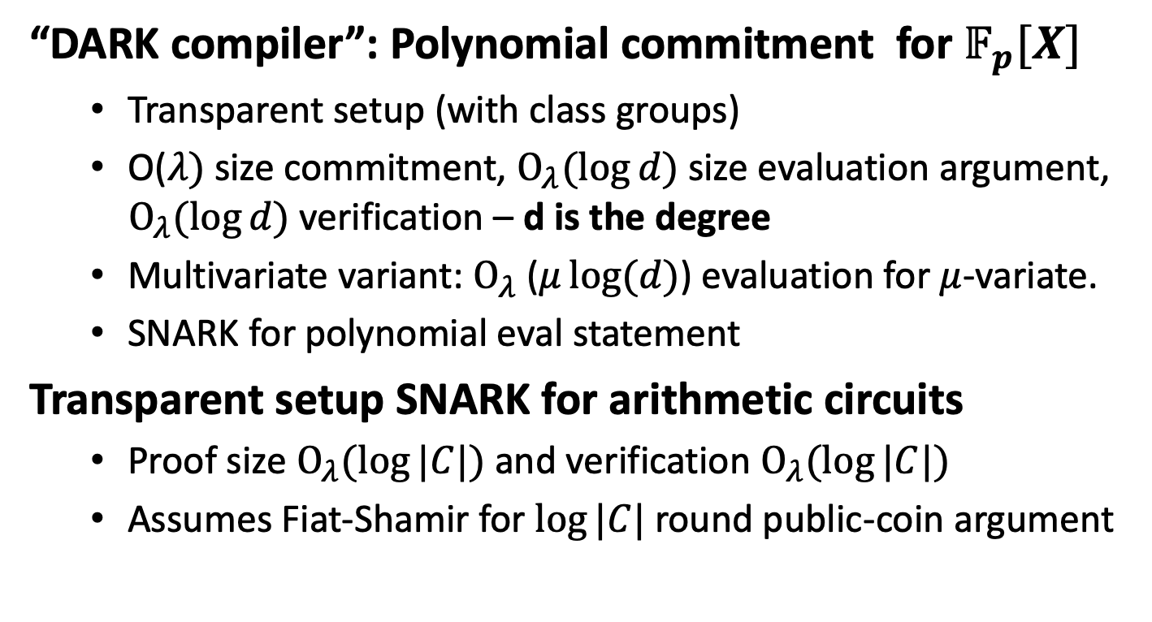
Summary of results
“DARK compiler”: Polynomial commitment for $𝔽_{p}[X]$
Transparent setup (with class groups)
O($λ)$ size commitment, $O_{λ}(\log{d})$ size evaluation argument, $O_{λ}(\log{d})$ verification – d is the degree
Multivariate variant: $O_{λ}$($μ\log{(d)}$) evaluation for $μ$-variate.
SNARK for polynomial eval statement
Transparent setup SNARK for arithmetic circuits
Proof size $O_{λ}(\log{|C|})$ and verification $O_{λ}(\log{|C|})$
Assumes Fiat-Shamir for $\log{|C|}$ round public-coin argument

Slide 9
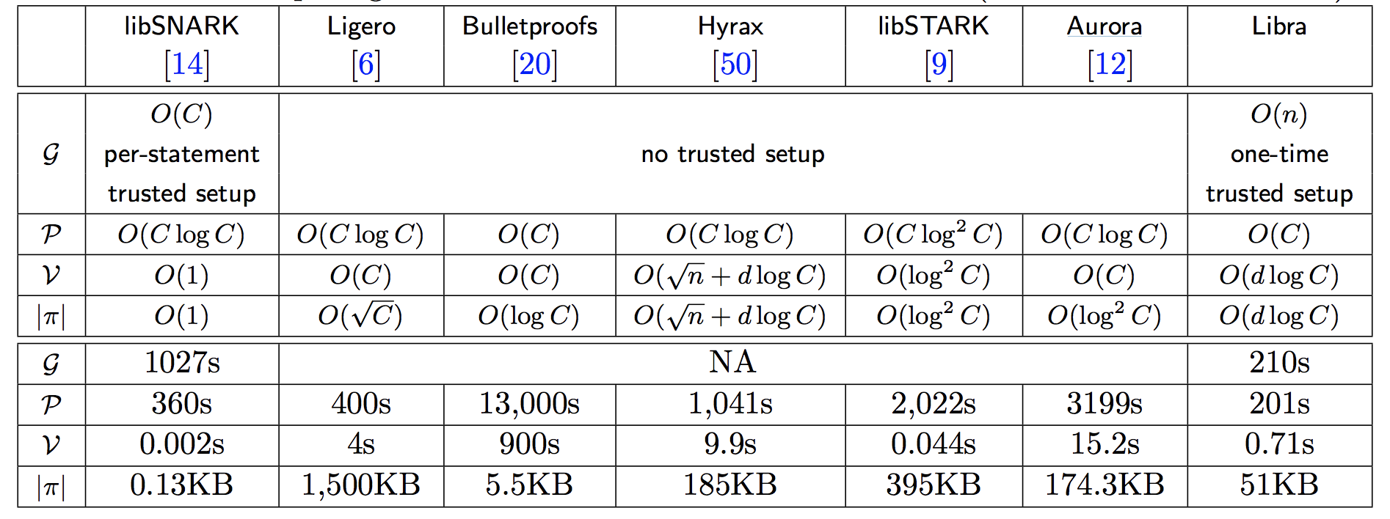
Recent Comparison
First practical transparent SNARK with log(C) proof size and log(C) verification
Implementation comparison in [XZZPS’19]

Slide 10
SNARKs from Polynomial Commitments

Slide 11
SNARKs from Polynomial Commitments
Recent construction paradigm: Sonic (MBKM, CCS'19), Plonk (GWC, ePrint'19), Marlin (CHM+, ePrint'19), Fractal (COS, ePrint'19), Libra (XZZ+, ePrint’19), Spartan (S, ePrint’19) also implicit in STARKs (BBHR, C’19).
Fiat-Shamir
(Hashing)
Constraint system
Polynomial testing
Non-interactive proof
Arithmetic
Circuit
Interactive argument
Polynomial commitments
Arithmetization

Slide 12
Cryptographic compilation
e.g. Merkle trees,
Fiat-Shamir + Random Oracle Hash
Information theoretic proof system
SNARK

Slide 13
Probabilistically Checkable Proofs
PCP Theorems
Theorems for checking specially formed long proof by reading only constant number of (random) locations
Can be done for any NP statement in theory

Slide 14
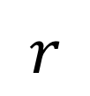
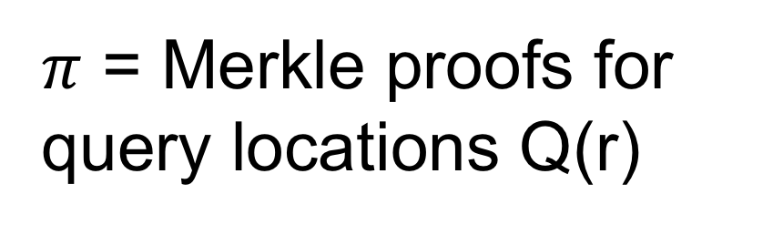
CS Proofs
[Kilian’92, Micali’00]
Commits to locations of long proof
T = Merkle tree root
$$r$$
$π$ = Merkle proofs for query locations Q(r)

Slide 15
CS Proofs
[Kilian’92, Micali’94]
Commits to locations of long proof
T = Merkle tree root
r = Hash(T,x)
$π$ = Merkle proofs for query locations Q(r)

Slide 16
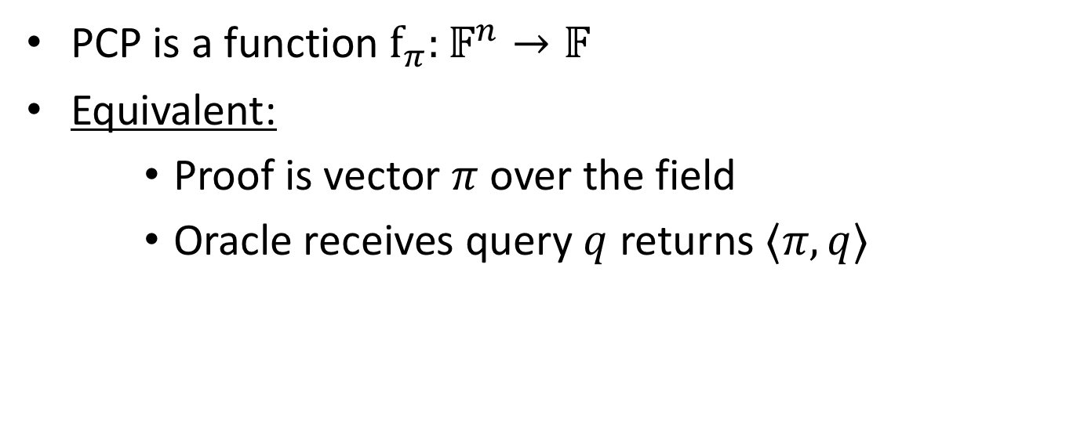
Linear PCP
[IKO’07]
PCP is a function $f_{π}:𝔽^{n}→𝔽$
Equivalent:
Proof is vector $π$ over the field
Oracle receives query $q$ returns $⟨π, q⟩$

Slide 17
Linear PCP
[IKO’07]
Cryptographic compiler:
Linear homomorphic encryption
4-move linear PCP based on Hadamard code
SNARK
Quadratic proving time
Linear verification time

Slide 18
QAPs
Gennaro, Gentry, Parno, Raykova 2013 (building on Groth ’10).
Quadratic Arithmetic Program instantiation of linear PCP
Developed further in many follow up works: PGHR13, Lipmaa13, BCIOP13, BCTV14, CFHKKNPZ15, Groth16

Slide 19
QAPs (GGPR)
Cryptographic compiler:
Linear-only encoding
[BCIOP’13]
QAP based linear PCP
SNARK
N log n proving time
Constant verification time
Notes:
Bitansky et. Al.

Slide 20
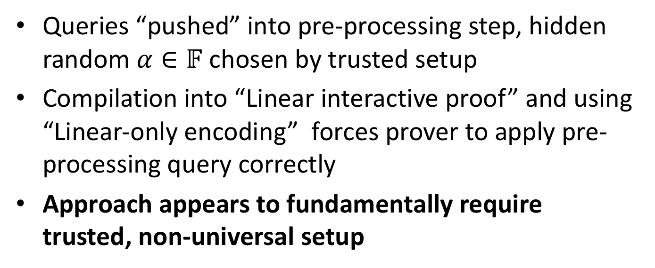
R1CS Preprocessing SNARK
Queries “pushed” into pre-processing step, hidden random $α∈𝔽$ chosen by trusted setup
Compilation into “Linear interactive proof” and using “Linear-only encoding” forces prover to apply pre-processing query correctly
Approach appears to fundamentally require trusted, non-universal setup

Slide 21
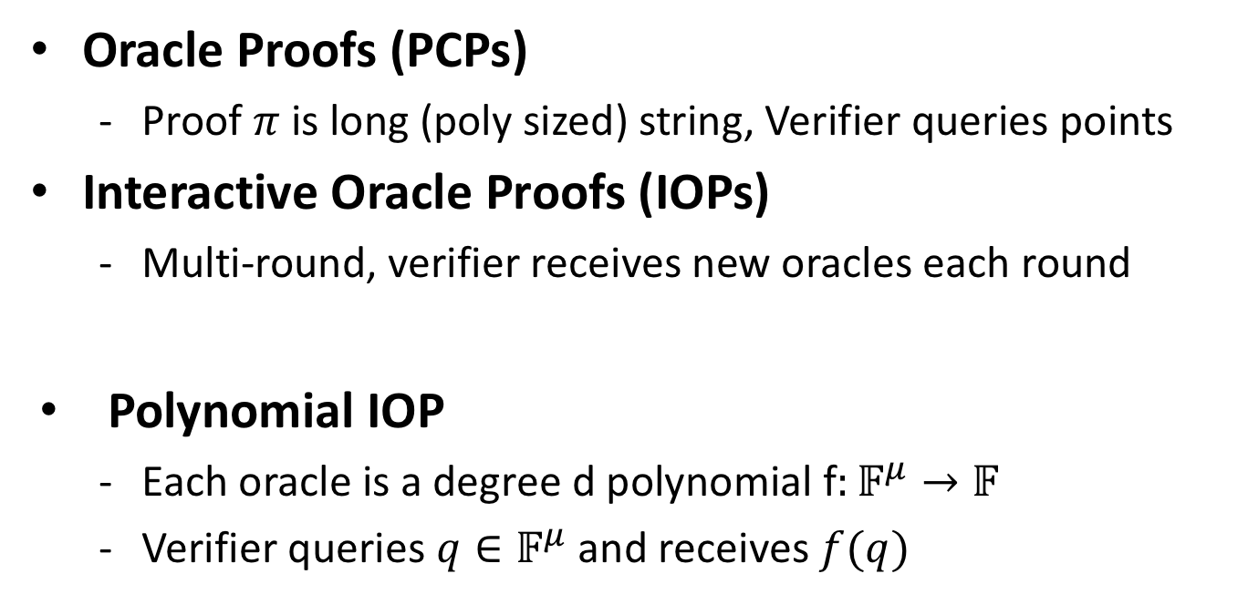
Interactive Oracle Proofs
[BCS16, RRR16]
Oracle Proofs (PCPs)
Proof $π$ is long (poly sized) string, Verifier queries points
Interactive Oracle Proofs (IOPs)
Multi-round, verifier receives new oracles each round
Polynomial IOP
Each oracle is a degree d polynomial f$:𝔽^{μ}→𝔽$
Verifier queries $q∈𝔽^{μ}$ and receives $f(q)$

Slide 22
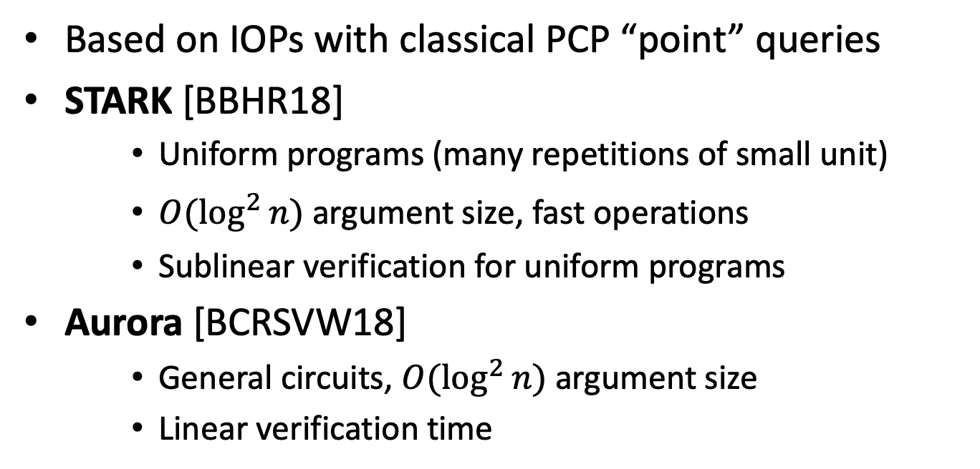
STARK, Aurora
Based on IOPs with classical PCP “point” queries
STARK [BBHR18]
Uniform programs (many repetitions of small unit)
$O(\log^{2}{n)}$ argument size, fast operations
Sublinear verification for uniform programs
Aurora [BCRSVW18]
General circuits, $O(\log^{2}{n)}$ argument size
Linear verification time

Slide 23
Interactive linear PCPs?
[BBCGI19]
What can be gained from linear PCPs with multiple rounds?
Linear IOPs (each round send linear PCP oracle, linear queries to prior oracles sent)

Slide 24
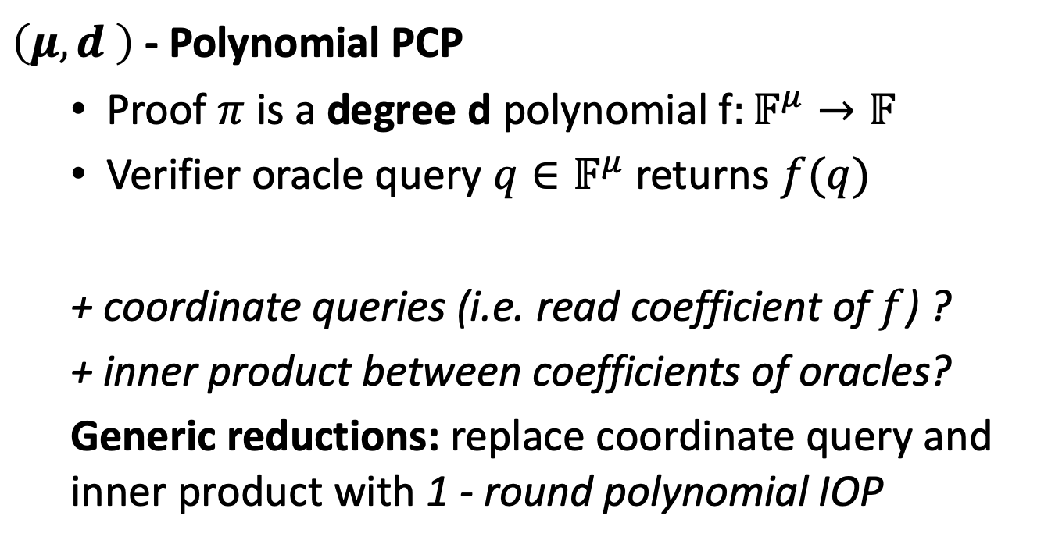
Polynomial IOPs
$\left(μ,d \right)$- Polynomial PCP
Proof $π$ is a degree d polynomial f$:𝔽^{μ}→𝔽$
Verifier oracle query $q∈𝔽^{μ}$ returns $f(q)$
+ coordinate queries (i.e. read coefficient of $f$) ?
+ inner product between coefficients of oracles?
Generic reductions: replace coordinate query and inner product with 1 - round polynomial IOP
Notes:
Linear query is monomials derived from q

Slide 25


Polynomial IOPs
Point PCPs (short)
$$⊂$$
Polynomial PCPs
$$⊂$$
Linear
PCPs
Notes:
Linear query is monomials derived from q

Slide 26
Polynomial IOP Compilation
Cryptographic compilers
Polynomial IOPs
Public coin
Polynomial commitment
Interactive Argument with preprocessing
Fiat Shamir
SNARK

Slide 27
Compiling Polynomial IOPs
IOP = Interactive Oracle Proof generalize PCPs [BCS16, RRR16]
Polynomial IOP – simple, intuitive, special case of “Linear PCPs”, capture many examples new and old
Model we introduce
Theorem [in this work]:
Any HVZK Polynomial IOP can be compiled into an HVZK interactive argument of knowledge using Polynomial Commitments
Similar theorem shown in Marlin (CHM+, ePrint'19)

Slide 28
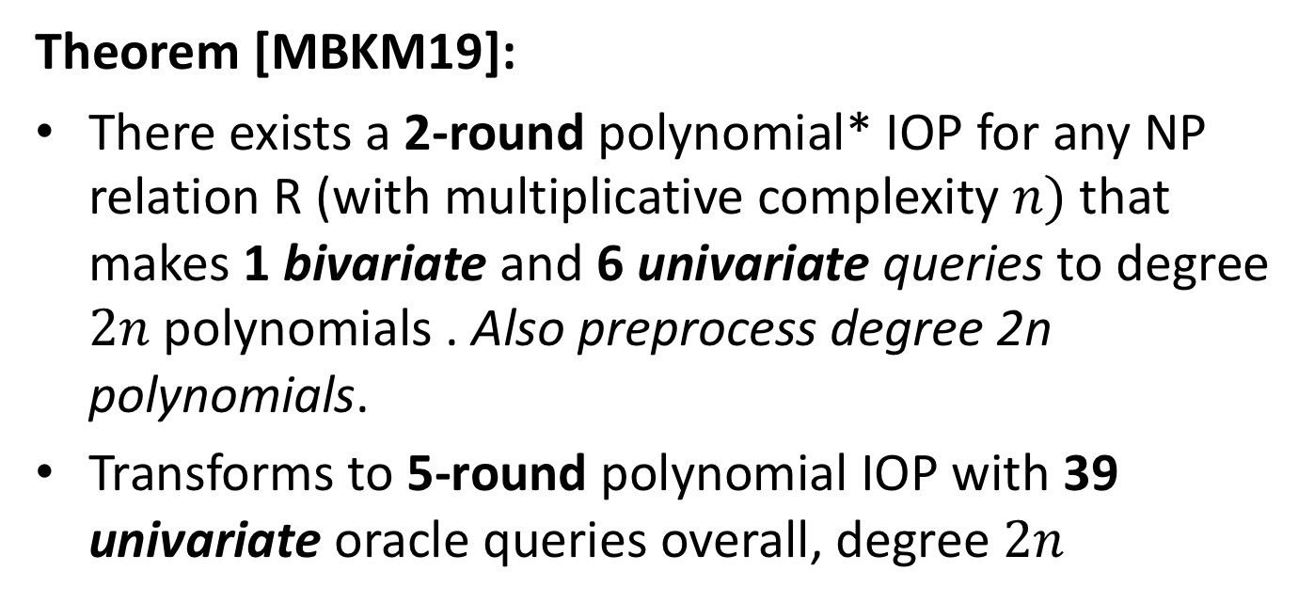
Sonic: Polynomial IOP for NP
Theorem [MBKM19]:
There exists a 2-round polynomial* IOP for any NP relation R (with multiplicative complexity $n)$that makes 1 bivariate and 6 univariate queries to degree $2n$polynomials . Also preprocess degree 2n polynomials.
Transforms to 5-round polynomial IOP with 39 univariate oracle queries overall, degree $2n$
Notes:
**Not really…assuming the IOP prover is restricted to sending Laurent polynomials that have no constant term. Or allowing coefficient queries for free.
Using our transformation for general coefficient queries, adds 1 round, three queries, but can be done in parallel (overall rounds remain the same)
Preprocessing: 4M oracles
Total number of online oracles is 4M + 2 = 14
Total number queries = 7M + 3 = 24 (batching removes 4 queries)

Slide 29
Main Construction

Slide 30

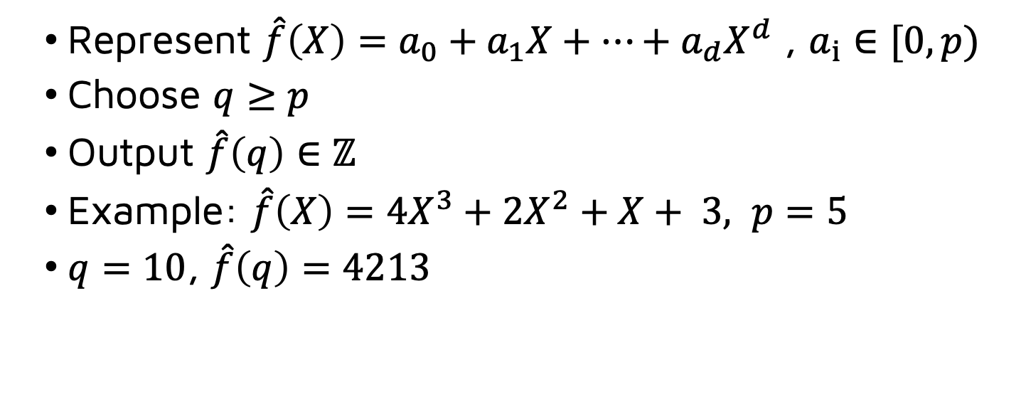

New Polynomial Commitment
Step 1
Integer encoding $f∈$ $𝔽_{p}\left[X\right]$ degree at most d:
Represent $\hat{f}\left(X\right)=a_{0}+a_{1}X+…+a_{d}X^{d}$ , $a_{i}∈[0,p)$
Choose $q≥p$
Output $\hat{f}\left(q\right)∈ℤ$
Example: $\hat{f}\left(X\right)=4X^{3}+2X^{2}+X+ 3, p=5$
$q=10$, $\hat{f}\left(q\right)=4213$
Still same size as $f$

Slide 31
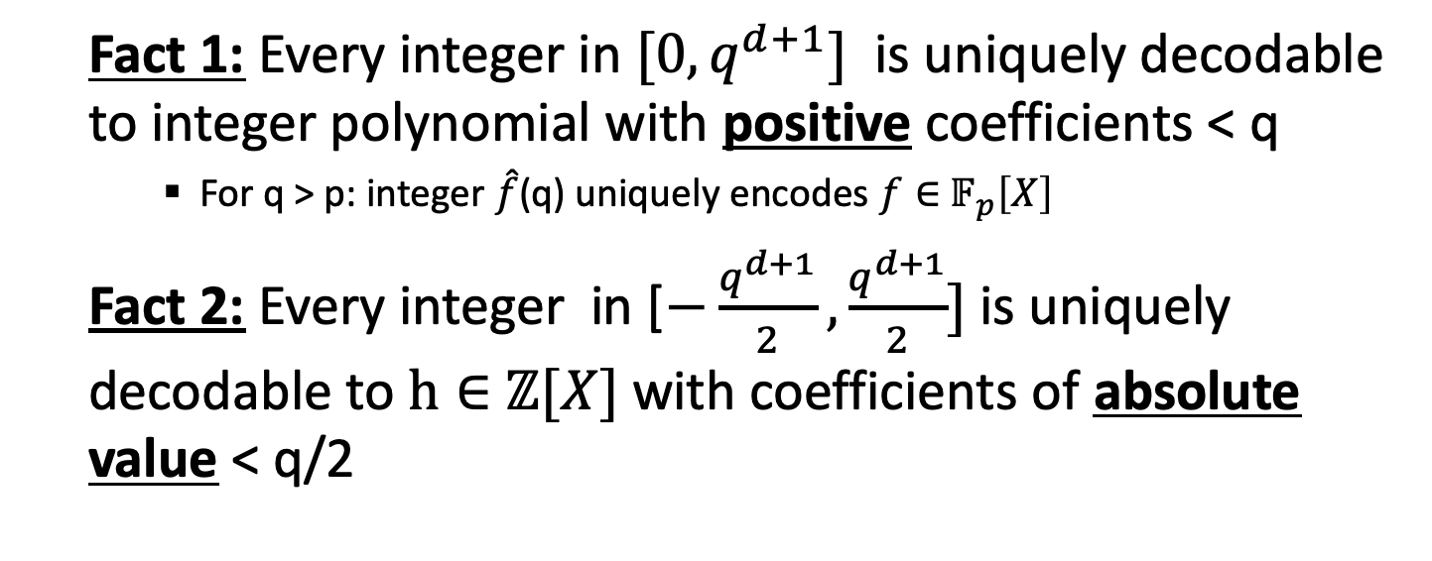
New Polynomial Commitment
Step 1
Integer encoding $f∈$ $𝔽_{p}\left[X\right]$ degree at most d:
Fact 1: Every integer in $[0,q^{d+1}]$ is uniquely decodable to integer polynomial with positive coefficients < q
For q > p: integer $\hat{f}$(q) uniquely encodes $f∈$ $𝔽_{p}\left[X\right]$
Fact 2: Every integer in [$−\frac{q^{d+1}}{2},\frac{q^{d+1}}{2}]$ is uniquely decodable to $h∈$ $ℤ[X]$ with coefficients of absolute value < q/2

Slide 32
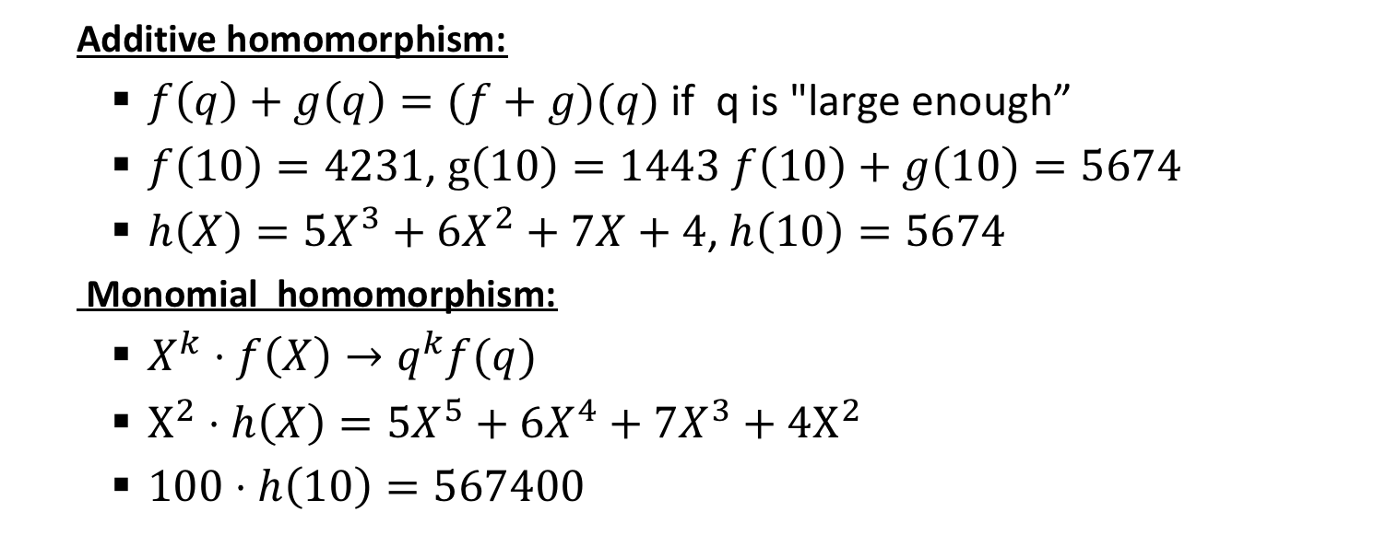
Integer Encoding
Step 2
Homomorphic properties of encoding
Additive homomorphism:
$f\left(q\right)+g\left(q\right)=(f+g)(q)$ if q is "large enough”
$f\left(10\right)=4231$, $g\left(10\right)=1443$ $f\left(10\right)+g\left(10\right)=5674$
$h\left(X\right)=5X^{3}+6X^{2}+7X+4$, $h\left(10\right)=5674$
Monomial homomorphism:
$X^{k}⋅f\left(X\right)→q^{k}f(q)$
$X^{2}⋅h\left(X\right)=5X^{5}+6X^{4}+7X^{3}+4X^{2}$
$100⋅h\left(10\right)=567400$

Slide 33

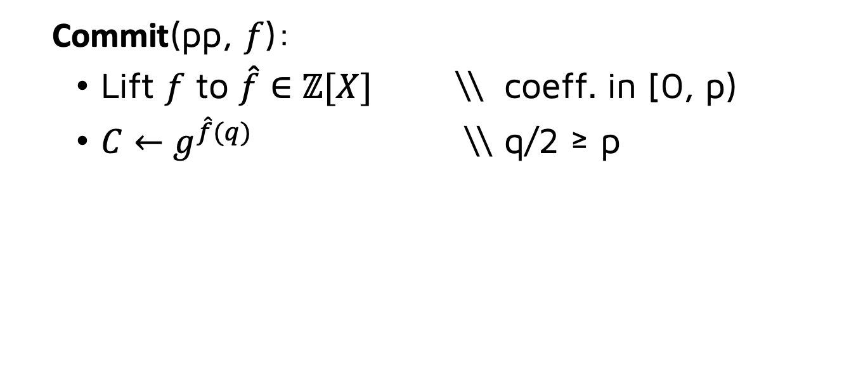
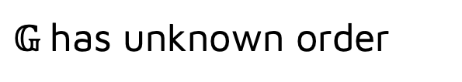
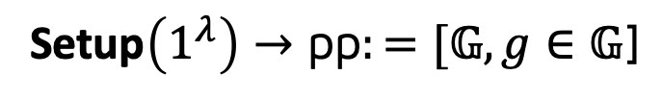
Groups of Unknown Order
Step 3
Commit $f∈$ $𝔽_{p}\left[X\right]$ degree at most d
Setup$\left(1^{λ}\right)→\text{pp}:=[𝔾,g∈𝔾\text{]}$
$𝔾$has unknown order
${ℤ→𝔾: x→C=g}^{x}$, homomorphic map ($g^{x}g^{y}=g^{x+y})$
Commit(pp, $f$):
Lift $f$ to $\hat{f}∈ℤ[X]$ \\ coeff. in [0, p)
$C←g^{\hat{f}(q)}$ \\ q/2 ≥ p

Slide 34
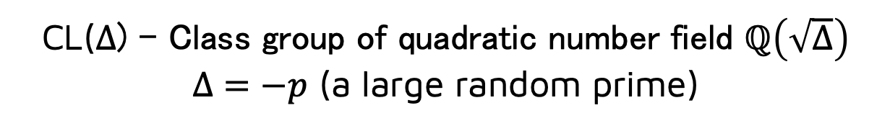
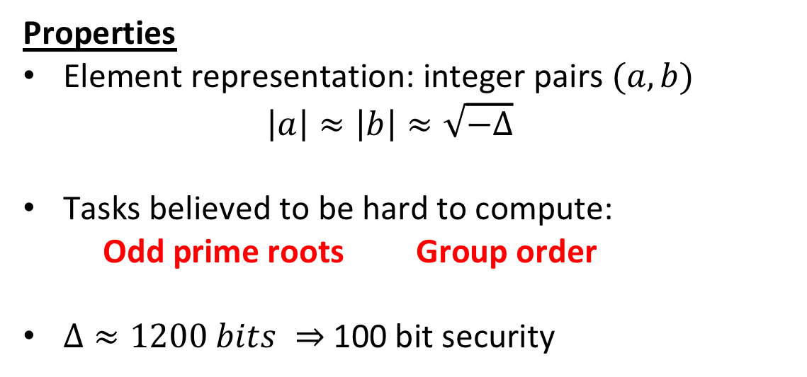
Class Groups [BW88,L12]
CL(Δ) - Class group of quadratic number field $ℚ\left(\sqrt{Δ}\right)$
$Δ=−p$ (a large random prime)
Properties
Element representation: integer pairs $(a, b)$
$$\left|a\right|≈\left|b\right|≈\sqrt{−Δ}$$
Tasks believed to be hard to compute:
Odd prime roots Group order
$Δ≈1200 bits ⇒$ 100 bit security
No trusted setup

Slide 35



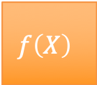




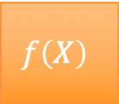

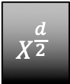


Evaluation protocol (DARK) intuition
$$f\left(X\right)$$
$$f_{L}(X)$$
$$f_{R}(X)$$
Degree d
$$f\left(X\right)$$
$$f_{L}(X)$$
$$X^{\frac{d}{2}}$$
$$f_{R}(X)$$
$$f_{L}(X)$$
$$f_{R}(X)$$
$$α$$
$$f_{L}(X)$$
$$α$$
$$f_{R}(X)$$

Slide 36



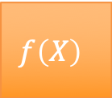

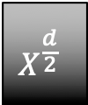

Evaluation protocol (DARK) intuition
$$f\left(X\right)$$
$$f_{L}(X)$$
$$f_{R}(X)$$
Degree d
$$f\left(X\right)$$
$$f_{L}(X)$$
$$X^{\frac{d}{2}}$$
$$f_{R}(X)$$
$$f_{L}(X)$$
$$f_{R}(X)$$
$$α$$
$$f′(X)$$
Degree d/2!

Slide 37


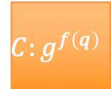



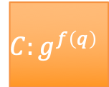

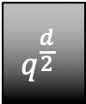

Evaluation protocol (DARK)
$$C:g^{f\left(q\right)}$$
$$C_{L}=g^{f_{L}\left(q\right)}$$
$$C_{R}=g^{f_{R}\left(q\right)}$$
Degree d
$$C:g^{f\left(q\right)}$$
$$C_{L}=g^{f_{L}(q)}$$
$$q^{\frac{d}{2}}$$
$$C_{R}=g^{f_{R}\left(q\right)}$$
$$g^{f_{L}\left(q\right)}$$
$$g^{f_{R}\left(q\right)}$$
$$α$$
$$g^{f^{′}\left(q\right)}$$
Degree d/2!

Slide 38


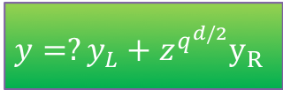




Evaluation protocol (DARK)
$$C:g^{f\left(q\right)}$$
$$C_{L}=g^{f_{L}\left(q\right)}$$
$$C_{R}=g^{f_{R}\left(q\right)}$$
$$y=f\left(z\right)mod p$$
$$C:g^{f\left(q\right)}$$
$$C_{L}=g^{f_{L}(q)}$$
$$q^{\frac{d}{2}}$$
$$C_{R}=g^{f_{R}\left(q\right)}$$
$$g^{f_{L}\left(q\right)}$$
$$g^{f_{R}\left(q\right)}$$
$$y_{L}←f_{L}\left(z\right)∈ℤ_{p}$$
$$y_{R}←f_{R}\left(z\right)∈ℤ_{p}$$
$$α$$
$${C=?C}_{L}C_{R}^{q^{d/2}}$$
$$g^{f^{′}\left(q\right)}$$
$$y=?y_{L}+z^{q^{d/2}}y_{R}$$
$y^{′}←y_{L}+α⋅y_{R}$

Slide 39

Evaluation protocol (DARK)
Proof of Exponentiation (Wesolowski 2018)
(Same trick used for VDFs)
Verifier does two
128-bit group EXP
$PoE$ Proof: $C_{R}^{q^{d/2}}$= $C/C_{L}$
$$α$$
$${C=?C}_{L}C_{R}^{q^{d/2}}$$

Slide 40

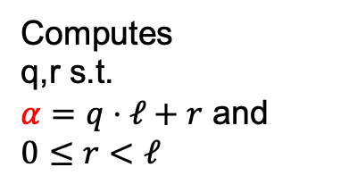


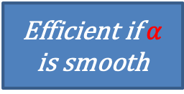
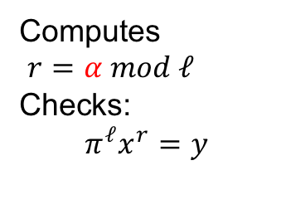
Proof of Exponentiation (Wes’18)
$$\left(x,y,α\right):x^{α}=y$$
$$y$$
Peggy
Random $λ$ bit prime $ℓ$
Victor
Efficient if $α$ is smooth
Computes
q,r s.t.
$α=q⋅ℓ+r$ and $0≤r<ℓ$
$$π=x^{q}$$
Computes
$r=α mod ℓ$
Checks:
$$π^{ℓ}x^{r}=y$$
Adaptive root assumption

Slide 41
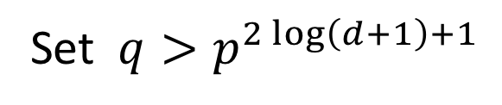

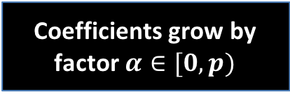





Evaluation protocol (DARK)
Coefficients grow by factor $α∈[0,p)$
Set $q>p^{2\log\left(d+1\right)+1}$
$$α$$
$$f_{L}(X)$$
$$α$$
$$f_{R}(X)$$

Slide 42
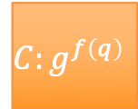



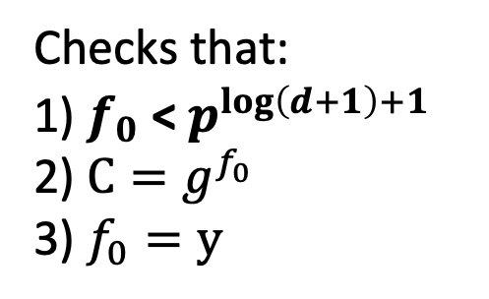
Final Step
$$C:g^{f\left(q\right)}$$
$f\left(X\right)=f_{0}$
$y$
Send $f_{0}$ (degree 0)
Checks that:
1) $f_{0}$ < $p^{\log\left(d+1\right)+1}$
2) $C=g^{f_{0}}$
3) $f_{0}=y$
2 log d group elements
2 log d field elements
Lots of batching properties

Slide 43
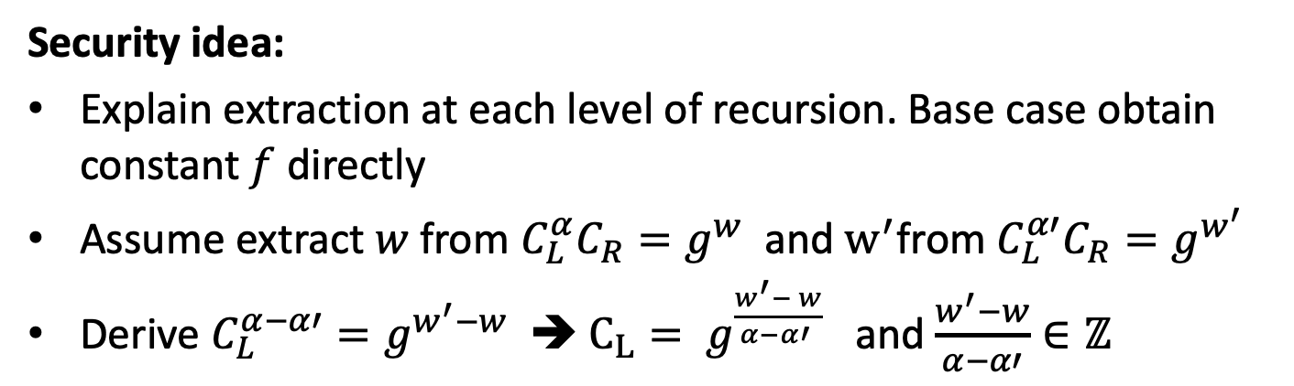
New Polynomial Commitment
Security idea:
Explain extraction at each level of recursion. Base case obtain constant $f$ directly
Assume extract $w$from $C_{L}^{α}C_{R}=g^{w}$ and $w^{′}$from $C_{L}^{α′}C_{R}=g^{w^{′}}$
Derive $C_{L}^{α−α′}=g^{w^{′}−w}$ ➔ $C_{L}= g^{\frac{w^{′}− w}{α−α′ }}$ and $\frac{w^{′}−w}{α−α′}∈ℤ$
Order assumption
Strong RSA assumption
Notes:
Coefficients grow at least by factor \alpha each round
Grow by 2\alpha in security proof, factor 2 comes from extraction argument

Slide 44
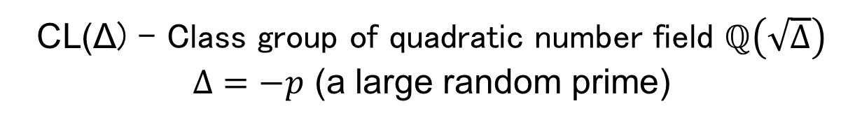
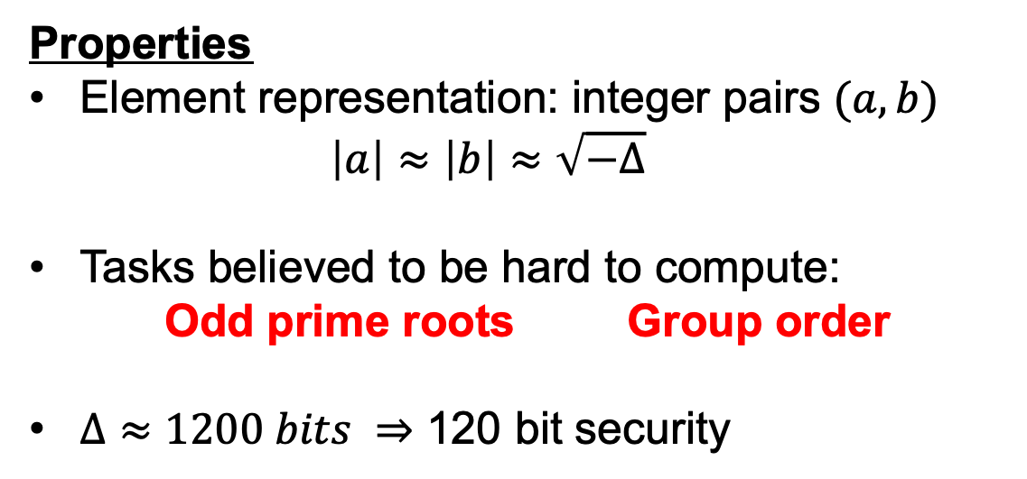
Class Groups [BW88,L12]
CL(Δ) - Class group of quadratic number field $ℚ\left(\sqrt{Δ}\right)$
$Δ=−p$ (a large random prime)
Properties
Element representation: integer pairs $(a, b)$
$$\left|a\right|≈\left|b\right|≈\sqrt{−Δ}$$
Tasks believed to be hard to compute:
Odd prime roots Group order
$Δ≈1200 bits ⇒$ 120 bit security
No trusted setup

Slide 45

Class Groups [BW88,L12]
CL(Δ) - Class group of quadratic number field $ℚ\left(\sqrt{Δ}\right)$
$Δ=−p$ (a large random prime)
Properties
Element representation: integer pairs $(a, b)$
$$\left|a\right|≈\left|b\right|≈\sqrt{−Δ}$$
Tasks believed to be hard to compute:
Odd prime roots Group order
$Δ≈1200 bits ⇒$ 120 bit security
Gauss Square Root Algorithm
(dyadic rationals)
Notes:
We have a fix to this however!
Prove result still works if coefficients of polynomial are “dyadic rational”, i.e. fractions with denominator powers of 2^i

Slide 46
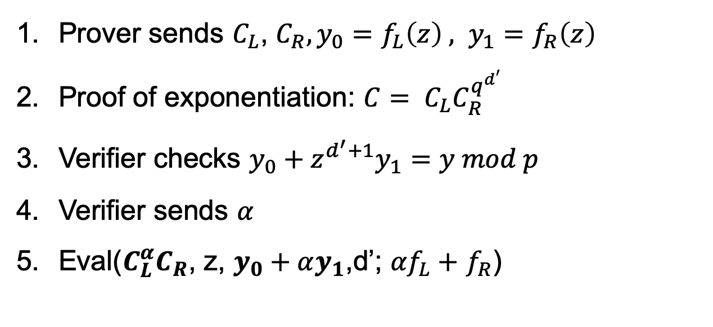
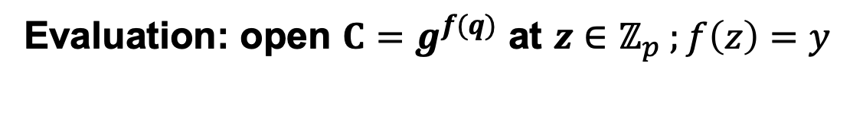
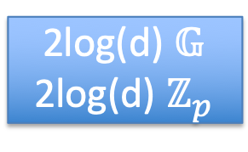
Optimizations
Evaluation: open $C=g^{f(q)}$ at $z∈ℤ_{p} ;f\left(z\right)=y$
Prover sends $C_{L}$, $C_{R},y_{0}=f_{L}\left(z\right) , y_{1}=f_{R}\left(z\right)$
Proof of exponentiation: ${C= C}_{L}C_{R}^{q^{d′}}$
Verifier checks $y_{0}+z^{d^{′}+1}y_{1}=y mod p$
Verifier sends $α$
Eval($C_{L}^{α}C_{R}$, z, $y_{0}+αy_{1}$,d’; ${αf}_{L}+$ $f_{R}$)
2log(d) $𝔾$
2log(d) $ℤ_{p}$

Slide 47
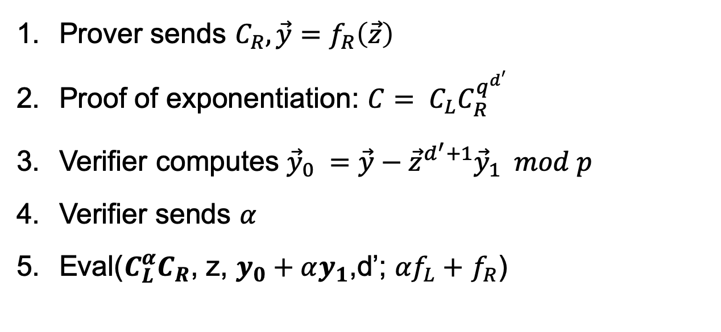
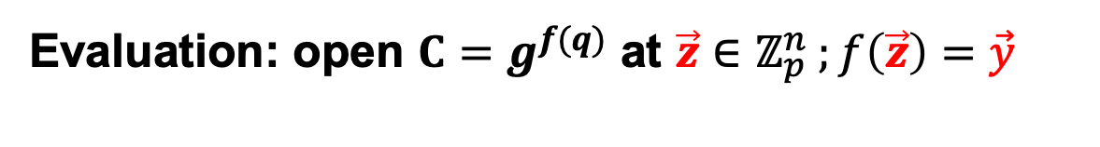
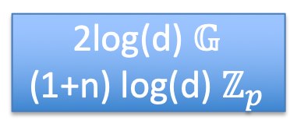
Optimizations
Evaluation: open $C=g^{f(q)}$ at $\vec{z}∈ℤ_{p}^{n} ;f\left(\vec{z}\right)=\vec{y}$
Prover sends $C_{R}, \vec{y}=f_{R}\left(\vec{z}\right)$
Proof of exponentiation: ${C= C}_{L}C_{R}^{q^{d′}}$
Verifier computes ${\vec{y}}_{0} =\vec{y}−{\vec{z}}^{d^{′}+1}{\vec{y}}_{1} mod p$
Verifier sends $α$
Eval($C_{L}^{α}C_{R}$, z, $y_{0}+αy_{1}$,d’; ${αf}_{L}+$ $f_{R}$)
2log(d) $𝔾$
(1+n) log(d) $ℤ_{p}$

Slide 48




Optimizations
Evaluation: open $C_{1}=g^{f(q)}$, $C_{2}=g^{h (q)}$ at $z∈ℤ_{p}$
such that $f\left(z\right)=y_{1} h\left(z\right)=y_{2}$
Prover sends $C_{1} ,C_{2}$
Verifier sends $α$
Eval($C_{1}^{α}C_{2}$, z, $y_{0}+αy_{1}$,d’; $αf(X)+g(X)$)
2log(d) $𝔾$
2log(d) $ℤ_{p}$
In general 2log(d) $𝔾+\left(k+1\right)\log{(d)}ℤ_{p}$
for n polys at k evaluation points
Supersonic: 10.1 KB at $2^{20}$ gates, Verifier ~75ms

Slide 49

Thanks!
https://eprint.iacr.org/2019/1229

