Slide 1
Proof-Carrying Data from Accumulation Schemes To appear at TCC ia.cr/2020/499
Benedikt Bünz
Alessandro Chiesa, Pratyush Mishra, Nick Spooner
Stanford
UC Berkeley
Notes:
Notes from call:
interstitial slide between 13 and 14
compress theorem 2 to one slide
“don’t accumulate, verify”
consider dropping poly commitments

Slide 2



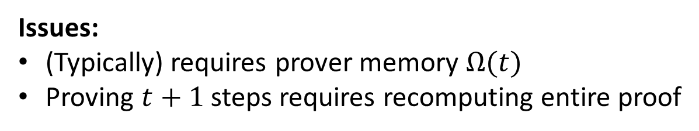




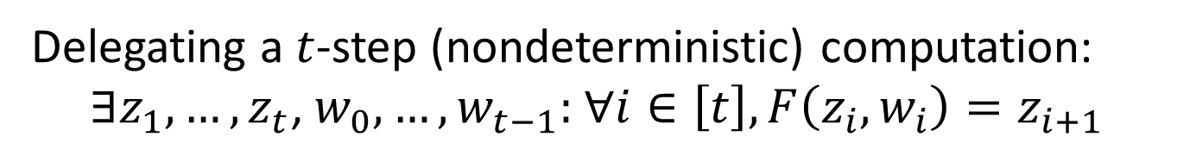













Motivation
Delegating a $t$-step (nondeterministic) computation:
$∃z_{1},…,z_{t}\text{,} w_{0},…,w_{t−1}:$ $∀i∈\left[t\right], F\left(z_{i},w_{i}\right)=z_{i+1}$
Option 1: Monolithic proof
$$F^{t}(z_{0};w_{1},…,w_{t})$$
$$P$$
$$π$$
Issues:
(Typically) requires prover memory $Ω(t)$
Proving $t+1$ steps requires recomputing entire proof
Option 2: Incrementally-verifiable computation (IVC) [Val08]
$$w_{0}$$
$$w_{1}$$
$$w_{2}$$
$$w_{t−1}$$
$$z_{1}$$
$$z_{2}$$
$$z_{t−1}$$
$$z_{t}$$
$$z_{0}$$
$$𝒫_{F}$$
$$𝒫_{F}$$
$$𝒫_{F}$$
$$𝒫_{F}$$
$$π_{1}$$
$$π_{2}$$
$$⋯$$
$$π_{t−1}$$
$$π_{t}$$
Proof-carrying data (PCD) [CT10,BCCT13] generalizes this from path graph to any DAG

Slide 3
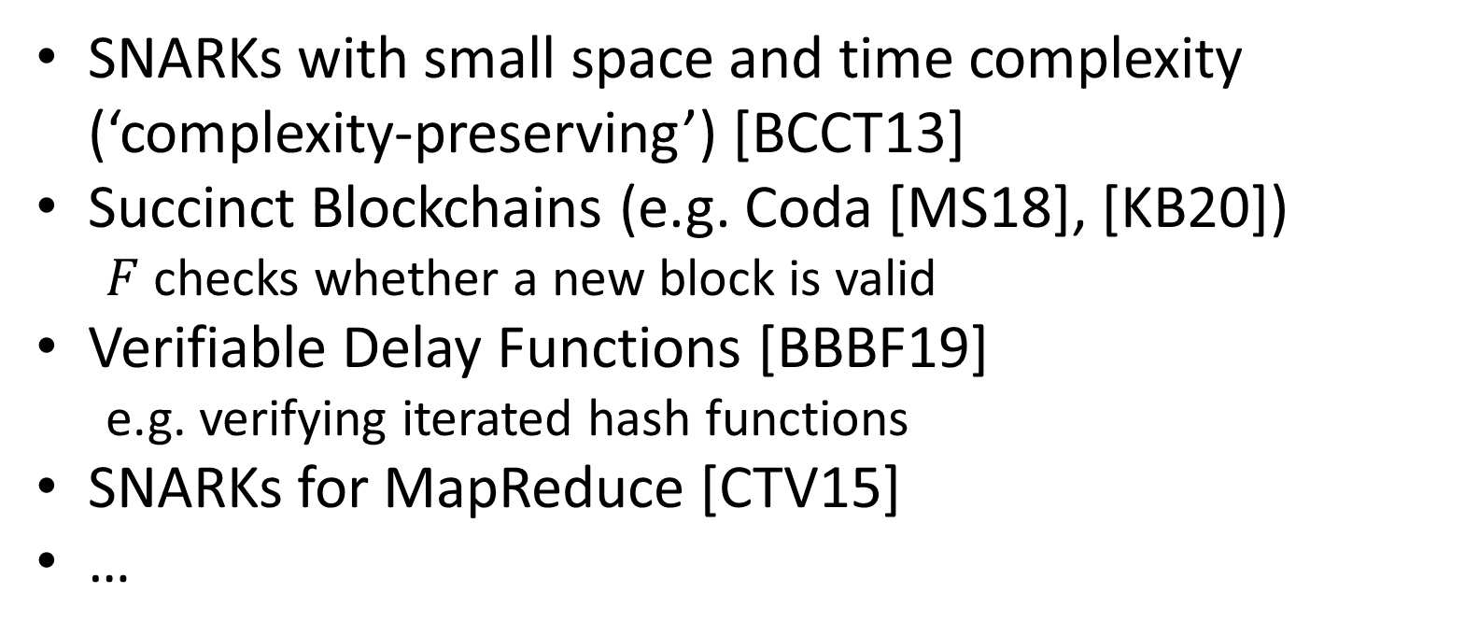
Applications of IVC/PCD
SNARKs with small space and time complexity (‘complexity-preserving’) [BCCT13]
Succinct Blockchains (e.g. Coda [MS18], [KB20])
$F$ checks whether a new block is valid
Verifiable Delay Functions [BBBF19]
e.g. verifying iterated hash functions
SNARKs for MapReduce [CTV15]
…

Slide 4
How do we construct IVC/PCD?
SNARK = Succinct
Non-interactive ARgument of Knowledge
[BCCT13]: SNARKs with succinct (polylog) verification imply IVC/PCD
[COS20]: SNARKs with sublinear verification imply IVC/PCD (also in the post-quantum setting!)
Sublinear verification requirement restricts the SNARKs we can use ☹
Is sublinear verification required for IVC/PCD?
[BGH19] suggests maybe not: they outline a novel approach to obtain IVC from a specific SNARK linear verification, and give details about important practical aspects (like elliptic curve cycles).
But they don’t provide a detailed construction or a security proof…

Slide 5
Summary of our results
Nothing to do with set accumulators!
We introduce accumulation schemes and show that:
Theorem 1. SNARKs with accumulation schemes imply IVC/PCD, even without sublinear verification.
Theorem 2. We can obtain SNARKs with accumulation schemes by combining a SNARK whose verification is sublinear relative to a primitive with an accumulation scheme for that primitive.
Theorem 3. Two popular polynomial commitment schemes have accumulation schemes.
standard model
random oracle model

Slide 6
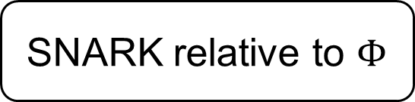
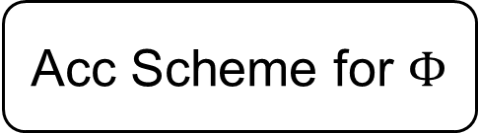
Summary of results
Succinct-verifier SNARKs
PCD/IVC
[BCCT13]
Theorem 1
SNARK with Acc Scheme
Theorem 2
SNARK relative to $Φ$
Acc Scheme for $Φ$
We don’t know how to instantiate these in the standard model ☹
Notes:
Point out that (a) Thm 2 is black box wrt RO, but (a) Thm 1 can’t handle Ros © so have to instantiate when we we don’t know accumulation schemes that don’t use Ros, but Thm2 is black box and doesn’t care. Split middle box into SNARK with AS and SNARK with AS in ROM, and connect them with a “RO heuristic” arrow.

Slide 7
Summary of results
New PCD/IVC constructions (heuristically)
Theorem 1
SNARK with Acc Scheme
(in standard model, heuristically)
RO heuristic
SNARK w/ Acc Scheme
(in ROM)
Theorem 2
SNARK relative to PC (in ROM) [CHMMVW20]
Theorem 3: Acc Schemes for PC (in ROM)
Notes:
Point out that (a) Thm 2 is black box wrt RO, but (a) Thm 1 can’t handle Ros © so have to instantiate when we we don’t know accumulation schemes that don’t use Ros, but Thm2 is black box and doesn’t care. Split middle box into SNARK with AS and SNARK with AS in ROM, and connect them with a “RO heuristic” arrow.

Slide 8
Background: IVC/PCD and recursive composition

Slide 9
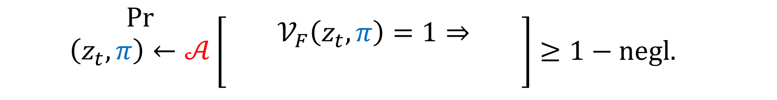

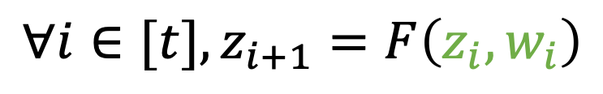

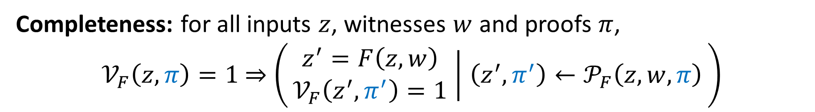


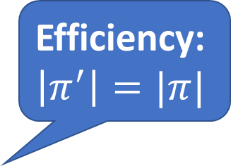







IVC definition
Efficiency:
$$\left|π^{′}\right|=|π|$$
$$z$$
$$𝒫_{F}$$
$$z′$$
$$z$$
$$𝒱_{F}$$
$$w$$
$$0/1$$
$$π$$
$$π′$$
$$π$$
Completeness: for all inputs $z$, witnesses $w$ and proofs $π$,
$𝒱_{F}\left(z,π\right)=1$ $⇒$ $\left(\begin{matrix}z^{′}=F\left(z,w\right) \\ 𝒱_{F}\left(z^{′},π^{′}\right)=1\end{matrix} ∣ \left(z^{′},π^{′}\right)←𝒫_{F}\left(z,w,π\right)\right)$
Proof of knowledge: for all efficient $𝒜$, there is an efficient extractor $ℰ_{𝒜}$ s.t.
$$\begin{matrix}Pr \\ \left(z_{t},π\right)←𝒜 \\ \end{matrix}\left[\begin{matrix}𝒱_{F}\left(z_{t},π\right)=1⇒ \\ ∀i∈[t], z_{i+1}=F\left(z_{i},w_{i}\right)\end{matrix}\right]≥1−negl.$$
$$∀i∈[t], z_{i+1}=F\left(z_{i},w_{i}\right)$$
$${\left(z_{i},w_{i}\right)}_{i=1}^{t−1}←ℰ_{𝒜}$$

Slide 10
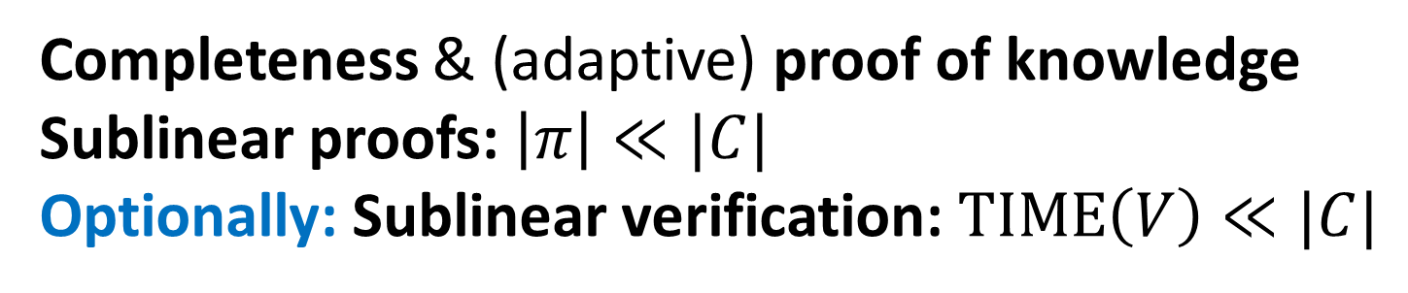








SNARKs with preprocessing
$$R=\{\left(C,x,w\right) :C\left(x,w\right)=1\}$$
$$Setup(C)$$
$$x,w$$
$$x$$
$$pk_{C}$$
$$vk_{C}$$
$$P$$
$$π$$
$$V$$
Completeness & (adaptive) proof of knowledge
Sublinear proofs: $\left|π\right|≪|C|$
Optionally: Sublinear verification: $TIME\left(V\right)≪|C|$

Slide 11

















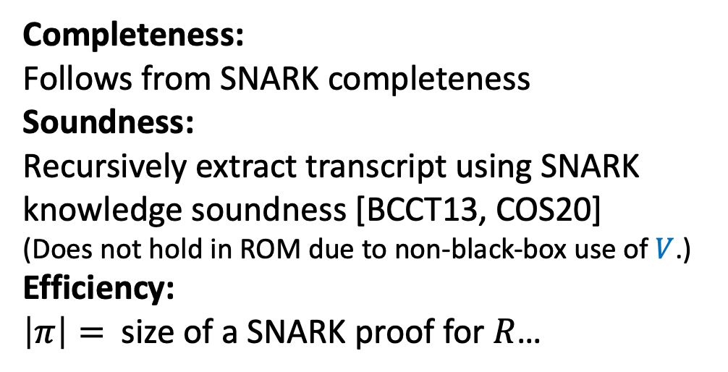
IVC from recursive composition of SNARKs [BCCT13, COS20]
$$({pk}_{R},vk_{R})←Setup(R)$$
$$IVC.𝒱_{F}$$
$$z_{1},z_{T}$$
$$IVC.𝒫_{F}$$
$$V$$
$$π_{T}$$
$$0/1$$
$${vk}_{R}$$
$$SNARK.P$$
Completeness:
Follows from SNARK completeness
Soundness:
Recursively extract transcript using SNARK knowledge soundness [BCCT13, COS20]
(Does not hold in ROM due to non-black-box use of $V$.)
Efficiency:
$\left|π\right|=$ size of a SNARK proof for $R$…
$$R$$
$$z_{t}$$
$$F$$
$$z_{t+1}$$
$$V$$
$$π_{t+1}$$
$$π_{t}$$
$${vk}_{R}$$
Notes:
soundness is nontrivial!

Slide 12





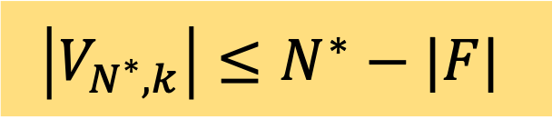

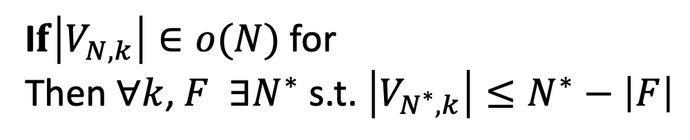

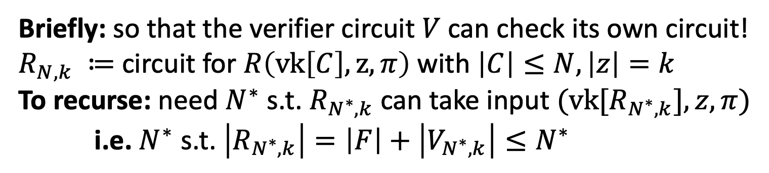

Why sublinear verification? [BCCT13, COS20]
Briefly: so that the verifier circuit $V$ can check its own circuit!
$R_{N,k} ≔$ circuit for $R\left(vk\left[C\right],z,π\right)$ with $\left|C\right|≤N,\left|z\right|=k$
To recurse: need $N^{∗}$ s.t. $R_{N^{∗},k}$ can take input $(vk[R_{N^{∗},k}],z,π)$
i.e. $N^{∗}$ s.t. $\left|R_{N^{∗},k}\right|=\left|F\right|+\left|V_{N^{∗},k}\right|≤N^{∗}$
What about SNARKs without sublinear verification?
$$R$$
$$z$$
$$F$$
$$z′$$
$$\left|V_{N^{∗},k}\right|≤N^{∗}−|F|$$
I$f\left|V_{N,k}\right|∈o(N)$for
Then $∀k$, $F$ $∃N^{∗}$ s.t. $\left|V_{N^{∗},k}\right|≤N^{∗}−\left|F\right|$
$$π$$
$$V$$
$${vk}_{R}$$
We say $N^{∗}$ is the ‘recursion threshold’
Notes:
$$\left|V_{N^{∗},k,λ}\right|≤\frac{1}{2}⋅(2α{\left(k,λ\right))}^{\frac{1}{1−ε}}≤\frac{N^{∗}}{2}≤N^{∗}−|F|$$

Slide 13
New tool: Accumulation schemes

Slide 14



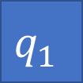

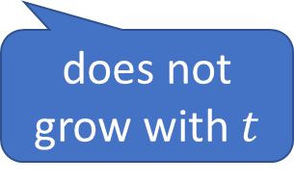




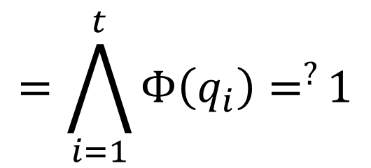








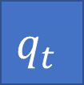





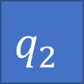





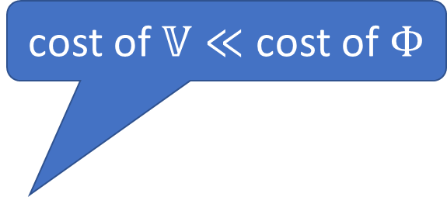

Accumulation schemes: overview
cost of $𝕍≪$ cost of $Φ$
0/1
0/1
0/1
0/1
$$𝕍$$
$$∧$$
$$𝕍$$
$$∧$$
$$⋯$$
$$∧$$
$$𝕍$$
$$∧$$
$$𝔻$$
$$=1$$
decider
$$ℙ$$
$$ℙ$$
$$𝕒_{0}$$
$$𝕒_{1}$$
$$𝕒_{2}$$
$$⋯$$
$$𝕒_{t}$$
$$⋯$$
accumulator
does not grow with $t$
$$q_{1}$$
$$q_{2}$$
$$⋯$$
$$q_{t}$$
$$⋯$$
$$=\bigwedge_{i=1}^{t}{Φ\left(q_{i}\right)=^{?}}1$$
$$Φ$$
$$Φ$$
$$Φ$$
$$∧$$
$$∧$$
$$⋯$$
$$∧$$
0/1
0/1
0/1

Slide 15
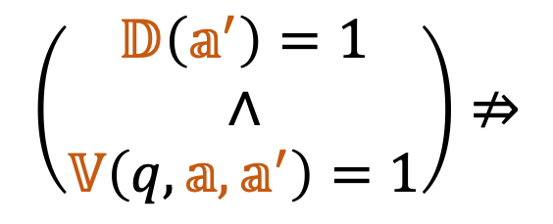



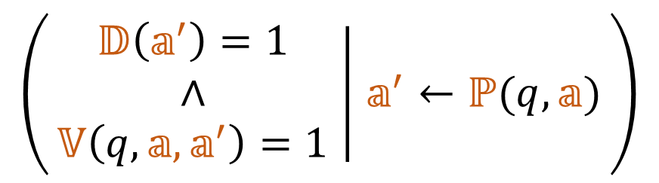
Accumulation schemes: definition
Accumulation scheme for $Φ :X→\left\{0,1\right\}$ is a triple $\left(ℙ,𝕍,𝔻\right)$ such that:
Completeness: for all accumulators $𝕒$, queries $q∈X$,
Soundness: for all efficient adversaries $𝒜$,
$$\begin{matrix}Pr \\ \left(q,𝕒,𝕒^{′}\right)←𝒜\end{matrix}\left[\left(\begin{matrix}𝔻\left(𝕒^{′}\right)=1 \\ ∧ \\ 𝕍\left(q,𝕒,𝕒^{′}\right)=1\end{matrix}\right)⇒\left(\begin{matrix}𝔻\left(𝕒\right)=1 \\ ∧ \\ Φ\left(q\right)=1\end{matrix}\right)\right]≤negl.$$
Efficiency: the size of an accumulator is a fixed poly in security parameter
$$\left(\begin{matrix}𝔻\left(𝕒\right)=1 \\ ∧ \\ Φ\left(q\right)=1\end{matrix}\right)⇒$$
$$\left(\begin{matrix}𝔻\left(𝕒^{′}\right)=1 \\ ∧ \\ 𝕍\left(q,𝕒,𝕒^{′}\right)=1\end{matrix} ∣ 𝕒^{′}←ℙ(q,𝕒)\right)$$
$$\left(\begin{matrix}𝔻\left(𝕒^{′}\right)=1 \\ ∧ \\ 𝕍\left(q,𝕒,𝕒^{′}\right)=1\end{matrix}\right)⇏$$
$$\left(\begin{matrix}𝔻\left(𝕒\right)=1 \\ ∧ \\ Φ\left(q\right)=1\end{matrix}\right)$$
Note: we always have a trivial accumulation scheme $(ℙ=∅,𝕍=Φ,𝔻=∅)$

Slide 16
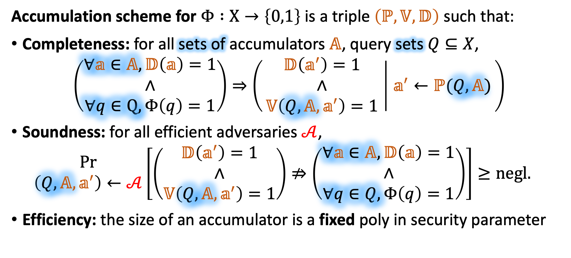
Accumulation schemes: definition
Accumulation scheme for $Φ :X→\left\{0,1\right\}$ is a triple $\left(ℙ,𝕍,𝔻\right)$ such that:
Completeness: for all sets of accumulators $𝔸$, query sets $Q⊆X$,
$$\left(\begin{matrix}∀𝕒∈𝔸,𝔻\left(𝕒\right)=1 \\ ∧ \\ ∀q∈Q, Φ\left(q\right)=1\end{matrix}\right)⇒\left(\begin{matrix}𝔻\left(𝕒^{′}\right)=1 \\ ∧ \\ 𝕍\left(Q,𝔸,𝕒^{′}\right)=1\end{matrix} ∣ 𝕒^{′}←ℙ(Q,𝔸)\right)$$
Soundness: for all efficient adversaries $𝒜$,
$$\begin{matrix}Pr \\ \left(Q,𝔸,𝕒^{′}\right)←𝒜\end{matrix}\left[\left(\begin{matrix}𝔻\left(𝕒^{′}\right)=1 \\ ∧ \\ 𝕍\left(Q,𝔸,𝕒^{′}\right)=1\end{matrix}\right)⇏\left(\begin{matrix}∀𝕒∈𝔸,𝔻\left(𝕒\right)=1 \\ ∧ \\ ∀q∈Q,Φ\left(q\right)=1\end{matrix}\right)\right]≥negl.$$
Efficiency: the size of an accumulator is a fixed poly in security parameter
Note: we always have a trivial accumulation scheme $(ℙ=∅,𝕍=⋀_{q}Φ,𝔻=∅)$
Notes:
highlight diff

Slide 17
Theorem 1: IVC/PCD from accumulation schemes

Slide 18
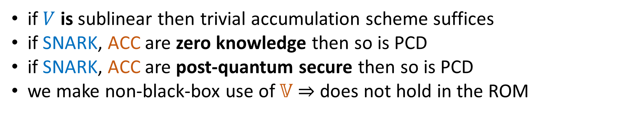



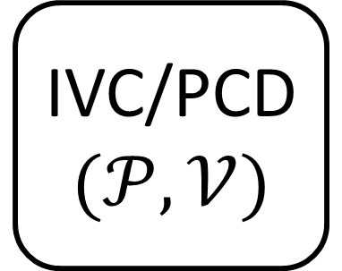
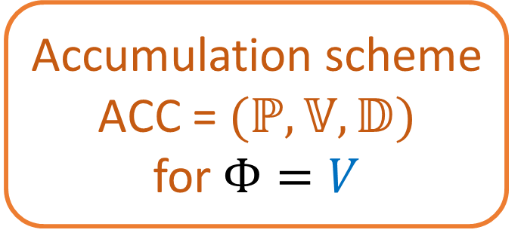
Theorem 1: IVC/PCD from accumulation
SNARK
$$(P,V)$$
Accumulation scheme ACC = $(ℙ,𝕍,𝔻)$
for $Φ=V$
IVC/PCD
$$(𝒫,𝒱)$$
$V$ need not be sublinear
$𝕍$ must be sublinear
if $V$ is sublinear then trivial accumulation scheme suffices
if SNARK, ACC are zero knowledge then so is PCD
if SNARK, ACC are post-quantum secure then so is PCD
we make non-black-box use of $𝕍$ $⇒$ does not hold in the ROM
Notes:
colours for SNARK + Acc
note that Acc scheme has no knowledge assumption

Slide 19






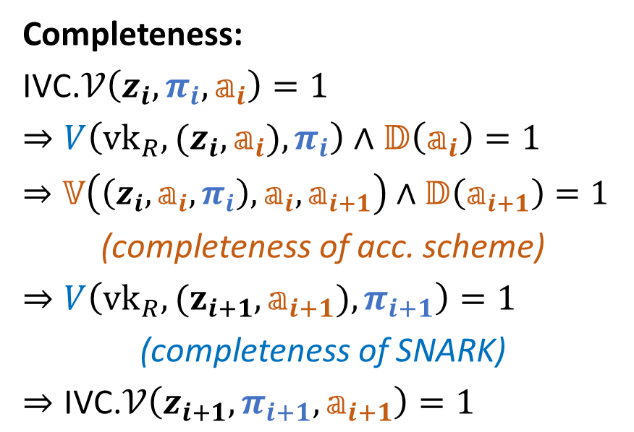
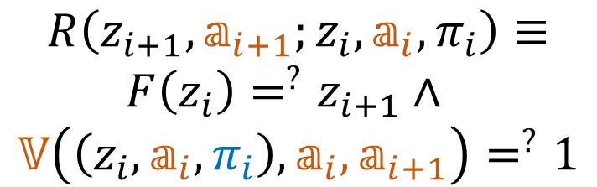




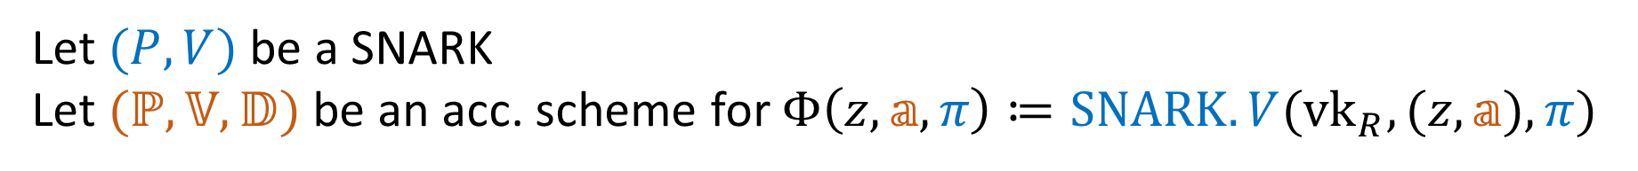




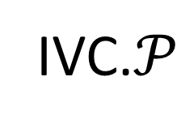
Theorem 1: Construction
$$R\left(z_{i+1},𝕒_{i+1};z_{i},𝕒_{i},π_{i}\right)≡$$
$F\left(z_{i}\right)=^{?}z_{i+1}∧$
$$𝕍\left(\left(z_{i},𝕒_{i},π_{i}\right),𝕒_{i},𝕒_{i+1}\right)=^{?}1$$
Let $(P,V)$ be a SNARK
Let $(ℙ,𝕍,𝔻)$ be an acc. scheme for $Φ\left(z,𝕒,π\right)≔SNARK.V({vk}_{R},(z,𝕒),π)$
IVC.$𝒫$
recursive circuit does not contain SNARK verifier
IVC.$𝒱$
Completeness:
IVC.$𝒱\left(z_{i},π_{i},𝕒_{i}\right)=1$
$⇒V\left(vk_{R},(z_{i},𝕒_{i}), π_{i}\right)∧𝔻\left(𝕒_{i}\right)=1$
$⇒𝕍\left(\left(z_{i},𝕒_{i},π_{i}\right),𝕒_{i},𝕒_{i+1}\right)∧𝔻\left(𝕒_{i+1}\right)=1$
(completeness of acc. scheme)
$⇒V\left({vk}_{R},(z_{i+1},𝕒_{i+1}),π_{i+1}\right)=1$
(completeness of SNARK)
$⇒\text{IVC}\text{.}𝒱\left(z_{i+1},π_{i+1},𝕒_{i+1}\right)=1$
$$SNARK.P$$
$$z_{i}$$
$$R$$
$$z_{i+1}$$
$$F$$
$$SNARK.V$$
$$[R]$$
$$π_{i}$$
$$𝕍$$
$$π_{i+1}$$
IVC proof
$$ℙ$$
$$𝔻$$
$$𝕒_{i}$$
$$𝕒_{i+1}$$
Notes:
namespaces & colours for differentiating ACC and SNARK
label IVC prover & verifier algorithms, SNARK prover

Slide 20
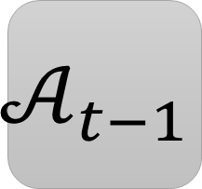


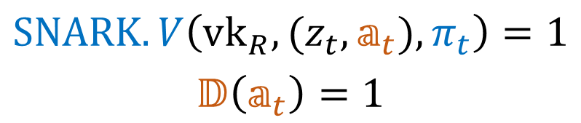








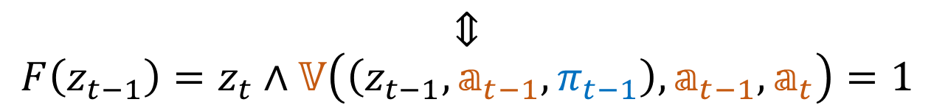



Theorem 1: Soundness
$$𝒜_{t}$$
$$z_{t}$$
$$SNARK.V\left(vk_{R},{(z}_{t},𝕒_{t}),π_{t}\right)=1$$
$$𝔻\left(𝕒_{t}\right)=1$$
SNARK extractor
$$π_{t}$$
$$𝕒_{t}$$
$$𝒜_{t−1}$$
$$R\left(z_{t},𝕒_{t};z_{t−1},𝕒_{t−1},π_{t−1}\right)=1$$
$$z_{t},z_{t−1}$$
$$⇕$$
$$F\left(z_{t−1}\right)=z_{t}∧𝕍\left(\left(z_{t−1},𝕒_{t−1},π_{t−1}\right),𝕒_{t−1},𝕒_{t}\right)=1$$
$$π_{t},π_{t−1}$$
$$𝕒_{t},𝕒_{t−1}$$
$$⋮$$
$$V\left(vk_{R},{(z}_{t−1},𝕒_{t−1}),π_{t−1}\right)=1∧𝔻\left(𝕒_{t−1}\right)=1$$
$$𝒜_{1}$$
$$z_{t},…,z_{1}$$
$$…$$
$$∀i∈[t], z_{i}=F(z_{i−1})$$
$$…$$

Slide 21

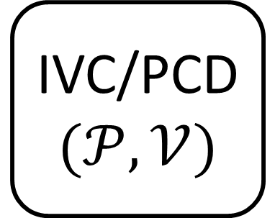

IVC/PCD from accumulation: summary
Theorem 1
SNARK
$$(P,V)$$
Accumulation scheme ACC = $(ℙ,𝕍,𝔻)$
for $Φ=V$
IVC/PCD
$$(𝒫,𝒱)$$
How do we construct SNARKs with accumulation schemes?

Slide 22
Theorem 2: SNARKs with accumulation schemes

Slide 23
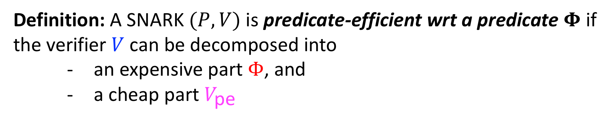
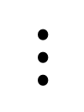


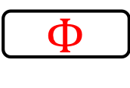
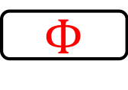





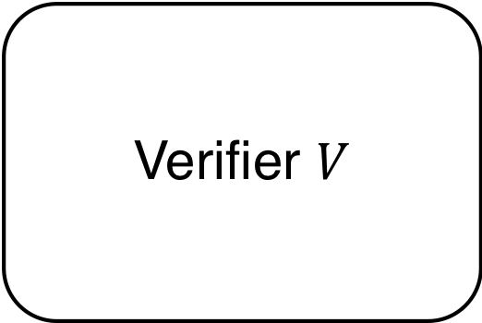



Predicate-efficient SNARKs
Definition: A SNARK $(P, V)$ is predicate-efficient wrt a predicate $Φ$ if
the verifier $V$ can be decomposed into
an expensive part $Φ$, and
a cheap part $V_{\text{pe}}$
Verifier $V$
$$q_{1}$$
$$Φ$$
Verifier $V$
$$Q$$
$$⋮$$
$$≡$$
$$(x,π)$$
b
$$q_{n}$$
$$(x,π)$$
$$V_{\text{pe}}$$
$$Φ$$
$∧$
b
$$b_{\text{pe}}$$
Cheap to compute
Expensive to compute
Notes:
- Remember to say that it’s only multiple copies of the same predicate

Slide 24
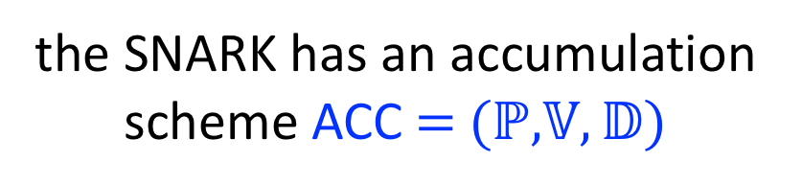
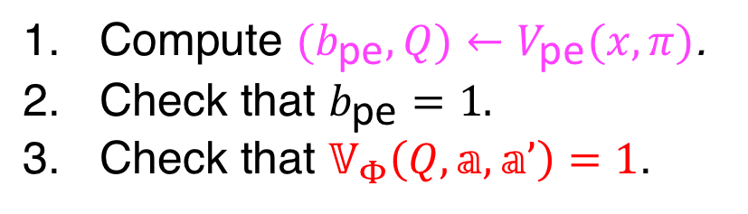
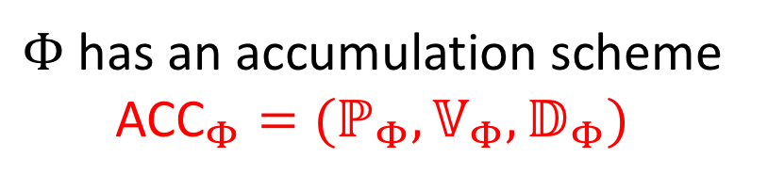






Accumulation for predicate-efficient SNARKs
Theorem 2: Suppose a SNARK is predicate-efficient wrt. a predicate $Φ$. Then,
$Φ$ has an accumulation scheme ${\text{ACC}}_{Φ}=(ℙ_{Φ},𝕍_{Φ},𝔻_{Φ})$
$$⟹$$
the SNARK has an accumulation scheme $\text{ACC}\text{ = (}ℙ\text{,} 𝕍,𝔻\text{)}$
Prover $ℙ\left(\left(𝕩,π\right),𝕒\right)$:
Verifier $𝕍\left(\left(x,π\right),𝕒, 𝕒’\right)$:
Compute $(b_{\text{pe}}, Q)←V_{\text{pe}}(x,π)$.
Output new accumulator ${𝕒’←ℙ}_{Φ}\left(Q, 𝕒\right)$
Compute $(b_{\text{pe}}, Q)←V_{\text{pe}}(x,π)$.
Check that $b_{\text{pe}}=1.$
Check that $𝕍_{Φ}\left(Q,𝕒, 𝕒’\right)=1$.
Decider $𝔻\left(𝕒’\right)$:
Check that $𝔻_{Φ}\left(𝕒’\right)=1$.
Notes:
Clarify that it’s a construction

Slide 25


Properties of $\text{ACC}$
Security:
Proof idea: Reduce security of $\text{ACC}$to security of ${\text{ACC}}_{Φ}$
If ${\text{ACC}}_{Φ}$ is quantum secure then so is $\text{ACC}$
If ${\text{ACC}}_{Φ}$ is zero-knowledge then so is $\text{ACC}$
Efficiency:
$\text{ACC}$ verifier is ${\text{ACC}}_{Φ}$ + predicate-efficient runtime
Upshot is this significantly reduces the complexity of designing Accumulation schemes

Slide 26
Where to find
predicate-efficient SNARKs?
Notes:
Done with Thm 2, (maybe have a similar recap) Now the question, how to find PE-SNARKs, and the accumulation schemes for their predicates.

Slide 27
A Popular Methodology for SNARKs
Sonic, PLONK, Marlin
Polynomial IOP/ AHP
SNARK
Compiler [BBB19, CHMMVW20]
Polynomial Commitment (PC)
[KZG10], [BBB19], Halo
Used to construct many popular SNARKs:
Sonic [MBKM19], PLONK [GWC19], Marlin [CHMMVW20].
Notes:
Have a call-out box for both the AHP and the PC with concrete instantiations. Mention that this methodology leads to many state of the art SNARKs

Slide 28



A Popular Methodology for SNARKs
Polynomial IOP/ AHP
SNARK
Compiler [CHMMVW20]
Verifier $V$
PC.Check
Polynomial Commitment (PC)
$$V_{\text{AHP}}$$
SNARK is predicate-efficient wrt. $Φ≔$PC.Check!
Notes:
SNARK is PE wrt \Phi := PC.Check Highlight PC.Check in Red.

Slide 29
Accumulating SNARKs based on Polynomial Commitments
[CHMMVW20]
AHP
SNARK that is predicate-efficient wrt PC.Check
Compiler
PC
Thm 2
Accumulation Scheme for SNARK
Accumulation Scheme for PC
Notes:
Add a pop-up where to get acc scheme for PC?

Slide 30
Theorem 3:
Constructing
Accumulation Schemes
for
Polynomial Commitments

Slide 31







Recap: Polynomial Commitments
Sender
Receiver
$$f\left(X\right)∈ 𝔽_{p}^{≤d}[X]$$
PC.Commit
Commitment $C$
$$C$$
$$z$$
Opening point $z∈𝔽_{p}$
PC.Open
PC.Check
Evaluation $v$, Proof $π$
Decision bit $b$
31

Slide 32





Accumulation Scheme for PC_{KZG}
Consider PC_{KZG}, a PC scheme based the construction of [KZG10].
SRS: $G,sG,s^{2}G,s^{3}G,…, s^{D}G$
PC.Commit($f$)$→C ≔f\left(s\right)G$
PC.Open($f,z$)$→W≔w\left(s\right)G; w\left(X\right) :=\frac{f\left(X\right)−f\left(z\right)}{X−z}$
PC.Check($C,W,z, v$)$→e\left(W, \left(x−s\right)H \right)=e(C −vG,H)$
Theorem: There exists an accumulation scheme in the ROM for the PC_{KZG} construction with the following properties:
PC.Check | Proof size
$2$ pairings | $$2 𝔾_{1}$$
Accumulation Verifier | Accumulator size | Decider
$O(1)$ $𝔾_{1}$ mults | $2 𝔾_{1}$ | 1 pairing
No pairings in verifying accumulation!
Notes:
Make this PC_AGM like PC_DL Highlight no pairings, and point out that the accumulation verifier is what goes into the recursive circuit
Point out ‘per-proof” for check pf size and acc verifier.

Slide 33






Accumulation Scheme for PC_{DL}
Consider PC_{DL}, a PC scheme based on the inner product argument of
[BCCGP16, Bulletproofs, Halo]. (Security of PC_{DL} depends on DL+RO.)
URS: $G,G_{1}, G_{2}, …, G_{D}$
PC.Commit($f$)$→C ≔\sum_{i}^{D}{f_{i}G_{i}}$
PC.Open($f,z$)$→W≔\text{I}\text{PA}\text{.}\text{Prove}(C, \vec{f}, \vec{z})$
PC.Check($C,W,z, v$)$→\text{IPA}\text{.}\text{Verify}(C, \vec{z},v, W)$
Halo [BGH19] describes a protocol for accumulating PC_{DL}.
Theorem: A variant of this protocol is an accumulation scheme in the ROM for PC_{DL} with the following properties:
PC.Check | Proof size
$O\left(D\right) 𝔾$ mults | $$O\left(log D\right) 𝔾$$
Accumulation Verifier | Accumulator size | Decider
$O\left(log D\right) 𝔾$ mults | $$O(log D) 𝔾$$ | $O\left(D\right) 𝔾$ mults
Verifying accumulation is exponentially faster than PC.Check!
Notes:
Remove n, and write below the relevant columns ”per eval proof” Have call-out pointing that verifier is exponentially faster.
[BGH19, Halo] describes a protocol for accumulating PC_DL they use to recurse. Thm: A modification of the Halo construction is an accumulation scheme for PC_DL… Add a parenthetical sentence about zk for the acc scheme at the bottom (for kzg10 also)

Slide 34


Summary: Theorems 1 and 2
PCD/IVC
Theorem 1
SNARK with Acc Scheme
Theorem 2
PE-SNARK wrt $Φ$
Acc Scheme for $Φ$
Notes:
Point out that (a) Thm 2 is black box wrt RO, but (a) Thm 1 can’t handle Ros © so have to instantiate when we we don’t know accumulation schemes that don’t use Ros, but Thm2 is black box and doesn’t care. Split middle box into SNARK with AS and SNARK with AS in ROM, and connect them with a “RO heuristic” arrow.

Slide 35


Summary of PCD constructions
PCD/IVC from bilinear groups
Trusted setup
Tiny proofs
No pairings in recursive circuit
PCD/IVC from standard groups
Transparent setup
Small proofs (<< [COS20])
More accumulation schemes from different assumptions with different properties?
Theorem 1
Theorem 1
Standard model
RO heuristic
RO heuristic
ROM
Theorem 2
Theorem 2
PE-SNARK wrt PC
ACC for $\text{PC}\text{KZG}$
PE-SNARK wrt PC
ACC for $\text{PC}\text{DL}$
Notes:
Make portion of arrow corresponding to RO heuristic dotted.

Slide 36
Thanks!
ia.cr/2020/499

