Slide 1
CIO Technology Workshops
PowerPoint – An Introduction to QPT

Slide 2
PowerPoint – An Introduction to QPT
5
Agenda
What is QPT?
Formatting Tools
Collaborating
Creating Slides
Introduction to the Quick Presentation Toolkit
What does the Quick Presentation Toolkit look like?
Accenture Templates
Confidentiality Note and Slide
Adding Other Master Elements
Use the Right Colors in Your Presentation
Add Agenda Pages
Library of Visuals
Merge Text
Convert Lines to Shapes
Touch
QPT Format Painter
Height and Width
Harvey Balls
Send/Save Selected Slides
Sticky Notes

Slide 3
PowerPoint - An Introduction to QPT
5
What is QPT?
What is QPT?
Formatting Tools
Collaborating
Creating Slides
Introduction to the Quick Presentation Toolkit
What does the Quick Presentation Toolkit look like?

Slide 4
Introduction to the Quick Presentation Toolkit
5
What is the Quick Presentation Toolkit?
Add-in for PowerPoint
Defines and implements standards and best practices
Automates tedious, time-consuming tasks
Proprietary to Accenture
Who uses the Quick Presentation Toolkit?
Anyone who wants to save approximately 90 minutes a week
That’s about 26,000 Accenture employees!

Slide 5
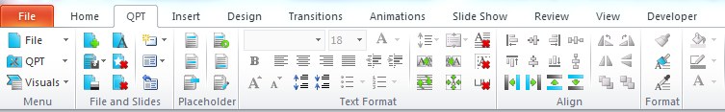


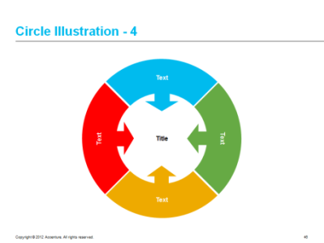




What does the Quick Presentation Toolkit look like?
QPT is a tab in PowerPoint’s ribbon!
Design Templates
Accenture Styles
Library of Visuals
Accenture Color Palette built in
Dynamic templates driven by the Accenture Style
Library of Visuals – that support our brand

Slide 6
PowerPoint - An Introduction to QPT
5
Creating Slides
What is QPT?
Formatting Tools
Collaborating
Creating Slides
Accenture Templates
Confidentiality Note and Slide
Adding Other Master Elements
Use the Right Colors in Your Presentation
Add Agenda Pages

Slide 7
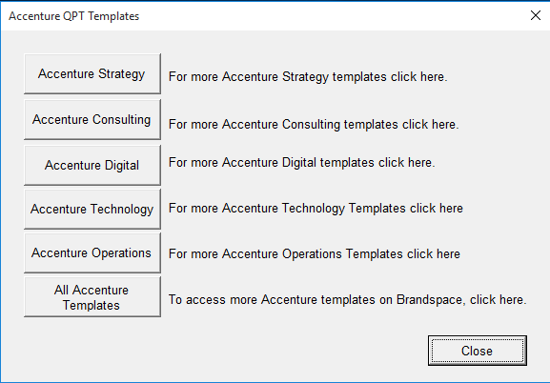
Create a New Presentation with Accenture Templates
Easy access to templates for the five Growth Platforms and many other Accenture templates that can be used by all employees.
Templates
Access to templates for download
Strategy
Consulting
Digital
Technology
Operations
All Accenture Templates

Slide 8
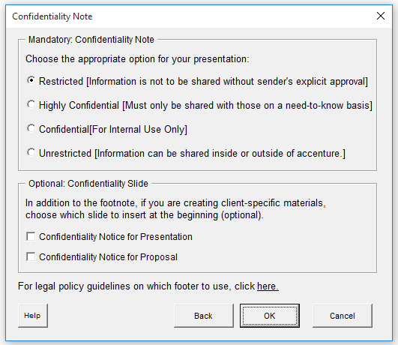
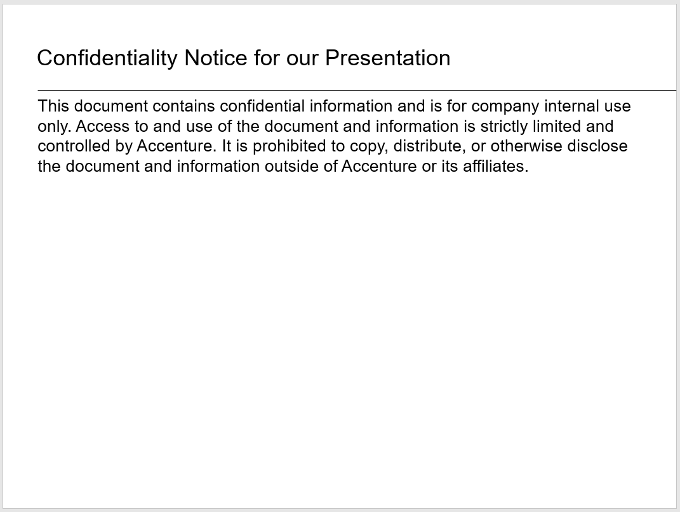

Adding a Confidentiality Note and Slide
More options for footnotes and slide disclaimers are provided to ensure our materials are protected and comply with our Accenture legal policies

Slide 9
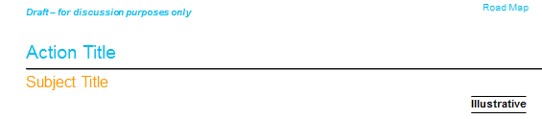
Add Other Master Elements to Your Presentation
Save time by adding a draft note to your presentation, standard or customized stamps, and client/project name or filename

Slide 10


Use the Right Colors in Your Presentation
QPT Color Picker makes choosing the right colors in your presentation quick, easy and helps you support our brand.
The colors picker dynamically selects the Accenture colors programmed into the colors palette of your QPT code template and displays them for ease of use.
These colors can be easily used for shape fills, fonts and lines. Choose the symbol on the left first (fill, line, or font), then pick the color.
Note: Avoid using more than the four theme colors within any presentation.

Slide 11

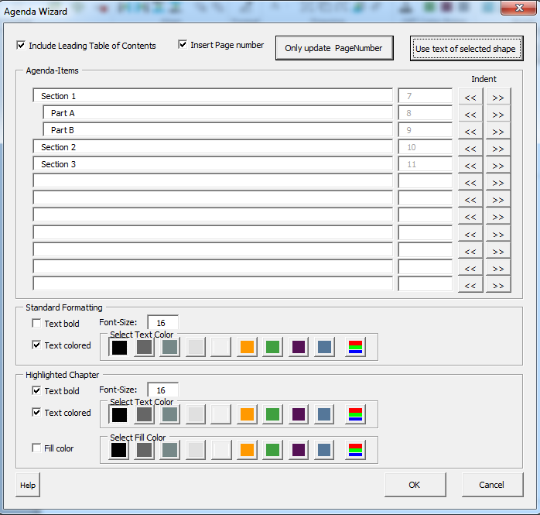
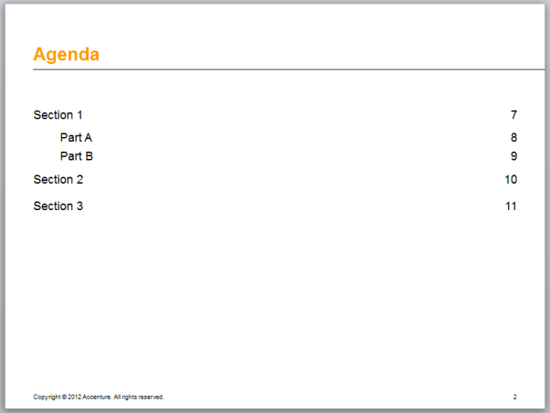
Add Agenda Pages
QPT makes it easy to create an agenda slide and organise your presentation
Write your agenda points on a blank slide.
Select the text box containing your agenda points.
Select the Add Agenda Pages feature.
Choose to either include the leading table of contents (the initial agenda that was created for the PPT) or the existing agenda and select fonts and styles.
Hint: Use Slide Sorter view to move agenda pages to their proper place in the presentation

Slide 12
PowerPoint - An Introduction to QPT
5
Formatting Tools
What is QPT?
Formatting Tools
Collaborating
Creating Slides
Library of Visuals
Merge Text
Convert Lines to Shapes
Touch
QPT Format Painter
Height and Width
Harvey Balls

Slide 13
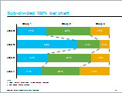
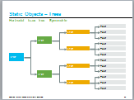
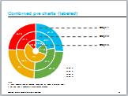
Library of Visuals
Commonly used visuals that support our brand standards are ready to use—and you can save your own!
Hundreds of visuals are ready to use
Charts
Dynamic concepts
Processes
Static objects
Standard visuals
Your own visuals can saved within PPT
PowerPoint SmartArt DOES NOT support the Accenture brand

Slide 14
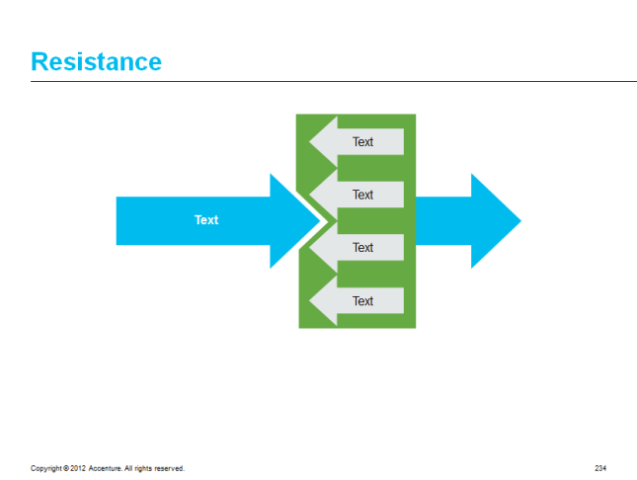
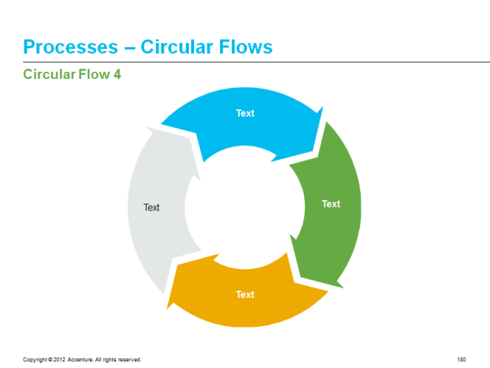
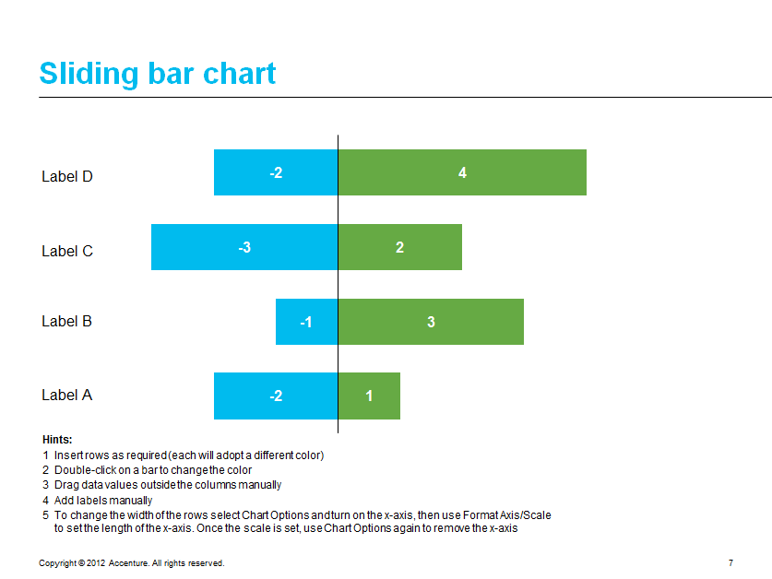
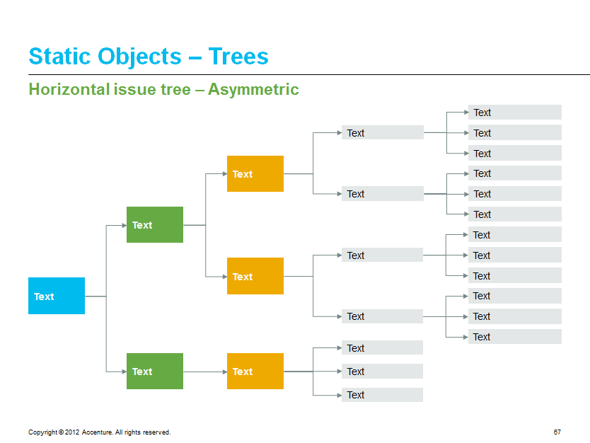
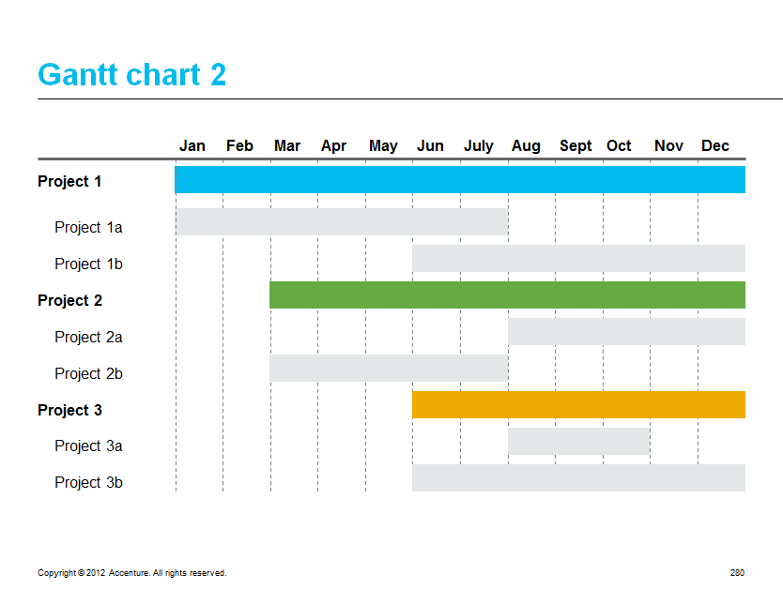
PowerPoint - An Introduction to QPT
Library of Visuals: Examples
Dynamic Concepts
Processes
Charts
Static Objects
Standard Visuals

Slide 15

Merge Text
Use QPT to consolidate multiple text boxes into one Select multiple text boxes by holding down the shift key. Once the merge text feature is used you have different options for formatting, line breaks, and bullets.
Before
After
Sometimes you have many text boxes.
Sometimes you have many text boxes. It would be nice if there were a way to easily combine them into one text box. Thankfully, Accenture employees can enjoy the convenience of the merge text feature in QPT.
It would be nice if there were a way to easily combine them into one text box.
Thankfully, Accenture employees can enjoy the convenience of the merge text feature in QPT.

Slide 16
Convert Lines to Shapes
Convert one text box with multiple lines into multiple textboxes, one for each line.
It is very important that you have at least three lines.
It is very important that you have at least three lines.
Click on the Convert Lines to Shapes icon in the Text Format Group.
The text box will be separated into separate text boxes depending on the number of lines that you had in the original text box.
QPT is awesome!
Click on the Convert Lines to Shapes icon in the Text Format Group.
The text box will be separated into separate text boxes depending on the number of lines that you had in the original text box.
QPT is awesome!

Slide 17

Touch
Touch feature allows you to touch objects together automatically
Touch Left
Q
P
T
Touch Up
Q
Q
P
Q
P
T
P
T
T

Slide 18
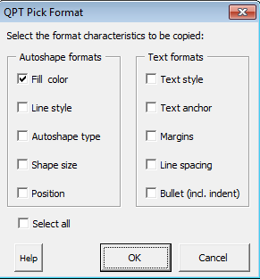
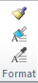
QPT Format Painter
The QPT Format Painter goes leaps and bounds further than the standard format painter found in Office
Use the QPT Format Painter to select different formatting options that you would like to copy to another object.
Then use the QPT Apply Format and apply away!

Slide 19

Height and Width
Set multiple shapes to the same height or width
The height or width of the last object selected will determine the default. In this example, the triangle was the last shape selected.
Before
After

Slide 20
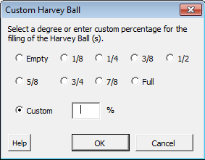
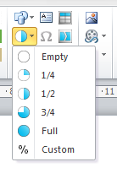
Harvey Balls
Add Harvey Balls with different percentages, preset or custom, to a presentation

Slide 21
PowerPoint - An Introduction to QPT
5
Collaborating
What is QPT?
Formatting Tools
Collaborating
Creating Slides
Send/Save Selected Slides
Sticky Notes

Slide 22
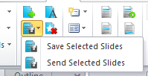
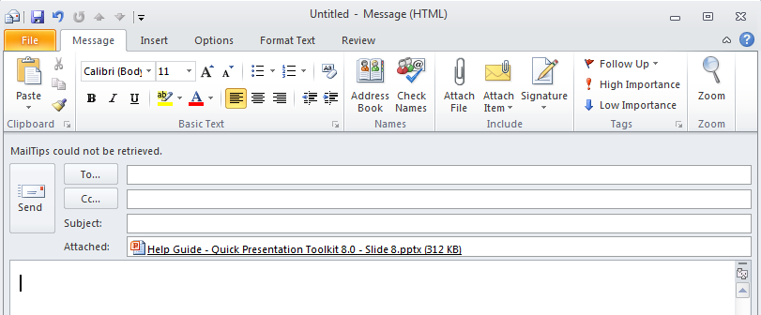
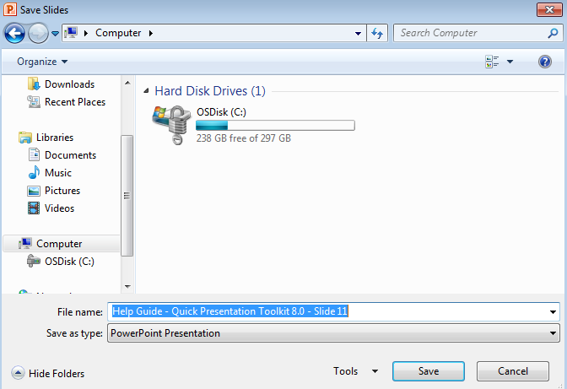
Send/Save Selected Slides
Send Selected Slides as an email attachment
Save Selected Slides as a new presentation

Slide 23

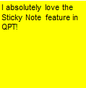
Sticky Notes
Easily manage sticky notes on a presentation to make reviewing easier
On the current slide or the whole presentation:
Make Sticky Notes visible
Hide Sticky Notes
Reposition Sticky Notes to the upper right hand corner
Delete Sticky Notes
Note: Please ensure to delete all sticky notes before sharing the presentation outside Accenture

Slide 24
PowerPoint - An Introduction to QPT
5
Summary
What is QPT?
Formatting Tools
Collaborating
Creating Slides
Introduction to the Quick Presentation Toolkit
What does the Quick Presentation Toolkit look like?
Accenture Templates
Confidentiality Note and Slide
Adding Other Master Elements
Use the Right Colors in Your Presentation
Add Agenda Pages
Library of Visuals
Merge Text
Convert Lines to Shapes
Touch
QPT Format Painter
Height and Width
Harvey Balls
Send/Save Selected Slides
Sticky Notes

Slide 25

PowerPoint - An Introduction to QPT
Getting QPT is as Easy as Using QPT!
1
Download QPT today from go.accenture.com/QPT
2
Having problems downloading or installing QPT? Share your issues on go.accenture.com/QPT
Have a general comment or suggestion for the next version of QPT? Share your comments with the community at go.accenture.com/QPT
3

Slide 26
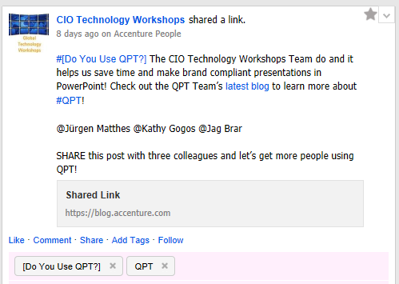
Help Spread the Word!
Go onto the Stream and find our post.
Share the post
Add a comment saying why you use QPT!
@ Target 3 colleagues

Slide 27

Questions?
5

Slide 28
Feedback
5
Please mark this session as “completed” on myLearning.
Please take the time to fill out the session survey, we use your feedback and comments to improve future workshop sessions.
For more information on Technology Workshops please visit: https://go.accenture.com/TechnologyWorkshops
Follow us @CIO Technology Workshops on the Stream and #technologyworkshops
If you have any feedback in relation to this workshop or any other workshops please e-mail the Global Technology Workshop Team: CIO.Tech.Workshops@Accenture.com

