Slide 1
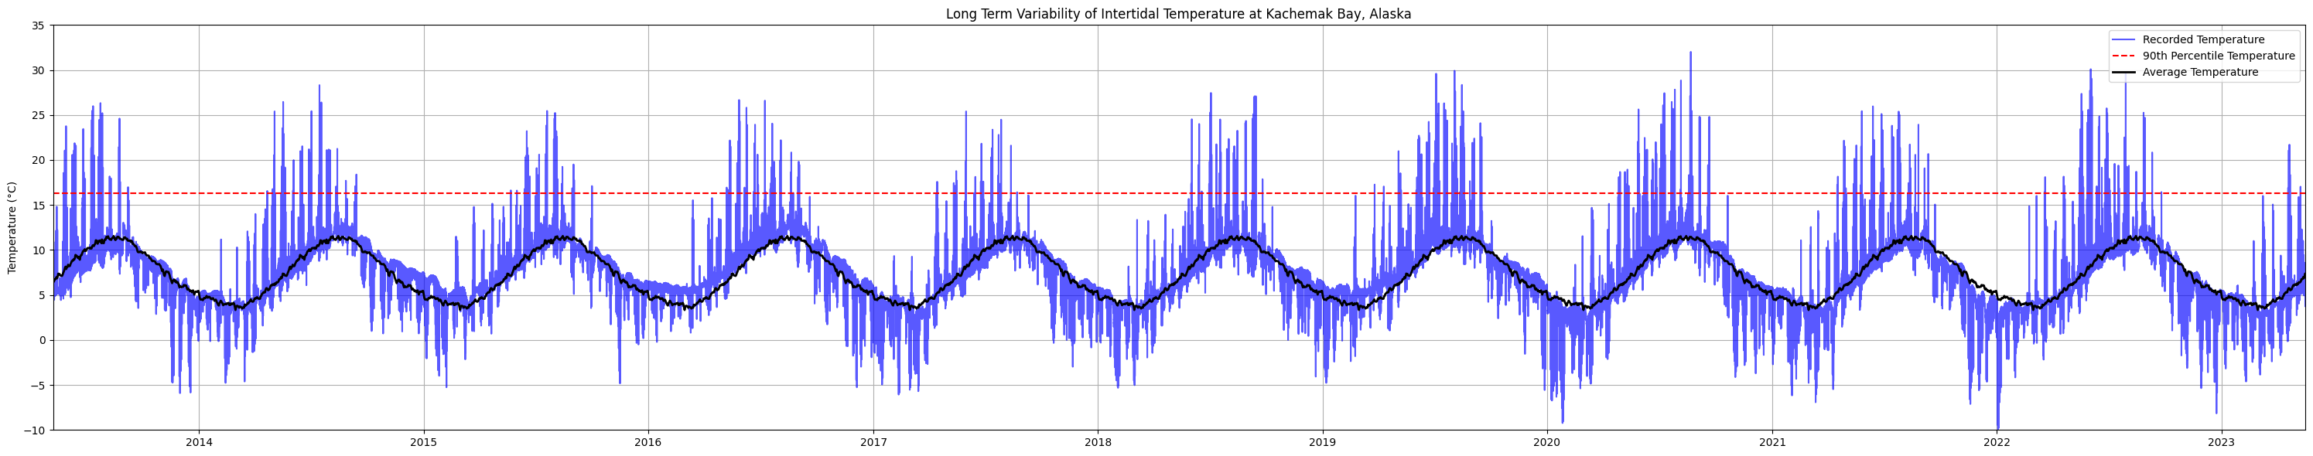
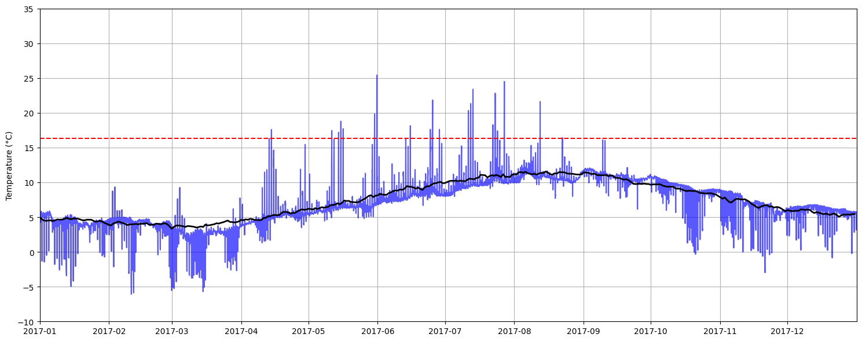
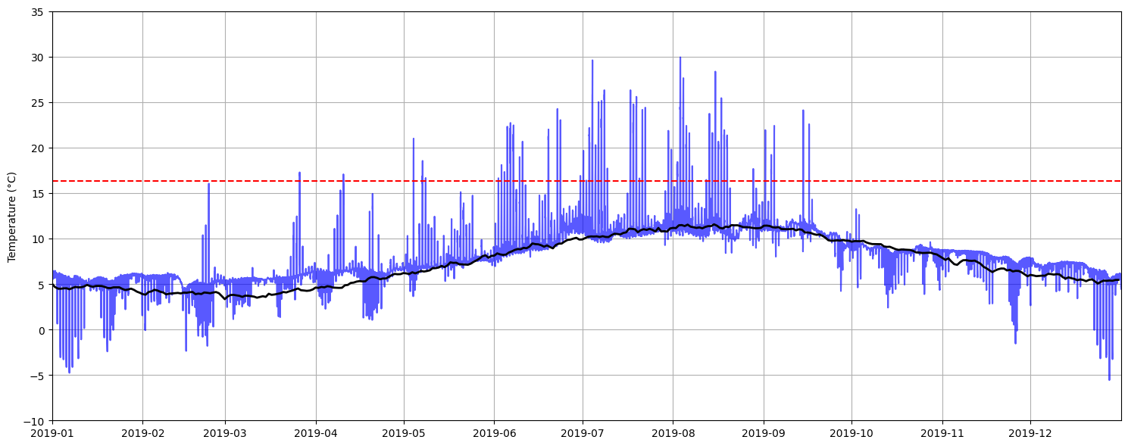
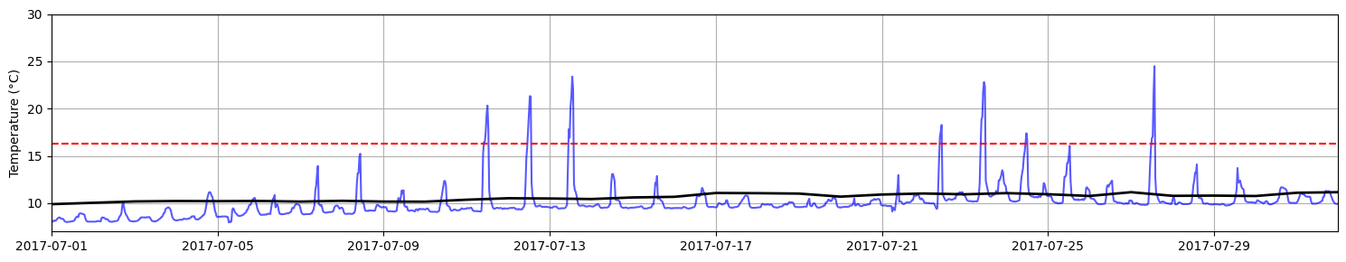
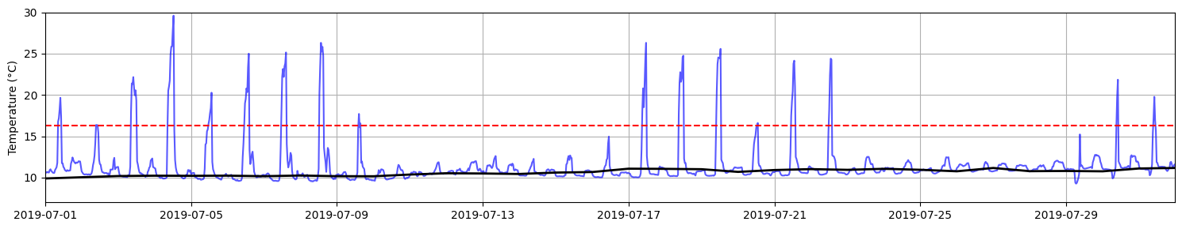
Figure 1. Profile of a temperature logger recording at 30 minute intervals in the mid-intertidal zone at Kachemak Bay, Alaska USA during the period of 2013-2023 (CITE Data Source - https://doi.org/10.5066/F7WH2N3T). (Top) One decade of temperature data (blue) and the mean temperature for each day calculated across the dataset (black, repeated yearly). Also pictured is the 90th percentile of daily maximum temperatures across the dataset (dotted red). (Middle Left) One year of data for 2017, a relatively cool year. (Middle Right) One year of data for 2019, a relatively hot year. (Bottom Left) Data for September 2017. (Bottom Right) Data for September 2019. For all panels colors are as in top panel legend.

