Slide 1
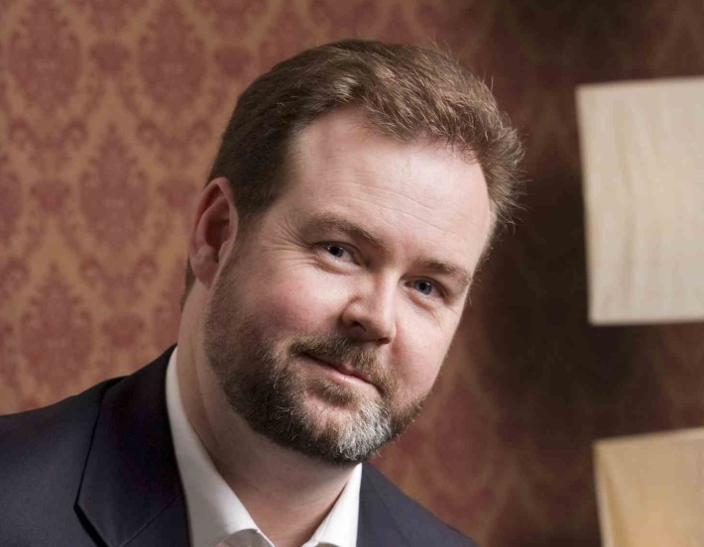
Welcome to the Short Course in Online Mentoring Topic 1 - Fundamentals
Presented by Brenton Burchmore
Agenda:
Defining students and comparing to F2F
Student expectations and motivations
Compartmentalisation and student engagement
The mentor persona and student interactions

Slide 2
Professional Online Students
Time-Poor
Are usually working and busy and do not have time to attend a traditional class
Experienced
Successful
Are familiar with the larger world and want to be treated as mature adults
Have found some degree of success in life and have enrolled in your subject to expand on that

Slide 3
Online versus Face to Face
F2F and the commitment to roll call
Engagement is incremental when online
“Lessons” are actually constructed by the student and are comprised of their multiple logins and interactions
Online mentors have no control over student participation
Online students are motivated mainly by long term goals
The online mentor is less “real” than the physical teacher

Slide 4
Online Student Expectations
Efficiency
Not losing time accessing or finding content
Structure
Compartments of learning that flow together
Guidance
Indications of what to engage with and when
Opportunity
Chances to express ideas and opinions

Slide 5
Action/Motivation Cycle
The learning journey
Plan how to engage with the topic
Absorb and consider the ideas presented
Share and express opinions with others
Complete practical tasks
The cycle runs for each topic and involves the actions and decisions that a student must make each cycle.
These actions represent key moments that should motivate the student to log on to the subject and engage with its compartments.

Slide 6
Compartmentalisation
Breaking down the interaction into bite size pieces
Showing causal links flowing from one action to the next
Creating a specific action-oriented reason to log on
Allowing student interaction in small time increments
Creating a feeling of progress by measurable increments

Slide 7
Student Engagement
Students share their opinions more easily than their knowledge
Asking students to demonstrate knowledge feels more like a test, and requires confidence.
Students are more comfortable sharing their opinions and views on their own terms.
Students will more easily engage in a debate when no-one can be clearly right or wrong.

Slide 8
Efficiency vs Excitement
Predictability leads to efficiency of decision
The unexpected leads to greater excitement
The balance between efficiency and excitement
The structure predicts where things are found
The content excites by being unknown
The syllabus predicts when things will happen
The discussion excites by being personal

Slide 9
The Mentor Persona
Be human
Be yourself and allow the students to see the real you
Be honest
Don’t hide or cover things up, deal with things as they are
Be personal
Share thoughts or experiences that have meaning to you
Be passionate
Show the students your enthusiasm for teaching the subject
Be adaptable
Be free to divert from plan A when a new path is interesting
Be grounded
Position yourself on equal terms with your students

Slide 10
Interactions Professional Students
They want to interact with each other as much as with you
They are less likely to ask for help even when they need it
They want clear expectations on when to interact
They want wide freedoms on how to interact
They want to study and learn on their own terms, but;
They want to clearly know what your terms are as well

Slide 11
Task – Topic 1
Consider an online subject with which you are familiar
Review the break down of its content into topics and sections.
Look at how this guides the student through the process of absorbing its content.
Decide how you might rearrange or otherwise deliver this content in a different sequence or in a new way to improve how the student might be engaged with it.

Slide 12
Next Topic
Using the CMS and Online Portal
CMS and online content layout
Online forums and engaging students
Content and resources
Official information

