Slide 1
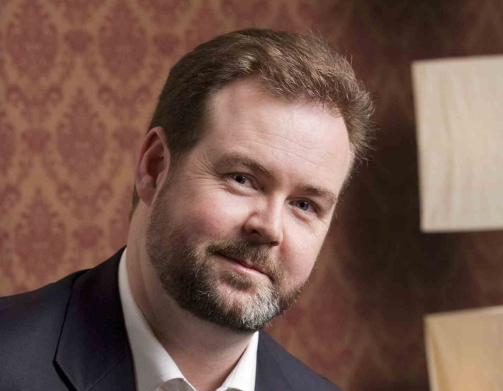
Welcome to the Short Course in Online Mentoring Topic 2 – Using the CMS
Presented by Brenton Burchmore
Agenda:
CMS and online content layout
Online forums and engaging the students
Content and resources
Official information

Slide 2
Areas of the CMS
Administration
About the relationship between student and faculty
Content
Resources
The knowledge of the subject and how to absorb it
The place for discussion and interaction
Assessment
Forums
Downloads, links, recordings and other references
Details about how to score marks in this subject

Slide 3
Online User Experience
The user experience is the total of the online interaction
Users have predictable behaviours we can follow
The patience threshold and decision making
Compartmentalisation, context and structure
The six-second rule of online interaction
Trust, clarity, assumption and contradiction

Slide 4
Online Interaction Cycle
One online session
A reason to log on to the CMS
Can I find what I am looking for now?
Distractions, opportunities and noice
Resolution or delay of the original need
This is the cycle of interaction when a student logs into a CMS. They begin with a reason or a need to fulfil. A lot depends on how long it takes them to find that.
Along the way they encounter distractions to their attention, or opportunities to solve other need they did not begin with.
Ultimately the original need is either met, or it is postponed due to a distraction or a failure to find it within the patience threshold

Slide 5
Topic Design
Learning Outcomes
Expectation of what this topic intends to do
Threshold Concepts
The biggest lessons this topic has
Guiding Questions
Helps to know when the topic is mastered
Observations
A simple task to demonstrate mastery
Task / Action
The main takeaway points from this topic

Slide 6
How Topics Work
The contextual breakdown of the subject
Constructivism and learning scaffolding
Logical flow and sequencing with assessments
Student self-checking and helpful guidance for it
The balance between stated content and referencing
Topic difficulty and student motivation/engagement

Slide 7
Topic Difficulty
Topics 1-3
Topics 4-6
Easy – help the student ease into the subject. Covers fundamentals and basic concepts that are built upon later
Topics 7-8
Topics 9-10
Easy – allowing that students lose motivation towards the end of the subject, so that it does not unfairly impact results
Medium – building upon the basics and leveraging early student motvation
Hard – the most challenging topics here that need a lot of preceding understanding for the student to master

Slide 8
Forums and Interaction
A place for important information & updates
A place to express and share ideas & opinion
The forum uses all forms of media direction
Push: to post important information
Pull: to provide reference info when needed
Interact: as a byway of sharing between students on a contextual basis
Collaborate: combining multiple input for a greater result

Slide 9
A Guideline for Forums
Compartmentalisation
Breaking down the discussions into separate areas
Contextualisation
Keeping things divided based on topic or other area
Provocative
Evoke reactions in students to trigger discussions & debates
Busy and Active
Keep the momentum, start a new discussion when needed
Open and Inviting
Encourage opinion and ideas rather than answers
Let Students Thrive
Do not take over or shut down student conversations

Slide 10
Task – Topic 2
Consider an online subject with which you are familiar
Review how the content is dispersed through the portal or CMS that it uses.
Examine the steps that a student would need to take to access various content elements within the portal.
Identify three changes you could make that would lower the barriers to engagement for a student of that subject.
Include in your revision how the forums could be better arranged to more clearly define the topics to make them easier for students to find/interact with.

Slide 11
Next Topic
Building Online Slide Decks
Online education slide deck defined
Artwork, style, theme & creativity
The practical learning tool
Structure and flow

