Slide 1
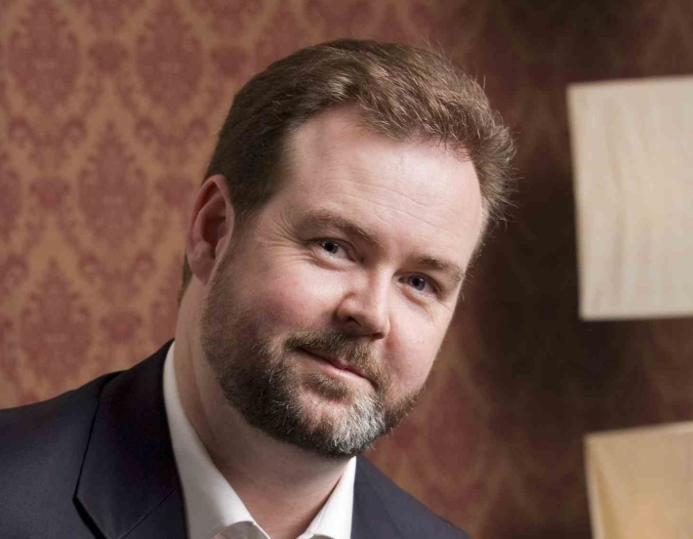
Welcome to the Short Course in Online Mentoring Topic 3 – Slide Decks
Presented by Brenton Burchmore
Agenda:
The online educational slide deck defined
Artwork, style, theme and creativity
The practical learning tool
Structure and flow

Slide 2
Online Learning Slides
Informational
Carry more information which must be converted into contextual knowledge
Internet-delivered
Study Aid
Need to be shared over weak internet links to dozens or even hundreds of people
Need to be used weeks later as a study aid to revisit parts of the webinar discussion

Slide 3
Key Attributes
Unlike corporate presentations, the slides are the star
Match pace with the discussion, but not BE the discussion
Contain low resolution images and graphics
Avoid animations, movement and live videos
Include pause points to encourage audience discussion
Roughly one slide per five minutes

Slide 4
Visual Characteristics
Artwork
Low-res, relevant and intellectual
Theme
Calming tones, medium colours, and solid plates
Style
Professional look low emotion & not dramatic
Creativity
Limited to the context of the topic it covers

Slide 5
Psychology of Slide Decks
For each point
Leap to assumptions about what is next
Quickly absorb the visual information
Compare visual with audio input & analyse
Decide the knowledge, its value & its use
The audience runs through a psychological cycle for each point that is presented during the slide presentation
They guess, they look, they listen, then they decide and judge. The slides are the leading force in this final outcome

Slide 6
Deck Structure
Opening with expectations and broad agenda
Begin with admin information, progress updates & news
Interlude with a poll, and interject with opinion questions
Include a discussion on the topic task
Conclude with a reference to the threshold concepts

Slide 7
Primacy & Recency
Viewers remember best what they just saw
The most recent information is best recalled immediately afterwards.
The most heavily discussed information is considered the most important.
Information that is repeated has the best long term recall.

Slide 8
Primacy & Recency
Recency - we remember best what we just saw
Primacy – we value most what we discuss most
The balance between primacy and recency
Finish each slide on the most important point
Finish each section on the most important concept
Finish the slide deck with the threshold concepts

Slide 9
Task – Topic 3
Consider a slide deck you have seen or built that was used for a live presentation
Review the differences and influencing factors that defined that slide deck for its intended purpose and audience.
Redesign that slide deck into a format to be used as an aid for an online webinar.
Try to retain as much of the original message as possible, but in the context of a learning experience.

Slide 10
Next Topic
Online Webinars
Webinar Basics
Sequencing the webinar
Persona and Delivery
Using the online tools

