Slide 1
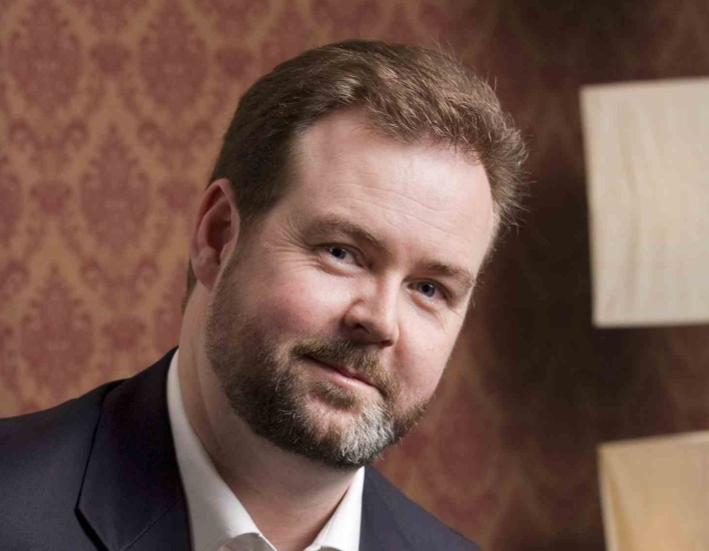
Welcome to the Short Course in Online Mentoring Topic 4 - Webinars
Presented by Brenton Burchmore
Agenda:
Webinar basics
Sequencing the webinar
Persona and delivery
Using the online tools

Slide 2
Relevant Webinar Factors
Sequencing
The flow or sequence of the discussion, how and when each element appears during the webinar
Tools
The software and systems, and how they are used and configured to help run the webinar
Presenter
That is you – the person who they are listening to, learning from and following

Slide 3
Sequencing
Admin
Any non-content material and info that they need
Early Concepts
The important ideas that need to be mastered
Response
Opportunities for them to reply and participate
Wrap-up
What they should remember the most afterwards

Slide 4
Presenter’s Persona
You are the representative of the content
Show your enthusiasm and pleasure in presenting it
Be human, do not worry about problems or errors
Show respect to all of the students and their input
Follow up later on anything you do not know at the time
It is not about you, it is about the content

Slide 5
Webinar Cycle
The Webinar sequence
Set expectations and resolve admin
Deliver initial content
Create chances to share and express
Wrap up with key points or important info
Each webinar will go through a cycle of expectation and delivery. Each slide goes through a mini version of this same cycle
Students will come to expect this and will tune in to the correct moments to fill their knowledge gaps

Slide 6
Using the Tools
The webinar software is for interaction, not broadcast
Include their comments in the shared window
Use polls to create collective input moments
Record each webinar, making sure to do that first!
Be careful when giving mic access to students
Pause screen sharing whenever you need to

Slide 7
Student Engagement
Students will take their cue from you on how to react to the content
Show enthusiasm to encourage theirs.
Create importance for the content by showing how it works in general daily activities.
Allow students to encourage each other by seeing each others comments as they go.

Slide 8
Answers vs Opinions
Answers can be wrong, do not need discussion
Opinions are never wrong, & encourage debate
The balance between answers and opinion
Answers are absolutes that end discussion
Opinions are variables that create discussion
Answers have risk that they might be wrong
Opinions are risk free and always allowed

Slide 9
The Webinar Rules
Be human
Be yourself and allow the students to see the real you
Be honest
Don’t hide or cover things up, deal with things as they are
Be personal
Share thoughts or experiences that have meaning to you
Be passionate
Show the students your enthusiasm for teaching the subject
Be adaptable
Be free to divert from plan A when a new path is interesting
Be grounded
Position yourself on equal terms with your students

Slide 10
Task – Topic 4
Review the recording of an online learning webinar
Consider the way in which it was conducted and how well it benefited from the content in this topic.
Define which areas of the delivery could be improved for better results, or better engagement.
Consider how you can incorporate those improvements into your next webinar.

Slide 11
Thank you for attending!

