Slide 1

Developed by Team XENO

Slide 2
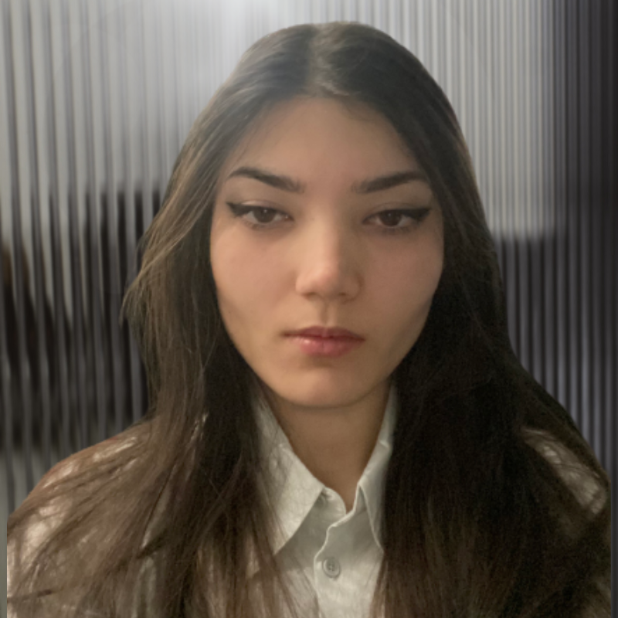

Meet Team XENO
We have a passion for developing startups that solve real world problems.
Briana Burton
Sunraj Sharma
Software Developer & UI/UX Designer
Software Developer & Business Strategist
brianareburton@gmail.com
sunraj751@gmail.com

Slide 3




The Problem
Students face difficulty accessing health care covered by insurance.
Students are at the mercy of their therapists schedule.
Students are left without care, delaying treatment, or paying out-of-pocket for services they should be covered for.
Rate of International Students Knowledgeable of the Canadian Health Care System
Source: University of Alberta

Slide 4

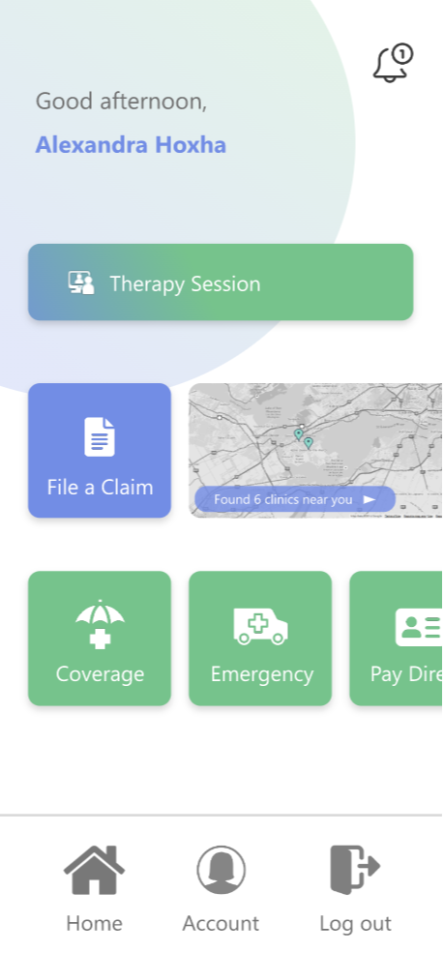



The Solution
Addresses the problem by finding and connecting students with in-network providers or therapists covered by their insurance.
Free preliminary self-diagnosis feature that allows students to enter their symptoms and receive a preliminary diagnosis based on a trained AI model.
Built-in map that finds transportation to nearby hospitals, walk-in clinics, dentists and therapists that are covered under the student’s insurance policy.

Slide 6





Feasibility
The healthcare market in Canada is worth around 310 Billion dollars.
HERE4U saves costs for insurance companies and colleges by removing the need to partner with multiple firms.
MVP would be hosted using Azure. It would be built in .NET MAUI (C#) and MySQL.
Percentage-based fee on each appointment booked through our platform that is covered by insurance providers.
Rate of Canadians Satisfied with their Access to Healthcare
Source: CBC News

Slide 7

Commitment
Both Sunraj Sharma and Briana Burton will be able to attend on May 6th In-person.
We both provide media consent
We would be able to show a functional and interactive mock-up of the app and provide buisness cases.

