Slide 1
A note on the CDR Presentation
You are presenting to a non-technical audience
Do not use words that non-electrical engineers would not understand
Examples: Op-amp, voltage-divider, interrupt service routine, special function register
Use simplified diagrams
An op-amp is familiar to us, but you can make it into a box labeled “amplifier”
If necessary, explain things using examples that anyone could understand
Diagrams are better than words. Pictures are even better.
You have 12 minutes.
It will go by quicker than you think.
Be prepared for questions afterwards.

Slide 2
Team WeDidTheThing!
Team 217
Brett Bushnell
Sydney Clark
Matt Dzurick
Ryan Trumpinski

Slide 3
Outline
Requirements
Approach (A high-level description of your whole approach)
Hardware
Software
Deliverables/Conclusion

Slide 4
Requirements

Slide 5
Requirements
Part 1:
Robot has to follow the line
Part 2:
Our sensor has to work
Part 3:
Get points!

Slide 6
Approach

Slide 7
Approach
Our strategy is to keep getting the most points we can by following the smallest triangles.
Our teammates will take care of the rest.
We will use three IR sensors that have enhanced sensitivity
Also our software has a cool path-finding algorithm
Our motion sensor will help us avoid other robots
…and hopefully it will not see “ghost” robots.

Slide 8
Approach
Easy to understand diagram of the proposed robot.

Slide 9
Hardware

Slide 10
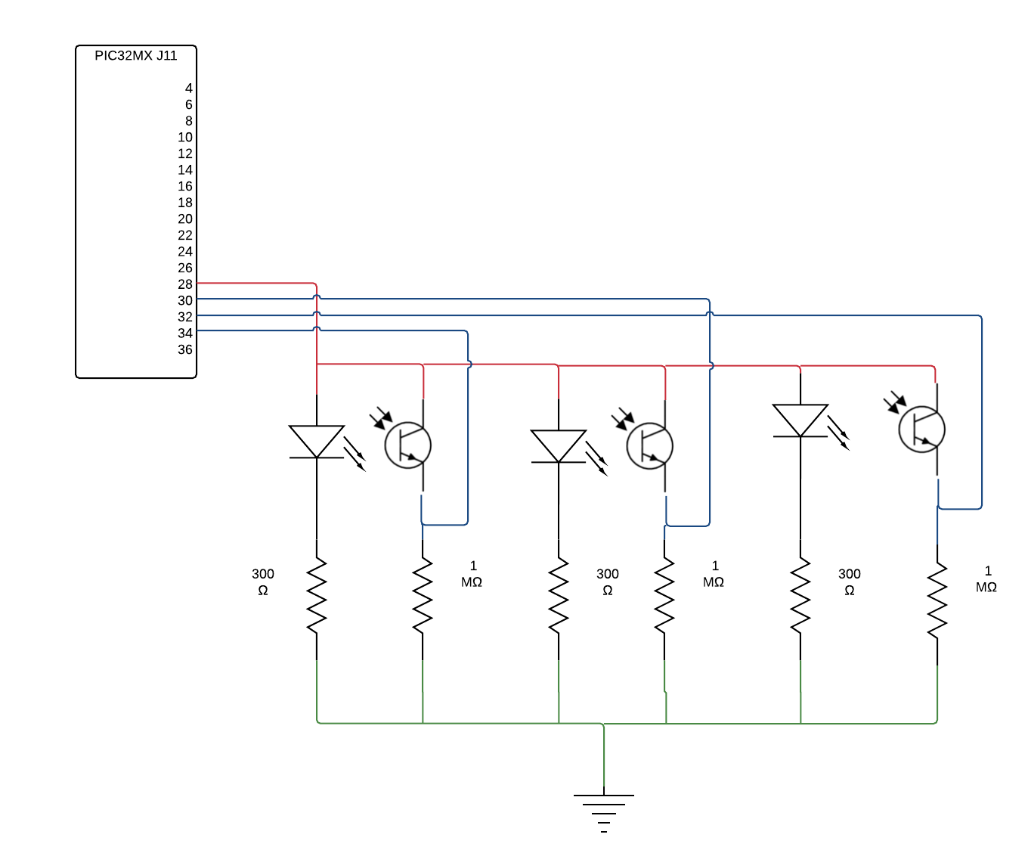
IR Circuit
Our IR circuit uses a phototransistor to tell the difference between “tape” and “no-tape.”
Here is a diagram of a basic circuit

Slide 11
Motor Control
We use a special amplifier called an H-bridge to power the motors
We will power this with an external power source to save energy
Yes, it will weight the robot down. No, it is not a huge problem.
Here is a diagram
We will also use a special device to count how many times the wheel spins
This gives us very precise control of the wheels

Slide 12
Covering
We also added some covering to our robot.
It shields the connections on the robot

Slide 13
Software

Slide 14
Following the Line
We will use a finite-state machine to describe our software.
Here is a simplified version of our wheel-following state machine

Slide 15
Motion Sensor
The motion sensor will trigger a software event
The robot basically does a circle
Here’s a diagram

Slide 16
Pathfinding
Basically, our robot does a zig-zag until it finds the line
Here’s a diagram

Slide 17
Deliverables/Conclusion

Slide 18
Deliverables
This is what this project will leave behind for others
Or to the instructor
Examples are: packaged source code, documentation, video explanation, etc..

Slide 19
Conclusion
Here is our approach again
It will work because it is simple
Thank you for listening

