Slide 1
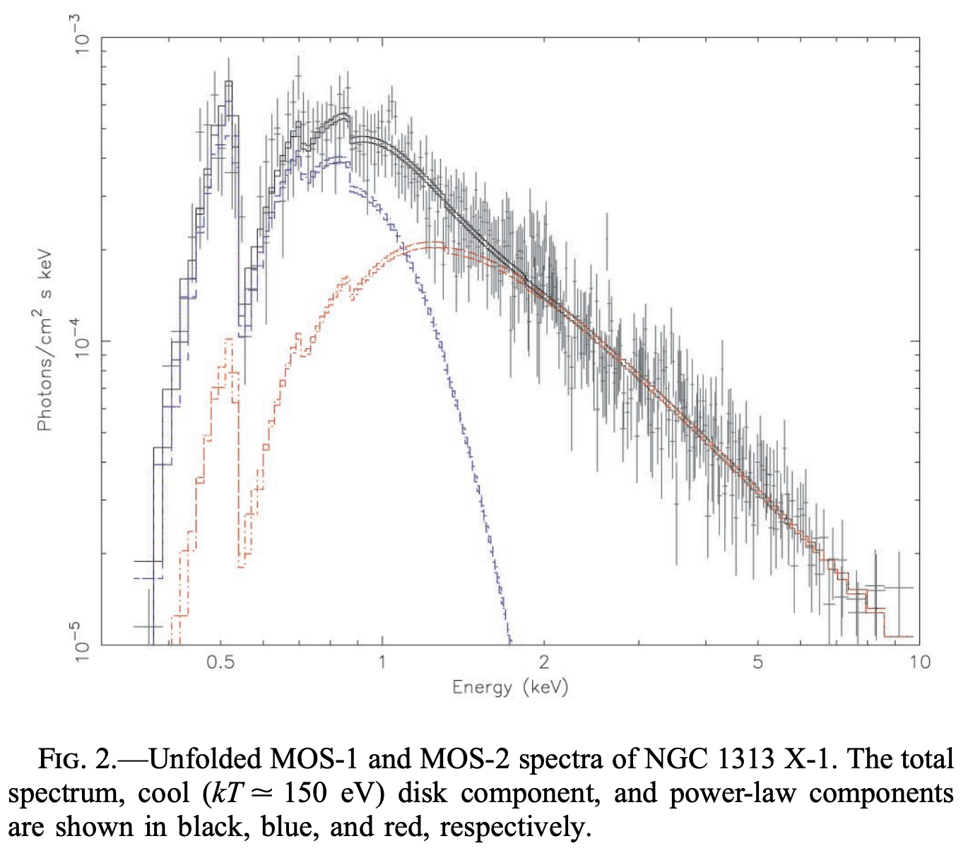
X-ray Spectroscopic Evidence For Intermediate-mass Black Holes: Cool Accretion Disks In Two Ultraluminous X-ray Sources
Miller, J.M. et al. 2003, ApJ, 585, L37

