Slide 1

INVESTOR PROTOTYPE
Rights-cleared physical work data for robotics
JULY 2026

Slide 2
THE BOTTLENECK
02
Robotics has a data mismatch
WHAT PEOPLE DO
WHAT ROBOTS NEED
Egocentric
video
≠
Action, state, rights, evaluation
Rich behavior, but no robot state or control signal.
A traceable episode that a buyer can train on, audit, and measure.
01
NO CALIBRATION
02
NO RIGHTS LINEAGE
03
NO ACCEPTANCE TEST
Camera motion rarely maps to the body or scene.
Consent and property permissions rarely follow each clip.
Video quantity says little about model lift or task success.
NVIDIA GR00T documentation; OECD AI capability indicators, 2026
WORKTRACE / 02

Slide 3
THE PRODUCT
03
WorkTrace is a trace compiler
It converts authorized work into a buyer-ready chain of evidence.
01
02
03
04
05
06
1
2
3
4
5
6
→
→
→
→
→
AUTHORIZE
CAPTURE
SEGMENT
VERIFY
RELEASE
EVALUATE
Worker, site, purpose
RGB, IMU, markers
Actions and corrections
State, success, quality
Mask, rights, lineage
Buyer acceptance test
OUTPUT
One accepted episode. Every claim carries evidence.
Human behavior data for pretraining, planning, perception, navigation, and evaluation. Robot-transfer claims require richer signals.
WorkTrace prototype architecture, July 2026
WORKTRACE / 03

Slide 4
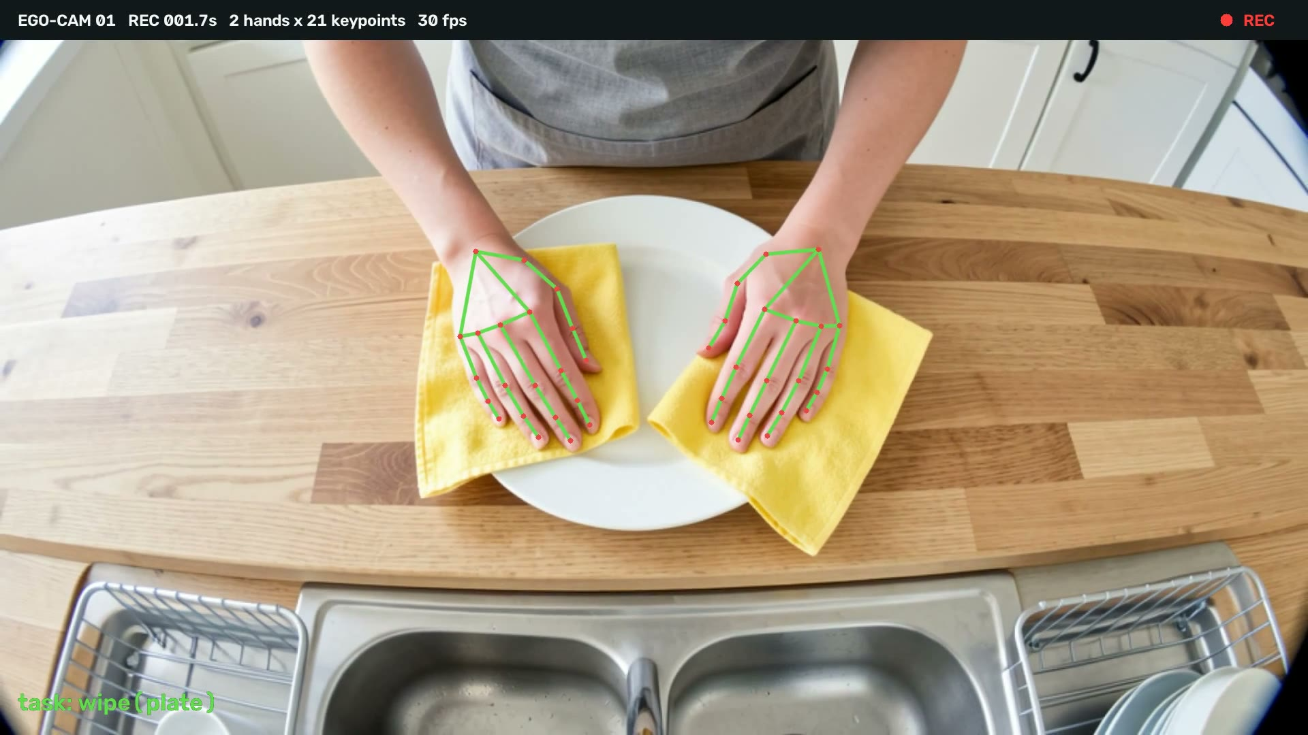
BUILT, NOT PROMISED
03A
The prototype already runs
Working software, purchased hardware, and a narrated film, all live as of July 17, 2026.
01
Live capture prototype
Browser app with MediaPipe hand tracking, task labeling, QA stats, episode export. Deployed on Cloudflare.
02
Cinematic landing site
WebGL particle experience plus the interactive WorkTrace trace console.
03
Offline pipeline
Hand tracking to parquet, task segmentation, QA acceptance gate, LeRobot-style export, CI fixture.
04
Ingest backend + field app
FastAPI presigned R2 uploads with manifest queue; Flutter capture app reference.
Real POV capture with live 21-landmark tracking
05
Bench hardware in hand
Cased ELP 1080P UVC camera, USB-C OTG, hat brim clip. $45 to $58 core kit.
06
Narrated explainer film
103 seconds, real POV footage with live tracking overlays.

Slide 5
ENTRY WEDGE
04
Vacant-home staging is unusually data-dense
It combines real residential complexity with lower bystander exposure and clear completion states.
LOWER PRIVACY
CEDAR HOUSE 014
01
Vacant spaces reduce faces, children, personal documents, screens, and resident audio.
One job.
Six task families.
BIMANUAL TASKS
02
Carry, unpack, assemble, place, align, correct, inspect, and remove.
CLEAR STATES
UNPACK
CARRY
ASSEMBLE
03
task episode
task episode
task episode
Empty room to staged room creates observable before, after, success, and correction events.
PLACE
CORRECT
INSPECT
OPERATING ACCESS
task episode
high-value recovery
task episode
04
Stagers already schedule crews, properties, supervisors, routes, and equipment.
WorkTrace proposed staging program; risk analysis is a planning judgment
WORKTRACE / 04

Slide 6
SELLABLE UNIT
05
The dataset is more than video
Every accepted episode carries six synchronized layers.
01
SENSORS
03
STATE
RGB, timecode, IMU, calibration
Before, after, success, correction
ACCEPTED
EPISODE
02
TASK
trace_id: CH014-0082
04
RIGHTS
Instruction, action, object, room
Worker, property, purpose, retention
05
QUALITY
06
EVALUATION
Coverage, blur, occlusion, timing
Buyer score, rejection reason, lift
Proposed WorkTrace episode schema; buyer specification required before capture
WORKTRACE / 05

Slide 7
WHY NOW
06
Demand is visible. Generality is not solved.
The strongest opportunity is the picks-and-shovels layer, not a bet on one humanoid forecast.
IFR
NVIDIA
CAPGEMINI
IFR SERVICE
621K
32K H
58%
>25K
industrial robots installed in 2025, preliminary
real demonstrations and human egocentric data used in GR00T 1.7 pretraining
of surveyed executives cited humanoid training challenges
professional cleaning robots sold in 2024, up 34%
FORECAST DISCIPLINE
2030 humanoid forecasts span <1M to >6M annual units.
WorkTrace can win if buyer models need better data. It does not require the biggest robot forecast to be right.
IFR 2026 preliminary; NVIDIA GR00T 1.7, Jul. 7, 2026; Capgemini, Apr. 2026; BCG, Apr. 2026
WORKTRACE / 06

Slide 8
COMPETITIVE TRUTH
07
The category is validated, and crowded
The pitch cannot be that WorkTrace invented human demonstration data.
COMPANY
OFFER
PUBLIC SIGNAL
WHAT IT PROVES
POSEIDON
Licensed household first-person video
$15M seed
Category validation
MOVO
Managed household capture in Colombia
$25 / $55 / $95 per hour
Price anchor
XDOF
Bimanual robot teleoperation data
130K open episodes
Robot-native signal
FIGURE
Property partnership and human video
100K+ homes
Access at scale
WORKTRACE DIFFERENTIATION
Vacant-home workflow access + fair worker economics + rights lineage + evaluation-grade packaging
No uniqueness claim. Win through a sharper wedge and buyer-measured lift.
Company claims: Poseidon, MoVo, XDOF, Figure. Scale and customer statements are not independently verified.
WORKTRACE / 07

Slide 9
BUSINESS MODEL
08
Sell the specification before scaling capture
A demand-first ladder keeps service subsidies from outrunning data value.
01
02
SPEC SPRINT
03
PAID PILOT
04
2 weeks
TASK PACK
50 to 100 h
PROGRAM
$15K to $30K
500 to 2,000 h
$6K to $20K
Annual
$50K to $250K
Task ontology + acceptance test
$250K+
Buyer-reviewed accepted hours
Rights-cleared custom dataset
Recurring tasks + repeat licenses
PUBLIC PRICE ANCHOR
$25 RAW
$55 QA
$95 LABELED
WorkTrace planning range: $95 to $125 per accepted hour
MoVo advertised asking prices, not verified transactions. Premium depends on task specificity, rights, calibration, and evaluation.
MoVo public pricing accessed Jul. 17, 2026; all WorkTrace prices are planning assumptions
WORKTRACE / 08

Slide 10
UNIT ECONOMICS
09
Measure profit per accepted hour
Cheap collection is irrelevant if footage fails buyer acceptance.
COGS / ACCEPTED HOUR
loaded raw-hour cost ÷ accepted yield + QA and compliance + platform
Workers are paid for scheduled time, even when footage is rejected.
LOADED RAW HOUR
ACCEPTED YIELD
QA + RIGHTS
PLATFORM
$14
80%
$18
$8
fair pay + partner + field ops
usable after privacy + quality
per accepted hour
storage + delivery
MEXICO PLANNING CASE
$95 price − $43.50 COGS = $51.50 contribution
54% contribution margin
Excludes engineering, legal, sales, tax, and corporate overhead.
Illustrative planning model; Mexico field inputs informed by 2026 wage, FX, and employer-cost sources
WORKTRACE / 09

Slide 11
COUNTRY PORTFOLIO
10
Sequence for data value, not wage arbitrage
Risk combines privacy, cross-border transfer, operating control, and worker-power concerns.
HIGHER DATA VALUE
1
US
PROVE
reference-quality staging
VN
MX
IN
2
REPLICATE
US
nearshore staging
MX
CO
3
PILOT
CO
hospitality turnover
4
IN / VN
BUYER-LED
PH
assembly and industrial tasks
5
PH
QA-FIRST
annotation before capture
LOWER EXECUTION RISK
HIGHER RISK
Risk and data-value scores are WorkTrace planning judgments, not third-party ratings
WORKTRACE / 10

Slide 12
COUNTRY SCENARIOS
11
Contribution on 1,000 accepted hours
Same formula, task-specific prices. Profit shown before central overhead.
COST + CONTRIBUTION
REVENUE / GM
US
Home staging proof
$85,667 COGS
$39,333 GP
$125,000 / 31%
MX
Staging and furniture placement
$43,500 COGS
$51,500 GP
$95,000 / 54%
CO
Hospitality turnover
$43,949 COGS
$51,051 GP
$95,000 / 54%
IN
Controlled assembly
$39,667 COGS
$55,333 GP
$95,000 / 58%
VN
Industrial kitting
$42,854 COGS
$67,146 GP
$110,000 / 61%
PH QA-FIRST: 5,000 reviewed raw hours | $225,000 revenue | $90,000 contribution | 40% margin
All prices, yields, and costs are planning assumptions. MoVo public asking prices provide the external anchor.
WORKTRACE / 11

Slide 13
MEXICO LAUNCH CASE
12
Nearshore staging, formal jobs, tight controls
Recommended first international market after a United States buyer-approved proof.
1,000 ACCEPTED HOURS
WAGE FLOOR
OFFICIAL FX
MXN 315.04 / day
17.4418 MXN / USD
$95,000
2026 general zone
July 17, 2026
planned buyer revenue
$43,500
WORKER CASH PAY
LAUNCH DESIGN
capture, QA, rights, platform COGS
MXN 80 to 100 / h
20 to 30 employees
$51,500
proposed, about 2.0x to 2.5x floor equivalent
Mexico City or Guadalajara, vacant sites
54% contribution margin
CONTROL FLOOR
Formal employment, written consent, property release, audio off, worker-paid rejection time
Before central engineering, legal, sales, tax, and corporate overhead.
STPS wage announcement; DOF FX, Jul. 17, 2026; LFPDPPP; WorkTrace pay and cost assumptions
WORKTRACE / 12

Slide 14
OPERATING LANES
13
Four countries, four different jobs
International expansion should add task diversity and operating leverage, not erase worker protections.
PILOT
BUYER-LED
BUYER-LED
QA-FIRST
COLOMBIA
INDIA
VIETNAM
PHILIPPINES
Hospitality turnover
Controlled assembly
Industrial kitting
Annotation and QA
CURRENT FACT
CURRENT FACT
CURRENT FACT
CURRENT FACT
COP 2.0M monthly wage package
INR 549 urban casual day average
VND 17.8K to 25.5K hourly floor
PHP 695 NCR daily floor on Jul. 17
OPERATING RULE
OPERATING RULE
OPERATING RULE
OPERATING RULE
Express authorization + structured transfer role
DPDP rules under phased implementation
Local raw vault + transfer assessment
Counsel confirms body-camera application before capture
$51,051 contribution / 1K h
$55,333 contribution / 1K h
$67,146 contribution / 1K h
$90,000 contribution / 5K QA h
Country wage and privacy sources: official agencies listed in appendix. Economics are WorkTrace assumptions.
WORKTRACE / 13

Slide 15
FINANCIAL SCENARIOS
14
Profit is possible, but not automatic
Three planning cases show how buyer adoption, yield, pricing, and repeat licensing change the outcome.
DOWNSIDE
BASE
UPSIDE
$3.2M
$7.8M
$14.0M
Y3 revenue
Y3 revenue
Y3 revenue
$-1.6M
Y3 EBITDA
$0.5M
Y3 EBITDA
$3.4M
Y3 EBITDA
32% gross margin
46% gross margin
55% gross margin
BASE CASE PATH
YEAR
REVENUE
GROSS MARGIN
GROSS PROFIT
OPEX
EBITDA
Y1
$0.5M
22%
$0.1M
$1.4M
$-1.3M
Y2
$2.3M
38%
$0.9M
$1.9M
$-1.0M
Y3
$7.8M
46%
$3.6M
$3.1M
$0.5M
Illustrative planning scenarios only. No historical revenue, customer count, or financial guidance is claimed.
WORKTRACE / 14

Slide 16
MARKET SIZING
15
Use buyer behavior, not a giant robot TAM
There is no audited market size for rights-cleared embodied-AI data. Build it from explicit spend assumptions.
40
6
2,000
$100
=
×
×
×
target buyers
task packs / buyer / year
accepted hours / pack
average price / hour
$48.0M
SERVICEABLE ANNUAL SPEND
Y3 BASE SOM
$48.0M
$7.7M
Planning case across 40 named target buyers. Not a published market forecast.
16 buyers × 6 packs × 800 accepted hours × $100
Rounded to $7.8M in the base financial scenario.
Bottom-up inputs are WorkTrace planning assumptions. Robot forecasts are context, not the spend calculation.
WORKTRACE / 15

Slide 17
GO TO MARKET
16
Customer money first
Do not make staging free until buyer acceptance and repeat value are measured.
1
2
3
4
0–60 DAYS
60–120
4–9 MONTHS
9–18 MONTHS
SPEC
PILOT
REPLICATE
PROGRAM
Interview 15 robotics teams. Sell one task specification sprint.
Collect 50 to 100 accepted staging hours with a small United States cohort.
Run one Mexico staging pilot against the same blind acceptance test.
Expand one task family, then add Colombia or an Asia buyer-led lane.
GATE: signed acceptance schema
GATE: paid buyer review
GATE: quality parity + margin
GATE: repeat order or LOI
NO FREE SERVICE DEFAULT
Partner subsidy + separate worker premium first. Test free staging only as a capped acquisition experiment.
Recommended commercialization sequence based on current public pricing and competitive evidence
WORKTRACE / 16

Slide 18
CAPITAL STRATEGY
17
Raise after demand evidence
Illustrative $2.0M pre-seed, only after a paid pilot or buyer LOI.
MILESTONES BEFORE THE NEXT ROUND
$2.0M
1
3 paying robotics or embodied-model buyers
18 months of runway
2
2 repeatable task specifications with buyer acceptance tests
35%
Platform and data operations
3
Mexico quality parity to the United States reference set
30%
Collection pilots
4
Complete rights manifests and auditable deletion workflow
20%
Buyer and partner development
5
Repeat order, exclusivity premium, or measured model lift
15%
Privacy, security, and legal
START WITH ONE TASK. PROVE ONE TRACE.
Illustrative capital plan. No fundraising outreach or investor commitment is represented.
WORKTRACE / 17

Slide 19
APPENDIX
18
Source book and modeling rules
Links are current through July 17, 2026. Company-reported figures are identified as such.
ROBOTICS + COMPETITION
COUNTRY INPUTS
1. IFR 2025 preliminary installations
10. Mexico wage and labor
2. IFR World Robotics 2025
11. Mexico official FX
3. IFR Service Robots 2025
12. Mexico private-sector privacy law
4. NVIDIA GR00T 1.7 data workflow
13. Colombia wage
5. Google DeepMind Open X-Embodiment
14. Colombia official FX data
6. OECD manipulation capability
15. Vietnam 2026 wage floors
7. Capgemini physical AI survey
16. India PLFS 2025
8. MoVo public pricing and company claims
17. Philippines NCR wage
9. Poseidon company announcement
18. Philippines NPC body-camera guidance
MODELING RULES
Facts and assumptions are separated. Accepted-hour COGS includes rejection yield. Workers are paid for scheduled time. Country profit excludes central overhead. Financial cases are planning scenarios, not guidance.
WorkTrace investor prototype, July 17, 2026
WORKTRACE / 18

