Slide 1






Slide 2

VACCINE STORAGE SOLUTIONS
FOR TROPICAL
CLIMATES
DR. KEMI AILOJE B.Pharm, MBBS, M.Sc.
PRESIDENT, CEO
DIVAF
Dr.Kemi.Ailoje@Divaf.org
PROFESSSOR ‘FOLA TAYO B.Pharm, PhD.
CHAIRMAN, BOARD OF TRUSTEES
DIVAF
Prof.Fola.Tayo@Divaf.org

Slide 3

Internal temperature distribution for maintenance of vaccines is critical to maintain the effectiveness of the active agent, the proteins or amino acid chains. These chains are structured in a curled configuration during vaccine preparation at the lab. This structure is crucial to their effectiveness.
The curled configuration of the amino acid chains are maintained by a weak electrical bond. If the temperature is too warm, small amounts of heat energy break this bond and change the configuration to a different structure. This renders the vaccine ineffective.
If the temperature is too cold, it alters the surface of the amino acid chain and dilutes the effectiveness of the vaccine as a function of the altered surface area. In either case, too warm or too cold, the chemical reaction is not reversible.

Slide 4
The maintenance of the vaccine within a closely defined temperature range between vaccine preparation and vaccine administration is a critical factor in the effective use of this medical tool. The entire preparation and distribution effort can be wasted simply due to failure to maintain proper temperature control over the vaccine during this intermediary process.
VACCINES MUST BE STORED AT A SECURELY DEFINED TEMPERATURE RANGE NO COOLER THAN 2⁰ C, AND NO WARMER THAN 8⁰ C.

Slide 5
VACCINE PREVENTABLE DISEASES CONTRIBUTE SIGNIFICANLY TO UNDER-5 MORTALITY AND MORBIDITY
ANY SUCCESS RECORDED AT THIS LEVEL WILL CONTRIBUTE TOWARD REDUCING CHILD MORTALITY (GOAL 4 OF MDGs)
DIVINE AMBASSADORS' FOUNDATION (DIVAF)
HAS A BURDEN TO REDUCE THESE PREVENTABLE DEATHS BY PROFFERING SOLUTIONS TO VACCINE COLD-CHAIN STORAGE AND SUSTAINABLE LOGISTICS IN THE TROPICS WITH ITS PARTNER, SUNDANZER (USA)

Slide 6
VACCINE STORAGE SOLUTIONS FOR TROPICAL CLIMATES
TARGETED RESULT
PROVIDE STORAGE CAPACITY FOR VACCINE
STABILIZED IN THE RANGE OF 2⁰ C TO 8⁰ C
UNDER CONDITIONS OF DESIGN CRITERIA

Slide 7
VACCINE STORAGE SOLUTIONS FOR TROPICAL CLIMATES
DESIGN CRITERIA
ELECTRICAL POWER
NONE AVAILABLE
INTERMITTENT WITH POOR QUALITY
OPERATIONS PERSONNEL
MINIMAL TECHNICAL TRAINING
MAINTENANCE REQUIREMENTS
NONE
SERVICE LIFE
15+ YEARS

Slide 8
VACCINE STORAGE SOLUTIONS FOR TROPICAL CLIMATES
CONFORMANCE STANDARDS
WHO/PQS/E03/RF05.1
SOLAR DIRECT DRIVE WITHOUT BATTERY STORAGE
DESIGN PARTNERS
PATH
DIVAF
LAGOS, NIGERIA

Slide 9
AN EFFECTIVE SOLUTION REQUIRES A CLEAR DEFINITION OF THE PROBLEM
AND
ENSURES THE SOLUTION TO ONE PROBLEM DOES NOT CREATE ANOTHER PROBLEM
THE SOLUTION MUST FIT SEAMLESSLY INTO THE EXISTING ENVIRONMENT
WITHOUT
DEPENDING ON A CHANGE IN ENVIRONMENTAL FACTORS

Slide 10
DIVAF HAS WORKED WITH SUNDANZER DEVELOPMENT TO DEVELOP A SOLUTION TO VACCINE STORAGE IN TROPICAL CLIMATES
WE HAVE EMPLOYED THERMAL MEMORY TECHNOLOGY ORIGINALLY DEVELOPED BY NASA AS A SOLUTION FOR REFRIGERATION IN REMOTE ENVIRONMENTS
THERMAL MEMORY TECHNOLOGY STORES THERMAL ENERGY USING PHASE CHANGE CHEMISTRY THUS REMOVING THE USE OF A BATTERY AND CHARGE CONTROLLER FOR PHOTOVOLTAIC POWERED REFRIGERATION APPLICATIONS
THIS REMOVES THE PRIMARY FAILURE POINTS AND MAINTENANCE ITEMS IN A TYPICAL SOLAR POWERED REFRIGERATION SYSTEM

Slide 11

DAVID BERGERON PE
PRESIDENT / CHIEF SCIENTIST – SUNDANZER DEVELOPMENT, INC.
Active in the refrigeration and aerospace industries for 23 years. He holds three refrigeration patents, and three spacecraft patents, and is the founder of SunDanzer. Mr. Bergeron has served as the lead engineer on a satellite with a capillary pump loop cooling system, the lead engineer and project manager for the Lunar habitat solar power heat pump demonstration test article development, and was the technical lead for NASA's Advanced Technology Refrigeration project, developing, testing, and evaluating thermoelectric, Stirling, and variable speed vapor compression cycle technologies. He is currently developing a solar powered, high efficiency refrigeration system for mobile terrestrial applications with Department of Energy support.
Mr. Bergeron has a BS in Mechanical Engineering and an MS in Finance.

Slide 12
BILL BARG PE
SENIOR MECHANICAL ENGINEER – SUNDANZER DEVELOPMENT, INC.
16 years of experience in design, analysis and project management. He has worked in diverse international engineering environments, with experience in multimillion dollar project management and directing engineering product design groups. His expertise is taking a project from conception to commissioning inside of tight schedule and budget constraints. Mr. Barg most recently worked as the Lead Mechanical Engineer for the Australian Synchrotron, where he was responsible for design and installation cooling systems for high heat load particle accelerators, among other responsibilities. He has also designed and installed water and liquid nitrogen cooled precision, opto/mechanical systems at synchrotrons in Brazil, Canada and in the United States.
Mr. Barg has a BS in Mechanical Engineering and a BA in Spanish with a minor in Portuguese.

Slide 13
TROPICAL CLIMATE VACCINE STORAGE PROJECT SCOPE
BULK REGIONAL DISTRIBUTION
Containerized refrigeration units for bulk transport of vaccines
URBAN MEDICAL CENTER STORAGE
Permanent refrigerated storage capacity for larger urban medical centers
CLINIC STORAGE
Mid-size permanent refrigerated storage for use at regional medical centers
HAND PORTABLE STORAGE
Distribution to point of use

Slide 14
THE FOCUS OF INITIAL DEVELOPMENT IS THE MID-SIZE CLINIC STORAGE FOR PERMANENT REFRIGERATED VACCINE STORAGE AT REGIONAL MEDICAL CENTERS

Slide 15
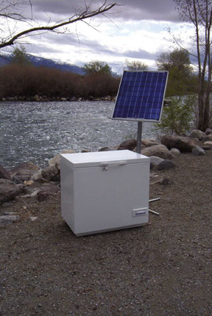
Secure Temperature Range 50 Liter
DIRECT DRIVE PHOTOVOLTAIC
AND/OR
AC GRID OR GENERATOR POWER THROUGH RECTIFIER
AND/OR
OTHER 12 V DC POWER
SOURCE

Slide 16
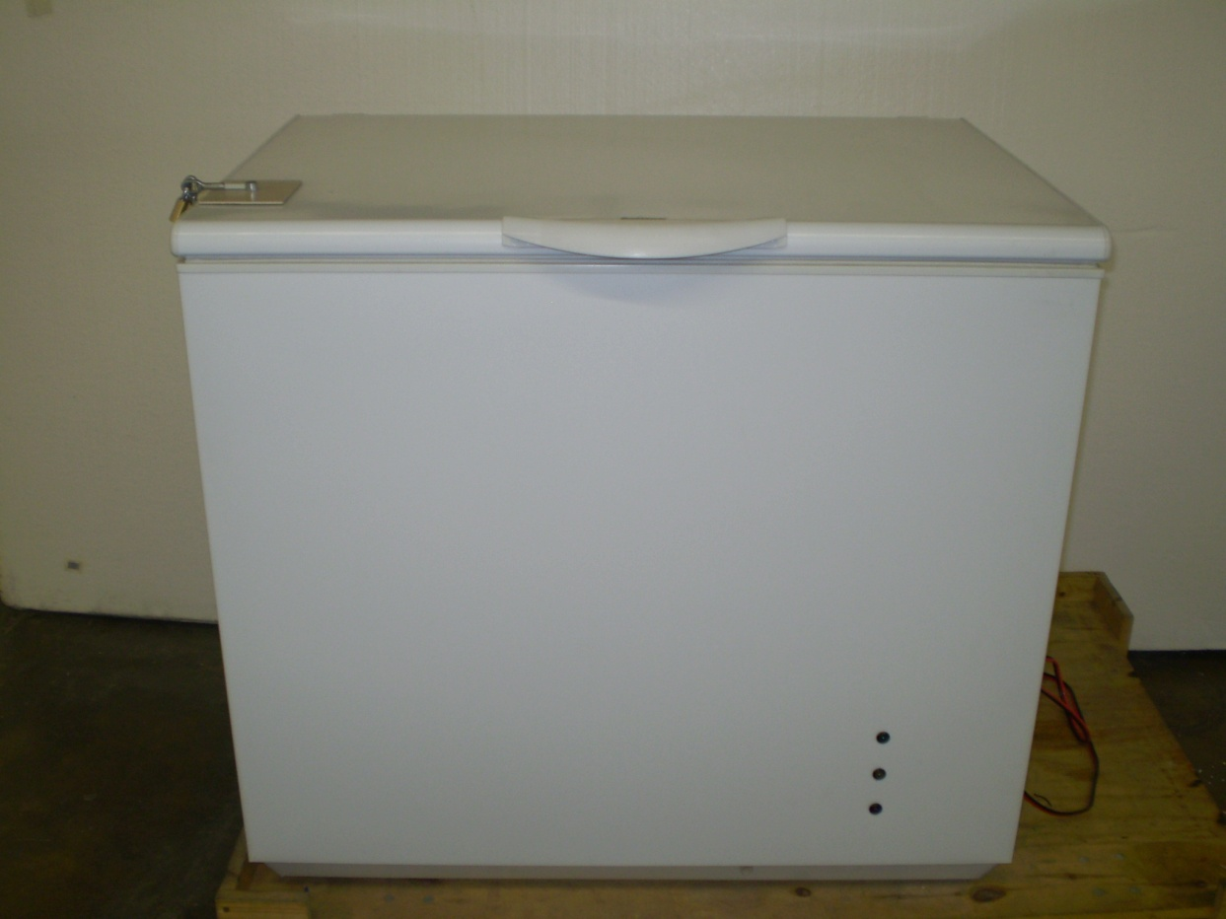
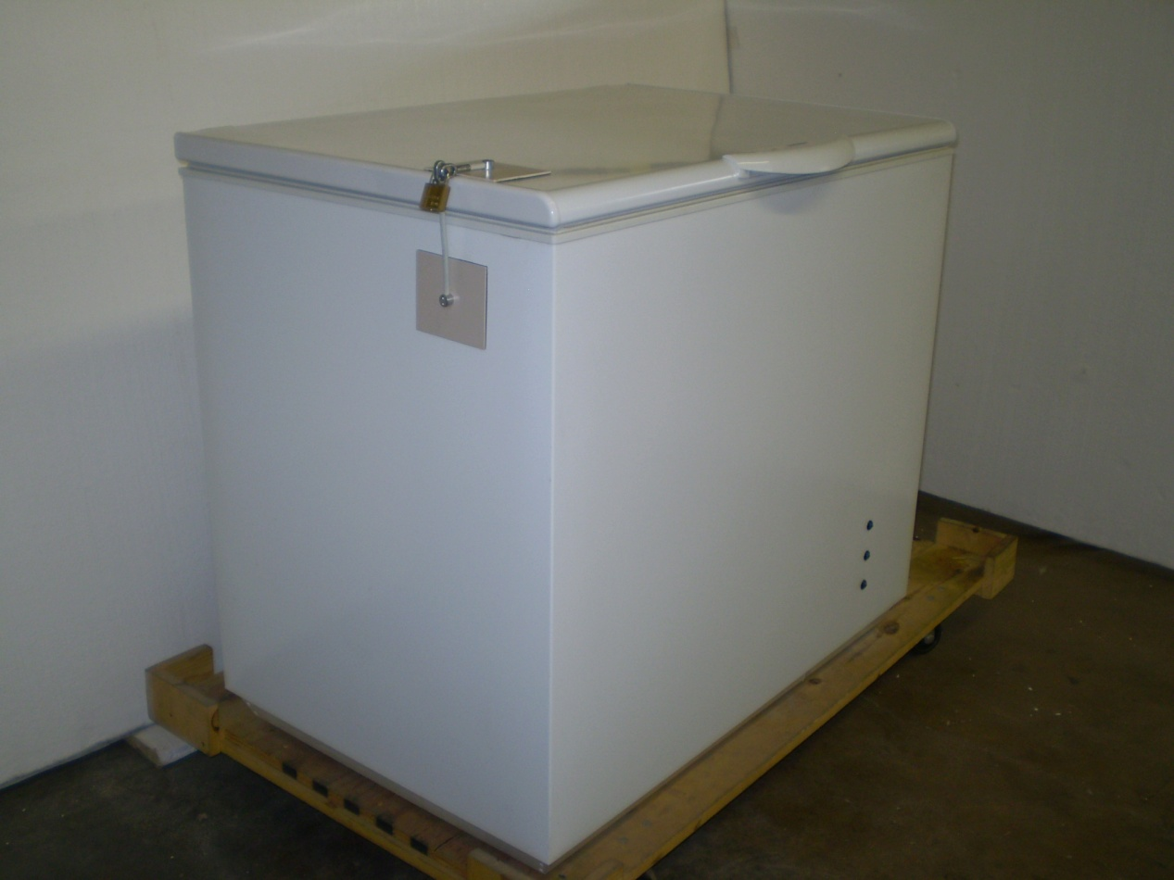
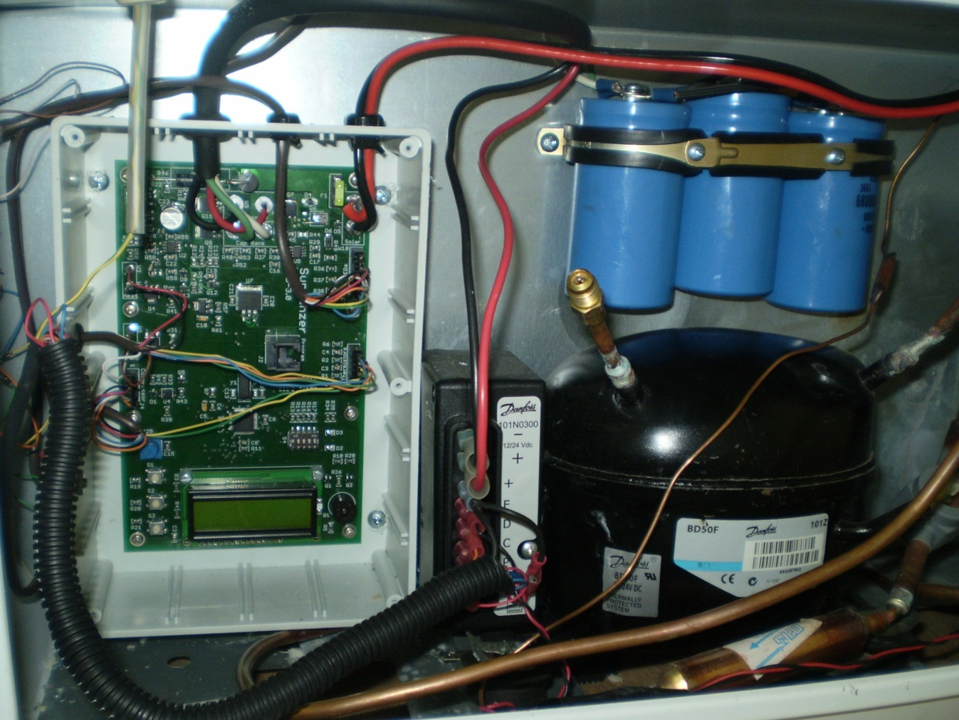
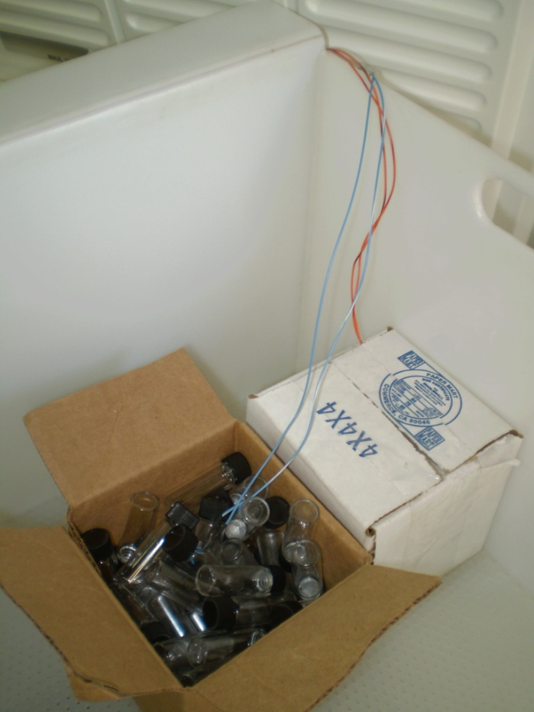
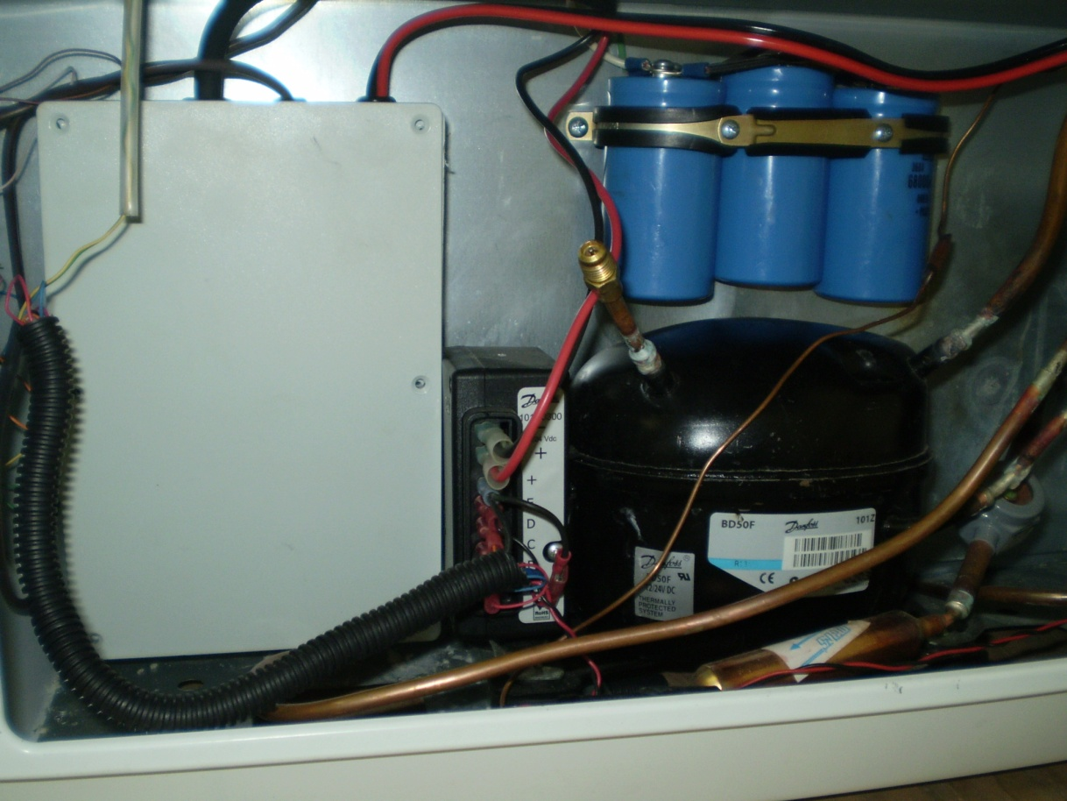
STR - 50

Slide 17
STR – 50
THERMAL MEMORY TECHNOLOGY
STORES THERMAL ENERGY NOT ELECTRICAL ENERGY
REQUIRES AVERAGE OF 30 HOURS POWER/WEEK
HOLDOVER TIME AT DESIGN TEMPERATURE WITH NO POWER = 4.5 DAYS (@ 30⁰ C AMBIENT)
SUNDANZER PROPRIETARY MICROPROCESSOR
CONTROLS VARIABLE SPEED COMPRESSOR BASED ON AVAILABLE POWER
EXTENDS COMPRESSOR EFFICIENCY AND SERVICE LIFE
PROVIDES FAIL-SAFE FOR IMPROPER POWER INPUT
AUTOMATIC REBOOT TO PREVENT LOGIC LOOP

Slide 18
STR – 50
MAXIMUM THERMAL EFFICIENCY DESIGN
ENHANCED EVAPORATOR AND CONDENSER SURFACE AREA
OPTIMIZED REFRIGERANT CHARGE
TOP OPENING DOOR
LCD PANEL FOR MONITORING FULL SYSTEM INFORMATION
MOUNTED INSIDE COMPRESSOR COMPARTMENT FOR USE BY TECHNICIAN

Slide 19
STR – 50
ADAPTABILITY
SIMPLICITY
REDUNDANCY

Slide 20
ADAPTABILITY
AC GRID POWER
OR GENERATOR POWER
OR SOLAR PANEL
OR OTHER 12 V DC POWER SOURCE
NO TECHNICAL TRAINING REQUIRED
NO MAINTENANCE REQUIREMENTS
SECURELY PERFORMS INDEPENDENT OF ENVIRONMENTAL VARIABLES

Slide 21
SIMPLICITY
LOCKED NON-ADJUSTABLE THERMOSTAT
PLUG-AND-PLAY CONNECTIONS FOR SOLAR PANEL OPTION
FAIL-SAFE PROTECTION FROM REVERSE POLARITY OR POWER QUALITY ISSUES
NO ASSEMBLY OR DISASSEMBLY
REMOVABLE BASKET FOR VACCINE STORAGE
NO SPECIAL CHARGING SCHEDULES FOR THERMAL STORAGE PACKS

Slide 22
REDUNDANCY
MULTIPLE POWER INPUTS
HIGH EFFICIENCY THERMAL INSULATION AND THERMAL STORAGE PACK BUFFER
STATE OF CHARGE LIGHTS AND MECHANICAL TEMPERATURE GUAGE
THERMAL POWER PACKS PHASE CHANGE TUNED TO DESIGN TEMPERATURE RANGE

Slide 23
STR – 50

Slide 24
STR – 50
All units come complete with integrated rectifier, AC plug, plug-and play DC connector
Solar Panel power supply provided as option, complete with plug-and-play connector to DC Solar Panel power supply
Additional DC options include plug-and-play 12 V connector for car battery or cigarette lighter for emergency use

Slide 25
DIVAF - SUNDANZER
VACCINE STORAGE SOLUTIONS PROJECT
TECHNICAL DESIGN
DAVID BERGERON IS THE DEVELOPER OF THE THERMAL MEMORY TECHNOLOGY DURING HIS TIME AT NASA. HE IS CURRENTLY PRESIDENT AND CHIEF SCIENTIST AT SUNDANZER DEVELOPMENT. THIS TECHNOLOGY IS LICENSED TO SUNDANZER FROM NASA, AND THIS IS THE THIRD GENERATION OF DEVELOPMENT FOR APPLICATIONS TO RELIABLE REFRIGERATION IN SEVERE ENVIRONMENTS.
ENVIRONMENTAL DESIGN
THE DIVINE AMBASSADORS FOUNDATION IS A HUMANITARIAN ORGANIZATION BASED IN LAGOS, NIGERIA. DIVAF WORKS CLOSELY WITH THE WEST AFRICAN HEALTH ORGANIZATION AND UNICEF PROVIDING HEALTH SERVICES FOCUSED ON THE CHILDREN IN REMOTE AREAS OF AFRICA.

Slide 26

DIVAF - SUNDANZER
VACCINE STORAGE SOLUTIONS PROJECT
INFORMATION AND AVAILABILITY:
Professor ‘Fola Tayo
Lagos Nigeria
Phone: (234) 803 335 8444
E-Mail: prof.fola.tayo@divaf.org
TECHNICAL SUPPORT:
Richard Ryan
Lagos, Nigeria
Phone: (234) 807 548 6575
E-Mail: richard.ryan@solarisps.com
Bill Byars
Sugar Land, TX, USA
Phone: (1) 832 641 3922
E-Mail: bill.byars@pdcllc.net

Slide 27

PROVIDING SOLUTIONS
FOR
HEALTHCARE
Children have rights

