Slide 1
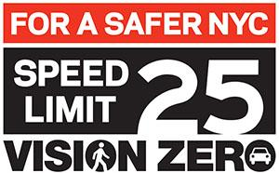
Vision: Zero Results
Revamping NYCDOT's Vision Zero Initiative
Stanley Guo

Slide 2
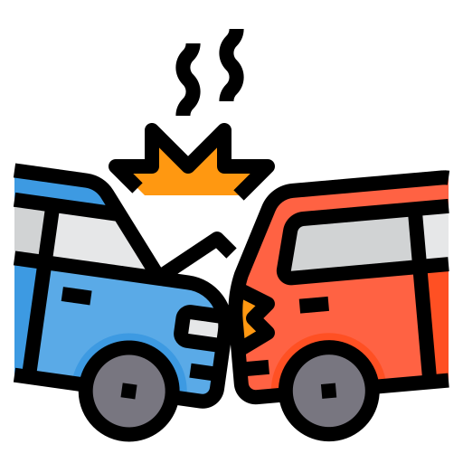
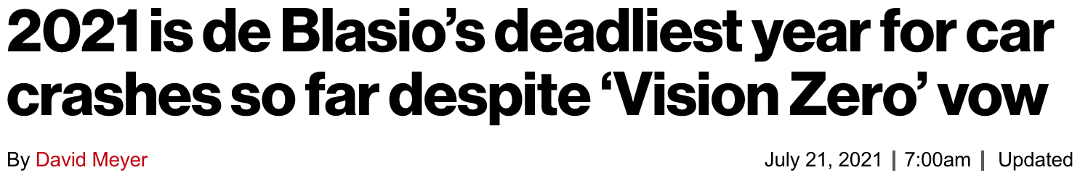
Introduction
Launched in 2014
Traffic accidents are at an all-time high
Exacerbated by the pandemic
Notes:
- Launched in 2014, start of Mayor de Blasio's mayorship, one of his biggest failures
- Goal to end all traffic deaths by 2024
- Exacerbated by pandemic, less cars and pedestrians, speeding habit

Slide 3

Data
1 million rows of data 2016 - Present
Focused on 2018 - 2019, 2020 - Oct 2021
Sampled 750 rows from each year
3000 total rows

Slide 4

Goals
Identify areas that are prone to traffic accidents
More effective allocation of resources
Improve city streets and roads
Notes:
certain areas of the city experienced very high increases in traffic accidents
allow us to focus budget on areas with high concentration of traffic accidents
improve the safety of vision zero, wont aim for original goal of zero traffic deaths by 2024, at least bring deaths down to pre pandemic levels

Slide 5
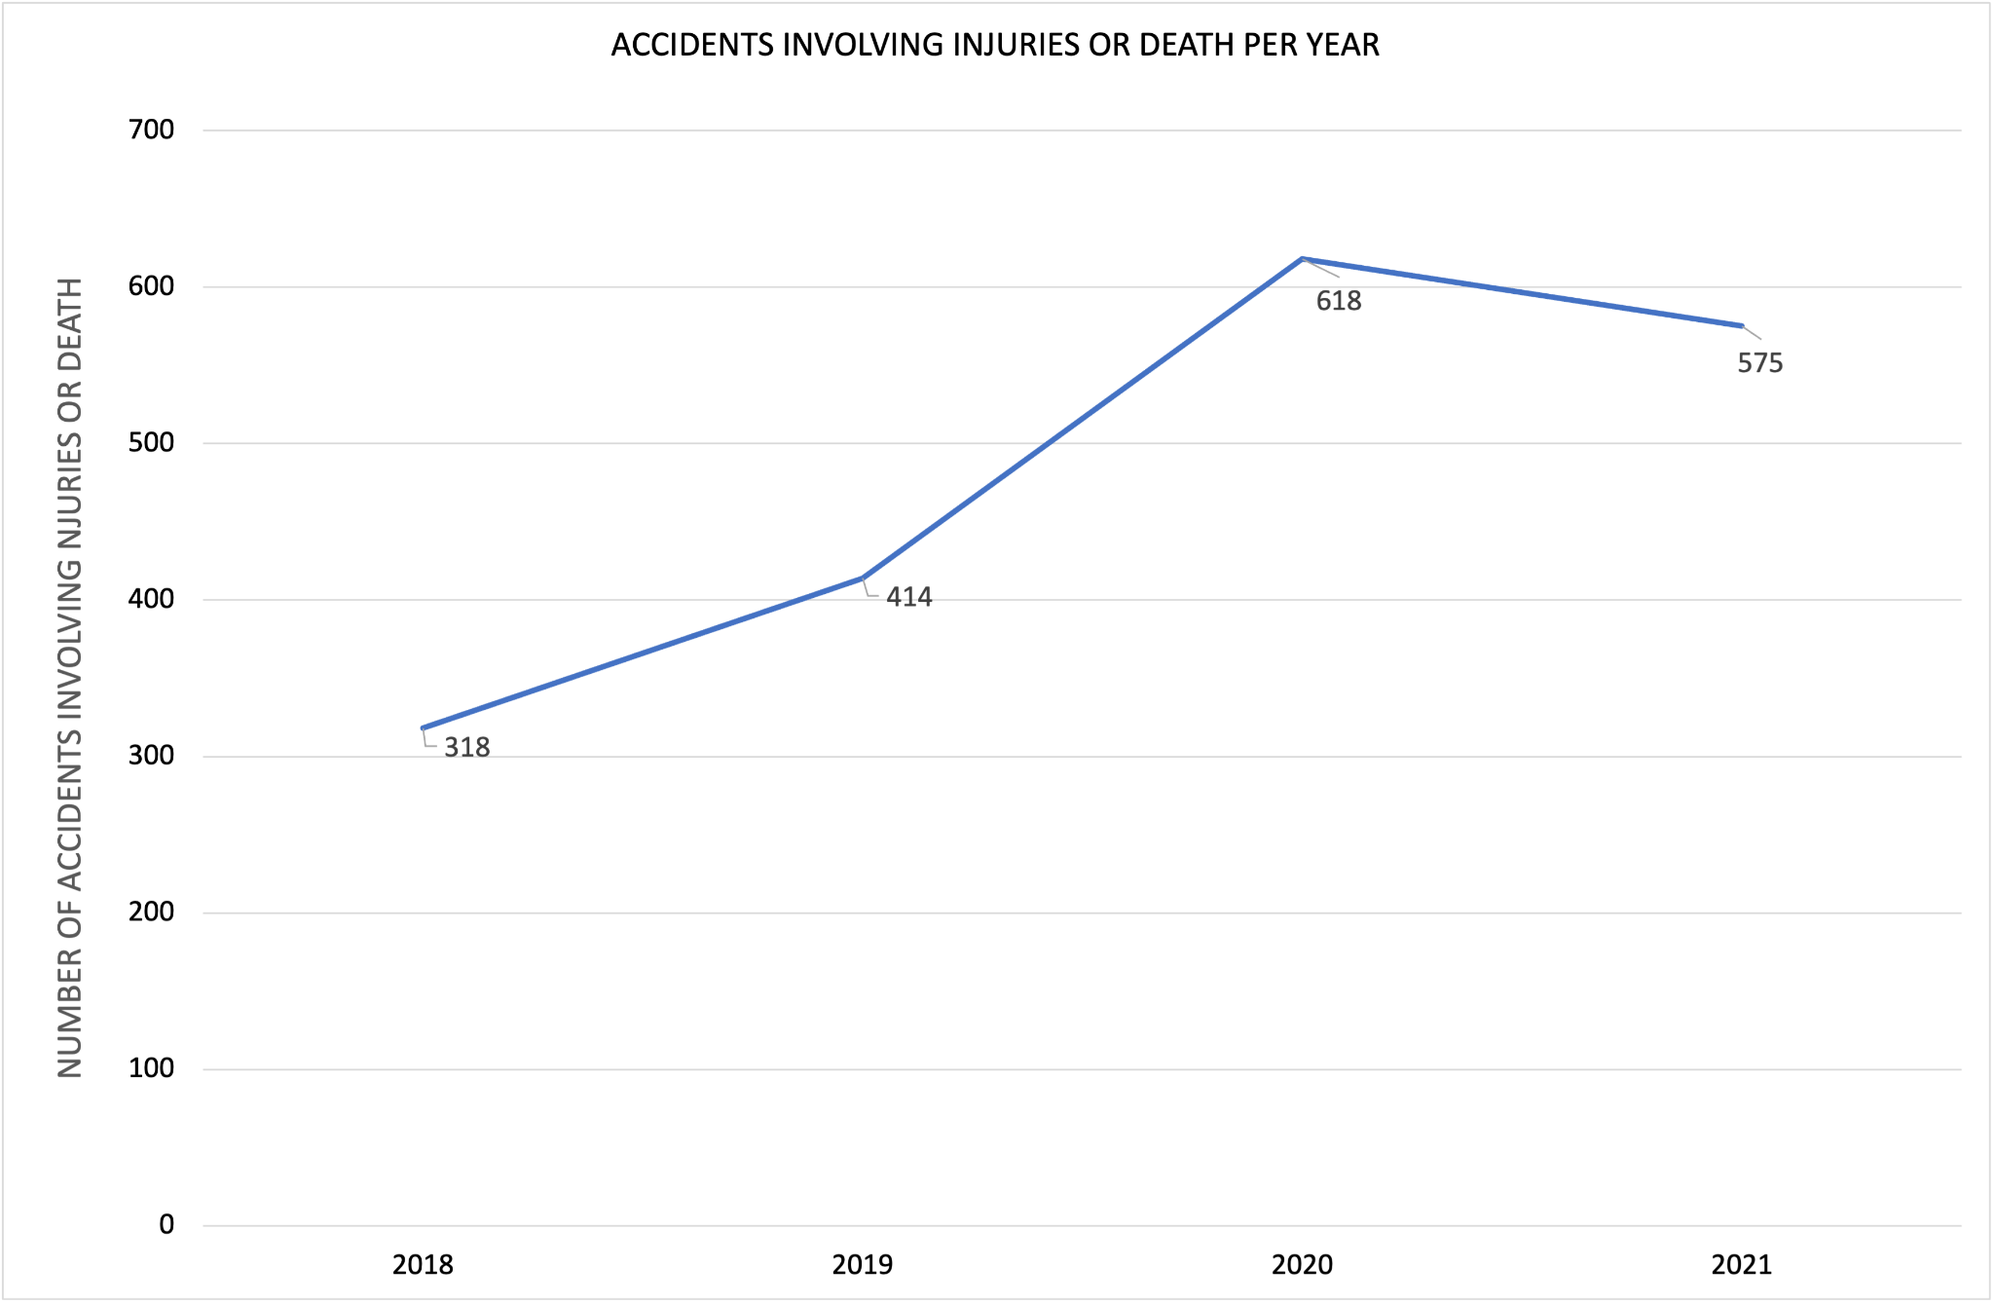
Initial Analysis
Notes:
2018 and 2019 data pre pandemic
2020 2021 are post pandemic
important to note that 2021 data includes up to the end of september, still have 3 months to go in 2021, so expecting 2021 to end with more injuries or deaths than 2020

Slide 6
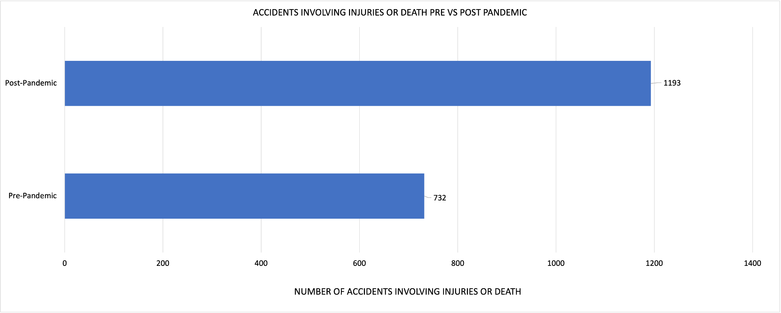
How Has The Pandemic Altered the Landscape?
↑ 63%
Notes:
traffic deaths and injuries increased in nyc by 63%, again expecting post pandemic data to be even higher since we still have three months left in 2021
why the increase
- drivers got into the habit of speeding during the pandemic since there werent a lot of cars on the road
- more and more people ditched their cars for bicycles
- nyc granted two companies, revel and lime, to operate electric mopeds on city streets
- increased driver agitation, due to open streets program, many streets are shut down, outdoor dining infrastructure clogging up streets.

Slide 7
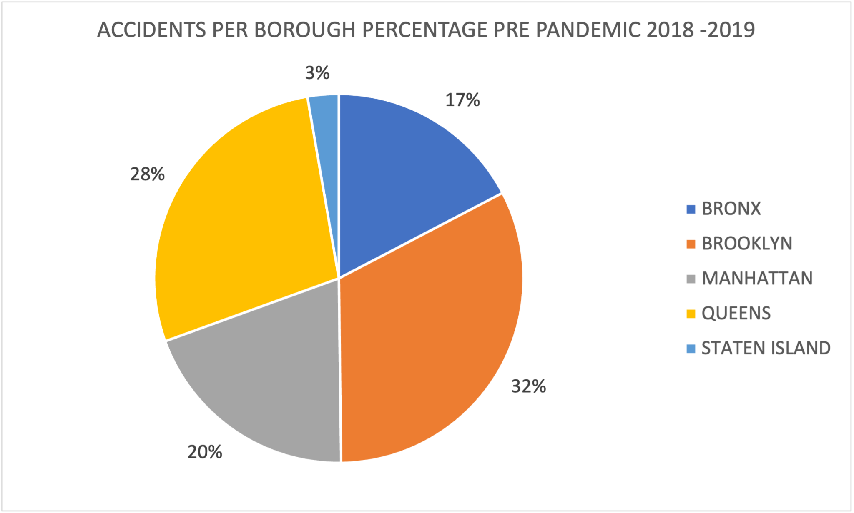
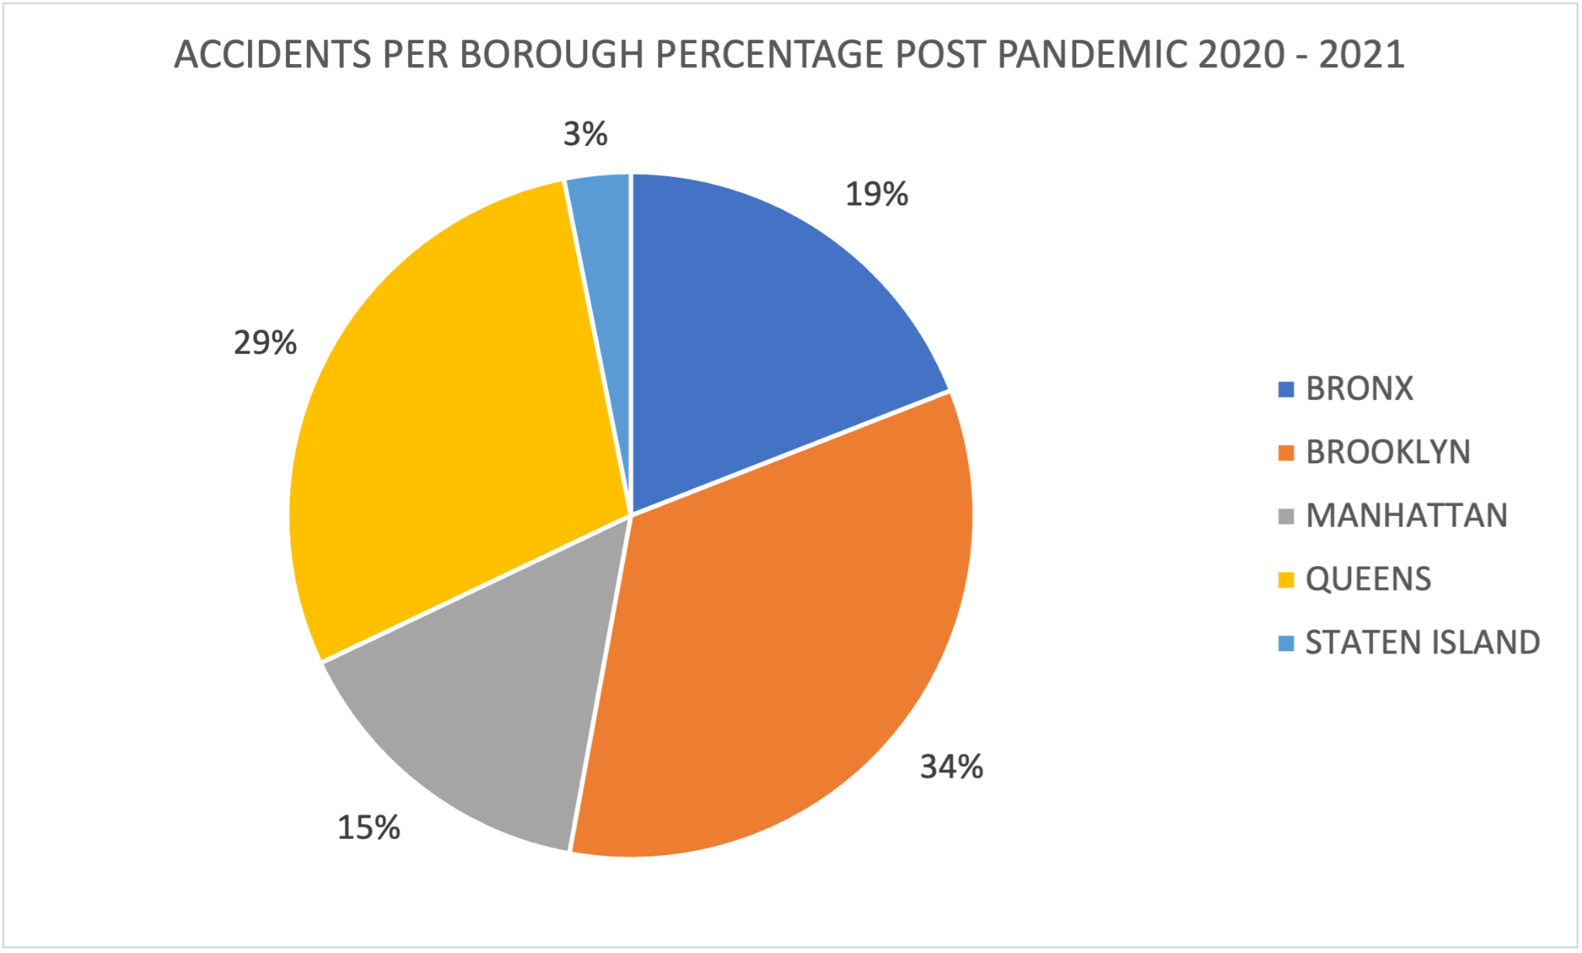
Traffic Incidents Per Borough Before and After COVID
Notes:
was the only borough with a decrease in accidents, can be expalied by the fact that many residents permanently left the city when the pandemic started, office workers are working from home which decreases the need for food delivery workers, less accidents involving delivery workers

Slide 8
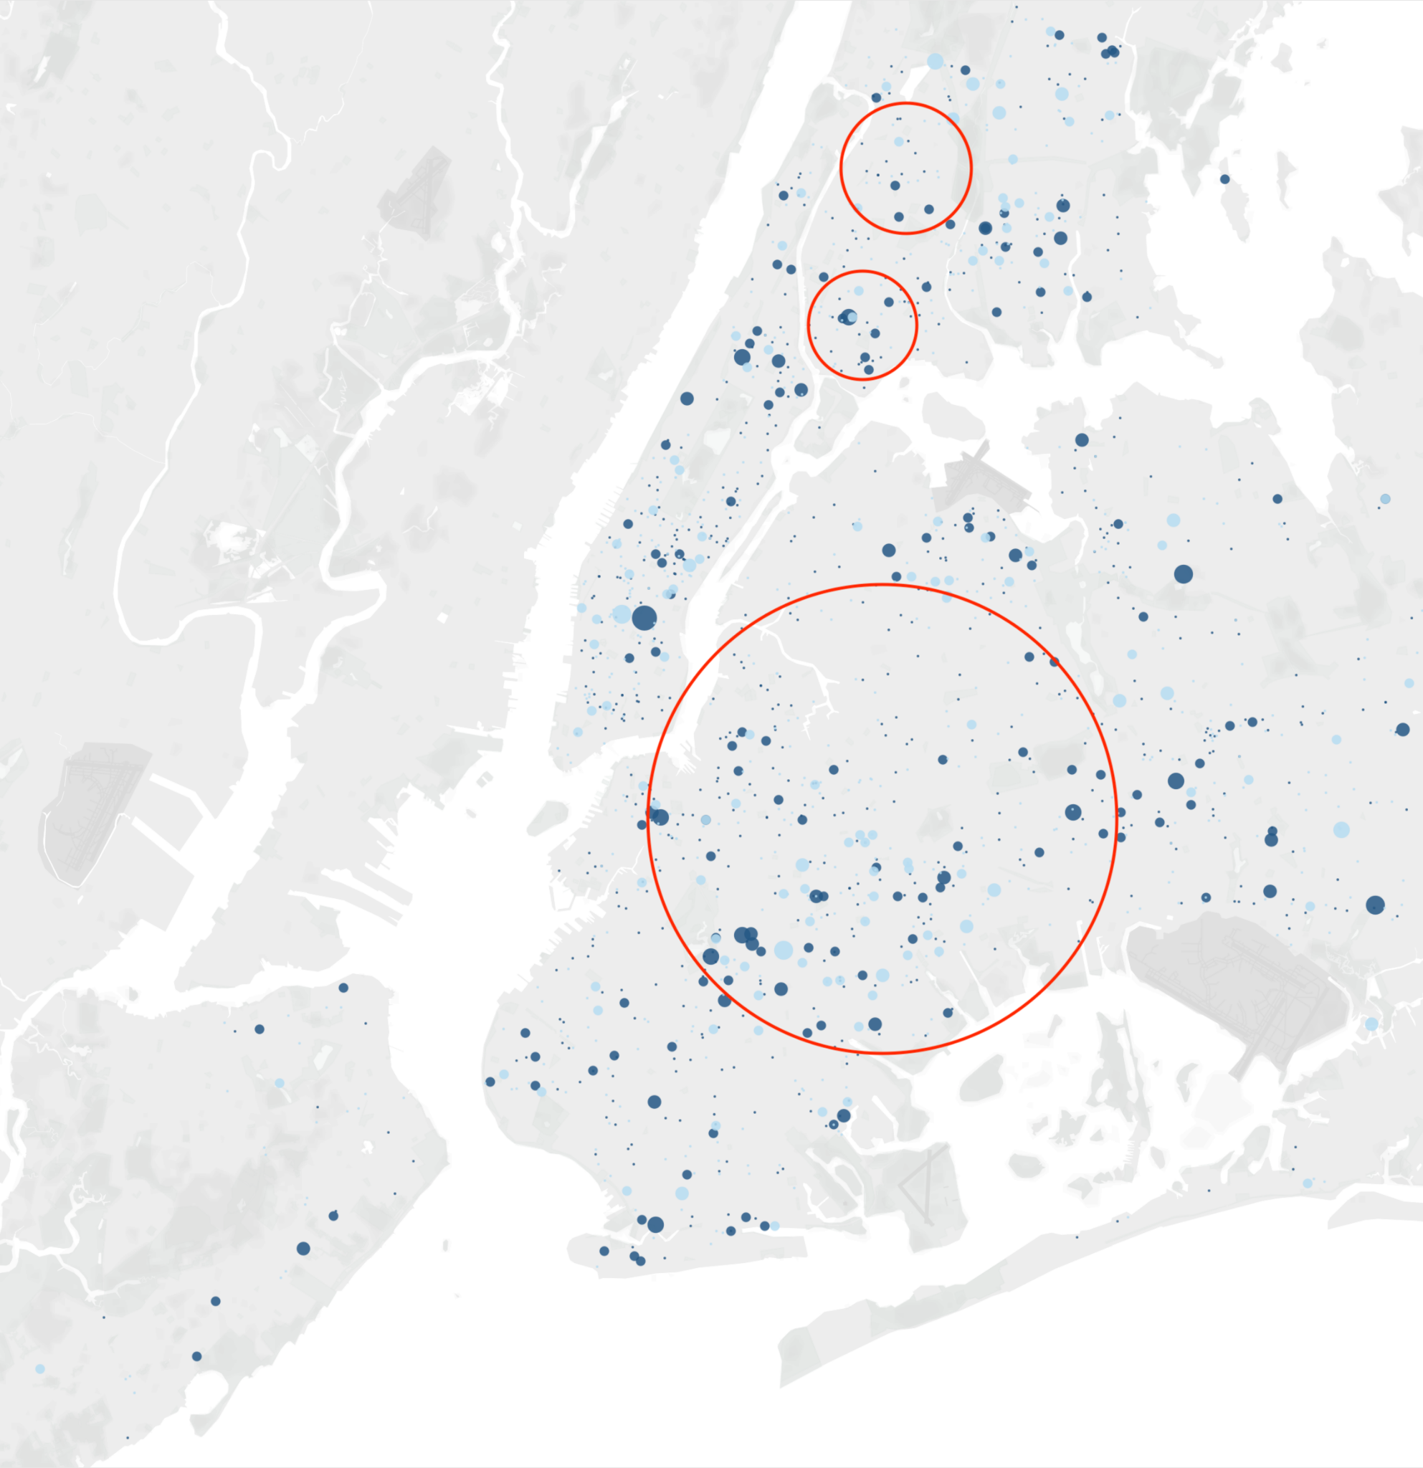
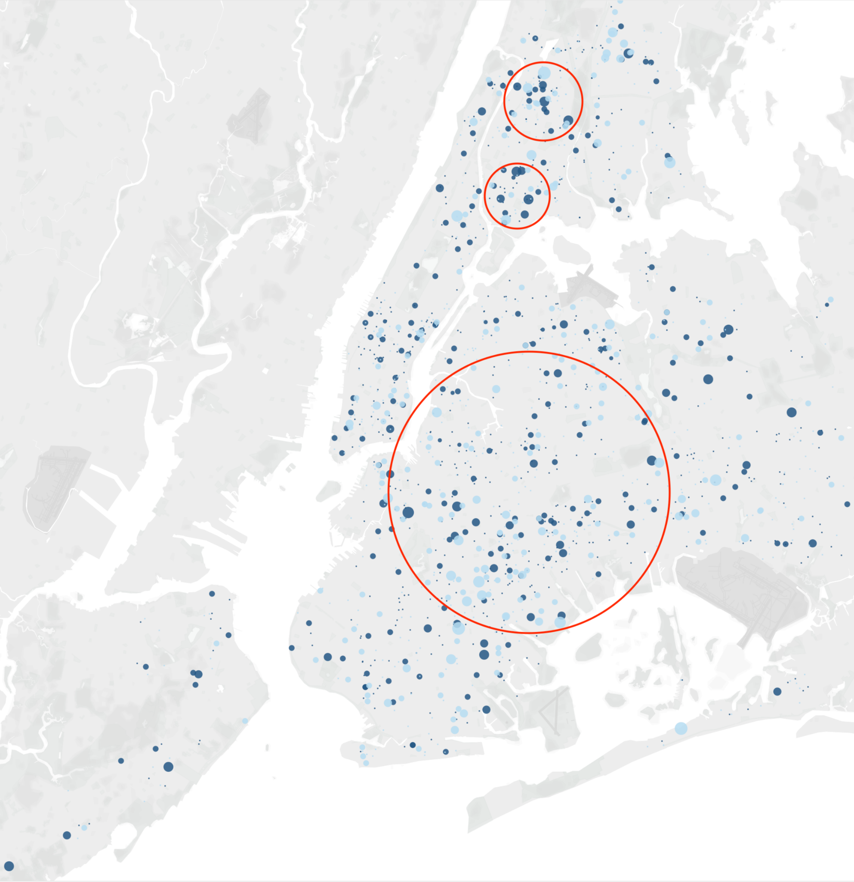
Concentration of Traffic Accidents
Pre-pandemic
2018 - 2019
Pandemic
2020 - Oct 2021
Notes:
bronx and brooklyn saw the highest increases in traffic accidents, large circle covers a large swath of residential area. these areas don't have many traffic lights, intersections mostly consists of all way stop signs

Slide 9

Conclusions
Highest increases were in the Bronx and Brooklyn
Mostly in residential areas
Pandemic had deadly effect on city streets and roads

Slide 10

What Can We Do
Ban the use of electric mopeds
Install more protected bike lanes
Add more speed bumps
Replace 'Stop All Way' signs with real traffic lights

Slide 11

Future Work
Break down accidents by types of vehicles
See which zip codes were more prone to accidents
Get a larger sample to improve accuracy

Slide 12
Thank you!

Slide 13
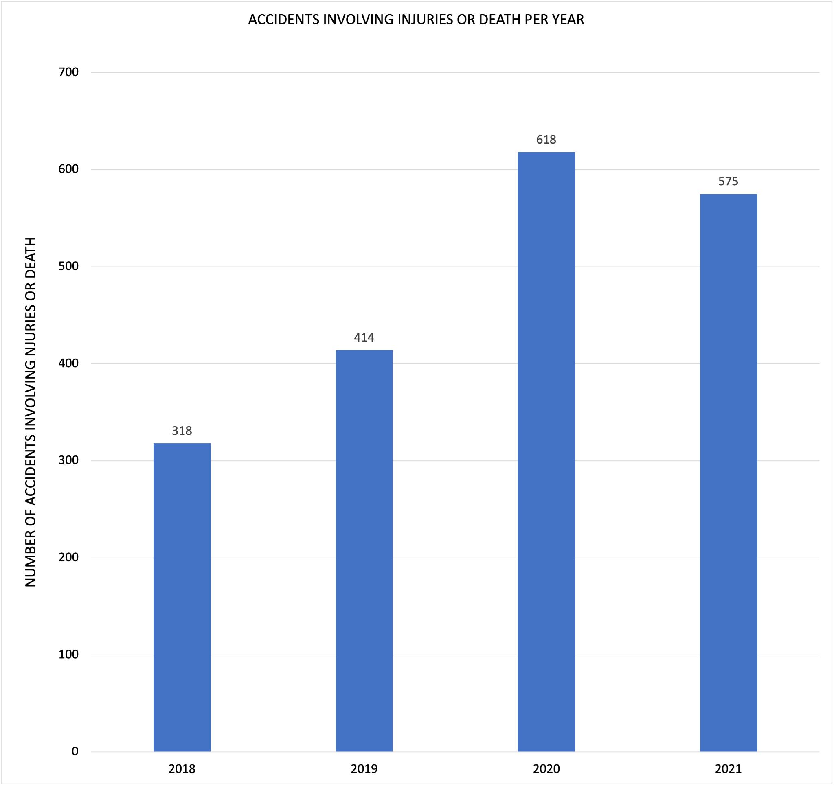
Appendix

Slide 14
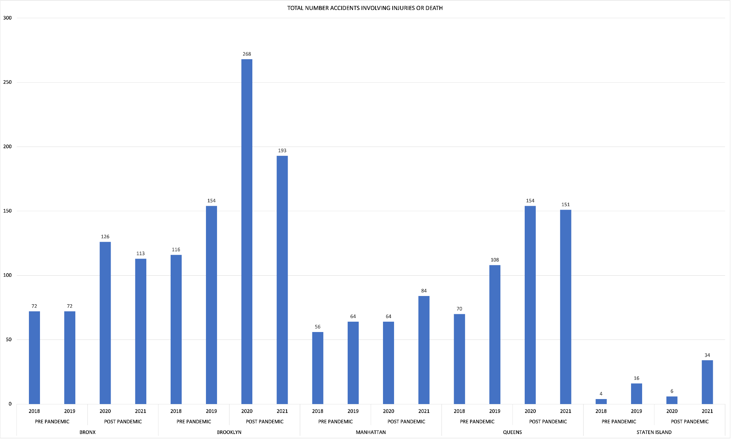
Appendix

