Slide 1

EDA MTA Project
Stanley Guo

Slide 2

Introduction
We have been tasked to optimize engagement and awareness for WomenTechWomenYes (WTWY) and their upcoming gala by using MTA subway data to help them strategically place street teams around the city.
The goal is to conclude which stations are the busiest and on which days to optimize street team placement for maximum campaign outreach.

Slide 3

Assumptions
1. Focus on total exits per station
Allows for data collection on travellers from surrounding areas - greater outreach than entries
2. Busier stations would ideally provide more engagement
More people = more emails collected, more diverse demographic
Notes:
Focus on number of exits which will allow for street team interaction with travelers coming from the tri-state and surrounding areas such as New Jersey, Westchester and Long Island who might be coming into the city via NJ Transit, Metro-North and LIRR, respectively.
Using exits will limit outreach to passengers that only reside within the five boroughs.

Slide 4







Process
1. Create shell of the database using SQLite 3
2. Scrape data from MTA website using a Python script
3. Export database into Jupyter notebook and explore using SQLAlchemy
4. Clean and model data using Pandas
5. Use Seaborn and Matplotlib for visualization
Notes:
1. Creation of database using SQLite 3
2. Scrape data from MTA website
3. Explore database into Jupyter using SQLAlchemy
4. Clean/model data using Pandas
5. Visualize data using Seaborn and Matplotlib

Slide 5

Issues With The Data
Issue 1: Duplicate data, some rows contained a 'RECOVR AUD' value in its 'DESC' column
Issue 2: Some rows had negative counts - previous entries/exits were greater than current entries/exits

Slide 6
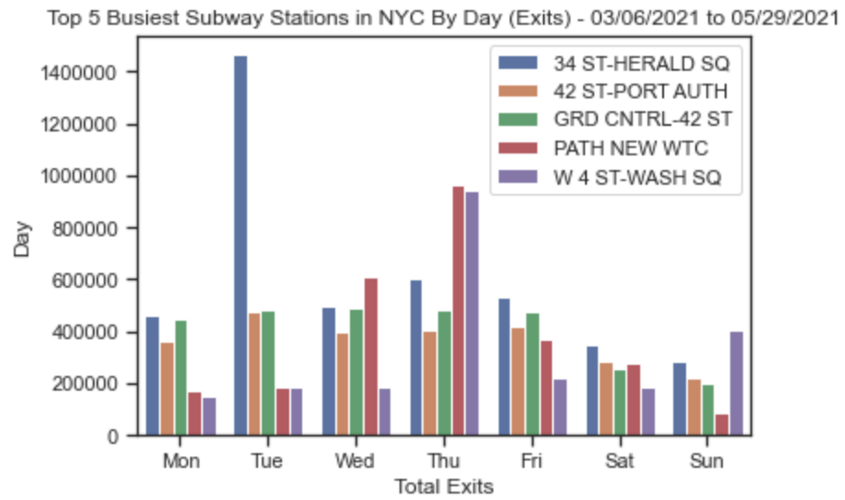
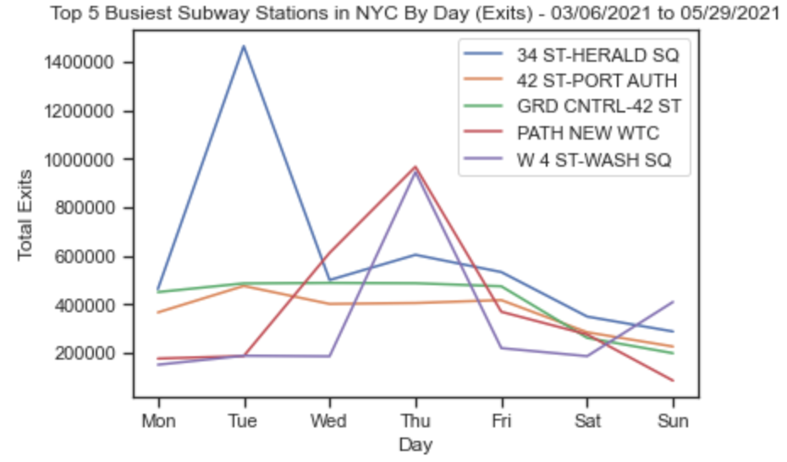
Results
Notes:
Two different graphs representing the top 5 busiest train stations around nyc, by day of the week.
originally the top 5 busiest stations around nyc was supposed to be 34 st herald sq, 42 st port-auth, 34 st penn station, grand central 42nd st, and path new world trade center
however, i decided to omit the 34st st penn station because it is too close to proximity to 34 st herald sq, and i replaced that with west 4th st, washington square

Slide 7
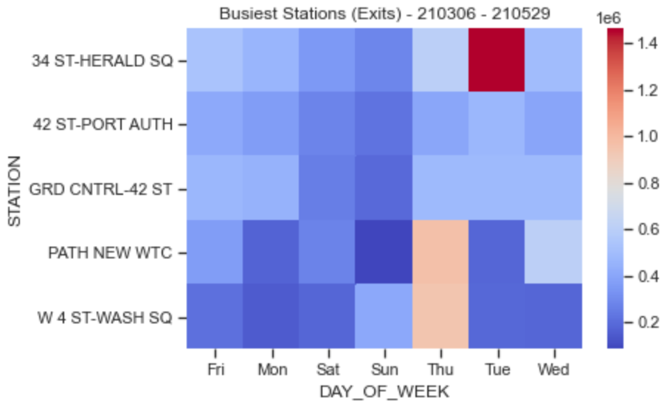
Results

Slide 8

Conclusion
For the most effective street team efforts, WTWY should focus on..
34 ST-HERALD SQ and GRD CNTRL-42 ST on Mondays, Tuesdays and Fridays
GRD CNTRL-42 ST and PATH NEW WTC on Wednesdays,
W 4 ST-WASH SQ and PATH NEW WTC on Thursdays,
34 ST-HERALD SQ and PATH NEW WTC on Saturdays,
W 4 ST-WASH SQ and 34 ST-HERALD SQ on Sundays
Since 34 ST-HERALD SQ is extremely busy on Tuesdays, it might make sense to concentrate the majority or all efforts there on Tuesdays.

Slide 9

Future Work
If there was more time, I would dissect the data to an even more granular level to not only split busy stations by day, but also by time of day. That will allow street teams to hit up multiple stations on the same day.

Slide 10
Appendix

Slide 11
Appendix

Slide 12
Appendix

