Slide 1

Predicting the Lifetime Gross Earnings of Movies
Stanley Guo

Slide 2

Decide which movies to invest in

Slide 3

Data
Scraped movies from Box Office Mojo
3144 Movies
NC-17, R, PG-13, PG, G

Slide 4

Methodology
Outcome
Predict a movie's lifetime gross earnings
Features
Domestic opening
Run time
Action
Release season
Domestic distributor

Slide 5

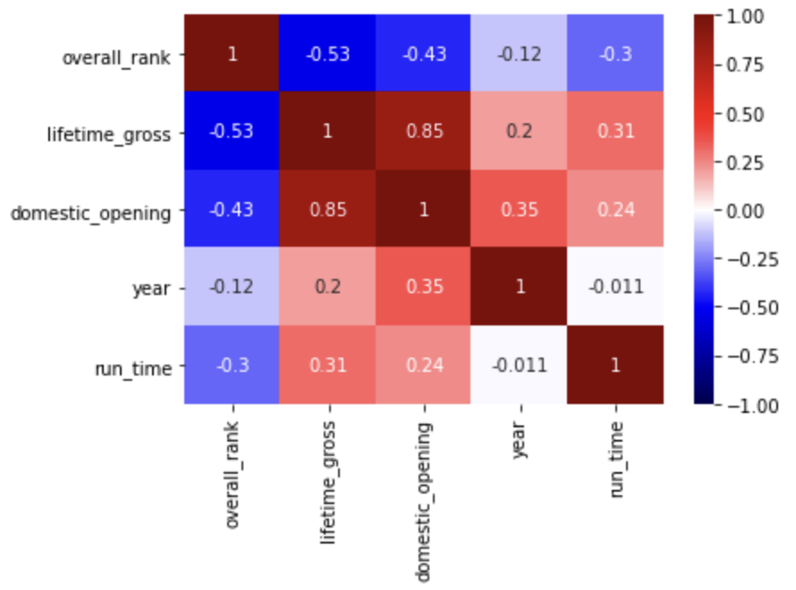
Base Model
Features Focused On:
Domestic Opening
Run Time

Slide 6

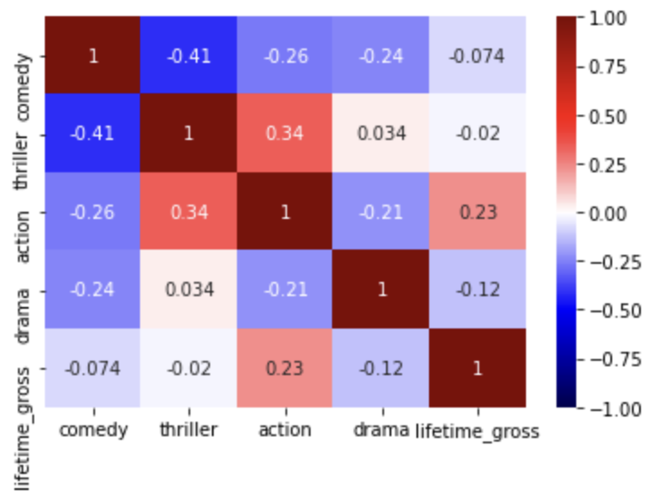
Genre Feature Engineering
Features Focused On:
Domestic Opening
Run Time
Action

Slide 7

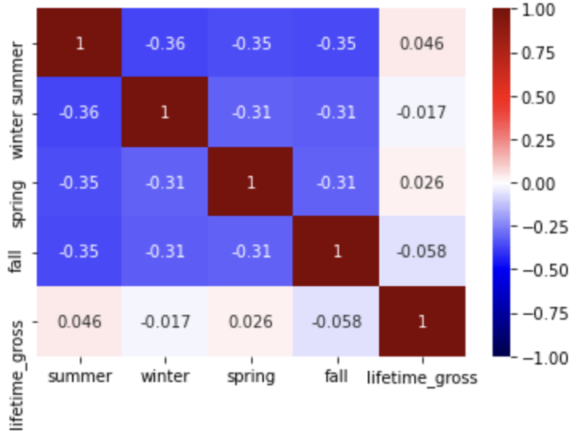
Release Season
Feature Engineering
Features Focused On:
Domestic Opening
Run Time
Action
Summer
'Summer Blockbuster'

Slide 8

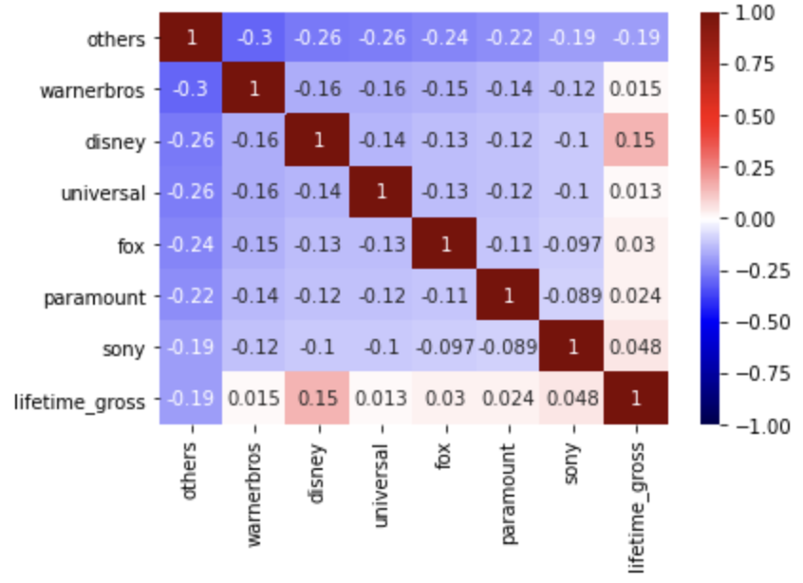
Domestic Distributor
Feature Engineering
Features Focused On:
Domestic Opening
Run Time
Action
Summer
Disney
R² of 0.7514

Slide 9

Key Features
Domestic Opening
Run Time
Genre
Release Season
Distributor

Slide 10

Future Work
Directors
Cast
Crew
Sequels
Franchises

Slide 11
Thanks for listening!

Slide 12
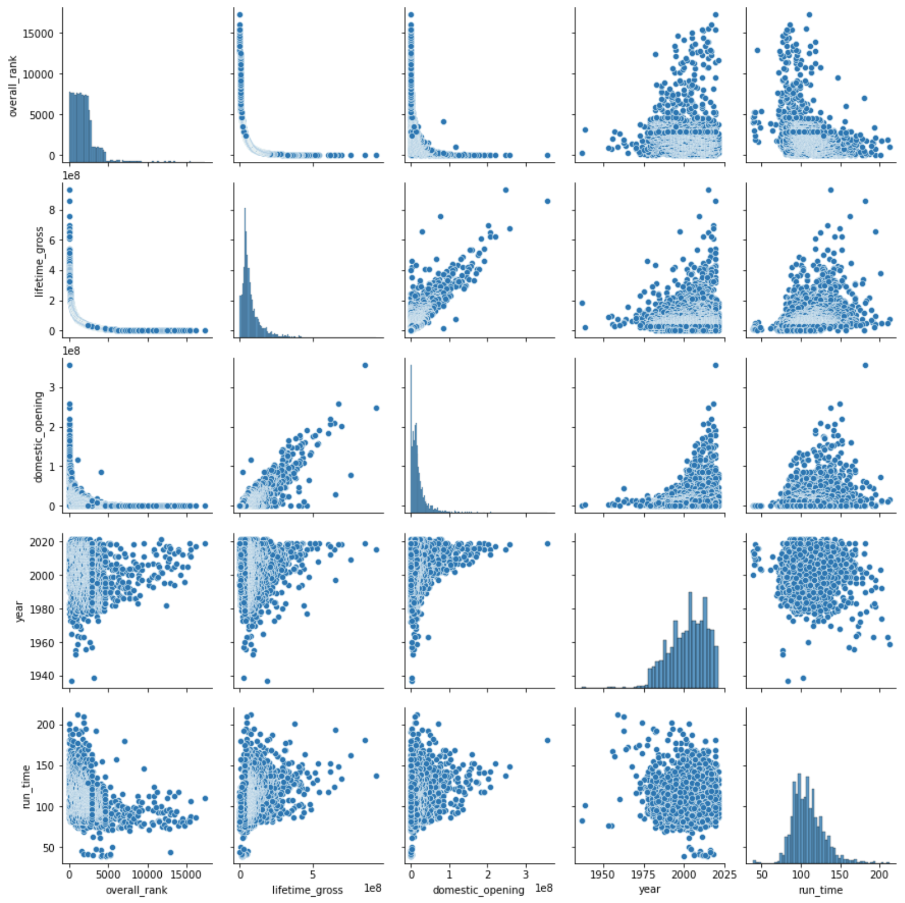
Appendix

Slide 13
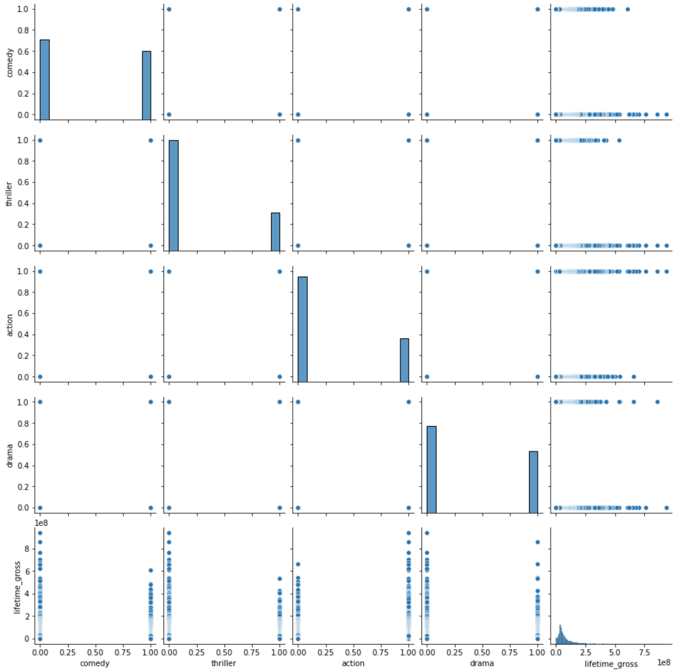
Appendix

Slide 14
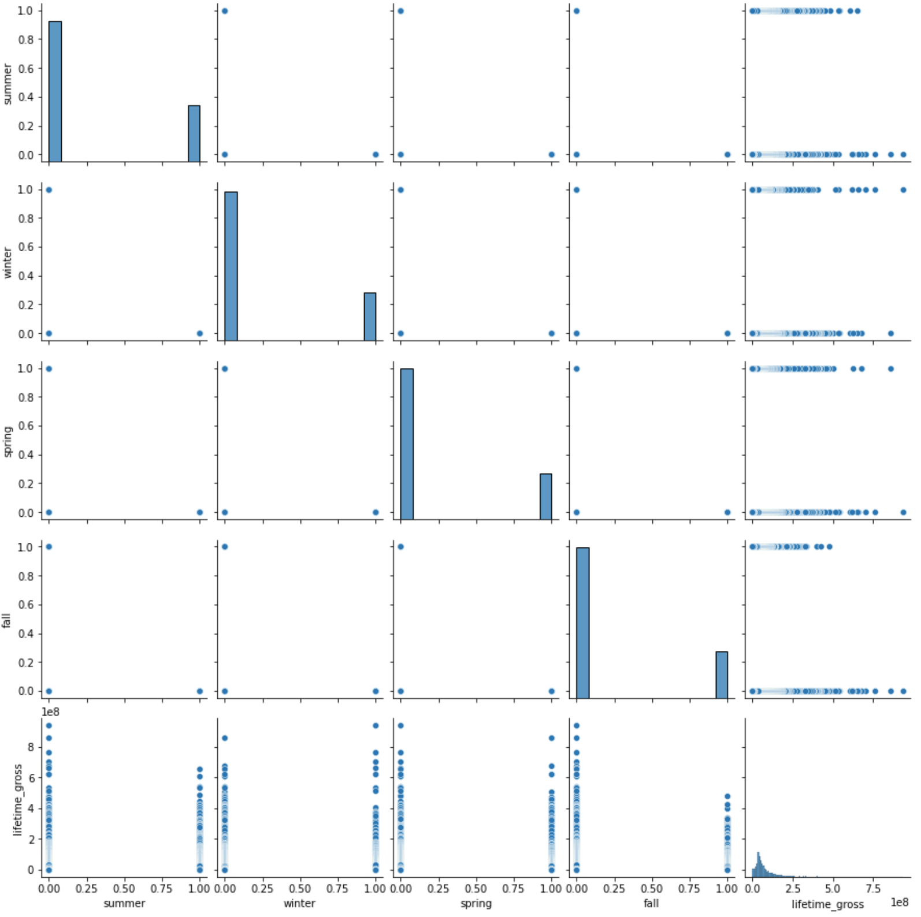
Appendix

Slide 15
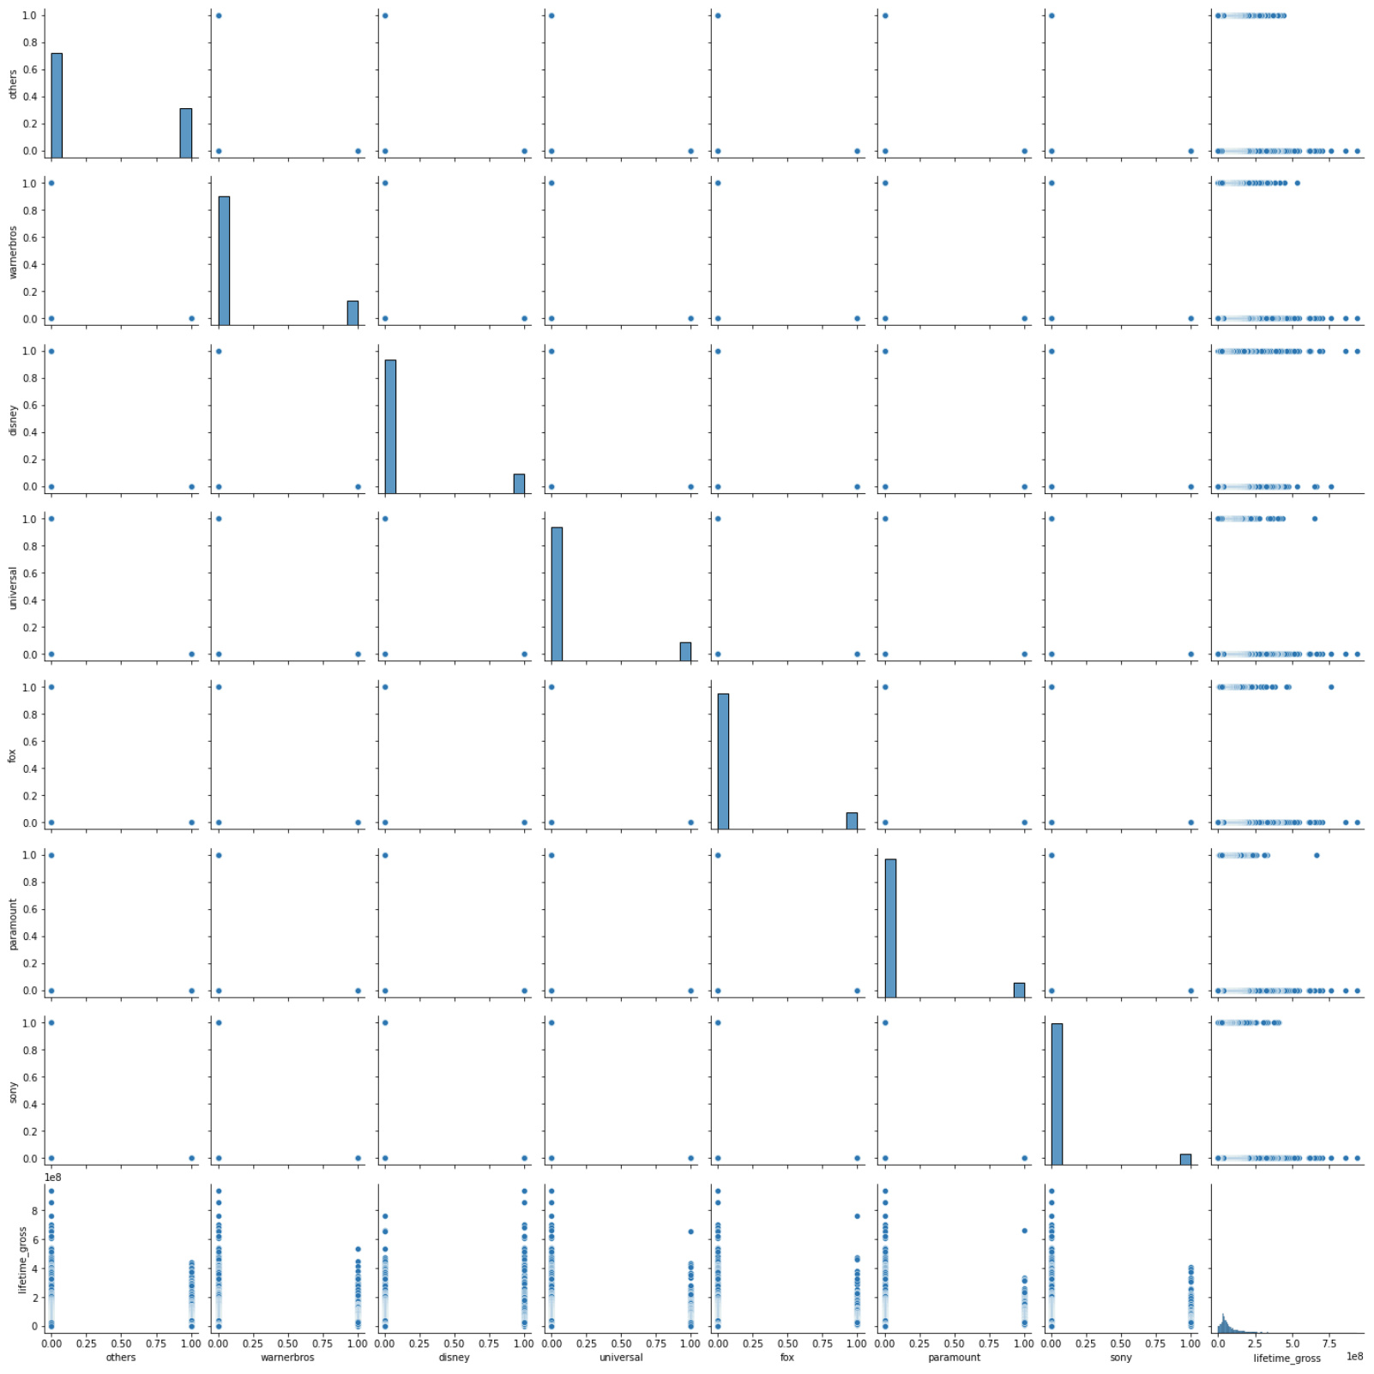
Appendix

