Slide 1
Lecture 32
LLM APIs & the Agency Spectrum
Theme 4: Agentic Systems — Building a Mini Claude Code (1/5)
CSCI 3397 / PSYC 3317: Biomedical Image Analysis | Spring 2026 | Donglai Wei

Slide 2
Housekeeping
Recap: Lec. 30-31 — Multimodal foundation models (CLIP, LLaVA)
Today: From using FMs to orchestrating them — giving LLMs agency
Theme 4 plan: 5 lectures → build a mini Claude Code step-by-step
Reference implementation: nano-claude-code (~5K lines Python)
Action: ps4 out (agentic systems)
Reading: smolagents intro (HuggingFace); Anthropic API quickstart

Slide 3
1
The Agency Spectrum

Slide 4
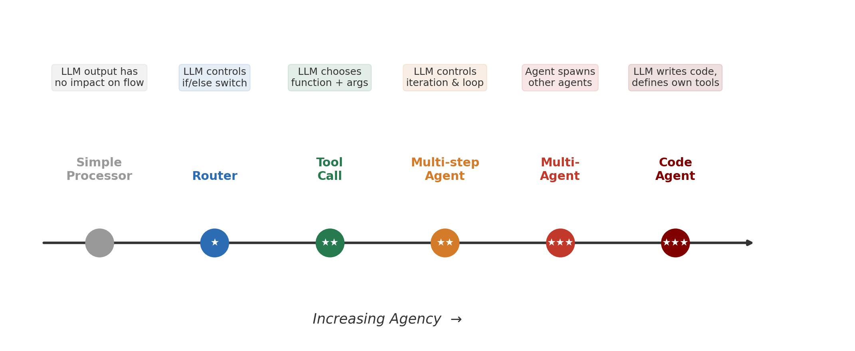
Agency Is a Spectrum, Not Binary
Source: adapted from HuggingFace smolagents conceptual guide

Slide 5
The Multi-Step Agent Pattern
memory = [user_task]
while llm_should_continue(memory):
action = llm_get_next_action(memory)
observations = execute_action(action)
memory += [action, observations]
This is the core of what we're building → nano-claude-code's agent.py

Slide 6
When to Use Agents vs. Simpler Approaches
✓ Workflow is predictable → hardcode it (100% reliable, no LLM errors)
✗ User requests are unpredictable, require flexible tool combinations → agent
Example: "Is it possible to reschedule my MRI to Wednesday and still
get results before my Thursday appointment?"
→ No fixed workflow can handle this
Biomedical motivation: clinical workflows involve many variable steps
(retrieve prior scans, compare, measure, report)

Slide 7
2
LLM API Basics

Slide 8
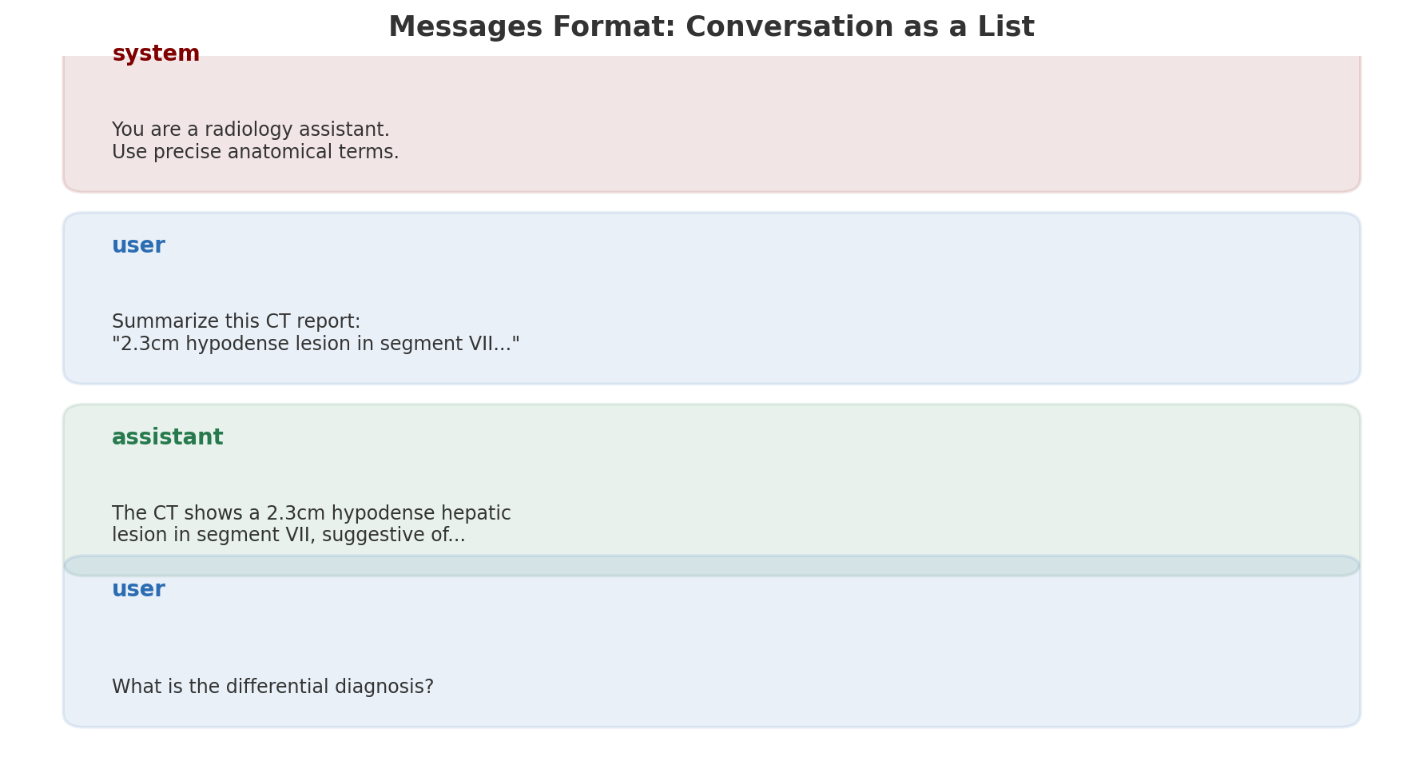
The Messages Format
Universal across Anthropic, OpenAI, Google — role-tagged message list

Slide 9
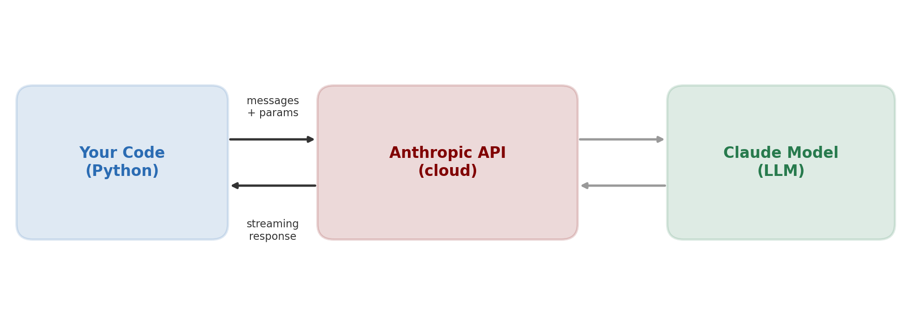
API Call Flow

Slide 10
Making an API Call (Anthropic Python SDK)
import anthropic client = anthropic.Anthropic() # reads ANTHROPIC_API_KEY from env response = client.messages.create( model="claude-sonnet-4-6-20250514", max_tokens=1024, system="You are a biomedical image analysis assistant.", messages=[{ "role": "user", "content": "What structures are visible in a brain MRI T1?" }] ) print(response.content[0].text)
nano-claude-code connection: this is providers.py — the API abstraction layer

Slide 11
Streaming — Tokens Arrive Incrementally
with client.messages.stream( model="claude-sonnet-4-6-20250514", max_tokens=1024, messages=[{"role": "user", "content": "Describe this slide..."}] ) as stream: for text in stream.text_stream: print(text, end="", flush=True)
Important for interactive UX — user sees output as it's generated

Slide 12
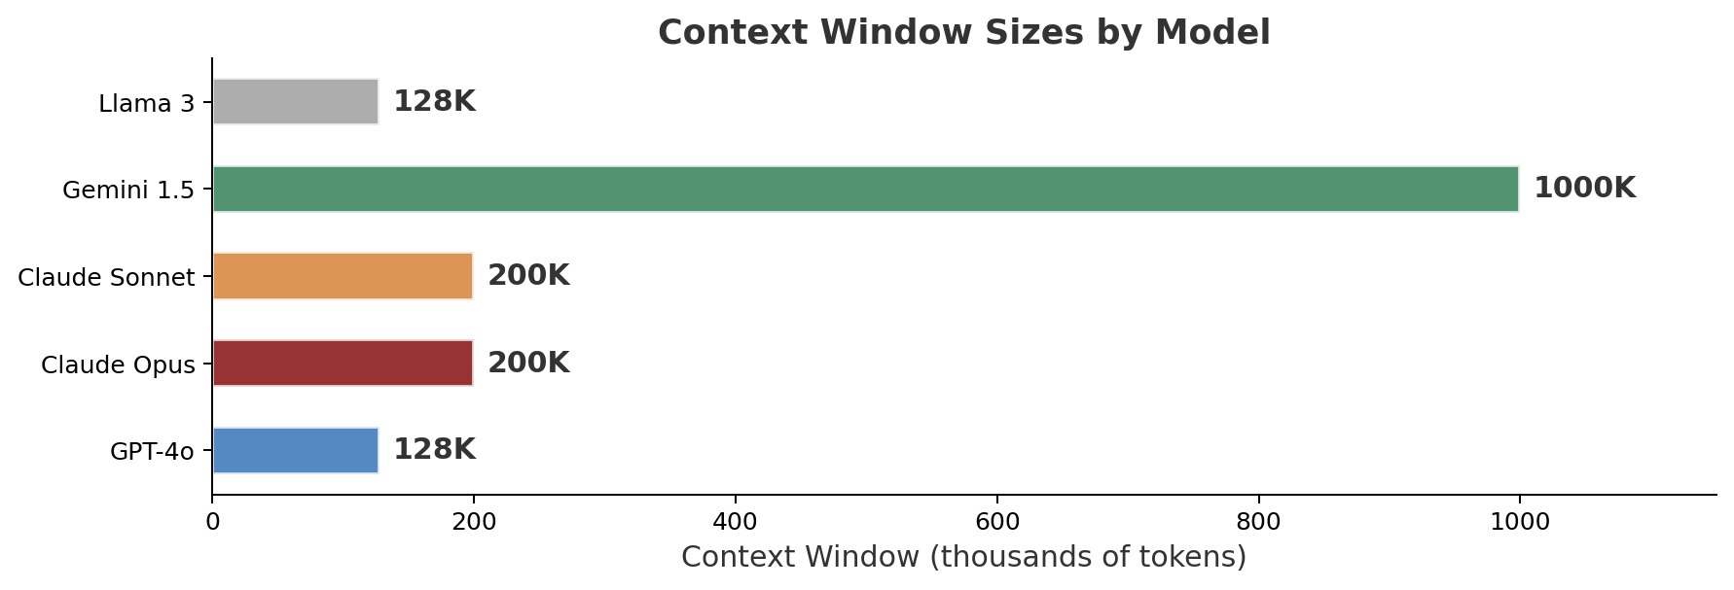
Key Parameters: Context Windows
Tokens ≈ len(text) / 3.5 | Cost = input_tokens + output_tokens

Slide 13
3
Structured Outputs & Prompt Engineering

Slide 14
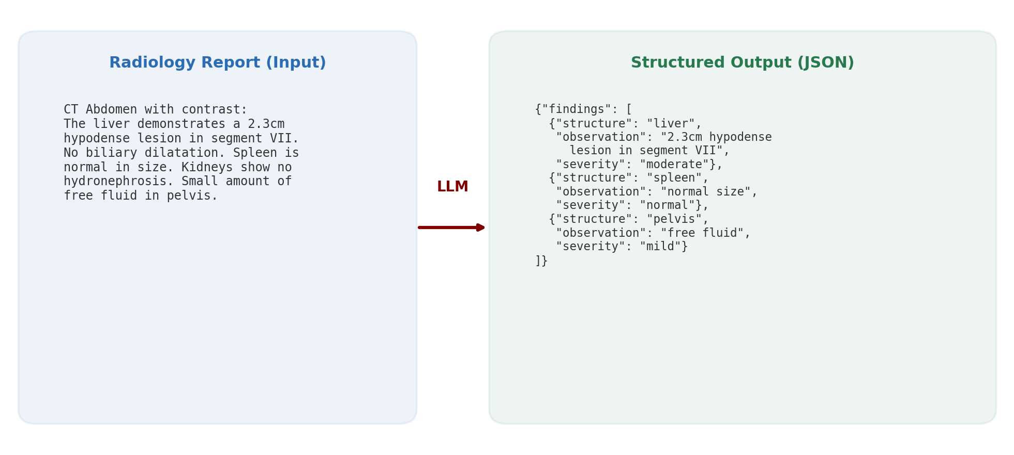
From Unstructured Reports to Structured JSON

Slide 15
Prompt Engineering for Medical Domain
1. Be specific: "Extract all anatomical structures" > "Analyze this report"
2. Provide examples (few-shot): show 1-2 input/output pairs
3. Set constraints: "Output only JSON. No explanations."
4. Domain grounding: include medical context in system prompt
5. Chain-of-thought: "First identify findings, then classify severity, then format"

Slide 16
Vision API — Sending Images to the LLM
response = client.messages.create( model="claude-sonnet-4-6-20250514", messages=[{ "role": "user", "content": [ {"type": "image", "source": {"type": "base64", "media_type": "image/png", "data": img_b64}}, {"type": "text", "text": "Describe the histological features."} ] }] )
Direct connection to Lec. 30-31 (multimodal FMs)

Slide 17
Wrap-Up & Looking Ahead
Key takeaway: LLM APIs are the foundation — messages in, text/data out
The agency spectrum shows how to give LLMs increasing control
What we built today: the API layer (providers.py in nano-claude-code)
Next (Lec. 33): Tool Use & the Core Agent Loop
→ We teach the LLM to call functions, turning it into an agent

