Slide 1
Lecture 33
Tool Use & the Core Agent Loop
Theme 4: Agentic Systems — Building a Mini Claude Code (2/5)
CSCI 3397 / PSYC 3317: Biomedical Image Analysis | Spring 2026 | Donglai Wei

Slide 2
Housekeeping
Recap: Lec. 32 — LLM APIs, messages format, streaming, structured outputs
Today: From ★☆☆ (text in/out) to ★★☆ (LLM calls functions)
This is the core of what makes an agent
Reading: Anthropic tool use docs
Code: nano-claude-code agent.py (179 lines) + tool_registry.py (98 lines)

Slide 3
1
What Is Tool Use?

Slide 4
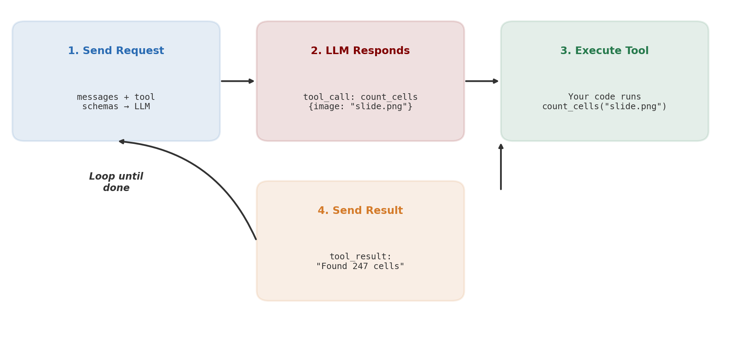
The Tool Use Cycle
The LLM doesn't execute anything — it only requests. Your code decides whether to run it.

Slide 5
Defining a Tool Schema (JSON Schema)
tools = [{ "name": "count_cells", "description": "Count cells in a microscopy image\nusing watershed segmentation.", "input_schema": { "type": "object", "properties": { "image_path": { "type": "string", "description": "Path to the microscopy image" }, "threshold": { "type": "number", "description": "Detection threshold (0-1)" } }, "required": ["image_path"] } }]
The LLM reads the description to decide when to use each tool

Slide 6
2
The Agent Loop — ReAct Pattern

Slide 7
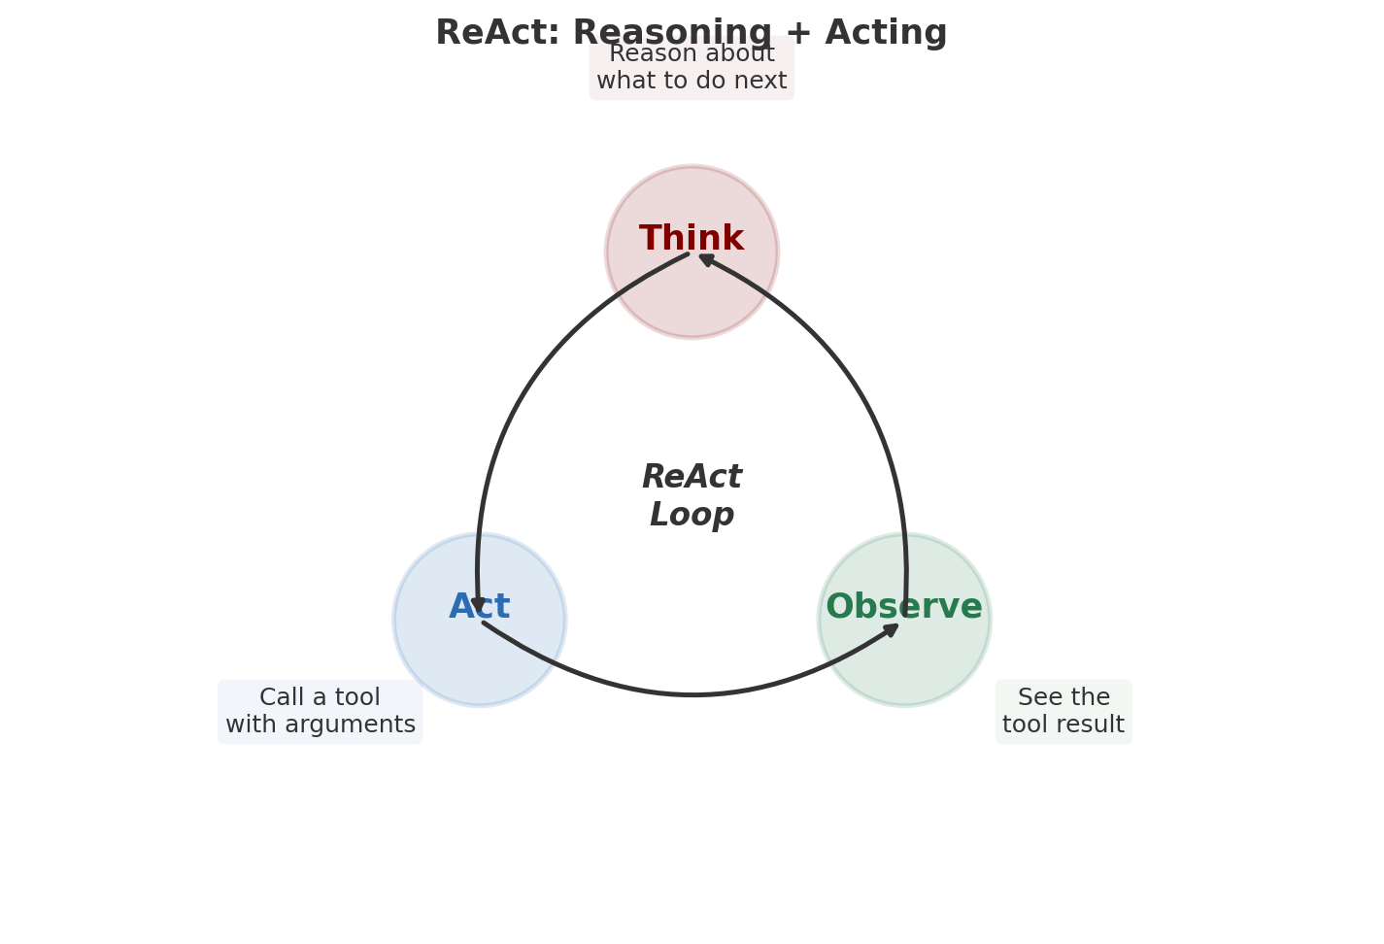
ReAct: Reasoning + Acting (Yao et al., 2022)

Slide 8
The Core Agent Loop (~30 lines of Python)
def agent_loop(user_message, tools, system_prompt): messages = [{"role": "user", "content": user_message}] while True: response = call_llm(messages, tools, system_prompt) messages.append({"role": "assistant", "content": response.content}) if response.stop_reason != "tool_use": return response.text # Done! for tool_call in response.tool_calls: result = execute_tool( tool_call.name, tool_call.input) messages.append({ "role": "user", "content": [{"type": "tool_result", "tool_use_id": tool_call.id, "content": result}] }) # Loop: LLM sees results, decides next action
nano-claude-code's agent.py: 179 lines with streaming events (TextChunk, ToolStart, ToolEnd)

Slide 9
Key Design Decisions in the Agent Loop
Loop termination: LLM decides when to stop (stop_reason != 'tool_use')
+ max-iterations guard to prevent infinite loops
Message accumulation: every action + observation appended
→ LLM sees its full history (context window matters!)
Multiple tool calls: LLM can request several tools in one turn
→ parallel execution for speed
Event-driven: agent.py uses Python generators (yield)
→ decouples logic from UI (same loop for CLI, web, notebook)

Slide 10
3
The Tool Registry — Plugin Architecture

Slide 11
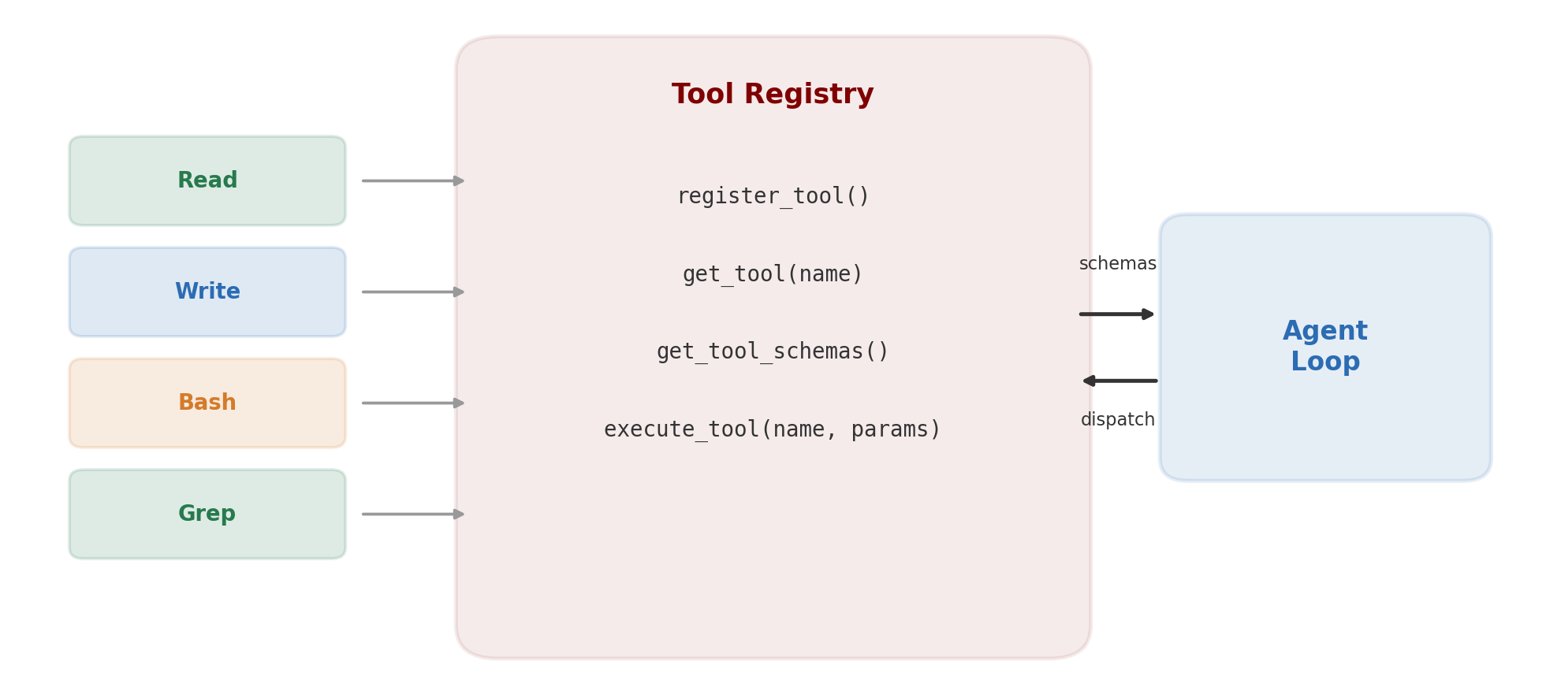
Tool Registry: Register Once, Use Everywhere

Slide 12
ToolDef: The Universal Tool Interface
@dataclass class ToolDef: name: str # "count_cells" schema: dict # JSON schema sent to API func: Callable # (params, config) -> result str read_only: bool # True = safe, auto-approve concurrent_safe: bool # True = can run in parallel # Registry operations: register_tool(tool_def) # add a new tool at runtime get_tool(name) # look up by name get_tool_schemas() # export all schemas for API execute_tool(name, params) # dispatch + output truncation # Output truncation: if result > 32K chars, # keep first 50% + last 25%
tool_registry.py: 98 lines. Open/closed principle — add tools without modifying the loop

Slide 13
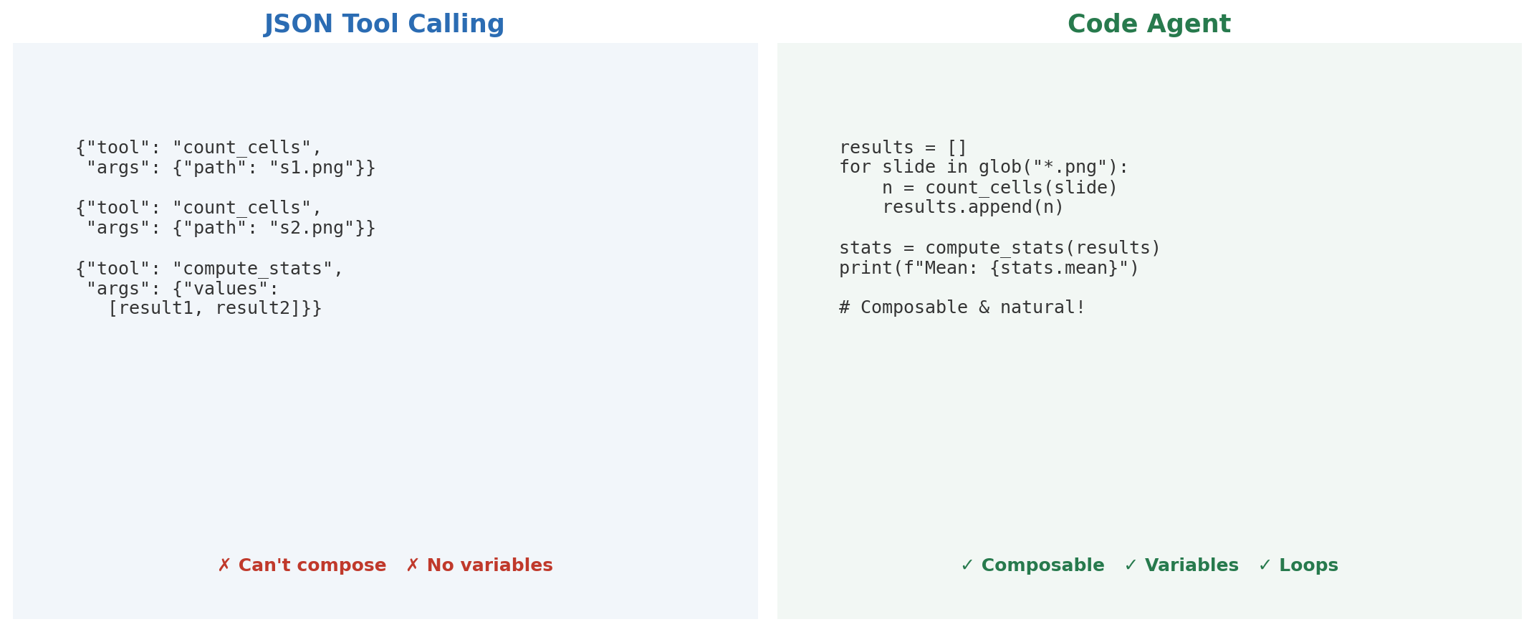
Code Agents vs. JSON Tool Calling
smolagents insight: LLMs are trained on code — writing Python is more natural than JSON

Slide 14
Demo: Agent with Biomedical Tools
3 tools: count_cells(), measure_area(), compute_statistics()
User: "Analyze slide_042.png — count cells, measure largest cluster, stats"
Agent execution:
Think → call count_cells("slide_042.png")
Observe → "Found 247 cells in 12 clusters"
Think → call measure_area("slide_042.png", label=3)
Observe → "Cluster area: 1,340 μm²"
Think → call compute_statistics([247, 1340, ...])
Observe → stats object
Done → final text report with summary

Slide 15
Wrap-Up & Looking Ahead
Key takeaway: Tool use + agent loop = core of every coding agent
The LLM reasons, calls tools, observes results, and loops
Entire loop is ~30 lines of Python
What we built: tool_registry.py + agent.py — the brain of nano-claude-code
Next (Lec. 34): Real tools — file I/O (Read, Write, Edit),
Bash execution, system prompts, and context management

