Slide 1
Lecture 34
Coding Agent with File I/O & Bash
Theme 4: Agentic Systems — Building a Mini Claude Code (3/5)
CSCI 3397 / PSYC 3317: Biomedical Image Analysis | Spring 2026 | Donglai Wei

Slide 2
Housekeeping
Recap: Lec. 33 — Tool use, ReAct loop, tool registry, code vs JSON agents
Today: Give the agent real power — file I/O + shell execution
→ turns it into a coding agent that writes and runs its own scripts
Code: nano-claude-code tools.py, context.py, compaction.py

Slide 3
1
File I/O Tools

Slide 4
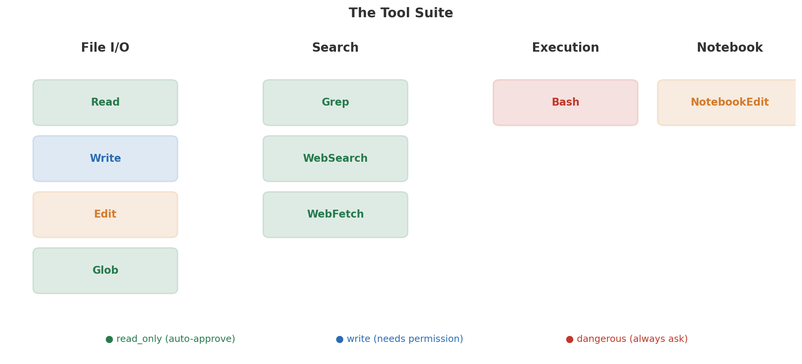
The Tool Suite: Read, Write, Edit, Glob, Grep, Bash

Slide 5
Read Tool — Returns File Content with Line Numbers
{"name": "Read", "description": "Read a file. Returns content with line numbers.", "input_schema": { "properties": { "file_path": {"type": "string"}, "offset": {"type": "integer", "description": "Start line"}, "limit": {"type": "integer", "description": "Num lines to read"} }, "required": ["file_path"] }} # Also reads: images (base64), PDFs, Jupyter notebooks # read_only=True → auto-approved in "auto" permission mode
Edit tool: exact string replacement (old_string → new_string). More surgical than Write.

Slide 6
2
The Bash Tool & Permission Gates

Slide 7
Bash Tool — Power and Danger
The agent can now:
• Run Python scripts it just wrote: python analyze_cells.py
• Install packages: pip install scikit-image
• Git commands: git diff, git log
• Data processing: ffmpeg, imagemagick, ls -la
But also could: rm -rf / or curl malicious_url | bash
→ This is why permission gates are essential

Slide 8
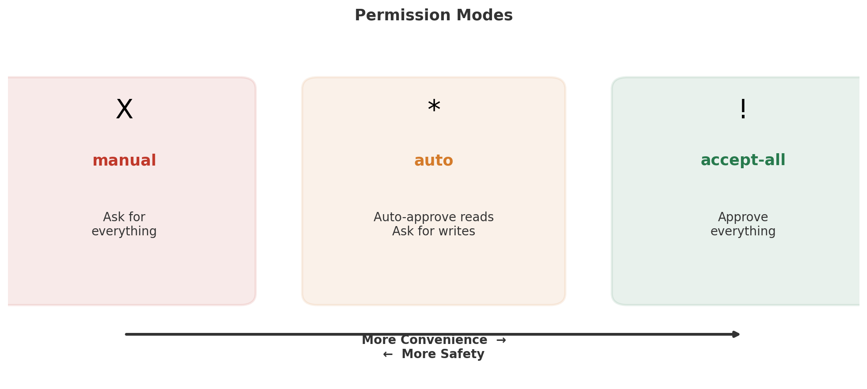
Three Permission Modes

Slide 9
3
System Prompt Engineering

Slide 10
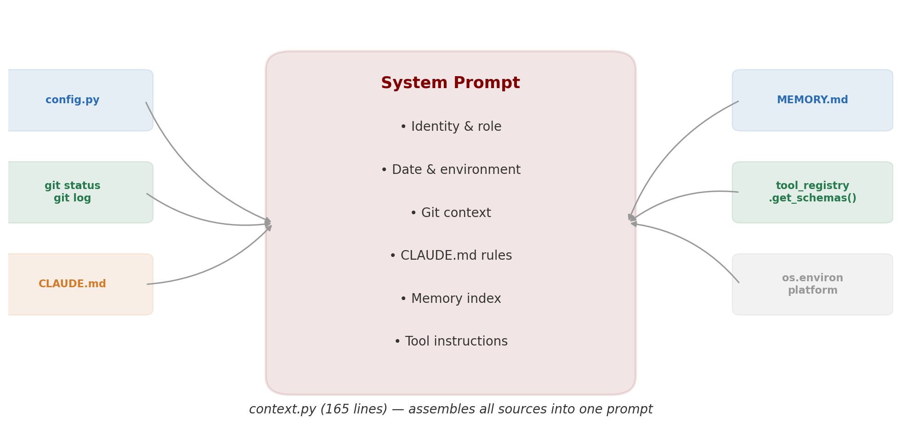
Building the System Prompt — context.py

Slide 11
Domain-Specific System Prompts for Biomedical AI
Include domain knowledge:
"This project analyzes H&E stained histopathology slides."
"Standard magnifications: 5x, 10x, 20x, 40x."
Include safety constraints:
"Never delete patient data."
"Always confirm before overwriting analysis results."
Include conventions:
"Use scikit-image for segmentation, pandas for stats."
Good tool descriptions are critical — the LLM reads them to decide
which tool to call

Slide 12
4
Context Window Management

Slide 13
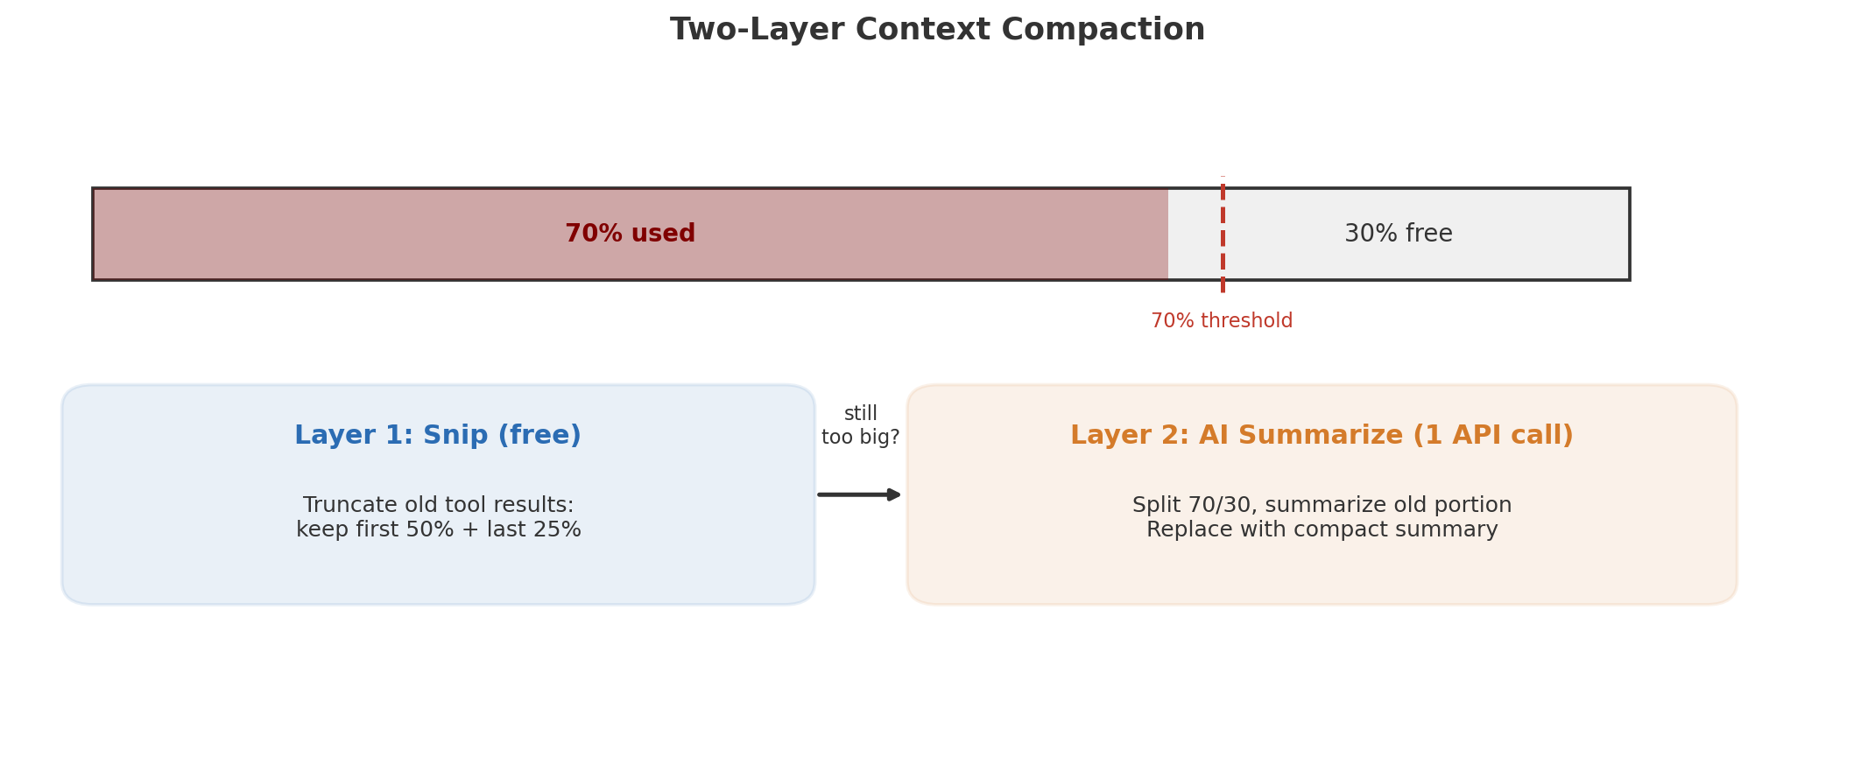
Two-Layer Context Compaction
compaction.py (196 lines). Without this, long analysis sessions crash.

Slide 14
Demo: Agent Writes & Runs Analysis Script
User: "Read all .tiff files in slides/, write a Python script that applies
Otsu thresholding, counts cells, saves results to CSV, show stats."
Agent execution:
1. Glob("slides/*.tiff") → finds 10 slides
2. Read(sample file) → inspects format
3. Write("analyze.py") → creates Python script
4. Bash("python analyze.py") → runs it
5. ❌ Script error → Read(traceback) → Edit("analyze.py") → re-run
6. Read("results.csv") → final text summary
The agent debugs its own code iteratively!

Slide 15
Wrap-Up & Looking Ahead
What we built: tools.py + context.py + compaction.py
Our mini Claude Code can now read, write, search, and execute
Key insight: coding agent = agent loop + tools + system prompt + compaction
These 4 components (< 700 lines) give 80% of Claude Code's capability
Next (Lec. 35): RAG, persistent memory, and multi-agent systems
→ search literature, remember past sessions, delegate to sub-agents

