Slide 1
Lecture 35
RAG, Memory & Multi-Agent Systems
Theme 4: Agentic Systems — Building a Mini Claude Code (4/5)
CSCI 3397 / PSYC 3317: Biomedical Image Analysis | Spring 2026 | Donglai Wei

Slide 2
Housekeeping
Recap: Lec. 34 — File I/O tools, Bash, system prompt, context compaction
Today: Three capabilities for complex workflows:
1. RAG — retrieve external knowledge
2. Memory — persist across sessions
3. Multi-agent — delegate to specialized sub-agents
Code: nano-claude-code memory/, multi_agent/, mcp/

Slide 3
1
RAG — Retrieval-Augmented Generation

Slide 4
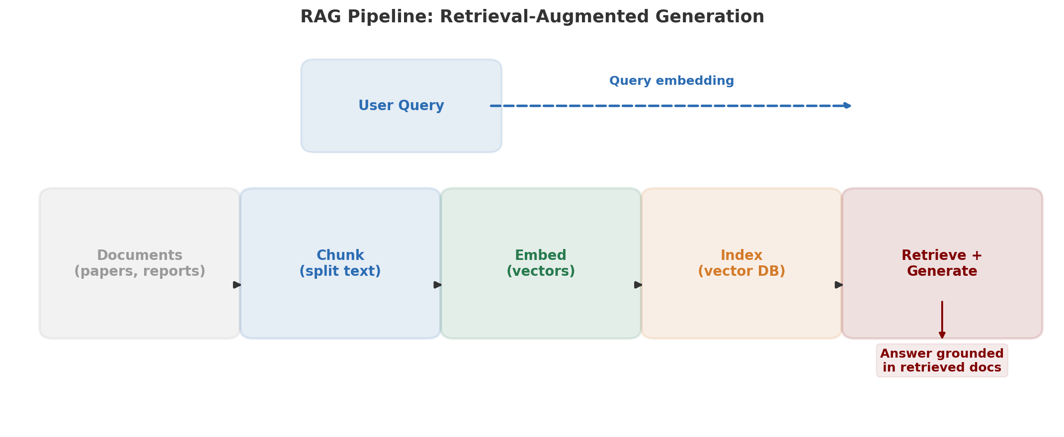
The RAG Pipeline

Slide 5
RAG as a Tool (Not a Standalone System)
# RAG is just another tool the agent can call: tools = [{ "name": "SearchLiterature", "description": "Search indexed medical literature.\nReturns relevant passages with citations.", "input_schema": { "properties": { "query": {"type": "string"} } } }] # The agent decides WHEN to search: # 1. Read the slide # 2. Form a hypothesis # 3. Search for supporting literature # Much more flexible than a fixed RAG pipeline!
Biomedical RAG: PubMed abstracts, radiology archives, clinical protocols

Slide 6
Biomedical RAG Examples
Index radiology archive → "Find prior reports with similar findings"
Index PubMed abstracts → "Differential diagnosis for 2cm hypodense liver lesion?"
Index clinical protocols → "Standard staining protocol for Ki-67?"
Embedding models for biomedical text:
General: OpenAI text-embedding-3-small, Cohere embed-v3
Domain-specific: PubMedBERT embeddings, BioLORD
→ Evaluate retrieval quality on your domain before committing

Slide 7
2
Persistent Memory

Slide 8
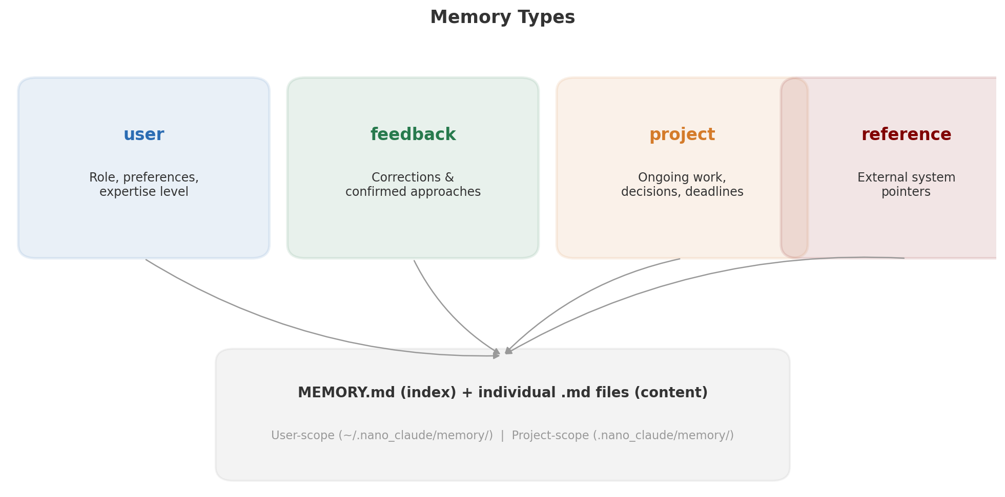
Four Memory Types

Slide 9
Memory in Practice
Each memory is a Markdown file with YAML frontmatter:
---
name: staining_protocol
type: project
---
Use 10-min hematoxylin, 3-min eosin. Deparaffinize at 60°C.
Memory tools: MemorySave, MemorySearch, MemoryDelete
User says: "Remember we use 20x magnification for this cohort"
→ Agent saves it, applies in all future sessions
Memory vs RAG:
Memory = small, curated, personal, always loaded
RAG = large external corpora, searched on demand

Slide 10
3
Multi-Agent Systems

Slide 11
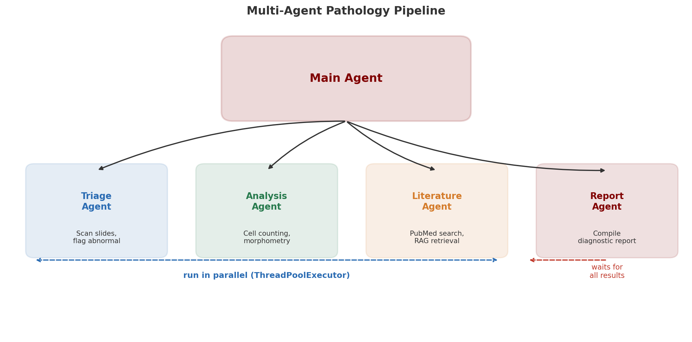
Multi-Agent Pathology Pipeline

Slide 12
Sub-Agent Implementation (ThreadPoolExecutor)
class SubAgentManager: def __init__(self, max_workers=3): self.executor = ThreadPoolExecutor( max_workers=max_workers) def spawn(self, prompt, system_prompt, tools): future = self.executor.submit( agent_loop, prompt, tools, system_prompt) return task_id # Depth limiting: max 3 levels of nesting # agent → sub-agent → sub-sub-agent (max) # Prevents infinite recursion # Built-in agent types: # researcher — read-only tools # coder — read + write tools # reviewer — code review with severity levels
nano-claude-code multi_agent/: cooperative cancellation, fresh context per sub-agent

Slide 13
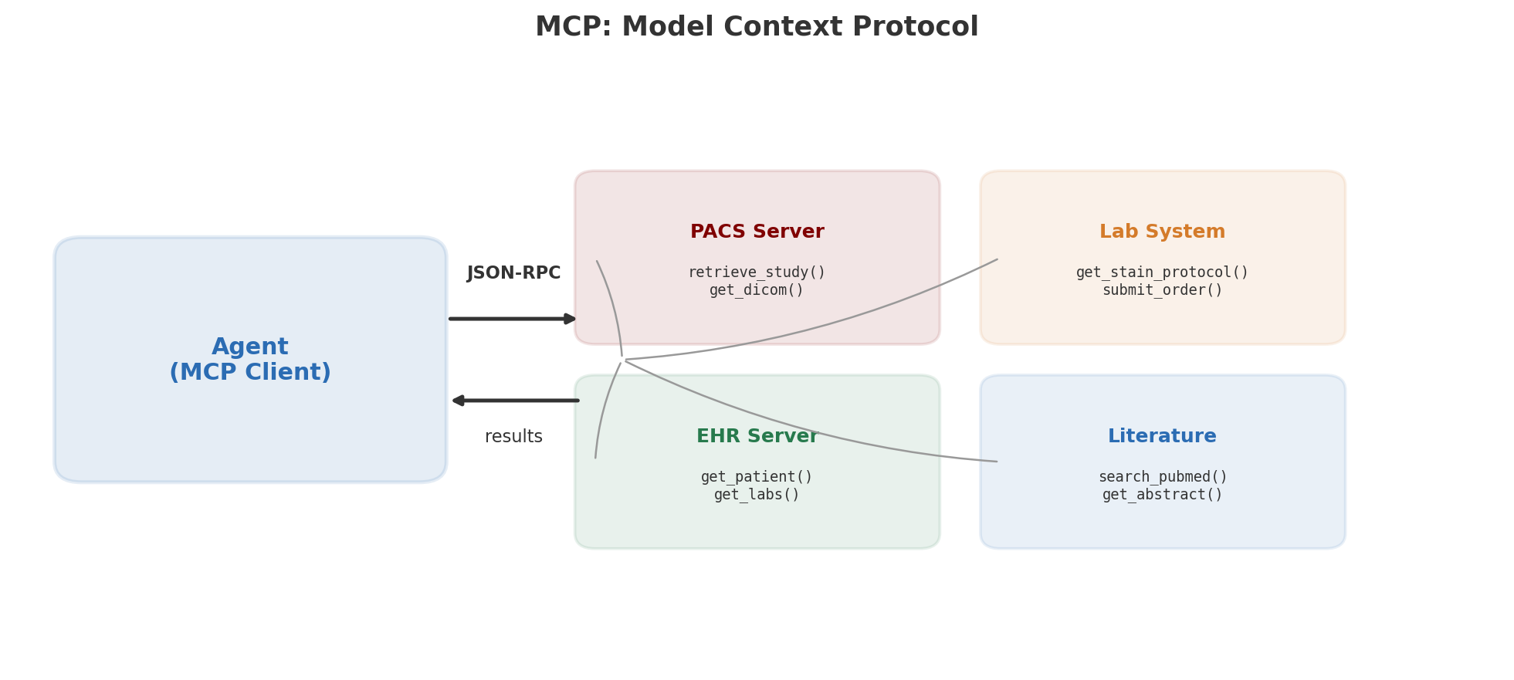
MCP: Connecting Agents to Clinical Systems
Standard protocol — auditable access without embedding credentials in the agent

Slide 14
Wrap-Up & Looking Ahead
RAG → external knowledge Memory → session continuity
Sub-agents → parallelism MCP → external systems
Together: single-loop agent → system for real clinical workflows
When NOT to use multi-agent: if the task is sequential and simple,
one agent is better — sub-agents add latency + complexity
Our mini Claude Code now has all major components!
Next (Lec. 36): Full architecture walkthrough, deployment
(HIPAA, FDA), and live demo of the complete system

