Slide 1
Lecture 36
Putting It All Together Agentic Biomedical AI
Theme 4: Agentic Systems — Building a Mini Claude Code (5/5)
CSCI 3397 / PSYC 3317: Biomedical Image Analysis | Spring 2026 | Donglai Wei

Slide 2
Housekeeping
What we built over Lec. 32-35:
32: LLM APIs & agency spectrum (providers.py)
33: Tool use & agent loop (tool_registry.py, agent.py)
34: File I/O, Bash, system prompts, compaction (tools.py, context.py, compaction.py)
35: RAG, memory, multi-agent, MCP (memory/, multi_agent/, mcp/)
Today: Full system, agent landscape, deployment, live demo
Action: ps4 due; final project slides due

Slide 3
1
The Full Architecture

Slide 4
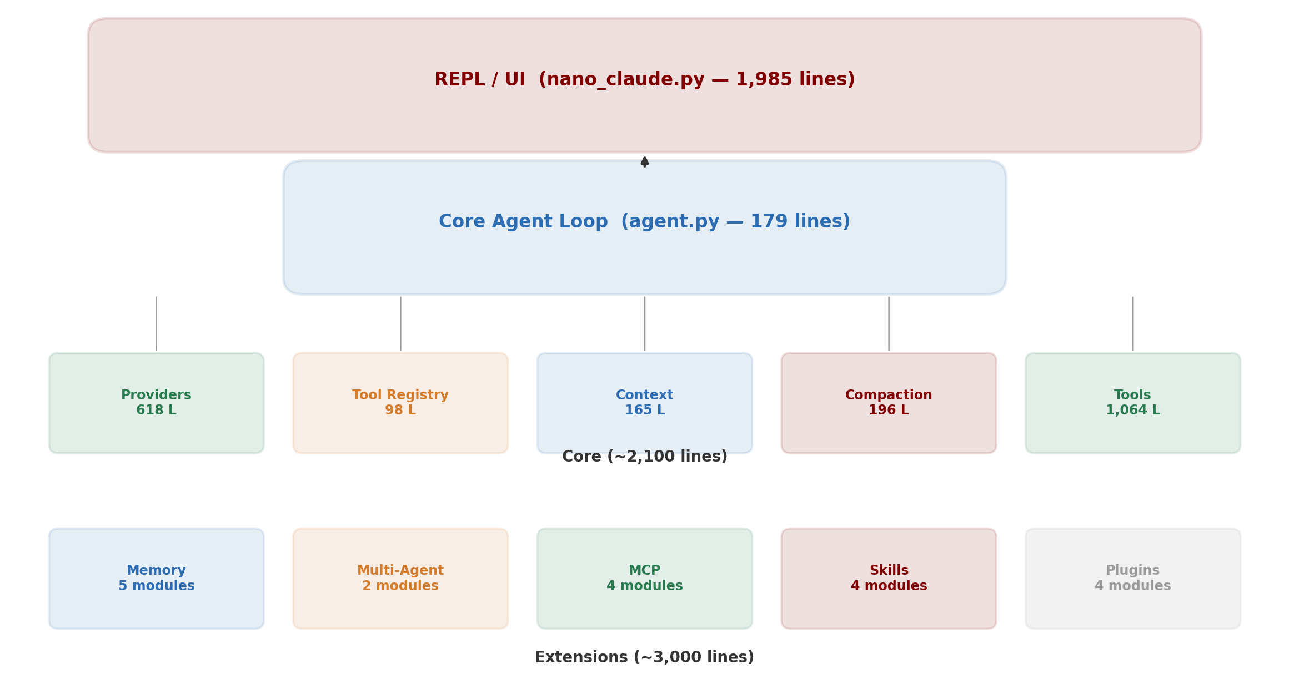
nano-claude-code: Complete Architecture

Slide 5
REPL, Skills & Plugins
REPL (nano_claude.py — 1,985 lines):
Interactive loop: read input → run agent → stream output
Slash commands: /model, /config, /memory, /save, /tasks
Permission prompts: ask user before writes/execution
Skills — reusable prompt templates (Markdown + YAML):
/commit → loads skill prompt → runs through agent loop
/analyze-slide → standard cell counting pipeline
Plugins — runtime-extensible tools:
Install from git: dicom-tools adds ReadDICOM, ExtractMetadata

Slide 6
2
The Agent Landscape

Slide 7
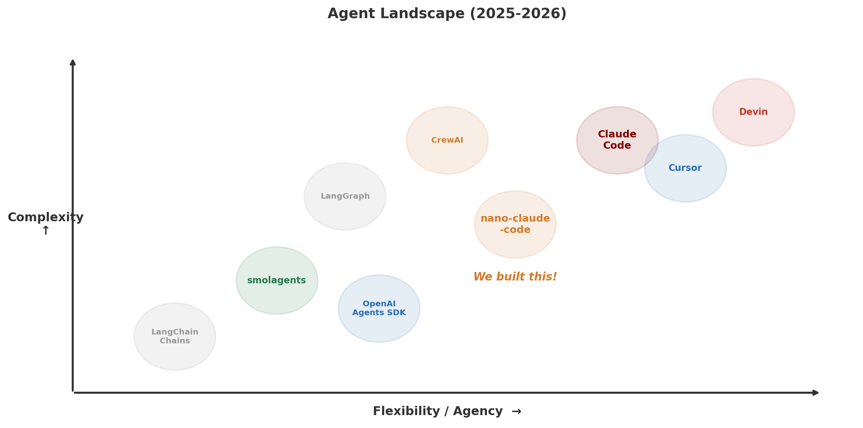
Where Does Our Agent Fit?

Slide 8
Architectural Approaches Compared
JSON tool calling (OpenAI, LangChain):
LLM outputs JSON → parse → execute. Safe, easy to validate.
Code agents (smolagents, Claude Code):
LLM writes executable Python. More flexible, needs sandboxing.
Graph-based (LangGraph):
Predefined state machine with LLM at decision nodes.
More predictable, less flexible.
The trade-off: more agency = more capability but less predictability
For clinical use, find the right balance

Slide 9
3
Deploying Biomedical AI Agents

Slide 10
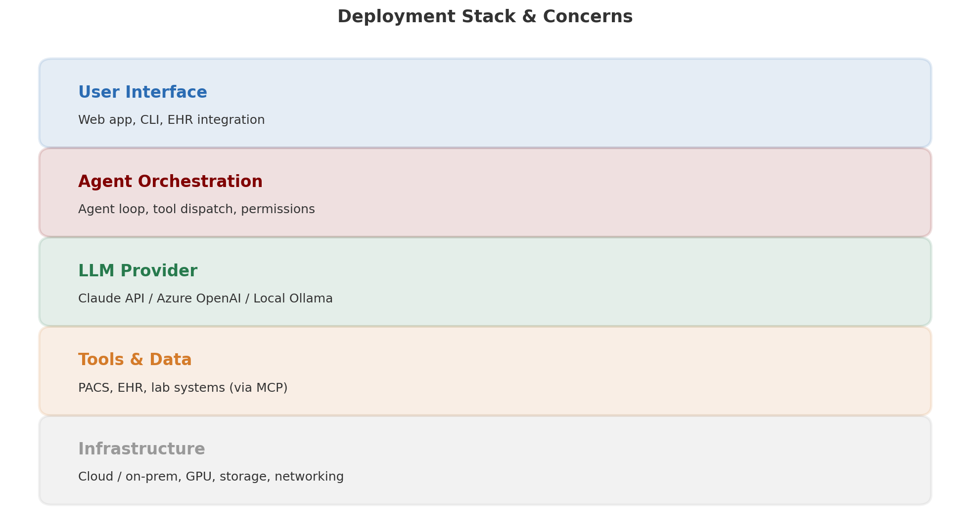
The Deployment Stack

Slide 11
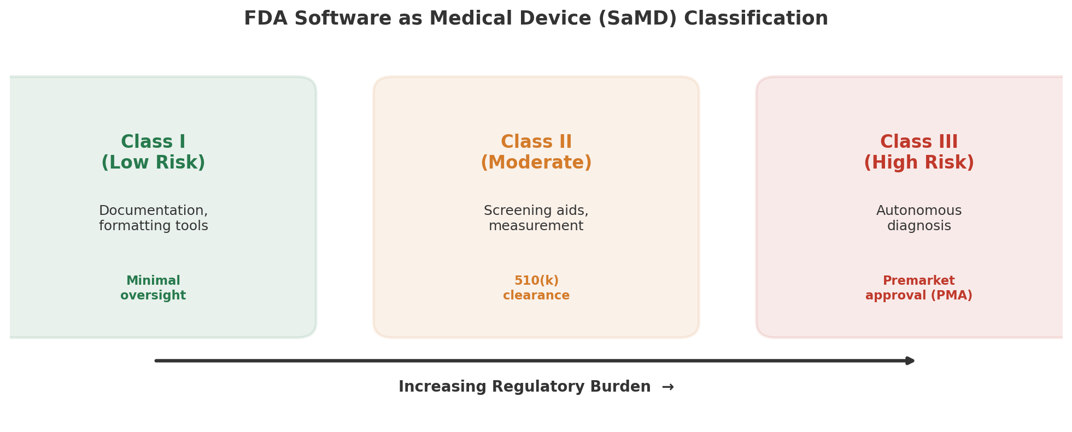
FDA: Software as Medical Device (SaMD)

Slide 12
HIPAA & Patient Privacy
PHI: patient names, dates, MRNs, images with metadata
Cloud API risk: sending PHI to Claude/GPT may violate HIPAA
unless a BAA (Business Associate Agreement) is in place
Solutions:
• Use providers with BAA (Anthropic, Azure OpenAI, AWS Bedrock)
• De-identify data before API calls
• Run local models (Ollama, vLLM) on hospital infrastructure
Our architecture supports this: providers.py abstracts over cloud & local
Switch Claude → Ollama with one config change

Slide 13
Latency, Cost & Monitoring
Latency: agent loops = multiple round trips (5-step = 5 API calls)
→ Use fast models for simple steps, parallel tool calls, caching
Cost: typically $0.01-0.10 per analysis
Monitoring:
• Log every tool call, LLM response, user interaction
• Track: token usage, latency, error rates, approval/rejection
• Drift detection: compare outputs against validation set
Permission model in production:
auto: routine analyses | manual: anything touching records
Never accept-all in production

Slide 14
4
Live Demo

Slide 15
End-to-End: Kidney Biopsy Cohort Analysis
1. Agent reads MEMORY.md → recalls project context, Otsu thresholding, 20x
2. Glob("slides/*.tiff") → finds 10 slides
3. Writes count_glomeruli.py (scikit-image watershed)
4. Bash("python count_glomeruli.py") → counts and areas
5. SearchLiterature("normal glomerular area") → retrieves 3 papers
6. Writes final Markdown report:
• Per-slide counts and areas
• Comparison to literature normals
• Flagged abnormal slides
7. MemorySave → records analysis parameters for future sessions

Slide 16
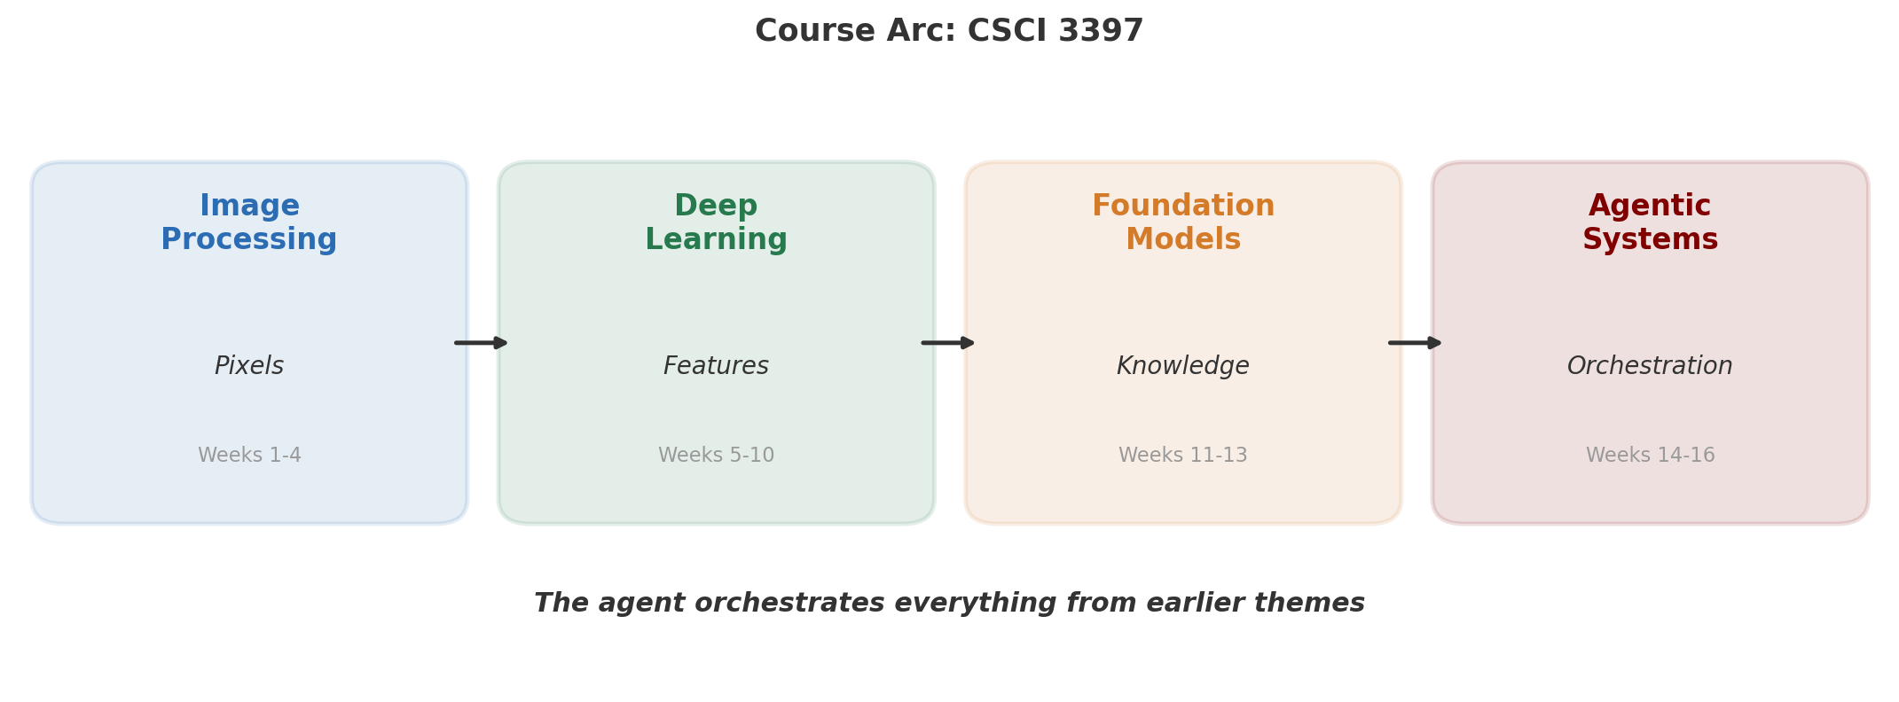
The Arc of CSCI 3397

Slide 17
What We Built in 5 Lectures
Lec 32: providers.py (618 L) — talk to LLMs
Lec 33: agent.py + tool_registry.py (277 L) — core loop + dispatch
Lec 34: tools.py + context.py + compaction.py (1,425 L) — real tools
Lec 35: memory/ + multi_agent/ + mcp/ (~3,000 L) — extensions
Lec 36: full system (~5,000 L) — complete coding agent
An AI agent is not magic —
it's a while loop, a tool registry, and a good system prompt.
Understanding the architecture demystifies tools like Claude Code
and empowers you to build domain-specific agents
for any biomedical workflow.

Slide 18
Good Luck with Final Projects!
Presentations: Fri Apr 24, Mon Apr 27, Wed Apr 29
The agent we built can USE everything from earlier themes:
• Image processing (weeks 1-4) — filtering, thresholding
• Deep learning (weeks 5-10) — U-Net, detection, segmentation
• Foundation models (weeks 11-13) — SAM, CLIP, LLaVA
• Agentic systems (weeks 14-16) — orchestrate all of the above
Thank you for a great semester!

