Slide 1
Muscle + Tendon = MTU Utilizing Ultrasound to Identify Contributions of Muscle and Tendon for Upper Limb Dynamical Tasks
Daniel A. Hagen & Christopher M. Laine
Brain-Body Dynamics Lab
May 7, 2018

Slide 2
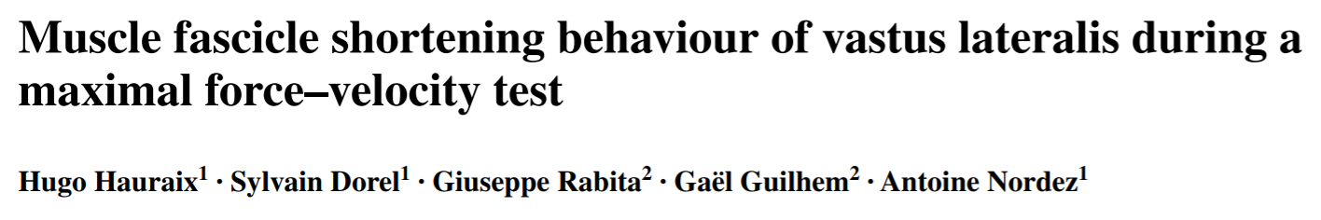
Previous Work
“Muscle fascicles shortening velocity increased linearly with the increase in knee joint velocity up to the maximal joint velocity.¹”
“Contribution of muscle fascicles to the muscle–tendon unit shortening velocity was much higher for the vastus lateralis in this study compared to the gastrocnemius medialis in two previous studies.¹”
“Contrary to the results obtained for plantar flexions… the muscle fascicle shortening velocity plateaued for joint velocities above 240° s⁻¹, suggesting an increase in the tendinous tissues contribution with the increase in knee extension velocity [which] may be associated with different mechanical tendon properties.¹”
Linear relationship for VL during unloaded movements.
This relationship changes across muscles.
Tendon properties could induce nonlinear relationships
¹Hauraix, H., Dorel, S., Rabita, G., Guilhem, G. and Nordez, A., 2017. Muscle fascicle shortening behaviour of
vastus lateralis during a maximal force–velocity test. European journal of applied physiology, 117(2), pp.289-299.
Notes:
ultrasound sam- pling frequency was set between 500 and 2000 Hz,

Slide 3
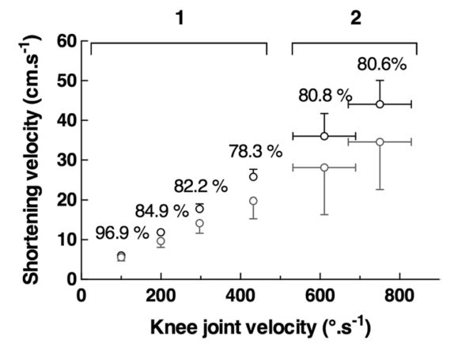
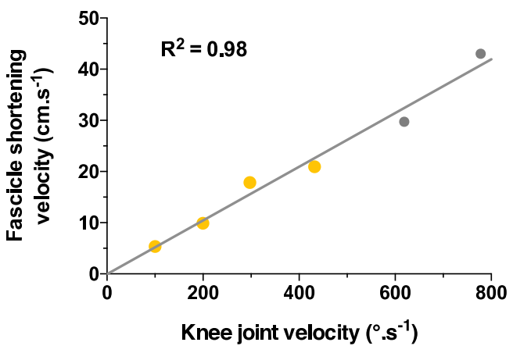


Previous Work
Regardless of the condition tested,
contributions of muscle and tendon
to the muscle–tendon unit shortening velocity
were almost constant.
Musculotendon Velocity
vs.
Muscle Velocity
$$r_{i,j}\left(θ_{j}\right)≈\frac{∂l_{m,i}}{∂θ_{j}}$$
¹Hauraix, H., Dorel, S., Rabita, G., Guilhem, G. and Nordez, A., 2017. Muscle fascicle shortening behaviour of
vastus lateralis during a maximal force–velocity test. European journal of applied physiology, 117(2), pp.289-299.
Notes:
Yellow and gray points corresponded to isokinetic and isoinertial conditions, respectively.

Slide 4
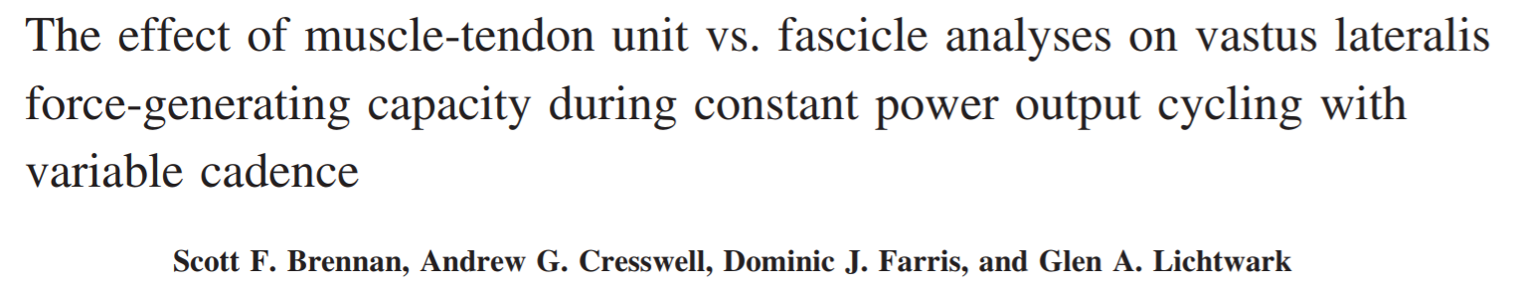
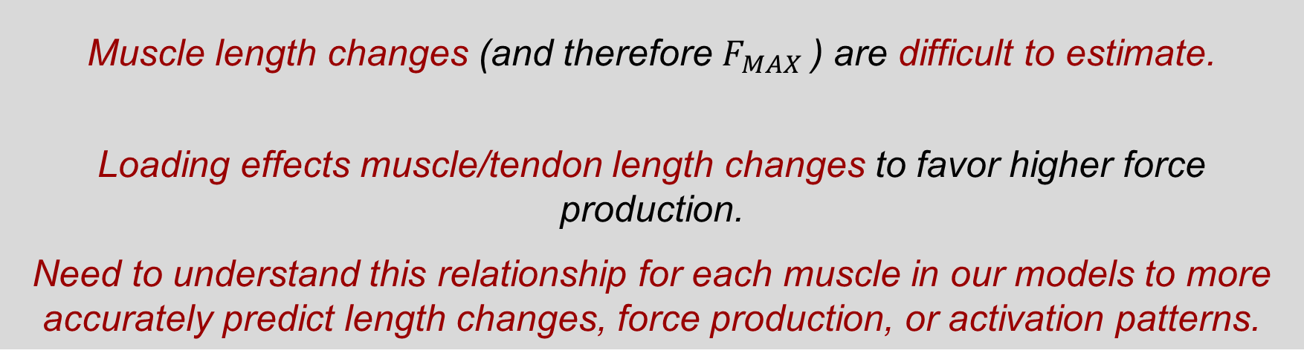
Previous Work
“Muscle-tendon unit (MTU) length changes can be estimated from joint kinematics; however, contractile element length changes are more difficult to predict during dynamic contractions… these differences would affect the predicted force capacity of the muscle.²”
“[There was a] significant increase in fascicle shortening as cadence decreased … whereas there were no significant differences in MTU lengths across any of the cycling conditions.²”
“These results reinforce the need to determine muscle mechanics in terms of separate contractile element and connective tissue length changes during isokinetic contractions, as well as dynamic movements like cycling.²”
Muscle length changes (and therefore $F_{MAX}$) are difficult to estimate.
Loading effects muscle/tendon length changes to favor higher force production.
Need to understand this relationship for each muscle in our models to more accurately predict length changes, force production, or activation patterns.
²Brennan, S.F., Cresswell, A.G., Farris, D.J. and Lichtwark, G.A., 2018. The effect of muscle-tendon unit vs fascicle analyses on vastus lateralis force generating capacity during constant power output cycling with variable cadence. Journal of Applied Physiology.
Notes:
We demonstrate that vastus lateralis (VL) muscle tendon unit (MTU) length changes do not adequately reflect the underlying fascicle mechanics during cycling. When examined across different pedaling cadence conditions, the force-generating potential measured only at the level of MTU (or joint) overestimated the maximum force capacity of VL compared with analysis using fascicle level data.

Slide 5
Previous Work
For exercises involving concentric contractions, muscle/tendon interactions:
Enhance the work produced by the muscle–tendon unit (Ishikawa and Komi 2004; Kawakami et al. 2002; Finni et al. 2001)
Improve efficiency (Lichtwark and Barclay 2010)
Reduce muscle fiber stretching to limit risk of strain/injury (Guilhem et al. 2016; Konow et al. 2012) ¹
¹Hauraix, H., Dorel, S., Rabita, G., Guilhem, G. and Nordez, A., 2017. Muscle fascicle shortening behaviour of
vastus lateralis during a maximal force–velocity test. European journal of applied physiology, 117(2), pp.289-299.
Notes:
Yellow and gray points corresponded to isokinetic and isoinertial conditions, respectively.

Slide 6
Question:
How do these relationships change for the muscles of the arm during activities for daily living (ADLs)?
Notes:
Yellow and gray points corresponded to isokinetic and isoinertial conditions, respectively.

Slide 7
Hypothesis:
Tendon lengthening vs. muscle lengthening will have (1) well-defined and (2) task-depended relationships.
Notes:
For a given isokinetic elbow rotation task, the difference of the estimated MTU velocity and the measured muscle velocity will be calculated to determine what relationship, if any, these two quantities share.
Possible relationships include:
Compensating: after a certain threshold, the tendon takes on more of the length change to aid muscle proficiency.
Linear: for unloaded tasks, the difference between MTU and muscle velocity is linear.
Saturating: after a certain threshold, the tendon cannot lengthen any further and all length change is taken up by the muscle.

Slide 8
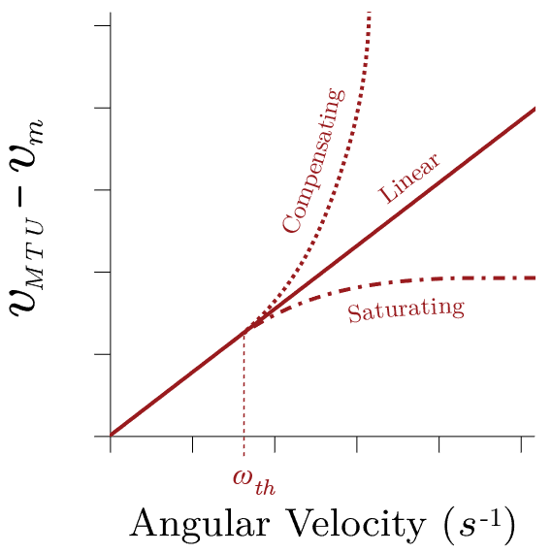
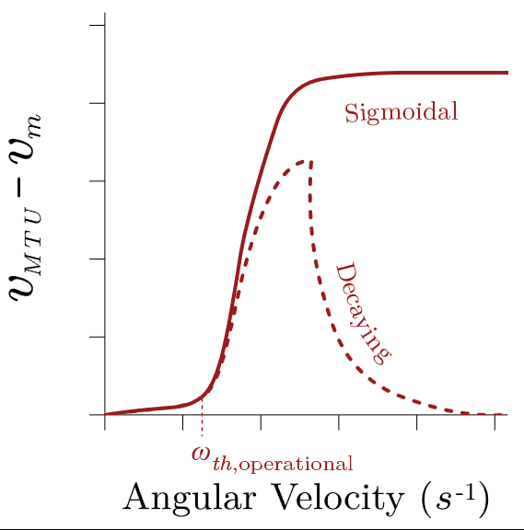

Proposed Work
Determine relationship by calculating the difference between the estimated MTU velocity and the measured muscle velocity for isokinetic single joint rotations.
Possible relationships include:
Compensating: The tendon takes on more of the length change to aid muscle proficiency at high $ω.$
Saturating: The tendon cannot lengthen any further at high $ω$ (length change is taken up by the muscle).
Linear
Additionally, the relationship could exhibit an operational threshold, where the MTU velocity is nearly equal to muscle velocity, with possible relationships:
Sigmoidal
Decaying
Notes:
For a given isokinetic elbow rotation task, the difference of the estimated MTU velocity and the measured muscle velocity will be calculated to determine what relationship, if any, these two quantities share.
Possible relationships include:
Compensating: after a certain threshold, the tendon takes on more of the length change to aid muscle proficiency.
Linear: for unloaded tasks, the difference between MTU and muscle velocity is linear.
Saturating: after a certain threshold, the tendon cannot lengthen any further and all length change is taken up by the muscle.

Slide 9
Implications
Curve shape will determine if and when it is appropriate to estimate muscle velocities as MTU velocities.
Well-defined and robust relationships across muscles or across tasks will allow for scaling and corrections to be made to provide more accurate estimates.
Results will either justify previously utilized muscle velocity simplifications or illustrate need for more physiologically accurate models with muscle contraction dynamics.

