Slide 1
BME 790 Spring 2017 Weekly Summary
Author: Daniel A Hagen
Week: 01/16/17-01/22/17
Relevant Topics: Manifolds, Lie Groups, Tangent Spaces

Slide 2
Manifolds
“A manifold is a space that is locally like Euclidean space but may have a more complicated global structure¹”
A manifold is structure that can define a configuration space while meeting these requirements:
- the infinitesimal region around each point must be homeomorphic.
- i.e. invertible (bijective – full one-to-one correspondence) and continuous.
- each point on the manifold must correspond to at least one chart in an atlas.
Often these infinitesimal regions (i.e. neighborhoods) must be C^{k}-differentiable or diffeomorphic.
- homeomorphic region that is also differentiable (as is its inverse!)
Three main building blocks (line ℝ¹, circle 𝕊¹, and sphere 𝕊²) can be used to find manifolds by:
- direct product (combination of spaces without mixing elements – thus preserving a group’s action)
- indirect product (elements may act on other spaces – thus some groups lose their properties)
¹An Introduction to Geometric Mechanics and Differential Geometry by Ross L Hatton and Howie Choset

Slide 3
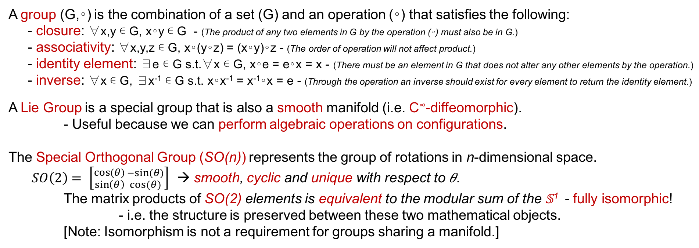
Lie Groups
A group (G,∘) is the combination of a set (G) and an operation (∘) that satisfies the following:
- closure: ∀x,y ∊ G, x∘y ∊ G - (The product of any two elements in G by the operation (∘) must also be in G.)
- associativity: ∀x,y,z ∊ G, x∘(y∘z) = (x∘y)∘z - (The order of operation will not affect product.)
- identity element: ∃e ∊ G s.t.∀x ∊ G, x∘e = e∘x = x - (There must be an element in G that does not alter any other elements by the operation.)
- inverse: ∀x ∊ G, ∃x⁻¹ ∊ G s.t. x∘x⁻¹ = x⁻¹∘x = e - (Through the operation an inverse should exist for every element to return the identity element.)
A Lie Group is a special group that is also a smooth manifold (i.e. C∞-diffeomorphic).
- Useful because we can perform algebraic operations on configurations.
The Special Orthogonal Group (SO(n)) represents the group of rotations in n-dimensional space.
$SO\left(2\right)= \left[{cos⁡(θ) \atop \sin\left(θ\right)}{−sin⁡(θ) \atop cos⁡(θ)}\right]$ → smooth, cyclic and unique with respect to 𝜃.
The matrix products of SO(2) elements is equivalent to the modular sum of the 𝕊¹ - fully isomorphic!
- i.e. the structure is preserved between these two mathematical objects.
[Note: Isomorphism is not a requirement for groups sharing a manifold.]

Slide 4
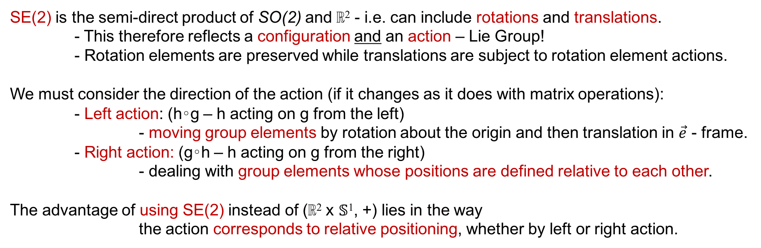
Special Euclidean Groups
SE(2) is the semi-direct product of SO(2) and ℝ² - i.e. can include rotations and translations.
- This therefore reflects a configuration and an action – Lie Group!
- Rotation elements are preserved while translations are subject to rotation element actions.
We must consider the direction of the action (if it changes as it does with matrix operations):
- Left action: (h∘g – h acting on g from the left)
- moving group elements by rotation about the origin and then translation in $\vec{e}$ - frame.
- Right action: (g∘h – h acting on g from the right)
- dealing with group elements whose positions are defined relative to each other.
The advantage of using SE(2) instead of (ℝ² x 𝕊¹, +) lies in the way
the action corresponds to relative positioning, whether by left or right action.

Slide 5
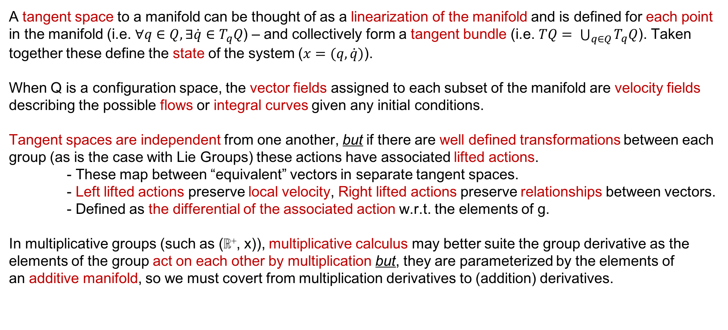
Tangent Spaces
A tangent space to a manifold can be thought of as a linearization of the manifold and is defined for each point in the manifold (i.e. $∀q∈Q, ∃\dot{q}∈T_{q}Q$) – and collectively form a tangent bundle (i.e. $TQ= \bigcup_{q∈Q}{T_{q}Q}$). Taken together these define the state of the system ($x=(q,\dot{q})$).
When Q is a configuration space, the vector fields assigned to each subset of the manifold are velocity fields describing the possible flows or integral curves given any initial conditions.
Tangent spaces are independent from one another, but if there are well defined transformations between each group (as is the case with Lie Groups) these actions have associated lifted actions.
- These map between “equivalent” vectors in separate tangent spaces.
- Left lifted actions preserve local velocity, Right lifted actions preserve relationships between vectors. - Defined as the differential of the associated action w.r.t. the elements of g.
In multiplicative groups (such as (ℝ⁺, x)), multiplicative calculus may better suite the group derivative as the elements of the group act on each other by multiplication but, they are parameterized by the elements of an additive manifold, so we must covert from multiplication derivatives to (addition) derivatives.

Slide 6
Tangent Spaces (Cont.)
This is done by the left and right lifted actions. - Multiplication derivatives relate the rate of change of function as a ratio of system parameters.
- The left and right multiplication (group) derivatives are the matrix forms of the right and left lifted actions mapping parameter velocities back to the origin.
- This is beneficial as it allows us to use the additive properties of the manifold.
Two configurations with the same group (multiplicative) velocities are unlikely to have the same manifold (addition) velocities.
- Left lifted action reconciles this by finding pairs of manifold velocities in the tangent spaces of different configurations that share the same group velocities (i.e. equivalent w.r.t. group actions!)
Therefore, integrating these manifold velocities (with standard addition integration) gives the same results as evaluating the product integral of the group velocities (which is easier and perhaps more intuitive).

Slide 7
Conclusions/Impressions
Smooth manifolds could be used to describe neuromechanical systems.
- Configuration spaces could be anything from joint angle space, muscle length space, or even potentially neural drive space.
Tangent spaces help to define the state of the system.
- For neuromechanical systems, theses states are associated with constraints.
Creating flows or integral curves across these manifolds (while mindful of constraints) may produce control strategies.

