Slide 1
BME 790 Spring 2017 Weekly Summary
Author: Daniel A Hagen
Week: 01/23/17-01/29/17
Relevant Topics: spatial and body velocities in two dimensions, lifted actions, geodesics, adjoint operators, and exponential map

Slide 2
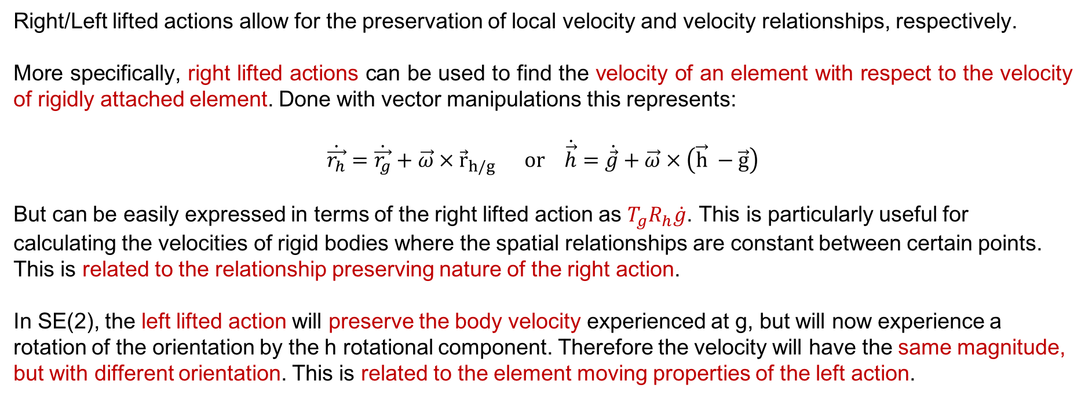
Lifted Actions (Revisted)
Right/Left lifted actions allow for the preservation of local velocity and velocity relationships, respectively.
More specifically, right lifted actions can be used to find the velocity of an element with respect to the velocity of rigidly attached element. Done with vector manipulations this represents:
$$\dot{\vec{r_{h}}}=\dot{\vec{r_{g}}}+\vec{ω} × {\vec{r}}_{h/g} or \dot{\vec{h}}=\dot{\vec{g}}+\vec{ω} × \left(\vec{h} −\vec{g}\right)$$
But can be easily expressed in terms of the right lifted action as $T_{g}R_{h}\dot{g}$. This is particularly useful for calculating the velocities of rigid bodies where the spatial relationships are constant between certain points. This is related to the relationship preserving nature of the right action.
In SE(2), the left lifted action will preserve the body velocity experienced at g, but will now experience a rotation of the orientation by the h rotational component. Therefore the velocity will have the same magnitude, but with different orientation. This is related to the element moving properties of the left action.

Slide 3
Geodesics
It is often useful to work with trajectories for which the system moves through the configuration space (Q) constant velocity – known as geodesics. For Lie groups there are two forms of geodesics:
- Those with constant velocity w.r.t. the manifold structure.
- Those with constant velocity w.r.t. the group action.
Geodesics on the manifold employ a metric structure for defining “length” and “speed” to ascertain the “shortest path” along the manifold (e.g., on a cylinder, these trajectories could be loops, axial lines, or helices on the surface of the manifold).
However, geodesics on a Lie group will require trajectories constant group velocity, which may not translate to flows along the “shortest path”. This can be further subdivided into left-invariant and right-invariant vector fields depending on the use of velocity chosen – either body velocity or spatial velocity (discussed on the next slide).

Slide 4
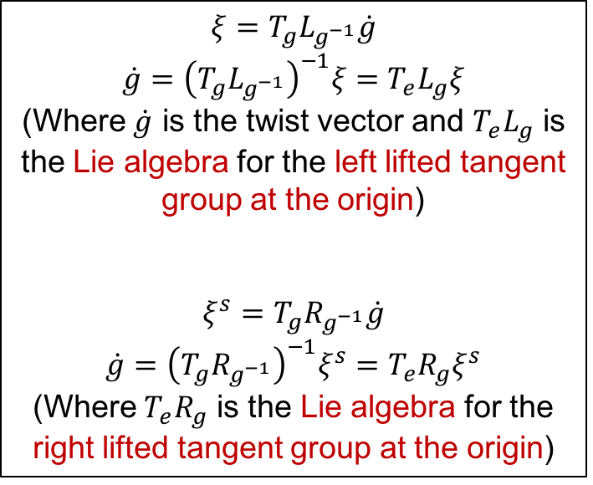
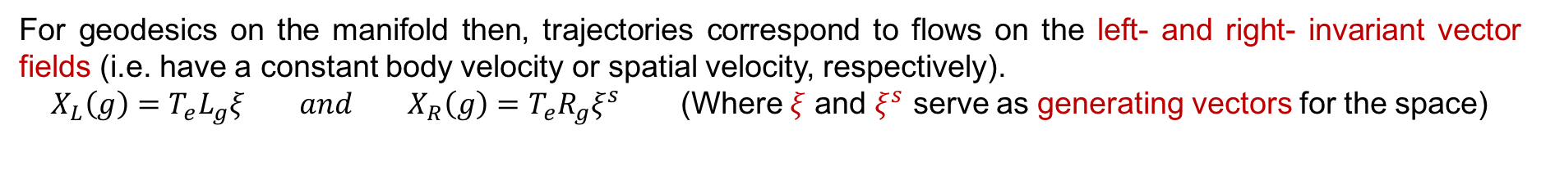
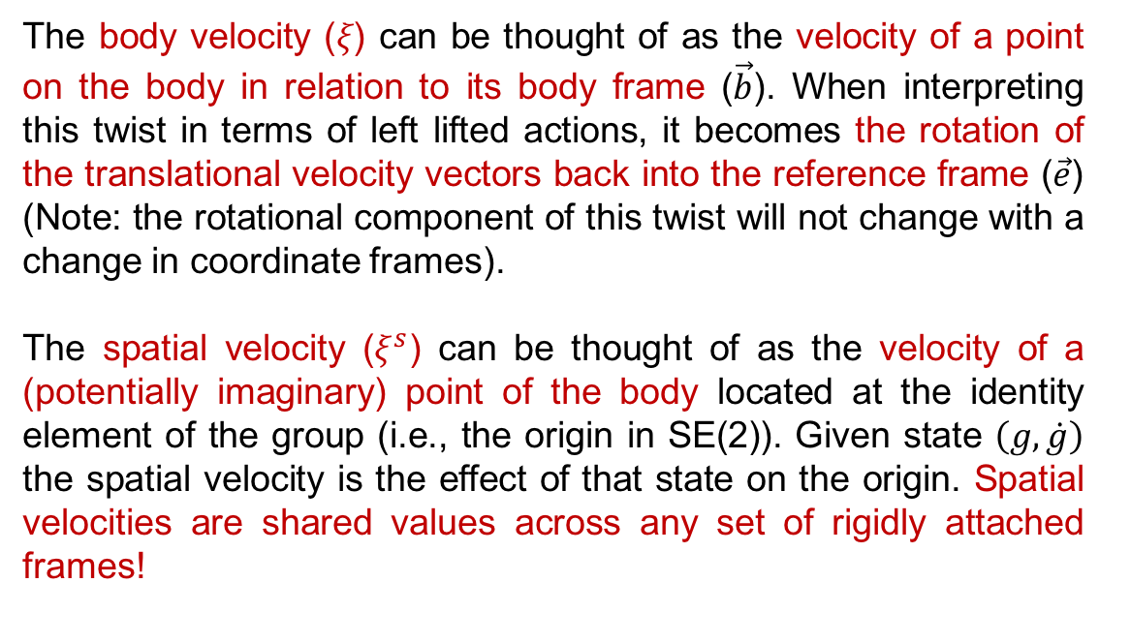
Body and Spatial Velocities
The body velocity (𝜉) can be thought of as the velocity of a point on the body in relation to its body frame ($\vec{b}$). When interpreting this twist in terms of left lifted actions, it becomes the rotation of the translational velocity vectors back into the reference frame ($\vec{e}$) (Note: the rotational component of this twist will not change with a change in coordinate frames).
The spatial velocity ($ξ^{s}$) can be thought of as the velocity of a (potentially imaginary) point of the body located at the identity element of the group (i.e., the origin in SE(2)). Given state $\left(g, \dot{g}\right)$ the spatial velocity is the effect of that state on the origin. Spatial velocities are shared values across any set of rigidly attached frames!
$$ξ=T_{g}L_{g^{−1}}\dot{g}$$
$\dot{g}={\left(T_{g}L_{g^{−1}}\right)}^{−1}ξ=T_{e}L_{g}ξ$
(Where $\dot{g}$ is the twist vector and $T_{e}L_{g}$ is the Lie algebra for the left lifted tangent group at the origin)
$$ξ^{s}=T_{g}R_{g^{−1}}\dot{g}$$
$\dot{g}={\left(T_{g}R_{g^{−1}}\right)}^{−1}ξ^{s}=T_{e}R_{g}ξ^{s}$
(Where $T_{e}R_{g}$ is the Lie algebra for the right lifted tangent group at the origin)
For geodesics on the manifold then, trajectories correspond to flows on the left- and right- invariant vector fields (i.e. have a constant body velocity or spatial velocity, respectively).
$X_{L}\left(g\right)=T_{e}L_{g}ξ and X_{R}\left(g\right)=T_{e}R_{g}ξ^{s}$ (Where $ξ$ and $ξ^{s}$ serve as generating vectors for the space)

Slide 5
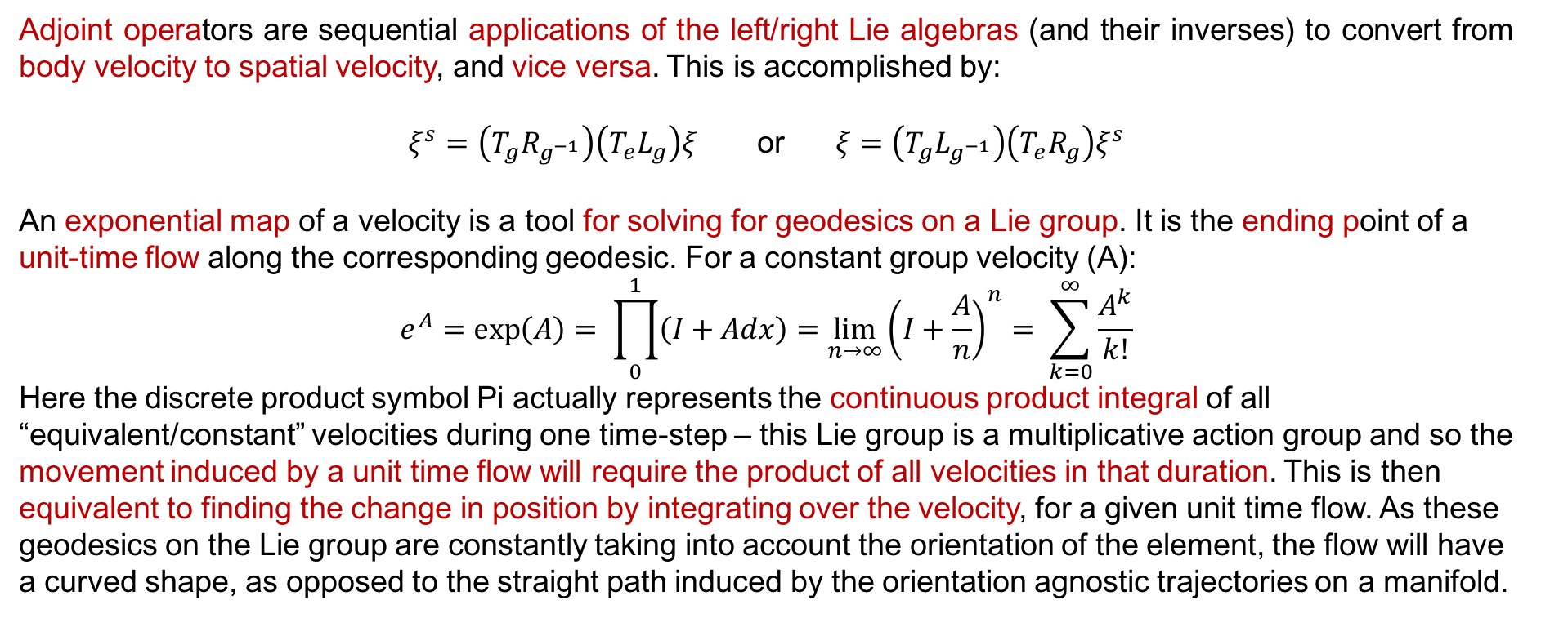
Adjoint Operators and Exponential Maps
Adjoint operators are sequential applications of the left/right Lie algebras (and their inverses) to convert from body velocity to spatial velocity, and vice versa. This is accomplished by:
$ξ^{s}=\left(T_{g}R_{g^{−1}}\right)\left(T_{e}L_{g}\right)ξ$ or $ξ=\left(T_{g}L_{g^{−1}}\right)\left(T_{e}R_{g}\right)ξ^{s}$
An exponential map of a velocity is a tool for solving for geodesics on a Lie group. It is the ending point of a unit-time flow along the corresponding geodesic. For a constant group velocity (A):
$$e^{A}=\exp\left(A\right)= \prod_{0}^{1}{\left(I+Adx\right)=\lim_{n→∞}{{\left(I+\frac{A}{n}\right)}^{n}}}= \sum_{k=0}^{∞}{\frac{A^{k}}{k!}}$$
Here the discrete product symbol Pi actually represents the continuous product integral of all “equivalent/constant” velocities during one time-step – this Lie group is a multiplicative action group and so the movement induced by a unit time flow will require the product of all velocities in that duration. This is then equivalent to finding the change in position by integrating over the velocity, for a given unit time flow. As these geodesics on the Lie group are constantly taking into account the orientation of the element, the flow will have a curved shape, as opposed to the straight path induced by the orientation agnostic trajectories on a manifold.

Slide 6
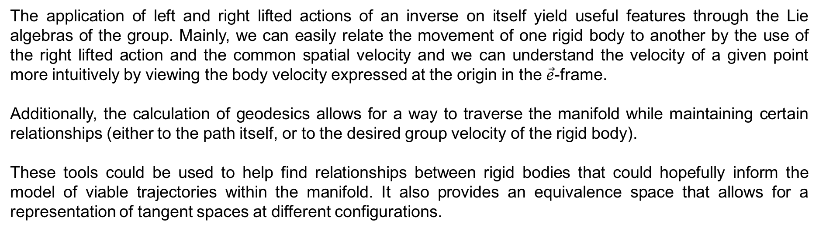
Conclusions/Impressions
The application of left and right lifted actions of an inverse on itself yield useful features through the Lie algebras of the group. Mainly, we can easily relate the movement of one rigid body to another by the use of the right lifted action and the common spatial velocity and we can understand the velocity of a given point more intuitively by viewing the body velocity expressed at the origin in the $\vec{e}$-frame.
Additionally, the calculation of geodesics allows for a way to traverse the manifold while maintaining certain relationships (either to the path itself, or to the desired group velocity of the rigid body).
These tools could be used to help find relationships between rigid bodies that could hopefully inform the model of viable trajectories within the manifold. It also provides an equivalence space that allows for a representation of tangent spaces at different configurations.

