Slide 1
BME 790 Spring 2017 Weekly Summary
Author: Daniel A Hagen
Week: 01/30/17-02/05/17 Relevant Topics: Articulated Systems, Holonomic Constraints, Fixed Base Systems, Intro to Mobile Systems

Slide 2
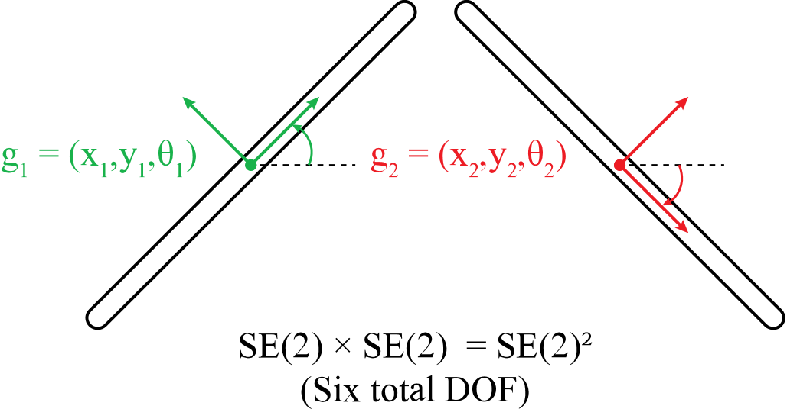
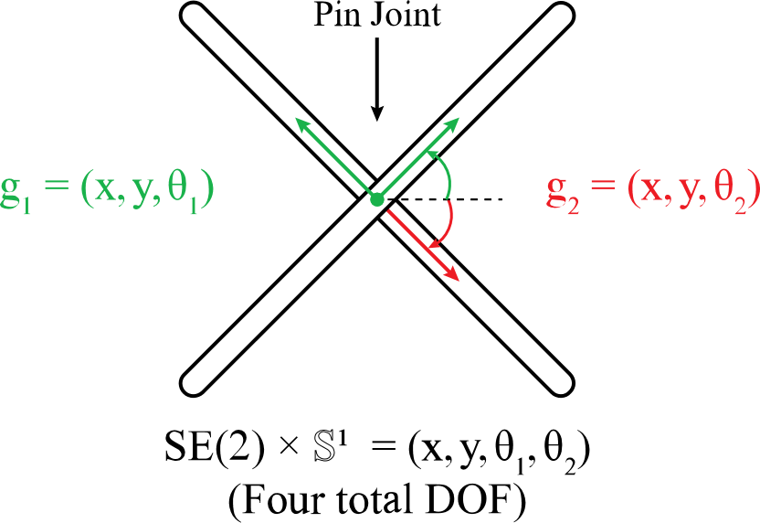

Articulated Systems and Holonomic Constraints
The full configuration space of a set of n planar rigid bodies is the direct product of their individual configuration spaces.
Multiple constraints act in concert, with the overall accessible manifold being the intersection of individual accessible manifolds.
Holonomic constraints – like this pin joint – are (possibly time-varying) constraint functions, f, on the configuration space that reduces the dimension of the system by 1 for each constraint applied.
Although these constraints reduce the dimensionality of the system, they do not remove the dependence of the system dynamics on the actual physical positions of the rigid bodies – Inertial and collision effects cannot be ignored!
The zero set forms the accessible manifold (i.e., the set of all configurations that satisfy these constraints.
It is therefore important to map between these configuration space positions and the ambient forces that are acting on the rigid bodies.
$$Zero Set=\left\{ q∈Q \right| f\left(q,t\right)=0 \}$$

Slide 3
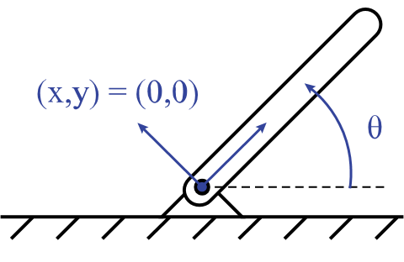
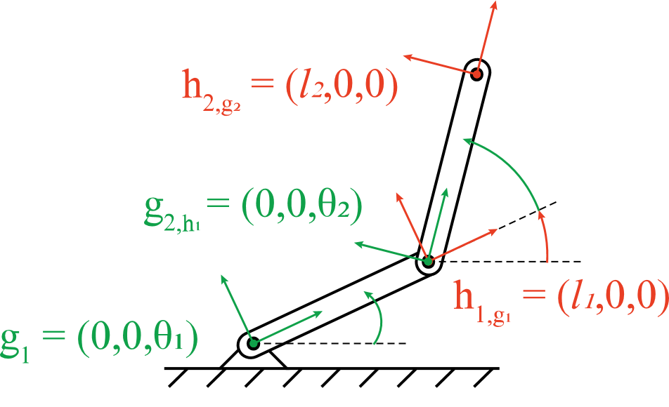

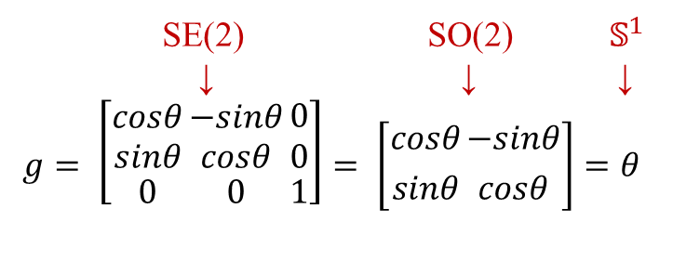
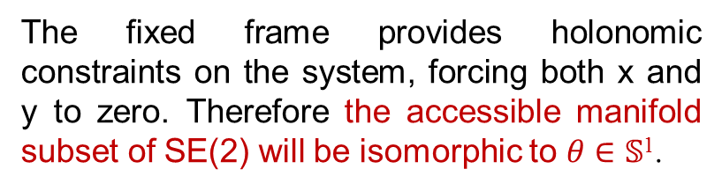
Fixed Base Systems
Note on Notation: g_{1,h} is the first frame of g defined with respect to base frame h
SE(2) SO(2) $𝕊^{1}$
↓ ↓ ↓
$$g= \left[{\begin{aligned}cosθ \\ sinθ\end{aligned} \atop 0}{\begin{aligned}−sinθ \\ cosθ\end{aligned} \atop 0}{\begin{aligned}0 \\ 0\end{aligned} \atop 1}\right]= \left[{cosθ \atop sinθ}{−sinθ \atop cosθ}\right]=θ$$
The fixed frame provides holonomic constraints on the system, forcing both x and y to zero. Therefore the accessible manifold subset of SE(2) will be isomorphic to $θ∈$ 𝕊¹.
Adding additional links provides additional constraints.
The distal and proximal end of any link will share orientation.
The joint constrains the position of the proximal end of one segment with the distal end of the previous segment.
Note that each frame is defined with respect to the previous frame. In terms of left/right actions, this notation reveals:
$$g_{1,h}=h^{−1}∘g_{1}$$

Slide 4
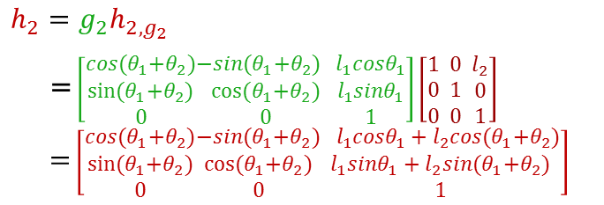
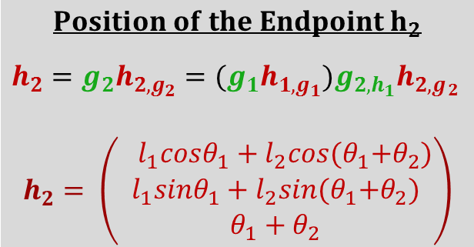
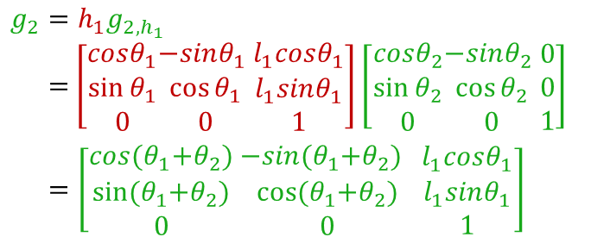
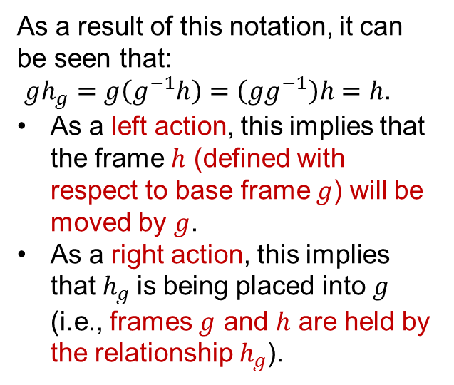
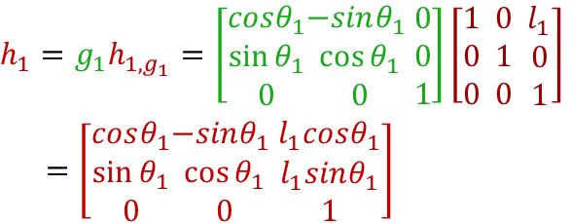
Fixed Base Systems (Cont.)
As a result of this notation, it can be seen that:
$gh_{g}=g\left(g^{−1}h\right)=\left(gg^{−1}\right)h=h$.
As a left action, this implies that the frame $h$ (defined with respect to base frame $g$) will be moved by $g$.
As a right action, this implies that $h_{g}$is being placed into $g$ (i.e., frames $g$ and $h$ are held by the relationship $h_{g}$).
$$h_{1}=g_{1}h_{1,g_{1}}=\left[\begin{aligned}cosθ_{1} \\ sin⁡θ_{1} \\ 0\end{aligned}\begin{aligned}−sinθ_{1} \\ \cos{θ_{1}} \\ 0\end{aligned}\begin{aligned}0 \\ 0 \\ 1\end{aligned}\right]\left[\begin{aligned}1 \\ 0 \\ 0 \end{aligned}\begin{aligned}0 \\ 1 \\ 0 \end{aligned}\begin{aligned}l_{1} \\ 0 \\ 1\end{aligned}\right]$$
$=\left[\begin{aligned}cosθ_{1} \\ sin⁡θ_{1} \\ 0\end{aligned}\begin{aligned}−sinθ_{1} \\ \cos{θ_{1}} \\ 0\end{aligned}\begin{aligned}l_{1}cosθ_{1} \\ l_{1}sinθ_{1} \\ 1\end{aligned}\right]$
$$g_{2}=h_{1}g_{2,h_{1}}$$ = $\left[\begin{aligned}cosθ_{1} \\ sin⁡θ_{1} \\ 0\end{aligned}\begin{aligned}−sinθ_{1} \\ \cos{θ_{1}} \\ 0\end{aligned}\begin{aligned}l_{1}cosθ_{1} \\ l_{1}sinθ_{1} \\ 1\end{aligned}\right]\left[\begin{aligned}cosθ_{2} \\ sin⁡θ_{2} \\ 0\end{aligned}\begin{aligned}−sinθ_{2} \\ \cos{θ_{2}} \\ 0\end{aligned}\begin{aligned}0 \\ 0 \\ 1\end{aligned}\right]$
$$=\left[\begin{aligned}cos{(θ}_{1}+θ_{2}) \\ sin⁡{(θ}_{1}+θ_{2}) \\ 0\end{aligned}\begin{aligned} −sin{(θ}_{1}+θ_{2}) \\ \cos{{(θ}_{1}+θ_{2})} \\ 0\end{aligned}\begin{aligned}l_{1}cosθ_{1} \\ l_{1}sinθ_{1} \\ 1\end{aligned}\right]$$
$$Position of the Endpoint h_{2}$$
$$h_{2}=g_{2}h_{2,g_{2}}={(g}_{1}h_{1,g_{1}})g_{2,h_{1}}h_{2,g_{\begin{aligned}2 \\ \\ \end{aligned}}}$$
$$h_{2}= \left(\begin{aligned}{ l}_{1}cosθ_{1}+l_{2}cos{(θ}_{1}+θ_{2}) \\ l_{1}sinθ_{1}+l_{2}sin{(θ}_{1}+θ_{2}) \\ θ_{1}+θ_{2}\end{aligned}\right)$$
$$h_{2}=g_{2}h_{2,g_{2}}$$
= $\left[\begin{aligned}cos{(θ}_{1}+θ_{2}) \\ sin⁡{(θ}_{1}+θ_{2}) \\ 0\end{aligned}\begin{aligned}−sin{(θ}_{1}+θ_{2}) \\ \cos{{(θ}_{1}+θ_{2})} \\ 0\end{aligned}\begin{aligned}l_{1}cosθ_{1} \\ l_{1}sinθ_{1} \\ 1\end{aligned}\right]\left[\begin{aligned}1 \\ 0 \\ 0 \end{aligned}\begin{aligned}0 \\ 1 \\ 0 \end{aligned}\begin{aligned}l_{2} \\ 0 \\ 1\end{aligned}\right]$
= $\left[\begin{aligned}cos{(θ}_{1}+θ_{2}) \\ sin⁡{(θ}_{1}+θ_{2}) \\ 0\end{aligned}\begin{aligned}−sin{(θ}_{1}+θ_{2}) \\ \cos{{(θ}_{1}+θ_{2})} \\ 0\end{aligned}\begin{aligned}{ l}_{1}cosθ_{1}+l_{2}cos{(θ}_{1}+θ_{2}) \\ l_{1}sinθ_{1}+l_{2}sin{(θ}_{1}+θ_{2}) \\ 1\end{aligned}\right]$
This will become particularly useful when discussing mobile articulating systems as this right action interpretation aids in determining the velocity kinematics of a system.

Slide 5
Conclusions/Impressions
Forward kinematics provides a way to understand the interaction of configuration spaces that produce endpoint configurations in articulated systems – with group actions being not only useful for these transformations in position space, but also in velocity space (to be discussed in Section 2.5 next week).
Holonomic constraints allow for a reduction in the dimensionality of the configuration space, BUT do not remove the considerations that must be made with respect to the physical world (inertial and/or collision interactions).
Matrix multiplication operators on the frames (and their positions/orientations) allows for a useful way to determine the position and relationship between rigidly attached frames – which will become more useful when these frames are in motion.

